Slide 1
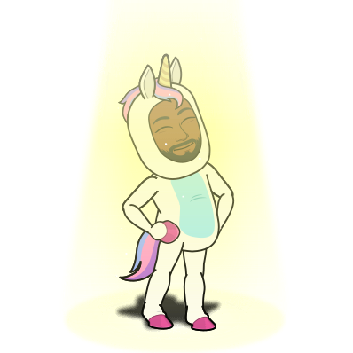
SCHOOL COUNSELING
FROM A DISTANCE:
SUPPORTING STUDENTS
DURING COVID-19
Mr. Brian Coleman, LCPC
2019 Nation School Counselor of the Year
@mrbriancoleman

Slide 2
OVERVIEW
DISCLAIMERS
WHERE TO BEGIN
DOMAINS OF SUPPORT
ACTION STEPS
SELF-CARE
RESOURCES
Q&A

Slide 3
DISCLAIMERS
UNIVERSALITY LIMITS
POLICY/LAW FIRST!
SHORT-TERM SUPPORTS
QUESTIONS OVER ANSWERS

Slide 4
CUSTOMIZE! CUSTOMIZE! CUSTOMIZE!

Slide 5
WHERE TO BEGIN?
POLICIES/LAWS/ETHICS
EXPECTATIONS
KEY STAKEHOLDERS
TECHNOLOGY
COMMUNICATION
COMMUNITY NEEDS
COUNSELING PROGRAM GOALS

Slide 6
WHERE TO BEGIN?
POLICIES/LAWS/ETHICS
What guidelines am I receiving at the national and local levels? Are they consistent?
How do my ethical and legal obligations inform my remote work strategy?
What support resources are available to clear up any confusion that I may have?

Slide 7
WHERE TO BEGIN?
EXPECTATIONS
What does my administration expect me do under the present conditions? How do these expectations sync up with union/district/state/federal guidelines (and my legal/ethical obligations?)
Based on how I understand my own school counseling identity, what do I expect of myself and/or my team during this period of closure?
To what extent will I be available during the period of closure (and in what ways?)

Slide 8
WHERE TO BEGIN?
KEY STAKEHOLDERS
Who do I need to collaborate with in order to devise and implement an intervention/program strategy?
Who are my target audiences of support? Why?

Slide 9
WHERE TO BEGIN?
TECHNOLOGY
What technology tools do I have access to during the period of closure?
What tools do my key stakeholders have access to? Any inconsistencies?
What legal/ethical considerations do I need to make when assessing the appropriate tools and resources?

Slide 10
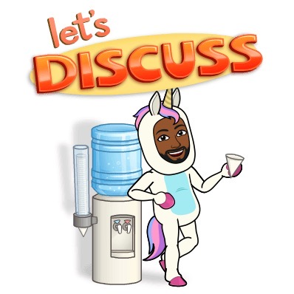
WHERE TO BEGIN?
COMMUNICATION
What information do I need to share with my key stakeholders at this stage?
What communications obstacles might exist in our rollout strategy?
How will I communicate with my target audiences of support during the period of closure? What are the legal/ethical implications of this strategy?

Slide 11
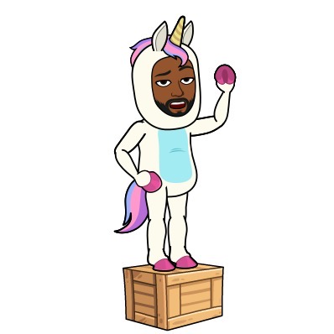
WHERE TO BEGIN?
COMMUNITY NEEDS
What are the needs of my target audiences of support? How might their needs differ?
What data/metrics am I using to assess the aforementioned needs?
What issues of equity/inclusivity/access do I need to address in order to support my target audiences?
How can I progress monitor their needs during this period of closure?

Slide 12
WHERE TO BEGIN?
COUNSELING PROGRAM GOALS
What programming did you already have scheduled for your target audiences at this stage in the year? Which aspects of that programming can be reworked for distance learning/intervention/support?
How have current events impacted your program goals and intervention strategy? What workarounds exist?
What tools and resources do you need to implement your revised goals at this stage?

Slide 13
DOMAINS OF SUPPORT
ACADEMIC
Transcript/Credit-Review
Course Scheduling
Enrichment/E-Learning
Teacher/Family Collaboration
Tertiary Skill Development
E-Credit Recovery/Acceleration
Course Scheduling

Slide 14
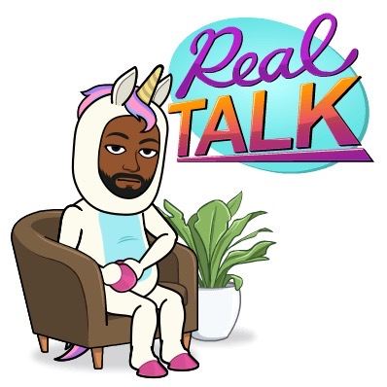
DOMAINS OF SUPPORT
PERSONAL/SOCIAL
Crisis Triage and Responsive Services
Consultation
Skill Development
Self-Care
Individual Student Planning

Slide 15
DOMAINS OF SUPPORT
COLLEGE/CAREER
Career/Interest/College/Financial Aid Research
Mock Job/Enrichment Interviews
Phone/Remote Informational Interviews
Summer Program/Enrichment Research and Application
Resume-Building
Self-Assessments and Letters of Recommendations

Slide 16
ACTION STEPS
Review pertinent federal/state/district guidelines
Identify/revise core program objectives
Consult w/key stakeholders on goals/expectations
Communicate plan to target audiences
Implement distance counseling programming
Progress monitor and revise as needed

Slide 17
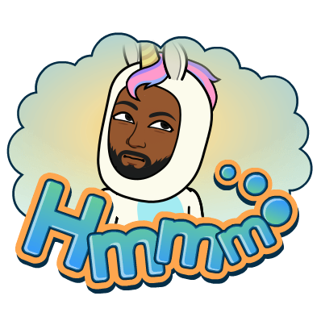
WAIT… WHAT ABOUT YOU?

Slide 18
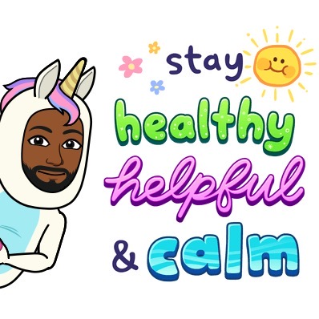
SELF-CARE
PHYSICAL
EMOTIONAL/PSYCHOLOGICAL
SPIRITUAL
DAILY STRUCTURE
MODELING IS KEY - LEAD WITH INTENTION!

Slide 19
RESOURCES
SEL RESOURCES
CALM
CASEL
HOTLINES
ASCA
COLLEGE/CAREER
NAVIANCE
COLLEGEBOARD
ACT
NACAC
FASTWEB
COMMUNICATION
ZOOM
GOOGLE MEET
ACADEMIC
KHAN ACADEMY
COVID-19
CDC
INTERNET
SPECTRUM
COMCAST

Slide 20
#DoTheNextRightThing

Slide 21
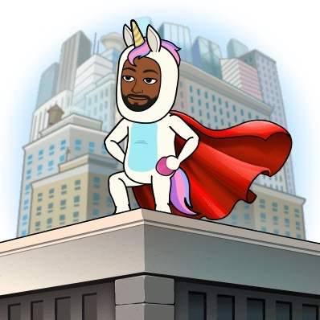
Questions?
@mrbriancoleman

