Slide 1
2017 SREB Annual Leadership Forum
Principals Can Make Math Instructional Shifts That Add Up
April 20, 2017
Kenna Barger

Slide 2
To what extent do you…
Ensure a balanced approach to mathematics?
Engage students in assignments that matter?
Utilize questioning and feedback?
Use formative assessment data?
Foster a classroom environment that supports student ownership?
Hold a foundational belief that ALL students are mathematical thinkers?

Slide 3
Foundational Belief:
ALL Students are Mathematical Thinkers
“Many people think that some students can work to high levels and some cannot because of the brains they are born with, but this idea has been resoundingly disproved.”
(Jo Boaler, Author of Mathematical Mindsets, 2016)
Growth Mindset vs. Math Gene Mentality

Slide 4
Foundational Belief:
ALL Students are Mathematical Thinkers

Slide 5
Powerful Math Practices that Add Up
1) Ensuring a Balanced Approach to Mathematics

Slide 6
Ensuring a Balanced Approach to Mathematics
Sample Excerpt from SREB Powerful Math Practices Observation Rubric – PINK Paper

Slide 7
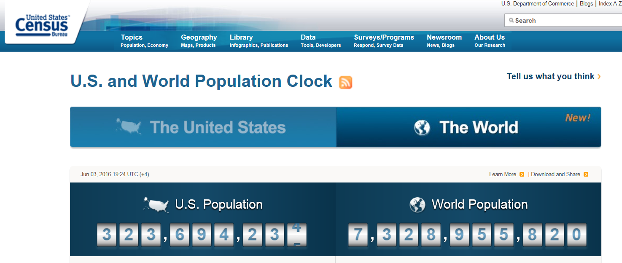
Ensuring a Balanced Approach to Mathematics
Click here to see the counter in action.
What do you notice?
What so you wonder?

Slide 8
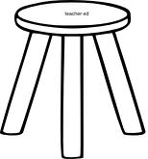
Ensuring a Balanced Approach to Mathematics
METACOGNITIVE
CONCEPTUAL
FACTUAL
PROCEDURAL

Slide 9
Powerful Math Practices that Add Up
2) Engaging Students in Assignments That Matter

Slide 10
Assignments That Matter
Sample Excerpt from SREB Powerful Math Practices Observation Rubric – Orange Paper

Slide 11
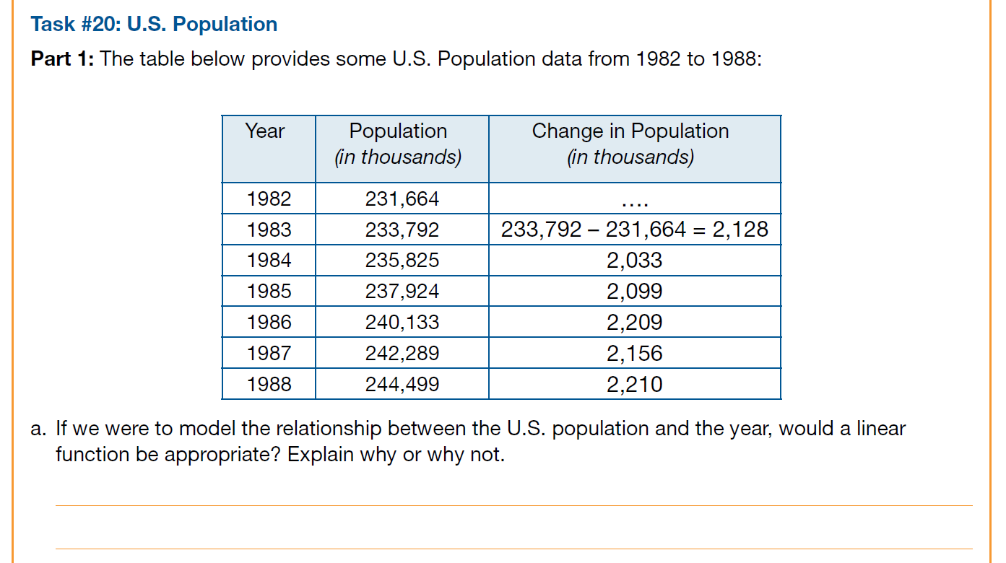
Assignments That Matter
What does this data tell us?

Slide 12
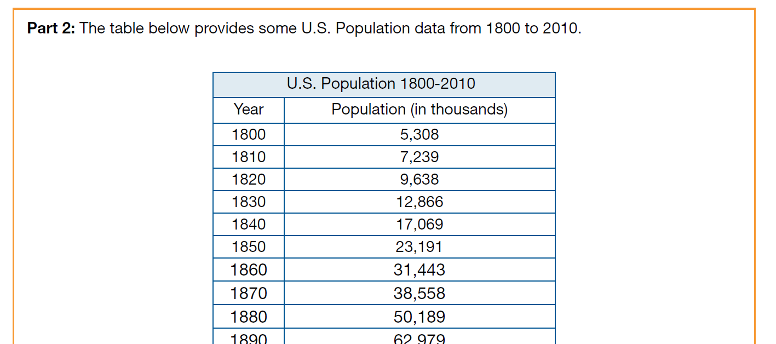
Assignments That Matter
Deeper Look at the Math: Concept of Local Linearity

Slide 13
Powerful Math Practices that Add Up
3) Utilizing Questioning and Feedback for Deeper Understanding

Slide 14
Using Questioning and Feedback
Sample Excerpt from SREB Powerful Math Practices Observation Rubric – Green Paper

Slide 15
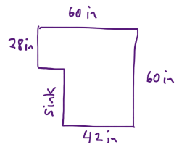
Utilizing Questioning and Feedback
Teresa is going to put down new ceramic tiles on her bathroom floor. She has selected square tiles that are 4 inches on each side. These are the kind of tiles that can be placed right next to each other without leaving additional space for grout. At The Home Station, she learned how to cut the tiles in case she needs any fractional pieces to cover her floor completely.
Questions: How many tiles will she need to buy to cover her floor? How many tiles will she have to cut in order to cover the entire space?
Extra: What is the size, using whole numbers, of the largest square tile that could be used to tile the entire floor with no cut pieces?
(Annie Fetter, NCSM, 2017)

Slide 16
Utilizing Questioning and Feedback
We Must Slow Down to Speed Up

Slide 17
Powerful Math Practices that Add Up
4) Using Formative Assessment Data

Slide 18
Using Formative Assessment Data
Sample Excerpt from SREB Powerful Math Practices Observation Rubric – Purple Paper

Slide 19
Using Formative Assessment Data
Include more short cycle and medium cycle formative assessments and adapt instruction according to results.
Notes:
“When teachers ask me how this can be possible, I tell them that the best thinking we have on this now is that the brain sparks and grows when we make a mistake, even if we are not aware of it, because it is a time of struggle; the brain is challenged and the challenge results in growth.”

Slide 20
Using Formative Assessment Data
Mistakes Grow Your Brain
(Boaler, 2015)
Notes:
“When teachers ask me how this can be possible, I tell them that the best thinking we have on this now is that the brain sparks and grows when we make a mistake, even if we are not aware of it, because it is a time of struggle; the brain is challenged and the challenge results in growth.”

Slide 21
Powerful Math Practices that Add Up
5) Fostering a Classroom Environment that Supports Student Ownership of Learning

Slide 22
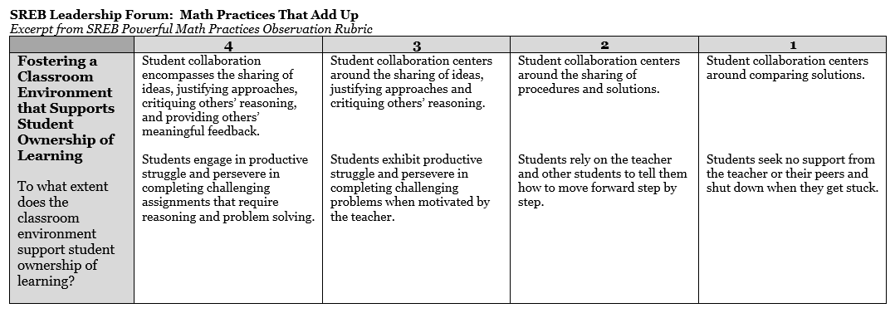
Fostering a Classroom Environment that Supports Student Ownership of Learning
Sample Excerpt from SREB Powerful Math Practices Observation Rubric – Yellow Paper

Slide 23
Fostering a Classroom Environment that Supports Student Ownership of Learning

Slide 24
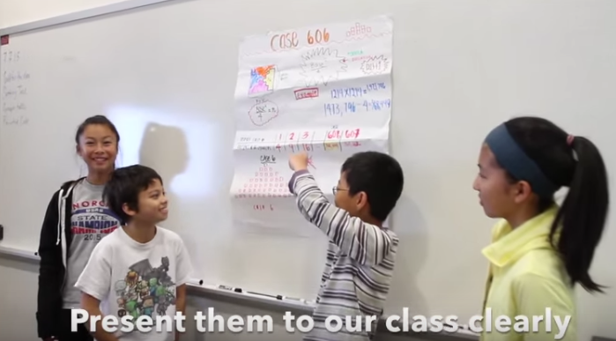
Fostering a Classroom Environment that Supports Student Ownership of Learning

