Slide 1
Introduction to History of Immigration In the United States
Gateway Lesson

Slide 2
Immigrant or emigrant?
An immigrant comes in to a country
An emigrant is going out, or leaving a country

Slide 3
America is a Nation of Immigrants
What does this statement mean?
Notes:
Ask students the question and try to create a discussion. Answers should include that everyone in America came here from somewhere else. Some students may point out that American Indians were here when the Europeans arrived. Explain that current theories indicate that even the Indians arrived in the Americas between 20,000 and 0

Slide 4
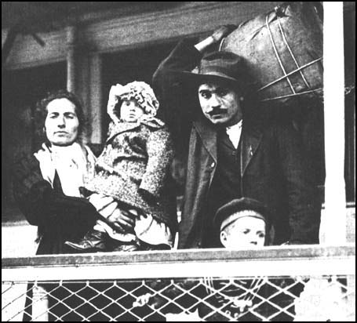
coun

Slide 5
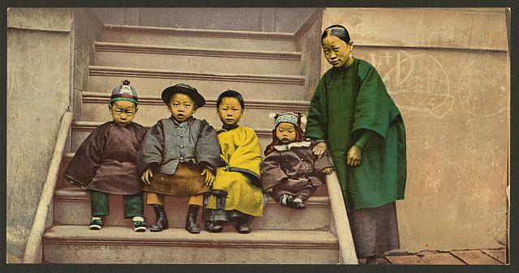

Slide 6
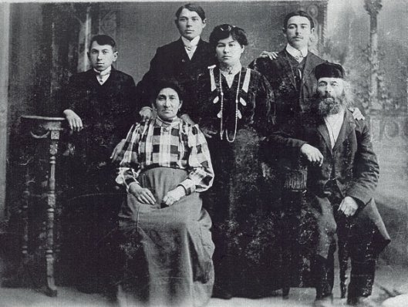

Slide 7
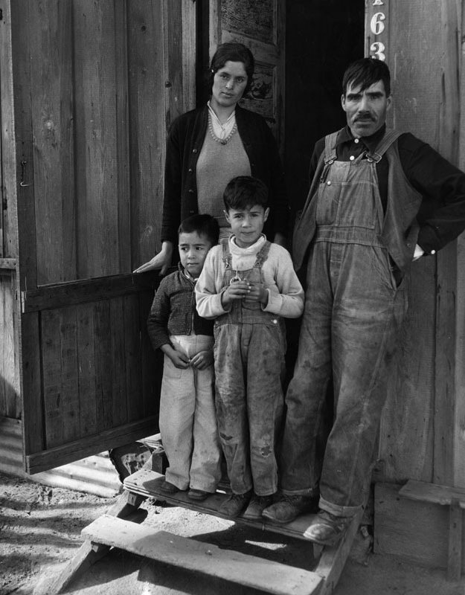

Slide 8
Source Pages
Image 1 - Italian family arriving in New York in 1905; www.spartacus.com
Image 2 Title: A Chinese family
Creator(s): Detroit Photographic Co.,
Date Created/Published: [between 1898 and 1905]
Medium: 1 photomechanical print : photochrom, color.
Reproduction Number: LC-DIG-ppmsca-17886 (digital file from original item)
Rights Advisory: No known restrictions on publication.
Call Number: LOT 13923, no. 78 [item] [P&P]
Repository: Library of Congress Prints and Photographs Division Washington, D.C. 20540 USA http://hdl.loc.gov/loc.pnp/pp.print
Image 3 - https://nyhistorywalks.wordpress.com/ A Jewish immigrant family
Image 4 https://www.hstry.co/timelines/a-history-of-immigration-in-the-usa

