Slide 1
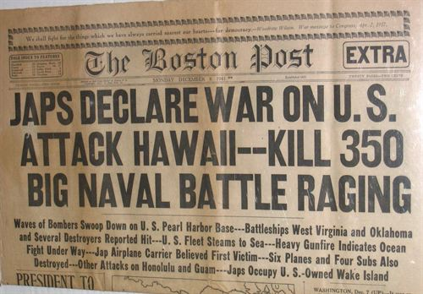

Slide 2
War in the Pacific
Pearl Harbor
Philippines
General Douglas MacArthur
Surrender
Bataan Death March
Chester Nimitz
Battle of Midway
Fall back
Kamikaze
Harry Truman

Slide 3

How to take Notes
And actually be able to study from them!

Slide 4
Strategy No. 1 Cornell Notes
What it is – a way to take more organized notes
What you will need – lined notebook paper (and something to write with of course!)

Slide 5
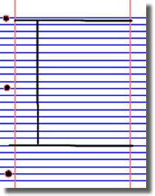
Cornell notes: How it works
Put the subject and date at the top of your paper (and each page thereafter), then
Divide your paper into three sections, like this:

Slide 6
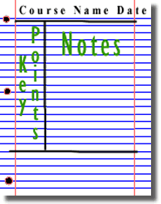
Cornell notes: How it works – Taking notes
The large box to the right is for writing notes, either from the lecture or as you read.
Skip a line between main ideas and topics.
Don't use complete sentences, and don’t try to copy down every word from the text or the lecture. Use abbreviations, whenever possible. Develop a shorthand of your own, such as using "&" for the word "and“, w/ for with, b/c for because, and so on.

Slide 7
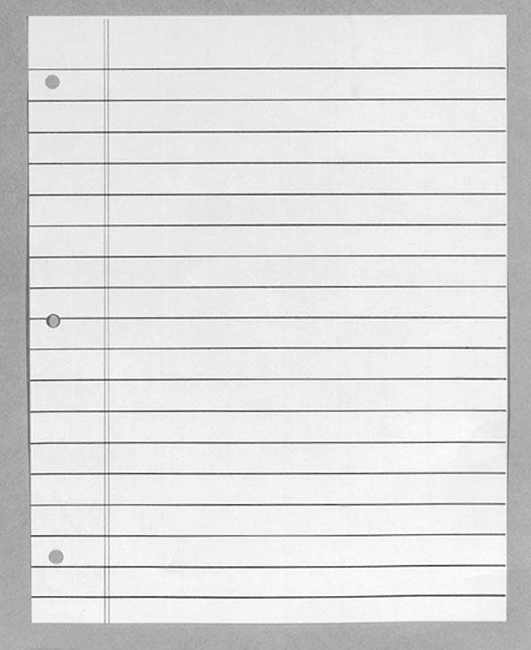
Cornell Notes: Using your notes to study
Course name, source (lecture, text), date
Review notes as soon as possible after class!
Pull out main ideas and put them in the left column
Yada, yada, yada, YADA
Yada YADA
Yada, yada
YADA, yada, yada, yada
YADA
YADA
YADA
YADA –
YADA -

Slide 8
Cornell Notes: Using your notes to study
Course name, source (lecture, text), date
Yada, yada, yada, YADA
Yada YADA
Yada, yada
YADA, yada, yada, yada
YADA
YADA
YADA
Write a summary of the main ideas in the bottom section
YADA –
YADA -
Yada yada yada yada yada yada yada yada yada

Slide 9
Now that you’re ready, study!
Reread your notes in the right column
Spend most of your time studying your notes in the left column and on your summaries at the bottom of the page
These are the things you will most likely be tested on.
Results?
A+!!

Slide 10
Sources:
The Learning Toolbox, James Madison University,
The Americans, McDougal Little, 2006, Danzer et. al.

Slide 11
Japanese-American Internment
Saboteurs
Japanese Americans
Anti-Japanese Paranoia
President Roosevelt
Concentration Camps
Nisei
Grievances
Executive Order 9066
Fred Korematsu
Korematsu vs United States

Slide 12
How to Analyze Primary Sources
Using Historical Thinking Skills

Slide 13
Historical Context
Intended Audience
Purpose
Point of View
Outside Information

Slide 14
Historical Context
Historical context is the political, social, cultural, and economic setting for a particular idea or event.
Historical context also refers to the moods, attitudes, and conditions that existed in a certain time.
Questions
What was going on during this time?
Where was this happening?
When was this happening?

Slide 15
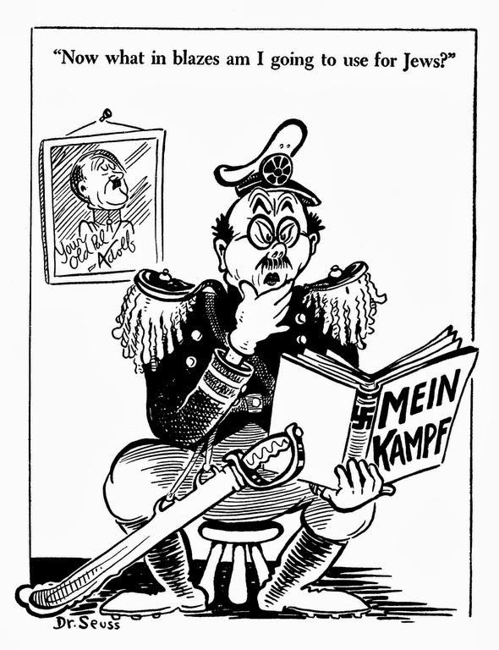
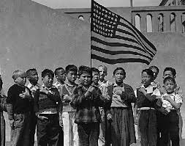
What is the Historical Context?

Slide 16
Intended Audience
The intended audience is the person or people the author created the document for.
Questions
Who will see the document?
Where was it published?
When was it published

Slide 17
Who is the Intended Audience?
Have you ever lain awake on Christmas Eve with everything about you strange, quiet and still as death?… As Christmas drew nearer, we older children knew that this year there wouldn’t be gifts and much fun for the little children, for out here in a concentration camp we thought no one would think of us. So we tried extra hard to make Christmas as happy as possible for the tots. Christmas was ushered in with cold, howling winds…. Refusing to be discouraged, we panned for a party for which everyone gladly donated some money. We decorated the Mess Hall with red and green crepe papers and wreaths made of desert holly…. As if with the waving of a magic wand the bare cold mess hall was changed into an enchanting place.
Emiko Kamiya, who was interned at the Poston Relocation Center, quoted in Werner, Through the Eyes of Innocents, p. 94

Slide 18
Purpose
The purpose is the authors reason for creating the document.
Questions
Why did the author create the document.
Is the author trying to provoke feelings in the reader?

Slide 19
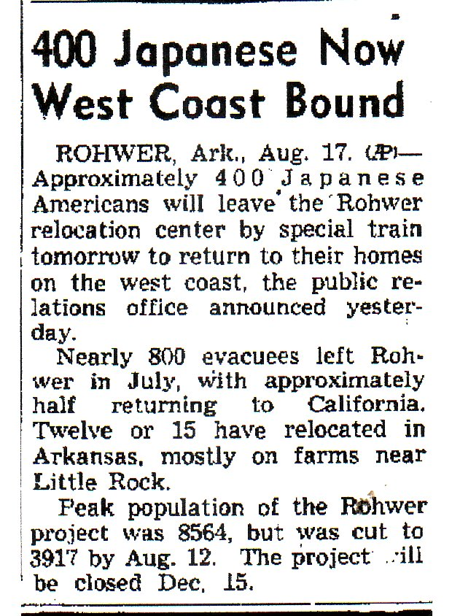
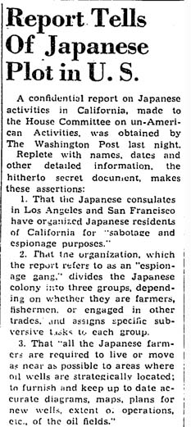
What is the Purpose

Slide 20
Point of View
The author’s point of view reveals the author’s beliefs, personal judgments or attitudes toward a certain subject.
Questions
What is the authors attitude toward the event?
What is the authors bias? (prejudice in favor of or against)
What is the authors background?

Slide 21
What is the Authors Point of View
Colonel Bendetsen showed himself to be a little Hitler. I mentioned that we had an orphanage with children of Japanese ancestry, and that some of these children were half Japanese, others one fourth or less. I asked which children should we send…. Bendetsen said: “I am determined that if they have one drop of Japanese blood in them, they must go to camp.
Father Hugh T. Lavey of the Catholic Maryknoll Center, quoted in Werner, Through the Eyes of Innocents, p. 85

Slide 22

Outside information
What specific outside information have you learned that can be connected with that in the document?
Questions:
How does document connect with other events during the time period?
How will use the document to support outside information in your argument/essay?

Slide 23
Sources
http://www.answers.com/
http://homeworktips.about.com
Google Images

