Slide 1
Close Reading: Activity 1
Lesson 3
Identifying topic, main idea, and
best supporting details

Slide 2
Essential Question of the Unit
What were the political, economic, and social motivations that contributed to the extreme actions taken by the United States, Germany, and Japan during WWII?

Slide 3
Warm Up
Read this paragraph. Choose the one or two words to best describe what this paragraph is all about.
During World War II, ghettos were city districts (often enclosed) in which the Germans concentrated the municipal and sometimes regional Jewish population and forced them to live under miserable conditions. Ghettos isolated Jews by separating Jewish communities from the non-Jewish population and from other Jewish communities. The Germans established at least 1,000 ghettos in German-occupied and annexed Poland and the Soviet Union alone. German occupation authorities established the first ghetto in Poland in Piotrków Trybunalski in October 1939.

Slide 4
Warm Up
The one word this paragraph is all about is:
Cities
Germans
Jews
Ghettos
This is called the topic of the paragraph. In this lesson we’ll look at how the topic of a paragraph is different from the main idea of the paragraph. Then we’ll identify how to find the BEST supporting details.

Slide 5
Topic VS Main Idea
There is a difference between the topic and the main idea.
A topic can be stated in one or two words or a phrase and refers to the subject of the paragraph.
A main idea states the topic of the paragraph AND also explains the author’s point or perspective regarding that topic. The main idea must be stated in a complete sentence.
The main idea must present a complete thought about a topic.

Slide 6

Topic VS Main Idea
Not sure of the difference? Use your prior knowledge and think of what you do know of topic and main idea.
Let’s use an example from a movie. Most people are familiar with the movie Beauty and the Beast.
The topic of Beauty and the Beast is first impressions.
The main idea of Beauty and the Beast is that
first impressions can be deceiving and the true beauty
of a person comes from within.

Slide 7

Let’s practice.
Smoking has been proven dangerous to people’s health, yet many continue to smoke for various reasons. For young people, smoking often represents maturity and individuality. Many smoke as a way to reduce tension. In addition, the regular smoker becomes addicted psychologically and physically to the nicotine in cigarettes.
Topic:
health c. addiction
smoking d. nicotine
Main Idea:
Smoking has been proven dangerous to people’s health in various ways.
Regular smokers become addicted to nicotine.
Although smoking is dangerous, people continue doing it for various reasons.
Nicotine is what smokers become addicted to both psychologically and physically.
(Langan 29)

Slide 8

Correct Answers
The topic is b: smoking
The main idea is c: Although smoking is dangerous, people continue doing it for various reasons.

Slide 9
How to Find the Main Idea
In a paragraph, a main idea statement is called the topic sentence. In a longer selection, a main idea statement is called a thesis.
In a paragraph, the main idea may be the first or last sentence. Sometimes it is in the middle of the paragraph.
In a longer selection, look carefully at the first paragraph or two, not just the first sentence.
Sometimes, the main idea will be implied. In which case you need to identify the topic, examine the supporting details and come up with the statement on your own using your own words to express the message the author is trying to get you to understand.

Slide 10
Supporting Details
Details explain and elaborate upon the main idea.
They are specific.
Careful consideration of each detail will help you to choose the one detail that BEST supports the main idea. Often this detail is discussed first within the given text.

Slide 11
Let’s practice.
Let’s read this example.
There is some evidence that colors affect you physiologically. For example, when subjects are exposed to red light respiratory movements increase; exposure to blue decreases respiratory movements. Similarly, eye blinks increase in frequency when eyes are exposed to red light and decrease when exposed to blue. This seems consistent with intuitive feelings about blue being more soothing and red being more arousing. After changing a school’s walls from orange and white to blue, the blood pressure of the students decreased while their academic performance improved.
What’s the topic? What’s the main idea? What are the supporting details?
(DeVito, qtd. in McWhorter 136)

Slide 12
Correct Answers
Topic: Colors
Main Idea: There is some evidence that colors affect you physiologically.
Supporting Details:
For example, when subjects are exposed to red light respiratory movements increase; exposure to blue decreases respiratory movements. Similarly, eye blinks increase in frequency when eyes are exposed to red light and decrease when exposed to blue. This seems consistent with intuitive feelings about blue being more soothing and red being more arousing. After changing a school’s walls from orange and white to blue, the blood pressure of the students decreased while their academic performance improved.

Slide 13
Choosing the BEST support
Which of these supporting details BEST supports the main idea that there is some evidence that colors affect you physiologically?
For example, when subjects are exposed to red light respiratory movements increase; exposure to blue decreases respiratory movements.
Similarly, eye blinks increase in frequency when eyes are exposed to red light and decrease when exposed to blue. This seems consistent with intuitive feelings about blue being more soothing and red being more arousing.
After changing a school’s walls from orange and white to blue, the blood pressure of the students decreased while their academic performance improved.

Slide 14
Correct Answers
The BEST supporting detail for the main idea that there is some evidence that colors affect you physiologically:
For example, when subjects are exposed to red light respiratory movements increase; exposure to blue decreases respiratory movements.
This is the best example because it is shows a direct correlation between the lights and physiological reactions. The other two examples show a weaker correlation.

Slide 15
Close Reading: Activity 2
Identifying topic, main idea, and
best supporting details

Slide 16
Close Reading
As an active reader, you must search for the sentence that states the central point of the paragraph or selection.
You should closely read the paragraph or selection to help you identify the main idea and supporting details.
We will practice close reading of a text to help us find the topic, main idea and best supporting details within a longer reading selection.
First, I will read through and model aloud my thinking. Then we will practice an example together. Finally, you will do one on your own to demonstrate your understanding and mastery of this skill.

Slide 17
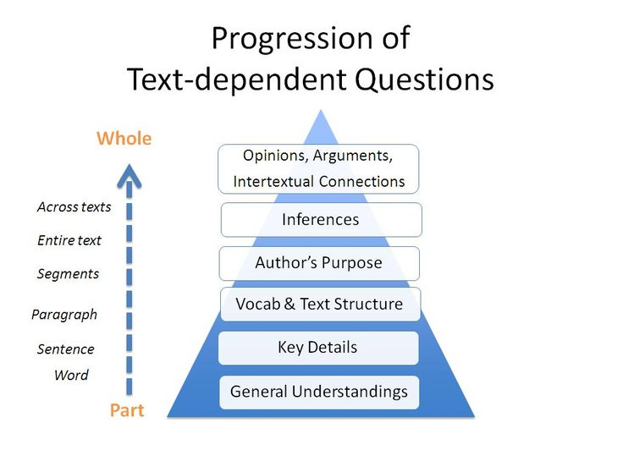
Questions to Guide Close Reading
Use text dependent
questions to guide thinking
as you closely read the selection.
By considering these points as
you read you arrive at deeper
and more complex
understandings.
Let’s work through an example
together.

Slide 18
from “I Never Saw Another Butterfly”
Read along in your academic notebook as I read aloud and model the thinking using text dependent questions.

Slide 19
Topic
What is the topic of this excerpt?

Slide 20
Correct Answer
What is the topic of this excerpt?
Theresienstadt Ghetto

Slide 21
Main idea
What is the main idea of this excerpt?

Slide 22
Correct Answer
What is the main idea of this excerpt?
Theresienstadt Ghetto was designed as a way to deceive the world of the atrocities of concentration camps throughout Europe.

Slide 23
Supporting Details
Which line from the text BEST supports the main idea?

Slide 24
Correct Answer
Which line from the text BEST supports the main idea?
“Make Terezin a “model ghetto,” exhibit it as “a town inhabited by Jews and governed by them and in which every manner of work is to be done’”

Slide 25
Practice with a partner
Read the next excerpt from “I Never Saw Another Butterfly” together with a partner. Then talk through the answers to each of the text dependent questions.

Slide 26
Independent Practice
Read the next excerpt from “I Never Saw Another Butterfly” independently. Then think through the answers to each of the text dependent questions.

Slide 27
Notes
Now that you’ve closely read three excerpts from “I Never Saw Another Butterfly” consider the possible answer to this question. Take notes in your chart to add to your list of evidence of political, social, and economic factors that motivated each country during World War II. Identify the best statements from the excerpts to support your answer.
After reading primary and secondary sources on the political, economic, and social motivations contributing to WWII write an informational/explanatory essay in which you compare and contrast either the political, economic or social motivations of the United States, Germany, and Japan during WWII. Support your discussion with evidence from the text/s.

Slide 28
References
"Ghettos." United States Holocaust Memorial Museum. United States Holocaust Memorial Council, 20 June 2014. Web. 28 June 2015.
Langan, John. Ten Steps to Advancing College Reading Skills. Second Edition. Marlton, NJ: Townsend Press, 1993.
McWhorter, Kathleen. Efficient and Flexible Reading. Ninth Edition. Boston: Pearson/Longman, 2011.

