Slide 1
Weathering & Erosion
Shaping the Earth

Slide 2
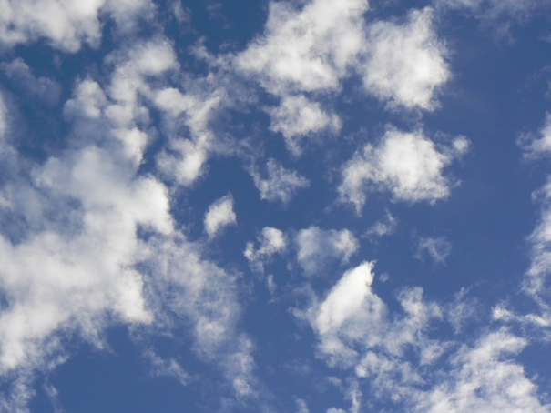

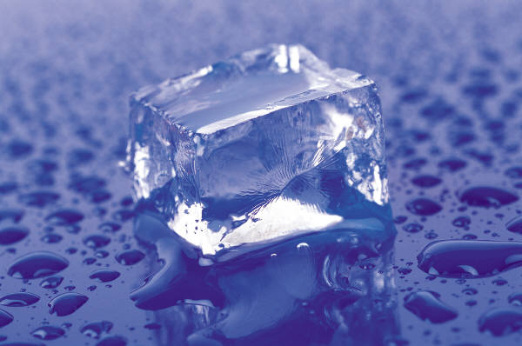
What is Erosion?
Erosion is defined as removal of rocks and soil by wind, water, ice and gravity.
Wind, water, ice and gravity are known as the agents of erosion.

Slide 3
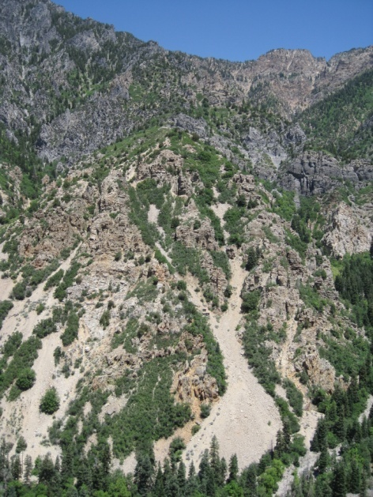
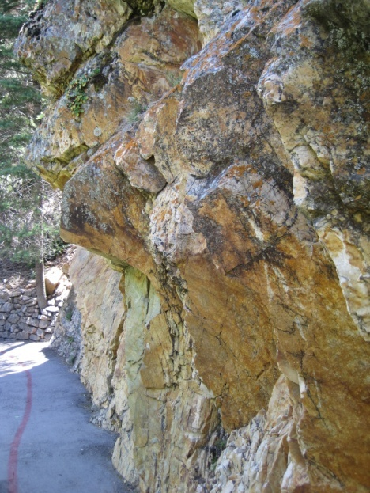
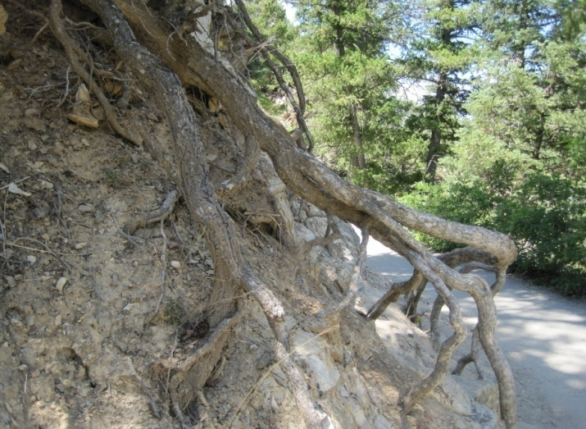
Weathering vs. Erosion
Weathering involves two processes
[physical, chemical]
that often work together to break down rocks. Both processes occur in place. No movement is involved in weathering.

Slide 4
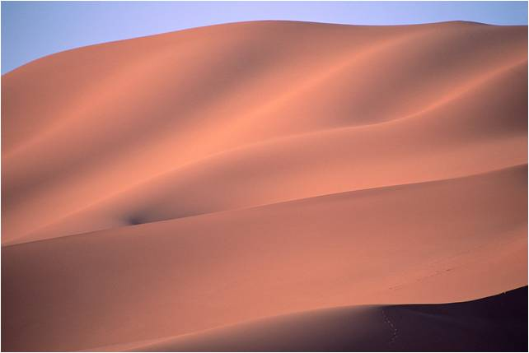
Wind Erosion
Wind can play a role by carrying material (especially sand and clay) from one place to another.
As the wind blows, it picks up small particles of sand/sediment and blasts large rocks with the sand/sediment, cutting and shaping the rock.
The intensity of wind erosion is determined by:
  Sum (amount of sand)
  Speed
  Slope
  Surface

Slide 5
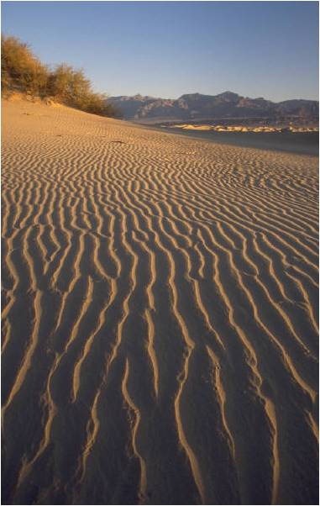
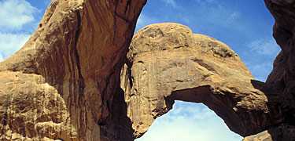
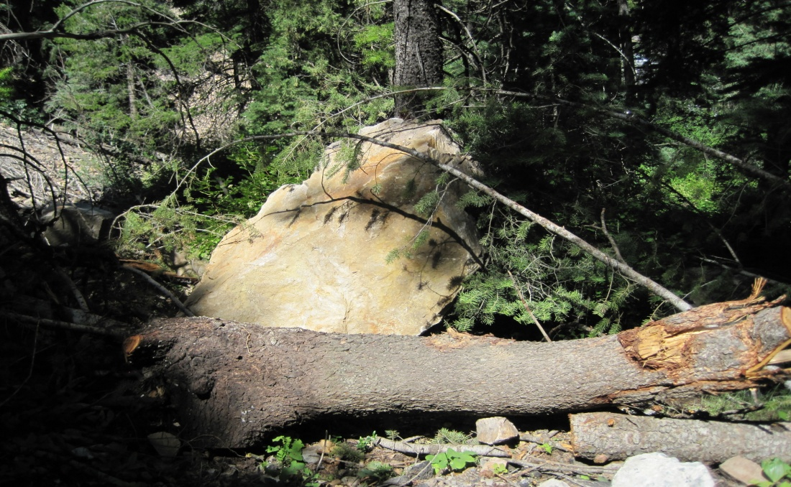
Wind Erosion

Slide 6
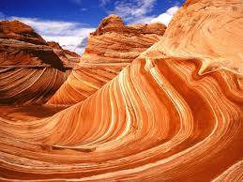
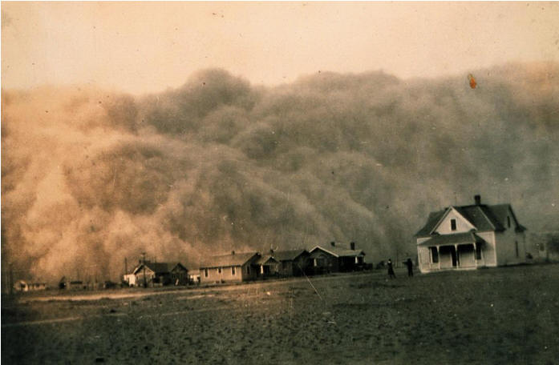
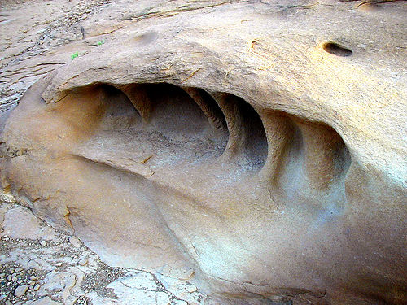
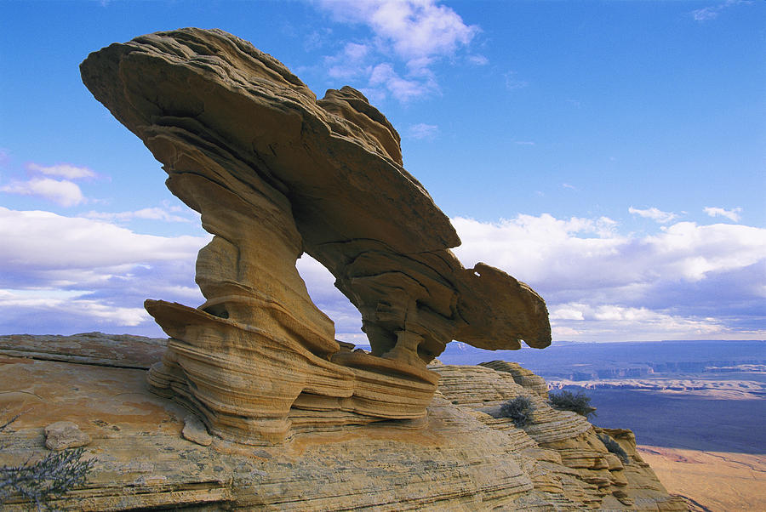
Wind Erosion

Slide 7
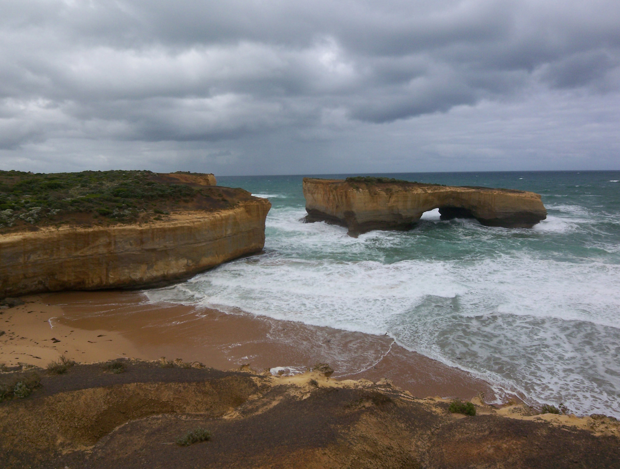
Water Erosion
When rain falls to the Earth it can evaporate, sink into the ground, or flow over the land as runoff. When it flows over land, erosion occurs.
Runoff picks up pieces of rock and "runs" downhill cutting tiny grooves (called rills) into the land.
How much erosion takes place is determined by the:
  Sum (amount of water)
  Slope
  Speed
  Surface

Slide 8
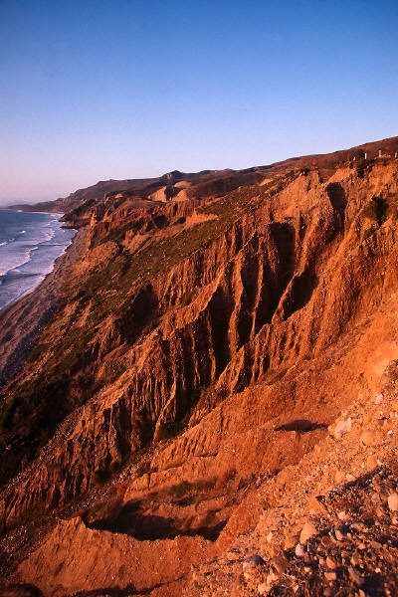
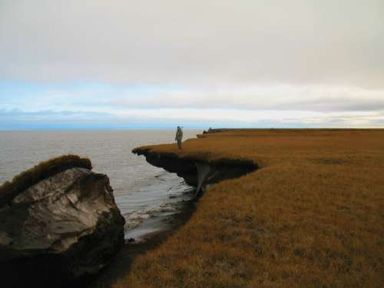
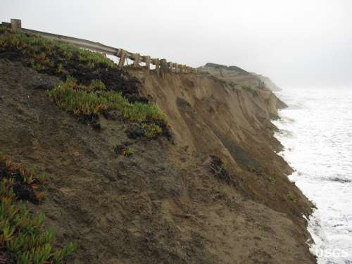
Water Erosion

Slide 9
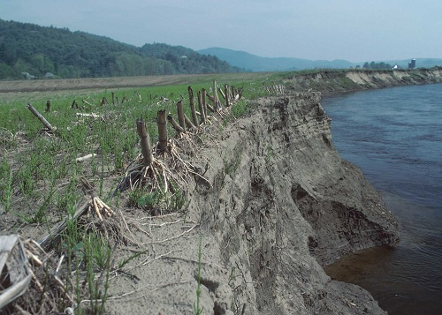
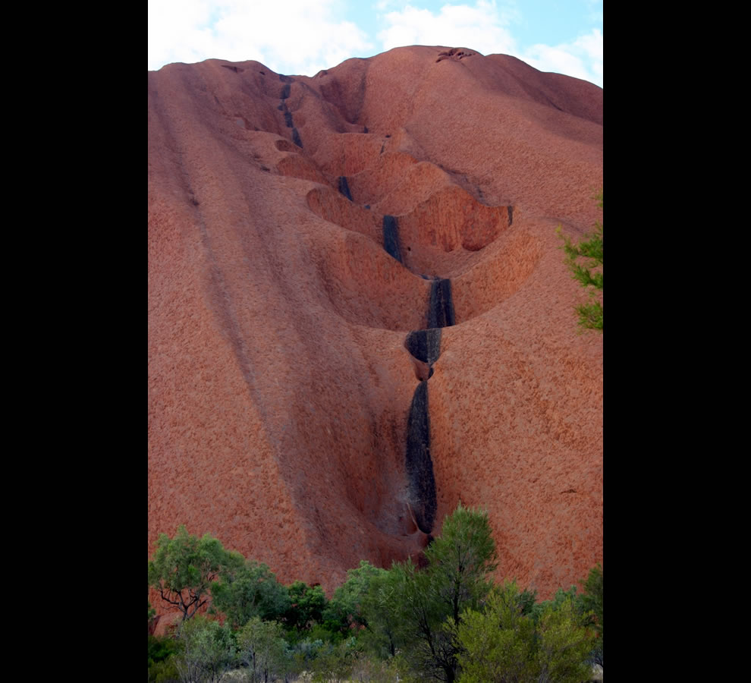
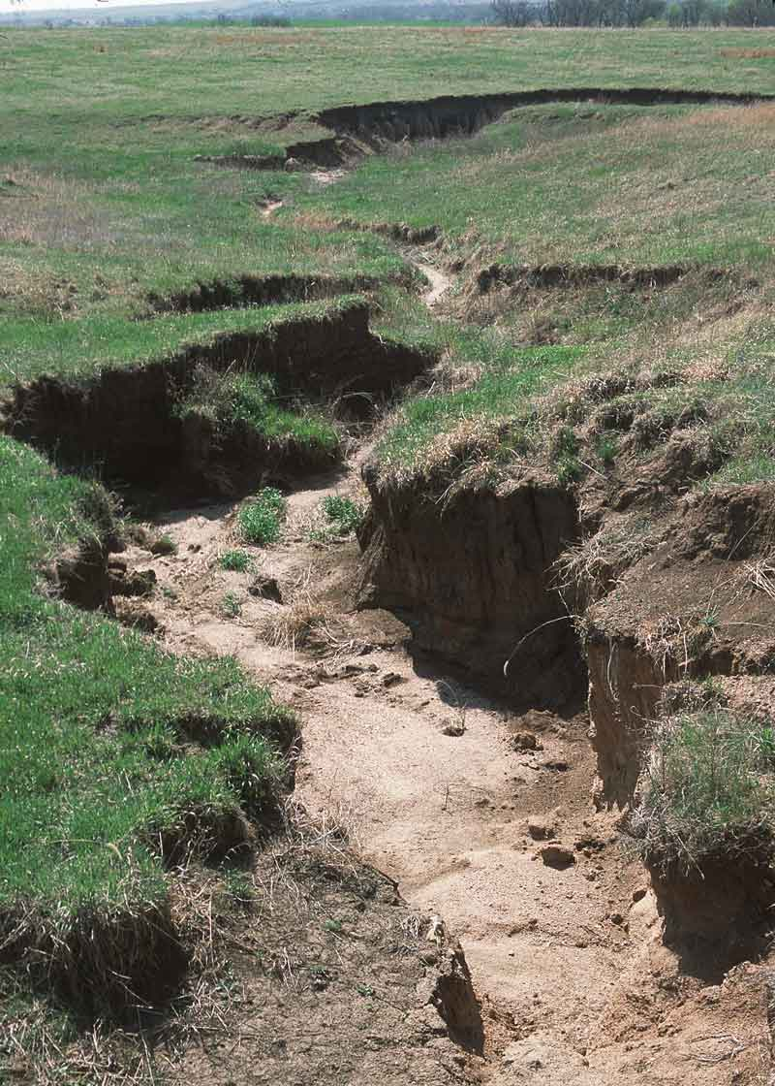
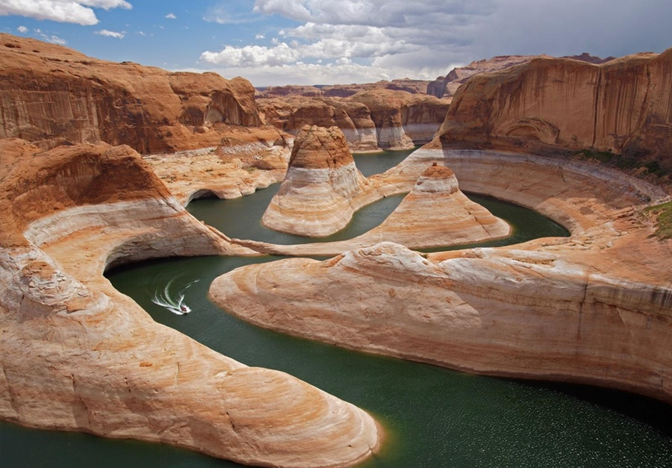
Water Erosion

Slide 10
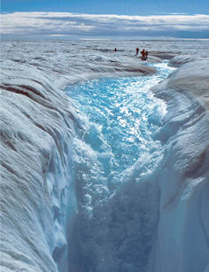
Ice Erosion
Glaciers wear down the landscape; by picking up and carrying debris that moves across the land along with the ice.
Glaciers can pick up and carry sediment that ranges in size from sand grains to boulders bigger than houses.
Moving like a conveyor belt or a bulldozer, a single glacier can move millions of tons of material!
How much erosion takes place is determined by the:
    **Sum (Glaciers are massive!)
    Slope
    Speed
    Surface

Slide 11
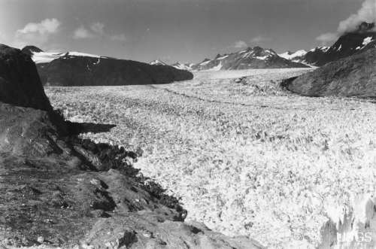
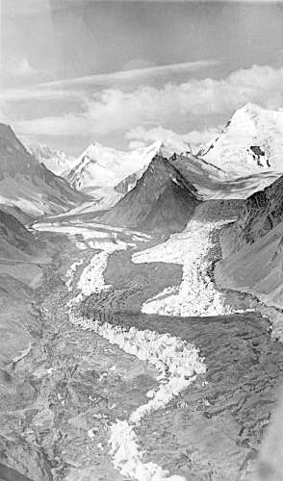
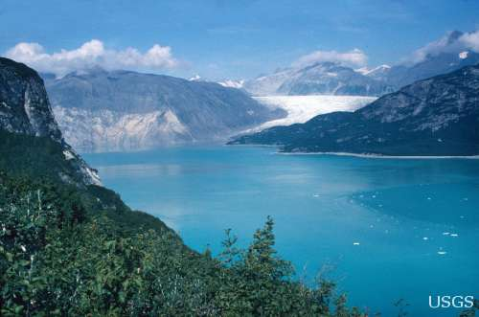
Ice Erosion

Slide 12
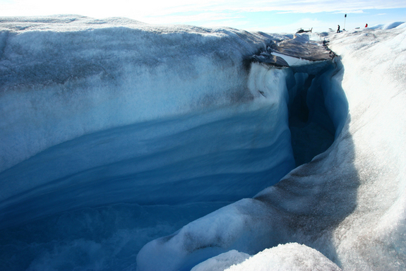
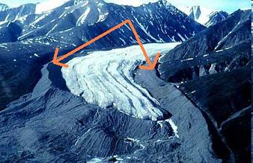
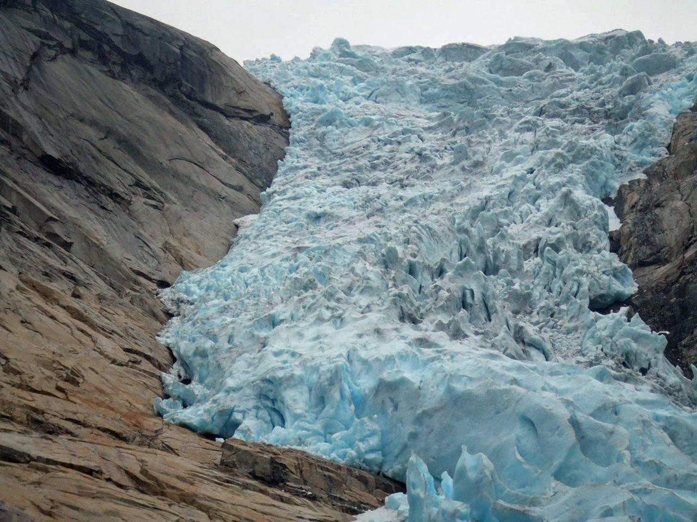
Ice Erosion

Slide 13
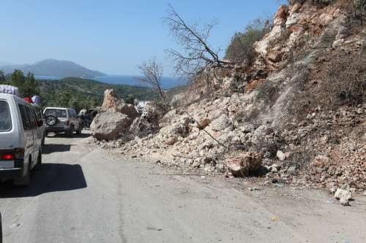
Gravity Erosion
Gravity Erosion is better known as Mass Movement and is defined as the transfer of rock and soil down slope by direct action of gravity without a flowing medium (such as water or ice). Some of the best examples of Mass Movement are:
Creep
Rock fall Slump
Landslides Avalanches

Slide 14
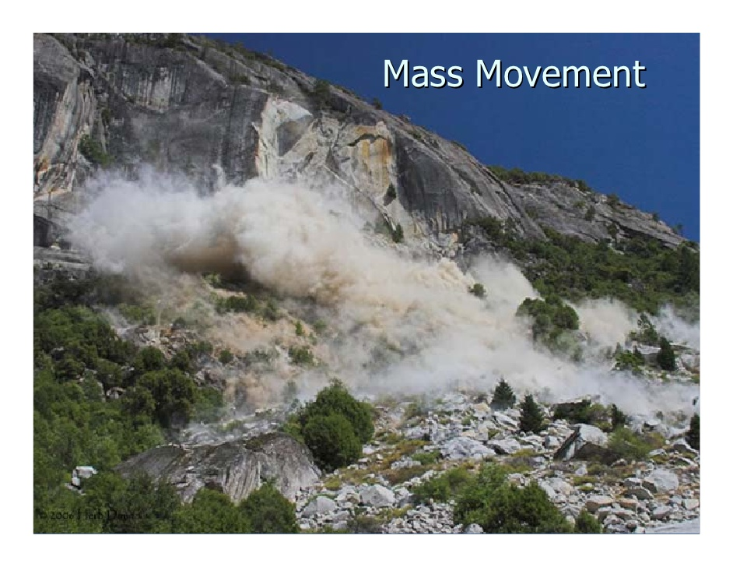
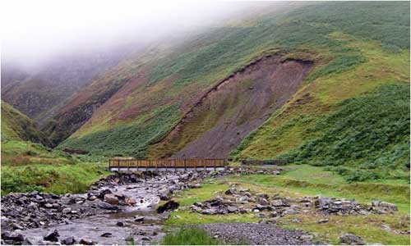
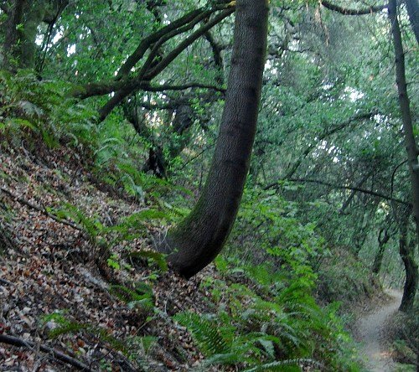
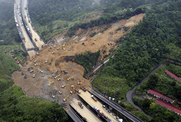
Gravity Erosion

Slide 15
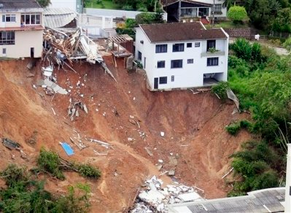
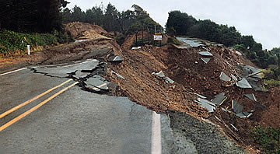
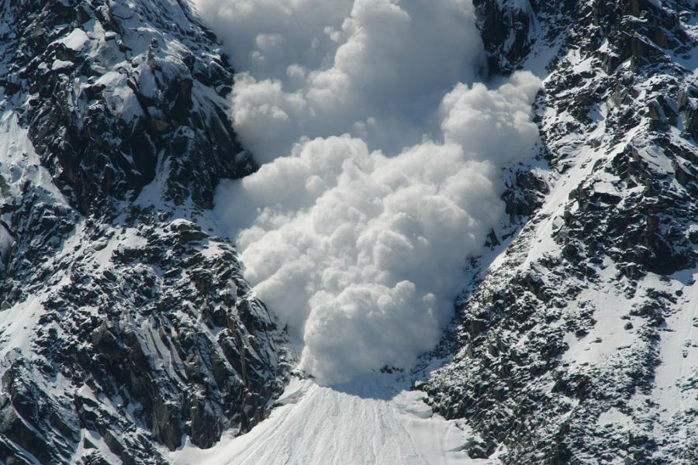
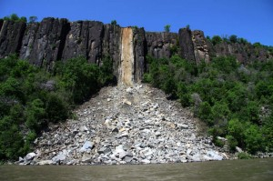
Gravity Erosion

