Slide 1

How to take Notes
And actually be able to study from them!
Cornell Notes

Slide 2
Strategy No. 1
Cornell Notes
What it is – a way to take more organized notes
What you will need – lined notebook paper (and something to write with of course!)

Slide 3
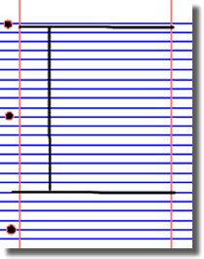
Cornell notes: How it works
Put the subject and date at the top of your paper (and each page thereafter), then
Divide your paper into three sections, like this:

Slide 4
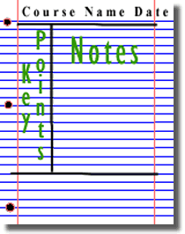
Cornell notes: How it works –
Taking notes
The large box to the right is for writing notes, either from the lecture or as you read.
Skip a line between main ideas and topics.
Don't use complete sentences, and don’t try to copy down every word from the text or the lecture. Use abbreviations, whenever possible. Develop a shorthand of your own, such as using "&" for the word "and“, w/ for with, b/c for because, and so on.

Slide 5
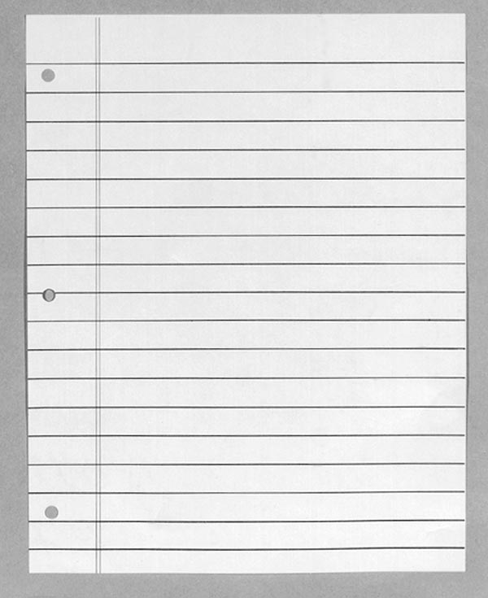
Cornell Notes: Using your notes to study
Course name, source (lecture, text), date
Review notes as soon as possible after class!
Pull out main ideas and put them in the left column
Yada, yada, yada, YADA
Yada YADA
Yada, yada
YADA, yada, yada, yada
YADA
YADA
YADA
YADA –
YADA -

Slide 6
Cornell Notes: Using your notes to study
Course name, source (lecture, text), date
Yada, yada, yada, YADA
Yada YADA
Yada, yada
YADA, yada, yada, yada
YADA
YADA
YADA
Write a summary of the main ideas in the bottom section
YADA –
YADA -
Yada yada yada yada yada yada yada yada yada

Slide 7
Notebook:
Look in your workbook on page ______ which has already been divided for you.
Read the assigned text, taking notes on the using this method
Your teacher may ask you to share your notes

Slide 8
Using a Laptop? No problem. . .
Cornell Notes – make yourself a template using the ‘tables’ feature and mark off the lines for each page using the line in the appropriate feature on your toolbar, just as you would on a sheet of notebook paper. Type your notes in the boxes

Slide 9
Sources
The Learning Toolbox, James Madison University

