Slide 1
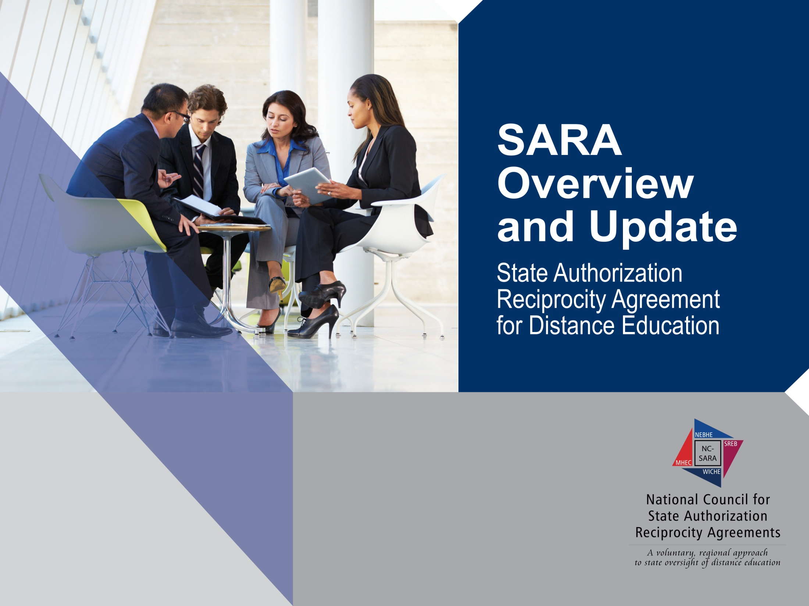
Pennsylvania SARA Meeting
Four Regional Educational Compacts and SARA

Slide 2



A regional education compact is not…..
An accrediting agency…
Concerns with
accreditors
are addressed
by accreditors

Slide 3

The Regional Compacts
  Midwestern Higher Education Compact (MHEC)
  New England Board of Higher Education (NEBHE)
  Southern Regional Education Board (SREB)
  Western Interstate Commission for Higher Education (WICHE)

Slide 4

A Closer Look: MHEC
Illinois, Indiana, Iowa, Kansas, Michigan, Minnesota, Missouri, Nebraska, North Dakota, Ohio, South Dakota, and Wisconsin.
…provide greater higher education opportunities and services in the Midwestern region, with the aim of furthering regional access to, research in and choice of higher education for the citizens residing in the several states which are parties to the compact.
Additionally, MHEC aims to help member states leverage postsecondary education institutions and programs as strategic assets in advancing economic and community development and improving quality of life for the region’s citizens.

Slide 5
A Closer Look: SREB
Alabama, Arkansas, Delaware, Florida, Georgia, Kentucky, Louisiana, Maryland, Mississippi, North Carolina, Oklahoma, South Carolina, Tennessee, Texas, Virginia, West Virginia
1948 to provide access to education for students in the South.
Regional Compact Program (RCP)
Academic Common Market (ACM)
Electronic Campus (EC)
SREB works with P-K20 initiatives

Slide 6

SREB’s
Commissions On..
College Affordability in the South
Career and Technical Education
Community College
Computer Science and Information Technology
Teacher Preparation

Slide 7
Challenge 2020 Goals
Student Achievement for all groups in the middle grades will exceed state standards and national averages – at rates that close the achievement gaps between groups
Eighty percent of all groups of ninth-graders will graduate from high school ready for college and career training

Slide 8
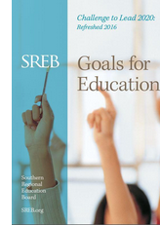
Challenge to Lead Goals for Education: Refreshed 2020
www.sreb.org/search/site/goals

Slide 9
What is a Regional Compact?
A regional compact….
four statutorily-created interstate compacts
Member state obligations, program fees, and foundation grants finance activities and support initiatives to increase regional collaboration and achieve outcomes that could not be realized by institutions and systems acting independently.

Slide 10


A regional education compact is not…..
Professional Licensure Requirements
(SARA increase focus on student notification)

Slide 11

A Closer Look: NEBHE
Connecticut, Maine, Massachusetts, New Hampshire, Rhode Island or Vermont
NEBHE was founded in 1955,
…the future prosperity of New England rested on higher education
states to the shared pursuit of academic excellence.

Slide 12
A Closer Look: WICHE
Alaska, Arizona, California, Colorado, Hawai'i, Idaho, Montana, Nevada, New Mexico, North Dakota, Oregon, South Dakota, Utah, Washington, U.S. Pacific Territories and Freely Associated States.
WICHE was created to facilitate resource sharing among the higher education systems of the West. It implements a number of activities to accomplish its objectives. (1950s)
WICHE began operations in 1953 in Eugene, OR, moving to its present location in Boulder, CO, in 1955.

Slide 13
Regional Compacts & SARA
Some states do not participate in regional education compacts; however, SARA requires state affiliation with a compact.
DC and PA affiliating with SREB
Puerto Rico is expected to do the same
NJ and NY will affiliate with NEBHE

Slide 14
SREB’s Goals for Education - Challenge 2020 Goals
    All Children entering school will exhibit the knowledge and the social and developmental skills needed for success in first grade.
    Student achievement for all groups in the early grades will exceed state standards and national averages – at rates that close the achievement gaps between groups
Notes:
Refreshed in 2016

Slide 15
Challenge 2020 Goals
Sixty percent of working-age adults will have a postsecondary credential: an associate or bachelor’s degree, or a career certificate. Public postsecondary institutions will make it a top priority to help states meet state needs by increasing graduates, public service and research.
Increasing percentages of adults without high school or postsecondary credentials will pursue opportunities to earn high school alternatives certificates, college degrees or career certifications.

Slide 16
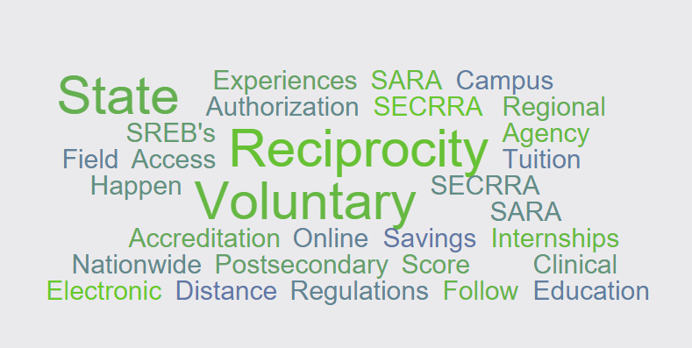
Questions?
As always, feel free to contact information@nc-sara.org with any additional questions or comments
Mary Agnes Larson
Director, Student Access Programs and Services
mary.larson@sreb.org or SARA@sreb.org

Slide 17
Welcoming PA and Its Institutions to SARA
State College, PA
November 30, 2016

Slide 18

Presenter:
Marshall A. Hill
Executive Director, NC-SARA

Slide 19
What’s the problem? (1)
Our country lags many others in the educational attainment of our 18-34 age population.
Distance education can play an important role in increasing attainment. We need to maximize its contributions.

Slide 20
What’s the problem? (2)
States and territories regulate higher education within their borders, with varying requirements for out-of-state institutions that want to enroll students in the state.
Before SARA, there was no alternative to each institution separately pursuing any needed approvals (state authorization) in each state and territory where it enrolls students.

Slide 21
What’s the problem? (3)
Consequently, thousands of institutions must contact and work with as many as 54 states and territories, and, sometimes, with multiple regulatory agencies in those states.
That process is inefficient, costly, and not effective in supporting access to high quality distance education throughout the country.

Slide 22
SARA Goals
SARA establishes a state-level reciprocity process that is making state authorization:
  more efficient, effective, and uniform in regard to necessary and reasonable standards of practice that could span states;
  more effective in dealing with quality and integrity issues that have arisen in some online/distance education offerings; and
  less costly for states and institutions and, thereby, the students they serve.

Slide 23
SARA: reconciling different interests
Institutions’ goals
Regulators’ concerns
Others
Accreditors
Regional compacts
National commission

Slide 24
The Evolution of SARA
Lumina Foundation provided funding to the Presidents’ Forum, working with the Council of State Governments (CSG), to develop a Model State Authorization Reciprocity Agreement (SARA) that states could adopt to acknowledge other states’ work and decisions in regard to institutional authorization.
Building upon the work of the Presidents’ Forum and CSG, the Western Interstate Commission for Higher Education (WICHE) advanced “W-SARA” in collaboration with the regional higher education compacts (SREB, MHEC, NEBHE).
Combining all prior efforts and input from all stakeholders, the Commission on the Regulation of Postsecondary Distance Education, founded by SHEEO and APLU, and chaired by former Secretary of Education Richard W. Riley, issued its report: “Advancing Access through Regulatory Reform: Findings, Principles, and Recommendations for the State Authorization Reciprocity Agreement (SARA).”
Funding for national and regional implementation provided by Lumina Foundation.

Slide 25
The SARA solution
A nation-wide system of reciprocity administered by the four existing regional compacts
MHEC
NEBHE
WICHE
SREB

Slide 26
Essential principles of SARA (1)
Voluntary for states and institutions.
Acknowledges the traditional roles within higher education’s “accountability triad”: federal government, states, and accrediting bodies recognized by the U.S. Department of Education.

Slide 27
Essential principles of SARA (2)
Lays out a framework for state-level reciprocity, including a governance structure, implementation by the four regional higher education compacts (MHEC, NEBHE, SREB, WICHE), a National Council for SARA to ensure comprehensive national coverage, and a financial plan to support operations.

Slide 28
Essential principles of SARA (3)
Requires states to approve their
in-state institutions for SARA participation (based upon institutional accreditation and financial stability) and resolve student complaints.
SARA states agree to impose no additional (non-SARA) fees or requirements on institutions from other SARA states.

Slide 29
Essential principles of SARA (4)
Open to degree-granting postsecondary institutions from all sectors: public colleges and universities; independent institutions, both non-profit and for-profit.
Requires accreditation by a recognized accreditor.
Sets forth a reasonable, uniform set of triggers of “physical presence”.
Preserves state approval and oversight of on-the-ground campuses.

Slide 30
Essential principles of SARA (5)
Shifts principal oversight responsibilities from the state in which the distance education is being received to the “home state” of the institution offering the instruction. (Host state can also work to resolve problems.)
Initial funding from Lumina Foundation and the Bill & Melinda Gates Foundation; now funded by institutional fees paid to the National Council for SARA.

Slide 31
SARA and experiential learning such as clinical education, internships, etc.
Why deal with experiential education at all?
  Many states regulate it;
  Beneficial for students;
  Required for certain programs.
What does SARA “cover” or allow?
  It’s complicated, but basically, 10 students per program per site
  For details, see NC-SARA website and SARA Manual

Slide 32
Benefits to students
Expands access to educational offerings.
Should lead to better resolution of complaints from students in SARA states.
Reduces a rapidly growing institutional cost that is in one way or another passed along to students.
Should enhance overall quality of distance education.

Slide 33
Benefits to institutions
Enables more efficient provision of distance education to a broader market.
Reduces number of applications to other states.
Reduces number of other-state regulations to monitor for changes.
Reduces costs.
  Reduced costs = potentially lower fees for students.

Slide 34
Benefits to states
Expands educational offerings to residents.
Allows SARA states to focus on their home-state institutions.
Maintains state regulation of on-the-ground instruction offered by out-of-state institutions.
Other SARA states will help resolve complaints.
Reduces costs for institutions.
No fees charged to states to participate in SARA.

Slide 35
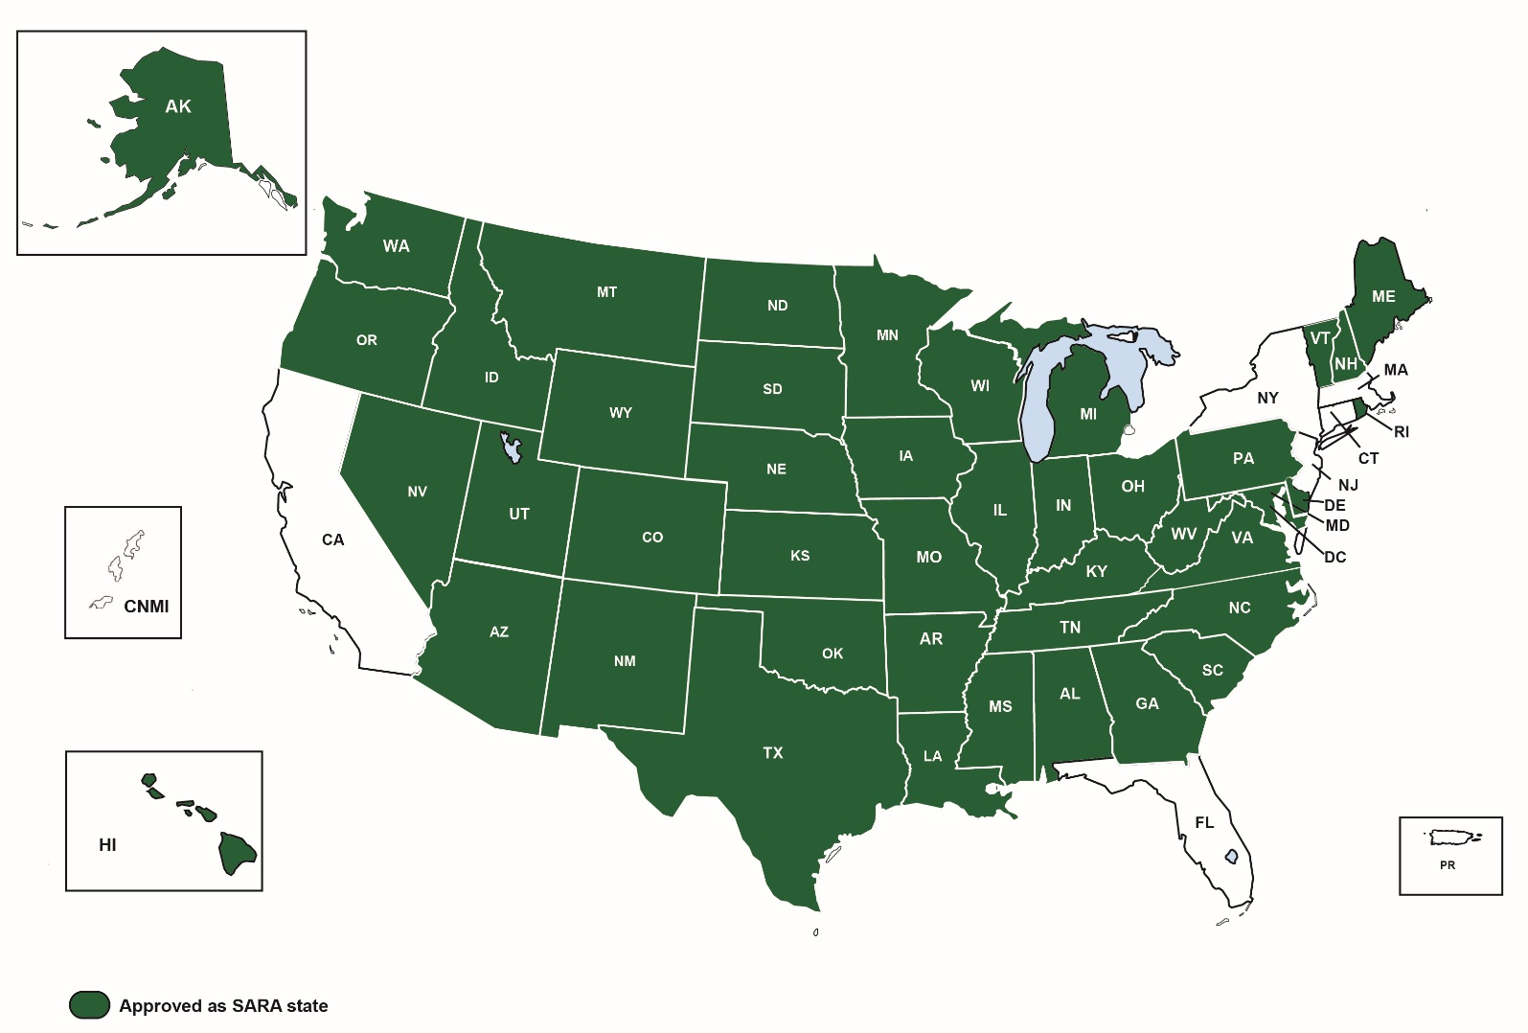
The Current SARA Landscape

Slide 36
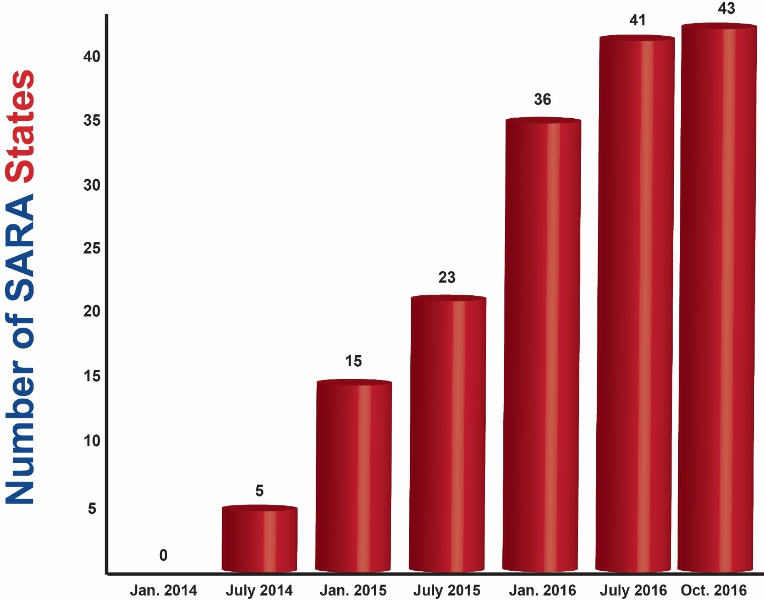
SARA Member States

Slide 37
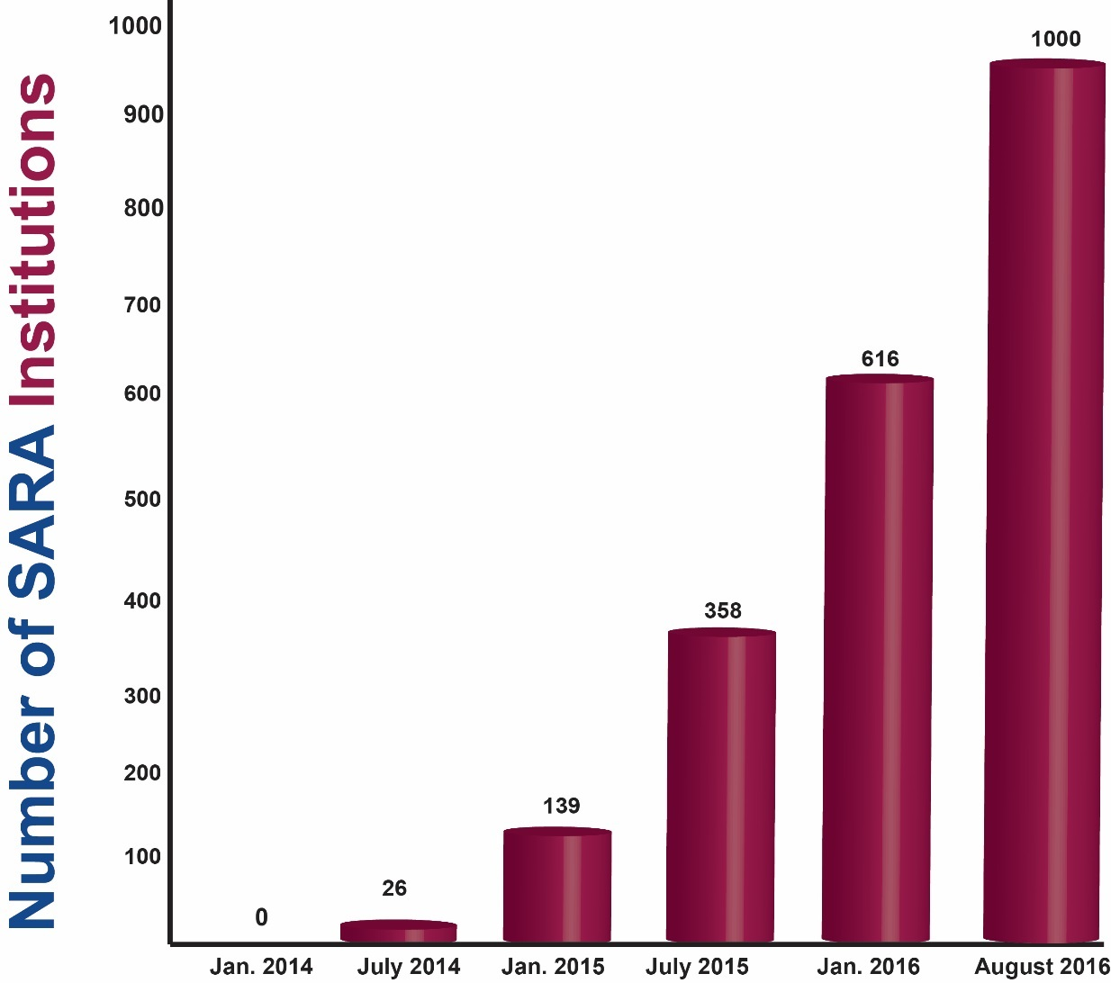
Participating Institutions

Slide 38
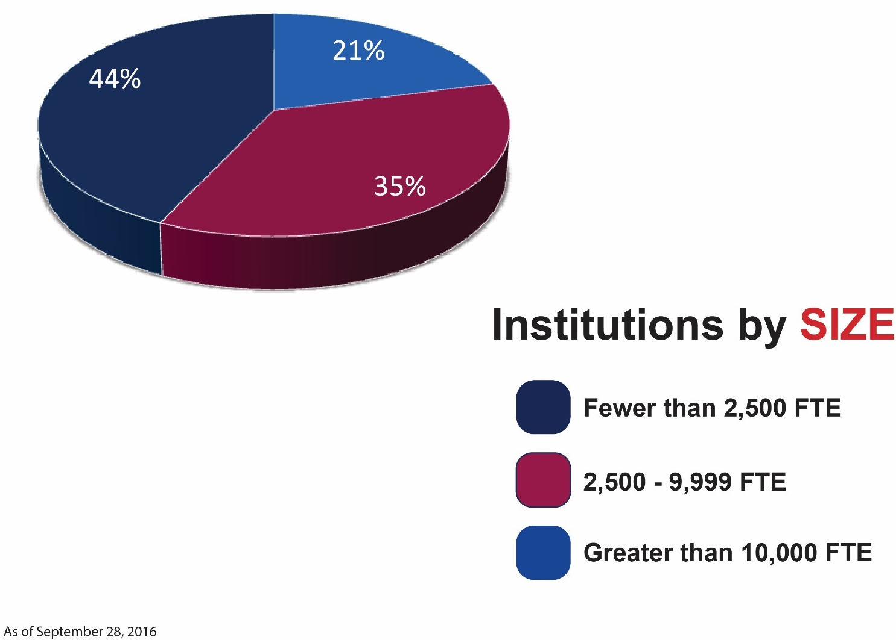
Participating Institutions
As of September 28, 2016

Slide 39
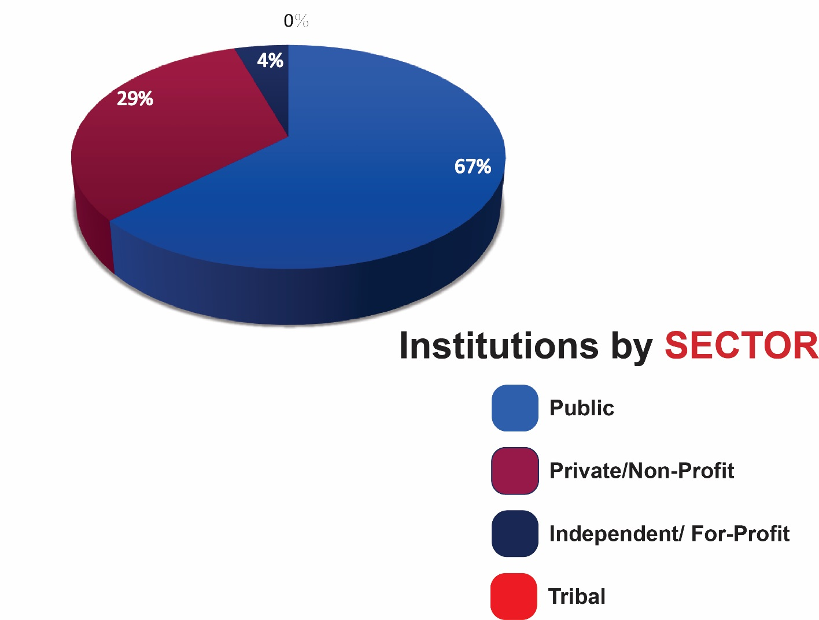
Participating Institutions
As of September 28, 2016

Slide 40
Financial Status of the Sara Initiative
SARA work by all SARA partners
(NC-SARA, MHEC, NEBHE, SREB and WICHE) is now fully dependent on fee revenue
Current and projected revenues are sufficient to support SARA
Consequently, NC-SARA has determined to keep fees at current levels through June, 2018

Slide 41
What’s Ahead for
SARA?
Complaint and enrollment
reporting and publication:
  Continuation of complaint reporting every quarter;
  SARA institutions reported their out-of-state enrollments in May, 2016; published in September;
SARA Manual (replacing Polices & Standards and FAQs)
Under consideration
  Student-focused information and assistance

Slide 42
Now That We’re Past the “Easy” Stuff…
Continue to add states and institutions
Implications and implementation of IRS 501 (c)(3) status for NC-SARA
  Establish independent budgeting, accounting, auditing and IT systems
  Establish appropriate staffing levels
Responding to “down-in-the-weeds” questions and policy issues
  Physical presence
  Experiential learning
  Etc., etc., etc.

Slide 43
Additional Resources
SARA
www.nc-sara.org
State Authorization http://wcet.wiche.edu/initiatives/state-authorization-network
State contacts http://sheeo.org/projects/state-authorization-postsecondary-education

