Slide 1
SREB
Council of Collegiate
Education for Nursing
The Ties that Bind

Slide 2
Coalition Building as a Mechanism to Create Trust, Collaboration & Strategic Alliances
Alexia Green RN, PhD, FAAN
Professor & Dean Emeriti
Texas Tech University Health Sciences Center
Lubbock, Texas

Slide 3
Objectives:
Differentiate between partnerships &
coalitions
Analysis the stages of political
development in nursing profession.
Discuss the role of “partnership &
coalition building” in developing the
profession.
Identify and integrate characteristics of effective partnership & coalition building into organizational strategies to improve nursing education.

Slide 4
Partnership Defined
A partnership is an arrangement where parties agree to cooperate to advance their mutual interests
Partnerships present the involved parties with special challenges that must be navigated unto agreement. Overarching goals, levels of give-and-take, areas of responsibility, lines of authority and succession, how success is evaluated and distributed, and often a variety of other factors must all be negotiated.
Lasker, Weiss & Miller(2001)

Slide 5
Coalition Defined:
“ A group of organizations whose members commit to an agreed-on purpose & shared decision making to influence an external institution or target goal, while each member organizations maintains its own autonomy.”
Mizzrahi & Rosenthal (2001)
“Coalitions are made up of multiple entities (generally other organizations) which in turn are made up of multiple individual actors who are in pursuit of specific goals”.
The California Endowment (2009)
Notes:
The phrase “influence an external institution or target” – is specific enough to reflect an external advocacy role but broad enough to encompass a variety of advocacy targets such as national/local policy, the public-at-large, educational or healthcare systems.

Slide 6
Understanding the Stages of Nursing’s Political Development:
Cohen, et. al. (2011)
Reactive with a focus on nursing issues
Learning the language
Minimal political awareness – occasional participation in partnerships/coalitions
Isolated impact on policy, minimal impact on community/society
Reactive to broader issues
Language focuses on “nurse jargon”
Some partnerships emerge with focus on nursing
Some impact related to nursing issues
Stage 1
Stage 2

Slide 7
Understanding the Stages of Political Development: Cohen, et. al. (2011)
Proactive engagement in nursing & other issues
Using parlance & rhetoric focused on broader issues beyond nursing
Participate in multiple partnerships & coalitions
Nurses appointed to committees/boards focused on health related issues
Proactive leadership & agenda-setting for broad-range of social & policy issues
Introducing terms that reorder the debate
Initiating partnerships & coalitions beyond nursing
Nurses sought after to fill multiple boards addressing multiple societal issues
Stage 3
Stage 4

Slide 8
When should you form Partnerships or join Coalitions?
First Question to be Addressed is not Evidenced Based – But Is A Strategic Decision
  Context Specific
  “When going it alone” is not an option due to
  lack of resources, influence or impact
  Results in greater social impact
  Requires Strategic Engagement
  Butterfield, K., Reed, R., & Lemak, D. (2004).
Notes:
This discussion assumes that understanding what makes an effective partnership or coalition and how to assess & improve them will increase your effectiveness as a leader AND reduce potential frustrations associated with engaging in partnerships and coalitions.

Slide 9
Seven Stages of Development
Mobilization
Establishing Organizational Structure
Building Capacity for Action
Planning for Action
Implementation
Refinement
Institutionalization
      Raynor (2011)
Notes:
This discussion assumes that understanding what makes an effective partnership or coalition and how to assess & improve them will increase your effectiveness as a leader AND reduce potential frustrations associated with engaging in partnerships and coalitions.

Slide 10
Capacities of Effective Partnership/Coalition Members:
Skills/knowledge to work collaboratively
Commit to the defined action as well in name
Ability to articulate what you bring to the table (time, resources, access, relationships, reputation, expertise, etc.)
Ability to articulate what you want from the table
Willingness to share resources
Willingness to openly identify conflicts between the individual organization/s and partners
Willingness to share power/credit

Slide 11
Capacities of Effective Partnership/Coalition Members Cont:
Willingness to speak as one
Willingness to explore alternative ideas and approaches
Willingness to dedicate staffing to implement assigned tasks
Willingness to commit for an extended and relevant period of time
Understanding how your issue/goal fits into a broader network of issues & shared goals
    Raynor (2011)

Slide 12
Benefits of Developing & Participating in Partnerships & Coalitions
Networking
Information Sharing
Access to Resources
Resource Pooling
Involvement in Important Cause or Strategy
Shared Mission
Ability to Attained Desired Outcomes
Enhanced Visibility and Power in Numbers
Enjoyment of collaboration & camaraderie
Ability to Build Skills

Slide 13
Effectiveness:
In addition to core capacities – organizational culture plays a role in how the partnership functions
Culture is the unique history, language, organizational structure, and set of values and beliefs of an organization.
Effective Partnership Cultures must have:
    Trust
    Respect
    Safe Dissent
    Unity
    Sensitivity to Power Differentials
    Lasker, R., Weiss, E., & Miller, R. (2001)

Slide 14

Partnership Exemplar # 1:
Seton Healthcare Family
Austin & Texas Hill Country, Texas
A Regional Partnership

Slide 15
Seton HC Family of Hospitals :
A member of the Ascension Healthcare System
11 hospitals, ambulatory facilities: home care and hospice services
Four ANCC Magnet Designated Hospitals since 2002
Five Pathway to Excellence Hospitals
Notes:
It is more productive to be proactive. First determine that a partnership is the best way to accomplish an important body of work. Then seek out the partner or partners who might best be able to help. In some cases you may have to create the right partner.
Sharing resources, benefits and recognition for successes keeps the partnership from becoming lopsided, or dominated by any one player. Each partner needs to see their contribution alongside the benefit gained.
If differences arise or performance lags, the formal written agreement provides a touchstone for accountability, revisiting intent and commitments, reconciliation, and getting back on track.
You need to instill the importance of continually acknowledging the contributions of each party to the overall effort. In essence, individualism needs to be transformed into shared stewardship and responsibility that is re-enforced by actions as well as words.

Slide 16
Addressing the Seton Nursing 2015 Strategic Direction…”nurses with the right skills”
Pipeline and Professional Development Partnerships
Seton 10.23.12
Notes:
16
Describe Seton Healthcare Family’s strategic community role in pipeline and professional development through partnerships.

Slide 17
Seton Healthcare Family Partnerships
The Health Industry Steering Committee (HISC)
Seton Healthcare Family co-leads a 13-year community partnership of secondary and post secondary education, workforce intermediaries and clinical agencies to meet the needs of all stakeholders
  Establishes community standards for student placements, background checks/screenings, immunizations, faculty competency standards, preceptor education, etc.
  Established the web based Central Texas Scheduling System to coordinate and manage student cohort placement in the 10 county region.
Notes:
For more than 13 years Seton has been a leader in ensuring a community approach is taken to address the mutual needs of the educational institutions and the clinical agencies. Their role in establishing the Health Industry Steering Committee has had a very positive impact for all the community stakeholders.

Slide 18
Mission of The Clinical Education Center (CEC)
The Clinical Education Center at Brackenridge is committed to:
Supporting interprofessional clinical education in an immersive learning environment
Facilitating a pipeline of well-qualified health practitioners for Central Texas
Conducting evaluations and research relative to CEC activities
Notes:
The mission of the CEC is to support interprofessional educaiton, healthcare practitioner pipeline, and to provide a rich environment for evaluation and research of innovative training/education practices

Slide 19






Notes:
These are some of our collaborative partners
UTSW, UTMB, UT Austin, Austin Community College, Texas Tech University, Concordia University
The center supports the workforce pipeline by collaborating with the University of Texas Southwestern Medical Residency program, University of Texas Medical Branch Medical School, University of Texas at Austin schools of Law, Pharmacy, and Social Work as well as Texas Tech University Health Science Center School of Nursing, Concordia University-Austin School of Nursing, and Austin Community College Associate Degree Nursing Program. Students from these institutions in the fields of medicine, nursing, pharmacy, and social work have participated in interdisciplinary education through a series of case events conducted in the training and simulation rooms to explore interdisciplinary team work.
Clinical Education Center Facts at a Glance:
12 Training Rooms
7 Conference Rooms
2 Computer Labs
4 Skills Labs with 45 patient care areas
4 High fidelity simulation labs featuring 6 high fidelity manikins
Wireless Internet access
Catering and nearby restaurants
Dedicated Parking Garage
24/7 operation and security
Medical Library

Slide 20
Seton Healthcare Family Partnerships
Seton Healthcare Family Contribution to area nursing schools
From 2002 – 2012 > $2,900,000
Austin Community College
MOUs 2002- September 2010
Funding support to expand capacity by 54%
Provided faculty and lab equipment/supplies
Provided Seton with 10 preferred slots in each Fall admissions cycle
Provides for 50 Seton Associates to register early for pre-nursing courses each semester
MOU August 2007-2011
Providing space at Seton’s Clinical Education Center (CEC) and faculty support
Approximately 200 ACC nursing students enrolled at the CEC
Notes:
The following slides give provide an overview of some of the more significant investments/partnerships Seton has made or been engaged in over the past ten years. Much of the financial and in-kind support was aimed at expanding capacity in areas schools of nursing.
Some benefits that Seton associates experienced include being able to register early for nursing pre-requisite courses at Austin Community College. Additionally, Seton was allocated with 10 slots in each fall semester class for Seton associates that met the admission requirements.
In 2007, Austin Community College was able to establish a satellite nursing campus at the Clinical Education center by being able to lease space in the facility. Approximately 200 ACC nursing students attend didactic and nursing skills/simulation classes annually at the CEC

Slide 21
Seton Healthcare Family Partnerships
University of Texas Austin
MOUs 2007-2013
Seton’s Nursing Research Fellowship and Writing for Publication Workshops supported by The UT Austin School of Nursing
Seton funds supported additional faculty to increase enrollment
Scholarships student enrolling in the ADN-BSN Program (up to $10,000/student)
Support for development of online courses for the ADN-BSN program
Provides part-time advisor for ADN-BSN Program
Provided for Pediatric Nurse Practitioner faculty in support of the ACPNP Post-Master’s program.
Notes:
Seton has a long-standing collaborative with The University of Texas at Austin School of Nursing. In 2007, A Seton-UT Austin collaborative resulted in the Seton Nursing Research Fellowship. More than 100 Seton nurses learned about EBP and Research through this relationship. A significant number of these nurses either implemented EBP projects or conducted research studies with the support of Seton doctoral prepared nurses researchers and nurse researchers at the UT School of Nursing.
Several writing for publication workshops have been offered as a result of this partnership and many of the Seton nurses have published in peer reviewed journals.
The Seton-UT Austin partnership also resulted in generous scholarship opportunities for students enrolling in UT’s ADN to BSN Program.
The school was able to offer post-masters Pediatric Nurse Practitioner courses because of Seton’s sponsorship

Slide 22
Seton Healthcare Family Partnerships
Texas Tech Health Science Center School of Nursing
Second Degree Program rents clinical skills labs, simulation labs and computer lab space at the Clinical Education Center
Seton support for more permanent presence in Central Texas
Fills niche market for Second Degree Students
Provides MSN and DNP Education for Seton nurses with special emphasis on Leadership
Concordia Lutheran University School of Nursing
Rents clinical skills labs, simulation labs and computer lab space at the Clinical Education Center
Notes:
Texas Tech University School of Nursing and the Concordia Lutheran University School of Nursing have also benefitted from Seton’s commitment to nursing education. Both schools rent space at the CEC that affords them the opportunity to have access to state of the industry facilities for teaching their students for a nominal fee.

Slide 23
Seton HC Family of Hospitals Partnership Grew to Coalition –
What strategies and tactics did Seton deploy to succeed?
What are the evidence-based indicators for success?
Let’s Dive Deeper into What Makes a Partnership or a Coalition Successful
Notes:
It is more productive to be proactive. First determine that a partnership is the best way to accomplish an important body of work. Then seek out the partner or partners who might best be able to help. In some cases you may have to create the right partner.
Sharing resources, benefits and recognition for successes keeps the partnership from becoming lopsided, or dominated by any one player. Each partner needs to see their contribution alongside the benefit gained.
If differences arise or performance lags, the formal written agreement provides a touchstone for accountability, revisiting intent and commitments, reconciliation, and getting back on track.
You need to instill the importance of continually acknowledging the contributions of each party to the overall effort. In essence, individualism needs to be transformed into shared stewardship and responsibility that is re-enforced by actions as well as words.

Slide 24
Building a Partnership Culture :
Focus on important needs
Make the Partnerships a Win-Win
Adopt a Shared Vision
Negotiate a Formal Agreement
Ensure Good Communication
Ensure the Partnership is Owned by Your
Whole Organization
Maintain an Environment of Trust
Leave Your Ego and Control at the Door
Notes:
It is more productive to be proactive. First determine that a partnership is the best way to accomplish an important body of work. Then seek out the partner or partners who might best be able to help. In some cases you may have to create the right partner.
Sharing resources, benefits and recognition for successes keeps the partnership from becoming lopsided, or dominated by any one player. Each partner needs to see their contribution alongside the benefit gained.
If differences arise or performance lags, the formal written agreement provides a touchstone for accountability, revisiting intent and commitments, reconciliation, and getting back on track.
You need to instill the importance of continually acknowledging the contributions of each party to the overall effort. In essence, individualism needs to be transformed into shared stewardship and responsibility that is re-enforced by actions as well as words.

Slide 25
Building a Partnership Culture Cont:
Understand Each Partner's Mission and
Organizational Culture
Utilize Strengths of Each Partner
Build Step by Step
Constantly Seek Out and Adopt Best
Practices
Diversify Your Funding Sources
Celebrate Success
Respect the Right to Disagree; Act on a
Consensus Basis
Notes:
The most successful partnerships recognize and value their differences and find ways to integrate them into a workable overarching partnership culture.
Successful partnerships are characterized by a flexible approach to how needs and responsibilities are matched given each partner's funding, policies, political connections, and other considerations. Challenge yourself and your partners to collectively raise the bar of expectations and advance the partnership step-by-step.
Work together to identify and engage the abundant human talent residing in most communities to participate in and assist your partnership.

Slide 26
Culture Trumps Strategy
(or Capacity)
In addition to core capacities – organizational culture plays a role in how the coalition functions
Culture is the unique history, language, organizational structure, and set of values and beliefs of an organization.
Effective Coalition Cultures must have:
    Trust
    Respect
    Safe Dissent
    Unity
    Sensitivity to Power Differentials
Notes:
Safe Dissent – include arbitration clause in any partnership or coalition agreement.

Slide 27
Leadership Capacities
Shared purpose and vision which builds cohesion
Common goal destination
Clear value proposition
Formalized set of rules/procedures
A “core” leadership team
A commitment to action
Transparent consensus decision-making processes
Strategically developed and engaged partners/members

Slide 28
Pros & Cons of Consensus Decision-Making
Increases commitment
Empowerment
Participation
Overcome resistance to
change
General satisfaction with
decisions
Builds morale
Theoretical message of equality
Difficulty defining specific tasks
Slow/Time consuming
Waiting to take action until all have spoken rather than when a decision has been made
Pros
Cons

Slide 29
Tactical Support a Must
For Success:

Slide 30
Understanding the Difference Between Strategic & Tactical Thinking
Strategic =
“Doing the Right
Thing”
Tactical =
“Doing Things
Right”
Leadership
Management

Slide 31
The Critical Difference
Strategy | vs. | Tactics
Central organizing statement. |  | Day to day actions.
Spin put on things. |  | Things or tools spun.
Road map for marketing plan |  | Vehicles for the trip.
Doing the right thing. |  | Doing things right.
Concept. |  | Tools of execution.
Organizing glue. |  | What gets glued.
Focused. |  | Typically, many things.
Mental, intangible. |  | Physical, sensory.
An "action" statement: verb. |  | Things: nouns.
Notes:
You need both for a successful partnership or coalition

Slide 32
Strategic Thinking:
Clarifying the vision & direction of the whole
Must have clear success “measures”
About identifying relationships which support the partners/coalition vision
About identifying leverage points for change
Disciplined thinking about desired outcomes
Clarifies goals & outcomes

Slide 33
Tactical Support & Operations Key to Coalition Success:
Provides support for achievement of the Strategic Plan
Focuses on planned or ad hoc activities
Requires resources for support of activities focused on implementation of strategies & achievement of goals
Tactics are decided by the “operations team”
Tactics may be decided by more than one “operating team” in a Coalition
Notes:
For instance in the Campaign for the Future – there are national level tactics, state level tactics, regional level tactics, and organizational level tactics.

Slide 34
Adaptive Capacities of Successful Partnerships:
Ability to monitor the policy environment
Effective & action-oriented planning
Ongoing monitoring & evaluation
Clear measures of goal destination – use of benchmarks
Measures of value proposition
Procurement of resources (financial & in-kind from both partners & external sources)

Slide 35
Management Capacities:
Frequent & productive communications
Facilitate language differences
Managing member participation
Delivery on reciprocity/expectations
Clear task & goal assignments
Clarity around member & staff roles
Ability to manage conflict
Careful record-keeping – including tracking of progress
Foster-Fishman, P., Berkowitz, S., Lounsbury, D., Jacobson, S., & Allen, N. (2001).
Notes:
Facilitating language differences is particularly important between health care orgs and consumers / non-healthcare orgs

Slide 36
Technical Capacities:
Coalition staffing
Communication skills
Policy/advocacy expertise
Tangible non-human resources (e.g. space,
equipment, website, social media)
Resource development skills (financial &
human resources)
Foster-Fishman, P., Berkowitz, S., Lounsbury, D., Jacobson, S., & Allen, N. (2001)
Notes:
Facilitating language differences is particularly important between health care orgs and consumers / non-healthcare orgs

Slide 37
Funding a Partnership or Coalition:
What is value to Funder?
Does partnership goals align with funder’s goals?
Can the partners articulate its value proposition?
Do the partners represent the breadth of constituencies affected by the issue? If not is there a good rationale
How will the funder hold the partners accountable?
Notes:
Facilitating language differences is particularly important between health care orgs and consumers / non-healthcare orgs

Slide 38
Funding a Partnership or Coalition:
What is the partners ability to do the work?
Can the partners demonstrate capacity to do the work?
Where are the resource gaps between what partners provide & what the partnership needs in order to do its work?
Notes:
Facilitating language differences is particularly important between health care orgs and consumers / non-healthcare orgs

Slide 39
Funding a Partnership or Coalition:
Is the partnership sustainable?
Is there transparency & equity?
Is the partnership funded at sufficient levels to get the job done?
Is there a “value proposition” beyond the funder’s relationships & funding draw?

Slide 40
Funding a Partnership or Coalition:
Should the partners incorporate?
Formal incorporation should be discouraged except in the most extreme circumstances.
If incorporation is pursued it should not be dependent upon a single funding source
Funders have several options in funding non-incorporated partnerships & coalitions
Notes:
Examples of non-incorporated: use of a fiscal agent or a funding “chair” organization on a rotating basis

Slide 41


Partnership Exemplar # 2

Slide 43

Campaign Vision
All Americans have access to high-quality, patient-centered care in a health care system where nurses contribute as essential partners in achieving success
6
Notes:
Now the Robert Wood Johnson Foundation -- the nation’s largest health care philanthropy -- is embarking on a national Campaign for Action in collaboration with the AARP, the nation’s largest consumer organization. The Campaign builds upon the IOM report’s findings. More than 70 national organizations have signed on to advance the report recommendations. And groups have coalesced in nearly every state, including Texas, to take action. Alexia Greene will be speaking in a little bit about the Texas Action Coalition.
This Campaign envisions a health care system that offers all Americans access to high quality, patient-centered care, where nurses contribute as essential partners in achieving success. It’s my hope that everyone in this room will help to realize this vision.

Slide 44


Nursing Must be Considered a
Societal Issue!
RWJF/AARP seeking support from:
Health professionals
Philanthropies
Payers
Educators
Consumer advocates
Hospitals and
health systems
Business
Public health agencies
Policy-makers
22
Notes:
We’re seeking support from a wide range of groups. Addressing nursing workforce challenges must be considered a societal issue – one that does not belong solely to nursing and its leaders – but rather to all who consider health and health care a priority for this nation.
Texas has done a great job of engaging diverse partners.

Slide 45
Campaign Strategies
Diverse Stakeholders
Action Coalitions
Policy-makers
RWJF
AARP
Advisory Committee
Research, Monitoring, Evaluation
Communications
Grantmaking
21
Notes:
So let me tell you a little bit about how we are organizing this campaign to ensure the full implementation of each of the IOM recommendations across the U.S., and in every health care setting.
This campaign is guided by an illustrious strategic advisory committee. We’re engaging diverse stakeholders and key policy-makers. We’re working with 48 Action Coalitions, including Texas, to mobilize a broad-based effort to push for changes at the national, state and regional levels. And we’re implementing a comprehensive communications program, and developing grant making and a research, monitoring and evaluating strategies to generate additional evidence in support of the campaign objectives and ensure accountability by fully gauging our successes and shortcomings.

Slide 46
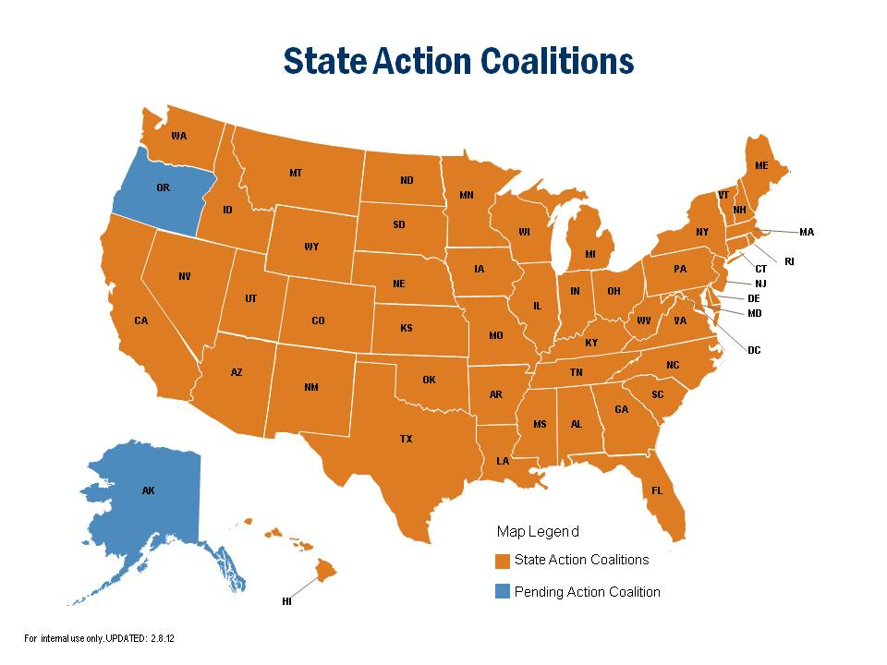
Campaign for Action State Involvement
23
Notes:
We’re also mobilizing on the ground at the state level in nearly every state. And we plan to be in Oregon and Alaska by the end of this year.
Action Coalitions are long-term alliances that we’re using to move key nursing-related issues forward at the local, state and national levels. We’re capturing best practices, tracking lessons learned and identifying replicable models.

Slide 47

Our Commitment to Advance the Health of Texans through Nursing
“Better Care, Better Health, Reduced Cost”
Notes:
Expresses a Value Proposition – Vision Statement

Slide 48

History of Texas Team
Green, A. et. al. (2011). Building academic capacity through statewide partnerships. Journal of Professional Nursing, 27: e50 – e57.

Slide 49
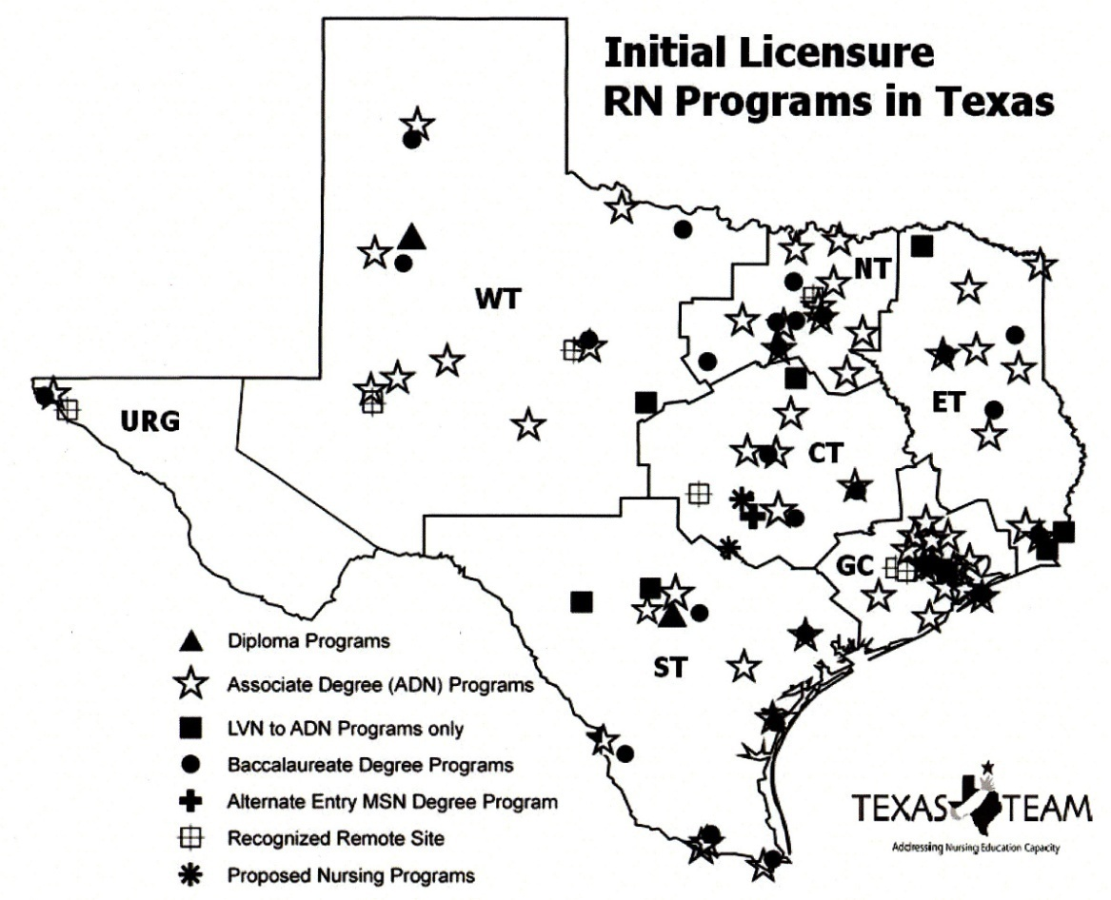
Texas Team Addressing Nursing Education
Using Regional Model for New Texas IFN Team

Slide 50
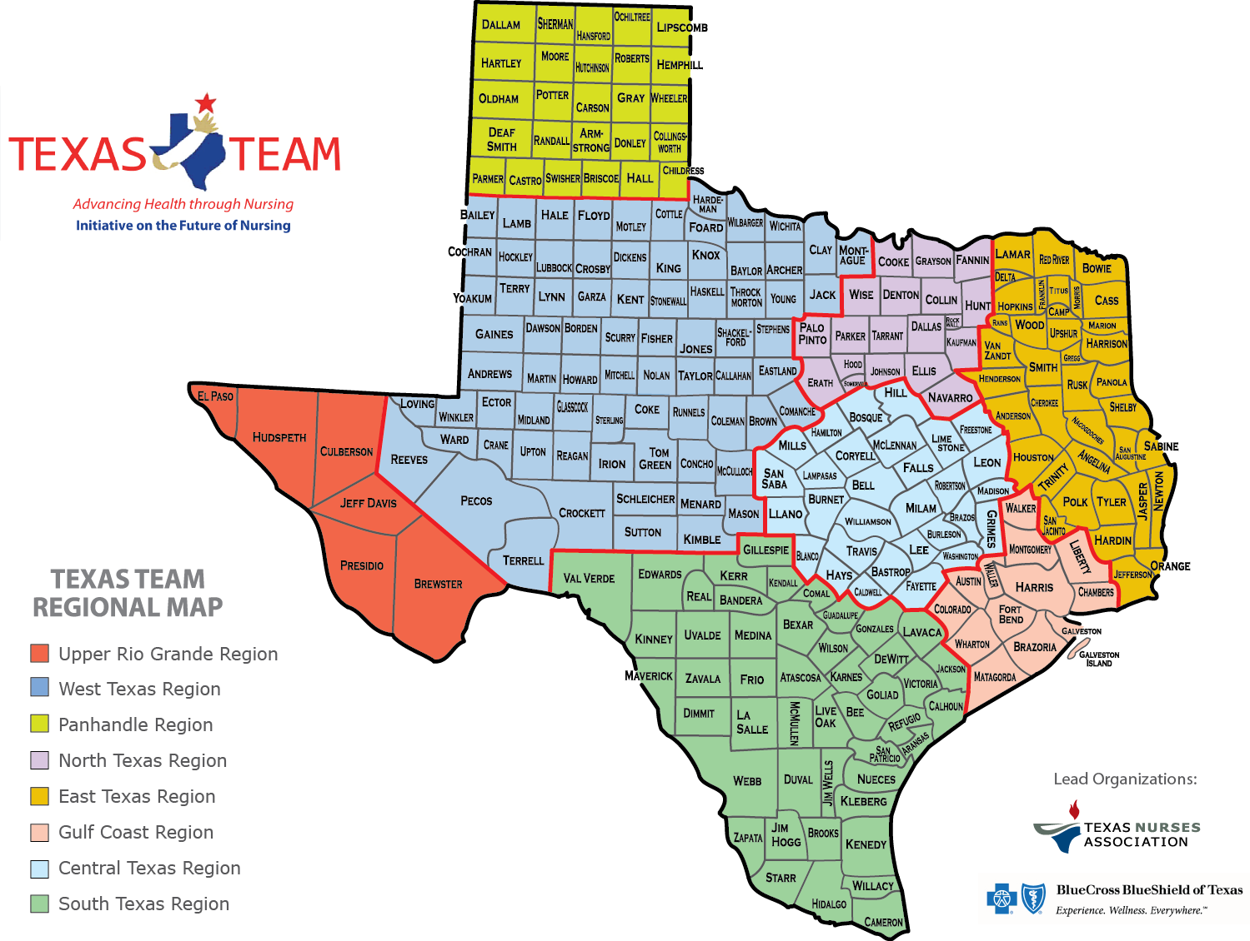
New Texas Team

Slide 51

Texas Team Leadership Org Structure
Strategic Advisory Committee
Executive Committee
Advancing Nursing Practice
Regional Leaders
Tactical Support and Operations
Advancing Nursing Education
Blue Cross/Blue Shield of Texas
Texas Nurses Association

Slide 52
The Texas Mission
Set clearly defined goals which align with IFN recommendations
Form and mobilize the broadest circle of agencies, communities, organizations, & public stakeholders representing a variety of sectors
Educating policymakers and other decision-makers
Reach out to philanthropies/funders to seek financial support for RAC efforts;
Gain visibility through the media and other outlets
Work to advance key IFN recommendations in Texas

Slide 53
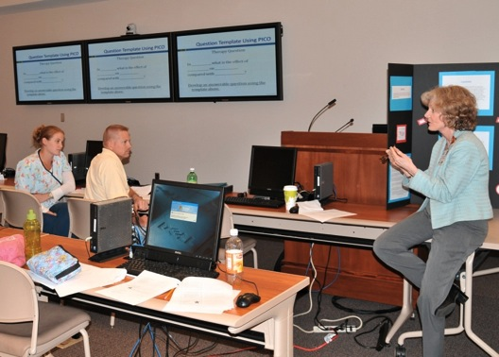

IOM – Education Recommendations
Increase the proportion of nurses
with BSN and higher degrees
Increase the number of nurses
with doctorates
Implement nurse residency programs
Promote lifelong learning
8
Notes:
The IOM report emphasizes that if nurses are to be as effective as possible in helping to provide high-quality patient care, they’ll need to be better prepared as care becomes more complex and moves into the community. We need more nurses with advanced degrees to provide primary care and teach the next generation of students.

Slide 54

Texas Challenge-Undereducated Workforce
Texas Challenges to achieving 80% BSN and doubling number with doctorates:
194,695 RNs in 2010
50% have BSN or higher
49% have ADN or Diploma
Only 16% of ADNs/Diploma continue on to earn higher degree
Data from Texas Center for Nursing Workforce Studies
Notes:
Over 50% of Texas nurses highest degree is an ADN/Diploma

Slide 55
49%
80%
Meeting goal for Texas will require educational mobility, collaboration, funding, and innovative models

Slide 56
BSN
31% increase
138,000+ more BSNs
Doctoral
Double
678 PhD and/or DNP
In order to meet IOM recommendation to increase number of BSNs to 80% by 2020,
Texas must raise number of BSN graduates by 31% (currently have 95,652 BSNs & need 234,000+ to have 80% of the workforce).
Texas must also produce 678 more nurses with doctorate degrees.

Slide 57

Notes:
Value Proposition….

Slide 58
Techniques to Assure Success:
Technique #1: Practice a proactive leadership approach; concentrate on getting results at the "big picture" level.
Technique #2: Be sure to differentiate between short term symptoms and long term root causes when addressing issues and opportunities.
Technique #3: Create regular and recurring time with your team for strategic thinking and planning; it's a good investment to take time to work "on" your business as well as "in" your business

Slide 59
Success Indicators:
Better implementation & coordination of actual programs addressing the issue
Sustained networks & relationships
Reduced sense of isolation
Cross-fertilization & shared innovations
Often leads to other positive unintended consequences
            Zakocs, R., & Edwards, E. (2006)

Slide 60
Seven Deadly Sins of Partnerships or Coalitions:
Debate to Death
Social Orientation
Avoidance of Conflict
Lack of Technical Expertise
Turn it Over to the Staff
No Ongoing Roles for Partners/Members
Dividing up the Credit
Raynor (2011)
Notes:
No nitpicking and nuancing every bit of info or decisions – lean toward a bias for action
Use different leaders in respective organizations for different task….each person can contribute a different technical aspect
Leaders can not take a passive role to the staff – they must lead!
Each partner needs to have a specific role
You have to divide up the credit and not let one individual or group claim credit for the work of the partners.

Slide 61
Questions????
Contact Info:
alexia.green@ttuhsc.edu

Slide 62
References
Butterfield, K., Reed, R., & Lemak, D. (2004). An inductive model of collaboration from the stakeholder’s perspective. Business & Society 43(2): 162-195.
Cohen S., Mason D., Kovner C., Leavitt, J., Pulcini J. & Sochalski J. (2011). Stages of nursing’s political development: Where we’ve been & where we ought to go. In Mason D., Isaacs S., & Colby D. (Eds) The nursing profession: development, challenges, & opportunities. Jossey-Bass: Princeton, NJ.
Foster-Fishman, P., Berkowitz, S., Lounsbury, D., Jacobson, S., & Allen, N. (2001). Building collaborative capacity in community coalitions: A review & integrative framework. American Journal of Community Psychology 29 (2): 241-261.
Lasker, R., Weiss, E., & Miller, R. (2001). Partnership synergy: A practical framework for studying & strengthening the collaborative advantage. Milbank Quarterly 79 (2): 179-205.
Mizrahi, T., & Rosenthal, B. (2001). Complexities of coalition building: Leader’s successes, strategies, struggles, & solutions. Social Work 46(1): 63-78.
Raynor, J. (2011). What makes an effective coalition? Evidence-based indicators of success. (A paper written for the California Endowment).
Zakocs, R., & Edwards, E. (2006). What explains community coalition effectiveness? A review of the literature. American Journal of Preventive Medicine 30(4): 351-361.

