Slide 1

Creating a Partnership for Development of a Nursing Facility
Mary Bennett PhD APRN
Director, Western Kentucky University
School of Nursing

Slide 2

Bowling Green KY
Notes:
21,000 + student population
1500 + nursing students – including pre-nursing
Largest major on campus

Slide 3

Bowling Green KY
Notes:
21,000 + student population
1500 + nursing students – including pre-nursing
Largest major on campus

Slide 4

Bowling Green KY
Notes:
21,000 + student population
1500 + nursing students – including pre-nursing
Largest major on campus

Slide 5

Bowling Green KY
Notes:
21,000 + student population
1500 + nursing students – including pre-nursing
Largest major on campus

Slide 6

Bowling Green KY
Notes:
21,000 + student population
1500 + nursing students – including pre-nursing
Largest major on campus

Slide 7

Bowling Green KY
Notes:
21,000 + student population
1500 + nursing students – including pre-nursing
Largest major on campus

Slide 8

Bowling Green KY
Notes:
21,000 + student population
1500 + nursing students – including pre-nursing
Largest major on campus

Slide 9

Bowling Green KY
Notes:
21,000 + student population
1500 + nursing students – including pre-nursing
Largest major on campus

Slide 10

Bowling Green KY
Notes:
21,000 + student population
1500 + nursing students – including pre-nursing
Largest major on campus

Slide 11

Greenview 170 Bed For Profit HCA
Notes:
21,000 + student population
1500 + nursing students – including pre-nursing
Largest major on campus

Slide 12

Medical Center 340 Bed not-for-profit
Notes:
21,000 + student population
1500 + nursing students – including pre-nursing
Largest major on campus

Slide 13

Medical Center Extension Sites
Notes:
21,000 + student population
1500 + nursing students – including pre-nursing
Largest major on campus

Slide 14
Kentucky Data
47% of nurses in KY have BSN or higher degree
However, at most local hospitals less than 30% of the nurses are BSN prepared
Several hospitals within the region are interested in seeking Magnet status and want to increase BSN
IOM recommendations for 80% BSN and Magnet hospitals need a plan to reach this number
Most local hospitals are considering changing hiring to BSN only, but currently still hire ASN and are looking at imposing deadlines to complete BSN, either for all new ASN hires or for all ASN’s employed at the facility.

Slide 15

Western Kentucky University
Notes:
21,000 + student population
1500 + nursing students – including pre-nursing
Largest major on campus

Slide 16

Western Kentucky University
Notes:
21,000 + student population
1500 + nursing students – including pre-nursing
Largest major on campus

Slide 17

Western Kentucky University
Notes:
21,000 + student population
1500 + nursing students – including pre-nursing
Largest major on campus

Slide 18

Western Kentucky University
Notes:
21,000 + student population
1500 + nursing students – including pre-nursing
Largest major on campus

Slide 19

Western Kentucky University
Notes:
21,000 + student population
1500 + nursing students – including pre-nursing
Largest major on campus

Slide 20

College of Health and Human Services
Notes:
21,000 + student population
1500 + nursing students – including pre-nursing
Largest major on campus

Slide 21
CHHS
New College at WKU, started 7 years ago with departments from all over campus pulled together to form CHHS
Fastest Growing College at WKU
30 % growth rate over last 5 years
Now the largest college at WKU
Nursing, Dental Hygiene and Communication Disorders have had capped enrollment for years
In the past year other CHHS programs have had to cap enrollments due to lack of classroom space, lab space, office space etc.
4,900 + students in CHHS majors this fall

Slide 22
CHHS
School of Nursing (ASN, BSN, RN-BSN, MSN and DNP)
Allied Health (Dental Hygiene and Health Informatics)
Kinesiology, Recreation and Sport
Public Health
Social Work
Family and Consumer Science
Communication Disorders
Physical Therapy – new for Fall 2012

Slide 23

CHHS

Slide 24
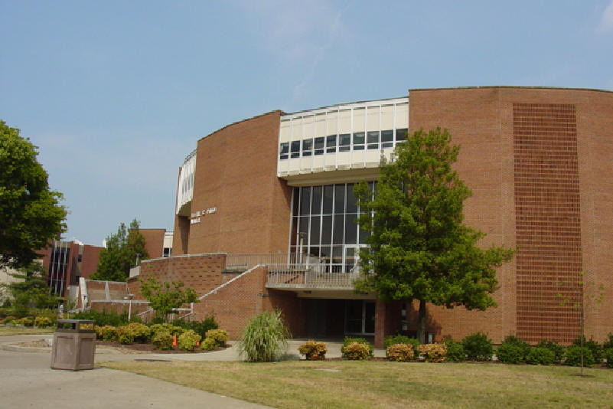
CHHS Overflow Building
Notes:
21,000 + student population
1500 + nursing students – including pre-nursing
Largest major on campus

Slide 25

Crowded, Outdated Classrooms
Notes:
21,000 + student population
1500 + nursing students – including pre-nursing
Largest major on campus

Slide 26
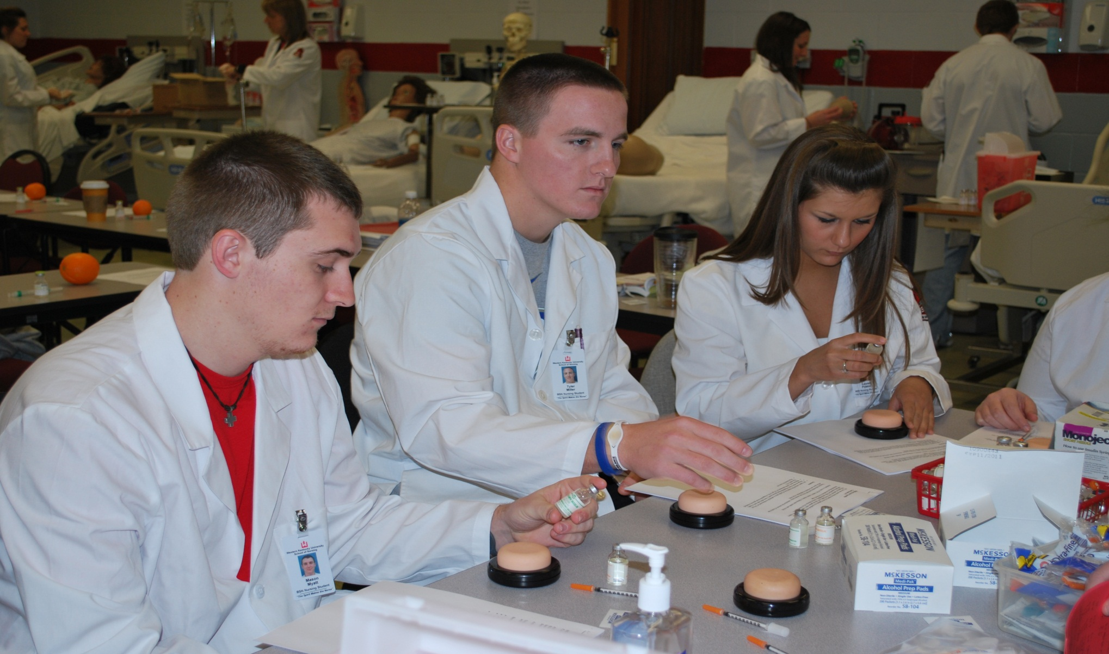
Crowded, Outdated Lab
Notes:
21,000 + student population
1500 + nursing students – including pre-nursing
Largest major on campus

Slide 27
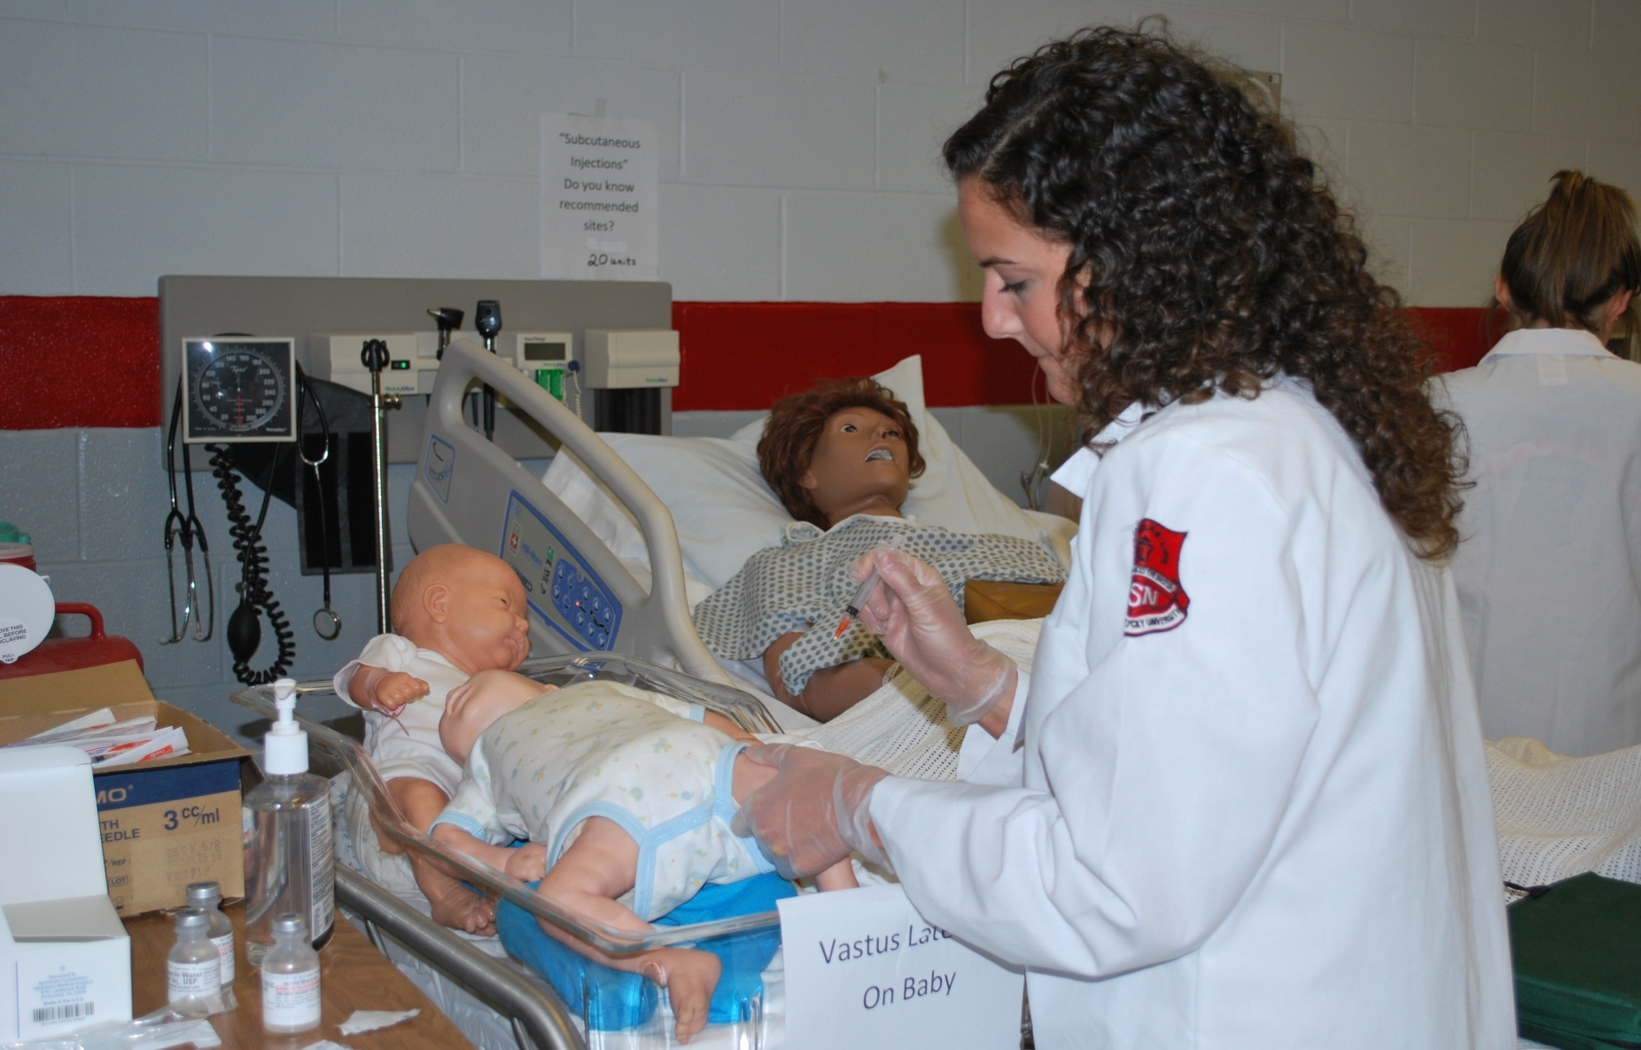
Crowded, Outdated Lab
Notes:
21,000 + student population
1500 + nursing students – including pre-nursing
Largest major on campus

Slide 28
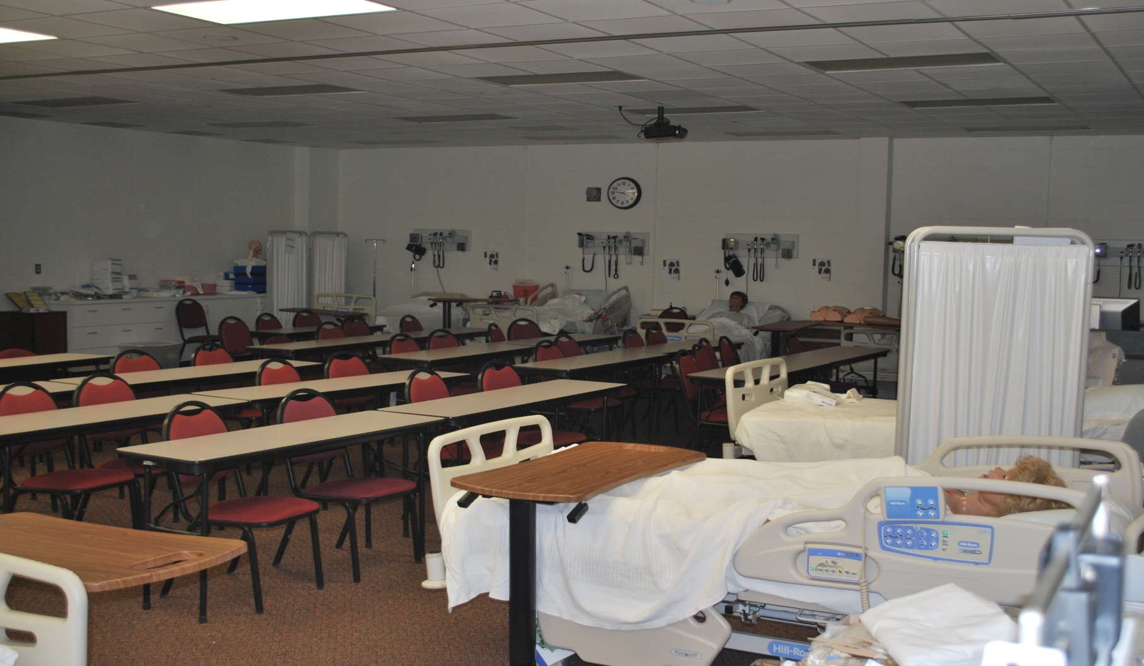
Classroom in Lab
Notes:
21,000 + student population
1500 + nursing students – including pre-nursing
Largest major on campus

Slide 29
WKU Plan to Increase numbers of
RN-BSN Students
RN-BSN program transitioned from IVS/Classroom to Online plus clinical at student’s location.
Increased class size of RN-BSN program from 30 students per semester to 50 students by adding additional faculty
With the exception of office space, online programs are facility neutral and do not require classrooms or labs.
However, the percentage of ASN’s who go on for RN-BSN remains low (20-35%).

Slide 30
Plan to Double Size of BSN Class
WKU admits 40 students every Spring and Fall to the BSN program
WKU turns away 40-60 qualified students every semester due to lack of space
Class size limited by classroom size, lab size, and number of faculty and faculty offices
Goal - increase class to 80 students per semester.

Slide 31

How to Enact the Plans

Slide 32

Medical Center New Tower

Slide 33

Medical Center Expansion, Stengel and Hill Architects
Notes:
21,000 + student population
1500 + nursing students – including pre-nursing
Largest major on campus

Slide 34

Medical Center

Slide 35

University of Kentucky School of Nursing Remodel by Stengel and Hill

Slide 36
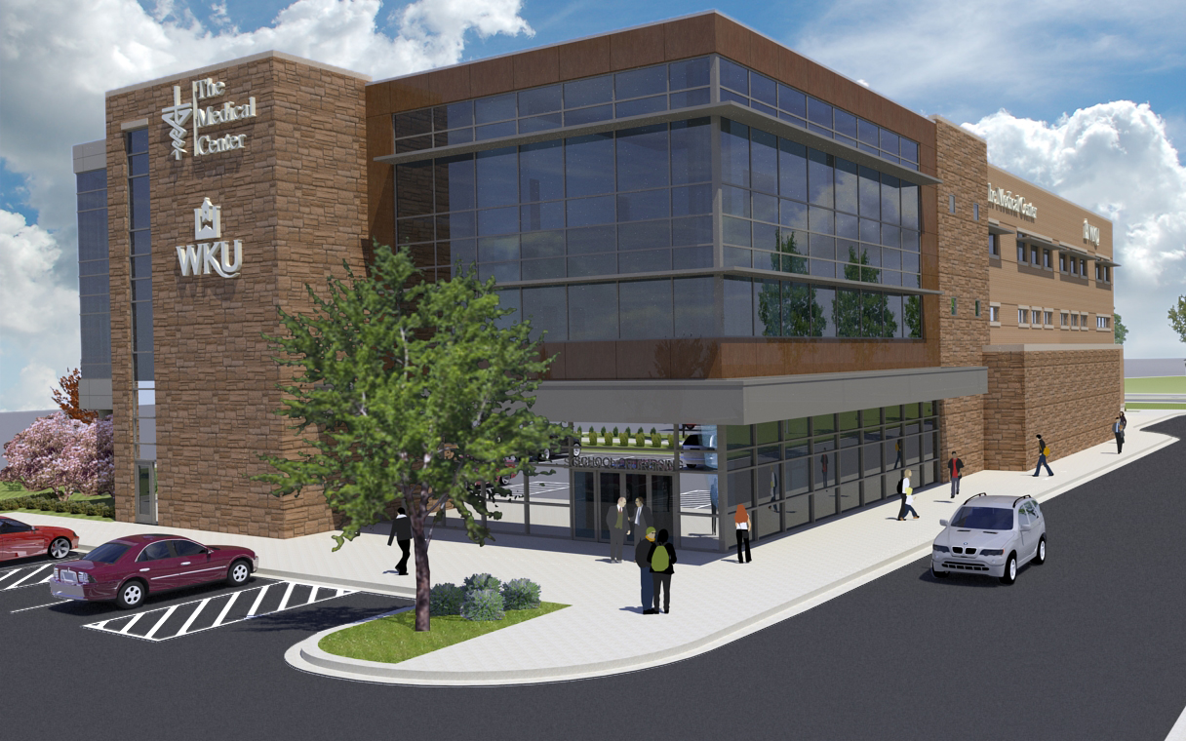
Joint Project Medical Center and WKU Health Sciences

Slide 37

Lobby

Slide 38

Lobby Bistro

Slide 39

Hospital Medical Education Center

Slide 40

Nursing Classrooms

Slide 41
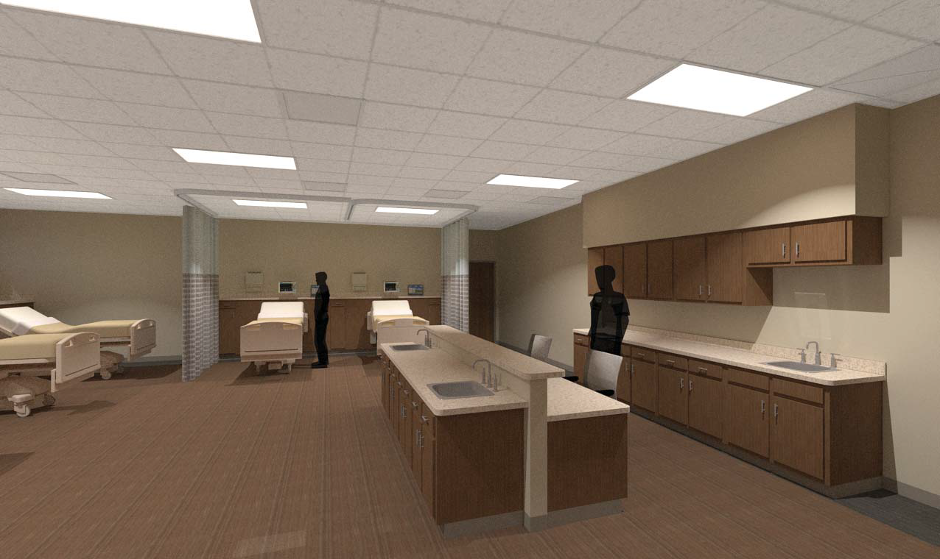
Nursing Classrooms

Slide 42

Faculty Meeting Space

Slide 43
WKU Benefits
Classrooms to seat 90 students
Two large skills labs
Two simulation rooms with observation rooms
90 Seat computer lab and testing center
Sufficient offices for faculty, staff and graduate students
Meeting, research and networking space
Easy access to clinical facilities
New parking lots adjacent to new building
Facilities for Physical Therapy

Slide 44
CHC Benefits
Additional BSN prepared nurses and physical therapists for regional workforce development.
200 seat Medical Education Space
20 Seat computer training center for EMR and new employee orientation
10 Skills lab for nursing skills training
2 HD simulation manikins with ability to simulate IC monitoring and other high tech skills
Closer collaboration with WKU Nursing and Physical Therapy

Slide 45
Great, but
How do we pay for this?
Medical Center Issues Bonds
Medical Center pays for and occupies 20% of building
Building benefits from location in the new Tax Incentive Funding District
WKU agrees to allow Nursing and Physical Therapy to retain tuition from increased student enrollment
Tuition from increased number of nursing students and New Doctor of PT pays for additional faculty, equipment and building lease.

Slide 46
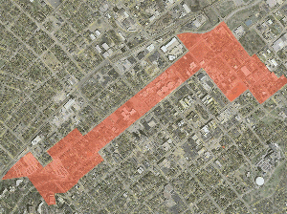
Tax Incentive Fund (TIF) District

Slide 47
Tax Incentive Funding District
The project is expected to cost $18 million, with WKU’s lease of the space being primarily paid with tuition fees from the new students that an expanded program can serve.
It now looks like funds back from TIF will pay nearly half of the building lease cost
Remaining cost will be covered by new student tuition income
University will reclaim up to 40% of tuition revenues once the programs show they are making sufficient profit.

Slide 48
Human Resources
Hired 4 additional faculty for the BSN program last year, have 4 additional lines for this years search.
Hired 2 additional faculty for the new DNP program and have 2 additional lines open this year
Have approval to hire additional staff to handle clinical agency contracts and preceptor placement
New Simulation Laboratory Coordinator position.
Additional money from tuition model is being used to increase faculty salaries to help ensure retention of nursing faculty

Slide 49
Clinical Resources
Medical Center giving priority to BSN student placements
Greenview also giving priority to BSN clinical placements
Hospitals with Medical affiliation also seeking BSN student placements
Other hospitals with 50 miles have opened up clinical slots for additional BSN students.

Slide 50


Groundbreaking June 2012
Notes:
21,000 + student population
1500 + nursing students – including pre-nursing
Largest major on campus

Slide 51
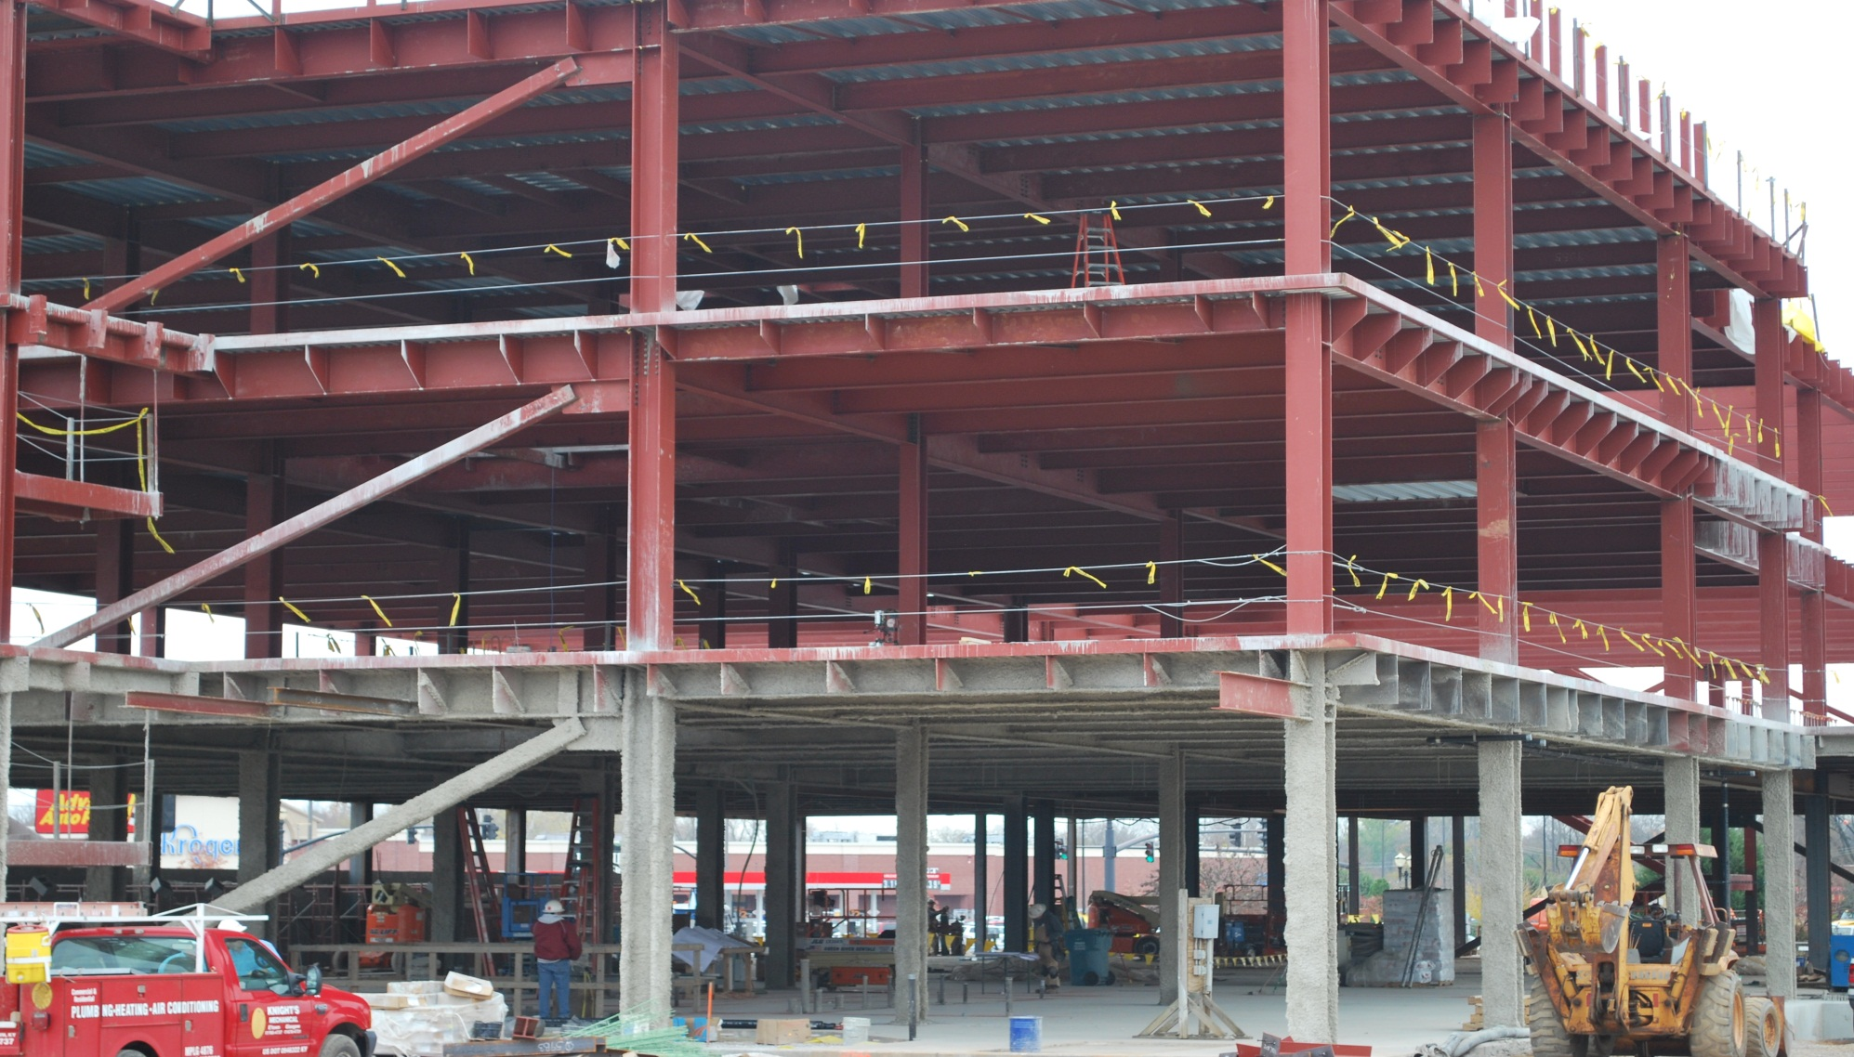
Under Construction Nov 2012
Notes:
21,000 + student population
1500 + nursing students – including pre-nursing
Largest major on campus

Slide 52

Western Kentucky University
CHC Medical Center
Notes:
21,000 + student population
1500 + nursing students – including pre-nursing
Largest major on campus

Slide 53
Western Kentucky University
Notes:
21,000 + student population
1500 + nursing students – including pre-nursing
Largest major on campus

