Slide 1

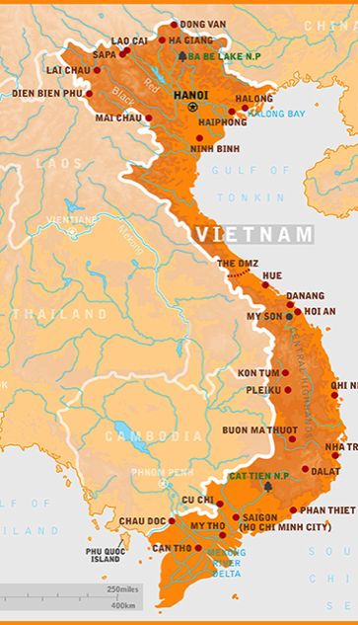
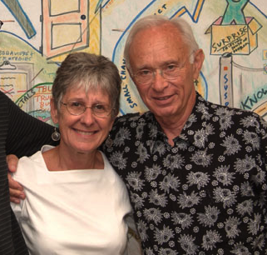
Vietnam: The Positive Deviance Origins Story
Vietnam

Slide 2
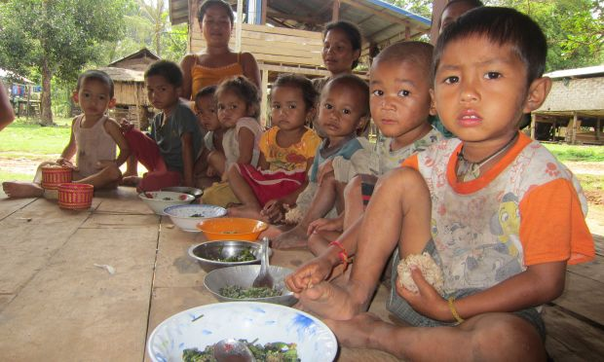
High rates of malnutrition – short time to fix it

Slide 3
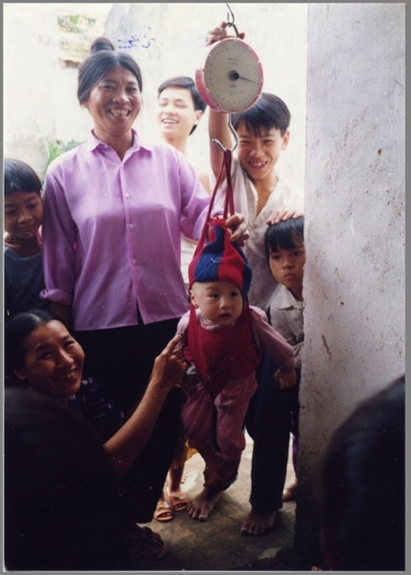
Even in the poorest communities – there were a few families whose children were growing WELL!

Slide 4
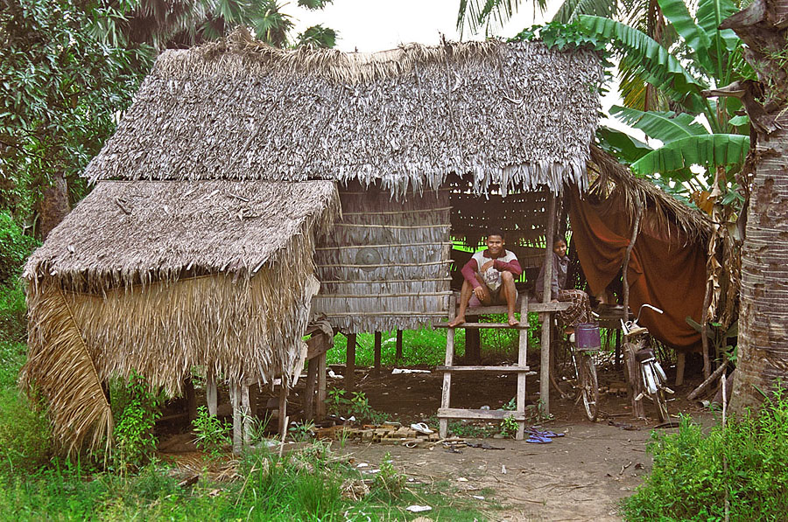
Interviews with these Families: PD Inquiries

Slide 5

Shrimp & Crabs & Greens

Slide 6
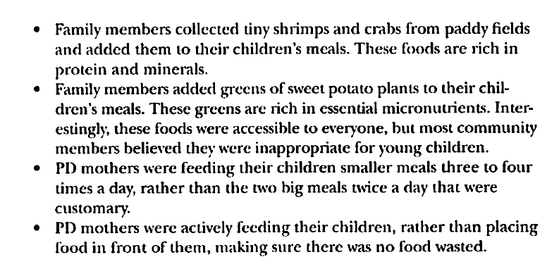
PD Behaviors in Vietnam

Slide 7
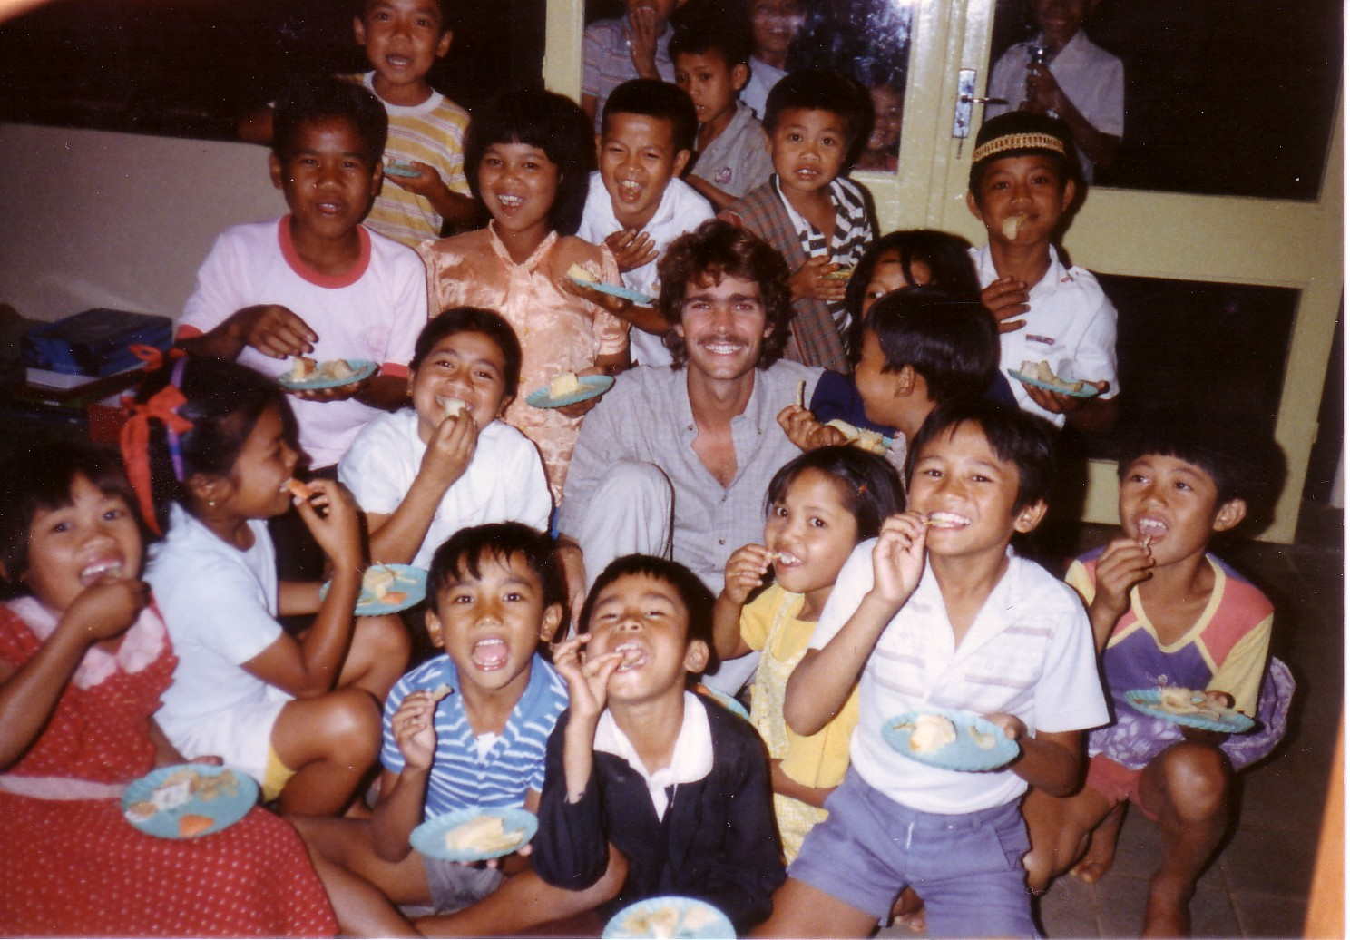
Indonesia
My 23rd Birthday Party in Indonesia

Slide 8
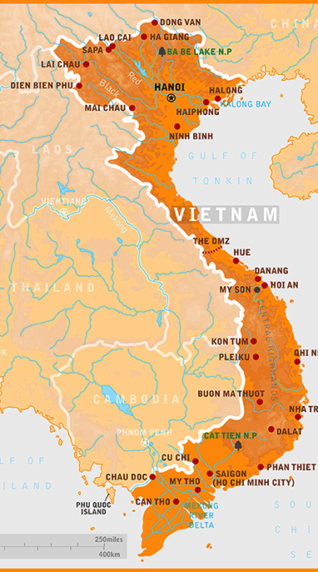



Trial of PD in Vietnam
Randomized whole villages to PD or usual care

Slide 9
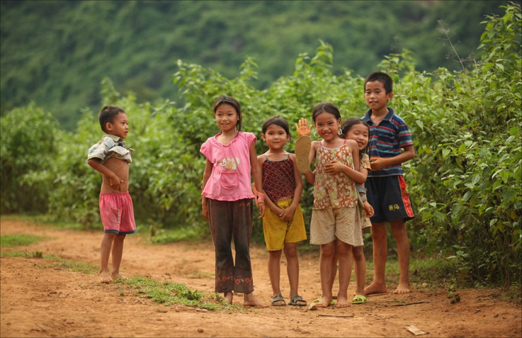
Children in PD Villages were taller
Even Younger Siblings who were born
AFTER Save the Children had left!

Slide 10

Randomized Trial - Positive Deviance
Randomized controlled trial of the PD Approach in Vietnam
Comparison of PD Approach with other “standard” discovery approaches (Lapping et al, Comparison with Case Control Study)

Slide 11
The Concept of Positive Deviance
In every community there are certain individuals or groups whose uncommon behaviors or strategies enable them to find better solutions to a problem than their peers, while facing similar challenges and constraints & having access to same resources.

Slide 12
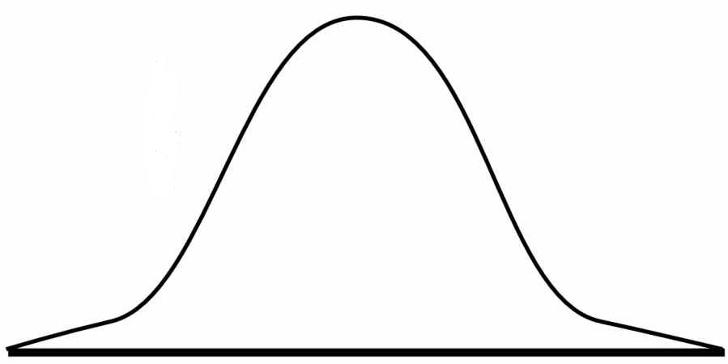
In any community, district, hospital, school, organization, corporation…

Slide 13
Success “Against the Odds”
 |  | Outcome Status
 |  | Good | Not Good
Risk Status | “Worse Off” | PD
 | “Better Off”
Notes:
13

Slide 14
PROBLEM SOLVING APPROACH
POSITIVE DEVIANCE
Internally Fueled (by “people like us”, same culture and resources)
Down-up, Inside-out
Asset Based “What’s right here?”
Begins with analysis of demonstrably successful SOLUTIONS
Solution Space enlarged through discovery of actual parameters
Bypasses Immune System (solution shares same “DNA” as host)
TRADITIONAL
Externally Fueled (by “experts” or internal authority)
Top-down, Outside-in
Deficit Based “What’s wrong here?”
Begins with analysis of underlying causes of PROBLEM
Solution Space limited by perceived problem parameters
Triggers Immune System “defense response”

Slide 15
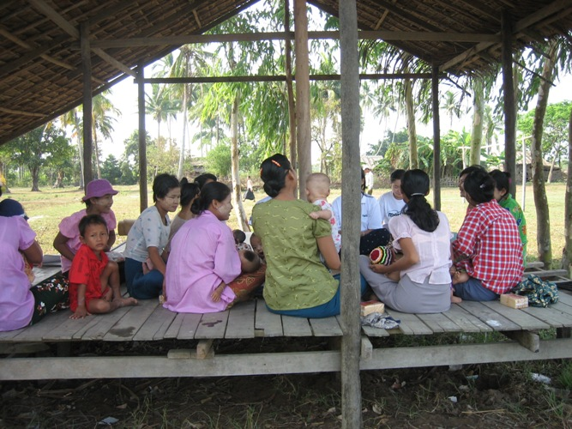
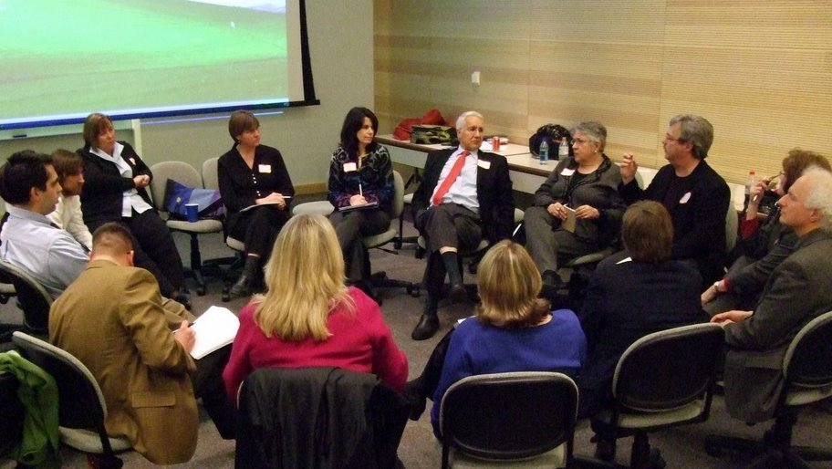
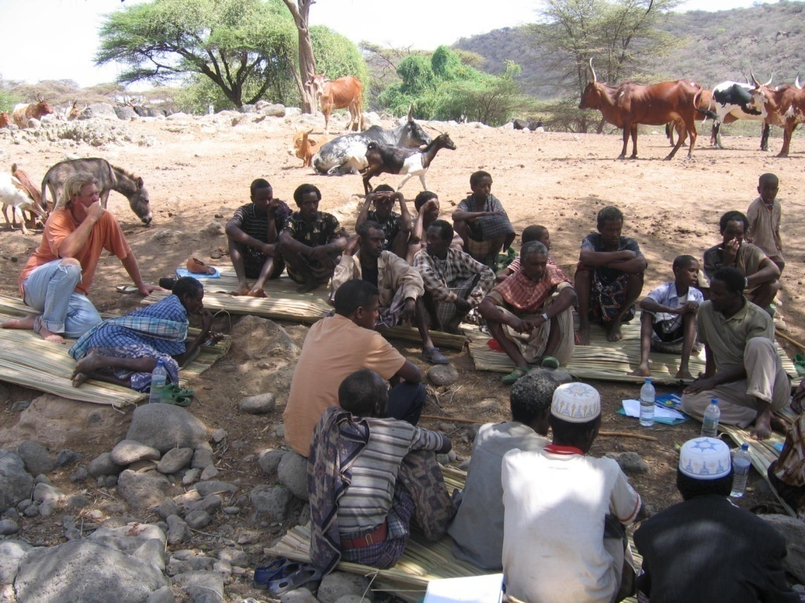
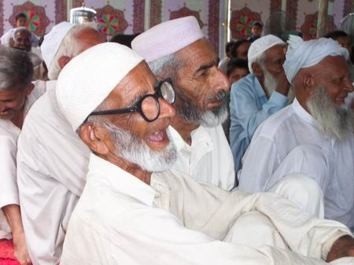
Community Ownership

Slide 16
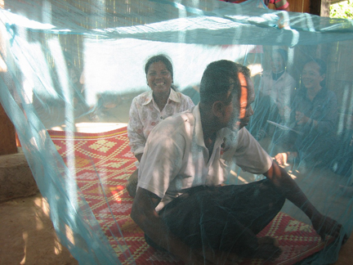
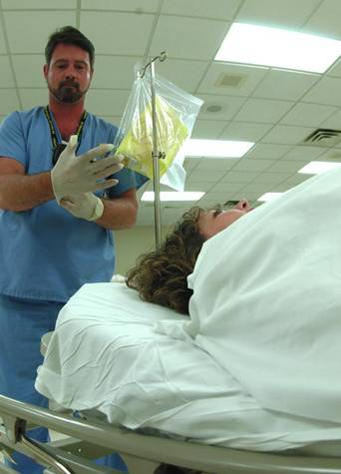
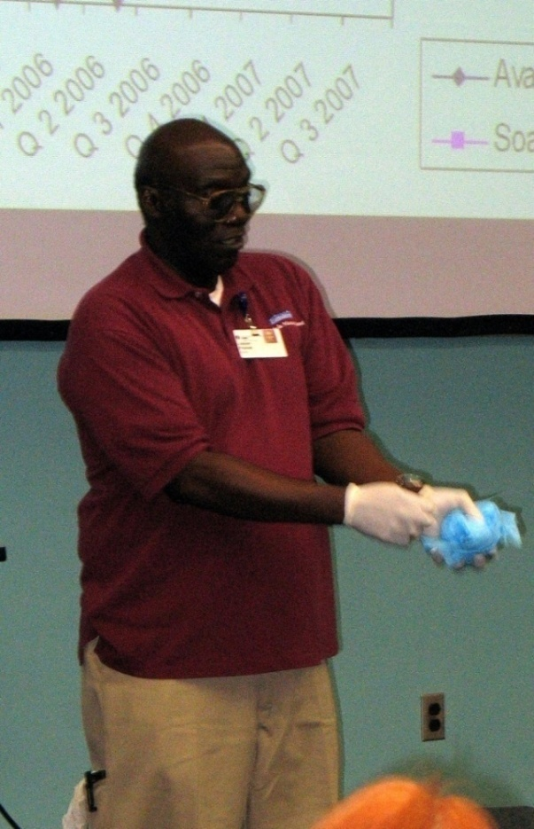
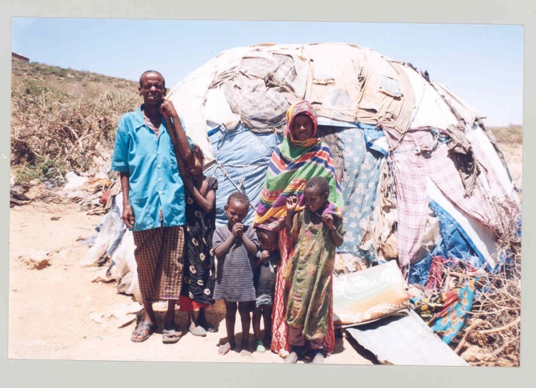
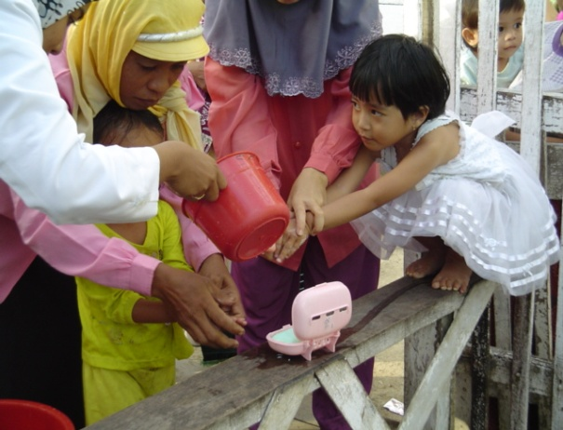
PD Individuals or Group as Social Proof

Slide 17
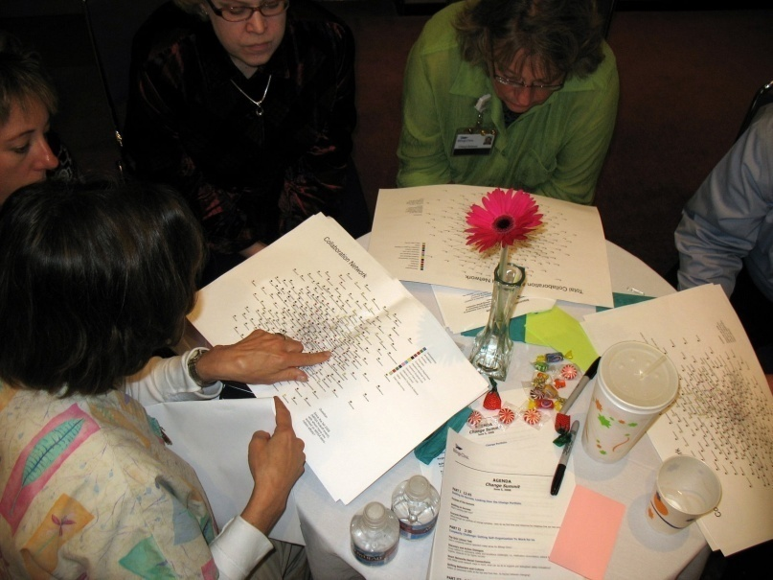
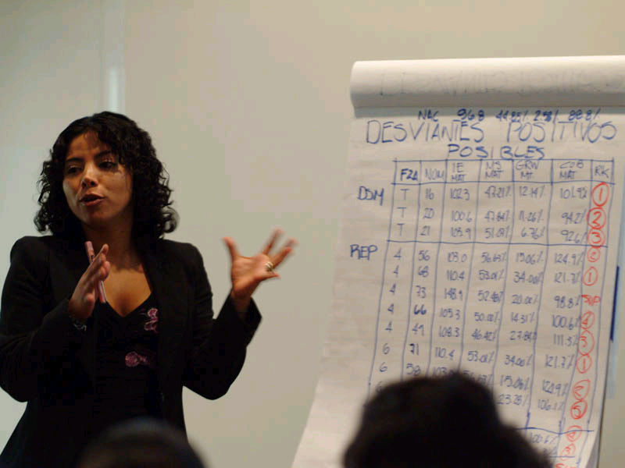
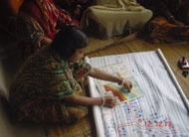
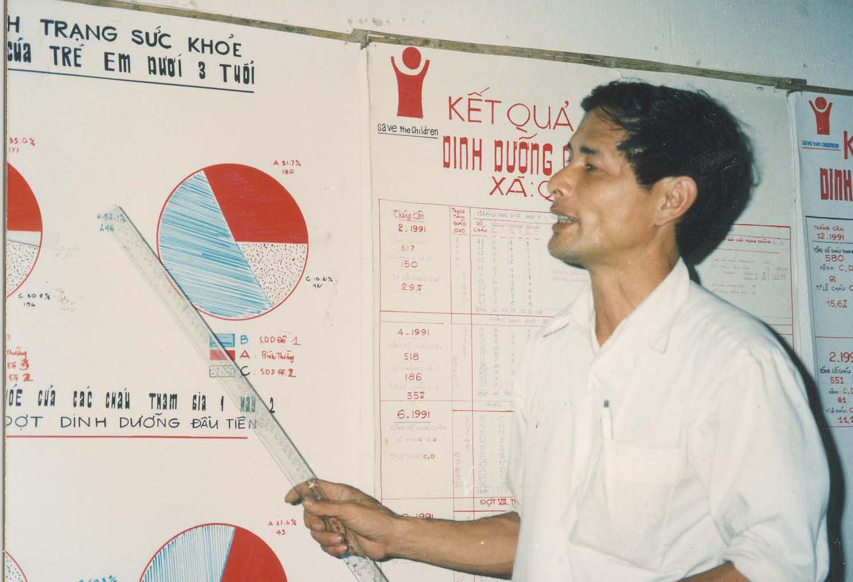
Community generated monitoring activities as behavior change strategy

Slide 18
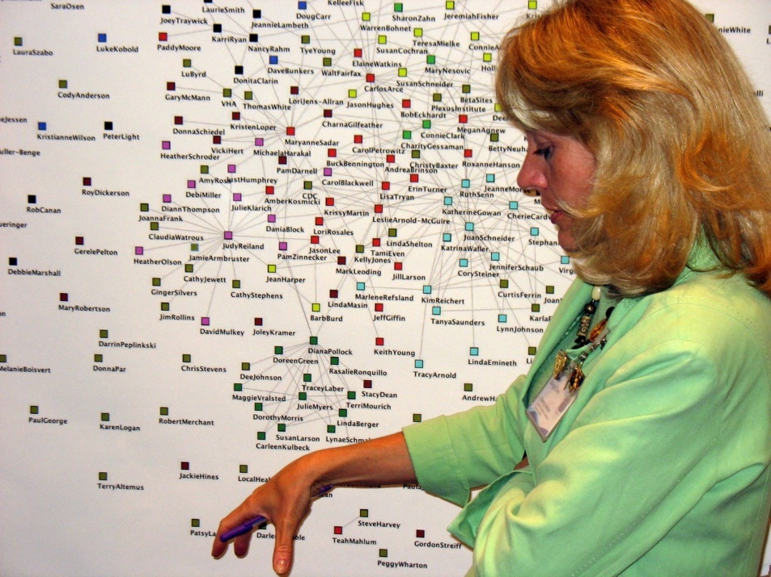
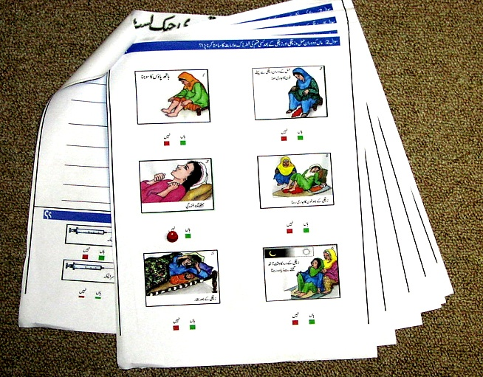
Developing Culturally Appropriate & Meaningful Monitoring Tools
Networks mapping & expansion,
Billings Clinic. Montana.USA
Pictorial monitoring tool for healthy delivery- Haripur, Pakistan

Slide 19
Positive Deviance (PD) Approach
The very people “whose behavior needs to change to solve the problem” identify existing solutions from within
Thereby suppressing the “immune rejection response”
Notes:
Part of the “positive psychology family” with Appreciative Inquiry. Part of the self-organization family with Open Space.

Slide 20
A- The Positive Deviance Method
There are 5 steps to the Positive Deviance
method carried out by members of the community:
  1. Define the problem
  2. Determine presence of PD individuals
  3. Discover existing uncommon behaviors & strategies
  4. Design and develop initiatives to leverage these solutions to the whole community
  5. Discern the effectiveness of initiative ( M & E)

Slide 21
PD “Secret Sauce” for behavior & social/organization change
Involvement of all stakeholders
Community ownership
Discovery of existing resources
Emphasis on practice versus knowledge
Leaders as facilitators and enhancers
Weaving networks across silos
Monitoring change fuels behavior change

Slide 22
When to Use the PD approach
Problem requires behavioral and social change
Seemingly intractable problem
Other expert driven attempts at solving problem have failed
Presence of Positive Deviants (individuals/ groups exhibiting desired outcome)
Leadership commitment to address issue

Slide 23
Challenges
Paradigm shift for practitioners, i.e.; from expert to facilitator (comfort with power sharing & lack of control)
Scaling up strategies
Time & human resources labor intensive
Requires comfort with uncertainties (donors, planners, implementers)
Skilled Facilitation

Slide 24

Emergency Meeting

Slide 25



Poor Engagement – Poor Management –
Poor Customer Experience
“No one picks up the phone”
“They don’t enroll in the wellness & DM programs we offer them for free!” “Even though they are in SPANISH!”
“Then, if they do enroll, they drop out of the program”
Diabetes

Slide 26
Mission Critical for Health Plans and Employers
“We’re a 100 year old company and if we don’t stop these trends (of increasing diabetes among Hispanics), we’re going to go out of business”
Beth Common
Director HR
H-E-B Supermarkets

Slide 27

Obesity & Diabetes – Epidemics among Hispanics
In the Top 10 most populous states in the U.S., where 80% of Hispanics live, 33% of all diabetics are Hispanic
Source: OMH, NHIS, 2010

Slide 28


A large community of individuals/households

Slide 29
Distribution of Diabetes Self-Management Quality among LOWER SALARIED Hispanic employees
How did THEY become MOTIVATED?
How do they DO it?
Positive
Deviants
← Worse Better →

Slide 30
Who are the Positive Deviants at Supermarket company?
All Employees
Non-Hispanic
And/or
High Salary
Positive
Deviants
Hispanic and
Low Salary
Best
Management
Poor Diabetes Management

Slide 31
Positive Deviance Study of Hispanic Diabetics: Objectives & Methods
Objectives
Gain a deeper understanding of Hispanic diabetics especially in regards to what motivates them to take control of their personal health and the practical, effective strategies and tactics they use to do so, and
Design & Enhance Interventions to improve enrollment, adherence and outcomes
Methods
Identification and in-depth interviews - “Positive Deviant” Hispanic diabetic employees
PD score based on 42 behaviors: screening, program participation, A1c control, Intent to lose weight, etc.
Analysis: 2,000 pages of discussion. Thematic analysis using MaxQDA.

Slide 32
How to Find Them? Positive Deviance Score
PD Score: 24 Indicators of self-care
  Five datasets: Employer, Health Plan, Vendors
  HRA: Dietary, exams, exercise,
  DM Indicators: Doctor Visits, Counseling

Slide 33
3. Discover and Analysis
78 Hispanics (Eng. and Sp.) Group and individual discussions
2,000+ pages of material
Qualitative Software: coded Frequency and Passion

Slide 34
Positive Deviance Inquiry Video

Slide 35
Themes & Analysis - I
Discussion Guide Themes
General
Motivation
Diabetes Education
Diabetes Management
Diet
Exercise
Self-Monitoring
Doctor Visits
Medications
Herbal Remedies
Tests and Immunizations
Emotions and Support
Other Strategies and Advice
Analysis Example: MOTIVATION Category 1: Who or What Motivates Subcode 1: Do/Feel Better Subcode 2: Family Subcode 3: Less Meds and Doctor Visits Subcode 4: Prevent Complications Subcode 5: Religion Category 2: How to Motivate Hispanics Category 3: Role of Religion
Ranked within each domain and question set
by Frequency and “Passion”

Slide 36
What Motivates You to Prevent or Control Your Diabetes?
Frequency/Passion Level | Motivators
High | Prevent complications Family
Medium | Feel better Religion
Low | Fewer medications and doctor visits

Slide 37
Most feared by Hispanic PD Diabetics
Consequence or Complication | Number of Independent Mentions
Amputation | 16
Blindness | 10
Premature Death | 7
Heart Attack | 3
Stroke | 3
Kidney Failure | 2
Fear of Dialysis | 2
Impotency | 1

Slide 38
Strategies & Tactics - Diet
Frequency/Passion Level | Subcodes
High | More fruits and vegetables Water or diet soda instead of regular Eat fish and lean meats Wheat bread/pasta/tortillas instead of white (“Don’t Eat White”) Bake/grill instead of frying
Medium | Use sugar substitute Change cooking oil Eat out less and more at home No eating after 6 or 8pm Use less salt Oatmeal to lower cholesterol Less or no alcohol
"Well, I've actually done pretty good staying away from soda, and changing that to water or it's actually Crystal Lite. They're, like, five calories; just pop that in a bottle of water. So that's one change I've been able to stick to." (Male)

Slide 39
Exercise – What type do you do?
Frequency/Passion Level | Subcodes
High | Walking
Medium | Running Work as form of exercise Weight lifting Biking Swimming Wii Gardening or yard work Dancing Team sports Martial arts and boxing Use stairs instead of elevator

Slide 40
How can we motivate Hispanics to exercise more?
High | Have exercise partner Find something enjoyable to do Educate on consequences of not exercising Have exercise equipment available
Medium | Educate on benefits of exercise Hold a competition Have exercise equipment at work Give discounts on exercise equipment or gym memberships Exercise while watching tv Incorporate more exercise into leisure activities

Slide 41


PD Archetypes
Realist
Usually men
Takes the “bull by the horns”
“Plays the hand they are dealt”
Makes the best of the situation
Educated and always wanting to learn more
Caretaker
Usually women
Cooks food for others
Concerned with and responsible for others’ wellbeing (e.g. children, parents, husband)

Slide 42





Teacher /
Leader
Social Butterfly
Young
Parent
Pretty
Woman
Soldier

Slide 43
Intervention Design
Core Messaging – Seriousness of condition & consequences
Hard Copy Handbook
In-store diabetes support groups
A walking buddies program
Linkage with in-store resources, pharmacies, in-store clinics & doctors

Slide 44
Take it Seriously Diabetes Program - Handbook
Website
Take it Seriously
Message & Education
Walking Buddies
Exercise
Lower BMI
Better
Clinical
Outcomes
Higher
Medication
Adherence
Fewer
Medical
Surgeries
Productivity
Lower
Costs
HRA
Enroll
All But Small &
Don’t Eat White
Diet
Hit Your Numbers
Tests & Exams
Peer Group Discussions & Support
Medical Professionals & Counseling
Operational Integration – Monitoring & Evaluation
Diagnosis Understanding Behaviors Outcomes Impact

Slide 45
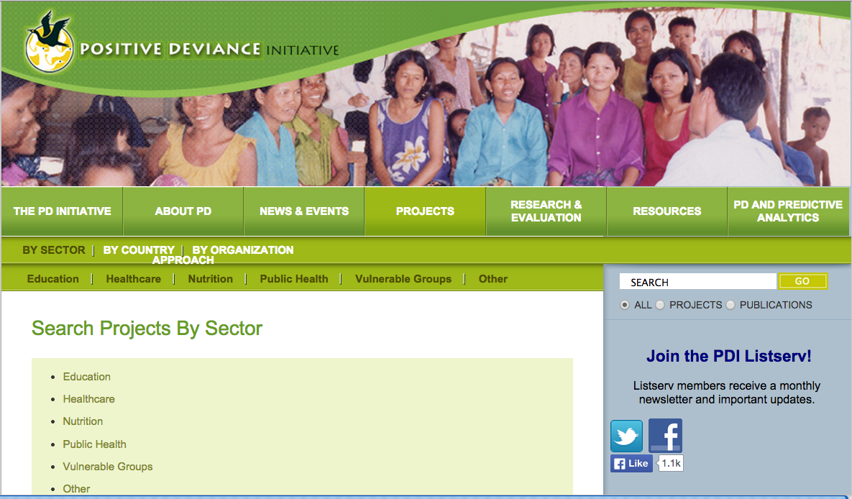
Positive Deviance Work – Beyond Health

Slide 46
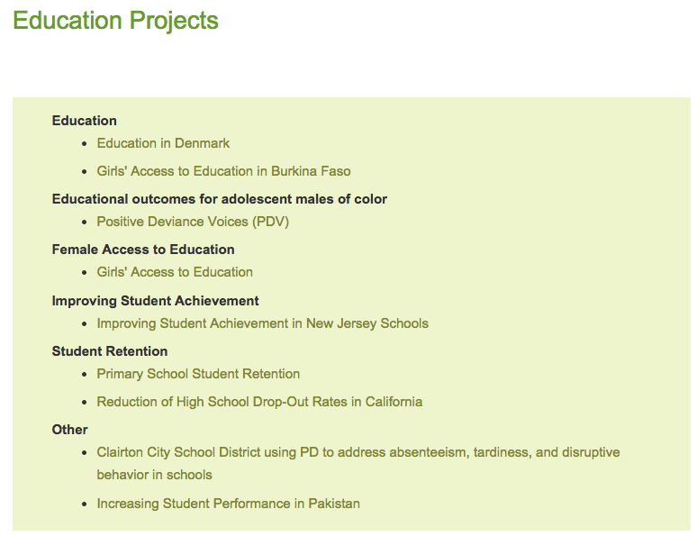

Slide 47
PD Process – PD Voices
Created a problem statement: The majority of black and Latino male students living in the Bronx do not succeed in school. The desired outcome is that most black and Latino male students will be successful in school in the coming years.
Developed a conceptual framework and related questionnaire: School success is impacted by: teen dating, respect in and out of school, family life, time management and social networking, after-school activities and violence.
Identified stakeholders for group interviews: teachers, parents, siblings, friends, school guards, janitors, coaches, pastors, tutors, counselors, neighbors, principals, mentors, shop owners, police and community-based organization members. These stakeholders each impact the success of students and helped identify positive deviant behaviors in interviews.

Slide 48
PD Process – PD Voices
Determined selection criteria for positive deviants: an 80% average in all subjects and meets one or more criteria such as being subject to gang violence or tough police tactics, or living in a home with a single working parent or where English isn't the primary language.
Conducted individual interviews with positive deviants and their families to see how their behaviors differ from the normative ones. In late May, the group presented results from those interviews and engaged in a community dialogue about the findings from this research. The findings include actions students can take on their own—such as sitting near the front of class and being considerate to all students, even those you might not like—and actions families can take together—eating meals, reviewing homework and even activities like grocery shopping and running errands as a group on weekends.

Slide 49
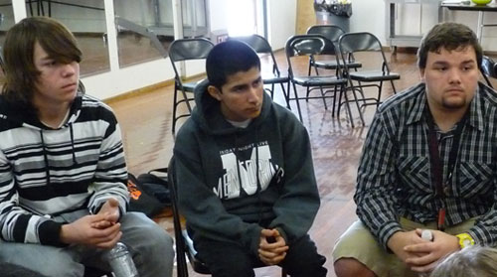
Using PD to reduce High School Drop Outs
Merced, CA 2008-present

Slide 50
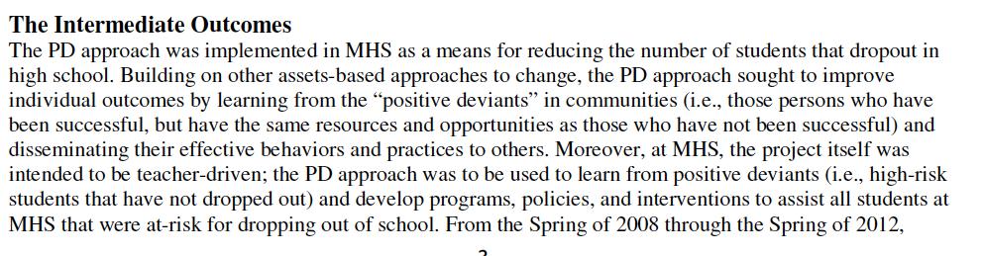
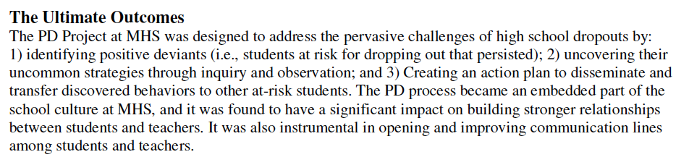
Merced – Drop Outs

Slide 51
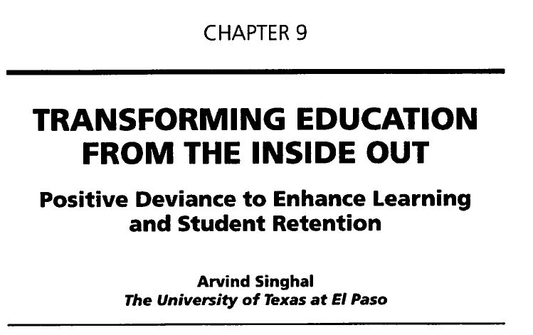

Slide 52
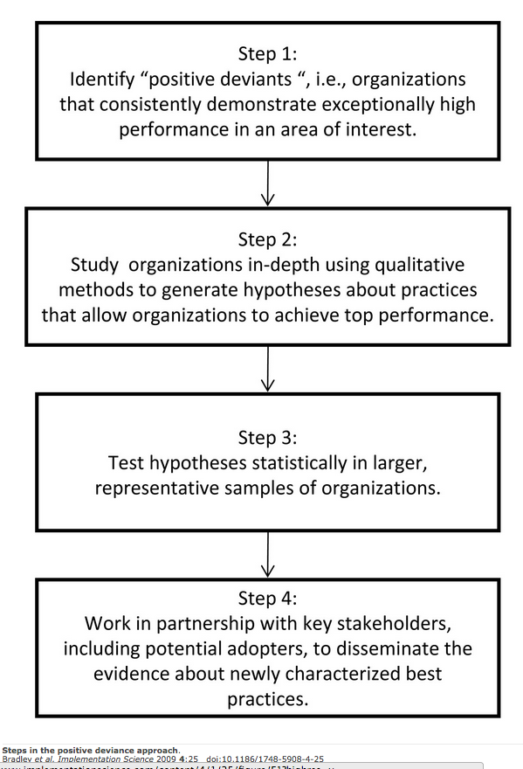
Steps in the PD Approach:
Applied at the Organizational Level

Slide 53
The PD Work Sheet

Slide 54
How to start a movement
http://youtu.be/lbaemWIljeQ

