Slide 1

Instructional
Shifts in a Nutshell
We want teachers to engage in intentional planning
We want students to take ownership of their learning
We want students to engage with multiple complex texts
We want students to cite texts for evidence
We want students to create authentic written products
We want students to learn math concepts, not just procedures
We want teachers to use formative assessments to plan their instruction around students’ needs
We want students to engage in productive struggle

Slide 2
Tools for Supporting Shifts
Conceptual Frameworks
Danielson, Marzano or Hattie
Protocols and templates
How to plan units and lessons
Standards-aligned curricula
State guidelines
Opportunities to create products with experts and peers
Collaborative planning
Lesson Study
District guides/maps
Textbooks and trade products
Critical Friends
Connection with larger teacher networks
How to implement problem-based instruction
Literacy Design Collaborative
How to create quality student assignments
Disciplinary specialty organizations
Mathematics Design Collaborative
C3 Social Studies

Slide 3
How a Framework Helps
Isolated instructional strategies
Teachers cannot see how strategies fit together
Requires much more planning time
Lack of tools and protocols to support early use results in low levels of implementation
A coherent set of strategies and tools
Framework provides a structure that makes sense to teachers
Planning is much more efficient
Tools, protocols and examples enable teachers to persist during initial stages of use

Slide 4
What do you believe are the biggest challenges/barriers for teachers to implement MDC/LDC strategies and tools?
83%/89%: Lack of time to prepare and plan
62%/73%: Lack of time to collaborate with other teachers
51%/52%: Lack of time to analyze student work

Slide 5
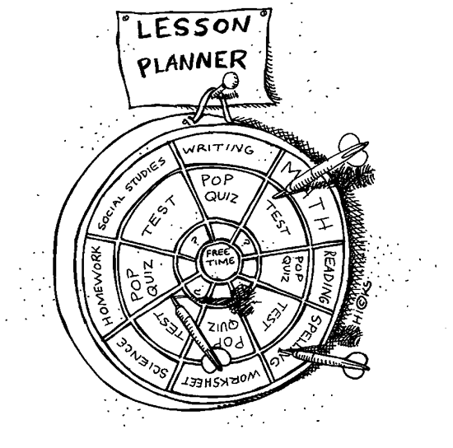

Slide 6
District support is often…
Pacing Guides
Curriculum Plans
Units of Study
Benchmarks
District assessments
“PLCs”

Slide 7


Slide 8


Slide 9


Slide 10
