Slide 1
EDUCATORS: THE OVERLOOKED WORKFORCE
Last Updated: January 2023
Notes:
Improving our education systems are key to the economy. Educators are integral to our economy but have been overlooked.

Slide 2
Every child deserves a great teacher — but teacher shortages hurt education and the economy
Notes:
Teacher shortages affect students. Teacher shortages affect student learning and the experiences students have in school. For example, teacher shortages can lead to increased class sizes and can increase a student’s likelihood of having a less experienced or out-of-field teacher.
Teacher shortages are a drain on the economy. A strong teacher workforce is crucial to fueling the current economy and preparing students for fulfilling careers of their own in the future. Businesses are reliant on the education system to produce a strong workforce and often choose to locate in places with high-quality educational experiences — so when students don’t have strong, well-trained teachers, these workforce needs are less likely to be met.
What is our response to others that say teacher shortages aren’t really an issue, are overstated, or haven’t been affected by COVID? This narrative may not fully account for regional differences or may be only looking at the overall quantity of teachers, but not the quality or diversity of those teachers. It also may not weigh the equitable distribution of strong teachers — for example, shortages in rural communities and/or low-income schools.

Slide 3
A SNAPSHOT OF
TEACHER WORKFORCE DATA
Notes:
What kinds of educator shortages are we having with the teacher workforce and why?

Slide 4
Unpacking Teacher Shortages: Overview
We can break this challenge down into three key areas:
Quantity
What proportion of teachers are entering and exiting the profession?
Is it enough to meet needs?
How well-prepared are novice teachers?
How effective is the teaching that is taking place?
What levels of experience and certification do teachers have?
How well-supported are teachers at various stages of their careers?
Quality
Diversity
What are the demographics of the teacher workforce?
Does the teacher workforce reflect student diversity?

Slide 5
1.3 million teachers serving
19.4 million students across 16 states
Teacher Race/Ethnicity in SREB States
15% Black
77% White
<9% Hispanic
<1% Asian
<2% Other
77% of teachers are women
Source: IES/NCES, 2019-20; and SREB analysis of state websites
Notes:
Note: State reported data on teacher count is inconsistently reported. Percentages by race and gender are approximate due to these inconsistencies.

Slide 6
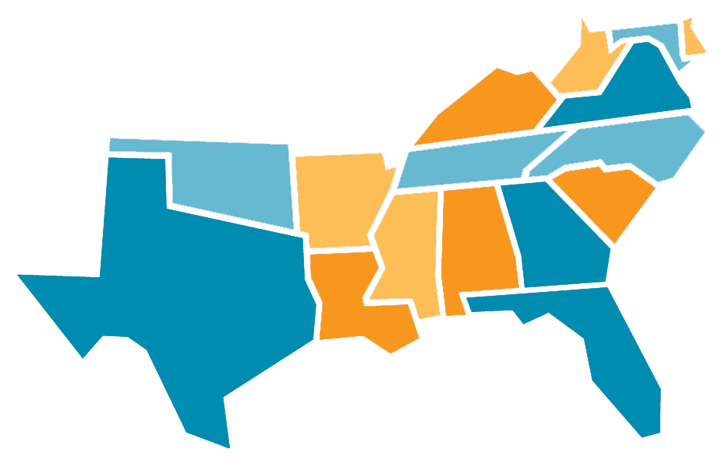
SREB Region At-A-Glance: How many teachers are in your state?
62k
19k
9k
101k
42k
94k
69k
76k
33k
53k
31k
46k
119k
48k
363k
179k
Source: IES/NCES, 2019-20
Notes:
Note: Numbers are approximate/rounded.

Slide 7
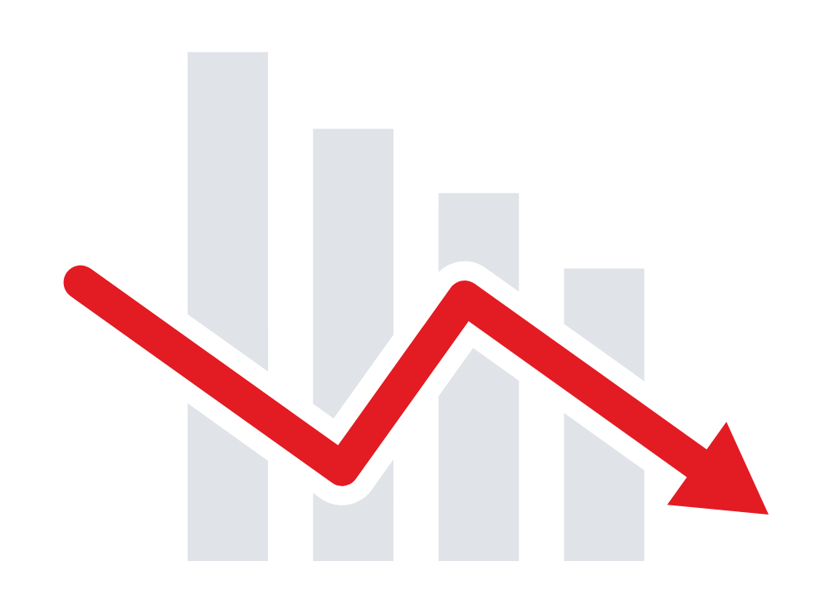
Teacher Shortages: Quantity (Entering)
of parents say they would not like their child to become a teacher
In a 2022 survey of Chief Talent Officers, 86% said they were currently finding it more difficult to hire new teachers
54%
One study found that 50% of high school students said they would be “somewhat,” “moderately,” or “definitely” interested in becoming a teacher — but the top reasons they cited for why they ultimately decided not to include:
Completion in teacher preparation programs is trending downward:
SREB states are preparing up to 50% fewer teachers than a decade ago
low pay
lack of career advancement
lack of flexibility
lack of prestige & respect
Sources: Title II Reports, 2019-20 | PDK Poll, 2018 | ACT Research & Policy, 2018 | TNTP, 2022
Notes:
Notes:
To understand the teacher quantity/supply issue, we need to understand why people aren’t entering the profession in the first place.
PDK’s 2018 poll was the first time since polling began in 1969 where a majority of parents said they would not want their child to become a teacher (46% said they’d support their child going into teaching; 54% said they would not want their child to become a teacher)
SREB states prepared 15k fewer teachers in 2019 than in 2013.

Slide 8
SREB Region-At-A-Glance: Teacher Preparation
54,143
people completed teacher preparation programs in the SREB region in 2020.
SREB states prepared
over 15,700 fewer
teachers since 2013, despite rising enrollment rates.
64%
Traditional Programs
36%
Alt.
Programs
Source: Title II Reports, 2019-20
Notes:
Notes:
In 2019-20, total enrollment in prep programs in the region was 247,891.
“Alternative Programs” in the chart above includes both IHE-based and non-IHE based alternative programs.

Slide 9
Teacher Shortages: Quantity (Exiting)
Working conditions are at the heart of why many states have trouble attracting and retaining a strong teacher workforce.
Teachers who leave cite:
Inadequate pay
School climate
Stress and burnout
School leadership
Lack of autonomy and value
2019-20
2021-22
76%
50%
45%
10%
Average turnover rate in SREB states
Average turnover rate in SREB states among teachers with ≤ 5 years of experience
Teachers who say they plan to leave their jobs
Chief Talent Officers who say resignations are higher now than in previous years
Sources: IES/NCES, 2019-20 | TNTP, 2022 | NEA, 2022 | RAND, 2021
Notes:
Notes:
To understand the teacher quantity/supply issue, we need to understand why people are choosing to leave the profession.
In 2019-20, turnover averaged 10.2% in the region, yet some states in the SREB region had an average turnover rate as high as nearly 19%.
The survey data included here is national, but likely indicative of similar trends in the SREB region.
Federal data shows that between January-November 2020, 800k resignations were handed in by employees who work in education at the state and local level — a 40% rise. For comparison, retail resignations rose 27% in that same timeframe.

Slide 10
Teacher Shortages: Quantity (Exiting)
SURVEY OF TEACHERS:
How much would you say these types of staffing shortages were a serious problem at your school in 2021-22?
In SREB states, the percentage of schools reporting vacancies is consistently trending up
87%
teachers
94%
substitutes
82%
support staff
TEACHER TURNOVER IS COSTLY
Average amount it costs school districts to replace each teacher
of teachers were asked to cover a class at least once per week during the 2021-22 school year
$21,000
64%
Sources: SREB, 2022 | Educators for Excellence, 2022 | Learning Policy Institutie
Notes:
Note: The survey data is national, but likely indicative of similar trends in the SREB region.
Vacancy rates are up. Shortages of teachers, support staff, subs and even bus drivers are up.
LPI found that the investments districts make in new hires (turnover, recruitment, hiring, training) don’t pay their full dividend when teachers leave within their first 1 or 2 years after being hired — and given that the average turnover rate in SREB states among teachers in their first 5 years is 45%, there’s a lot of monetary inefficiencies and challenges that come with teacher turnover and shortages.

Slide 11
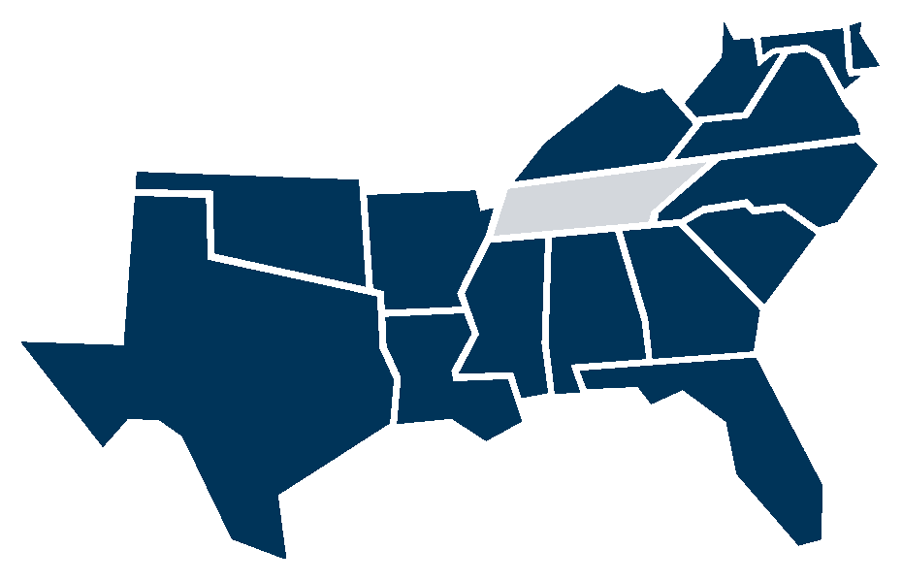
Teacher Shortage Areas
SPECIAL EDUCATION
15 STATES HAVE SHORTAGES
 | Shortage across all grade levels
 | Shortage primarily in elementary grades
 | Shortage primarily in secondary grades
Source: USDOE, Teacher Shortage Areas Report
Notes:
Notes:
More specific state-by-state data can be found on page 4 of the teacher blueprint report (or at the USDOE teacher shortage areas website).
In this data, middle school grades are typically lumped in with secondary.

Slide 12
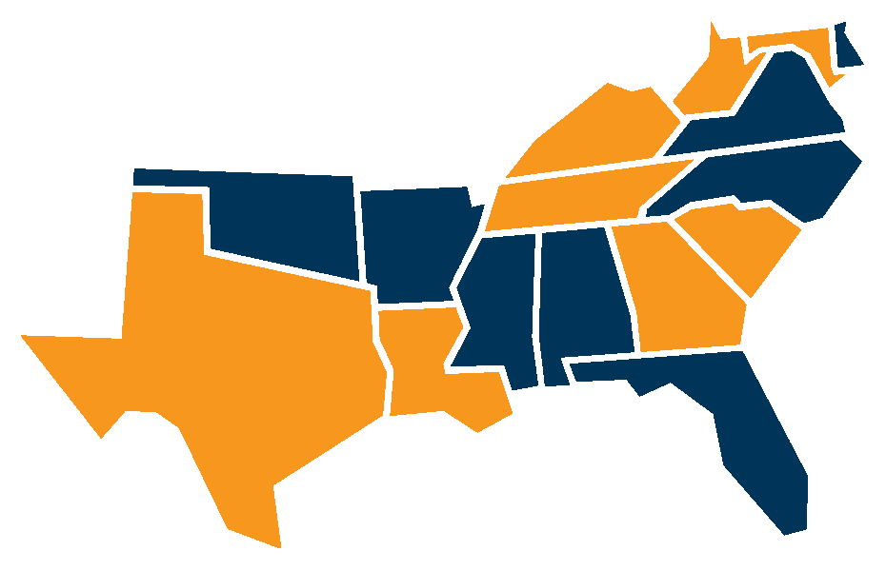
Teacher Shortage Areas
MATH
ALL 16 STATES HAVE SHORTAGES
 | Shortage across all grade levels
 | Shortage primarily in elementary grades
 | Shortage primarily in secondary grades
Source: USDOE, Teacher Shortage Areas Report
Notes:
Notes:
More specific state-by-state data can be found on page 4 of the teacher blueprint report (or at the USDOE teacher shortage areas website).
In this data, middle school grades are typically lumped in with secondary.

Slide 13
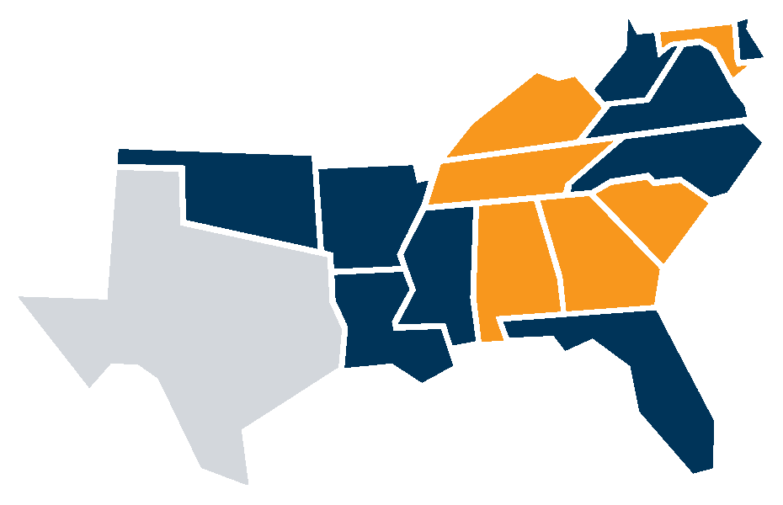
Teacher Shortage Areas
SCIENCE
15 STATES HAVE SHORTAGES
 | Shortage across all grade levels
 | Shortage primarily in elementary grades
 | Shortage primarily in secondary grades
Source: USDOE, Teacher Shortage Areas Report
Notes:
Notes:
More specific state-by-state data can be found on page 4 of the teacher blueprint report (or at the USDOE teacher shortage areas website).
In this data, middle school grades are typically lumped in with secondary.

Slide 14
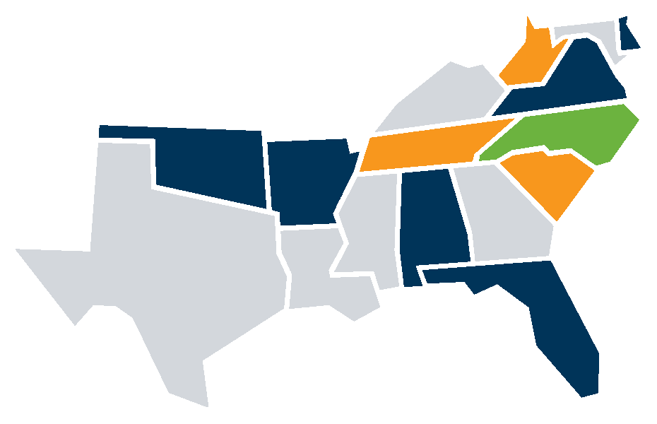
Teacher Shortage Areas
ENGLISH LANGUAGE ARTS
10 STATES HAVE SHORTAGES
 | Shortage across all grade levels
 | Shortage primarily in elementary grades
 | Shortage primarily in secondary grades
Source: USDOE, Teacher Shortage Areas Report
Notes:
Notes:
More specific state-by-state data can be found on page 4 of the teacher blueprint report (or at the USDOE teacher shortage areas website).
In this data, middle school grades are typically lumped in with secondary.

Slide 15
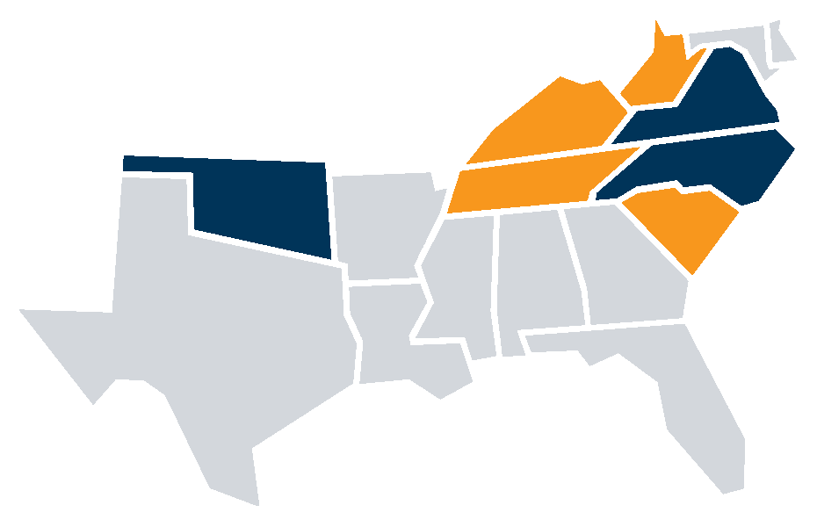
Teacher Shortage Areas
SOCIAL STUDIES
7 STATES HAVE SHORTAGES
 | Shortage across all grade levels
 | Shortage primarily in elementary grades
 | Shortage primarily in secondary grades
Source: USDOE, Teacher Shortage Areas Report
Notes:
Notes:
More specific state-by-state data can be found on page 4 of the teacher blueprint report (or at the USDOE teacher shortage areas website).
In this data, middle school grades are typically lumped in with secondary.

Slide 16
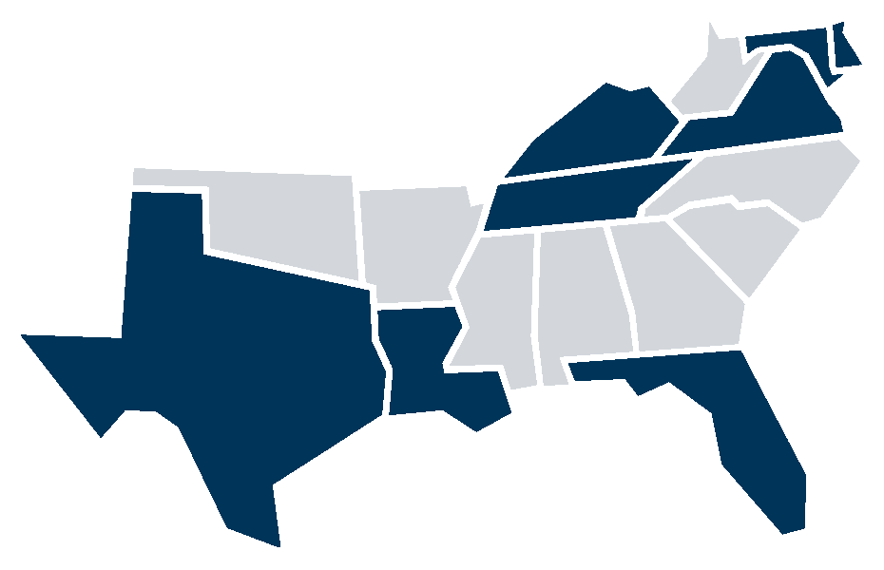
Teacher Shortage Areas
ENGLISH AS A SECOND LANGUAGE
8 STATES HAVE SHORTAGES
 | Shortage across all grade levels
 | Shortage primarily in elementary grades
 | Shortage primarily in secondary grades
Source: USDOE, Teacher Shortage Areas Report
Notes:
Notes:
More specific state-by-state data can be found on page 4 of the teacher blueprint report (or at the USDOE teacher shortage areas website).
In this data, middle school grades are typically lumped in with secondary.

Slide 17
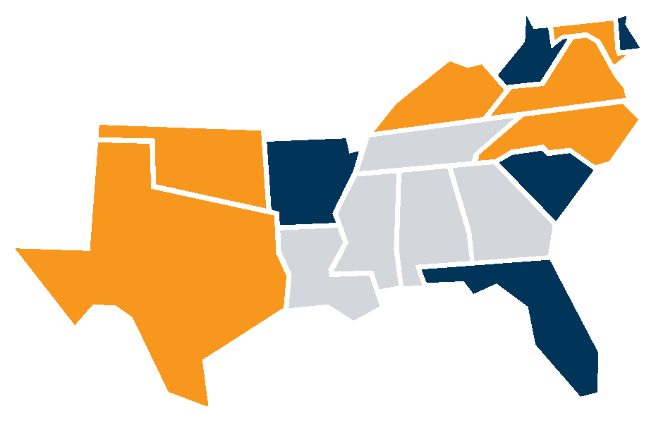
Teacher Shortage Areas
CAREER & TECHNICAL EDUCATION
11 STATES HAVE SHORTAGES
 | Shortage across all grade levels
 | Shortage primarily in elementary grades
 | Shortage primarily in secondary grades
Source: USDOE, Teacher Shortage Areas Report
Notes:
Notes:
More specific state-by-state data can be found on page 4 of the teacher blueprint report (or at the USDOE teacher shortage areas website).
In this data, middle school grades are typically lumped in with secondary.

Slide 18
Teacher Shortages
The South makes up a majority of known U.S. teacher vacancies.
An estimated number of teacher vacancies by region shows shortages are felt everywhere, but especially in the South.
Source: K-12Dive / Annenberg Institute at Brown University 2022
Notes:
Notes:
More specific state-by-state data can be found on page 4 of the teacher blueprint report (or at the USDOE teacher shortage areas website).
In this data, middle school grades are typically lumped in with secondary.

Slide 19
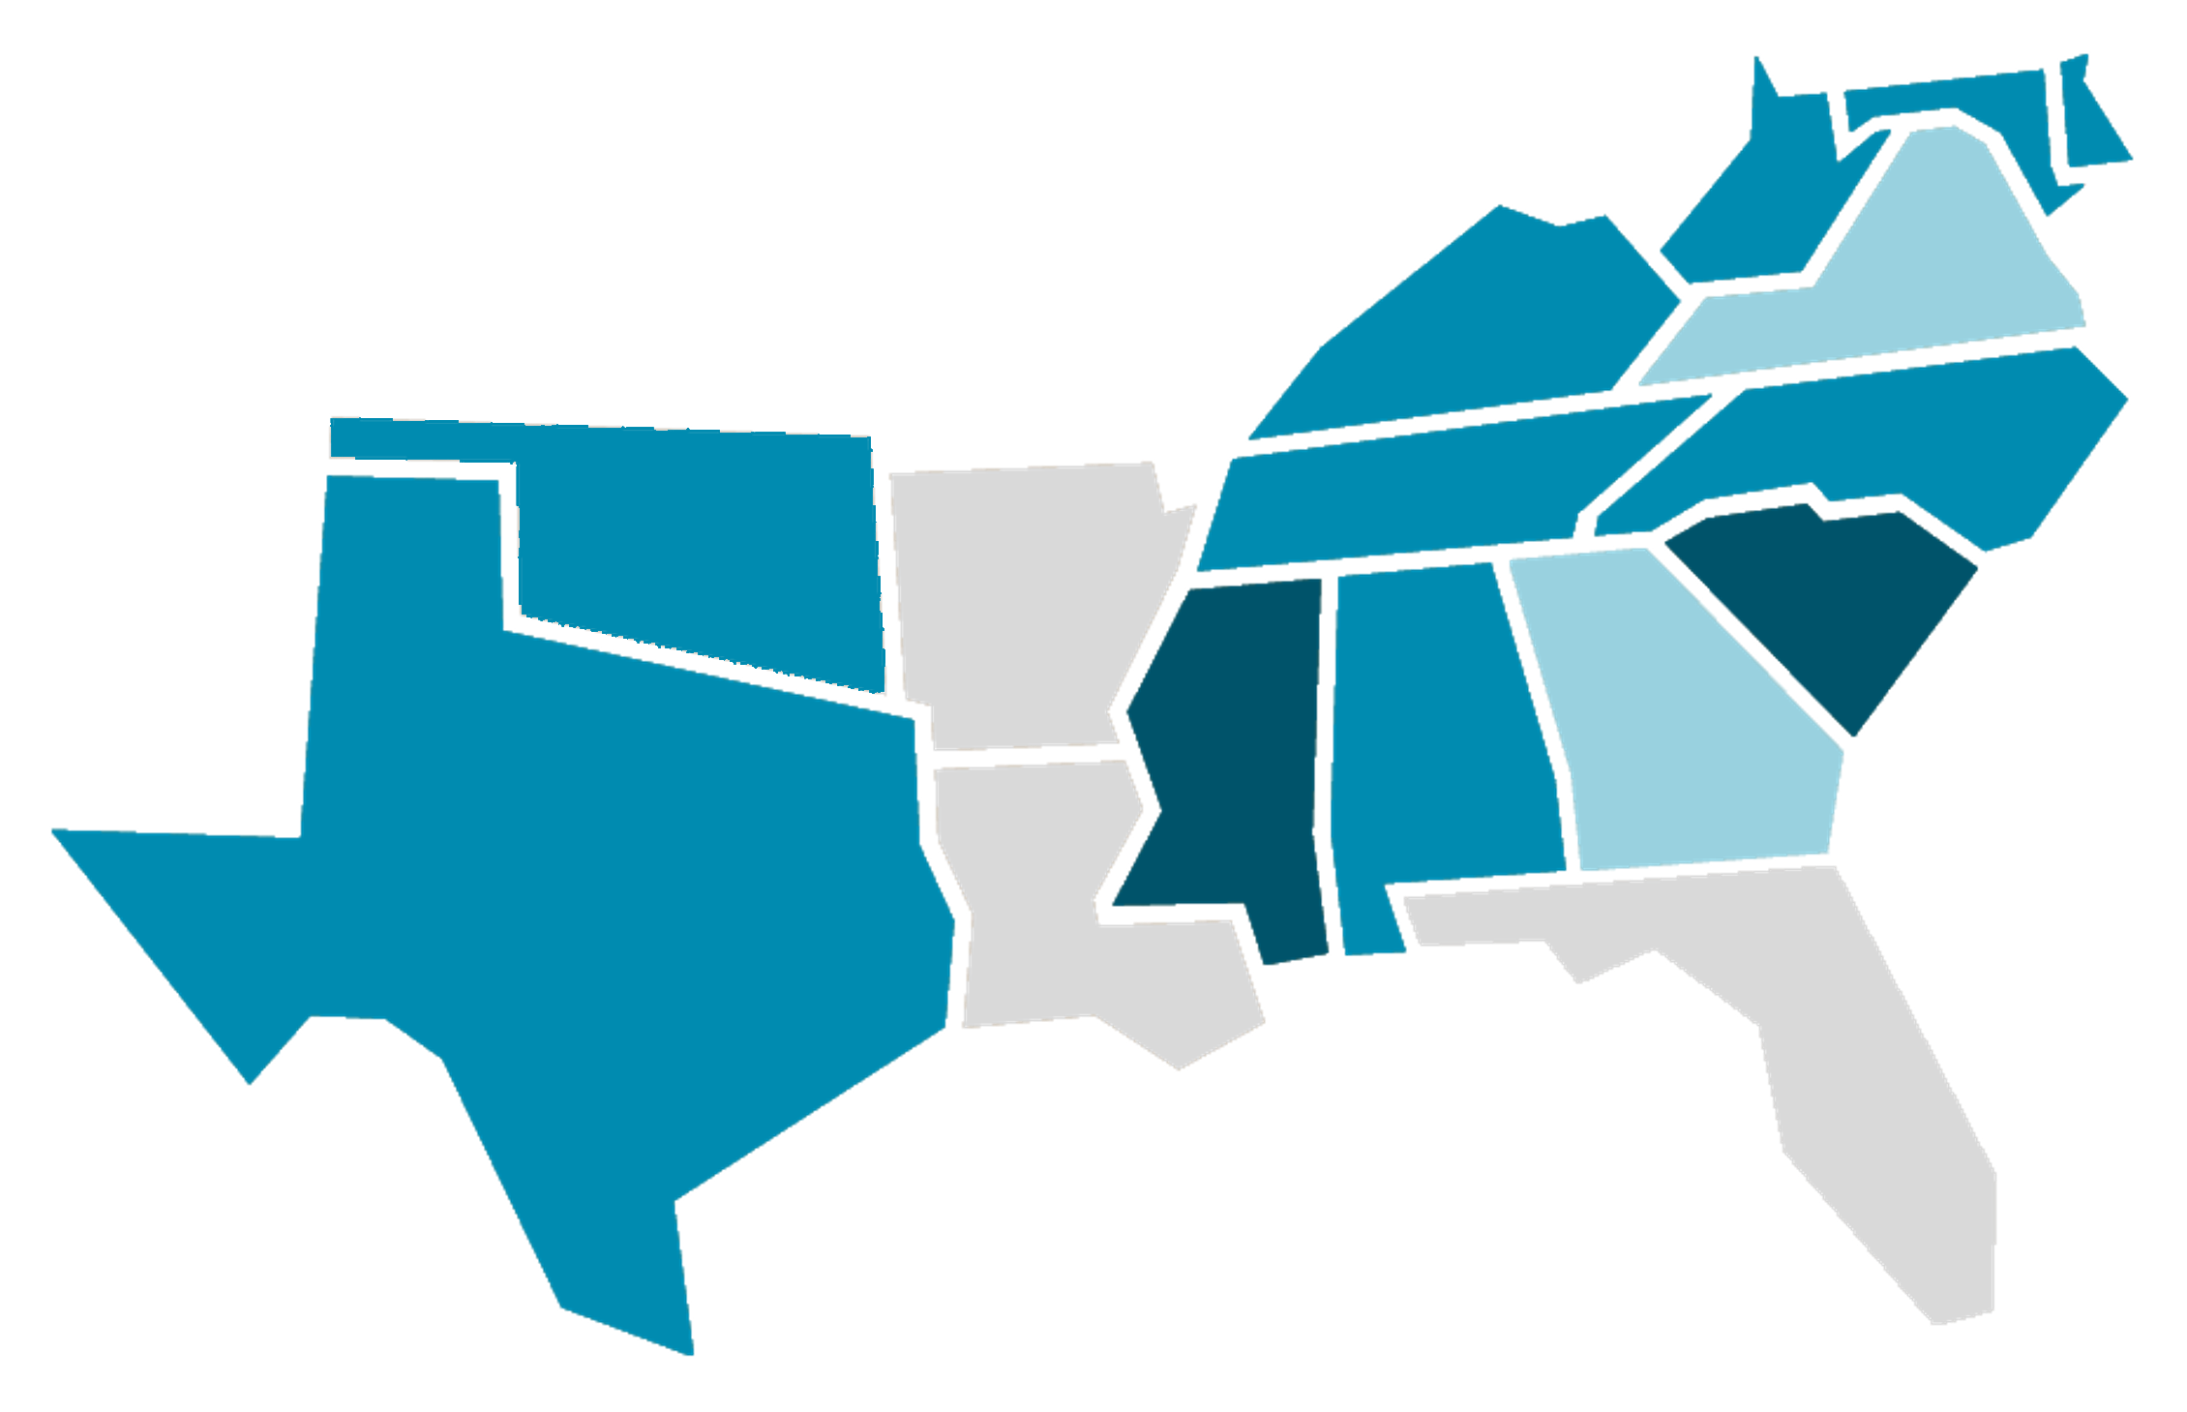
SREB Region-At-A-Glance: Teacher Experience
State | Inexperienced %
AR | NA/Unknown
FL | NA/Unknown
LA | NA/Unknown
VA | 4.7%
GA | 5%
OK | 14.1%
TX | 14.3%
TN | 15.1%
NC | 16.3%
AL | 16.2%
KY | 17.6%
MD | 17.6%
DE* | 17.9%
WV | 18.4%
MS | 22.8
SC | 26.4
Percent of Teaching Workforce with ≤ 3 Years of Experience
17.6
18.4
17.9*
4.7
17.6
15.7%
of teachers in the SREB region are in their first 2 years
16.3
15.1
14.1
26.4
22.8
16.2
5
14.3
N/A or Unknown | Less than 10% | Between 10-20% | More than 20%
Source: IES/NCES, 2019-20
Notes:
*Note: Delaware’s number (17.9%) actually reflects those who are within their first 4 years (because that was the only data available).

Slide 20
Teacher Shortages: Quality
On average, in the SREB region…
15.7% of teachers are inexperienced (≤ 3 years)
4.2% are uncertified or emergency certified
11.1% are teaching out-of-field
In some SREB states, the share of teachers who are uncertified and/or inexperienced has reached 30%
Sources: IES/NCES, 2019-20 | Title II Reports, 2019-20 | Learning Policy Institute, 2017
Notes:
Notes:
Data such as teacher experience level and certification/credentials are not a perfect proxy for teacher quality, but they are one valuable input/indicator.
“Teaching Out-of-Field” refers to teachers who spend more than a certain percentage of their time teaching in grade levels, subject areas, or specialized areas (such as ELL or special education) that they are not certified in.
In one SREB state, over 35% of teachers are inexperienced, uncertified or teaching a majority of classes out of their trained field, affecting up to $165k students in the state.

Slide 21
National Ranking | State | % of Teacher Workforce
#1 | NC | 23.2%
#3 | SC | 17.4%
#4 | MS | 14.5%
#6 | KY | 9.9%
#7 | AR | 9%
#8 | FL | 8.2%
#9 | AL | 7.8%
#10 | OK | 7.2%
#13 | WV | 6.1%
#14 | MD | 5.6%
#17 | LA | 4.9%
#19 | DE | 4.8%
#20 | VA | 4.5%
National Average = 3%
#29 | GA | 2.2%
#37 (tied) | TN | 1.2%
#49 | TX | 0.3%
The SREB region leads the nation in the percent of teachers who are
National Board Certified
Source: NBPTS, 2022
Notes:
Note: TN is tied at #37 with PA.
National avg is 3%, SREB avg is 7.9%

Slide 22
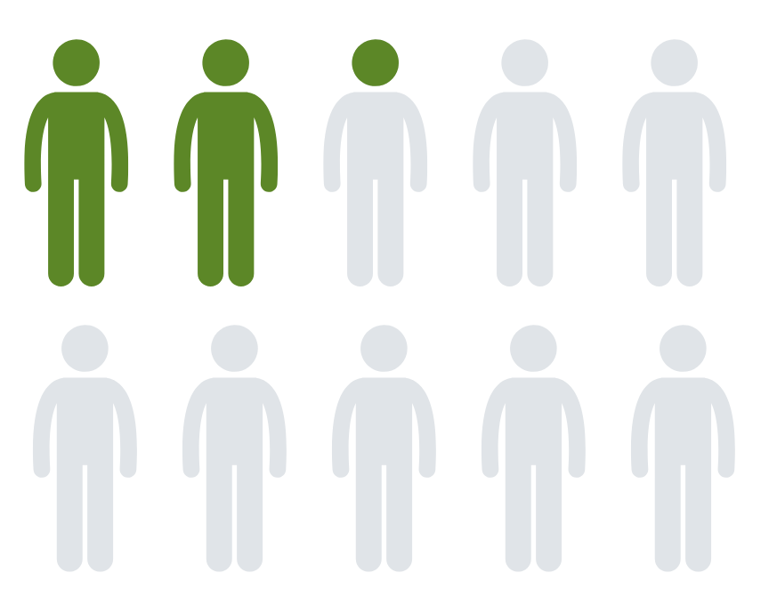
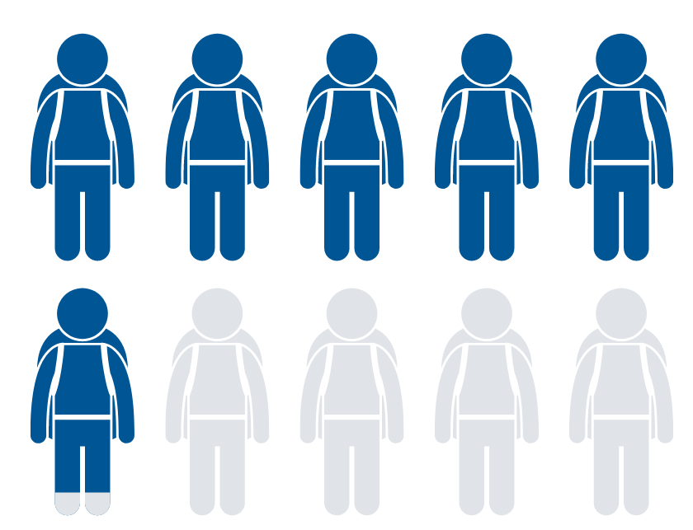
Teacher Shortages: Diversity
Research shows students (and especially students of color) benefit from racially and ethnically diverse teachers.
Yet in SREB states…
just 22% of teachers are people of color
…despite 59% of students being people of color
In some states, as few as 5% of teachers are people of color.
Sources: IES/NCES, 2019-20 | Title II Reports, 2019-20 | Alliance For Resource Equity, 2021 | The Education Trust, 2019
Notes:
Note: Nationally, racial/ethnic diversity among public school students is growing quicker than among teachers — this is likely true regionally as well. And the student-teacher data here mirrors national trends — in 2015-16, 51% of students were people of color, but only 20% of teachers were people of color.

Slide 23
Teacher Shortages: Diversity
KEY TAKEAWAY:
The next generation of teachers (currently enrolled in preparation programs) is slightly more diverse, but still not proportional to the student population overall.
Race/Ethnicity of Students, Teachers, and Prep Program Enrollees in SREB States
 | Students
 | Teachers
 | Prep Program Enrollees
Sources: IES/NCES, 2019-20 | Title II Reports, 2019-20
Notes:
Note: Additionally, 0.16% of students in the SREB region are Native Hawaiian or Pacific Islander — the percent of teachers and prep program enrollees is under 0.01%.

Slide 24
Teacher Shortages: Diversity
According to 2021-22 surveys, an increasing proportion of educators are thinking about leaving the profession — and Black and Hispanic educators, who are already underrepresented, are even more likely to be looking toward an exit. This could leave the teaching profession less diverse.
According to focus groups, barriers to recruiting and retaining teachers of color include:
Windows and mirrors…students should be able to see mirror images of themselves leading classrooms. But if they’re students of color, they just get windows.
Unfavorable working conditions & unwelcoming school cultures
Lack of agency & autonomy to tailor their teaching to the students they serve
Monetary costs — for example, lack of generational wealth or not having the financial means to supplement low pay
Psychological costs & burnout— including feeling undervalued, especially for unrecognized or uncompensated work
-High School Principal
Sources: The Education Trust, 2019 | NEA, 2022 | RAND, 2021

Slide 25
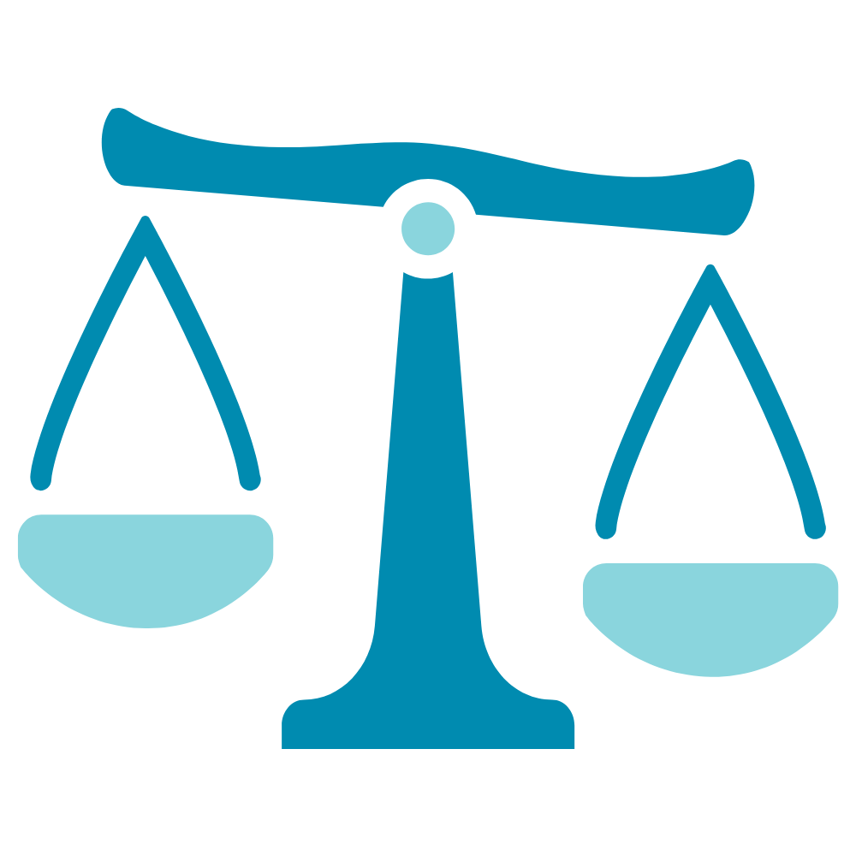
The teacher shortage challenge is one of:
Quantity
Quality
Diversity
The challenge also becomes the distribution of teachers.
This means that teacher shortages are an equity issue.
In other words, it is more difficult to attract strong teachers, get them to stay, or to fill vacancies in:
Rural communities
Low-income schools
Certain subject areas
In the SREB region, students of color and students from low-income backgrounds are disproportionately taught by teachers who are:
Less experienced
Less effective
Out-of-field
Notes:
Teacher shortages are a pervasive challenge across the country and especially in the South if you look at them in quantity, quality, diversity and distribution of talent across the state. Rural and low-income schools, of which most are high-minority populations, are far more likely to have more inexperienced, ineffective, out-of-field certification and to have major vacancies in STEM and SPED teachers. The few states that collect and report on this distribution data show high rates of inequity, correlating to lower or even declines in learning gains in these schools.
Note: AKA “The ‘equitable distribution’ of teachers” or ‘equitable access to strong teachers.’

Slide 26
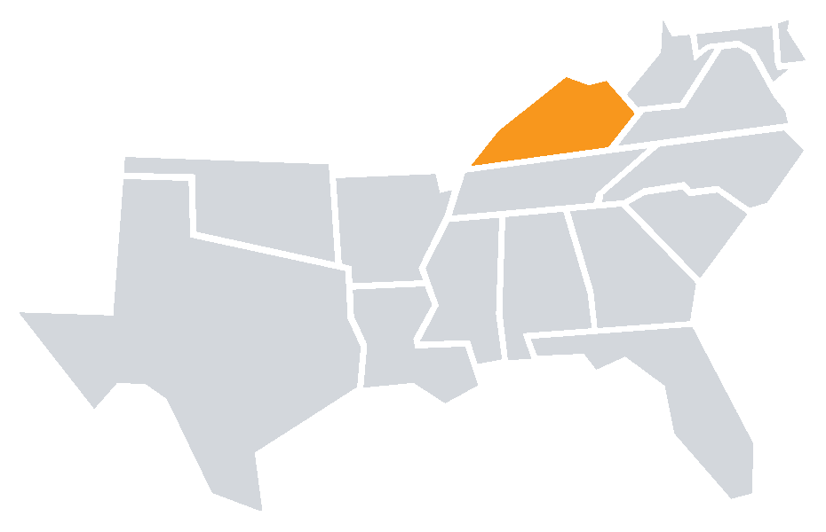
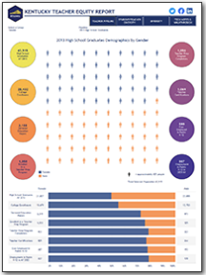
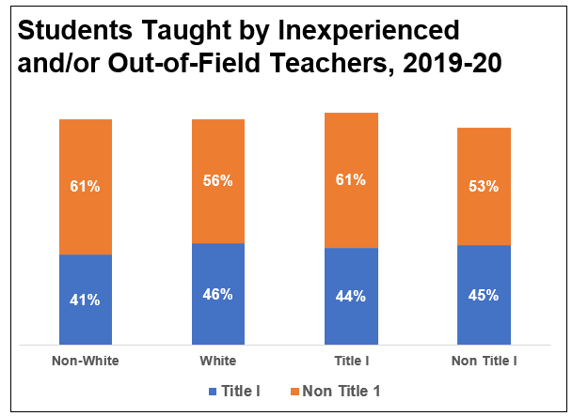
Teacher Shortages: Equity
KENTUCKY DATA:
Reporting on Equitable Distribution of Teacher Talent
Kentucky Teacher Talent Spotlight
Only a few states collect data on what many call “teacher equity,” yet all states should. Kentucky publicly reports on the percent of students from different demographics that are taught by less experienced, ineffective, or out-of-field teachers. The chart below highlights their data
Kentucky’s Teacher Equity Report:
An interactive dashboard that presents two perspectives on the educational workforce.
Published July 2021
Sources: Kentucky School Report Cards; KYSTATS

Slide 27
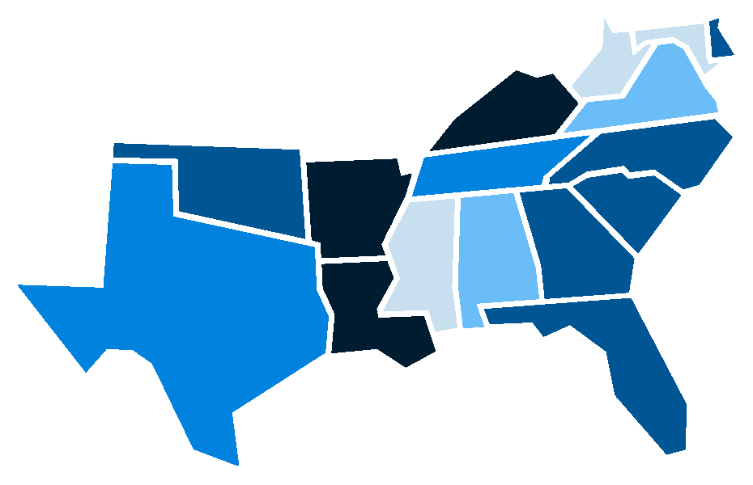
Robust, quality data can help states effectively address teacher shortages.
6 Best Data Practices
Does your state produce new teacher supply data?
Does your state produce new teacher demand data?
Does your state disaggregate supply and demand data to the institution, district, and certification level?
Does your state report on teacher shortages?
Does your state publish teacher mobility data?
Does your state make school-level aggregates of teacher performance data publicly available?
On average, SREB states employ less than half of these 6 practices
0
3
0
1.5
4
2.5
3
3.5
4
3.5
0
1.5
3
2.5
4
3
Source: NCTQ, 2021

Slide 28
Why is there a critical shortage of teachers in certain areas?

Slide 29
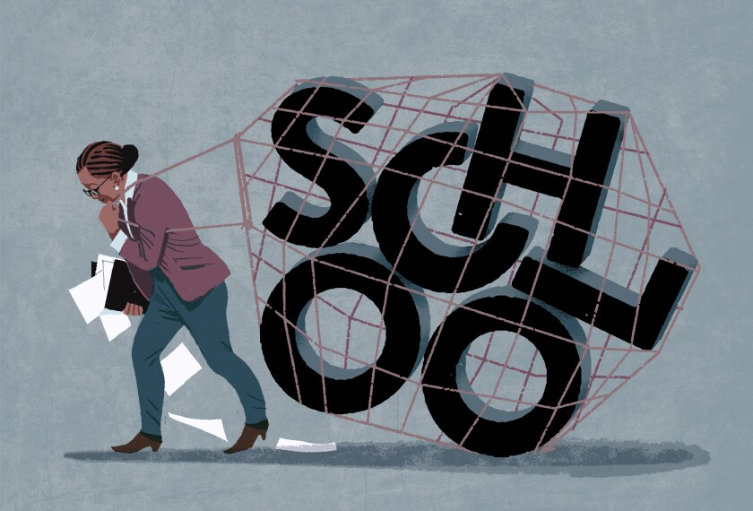
SREB Region-At-A-Glance: Teacher Stress
Pre-pandemic, about half of teachers reported frequent job-related stress.
This was tied with doctors for the highest among 14 professional categories.
Research shows teacher stress can negatively impact
student learning
This number has increased since COVID — 3 in 4 teachers now report high levels of daily stress.
Compared to 40% for other working adults.
THE GOOD NEWS?
Only 2% of teachers say there is nothing their school or district can do to help relieve their stress
Sources: Gallup, 2013 | RAND, 2021 | EdWeek, 2021
Notes:
Note: This data is national, but likely indicative of similar trends in the SREB region.
Teachers cite lack of preparedness for the job and lack of enough administrator and colleague support as the two most significant aspects contributing to unnecessary stress.

Slide 30
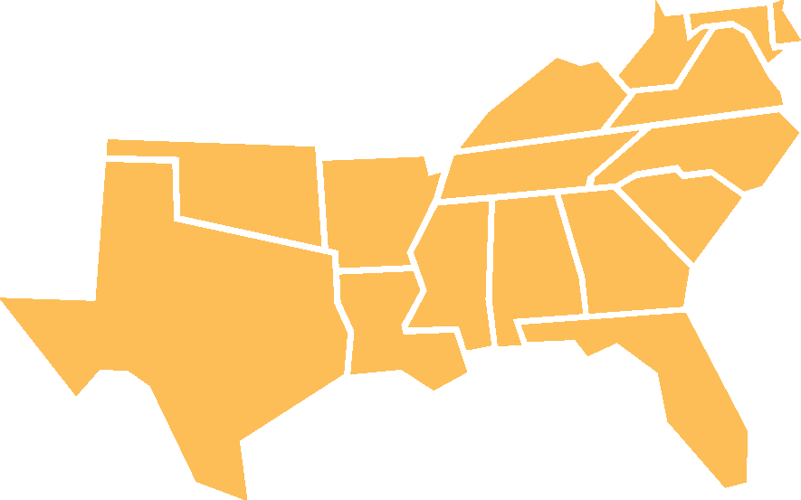
SREB Region-At-A-Glance: The Sustainability of Teaching
In the SREB region,
18.5% of teachers
have a second job.
The demands on teachers have gotten greater…and [they have] fewer resources and fewer choices — when you combine those two, you’re basically putting teachers in a vise.
44%
This makes them
3x more likely
to balance multiple jobs than other workers.
of teachers report working more hours during the pandemic.
-Professor of Education at University of Virginia
Sources: Educators for Excellence, 2021 | IES/NCES State Profiles, 2017-18 | EdWeek, 2021
Notes:
Note: The region-specific data is from 2017-18 because that is the most recent year available for data on second jobs

Slide 31
SREB Region-At-A-Glance: Teacher Voice
Most teachers feel like their voices are heard at school, but there is a sharp decline when it comes to more systemic conversations and decision-making.
PERCENT OF TEACHERS WHO FEEL THEIR OPINIONS ARE
FACTORED INTO DECISION-MAKING
We’re experts when it comes to our students and profession, but policymakers often don’t invite us to the table to share our experience and our opinions. One way of empowering and valuing teachers is listening to us.
53%
SCHOOL-LEVEL
19%
DISTRICT-LEVEL
2%
STATE-LEVEL
1%
NATIONAL-LEVEL
-10th Grade Teacher
Sources: PDK Poll, 2019 | TALIS, 2018 | Educators for Excellence, 2021
Notes:
Notes:
This data is national, but likely indicative of similar trends in the SREB region.
Additionally, only 36% of U.S. teachers believe American society values the teaching profession.

Slide 32
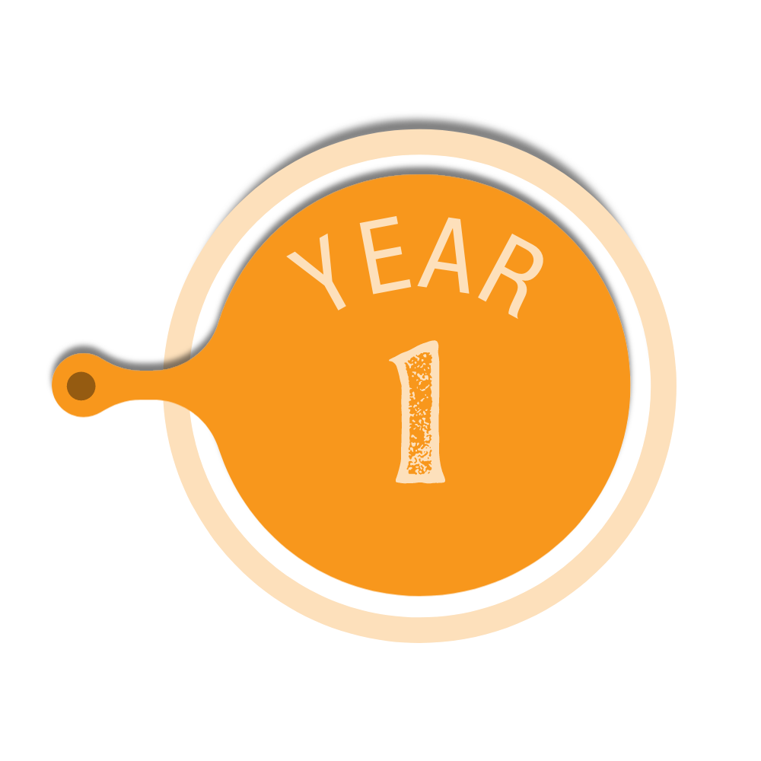
SREB Region-At-A-Glance: Teacher Compensation
TAKE HOME PAY
Average Annual Net Salary in Region
$75.9k
$68.6k
$29,025
$64.1k
$55.2k
$39.8k
$41.2k
REGIONAL
NATIONAL
REGIONAL
NATIONAL
REGIONAL
NATIONAL
$36,205
Average Starting Salary
Average
Top
Salary
Average Overall Salary
$45,921
Source: SREB Teacher Compensation Dashboard, 2019-20
Notes:
Note: Although the cost of living index for the region is 95.2% (slightly lower than national), these discrepancies in compensation outweigh that.

Slide 33
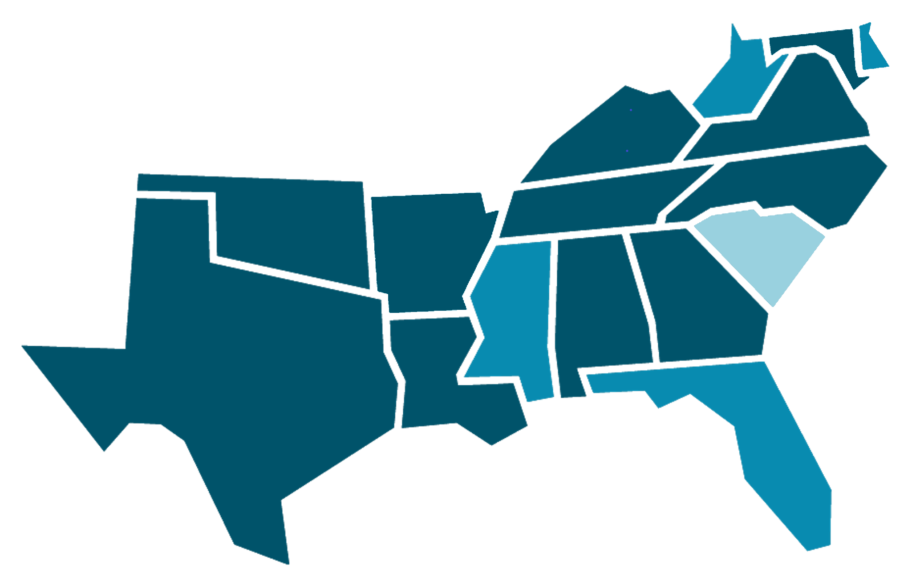
SREB Region-At-A-Glance: Teacher Compensation
State | Regression-Adjusted Weekly Wage Penalties
SC | -8.3%
DE | -10.9%
MS | -14.7%
WV | -19.2%
FL | -19.6%
MD | -20.3%
AR | -20.5%
TX | -21.5%
TN | -23.8%
NC | -24.5%
KY | -24.7%
GA | -26.8%
LA | -27.8%
AL | -30.6%
VA | -32.7%
OK | -32.8%
Teachers consistently make significantly less than other college-educated workers — this is called the “Teacher Wage Gap.”
Percent of Teachers Who Say They Feel Fairly Paid
-20.3%
-10.9%
What is the Teacher Wage Gap in your state?
-19.2%
60%
-32.7%
-24.7%
47%
-23.8%
-24.5%
39%
-32.8%
-8.3%
-20.5%
28%
30%
-14.7%
-30.6%
-26.8%
NATIONAL
SOUTH
MIDWEST
WEST
NORTHEAST
-21.5%
-27.8%
-19.6%
Less than 10% | Between 10-20% | More than 20%
Sources: PDK Poll, 2019 | Economic Policy Institute, 2022
Notes:
Notes:
The map shows regression-adjusted weekly wage penalties (how much less, as a percentage, K-12 public school teachers early in weekly wages than their college educated peers in other progressions).
For reference, the average teacher wage gap nationally hovers near 20% — this map shows an approximate average of 21% in the SREB region.

Slide 34
SREB Region-At-A-Glance: Teacher Expenses
A significant majority of teachers report buying:
of teachers say their classroom supply budget is not enough to meet their students’ needs
95%
basic classroom supplies
food for students
basic health supplies
cleaning supplies
of teachers report paying for classroom supplies and instructional materials without reimbursement
94%
…and a quarter report buying clothes for students
Source: Forbes, 2018
Notes:
Notes:
This data is national, but likely indicative of similar trends in the SREB region.
Although this data is pre-pandemic, it is likely that COVID exacerbated these realities and led to teachers incurring additional costs due to not having the resources they needed to change lesson plans, decreased access to supplies that could no longer be shared, additional health and safety supplies, technology and remote learning supports, and adaptive materials to help students bounce back from pandemic-related learning disruptions.

Slide 35
The Impact of COVID-19: The pandemic created or exacerbated challenges for educators.
Being spread thin due to switching between various modes of teaching
Grappling with technology challenges
Navigating declining student engagement
Responding to more various student needs
Balancing care of their own families and health

Slide 36
The Impact of COVID-19: Early indicators point to a mounting teacher shortage problem.
What’s increasing?
What’s decreasing?
Workloads
44% of teachers report working more hours during the pandemic.
Morale
84% of teachers and admins say morale is lower than prior to COVID.
2. The percent of teachers who say they plan to leave
2. The percent of teachers who are ‘very satisfied’
Sources: Educators for Excellence, 2021 | NEA, 2022 | RAND, 2021 | Horace Mann, 2020 | Mission Square Research Institute, 2020 | EdWeek Research Center, 2020 | EdWeek Research Center, 2022
Notes:
Note: This data is national, but likely indicative of similar trends in the SREB region.

Slide 37
A SNAPSHOT OF
FACULTY WORKFORCE DATA
Notes:
PSE faculty numbers – current shortages by discipline, compensation
Correlation of these educator shortages with high demand career shortages – nursing, IT as examples

Slide 38
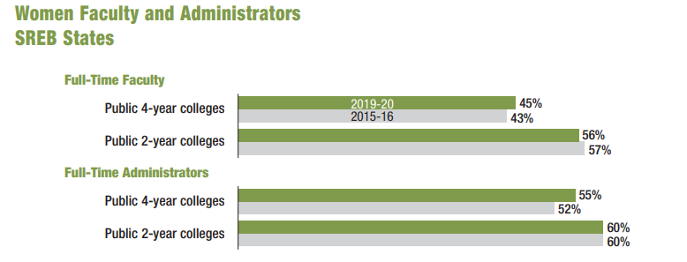
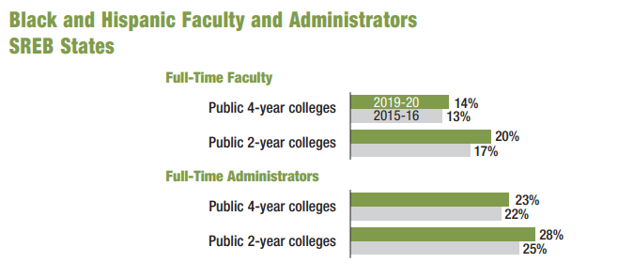
SREB Region-At-A-Glance: Faculty Demographics
Women and minority representation increased at public institutions.
Source: SREB Fact book on Higher Education, 2021
Notes:
Start with bright spot – diversity of faculty is getting better over time, similarly too teacher diversity. But still room to grow.

Slide 39
SREB Region-At-A-Glance: Faculty Status
Faculty consistently represent mostly part-time staff.
Source: SREB Fact book on Higher Education, 2021
Notes:
Public higher ed faculty consistently represent a majority part-time staff over the last 5 years.

Slide 40
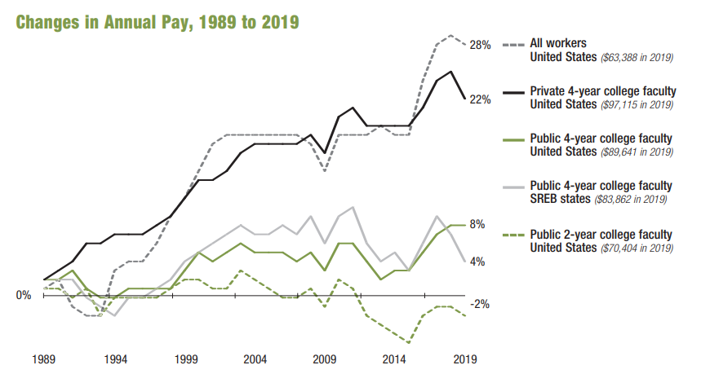
SREB Region-At-A-Glance: Faculty Compensation
Faculty salaries rose, but inflation negated the increases, even prior to current inflation highs.
Source: SREB Fact book on Higher Education, 2021; Adjusted for inflation. Faculty salaries are 9-month or 9-month-equivalent.
Notes:
Compensation of public college faculty isn’t keeping up with changes in annual pay in comparison to all workers, nor private college faculty, OR inflation. Plus part-time, adjunct and non-tenured faculty make far less than their full-time tenured peers.

Slide 41
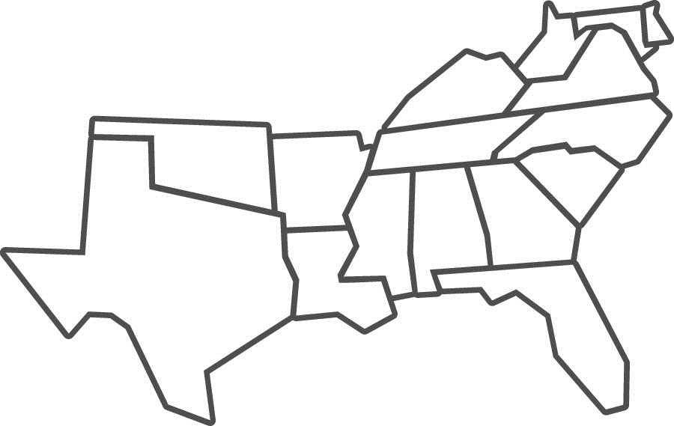
SREB Region-At-A-Glance: Faculty Compensation
SREB states significantly lag all other regions in terms of salaries for public two- and four-year colleges and universities.
Source: SREB Fact book on Higher Education, 2021; Inflation-adjusted change 2014-15 to 2019-20 shown in parentheses
Notes:
Salaries in the region significantly lag the other regions of the US – similarly with teachers. We are severely underpaying all educators in the South, and that issue is catching up with us.

Slide 42
Nation-At-A-Glance: Faculty Shortages
Supply gaps of higher education faculty are highest among several in-demand career fields like healthcare.
US Higher Education Faculty Employment, Supply and Demand, 2021
Source: JobsEQ, 2021
Notes:
PSE faculty current shortages by discipline
Correlation of these educator shortages with high demand career shortages – nursing, IT as examples.
With these shortages, states and the region are not able to provide enough seats in courses to amply prepare for the workers we need in healthcare, education, IT and engineering – all high-needs fields!
Not enough teaching talent in schools and colleges = limitations to learning for students, declines in prepared K-12 students who can successfully transition and complete any higher education = not enough trained/educated workers to sustain and grow our economy.
https://www.cupahr.org/surveys/research-briefs/higher-ed-employee-retention-survey-findings-july-2022/.
Report Findings
Higher ed employees are looking for other jobs, mostly because they desire a pay increase. More than half (57%) of the higher ed workforce is at least somewhat likely to look for other employment opportunities in the next 12 months. The most common reason for seeking other employment (provided by three-fourths of those likely to look for another job) is an increase in pay. Other reasons are that they desire more remote work opportunities, a more flexible schedule, and a promotion or more responsibility.
Higher ed institutions are not providing the remote work opportunities that employees want. Nearly three-fourths (71%) of employees report that most of their duties can be performed remotely, and 69% would prefer to have at least at least a partially remote work arrangement, yet 63% are working mostly or completely on-site.
Higher ed employees are working longer and harder than ever. Two-thirds (67%) of full-time staff typically work more hours each week than what is considered full-time. Nearly two-thirds (63%) have taken on additional responsibilities of other staff who have recently left, and nearly three-fourths (73%) have taken on additional responsibilities as a direct result of the pandemic.
Higher ed employees have clear areas of satisfaction and dissatisfaction. Areas of satisfaction include benefits, relationship with supervisor, job duties, and feeling a sense of belonging. Areas of dissatisfaction include investment in career development, opportunities for advancement, fair pay, remote work policies and parental leave.

Slide 43
PROJECTIONS
THE FUTURE EDUCATOR WORKFORCE
Notes:
If no changes are made and current trends continue, here is a peak into what the educator workforce could look like in the next decade.

Slide 44
Projections in SREB States
2019-20 DATA
2029-30 PROJECTIONS
1.3 million teachers serving
19.4 million students
across 16 states
1.8 million teachers serving
27.3 million students
across 16 states
23% teachers of color
27% teachers of color
Source: SREB projected data calculations using Census data
Notes:
Diversity of the student population in the SE is predicted to continue to rise more than in the rest of the nation.

Slide 45
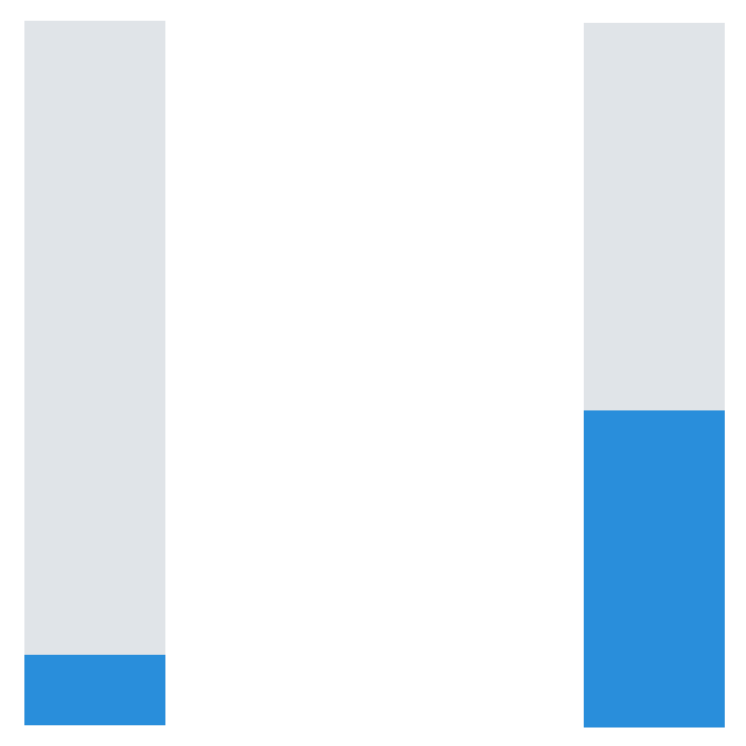
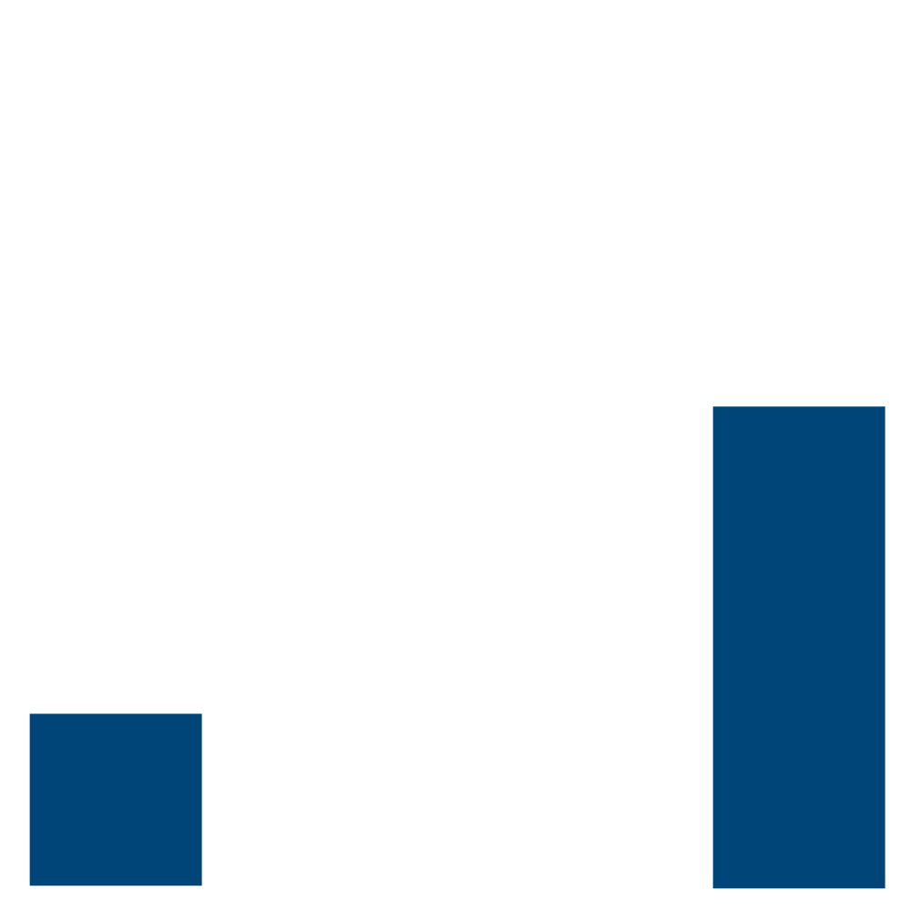
Projections in SREB States
2019-20 DATA
2029-30 PROJECTIONS
56%
45%
20%
10%
Average teacher turnover rate
Average new teacher turnover rate among teachers with ≤ 5 years of experience
Projected average teacher turnover rate
Projected average new teacher turnover rate among teachers with ≤ 5 years of experience
Source: SREB projected data calculations
Notes:
Turnover will double – and new teacher turnover will reach over 50%, costing school districts enormous amounts in turnover costs to hire, train and retain more new teachers – or rely further on underprepared staff.

Slide 46
Projections in SREB States
2019-20 DATA
2029-30 PROJECTIONS
4.2% Uncertified or Emergency
5.4% Uncertified or Emergency
By 2030,
16.1 million
K-12 students may be taught by an unprepared or inexperienced teacher
11.1% Teaching Out-of-Field
12.7% Teaching Out-of-Field
15.7% Inexperienced
40.9% Inexperienced
Source: SREB projected data calculations
Notes:
The inexperience and ill-prepared levels will rise significantly – putting more than half of all students in the SREB region at risk of having a teacher who is not qualified or ready to teach the courses they are teaching.

Slide 47
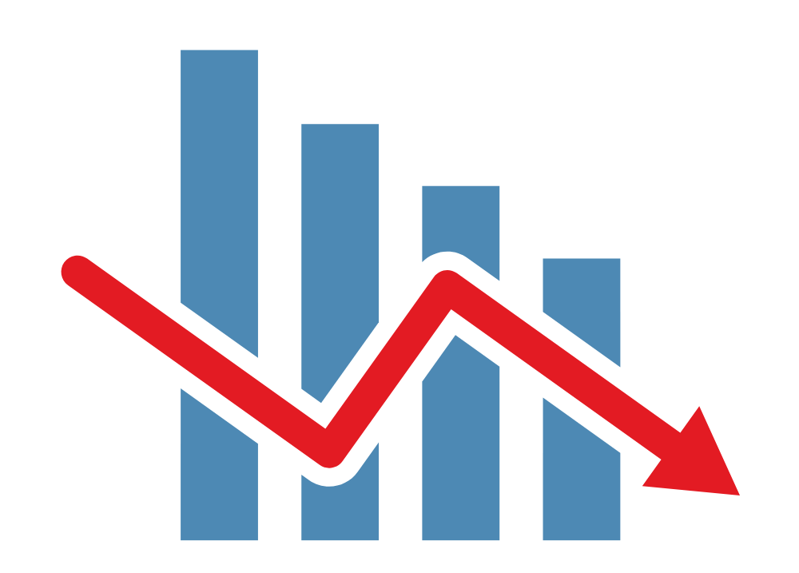
Projections in SREB States
2019-20 DATA
2029-30 PROJECTIONS
54,143
people completed teacher preparation programs in 2020 — a decline of 23% in the region since 2013
31,470
predicted completers in the SREB region in 2030, despite projected rising enrollment rates for most SREB states
That’s
42% fewer
Source: SREB projected data calculations
Notes:
Teacher preparation COMPLETION rates will continue to decline, despite more enrolling. Some states will only be producing a couple hundred new teacher grads each year, if current trends continue.

Slide 48
U.S. Higher Education Faculty Projections
Projected Employment and Highest Supply Gaps, 2031
-24%
-22%
-24%
-19%
-22%
-25%
-18% supply gap
-26%
-23%
-25%
-21%
Projected Faculty Supply Gap: -21%
Source: JobsEQ
Notes:
Faculty supply gaps will increase in the highest shortage disciplines.
Total Healthcare faculty supply gap = -37% of necessary projected positions
The supply gap of higher education faculty will increase from -6% gap to -21% gap by 2031. This will significantly contribute to the inability for states to increase the numbers of K-12 teacher graduates coming out of schools of education or alt prep programs over the next decade!

Slide 49
How do we recruit, develop, and retain enough strong, diverse educators — especially in the places they’re needed most?
Notes:
Closing:
It extremely important for states to collect this data to understand the issues at play in and around your state, and not rely just on aggregate data.
Once you have great data to understand the problem better, you can work toward solutions to these teacher shortage issues.
So how do we fix the issues we face now to ensure our kids and grandkids will have quality, fully prepared and supported teachers?

Slide 50
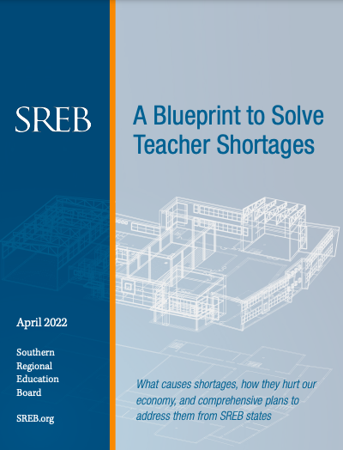
TO SOLVE TEACHER SHORTAGES, STATES NEED
A RENOVATION BLUEPRINT
SREB’s new blueprint report includes:
A closer look at the teacher shortage challenge
A framework for renovating teacher workforce policy
Recommended action steps for states
Notes:
Closing Comment:
Let’s make teaching an attractive career. Elevate the teaching profession — make it a rewarding, valued, appreciated position in our communities. Patchwork repairs are not solving our leaky pipeline problem, nor are they attracting new talent. What do we do? Renovate our teacher workforce policies from the foundation up.
SREB has published a blueprint report of ideas from states in our region. There are a lot of great ideas and changes happening to support our educators and build up the pipeline. Look to each other for help. Build a collaborative team in your state to solve this huge problem and SREB is willing to help if you need us.
This work is monumental, but....We owe it to our students. We owe it to our educators. We owe it to our businesses. We owe to ourselves and our families.

Slide 51
SREB works with states to improve education.
Support Action
We help policymakers and state agencies navigate policy and practice.
Convene & Engage
We help states collaborate and share resources.
Analyze & Publish
We share promising practices, and we provide states with reliable data and research to inform strategy.
To explore teacher workforce data, learn about our Human Capital Roundtables, or get support, visit: sreb.org/topic-teacher-workforce-policy

Slide 52
Main Sources:
Elementary/Secondary Information System — Institute of Education Sciences/National Center for Education Statistics
State Dashboards — Institute of Education Sciences/National Center for Education Statistics
Title II Reports — US DOE
A Blueprint to Solve Teacher Shortages — SREB
Teacher Compensation Dashboard — SREB
State Rankings by Percentage of National Board Certified Teachers — National Board for Professional Teaching Standards
Frustration In The Schools / 2019 Poll — Phi Delta Kappan
TALIS / 2018 Survey — Institute of Education Sciences/National Center for Education Statistics
Voices from the Classroom 2021 and Voices from the Classroom 2022 — Educators For Excellence
Job-Related Stress Threatens Teacher Supply: Key Findings from the 2021 State of the U.S. Teacher Survey — RAND
2022 Poll Results / Stress and Burnout Pose Threat of Educator Shortages — National Education Association
What We’ve Been Hearing About Teacher Shortages / 2022 Survey Data — TNTP
Encouraging More High School Students to Consider Teaching — ACT Research & Policy
Teaching Quality & Diversity Guidebook — Alliance for Resource Equity
If You Listen, We Will Stay: Why Teachers of Color Leave and How to Disrupt Teacher Turnover — The Education Trust
State of the States 2021 / State Reporting of Teacher Supply and Demand Data — NCTQ
*Other sources where otherwise noted.

