Slide 1
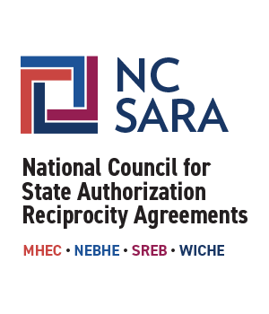
S-SARA RSC Meeting
NC-SARA Updates & Discussion
June 6, 2023
Notes:
MB

Slide 2
Our Time Together
Welcome & NC-SARA Updates: Marianne Boeke
Current and Future Areas of Work: Emily Jacobson
Questions and Discussion
Notes:
MB

Slide 3
NC-SARA Updates
CORE Focus
Board Work
Negotiated Rule Making / Communications with USDE
Notes:
M/B

Slide 4
NC-SARA CORE Work
Support the board, board committees, and task force.
Support the regional compacts, regional steering committees (RSCs), State Portal Entities (SPEs), and institutions.
Facilitate, with the regional compacts & RSCs, the SARA Policy Modification Process.
Monitor federal and state regulatory and policy changes that may impact SARA.
Conduct SARA research and data work (analyzes and shares data from SPEs and SARA-participating institutions).
Improve internal operations.
Notes:
M/B

Slide 5
NC-SARA Board Task Force and Committees
NC-SARA Board
19 board members / 4 board meetings a year
Executive and Finance Committees
Policy Committee
Strategy Committee
Governance and Nominations Committee
Task Force on Consumer Protection
Board Commitment to transparency and engagement
NOTE: Board Member Nominations!
Notes:
M/B

Slide 6
Overview of U.S. Department of Education Draft Regulations Effecting SARA
On Friday May 19, 2023, the U.S. Department of Education released proposed regulations coming out of the spring 2022 negotiated rulemaking sessions. Language that was proposed that would potentially impact State Authorization Reciprocity Agreements (SARA) has been modified since then and now reads:
§ 668.14(32)(iii)
(32) In each State in which the institution is located or in which students enrolled by the institution are located, as determined at the time of initial enrollment in accordance with 34 CFR 600.9(c)(2), the institution must determine that each program eligible for title IV, HEA program funds
(iii) Complies with all State consumer protection laws related to closure, recruitment, and misrepresentations, including both generally applicable State laws and those specific to educational institutions;
Notes:
M/B

Slide 7
Next Steps: U.S. Department of Education Draft Regulations Effecting SARA
Who’s involved?
NC-SARA Board Task Force members
NC-SARA Board Officers
Regional Compact Presidents
Important dates:
June 1, 2023 – Department of Education Draft Regulations and SARA: What To Know (webinar)
June 20, 2023 – The Department accepts public comments until this date
July 2023 - Negotiator nominations due
Notes:
M/B

Slide 8
Update and Discussion: Current Areas of Work
SARA Portal Enhancements and Improvement: SPE Portal Advisory Group, SPE Workshop, dashboard enhancements, IT open office hours, managing bounce backs
Realignment of SARA Institutional Participation Dates
Approaching Changes to Applications and Administrative Forms (e-forms)
Institutional Directory and Changes (the map!!!)
Notes:
Emily

Slide 9
Update and Discussion: Future Areas of Work
Late Fees for Participating Institutions and Communications
SARA Portal Enhancements and Additions: Branch Campuses and IPEDS FTE Number
NC-SARA Auto-Generated Emails to Institutions
Institutional Extensions and Related Processes
NC-SARA Public Facing Website
Notes:
M/B Late Fees, Emily covers rest

Slide 10
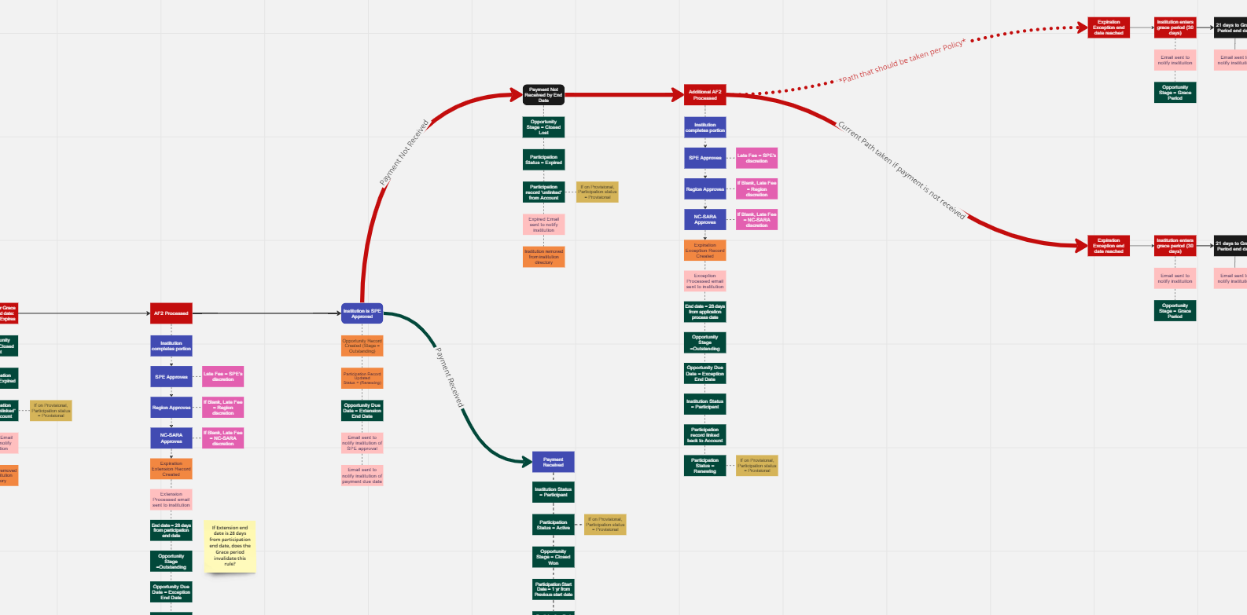
SARA Portal Adventures
Notes:
Emily

Slide 11
Notes:
Both

