Slide 1
Brief History of SREB & SARA
SREB-SARA RSC Meeting
San Juan, Puerto Rico
June 5, 2023

Slide 2
GLOSSARY OF ACRONYMS
RSC – Regional Steering Committee
NC-SARA – National Council for State Authorization Reciprocity Agreements
SARA – State Authorization Reciprocity Agreement
SPE – State Portal Entity
UA – Unified Agreement
MHEC – Midwestern Higher Education Compact
NEBHE – New England Board of Higher Education
SREB – Southern Regional Education Board
WICHE – Western Interstate Commission for Higher Education

Slide 3
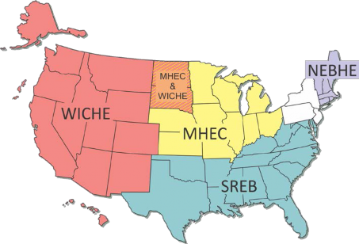
REGIONAL COMPACTS

Slide 4
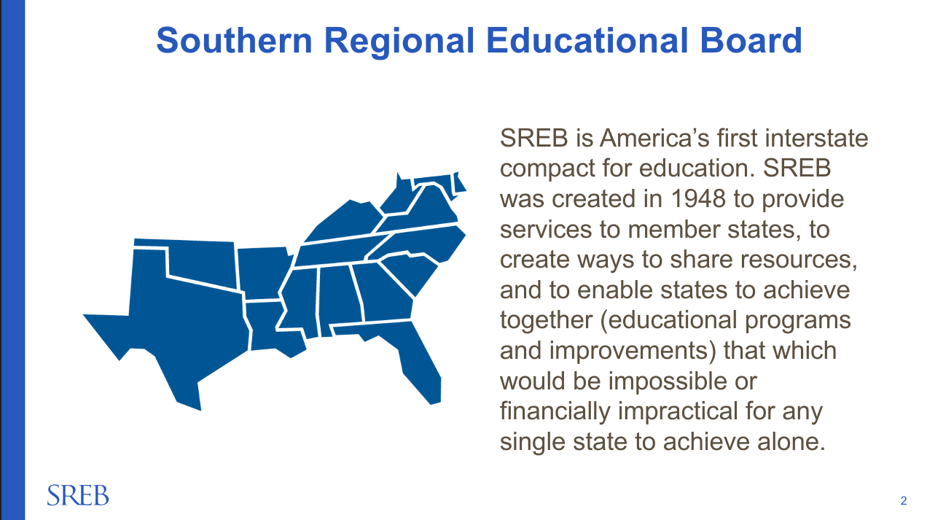

Slide 5
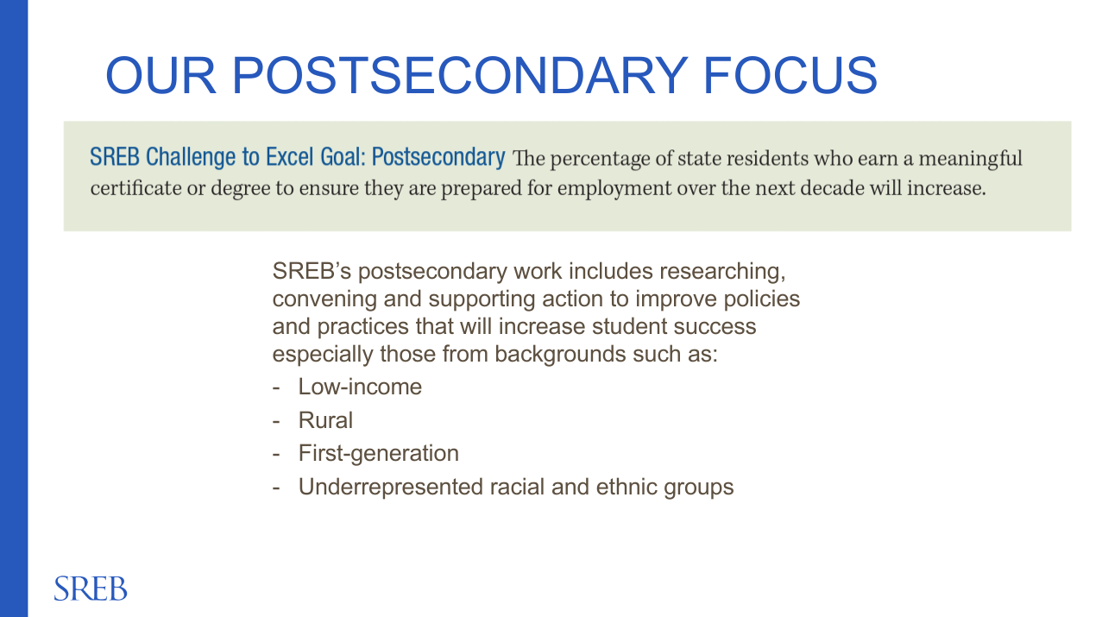

Slide 6
WHAT IS STATE AUTHORIZATION
States require institutions to obtain approval for regulated activities that occur in their state.
These requirements vary by state, and may include, but are not limited to, online learning, practical experiences, faculty in the state, marketing, and advertising.
Compliance with state authorization regulations is also required by the federal government for institutions to be eligible for federal financial aid.

Slide 7
WHAT IS SARA
SARA is a set of agreements between member states, districts, and territories that establishes comparable national standards for interstate distance education program offerings.
These reciprocity agreements help streamline distance education regulations and improve coordination between states and higher education institutions.
They also help ensure member states and participating institutions adhere to a set of common consumer protections for students.
Permits a state to voluntarily and formally participate in SARA.
States join as members, while institutions also voluntarily choose to participate through their home states

Slide 8
WHAT IS SARA
In 2013, higher education stakeholders – including state regulators and education leaders, accreditors, the U.S. Department of Education, and institutions – joined together to establish the State Authorization Reciprocity Agreement (SARA).
In Dec. 2013, NC-SARA was created and states began joining SARA in 2014.
The Unified Agreement (UA), adopted in 2015, establishes the guiding principles of SARA and the framework for SARA’s operational and administrative structure.

Slide 9
WHAT IS NC-SARA
A private, 501(c)(3) nonprofit organization.
Helps expand students’ access to postsecondary educational opportunities and ensure more efficient, consistent, and effective regulation of distance education programs through SARA.
NC-SARA exists to coordinate the SARA work of the regional compacts, ensure that SARA has consistent nationwide coverage, and maximize efficient operations of the SARA initiative.

