Slide 1
SREB State Doctoral Scholars Program Regional Advisory Committee Meeting
Thursday, January 26, 2023
10 am EST

Slide 2
Agenda
Meeting Convenes
Welcome
Introductions
Meeting Context
Annual Status Report
Programmatic
Financial
Benefits and Services
Break
State and Institution Reports
Highlights
Changes
New Topics/Concerns/Open Floor Discussion
Adjourn

Slide 3
Welcome and Introductions
SREB Staff
RAC Committee Members
Invited Guests

Slide 4
SREB-State Doctoral Scholars Program Staff
Dr. Ansley Abraham, Director
Dr. Bob Belle, Special Consultant
Tiffany K. Harrison, Program Specialist
Veda Overton-Houston, Program Accountant
Veronica Johnson, Program Coordinator
Andrea Kiely, Program Specialist
R. Christian Ford, Grant Assistant

Slide 5
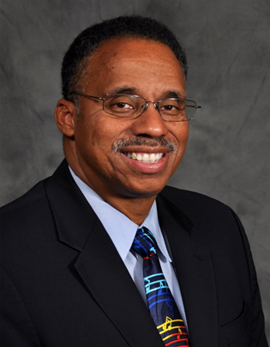
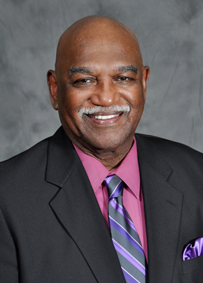
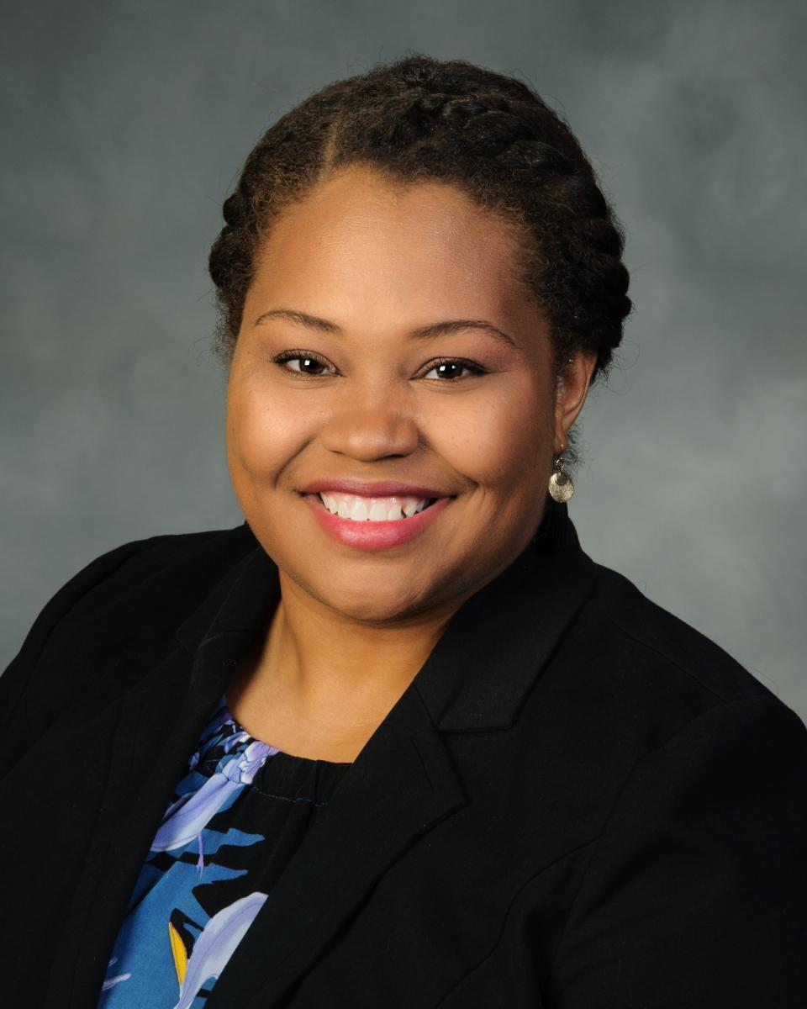
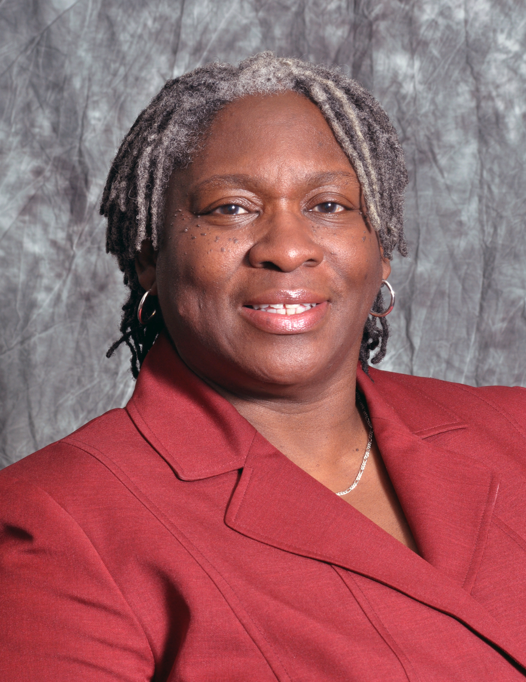
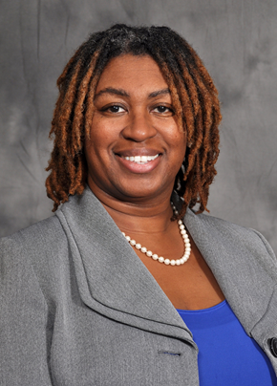
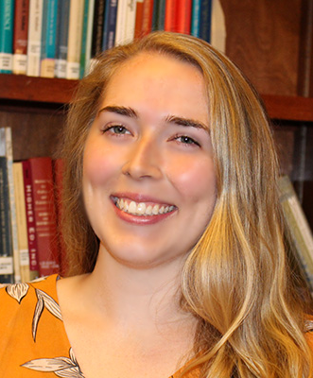
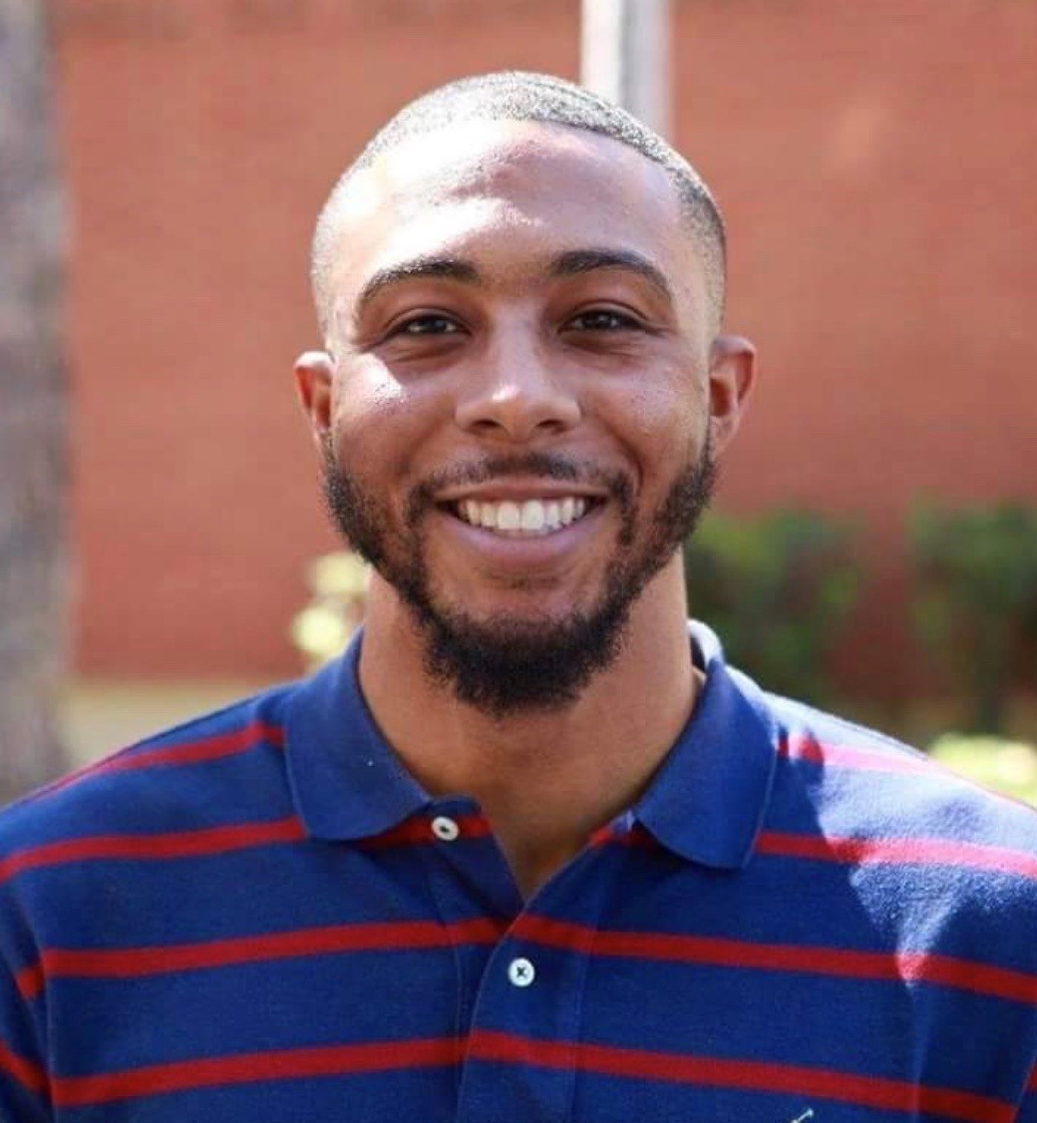
Dr. Ansley Abraham
Dr. Bob Belle
Tiffany K. Harrison
Veda Overton-Houston
Veronica Johnson
Andrea Kiely
Christian Ford

Slide 6
RAC Members and Guests
Jennifer Airey
Charlene Alexander
Lee Andes
Suzanne Barbour
Margaret Cabble
Tamekka Cornelius
Rebecca Corvey
Lisa Covington
Jasmine Crenshaw
Natasha Croom
Michael Cunningham
Karen Dace
NaTashua Davis
Karen DePauw
Tia Dumas
Julius Eason
Mary Farmer-Kaiser
Paul Frazier
Murielle Gammons
Kevin Gibson
Maurice Gipson
Chon Glover
Chrystal Guin
Tabitha Hardy
Taja-Nia Henderson
Elizabeth Hordge-Freeman
Layla Jasper
Tyrel Jernigan
Rana Johnson
Keith Johnson
Tera Jordan
Makini King
Annette Kluck
Jerry Knighton
Robyn Kotzker
Aimee Lay
Elizabeth Manuel
Patrick Mensah
Priscilla Moore
Dawn Offutt
Christopher Perez
Robin Jeanette Phelps-Ward
Bryan Porter
Cleo Price
Ramu Ramachandran
Josue Ramirez
Carrie Robison
David Shafer
Wendy Smooth
Adrienne Stephenson
Carol Sumner
Steve Tauber
Clovier I. Torry
Melissa Tyler
Scott Vignos
Carol Wicks
Robert Wojtowicz
Karen Woodfaulk
Cynthia Wright
Karian Wright
Yolanda Zepeda

Slide 7
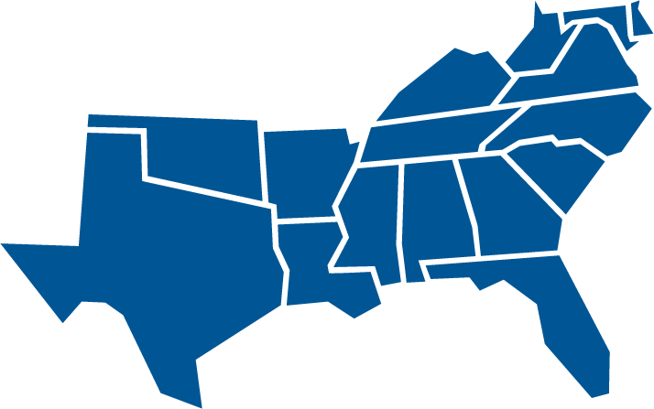
Southern Regional Educational Board State Doctoral Scholars Program
SREB is America’s first interstate compact for education. SREB was created in 1948 to provide services to member states, to create ways to share resources, and to enable states to achieve together (educational programs and improvements) that which would be impossible or financially impractical for any single state to achieve alone.

Slide 8
Annual Status Report - Programmatic
SREB Regional Profile and Statistical Reports
DSP Graduate Profile
Fall 2023 Projections
https://www.sreb.org/2023-regional-advisory-committee-meeting-docs

Slide 9
SREB Statistical Profiles
https://www.sreb.org/statistical-profiles

Slide 10
Annual Status Report - Financial
Operational Budget
Professional Development
Contingency Fund Activity
Donations

Slide 11
Professional Development
The Professional Development fund supports scholars for professional presentations or preparations.
Funds are available based on distributions of up to $500/yr. for a period of 3 years (non-consecutive) for a total of $1,500 (non-cumulative).
Funds reimburse scholars directly with original receipt.
The PD fund was established with a $100K endowment for scholar support.

Slide 12
Contingency Fund
The Contingency Fund was established in 1999.
It is supported using unused Academic Support funds from cycled-out or completed scholars at the end of each fiscal year.
These funds may be distributed to scholars based on request for support when normal program funding mechanisms are not applicable.
Funding requests of $500 or less are at the discretion of the Program Director; request greater than $500 require consultation with the state’s Advisory Committee representative.

Slide 13
Benefits and Services
Institute on Teaching and Mentoring
29th Annual meeting evaluation results
30th Institute on Teaching and Mentoring Celebration Gala
DSP Communications
Application Periods

Slide 14
29th Annual Institute on Teaching and Mentoring – Evaluation Responses
Rate your overall experience at the Institute.
Scholars responded with a score of 4.7 out of 5
The Institute offered useful tips to successfully navigate graduate school.
Scholars responded with a score of 4.0 out of 5
The Institute encouraged me to continue pursuing graduate school.
Scholars responded with a score of 4.0 out of 5
The Institute provided me opportunities to meet other scholars, faculty.
Scholars responded with a score of 4.0 out of 5

Slide 15
30th Annual Institute on Teaching and Mentoring – Celebration Gala
Option A
Institute 30 Year Gala Celebration
July or August 2023
Orlando, FL
Friday: Evening Reception
Saturday: Continental Breakfast, Evening Banquet and Dance
Sunday: Continental Breakfast and Departure

Slide 16
30th Annual Institute on Teaching and Mentoring – Celebration Gala
Option B
Institute 30 Year Gala Celebration
(Same dates as Institute on Teaching and Mentoring)
October 26 – 29, 2023
Tampa, FL
Saturday Evening: Banquet and Dance

Slide 17
30th Annual Institute on Teaching and Mentoring – Celebration Gala
Answer Choices | Option A Responses % | Responses # | Option B Responses % | Responses #
Definitely Would | 26.11% | 88 | 50.00% | 172
Probably Would | 25.22% | 85 | 33.43% | 115
Probably Would Not | 19.88% | 67 | 8.14% | 28
Definitely Would Not | 13.65% | 46 | 3.20% | 11
Will need additional information to decide | 15.13% | 51 | 5.23% | 18

Slide 18
DSP Communications
Webinars
DSP Newsletter
Publications – reports, blogs, briefs
Social Media

Slide 19
Application Period
DSP State Application
January 9 – March 31, 2023
Bob Belle Service Grant Award Application
February 1 – March 31, 2023

Slide 20
Break Time!
Return at 12:30pm

Slide 21
State and Institutional Report Out
Highlights
1 – 3 points regarding DSP at your campus or agency
Changes
Financial, leadership, policy

Slide 22
New Topics and Open Floor
Raising the cap amount on the DSP Fellowship
In-person meetings going forward
Open discussion

Slide 23
Fellowship Cap
Sloan - large sum grants to institutions, grantee institutions determine stipend and fees etc.
Gates – program ended in 2021
McKnight - Florida specific, covers tuition and annual stipend of $12,000
McNair - varies depending on school, often includes tuition and a stipend of $5,000-$25,000
NSF Graduate Research Fellowship - three-year annual stipend of $37,000 plus $12,000 to institution for tuition and fees
NIH – NRSA program, yearly stipend of $26,353 with stipend levels evaluated yearly

Slide 24
Fellowship Cap (cont.)
MARC – large sum grants to institutions, stipend and tuition support but amount varies
GEM - $16,000 stipend for one year plus tuition and fees, must intern with specified employer, additional years stipend is equal to the funding level at that university
Ford – phasing out the program, students cannot accept other awards, 3 years of support, $27,000 stipend, tuition coverage not specified
Hertz - $34,000 yearly stipend plus tuition, can accept and coordinate with other fellowship offers
GFSD - $20,000 stipend plus paid internship for 1-2 summers

Slide 25
Fellowship Cap (cont.)
Bureau of Labor Statistics, Occupational Employment and Wages for Postsecondary TAs
Grad Students’ ‘Fight for $15’

Slide 26
In-Person Meetings
Annual In-Person
Quarterly virtual
Other

Slide 27
Contact Information
Dr. Ansley Abraham, Director
Ansley.Abraham@sreb.org
Tiffany K. Harrison, Program Specialist
Tiffany.Harrison@sreb.org

Slide 28
Thank you for your support!

