Slide 1
SREB State Doctoral Scholars Program Regional Advisory Committee Meeting
February 3 - 4, 2025

Slide 2
Agenda – Day 1
Working Lunch
Meeting Convenes
Welcome
Introductions
Meeting Context
SREB Commission on Artificial Intelligence in Education
Break
Annual Status Report
Programmatic
Financial
Benefits and Services
Adjourn for the day

Slide 3
Welcome and Introductions
SREB Staff
RAC Committee Members
Invited Guests

Slide 4
SREB-State Doctoral Scholars Program Staff
Dr. Ansley Abraham, Director
Dr. Bob Belle, Special Consultant
Tiffany K. Harrison, Program Specialist
Veda Overton-Houston, Program Accountant
Veronica Johnson, Program Coordinator
Andrea Kiely, Program Specialist
Dr. Robert Puckett, Meeting Coordinator
R. Christian Ford, Grant Assistant

Slide 5
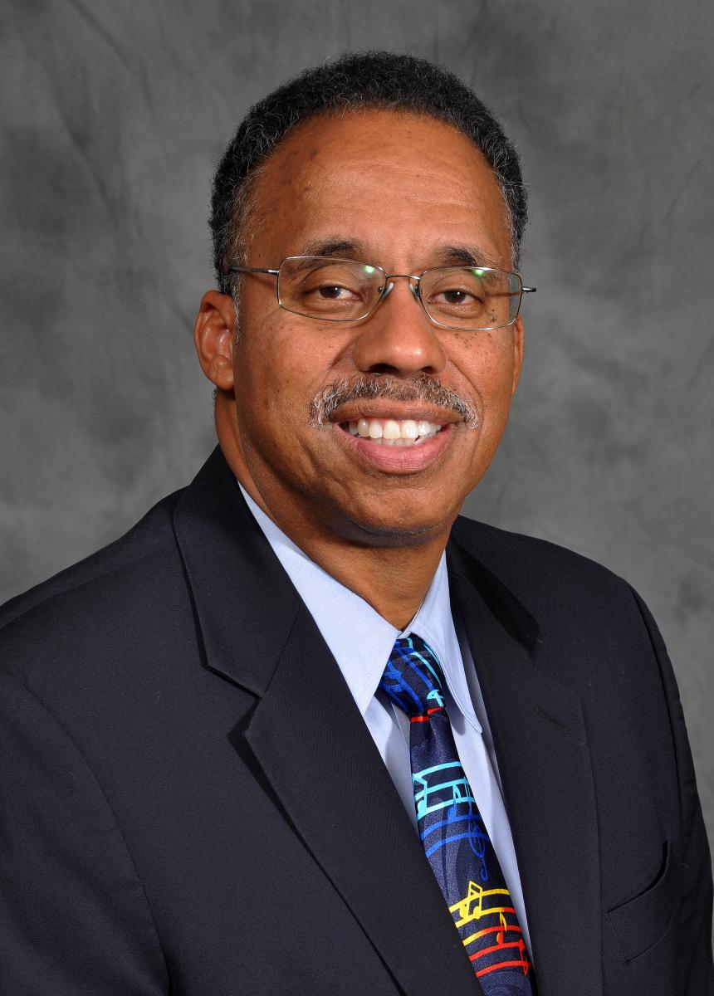
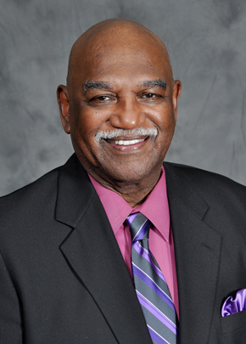
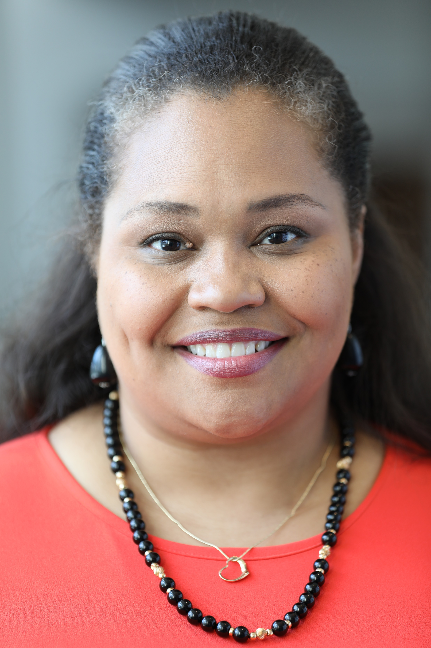
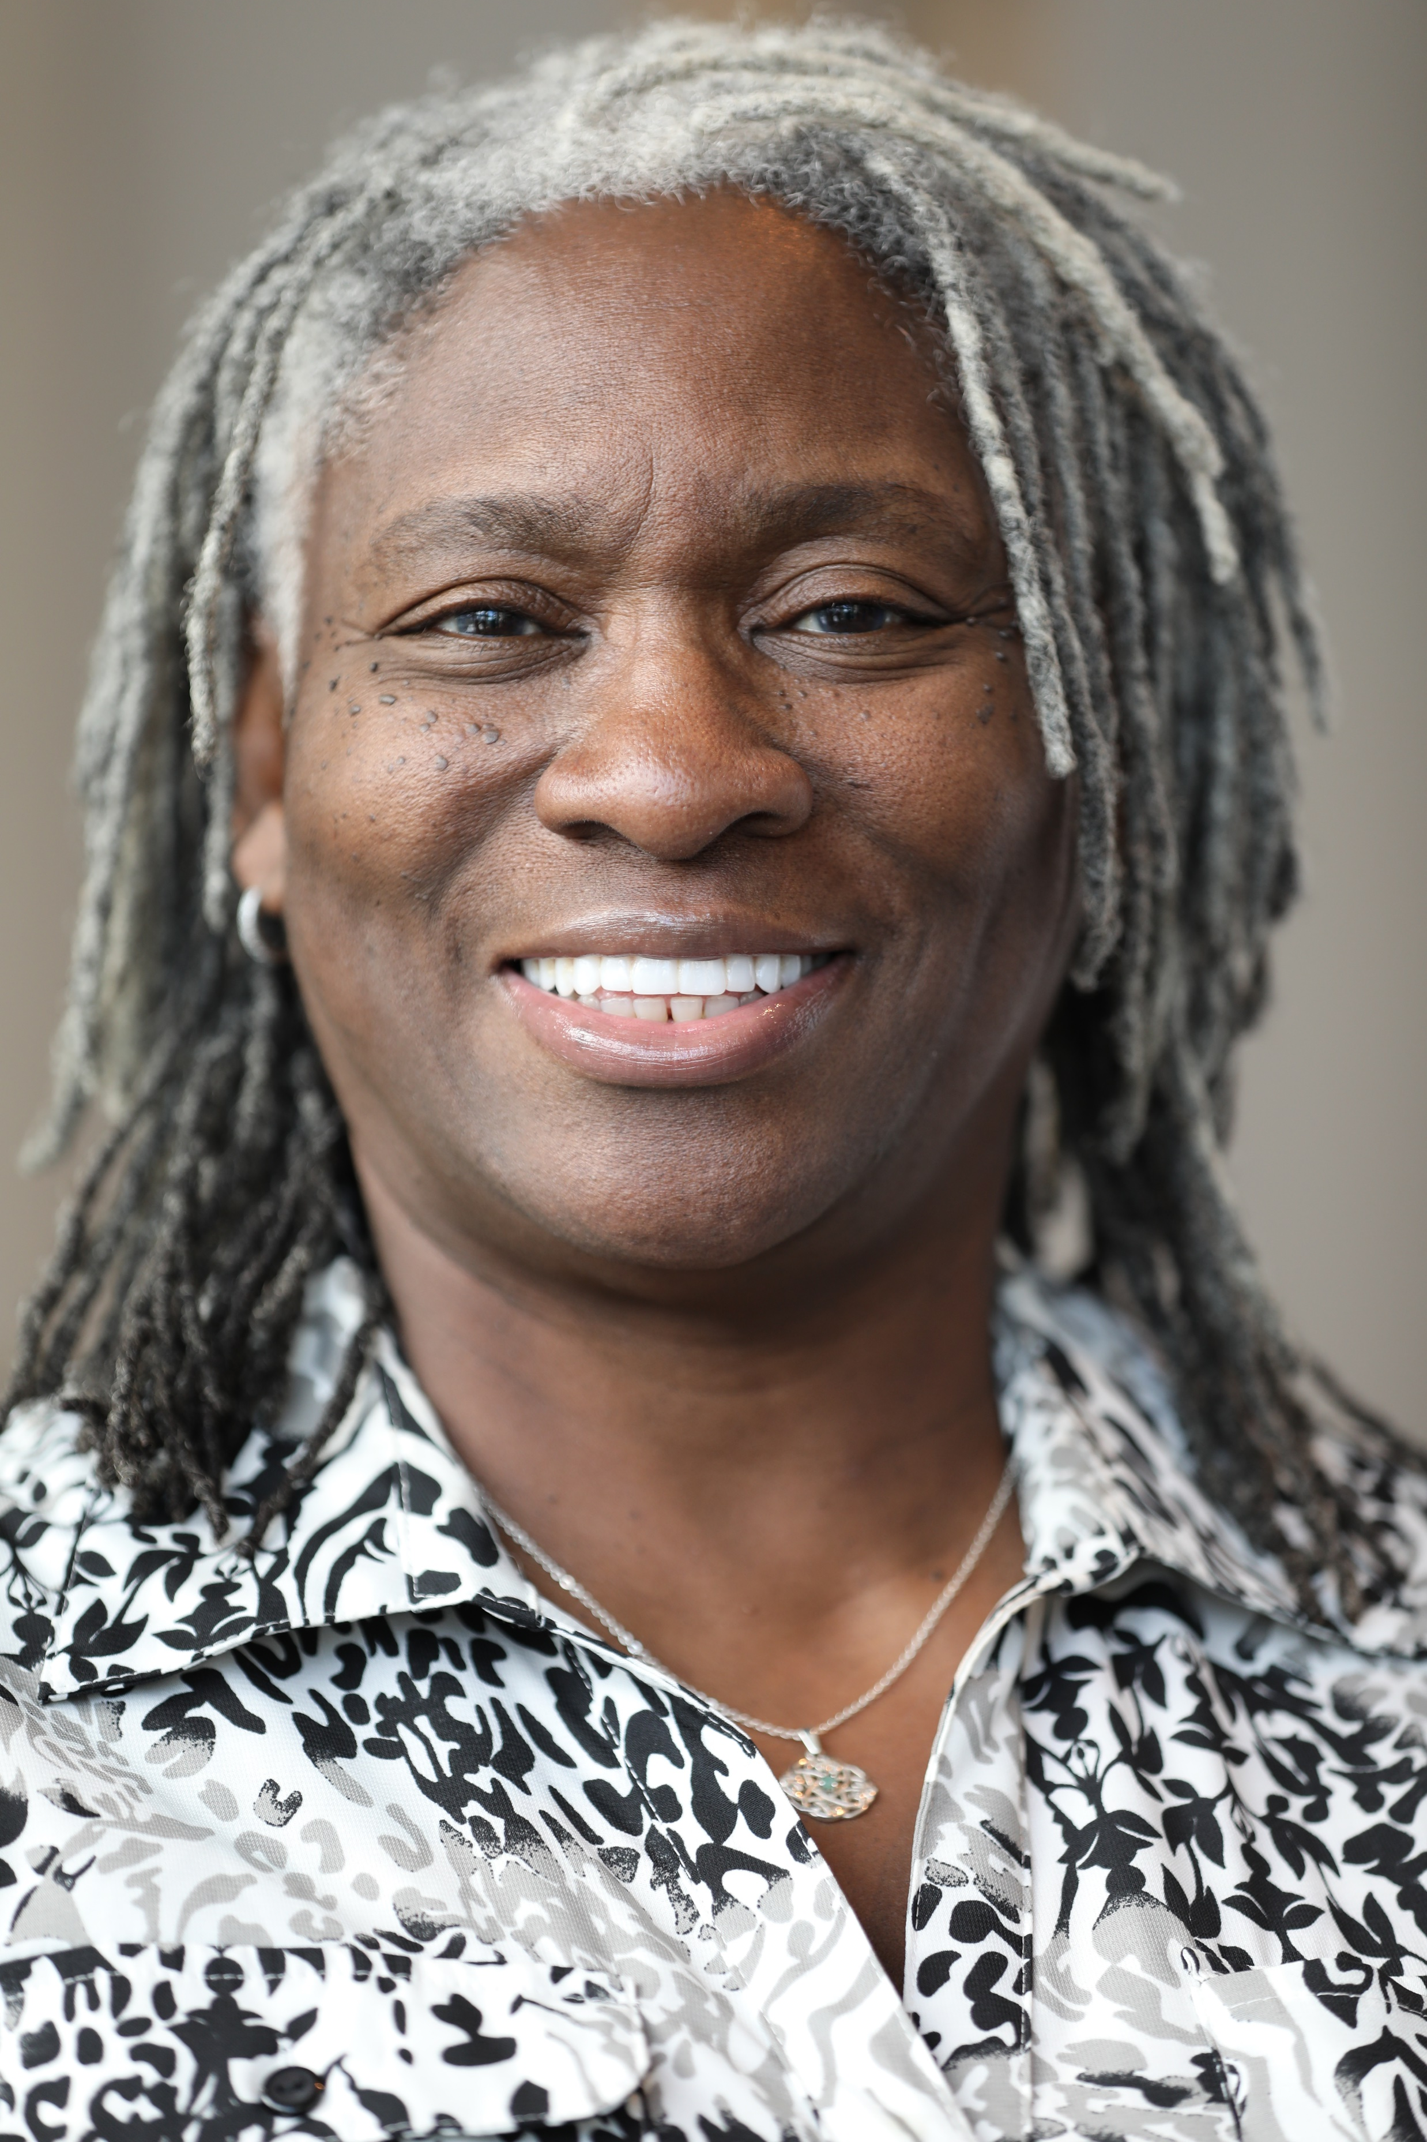
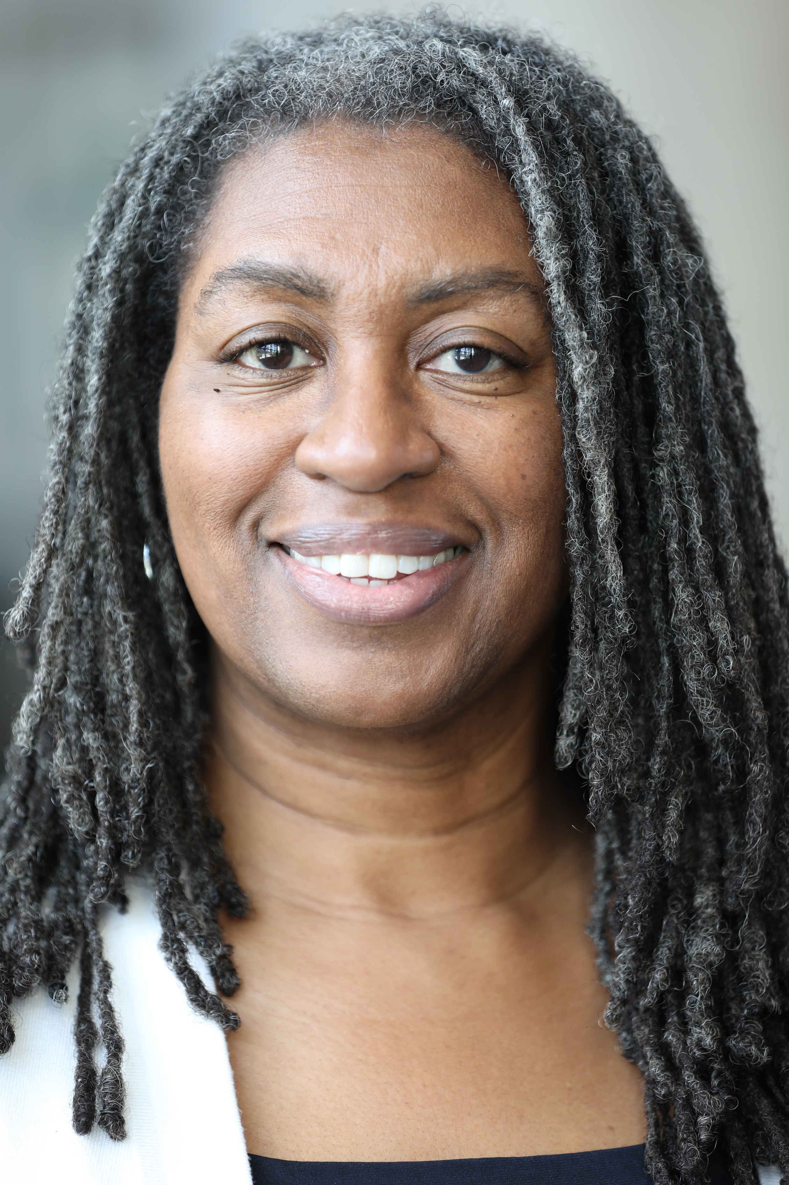
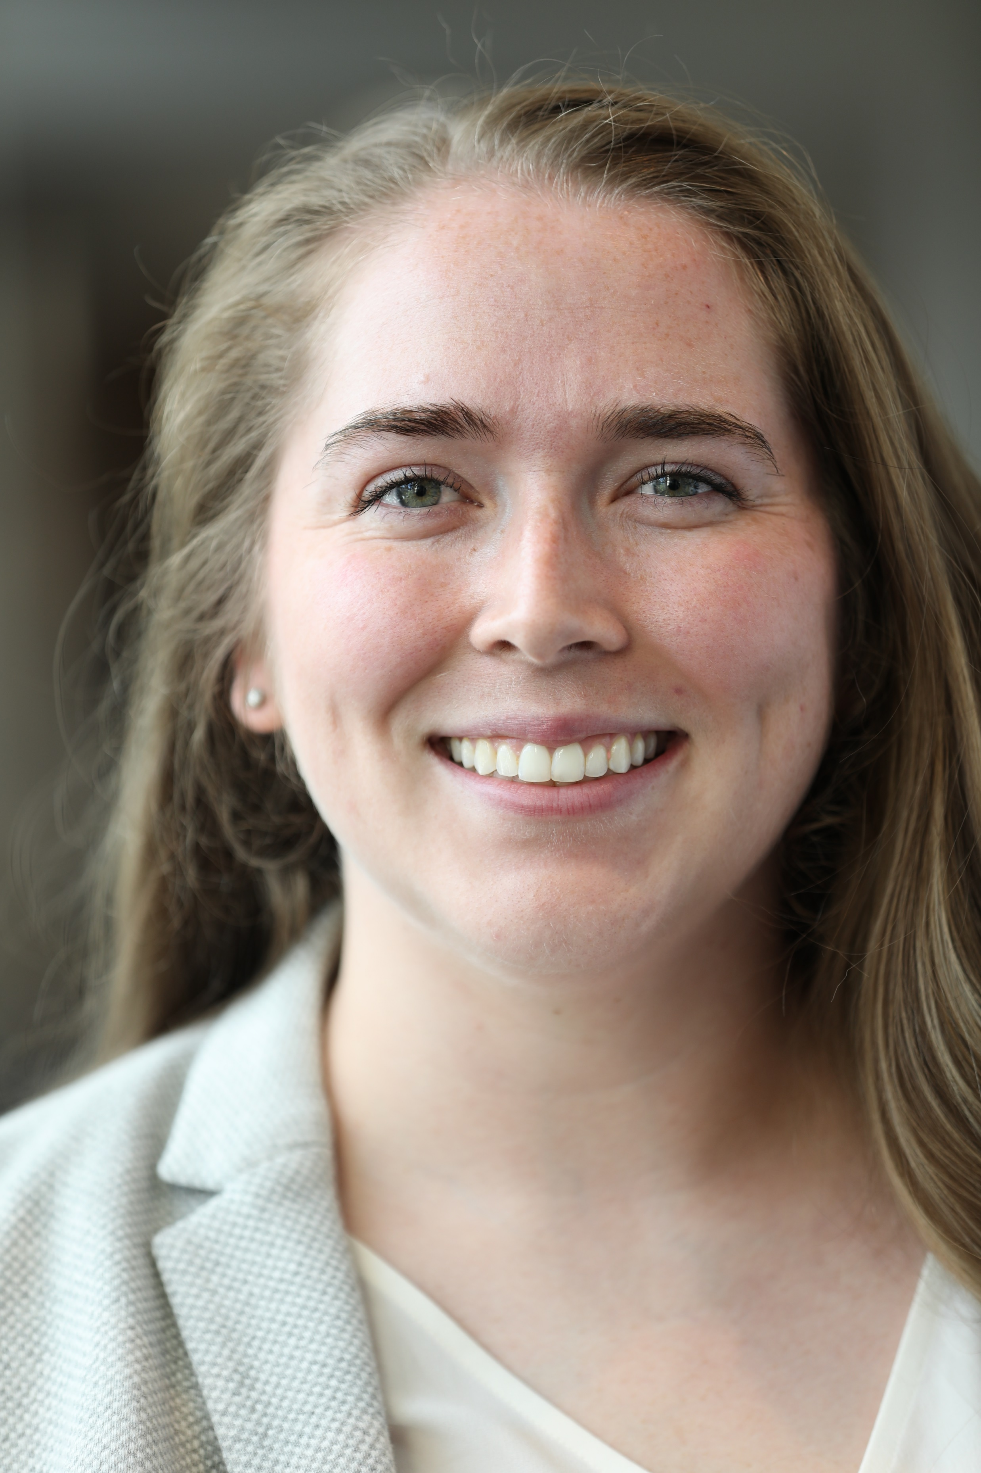
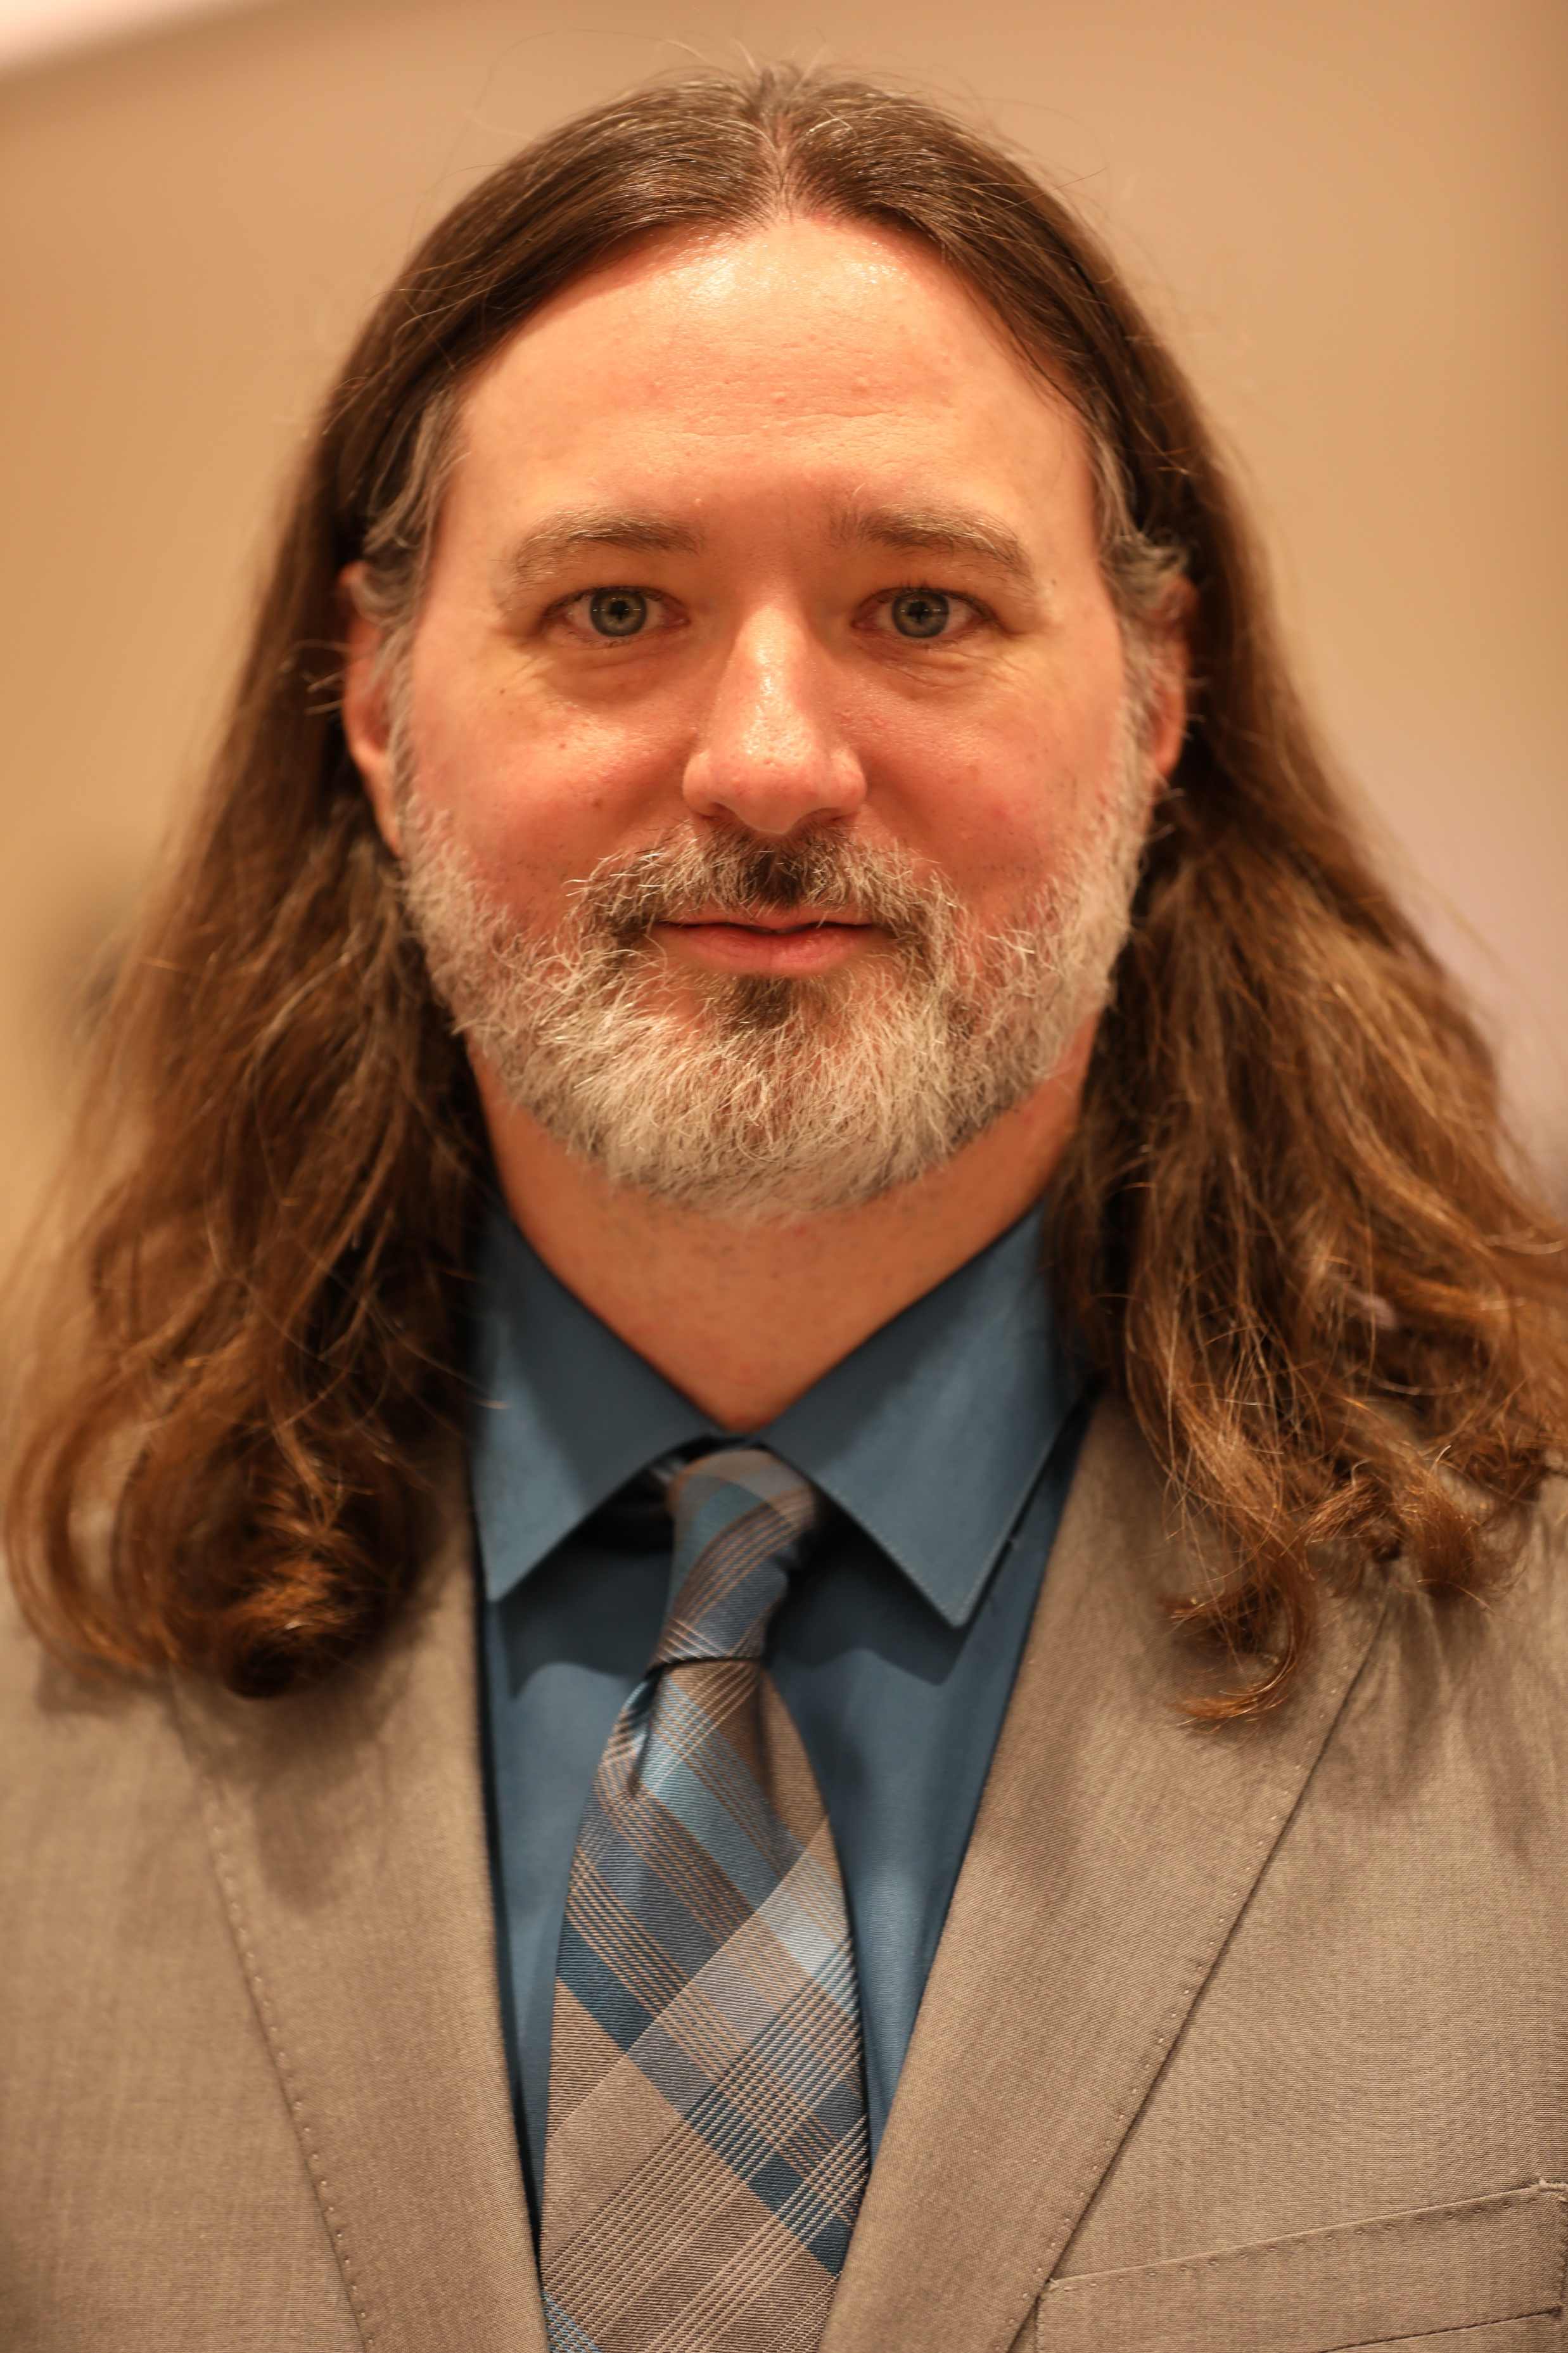
Dr. Ansley Abraham
Dr. Bob Belle
Tiffany K. Harrison
Veda Overton-Houston
Veronica Johnson
Andrea Kiely
Christian Ford
Dr. Robert Puckett

Slide 6
RAC Members
Alabama*
Margaret Cabble, Alabama Commission on Higher Education
Arkansas*
Josue Ramirez, Arkansas Department of Education
Georgia*
Indiana
Mohamadreza Babaee, Indiana University
Karen Dace and Tabitha Hardy, IU – Indianapolis
Kevin Gibson, Purdue University
Robin Phelps-Ward, Ball State University
Kentucky*
Dawn Offut, Council on Postsecondary Education
Louisiana*
Carrie Robison, Board of Regents
Michael Cunningham, Tulane University
Ramu Ramachandran, LA Tech
Mary Farmer-Kaiser, U of L – Lafayette
Patrick Mensah, Southern University
Matthew Calamia, LSU
Maryland*
Robyn Kotzker, University of Maryland
Mississippi
Annette Kluck, University of Mississippi
Delaney Foster, Mississippi State University
Missouri
NaTashua Davis, University of Missouri
Christine Getz, University of Missouri – Kansas City
New Jersey
Taja-Nia Henderson, Rutgers University
New York
Karian Wright, Stonybrook University
North Carolina
Dave Shafer, North Carolina State University
Oklahoma
Caitlin Getchell, University of Tulsa
Oregon
Scott Vignos, Oregon State University
Pennsylvania
Alydia Thomas, University of Pittsburgh
South Carolina*
Karen Woodfaulk, SC Commission on Higher Education
Virginia*
Scott Kemp, State Council of Higher Education for Virginia
Melissa Tyler, Virginia Commonwealth
Philip Trella, University of Virginia
Aimee Surprenant, Virginia Tech
West Virginia*
Matt Turner, West Virginia Higher Education Policy Commission

Slide 7
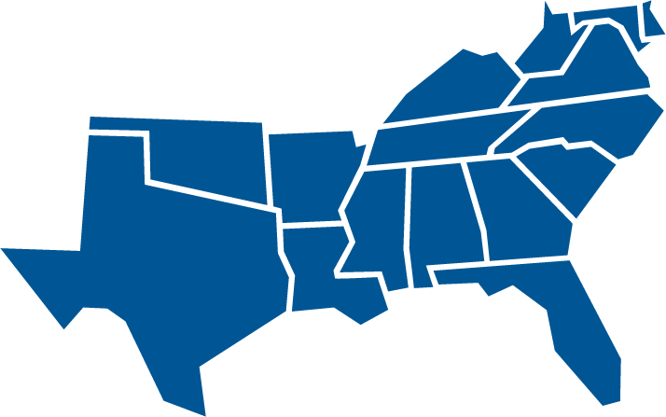
Southern Regional Educational Board State Doctoral Scholars Program
SREB is America’s first interstate compact for education. SREB was created in 1948 to provide services to member states, to create ways to share resources, and to enable states to achieve together (educational programs and improvements) that which would be impossible or financially impractical for any single state to achieve alone.

Slide 8
SREB Commission on Artificial Intelligence in Education
JEFF GAGNE
Director, Policy Analysis
Jeff Gagne joined the Southern Regional Education Board in 2010. He oversees SREB’s policy analysis efforts including the customized biennial state progress reports, policy briefs, reports and state policy support efforts.
Prior to working at SREB, Jeff worked for a governor, a state department of education, and the United States Senate. He earned his Ph.D. from Louisiana State University and has worked in public policy at the state, federal and regional level for three decades.

Slide 9
BREAK TIME

Slide 10
Annual Status Report - Programmatic
SREB Regional Profile and Statistical Reports
DSP Graduate Profile
Fall 2025 Projections
https://www.sreb.org/2025-regional-advisory-committee-meeting-docs

Slide 11
SREB Statistical Profiles
https://www.sreb.org/statistical-profiles

Slide 12
Annual Status Report - Financial
Operational Budget
Professional Development
Contingency Fund Activity
Donations

Slide 13
Operational Budget

Slide 14
Professional Development
The Professional Development fund supports scholars for professional presentations or preparations.
*Funds are available based on distributions of up to $750/yr. for a period of 3 years (non-consecutive) for a total of $2,250 (non-cumulative).
Funds reimburse scholars directly with original receipt.
The PD fund was established with a $100K endowment for scholar support.

Slide 15
Contingency Fund
The Contingency Fund was established in 1999.
It is supported using unused Academic Support funds from cycled-out or completed scholars at the end of each fiscal year.
These funds may be distributed to scholars based on request for support when normal program funding mechanisms are not applicable.
Funding requests of $500 or less are at the discretion of the Program Director; request greater than $500 require consultation with the state’s Advisory Committee representative.

Slide 16
Professional Development and Contingency Fund

Slide 17
Benefits and Services
Institute on Teaching and Mentoring
31st Annual meeting evaluation results
32nd Institute on Teaching and Mentoring
Communications and Marketing
Application Period
Compact 2.0

Slide 18
31st Annual Institute on Teaching and Mentoring
1,006 Attendees
97% Satisfied or Very Satisfied with the Institute Overall (4.75 average rating on 1-5 Scale)
29% were first-time attendees
252 Institutions represented
227 Recruiters representing 97 Organizations were in the Recruiters' Hall
32 concurrent breakout sessions and 4 plenaries
Average of 35 attendees in breakout sessions, with an average rating of 4.7 out of 5
9 sponsoring organizations and 4 Friends of the Institute

Slide 19
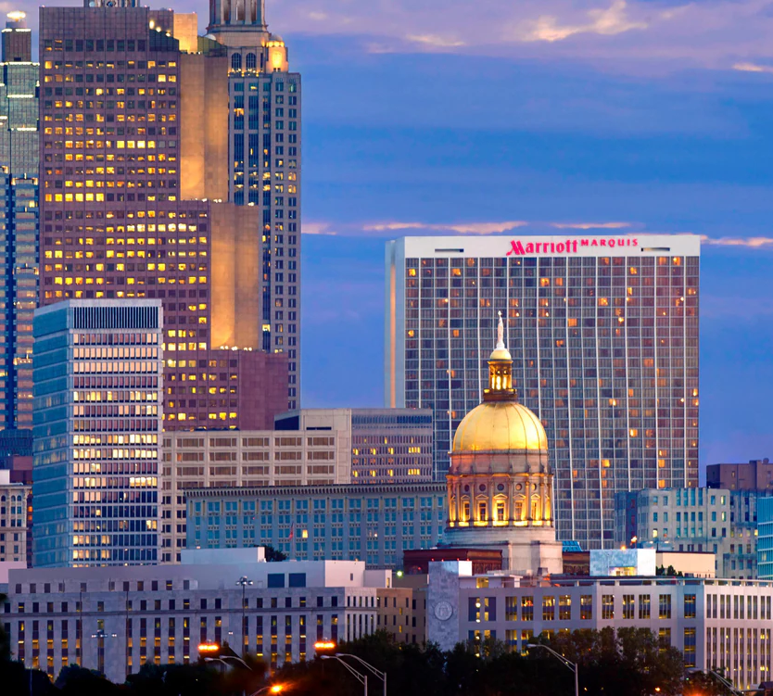
32nd Institute on Teaching and Mentoring
Atlanta Marriott Marquis, October 30 - November 2
Theme: Collective Brilliance: Advancing Research, Mentorship, and Leadership

Slide 20
Communications and Marketing
Webinars
DSP Newsletter
Publications – reports, blogs, briefs
Social Media
Marketing

Slide 21
Application Period
DSP State Application
January 6 – March 31, 2025
Bob Belle Service Grant Award Application
February 17 – March 31, 2025

Slide 22
Grant Award Updates
Sloan Foundation Grant
Compact 2.0
Mellon Foundation Planning Grant

Slide 23
Compact 2.0
History
What is Compact 2.0?
New version of the original compact that started Doctoral Scholars
Who is participating
All regional compact boards: NEBHE, WICHE, MHEC and SREB
Current status and future plans
Questions and Ideas

Slide 24
Adjourn for the Day
Meet us for dinner:
Puttshack Atlanta-Midtown
1115 Howell Mill Rd
Atlanta, GA 30318

Slide 25
Agenda – Day 2
What’s New at SREB (Working Breakfast)
SREB Leadership
State and Institution Reports
Highlights
Changes
Break
Supreme Court Decisions and the Impact on Graduate Education
New Topics/Open Floor Discussion
Adjourn (Box lunch)

Slide 26
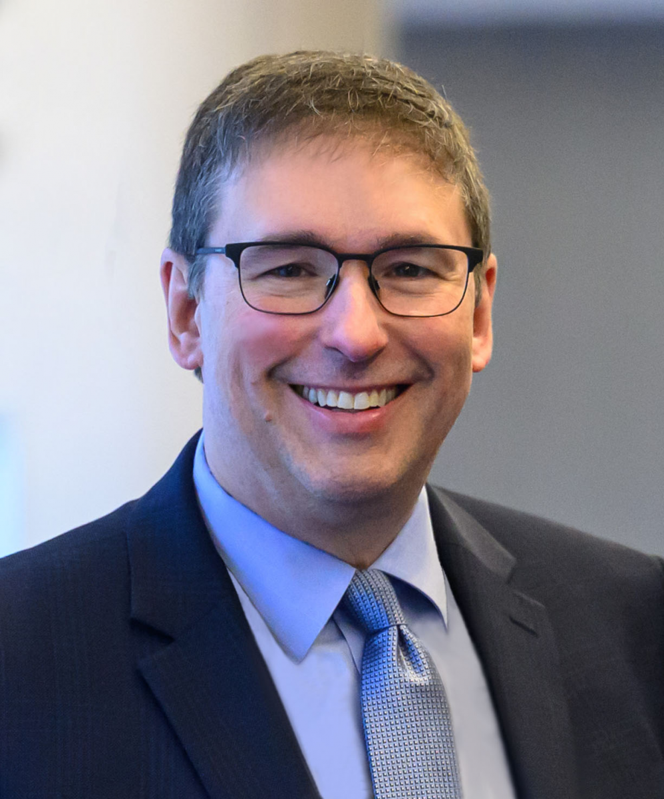
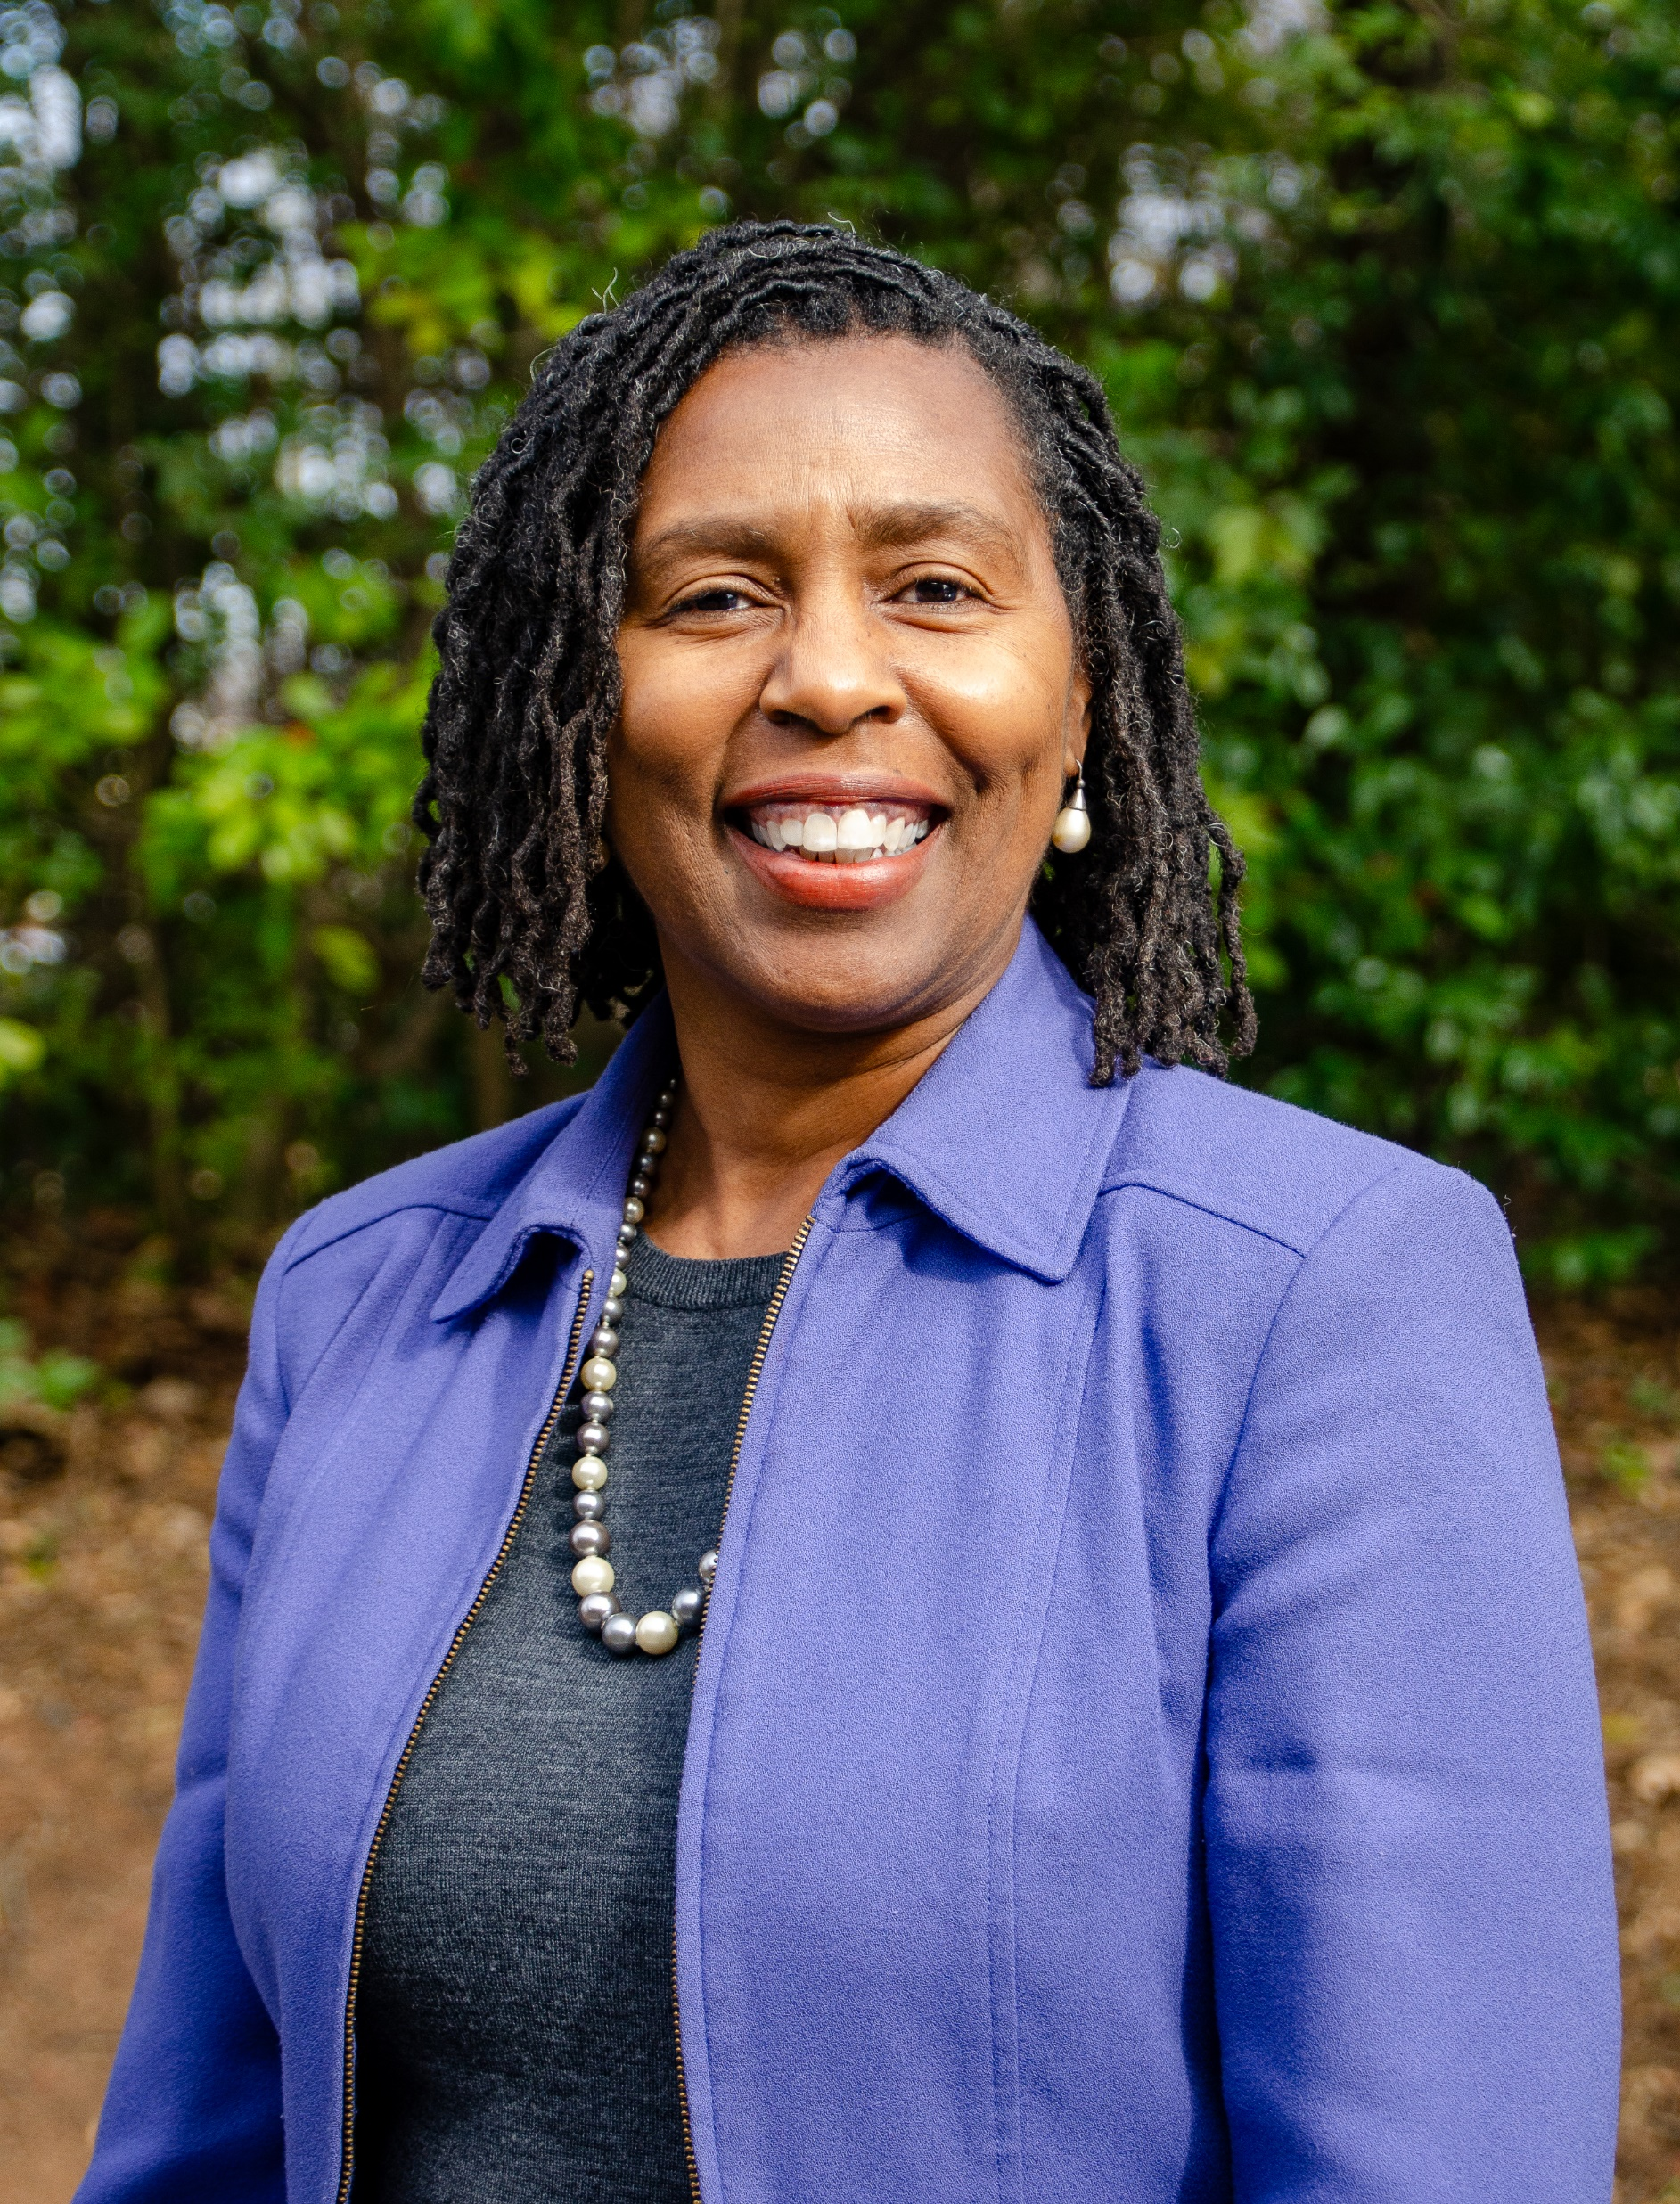
What’s New at SREB
Stephen Pruitt, President
Harriette Scott, VP Postsecondary Education

Slide 27
State and Institutional Report Out
Highlights
1 – 3 points regarding DSP at your campus or agency
Changes
Financial, leadership, policy

Slide 28
BREAK TIME

Slide 29
Critical Considerations in the Current Political Climate (See Discussion Guide)

Slide 30
New Topics and Open Floor
Change to Annual Meeting
Graduate students and unions
Open discussion

Slide 31
Contact Information
Dr. Ansley Abraham, Director
Ansley.Abraham@sreb.org
Tiffany K. Harrison, Program Specialist
Tiffany.Harrison@sreb.org

Slide 32
Thank you for your support!

