Slide 1
Financial Reviews for S-SARA RSC Members
Presentation by Phil Embry on behalf of the Georgia Nonpublic Postsecondary Education Commission

Slide 2
Introduction
I'm a contract External Auditor/Consultant for GNPEC
I'm not a CPA
I've worked in banking, state auditing and state tax administration for 40 years; retiring from GDOR in 2010.
I've worked for GNPEC for 13 years and developed their Financial Viability Program which I'll explain shortly.
That's who I am, how many of you have experience in analyzing financial reports and audits for educational institutions?

Slide 3
Financial Viability Assessments
This Photo by Unknown Author is licensed under CC BY-SA

Slide 4
Overview of FVA Process
The Financial Viability Program in Georgia consists of reviewing Financial Statements (P/L and Bal Sheets) and CPA Audits of the authorized institutions.
This program was developed to assess an institution's financial strengths and weaknesses annually to determine if they can continue to operate.
After the review is complete, we grade them as Low, Moderate or High Financial Monitoring (LFM, MFM or HFM)

Slide 5
FVA Process
The primary financial elements to review are:
BS - Asset to Liability Ratio (Total Assets/Total Liabilities) +1.5 - good
BS - Cash to Liability Ratio (Cash + AR/Current Liabilities) +.75 - good
BS – Equity (Net assets after all assets are liquidated and debts paid)
P/L - Profit or Loss
These elements are found in Financial Statements or an Audit of the institution.
See examples on following slides of a sample Audit and FVA

Slide 6
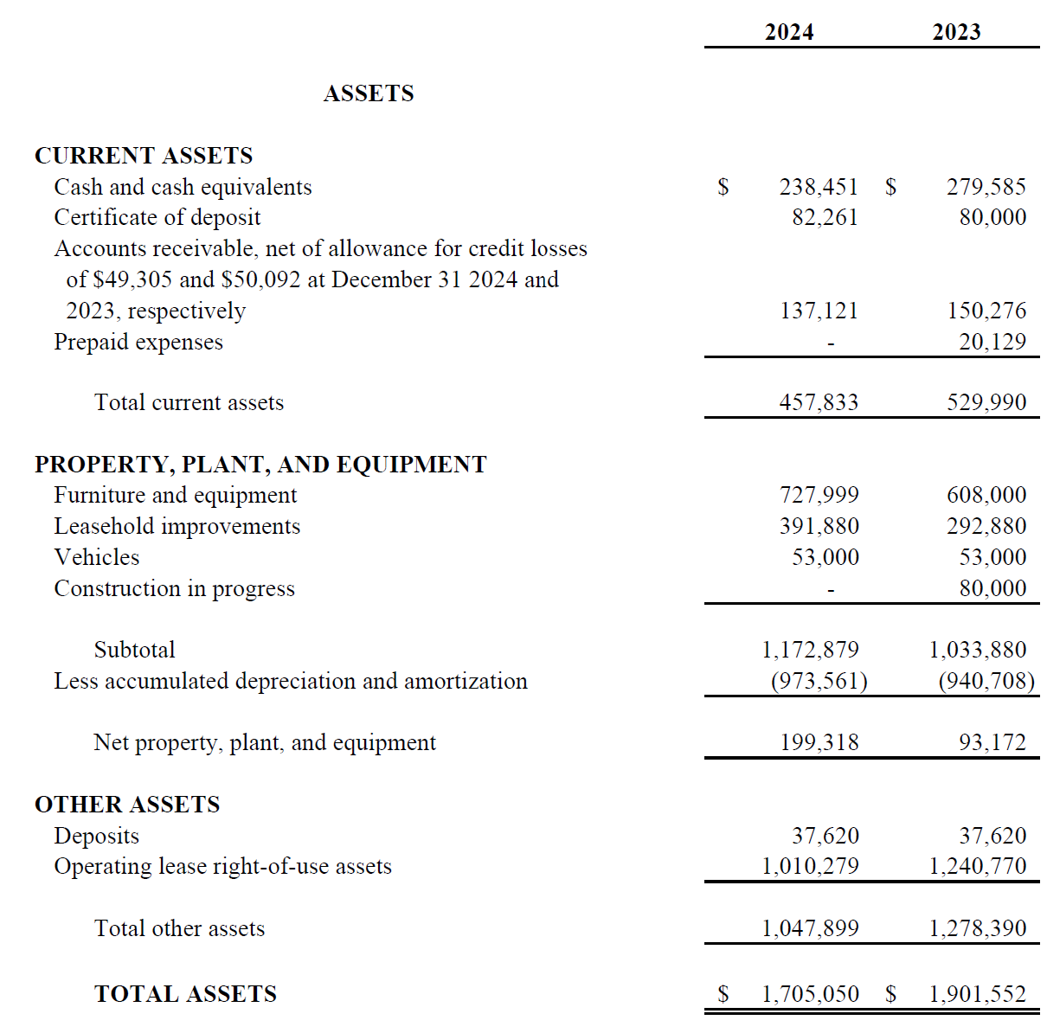
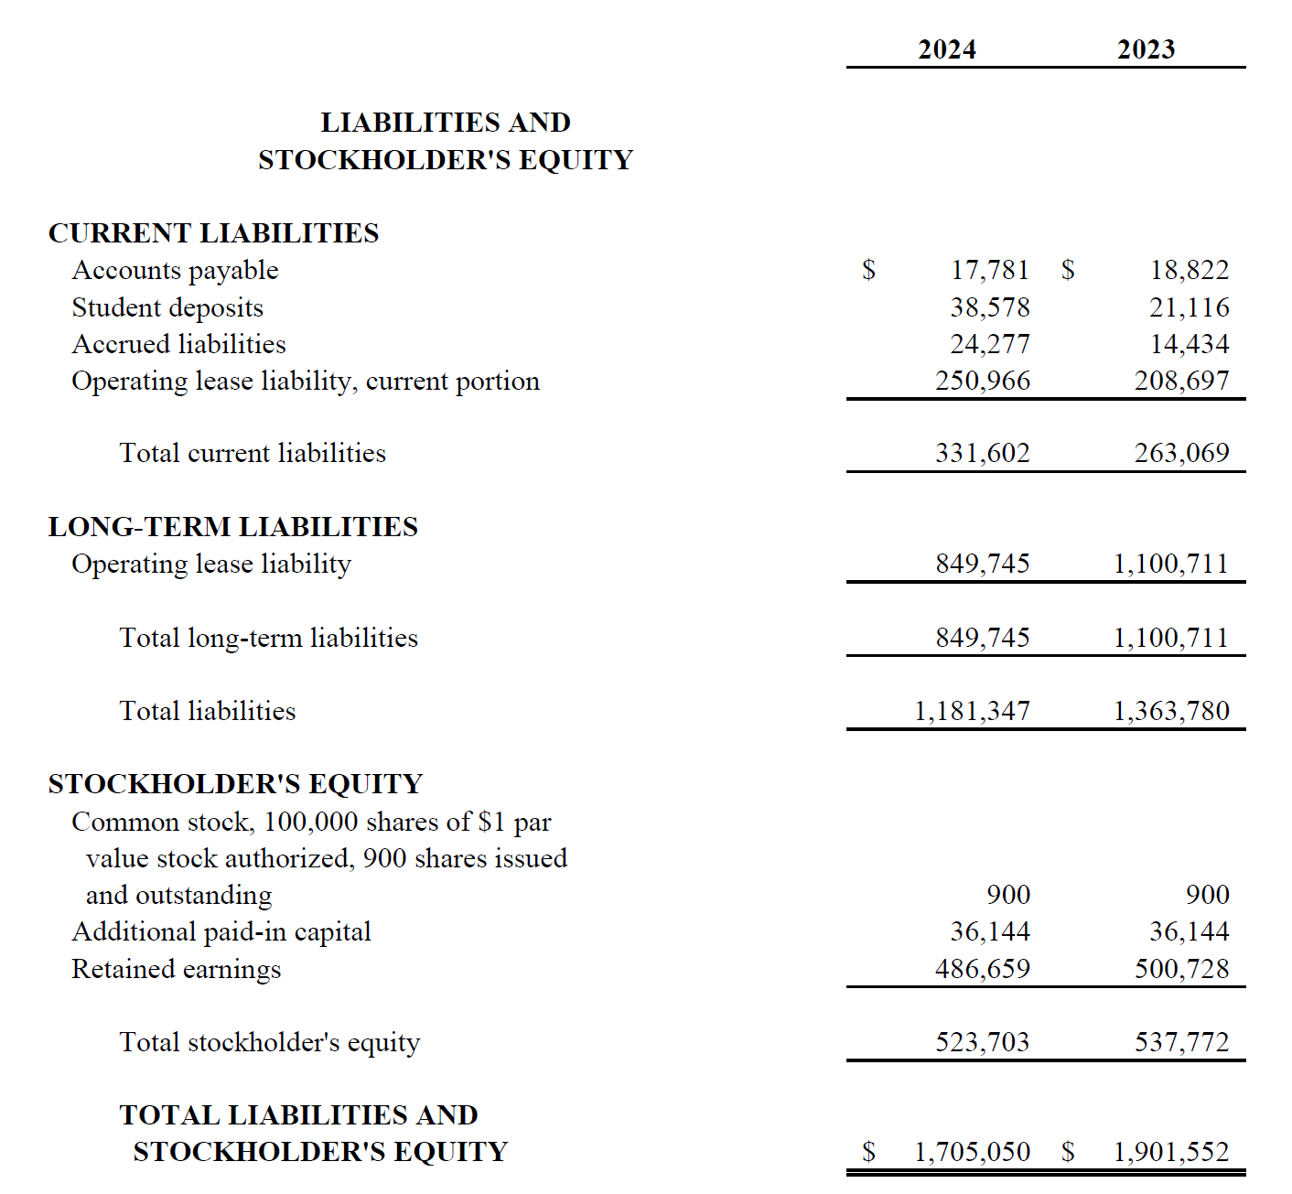
Example of Balance Sheet

Slide 7
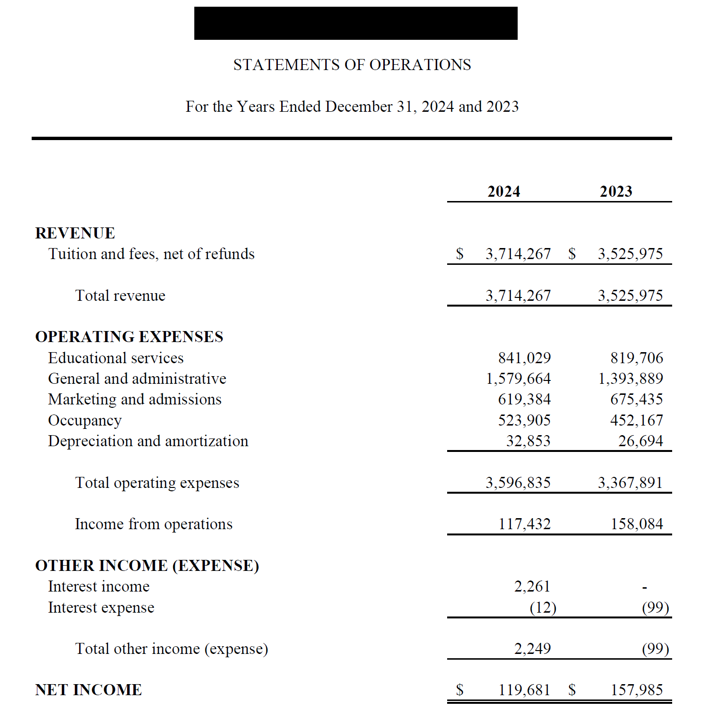
Example of
Profit-Loss
Statement

Slide 8
GNPEC Financial Viability Assessment (FVA)

Slide 9
See handout for example of FVA

Slide 10
Red Flags to give Fuller Picture
Things to investigate:
AL ratio under 1.0 or Cash ratio under .5
Losses for two or more years and Equity that can't sustain losses
Debt that supports non-capital projects (operations)
Composite Score lower than 1.5 (more on that later)
Investments (stock) that exceeds 50% of Total Assets or Equity
This Photo by Unknown Author is licensed under CC BY

Slide 11
Financial Monitoring Status
Low Financial Monitoring – no significant issues found
Moderate Financial Monitoring – 2 or more issues found
Requires Financial Improvement Plan (FIP)
High Financial Monitoring – 2 or more issues still present and little progress on FIP
Requires updated FIP and Bond or Letter of Credit (LOC)
Questions on FVA Process?

Slide 12
Composite Scores
This Photo by Unknown Author is licensed under CC BY

Slide 13
Calculating Composite Scores
The Composite Score was introduced by USDOE in 1997 to standardize the evaluation of an institution's financial strength.
There are 3 ratios used to calculate the Composite Score, each are then given a "strength factor" and a "weight factor" to differentiate among for profit and non-profit institutions.
Primary Reserve Ratio (the most complicated)
Equity Ratio
Net Income Ratio

Slide 14
Primary Reserve Ratio
Total Equity
Less Goodwill
Less Intangible assets
Less unsecured receivables (assets)
Less pre and post implementation assets (Right of Use or ROU lease)
Less property, plant and equipment (PP&E)
Plus pre and post implementation debt (capped to PP&E)
Plus pre and post implementation lease liabilities (capped to ROU assets)
Total Adjusted Equity/ Total Expenses = Primary Reserve Ratio

Slide 15
Equity Ratio = Total Equity/Total Assets
Total Equity
Less Goodwill
Less Intangible assets
Less unsecured related party receivables
Less pre and post implementation assets
Plus pre and post Implementation liabilities
Total Assets
Less Goodwill
Less Intangible assets
Less unsecured related party receivables
Less pre and post implementation assets
Plus pre and post implementation Liabilities

Slide 16
Net Income Ratio
Income Before Taxes/ Total Revenues
This is the simplest calculation

Slide 17
Difference with For-Profit and Non-Profit Financials
The calculation of Composite Scores among these two types of institutions differ in the strength and weight factors.
The formulas and ratios are the same
The floors are also the same [(1) and 3] after strength factor is applied

Slide 18
For-Profit Strength and Weight Factors
Primary Reserve Ratio x 20 x 30% = Adjusted PR ratio
Equity Ratio x 6 x 40% = Adjusted Equity ratio
Net Income Ratio (33.3 +1) x 30% - Adjusted Net Income ratio
Each ratio has a Strength floor of (1) or 3
If any result is lower than (1) or above 3, then use the floor
If the PRR x 20 > 3, Use 3 x 30%
If the ER x 6 < (1), use (1) x 40%

Slide 19
Non-Profit Strength and Weight Factors
Primary Reserve Ratio x 10 x 40% = Adjusted PR ratio
Equity Ratio x 6 x 40% = Adjusted Equity ratio
Net Income Ratio (25/50 +1) x 20% - Adjusted Net Income ratio
Use 25 if NIR is negative and 50 if NIR is positive
Each ratio has a Strength floor of (1) or 3
If any result is lower than (1) or above 3, then use the floor
If the PRR x 20 > 3, Use 3 x 30%
If the ER x 6 < (1), use (1) x 40%

Slide 20
Summary of Ratios
Once the Adjusted ratios are calculated, then add each of the 3 ratios together.
Before adding them, round up to the nearest 100th
E.g., .0965 should be rounded to .097
After they are added together, round to the nearest 10th
E.g., .097 + .737 + .622 = 1.456 or 1.5
This institution has a 1.5 Composite Score
See a redacted example of a CPA calculated Composite Score

Slide 21
Composite Score Example – Atlanta Institute of XYZ

Slide 22
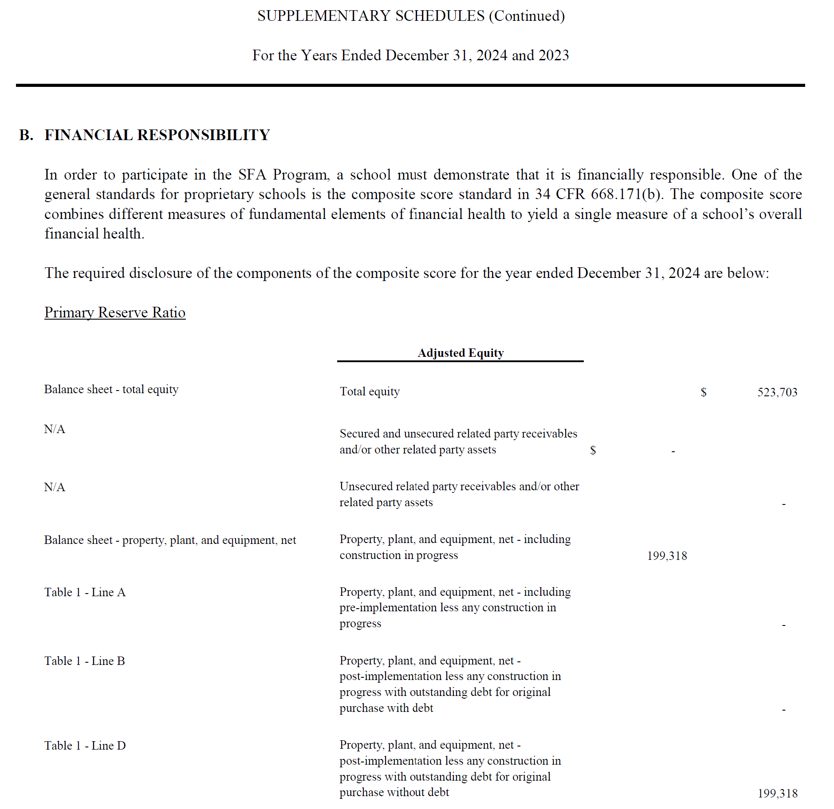

Slide 23
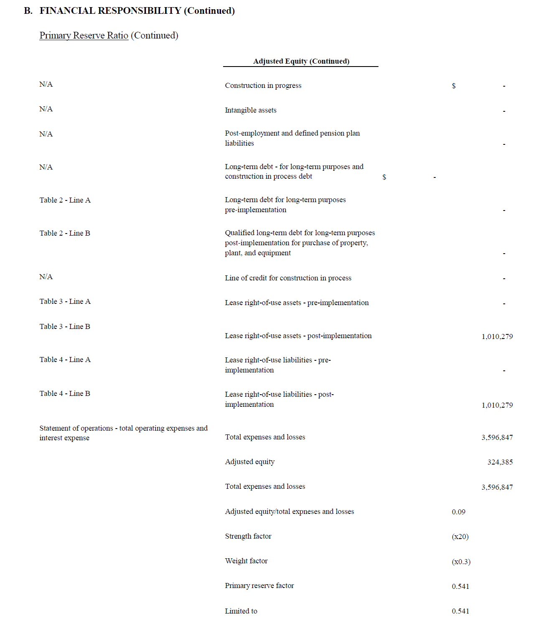

Slide 24
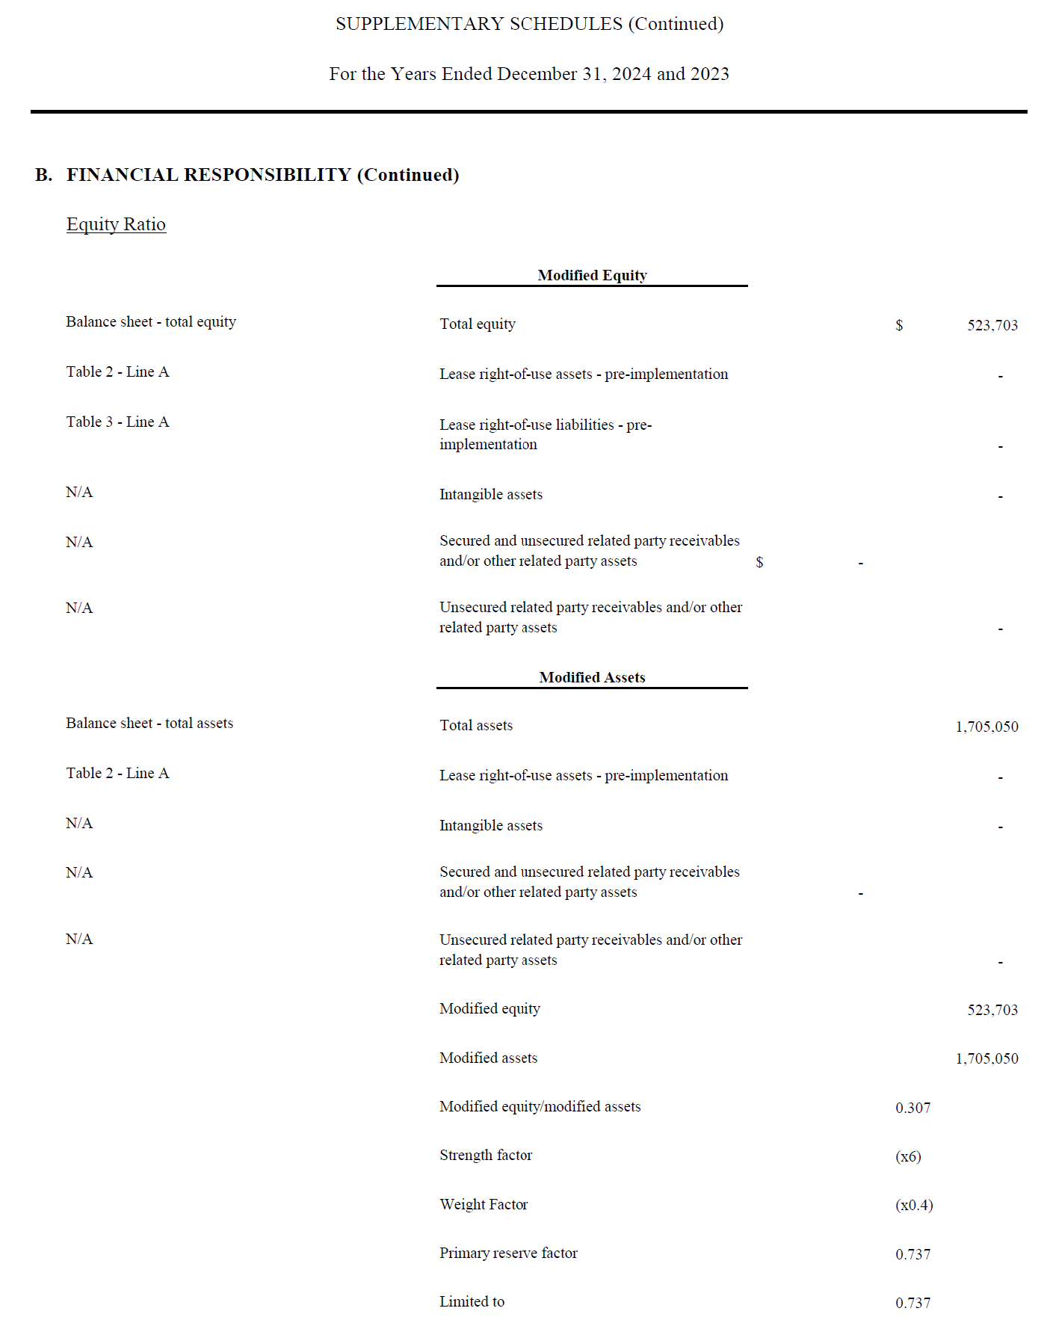
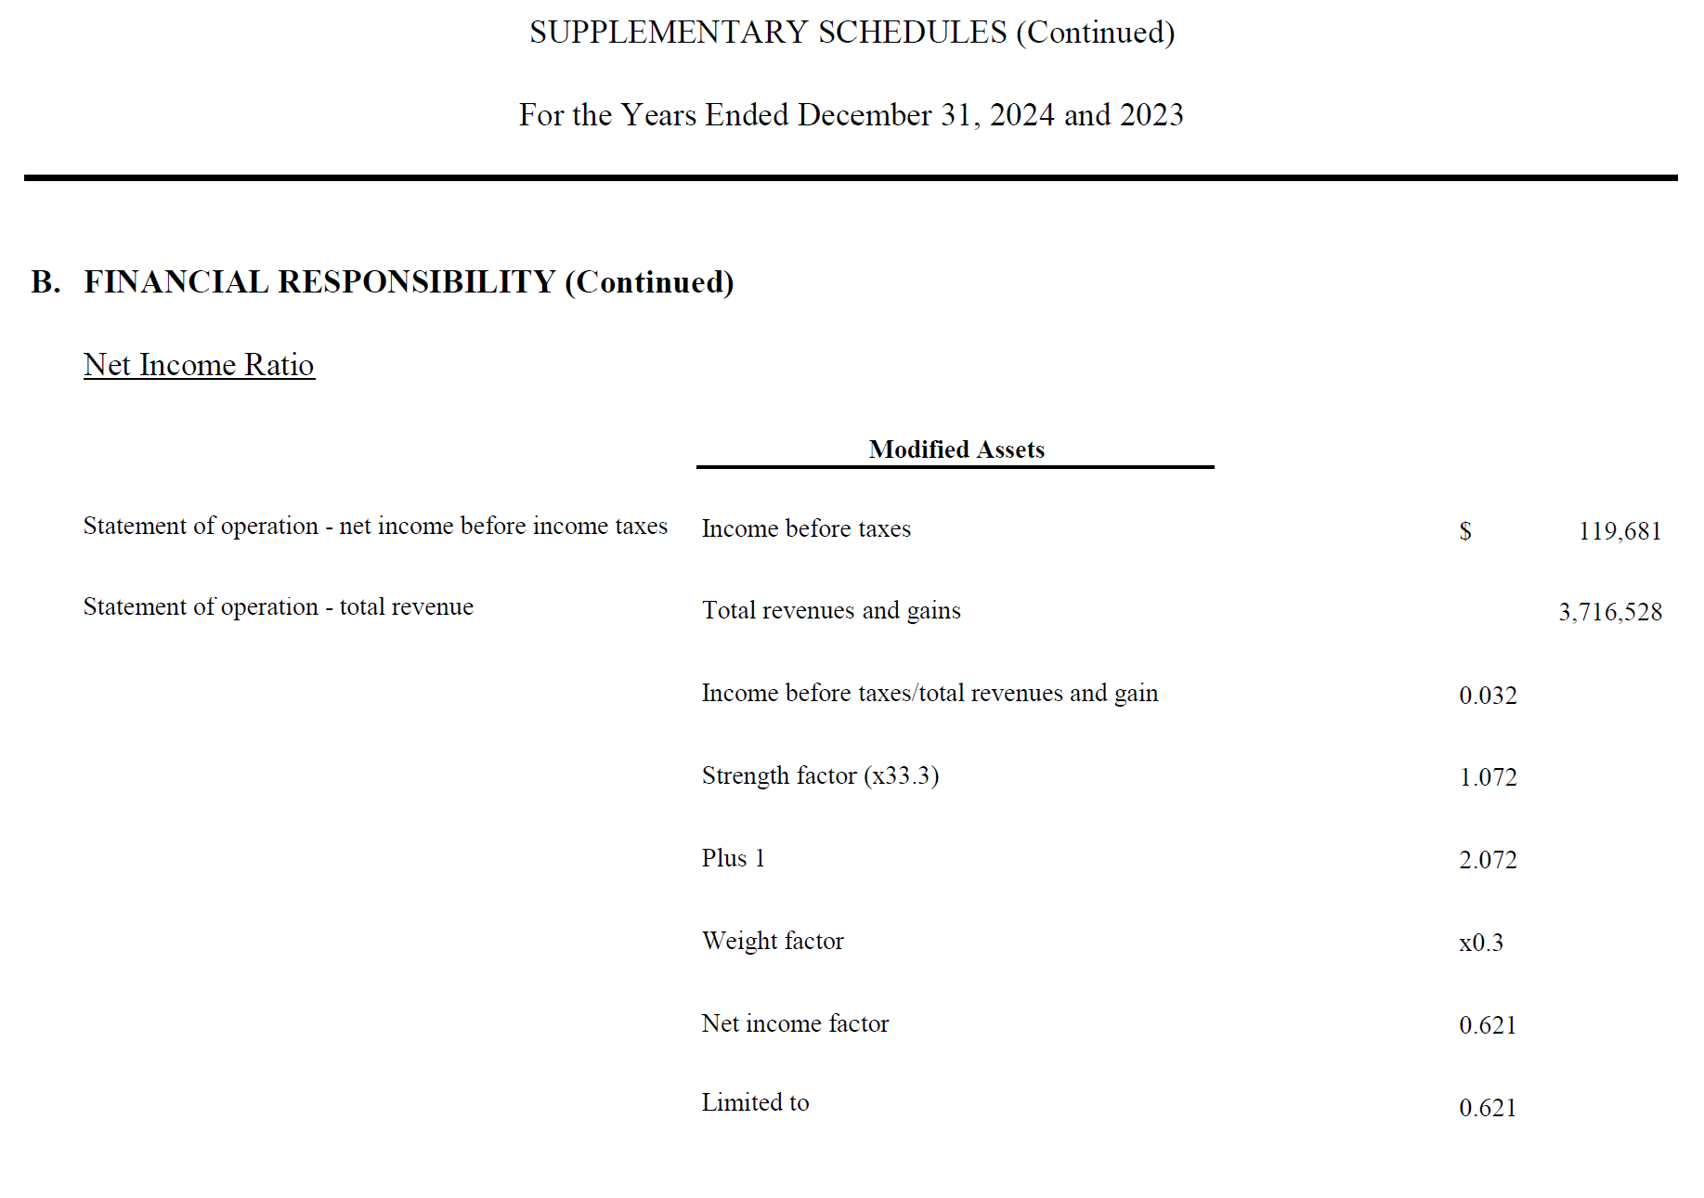

Slide 25
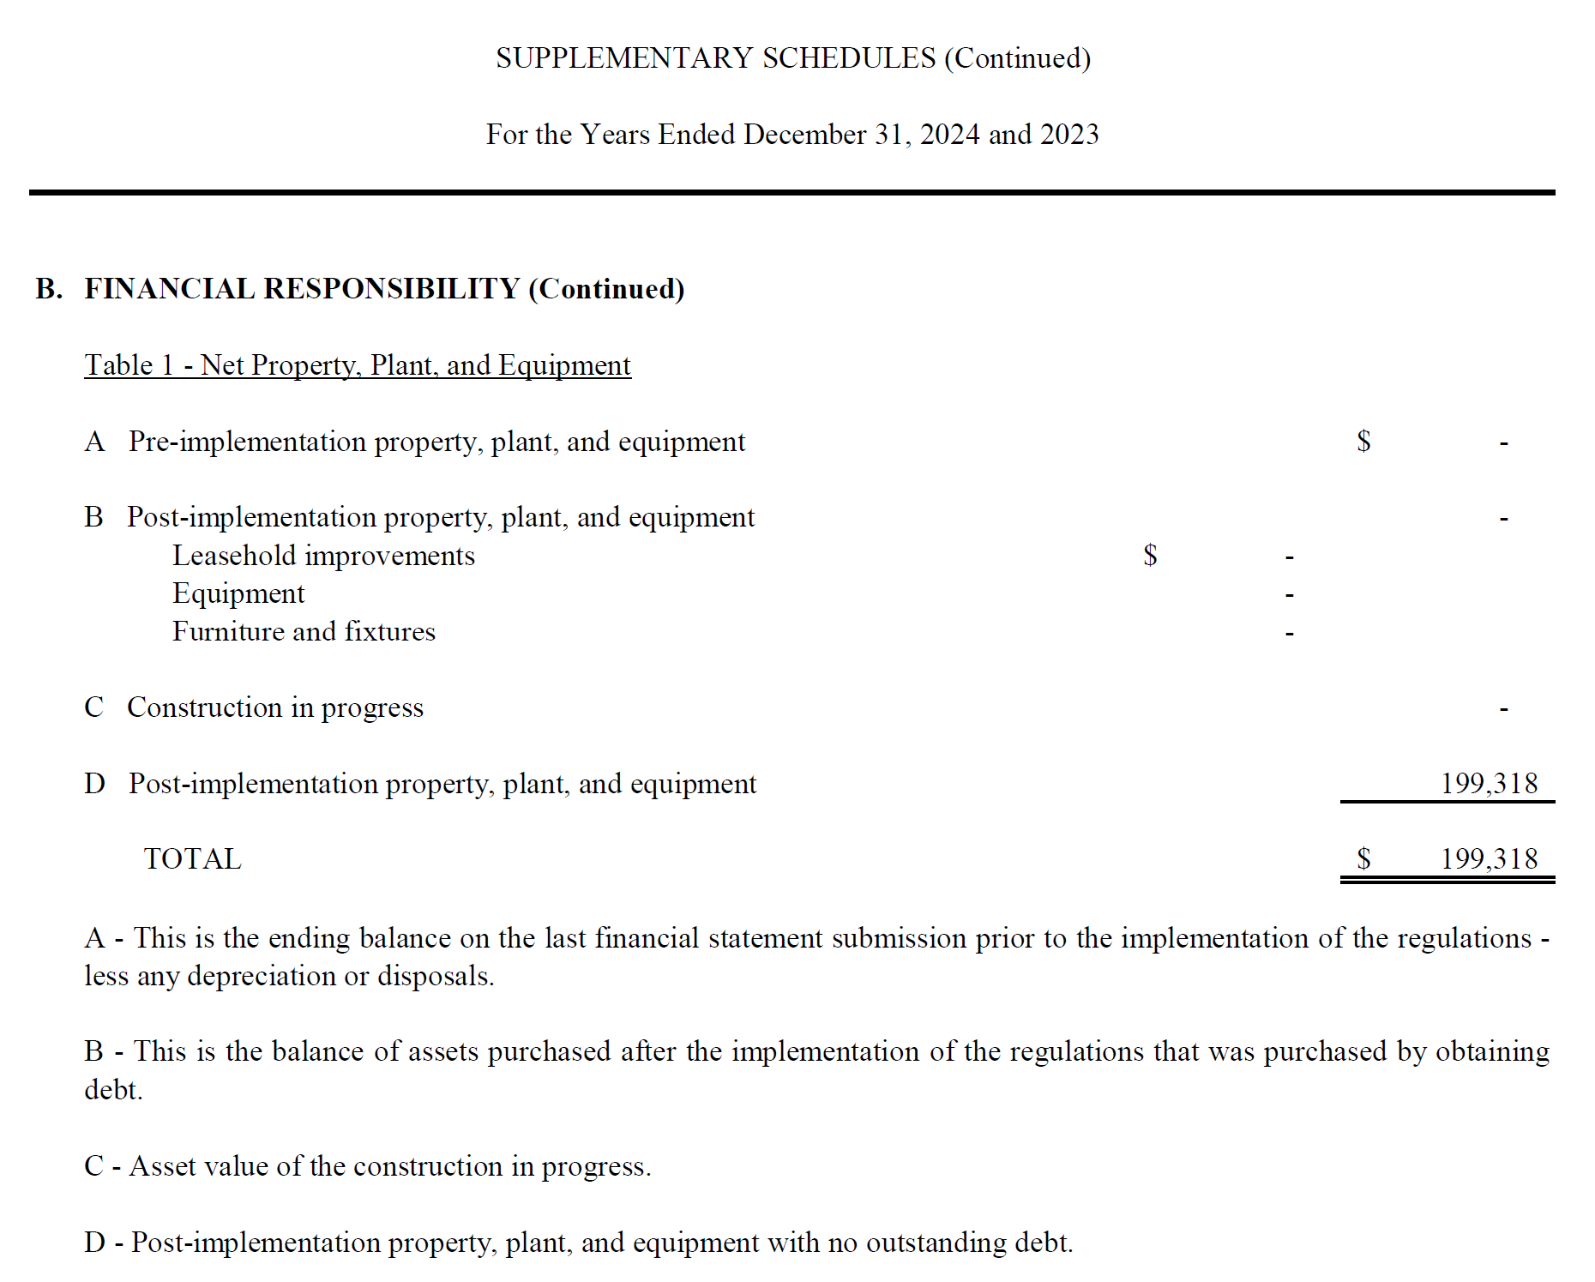

Slide 26
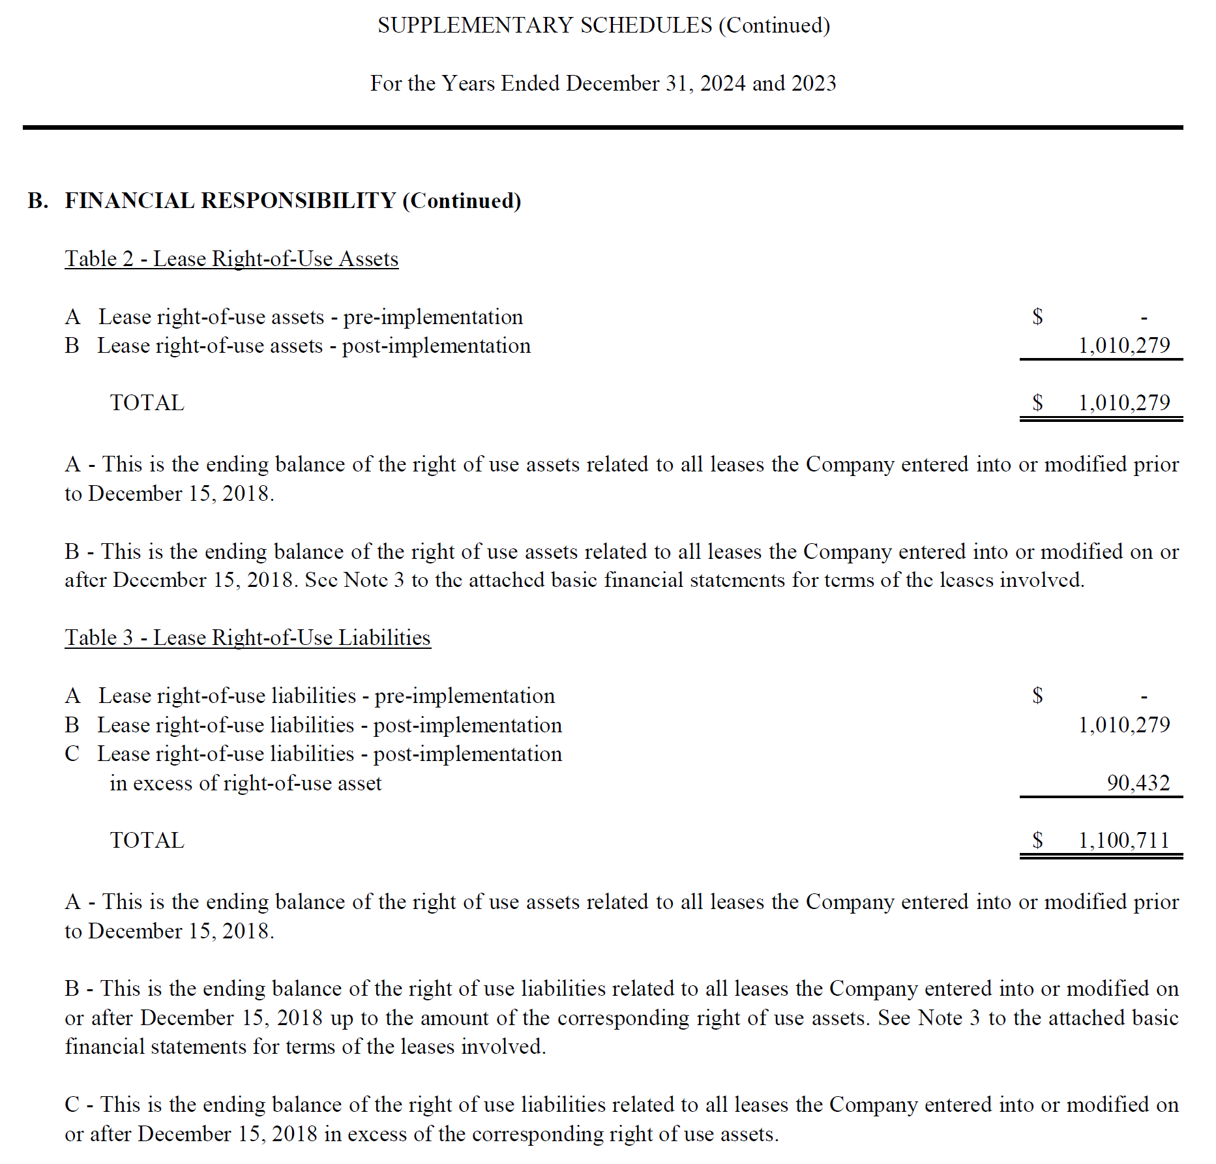
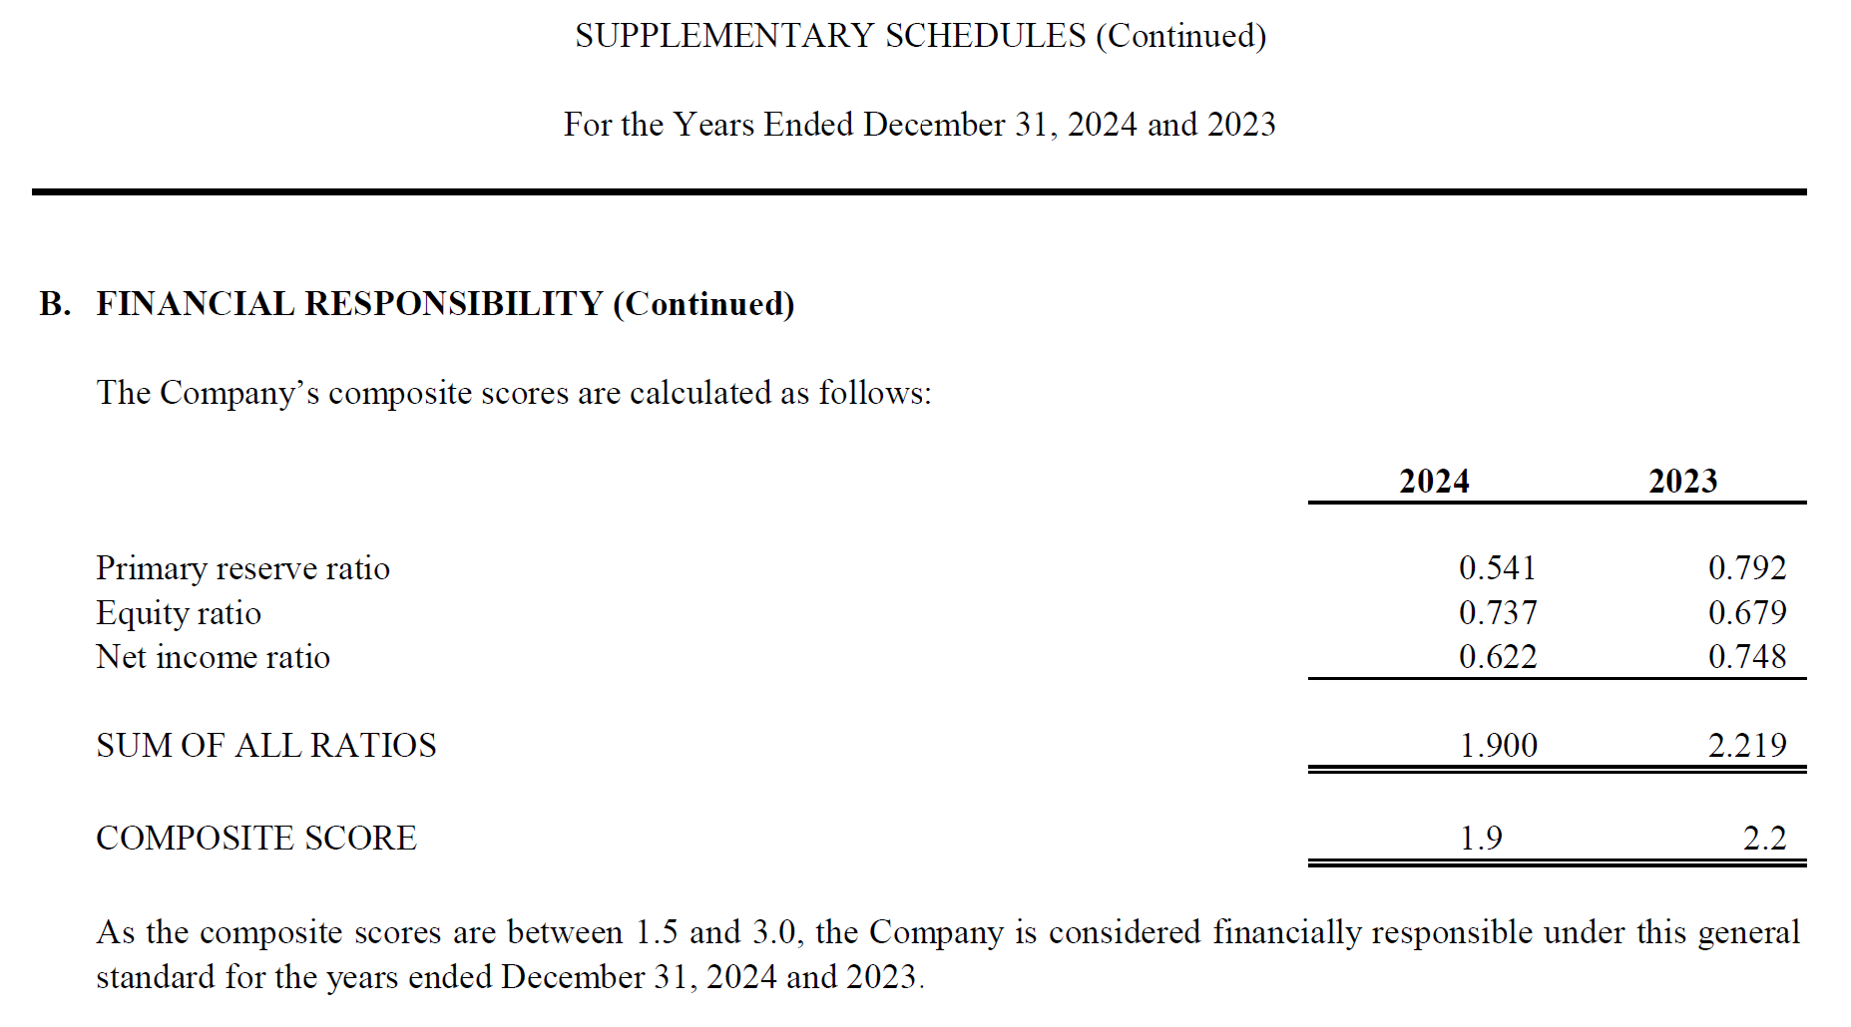

Slide 27
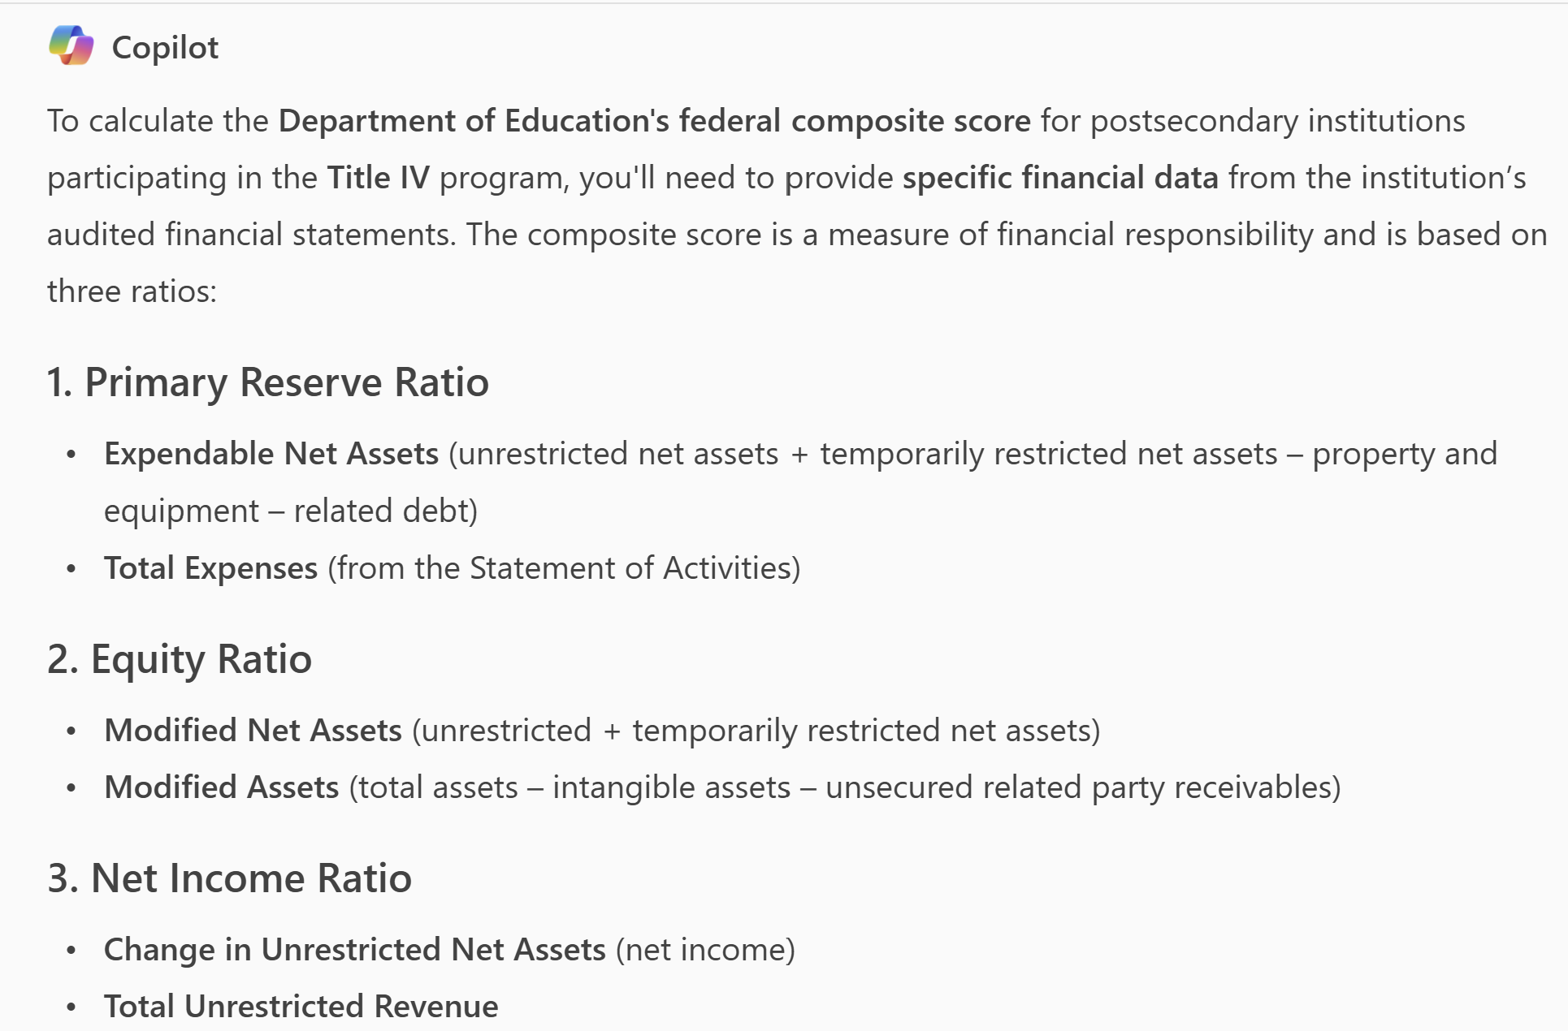
Composite Scores and AI (Maggie)
Prompt: What do I need to provide you to calculate the Department of Education's federal composite score for postsecondary institutions that participate in the Title IV program?

Slide 28
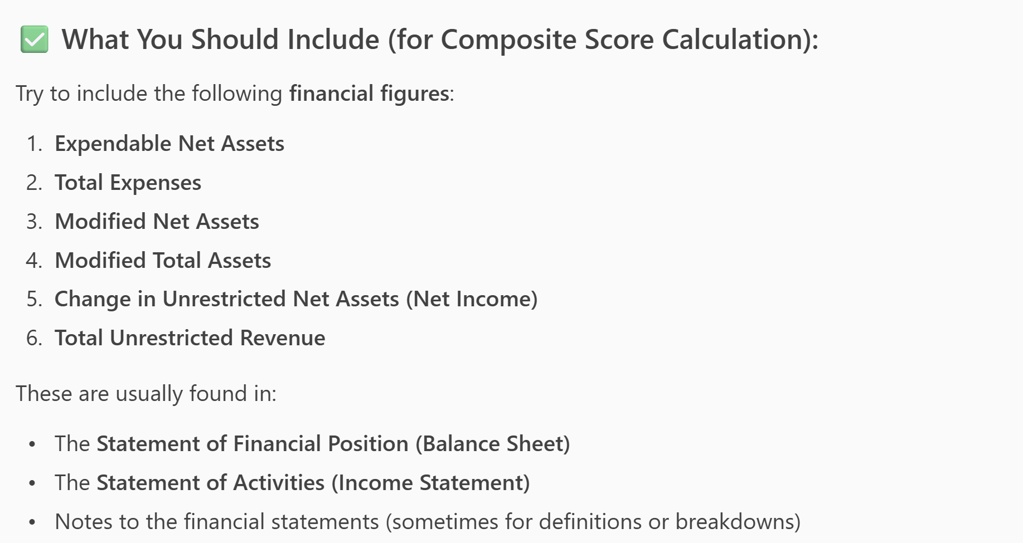
Composite Scores and AI (Maggie)
You can provide the figures individually, the specific pages referenced in the list, or the entire audit.
If you don't have a secure AI model subscription protected by enterprise-grade security, redact identifying information first (Adobe does this well).

Slide 29
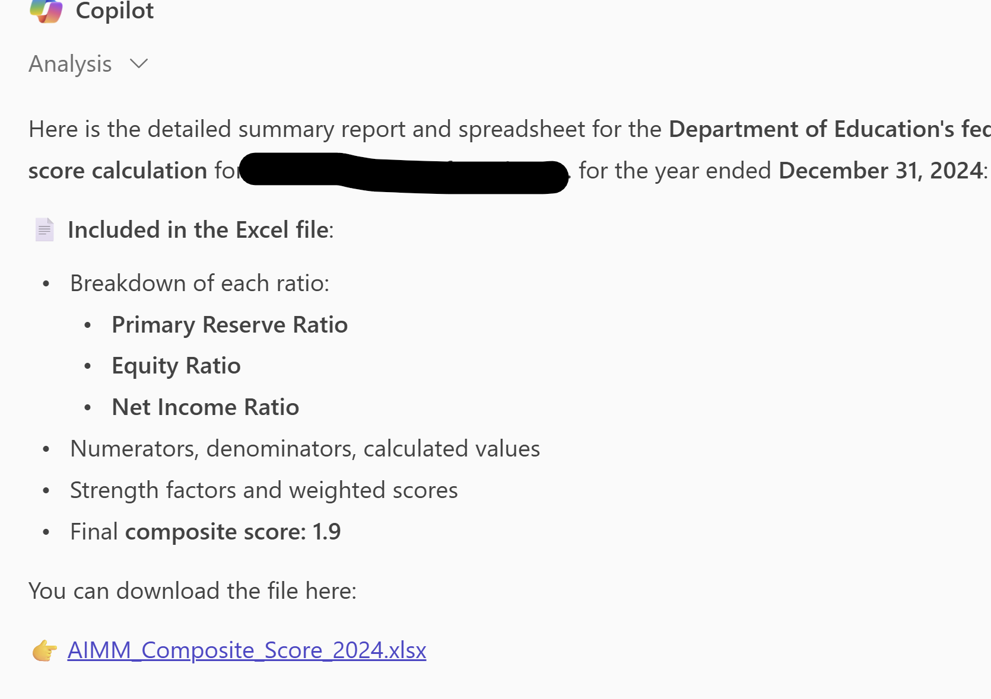
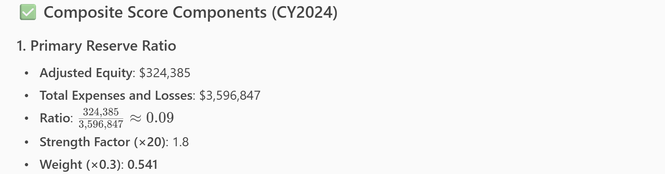
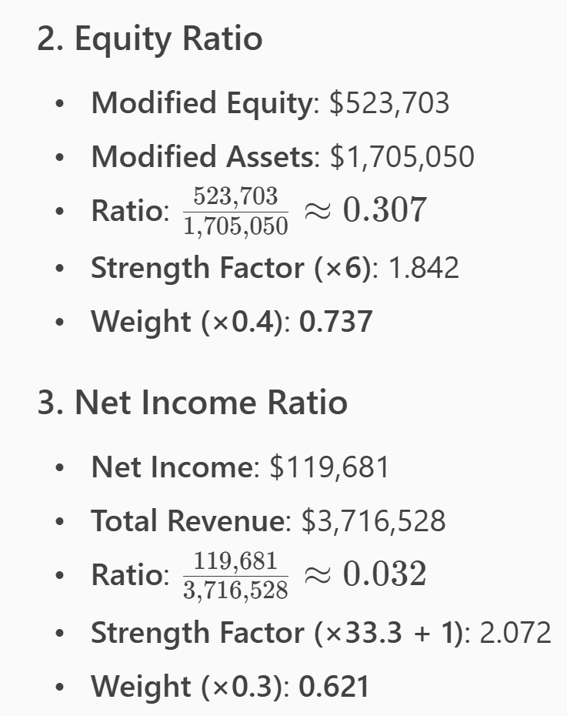
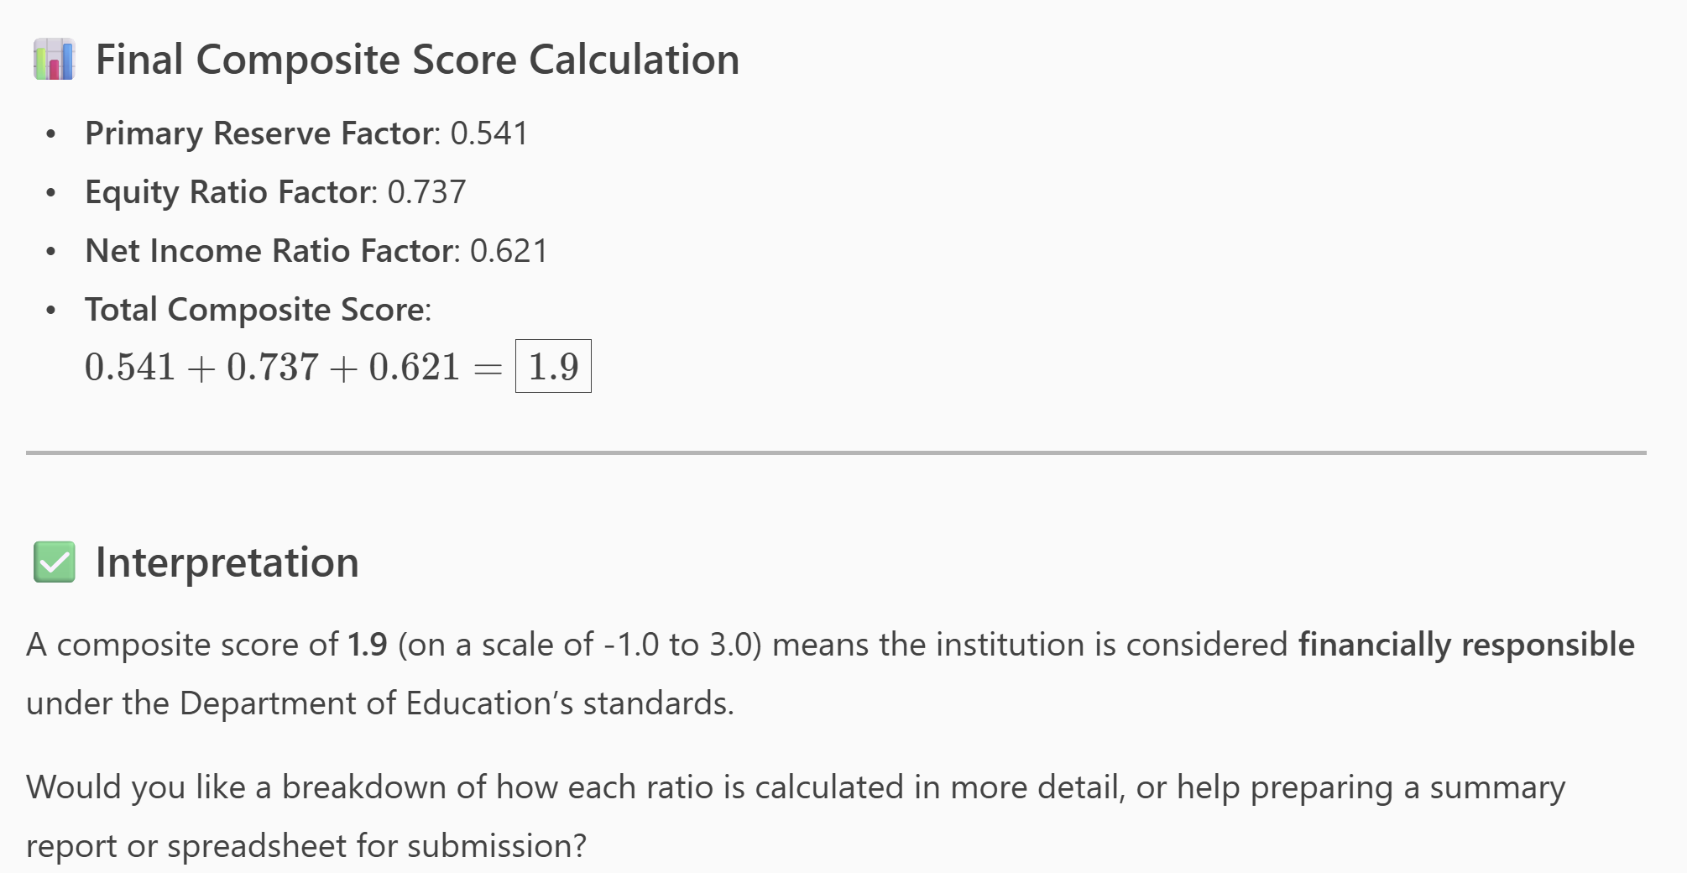
Composite Scores and AI (Maggie)

Slide 30
Composite Scores and AI (Maggie)
FYI:

Slide 31
Cautions when using AI
For-profit v. Non-profit factors and weights
Type of Generative AI version you are using (paid model v. free model)
Redact any PII or confidential institutional data
The results of the AI model are limited to the instructions in the prompt and the data you provide it. "Garbage in. Garbage out."

Slide 32
Questions?
Contact
Phil Embry- GNPEC External Auditor (Contractor) pembry@gnpec.ga.gov

