Slide 1

Leveraging Leadership for School Improvement
Andrew M. Cole
The Wallace Foundation
CCSSO State Plan Implementation Meeting
April 19, 2018

Slide 2
Today’s discussion
The role of education leadership in school improvement
Growing recognition of the importance of leadership
How states can leverage education leadership
  Implementation strategies
“Crystal Ball” forecasting

Slide 3
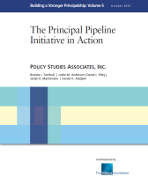
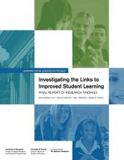



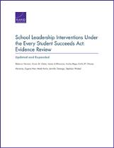

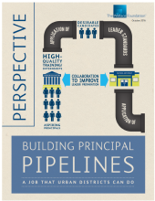


Wide array of research on education leadership

Slide 4

30+ studies on school leadership meet ESSA evidence requirements
18 meet Tiers I through III evidence requirements
Key conclusions:
  “School leadership can be a powerful driver of improved education outcomes.”
  “Activities designed to improve school leadership demonstrate positive impact on student, teacher, and principal outcomes….”
Source: School Leadership Interventions Under the Every Student Succeeds Act Evidence Review, Rebecca Herman, et al, RAND, 2016

Slide 5
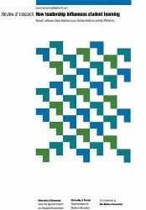

Principals are key to student learning
Principals are “second only to classroom instruction among all school-related factors that contribute to what students learn at school.”
      -- How Leadership Influences Student Learning, Kenneth Leithwood, et al, University of Minnesota, University of Toronto, 2004
“Principals are multipliers of effective teaching.”
      -- Developing Excellent School Principals to Advance Teaching and Learning: Considerations for State Policy, Paul Manna, The Wallace Foundation, 2015

Slide 6
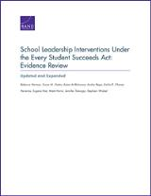

Principals are key to retaining good teachers
“Teacher turnover is lower in schools led by high-quality principals…. Research further indicates that principal turnover leads to lower teacher retention and lower gains for students.”
  -- School Leadership Interventions Under the
  Every Student Succeeds Act: Evidence Review,
  Rebecca Herman, et al, RAND, 2016
“Principal effectiveness is associated with greater teacher satisfaction and a lower probability that the teacher leaves the school within a year. Moreover, the positive impacts of principal effectiveness on these teacher outcomes are even greater in disadvantaged schools.”
  -- Can Good Principals Keep Teachers in Disadvantaged Schools? Linking Principal Effectiveness to Teacher Satisfaction and Turnover in Hard-to-Staff Environments, Jason A. Grissom, Teachers College Record, 2011

Slide 7
Principals are critical to improving struggling schools
“…there are virtually no documented instances of troubled schools being turned around without intervention by a powerful leader. Many other factors may contribute to such turnarounds, but leadership is the catalyst.”
“There seems little doubt that both district and school leadership provides a critical bridge between most educational-reform initiatives, and having those reforms make a genuine difference for all students.”
    -- How Leadership Influences Student Learning, Kenneth Leithwood, et al, University of Minnesota, University of Toronto, 2004

Slide 8
School leadership is important to state school improvement efforts
“Especially during the last five to ten years, states have pushed forward ambitious education initiatives that will be unlikely to succeed without principals actively leading the work on the ground.”
      -- Developing Excellent School Principals to Advance Teaching and Learning, Paul Manna, 2015

Slide 9
State of the Principalship
50% of principals leave by the end of their third year and 70% after five years
Numbers are even higher in high-need schools, approximately 28% leaving each year
Burnout from the overwhelming demands of the job, lack of decision-making authority, and isolation all contribute to this turnover
Constant “churn” of principals has significant costs to students. Schools that lost principals were more likely to see a drop in student academic performance in the subsequent year.

Slide 10
And Also…
It takes an average of five years to put a vision in place, improve the teaching staff and fully implement policies and practices that positively impact the school’s performance
There is an empirical link between school leadership and improved student achievement
High-quality principals hire better teachers – and then hold on to them.
School Leaders Network, 2014
Building a Principal Pipelines. The Wallace Foundation

Slide 11
The evolution of initiatives in education leadership
2000-2010
First Generation
15 states;
15 districts
2011-2017
Principal Pipeline Initiative
6 districts
2014-2019
Principal Supervisor Initiative
8 districts
Lessons
Lessons
Emerging Question:
If an urban district and its principal training programs provide large numbers of talented, aspiring principals with the right pre-service training and on-the-job evaluation and supports, will the result be a pipeline of principals able to improve teaching quality and student achievement, especially in schools with the greatest needs?
Emerging Question:
If principal supervisors in urban districts shift from overseeing compliance to shaping principals’ instructional leadership capabilities and if they (both incumbents and aspirants) are provided with the right training, support and number of principals to supervise, would this improve the effectiveness of the principals with whom they work?
Notes:
This cycle is easiest to understand with an example. Here is one from our work in education leadership.
When we started working in this area, the role of the principal was seen essentially as a facilities managers primarily responsible for buses, boilers and budgets.
Our foundation spent about $300 million from 2000 to 2010 exploring whether principals matter in improving schools, what the characteristics of an effective principal are, and how to teach them.
Research we funded demonstrated that an effective principal – a true instructional leader – can be a driver of student achievement, second only among school-based factors to the quality of teaching in the classroom. And the quality of the principal is the single most important factor in whether or not high quality teachers stay in high needs schools. Better still, we funded leader training programs that were able to demonstrate these skills could be taught.
But these findings suggested a new question.
How could a school district build a pipeline of effective principals and, if they did, would it improve teaching and learning at the scale of an entire district?
This led to our Principal Pipeline Initiative, in which we are funding six large urban districts to implement the elements prior research suggests are critical to such a pipeline and to participate in a rigorous study of its effects. We are about two thirds of the way through this $80 million initiative.
As we worked with the Pipeline districts, we learned that a stumbling block to improving the performance of principals was their supervision. Having spent their careers as principals in the old model, current supervisors are mainly focused on compliance, not on helping principals improve instruction in the classroom.
This has led us to launch a new initiative before the current one is complete with six additional districts seeking to to answer the question: “If principal supervisors shift from overseeing compliance to shaping principals’ instructional leadership capabilities... Would this improve the effectiveness of the principals with whom they work.”

Slide 12
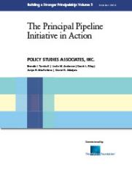
Principal pipelines benefit both districts and new principals
The benefits for both districts and new principals are substantial
Leader standards are important
Leader evaluation systems seen as ‘fair’
Mentors and principal supervisors most valued supports among novice principals
Districts can do it
Source: The Principal Pipeline Initiative in Action, Building a Stronger Principalship Vol 5, Brenda Turnbull, et al, Policy Studies Associates, 2016

Slide 13
Putting it all together: The Principal Pipeline
Leader standards
High-quality aspiring leader preparation programs
Selective hiring
Evaluation and on-the-job support
Notes:
Based on the lessons learned through research and investment in practice decided to take a system approach and invest in the development of a principal pipeline in 6 districts that included 4 major integrated components
Standards provides a specific target to provide a foundation for all the subsequent work
A high quality leadership development program that supports the development of aspiring principals by developing partnerships with both local and national providers and in some cases developing their own programs
A selective hiring process that ensures the best candidates ascent to the principalship
A process that principals are fairly evaluated and supported in their leadership
Six districts were selected as demonstration sites in 2011 Denver, NYC PGCPS, CMS, Gwinnett, and Hillsborough

Slide 14
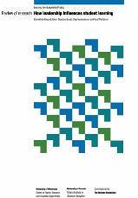
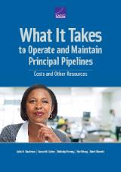
Principal pipelines are cost effective
Because of leaders’ influence on schools, “efforts to improve their recruitment, training, evaluation and ongoing development should be considered highly cost-effective approaches to successful school improvement.”
          – How Leadership Influences Student Learning, Kenneth Leithwood, et al, University of Minnesota, University of Toronto, 2004
New RAND study finds principal pipelines are affordable
  Pipelines are 0.4% of annual district budgets, according to study of six districts
  Minimal cost for two “quick wins” – leader standards and selective hiring
  Coaching/Mentoring: Average cost $1,500 per principal
      -- Source: What it Takes to Operate and Maintain Principal Pipelines, Julia H. Kaufman, et al, RAND, 2017

Slide 15
Principal Pipeline Districts
Denver, Colorado
New York City, New York
Charlotte Mecklenburg, North Carolina
Prince Georges County, Maryland
Gwinnett County, Georgia
Hillsborough County, Florida

Slide 16
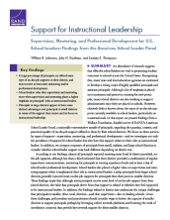
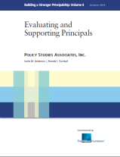
Principal supervisors play an important role in supporting principals
Principals need support from principal supervisors, including relevant evaluation, in order to maximize their impact
A focus on strengthening teaching and learning is crucial
  Representative survey of principals nationwide finds principals value their supervision and mentoring more when it’s focused on instruction
86% of principals in six urban districts who were advised to improve received support to do so from their supervisors
    Source: Support for Instructional Leadership, RAND, 2016; and Evaluating and Supporting Principals, Building a Stronger Principalship, Volume 4, Policy Studies Associates, 2016

Slide 17
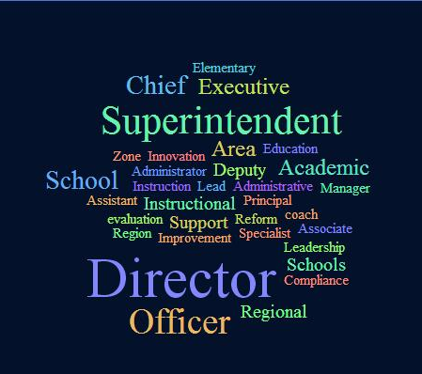
One position, many names
CGCS Report

Slide 18
Principal Supervisors are Critical to Principal Performance Yet…
Position definition varies from district to district
Hiring criteria can be vague
Those in the position have little experience or training for the job
The number of principals supervised prevents a sharp focus on principal performance
Need to move from a compliance focus to an instructional focus building the principal performance

Slide 19
The Principal Supervisor Job is Critical to the Success of Principals
Five Critical aspects of Principal Supervisor Support:
  Identify the training needs of the principals they supervise and provide this on an individualized basis;
  Manage learning networks among the principals with whom they work;
  Strengthen principals’ accountability by setting goals and objectives, supporting them in achieving them, and holding them accountable for the results;
  Strategically marshal resources and relationships in the community and serve as a buffer for principals with local groups; and
  Develop clear and shared visions, policies and expectations that focus on instructional improvement.

Slide 20
Four Goals of PSI Initiative
Design, implement and test training and support to improve the performance of all principal supervisors in selected districts and develop methods to train and develop pools of successors;
Assist districts in reducing principal supervisors’ “span of control” (i.e., the number of principals they supervise) and in planning central office redesign to support and sustain these changes;
By looking across all the districts, develop emerging lessons about best ways to change the central office structure to support principal supervisors; and
Assess the effectiveness and the effects of these activities across participating districts.
Notes:
Wallace embarked last year on a new Principal Supervisor Initiative with four specific goals

Slide 21
Principal Supervisor Initiative Sites
Broward County Public Schools
Cleveland Public Schools
DeKalb County Public Schools
Des Moines Public Schools
Minneapolis
Long Beach
Tulsa Public Schools*(Lead District)
District of Columbia Public Schools*(Lead District)
Notes:
Six districts were selected to participate in the Initiative
2 districts were selected as lead districts that were a little further developed in their work on the PS and you will have the opportunity to hear about the outstanding work being done by Tulsa

Slide 22

Landscape survey
Districts dissatisfied; universities also want to improve
Strong university-district partnerships are important, but rare
Course of study does not match on-the-job realities
States have authority to improve principal preparation, but are not using it as effectively as they could.
Source: The Wallace Foundation, Improving University Principal Preparation Programs, 2016

Slide 23
What we hope to learn now
How can university principal preparation programs—working in partnership with high-needs school districts, exemplary preparation programs and the state—improve their training so it reflects the evidence on how to best prepare effective principals?

Slide 24
The initiative design
State policies
7 University programs
TA,
PLC
6 partner providers
Districts that employ graduates
Evaluation
Conference to share lessons with non-grantees

Slide 25
University Principal Preparation Initiative Grantees
Albany State University
Florida Atlantic University
North Carolina State University
San Diego State University
University of Connecticut
Virginia State University
Western Kentucky University

Slide 26
UPPI Elements
Redesigned and implemented high Quality courses of Study with Practical on the job experiences with Partner Exemplar Programs
States Receiving resources to review Principal Preparation Policies
Putting into place Strong Robust University-District Partnerships

Slide 27
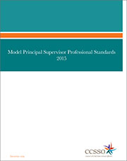

Practitioner tools help translate evidence into practice
    Sources: Principal Preparation Program Self-Assessment Toolkit, Education Development Center, 2009 and 2013; Model Principal Supervisor Standards, Council of Chief State School Officers, 2015.

Slide 28
Today’s discussion
The role of education leadership in school improvement
Growing recognition of the importance of leadership
How states can leverage education leadership

Slide 29
Growing recognition of the importance of school leadership
The Education Commission of the States reports that 37 states introduced or passed legislation related to school leadership in 2017
New Leaders reports that all 50 states (plus DC and Puerto Rico) have included education leadership in their ESSA plans
Some 46 states require of prioritize strategies to support school leadership or school improvement
At least 10 states have updated their leader standards to be in accord with the 2015 national Professional Standards for Educational Leaders (PSEL)

Slide 30
Today’s discussion
The role of education leadership in school improvement
Growing recognition of the importance of leadership
How states can leverage leadership
  Implementation strategies
Crystal Ball Forecasting

Slide 31
How states can leverage school leadership
Develop policies and guidelines such as:
  Leader standards
  Accreditation of principal preparation programs
  Principal licensure standards
  Align program accreditation with principal licensure
Develop statewide principal pipelines/leadership academies; empower districts to do so
Disseminate effective practices throughout the state
Gather and use accurate, timely and actionable data

Slide 32
34 states and D.C. working with Wallace and/or CCSSO on school leadership strategies
Hawaii
Wallace/CCSSO
CCSSO

Slide 33
Using ESSA
24 states using Title II A optional setaside
  Other states using Title IIA or other Title II funding
Examples of what they are funding:
  Principal training academies
  Mentoring
  Principal supervisors
  Principal pipelines
  Strategies to retain principals in high needs schools
  Professional learning communities

Slide 34
“Crystal Ball” Thoughts
Challenges
Opportunities
Salary compression and its impact on Principal Hiring
SEA capacity
National Focus/Capacity
Funding
Equity
Rural issues (poor and minority)
Stakeholder Engagement
Principal Pipelines
Robust Partnerships with Universities and other providers
Redefinition of schools
Better support for principals through alignment
Principal Supervisor development

Slide 35
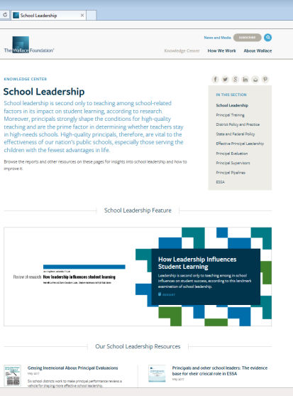
For more information – wallacefoundation.org

