Slide 1
Authorization of Foreign Locations
SREB-SARA Steering Committee Meeting
October 17, 2018

Slide 2
Foreign Locations
U.S. is the largest provider of international branch campuses!
34 CFR §600.9(d) NOT delayed!
Effective July 1, 2018
Branch campuses, physical locations in foreign country
Does not apply to
Branch campus on military base
Study abroad if less than 50% of program
If only online
If not offering federal financial aid to students

Slide 3
Requirements
Legally authorized by appropriate government authority
Produce authorization upon request by ED Secretary
Branch campus/location approved by accreditor
Meet any additional requirement of that country
Report to state of main campus at least annually
Comply with home state limitations on foreign locations
Disclose complaint process to enrolled/prospective students
Not authorized if home state excludes foreign locations.

Slide 4
Which States Are Affected?
Arkansas
Florida
Georgia
Louisiana
Maryland
Pennsylvania
Texas
Virginia
Campuses now closed:
Alabama

Slide 5
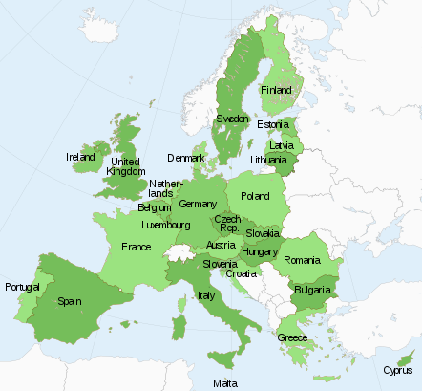
Branch Campuses in EU Countries
Florida
Georgia
Maryland

Slide 6
Where are your students?
This Photo by Unknown Author is licensed under CC BY-SA-NC

Slide 7
Resources
List of Foreign Ministry Locations
List of Foreign Branch Campuses
http://cbert.org/branch-campus
WCET-SAN Frontiers Blog

