Slide 1
Leveraging Principal Meetings for Principal Development
Brannon F. Gaskins, Area Executive Director

Slide 2
Essential Questions
What promising practices are districts using in selecting school leaders?
What promising practices are districts using in preparing school leaders?
What promising practices are districts using in providing ongoing professional development for school leaders?
What state policies are necessary to support districts in finding and preparing the leaders they need?

Slide 3
100 Graduates

Slide 4
40 students out of every 100(40%)

Slide 5
10 African American Males Out of every 100(10%)

Slide 6
Achievement Zone
The mission of the Achievement Zone is to accelerate and concentrate research-based reform efforts, offering a wide range of supports and opportunities to remove obstacles to dramatic school improvement and provide access for all families with students in the Zone to receive a high quality education.
The Achievement Zone is a geographic area that makes up the Banneker High School attendance boundary in the southern end of the Fulton County School district.

Slide 7
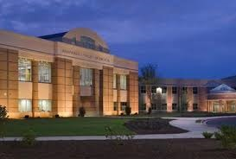
The Banneker Cluster of Schools were impacted by three challenges common in low performing schools:
1
Inability to recruit and retain high quality experienced and novice staff
Pervasive culture of low expectations
Lack of intensive supports for struggling students
2
3
Notes:
The schools in the Banneker Feeder Pattern suffered from three major challenges that are common across the Nation when reviewing research on struggling schools.
Read three points on slide

Slide 8
Strategic Themes
The purpose of the Achievement Zone is to design, coordinate, and implement research-based strategies to close the achievement gap between the Banneker cluster of schools and the district at large.
Notes:
In an effort to break the cycle of generational poverty, social inequity and make social justice a reality, the goal is to remove barriers to dramatic school improvement and provide opportunity for every family to access a high quality education. With an understanding that our students are school dependent and what we do during the course of a school day matters, together have the opportunity to change the life trajectory of students and generations to follow!
The strategic plan for the Achievement Zone focuses on three strategic themes. (Talent, Culture and Climate and Intensive supports for Learning and Teaching) We believe that as a district we must be willing to be innovative and engage strategic partners around these three themes to help us accomplish goals. Collectively we can accomplish much more than isolated efforts.

Slide 9
2015-2016 Strategic Initiatives/Tactics
Talent
Develop a strategic partnership for school turnaround leadership development.
Culture & Climate
Provide restorative practices, cultural competency, PBIS and SERVE PD
Learning & Teaching
Facilitate innovative learning opportunities for students to catch up, keep up, or move up in all content areas.
Hire and screen leadership candidates based on school turnaround competencies using the behavioral event interview technique.
Attract, hire, and retain highly effective staff.
Develop strategic partnerships for case management, after-school programming, tutoring, mentoring, and early childhood education.
Strengthen and monitor implementation of the balanced literacy initiative.
Implement the Junior Achievement-Magnet Business Academy at Banneker
Notes:
Talent
Develop a strategic partnership for school turnaround district and leadership development.
UVA
Hire and screen principal candidates based on school turnaround competencies using the behavioral event interview technique.
Remove the most underperforming staff and focus on attracting, hiring, and retaining effective and highly effective staff.
Prioritized Career Fairs
Professional development for leaders on recruitment and retention of high performing staff
Signing Incentives
No Forced Placements
Strategic staffing
Culture & Climate
Provide professional development focused on culture, including restorative practices, cultural competency, Positive Behavior Interventions and Supports (PBIS), and SERVE training for front line staff.
Develop strategic partnerships for case management, after-school programming, tutoring, mentoring, and early childhood education.
Learning & Teaching
Facilitate innovative learning opportunities for students to catch up, keep up, or move up in all content areas.
Implement Gateway Academies at McNair and Woodland MS
Launch the Junior Achievement - Magnet Business Academy at Banneker.
Strengthen and monitor implementation of the balanced literacy initiative.
Explicit focus on phonics and sight words in grades PK-2

Slide 10
Leadership Development

Slide 11
Our Purpose:
Our schools will be empowered to coordinate and implement research-based strategies to close the achievement gap between our schools and the district at large. We will invest in people to remove barriers to dramatic school improvement and provide opportunities for every student to pursue their college or career path of choice. We have the opportunity to not only impact the lives of students we serve, but to transform communities and ultimately our future.
Notes:
Dara
We have been working over the past two years to improve our principal meeting time, as well as our site visits. We are being very intentional about focusing on our Big Rocks and Common Expectations, utilizing the rubrics for effective practices provided by UVA, as well as looking for trends and patterns across our schools to develop our meeting agendas and differentiate our site visits based on school progress and leadership development. We utilize interactive agendas so that all accompanying documents are housed in a central place for principals to reference at later times. We have seen other systems use systems like Canvas to house their work. We use Office 365, so we opt to use the interactive agendas with links. In the past, we always started our meetings with our norms. However, this year, we began adding our purpose to start our meetings. We start each meeting with a story or video that reminds us of our purpose. Here is an example of how we started one meeting to focus us on the importance of our work.

Slide 12
Meetings are utilized to reinforce common expectations of the turnaround initiative.
Big Rocks and Common Expectations
Notes:
Brannon:
In an effort to actualize our purpose, we focused on claiming our common expectations. Talk about claiming the common expectations.
We want to take a few moments to share our Big Rocks and Common Expectations. These common help focus the work of our principals and their teams. Our common expectations are literacy (which we found a root cause and a barrier to student achievement K-12, data driven instruction (DDI), culture and climate, and coaching. Before identifying common expectations as a learning community, schools had autonomy to focus on their own self selected initiatives; however, with transient populations and schools in multiple years of decline, we found it important to help our schools focus on specific researched based strategies that we could support them and and garnered results.

Slide 13
Principals share-out best practices to support their colleagues.
November 2, 2016 SLC AZ Principal meeting agenda
Leadership Team Presentation
Notes:
Dara:
At the end of each meeting, we conduct a plus/delta activity (either openly in the meeting or via a meeting link to provide feedback. We consistently receive very positive feedback about having principal colleagues share best practices with them. However, we don’t just allow anyone sign up to present for the sake . There is a method around how we do that. Generally, when we include principals sharing best practices, it is based on a common trend or patterns we have identified through site visits. For example, several schools had leadership teams show up in the school readiness assessment as an opportunity to improve and leverage. We also noted this as a common problem across our learning community through site visits. We identified a principal who stood out as an exemplar around leveraging leadership teams to move the owrk, as well as building the leadership team’s capacity in her building. Her eis an example of agenda that demonstrates that and part of her presentation that was shared with principals.

Slide 14
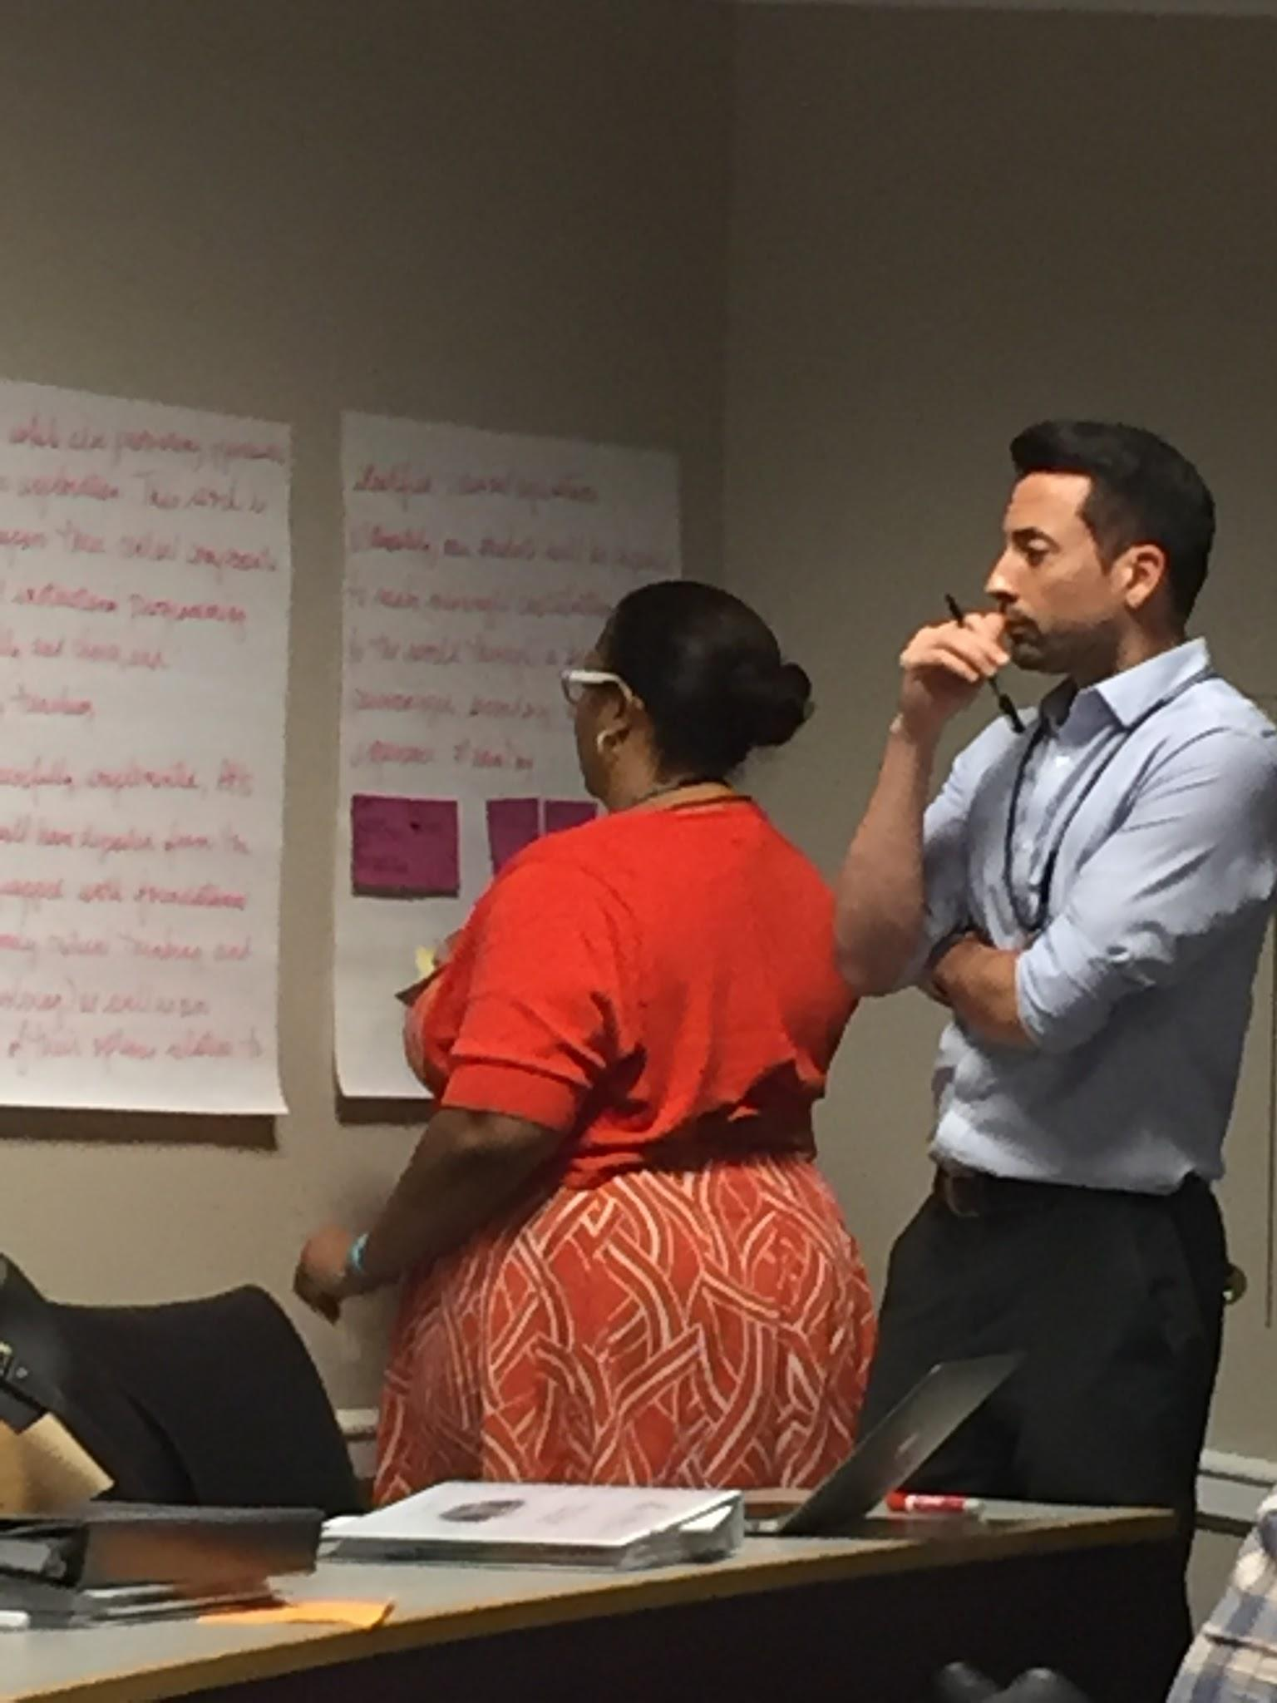
Meetings provide for peer to peer dialog that encourages feedback and collective problem solving.
October 6, 2016 SLC AZ Principal Meeting
December 12, 2016 SLC AZ Agenda
Notes:
Brannon
Learning and safe practice: principals brought videos of themselves-paired up and provided feedback to each other
Last year we used Leverage Leadership to anchor our learning on observation and feedback. We asked our principals to work with one teacher and provide them feedback and videotape the experience. They brought their videos to our principal meeting and and switched with their colleagues to give peer feedback using Paul Bambrick Six steps to effective feedback protocol.

Slide 15
Meetings are utilized to strengthen the leadership skills and competencies of principals.
November 1, 2017 SLC AZ Principal Meeting
August 30 , 2017 SLC AZ Principal Meeting Agenda
Notes:
Brannon
Last year focus around coaching was to provide knowledge and safe practice. This year moving to accountability-included in their leadership professional development goals as part of our performance management system. Although we are holding principals accountable for this professional devleopment goal, we are still providing them with support for this goal. Denise Watts provdied training on See It, Name It, and Do It (which is a revision to Paul Bambrick’s 6 Steps to effective Feedback). Within this observation/feedback protocol we are ensure that school are using the curriculum documents, (something about SMF, proficiency sclaes)... link to coaching and DDI (common expectations)

Slide 16
How is content carried to other meetings?
Scope and Sequence Doc
Notes:
Dara (Coaching and district coaching plan, Assessment and Math and calibration/scoring, SMF and learning and teaching)
How do we get started with our working each year. We look at our common expectations, feedback from previous meetings, and trends from our site visits.
We have divided responsibilities on the team:
Dara/Brannon: Principal Meetings (Dara-content/Brannon logistics/everyone owns parts of the work delivered)
AZ Release Days: Brannon owns logistics and content
SLC/AZ Team: Gyimah Whitaker owns content and logistics
SLZ AZ AP meetings: Kirk owns content and logistics
DDI example:
how we made it a district priority
Dashboards
Rising 30 work
assessment now owned by the district
Learning Community Team Meetings-Gyimah Whitaker
Learning Community AP Meetings-Kirk Sykes
District Principal Meetings
District AP Meetings
District Coaches Meetings
AZ Release Days

Slide 17
Results to Date

Slide 18
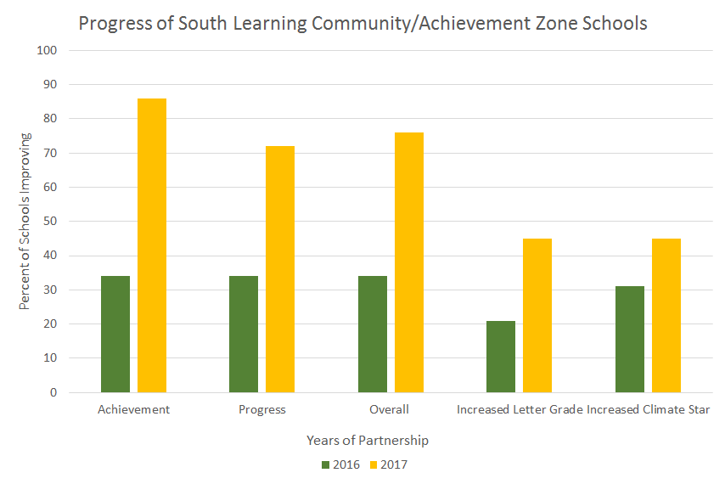
State Results
Notes:
Dara

Slide 19
BHS graduation rate continues to climb
AZ Created
Gap:
18.3
Gap:
15.7
Gap:
22.8
Gap:
27.8
Gap:
33.8
Notes:
Graduation rate is continuing to climb and the gap is closing between Banneker and the District Average

Slide 20
Banneker Milestones End of Course Data
Notes:
Banneker showed gains in 6/8 EOC courses

Slide 21
Removed from State List
Removed from State Takeover List
Benjamin Banneker HS
Heritage ES
Remained off State Takeover List
Brookview ES
Love T. Nolan ES
Mary M. Bethune ES
Removed from Focus or Priority List
Asa G. Hilliard ES
Benjamin Banneker HS
Mary M. Bethune ES

Slide 22
Beating the Odds
Heritage ES
Love T. Nolan ES
Woodland MS

Slide 23
Middle School Students Taking High School Credit Courses

Slide 24
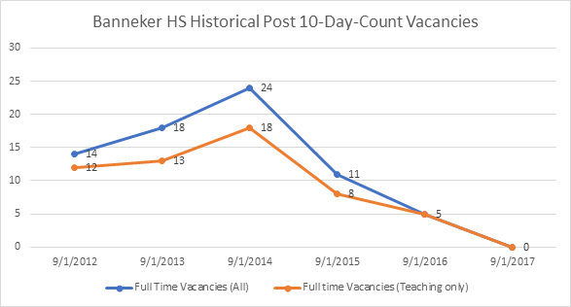
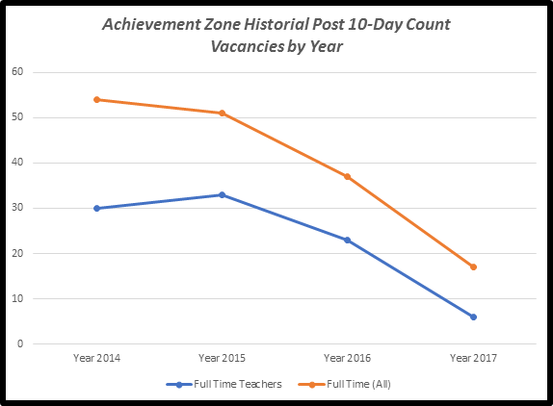
Banneker HS and AZ Teacher and Staff Vacancies

Slide 25
Grant Recipients
Brookview ES: The Woodward Fund ($5 million)
Banneker HS: School Improvement Grant ($5.2 million)
College Park ES: GOSA Literacy Grant ($38,000)
Woodland MS and Banneker HS: Dobbs Grant ($180,000)
Bethune ES: Playworks ($5,000)
McNair MS: Project Lead the Way ($20,000)

Slide 26
Partnerships and Wrap Around Services
Community in School
Kaiser Permanente
Future Foundations
Land of Promise
Action Ministries
Eagles Economic Community
Hands On Atlanta
YMCA
Stand Up for Kids
Teach for America
Playworks
TutorMate
Oak Hill
Ripple Effects
Goodwill
United Way
Odyssey Family Counseling
Next Generation Men & Women

Slide 27
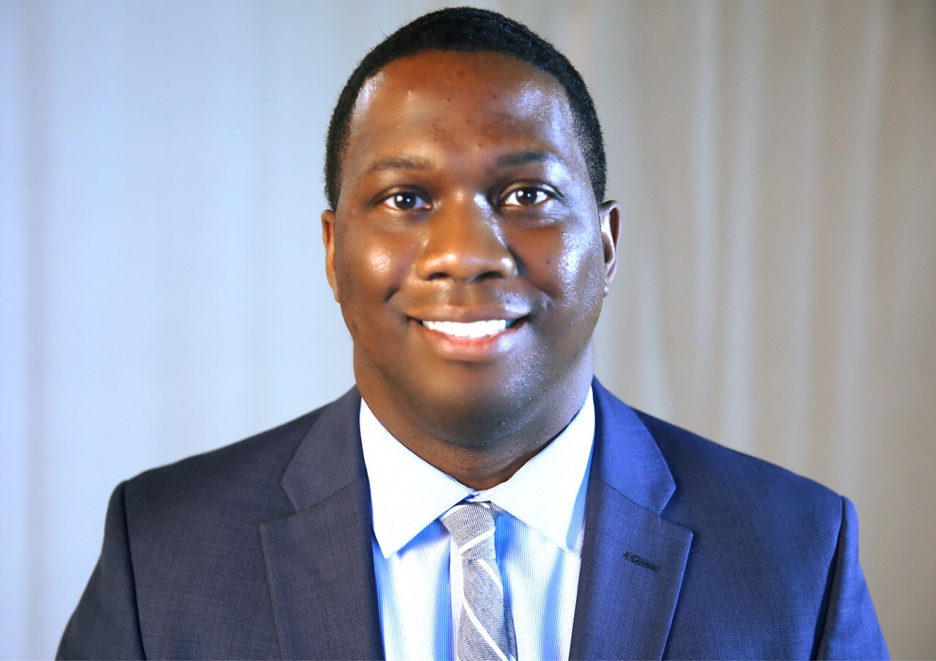
Contact Information
Brannon F. Gaskins
Area Executive Director-Fulton County Schools
Gaskinsb@fultonschools.org
Twitter: @BFGaskins

