Slide 1
2017 SREB Annual Leadership Forum
Discussion: Improving University Preparation of Principals
Panel Moderator: Daniel Reyes-Guerra, Florida Atlantic University
Panel Participants: Tricia McManus, William Black, Pamela Tucker, and Karen Sanzo

Slide 2
Panel Discussion Goals:
  What are the innovations that we have been engaged in?
  What are cutting edge universities doing to improve principal leadership preparation?
  What are the new frontiers that we are examining…
Walk away with specific ideas and strategies that I could implement.

Slide 3
Hillsborough Principal Pipeline
“Effective Principals are the Key to Improving Our Schools”

Slide 4
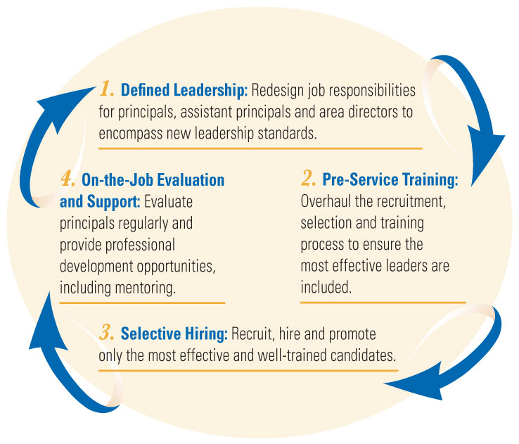
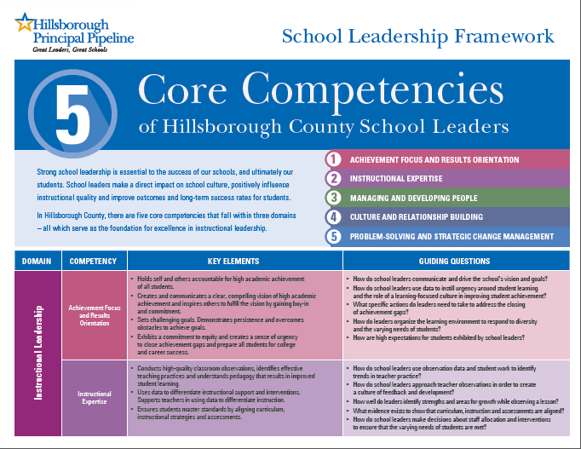
Supporting and
Developing Future Leaders
The Hillsborough Principal Pipeline consists of four integrated components built around five core leadership competencies.

Slide 6
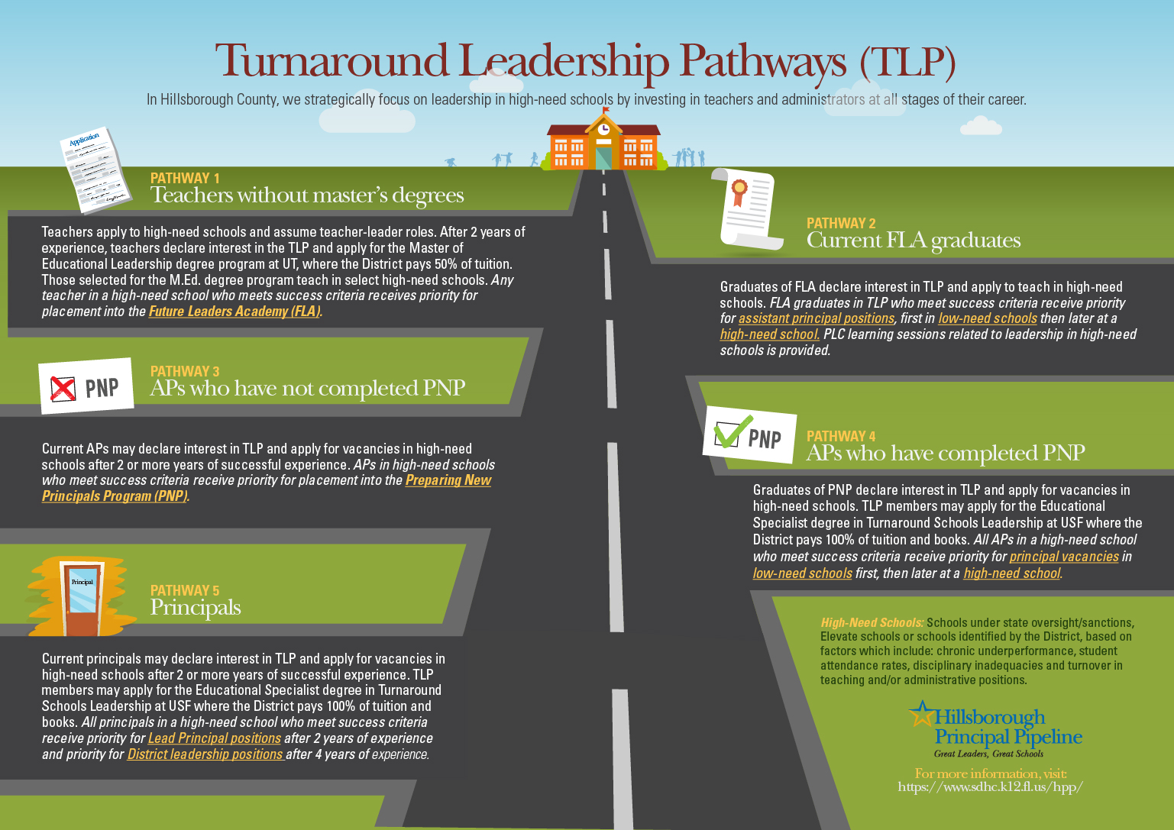

Slide 7


Ed.S in Leadership for School Turn Around
Preparing Students for Life
To create pool of high performing principals who are ready to lead in our highest needs schools.
Research based curriculum designed in partnership with USF, HCPS and national leaders in the field of school turn around.
18 month program with capstone project

Slide 8
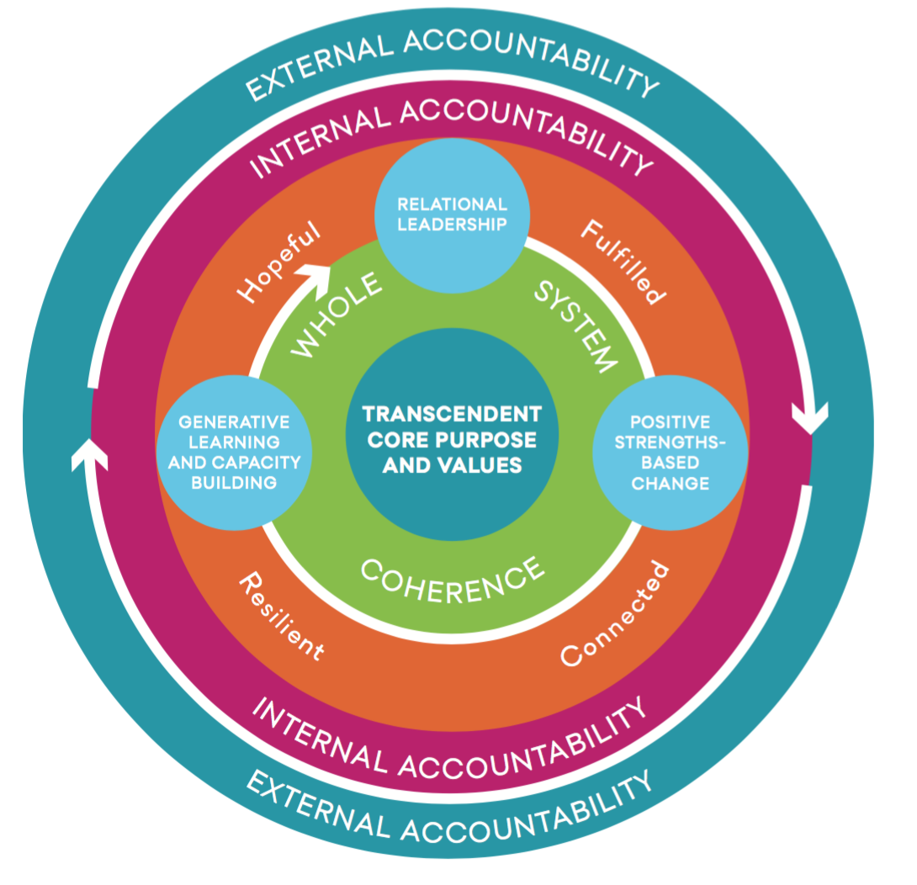
Ed.S in Leadership for School Turn Around
Preparing Students for Life
Appreciative Inquiry and Asset-Based Orientation
Responsive and customized curriculum.
Students can then choose to enroll in Ed.D. in Program Development

Slide 9
Strong University Partnerships
Ongoing communication and collaborative planning
Innovative thinking
Sharing of data, tools, and processes
Honest and open feedback
Common vision, goals, and shared agreements

Slide 10
Working Together
Pedagogies of Enactment in Leadership Preparation
Pamela D. Tucker
April 21, 2017
Notes:
PAM

Slide 11
Pedagogies of Enactment
Pedagogies of enactment require
skilled coaching, including focused feedback, to
“distinguish features of a complex practice that may be difficult to fully appreciate until one tries to enact the practice” (Grossman et al., 2009, p. 285).

Slide 12
Working With Teacher Education to Strengthen Clinical Practice
Goal: Collaborate to better support leader and teacher candidate development through a parallel learning process
Pre-service teachers
Pre-service leaders
Strategy: Administrative Interns in Leadership Program serve as University Supervisors of Student Teachers

Slide 13
Pedagogies of Enactment
Opportunities for Administrative Interns to:
Deconstruct teaching practice
Facilitate candidates’ self-observation and analysis
Frame actionable feedback
Monitor progress
Coaching Support from Teacher Education:
Increase fidelity to the protocol (MyTeachingPartner)
Guide supervisors toward language that promotes high-quality analysis of practice
Create an empowering working relationship
Model trust

Slide 14
Pre-Service Leader Testimonial
I'm really enjoying the training modules and I feel like they are helping me deepen my understanding of my own teaching practice. I think administrators employing the CLASS Observation System should take their teachers through the Domains and Dimensions of the CLASS, including watching videos and encouraging dialogue. This is a far cry from what I'm seeing in my school system currently!

Slide 15
Working With Chesterfield County to Strengthen Clinical Practice
Goal: Collaborate to better support leader development through a full-time internship during the second year of a master’s program in educational leadership
Strategy: Administrative Interns will serve in Dean of Students role for second year of program and will be individually coached by Senior administrator and will participate in a structured mentorship program

Slide 16
Pedagogies of Enactment
Opportunities for Administrative Interns to:
Deconstruct leadership practice
Develop self-observation and analysis skills
Reflect on their own performance
Obtain actionable feedback
Monitor their own progress

Slide 17
Extension Support Services
PK-12 Educational Leadership
Karen L. Sanzo, Ed.D.
Notes:
I changed the title to include human centered design

Slide 18

Webinars

Slide 19
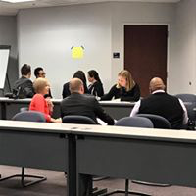
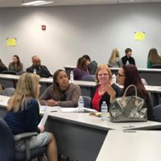
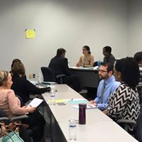
Professional Development Opportunities

Slide 20
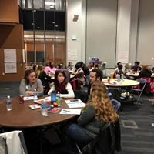
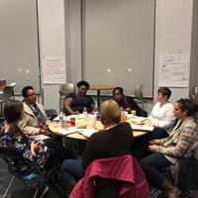
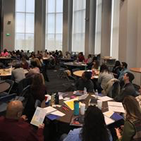
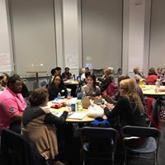
Adaptive Schools

Slide 21
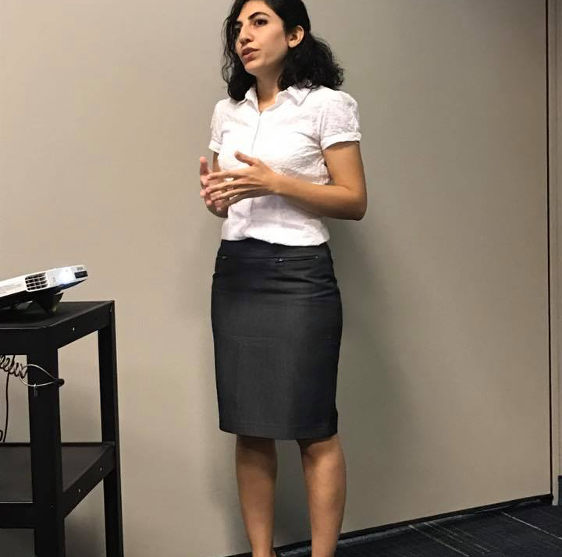
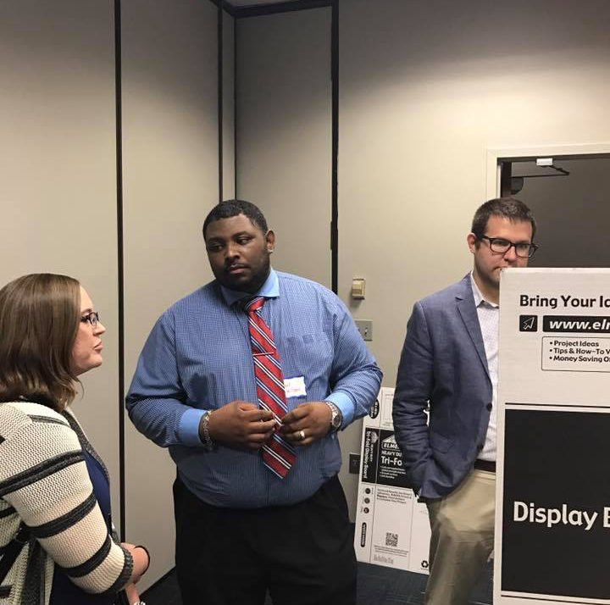
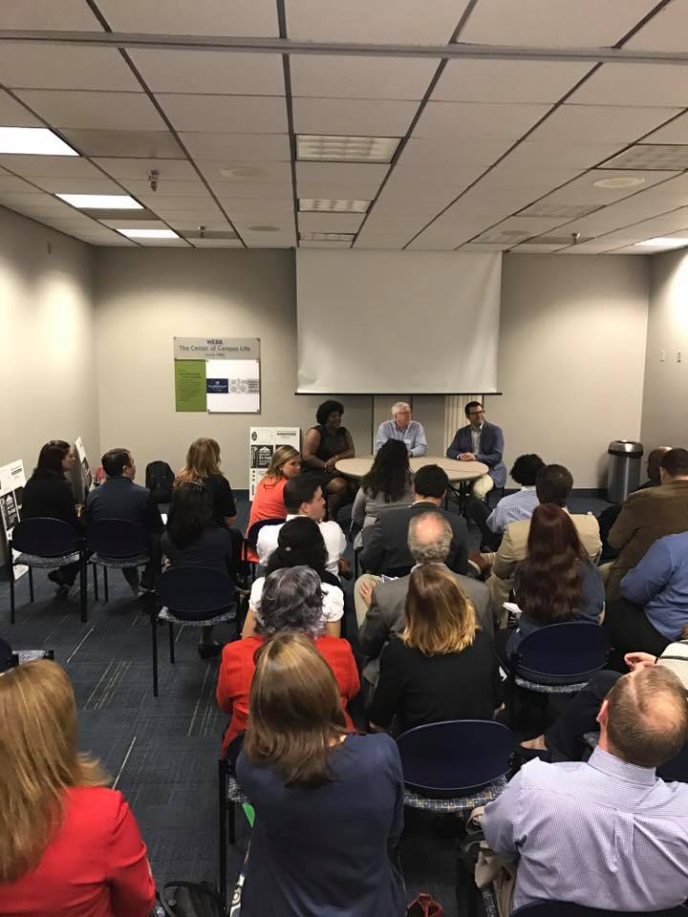
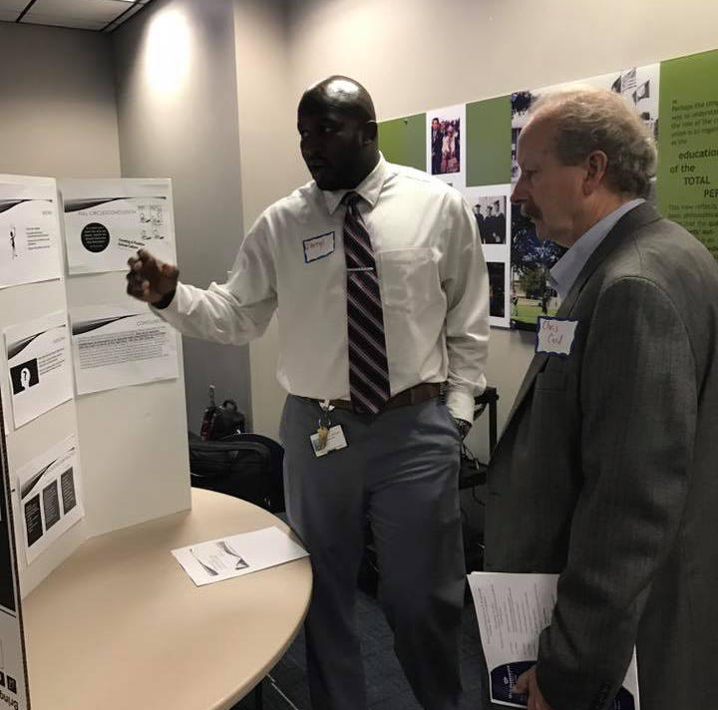
GRC

Slide 22
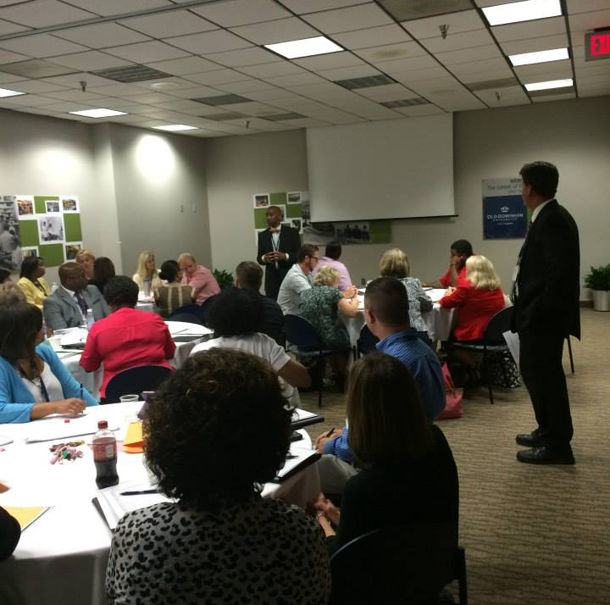
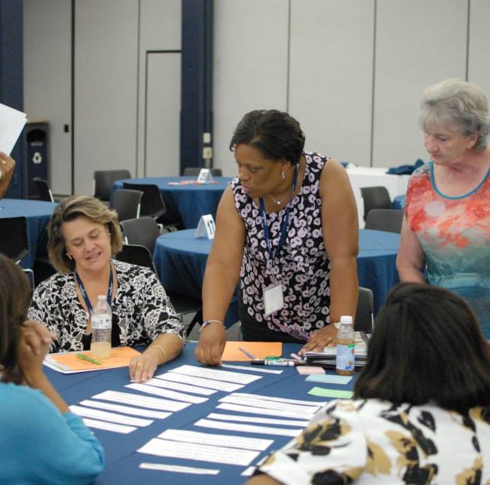
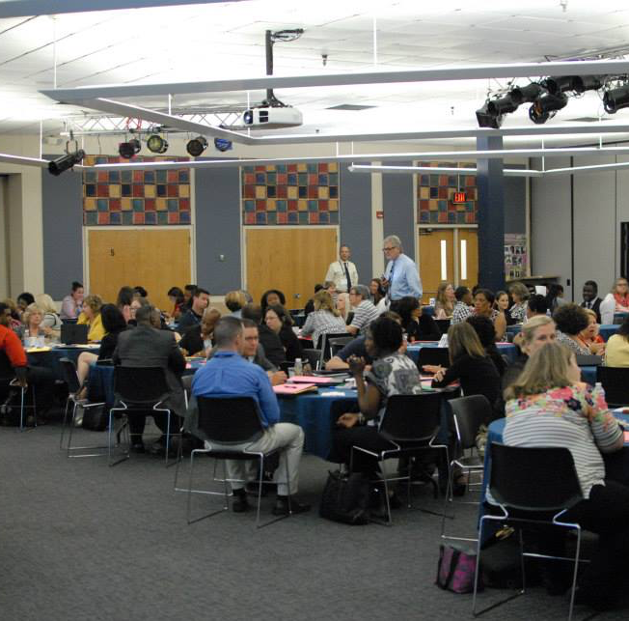
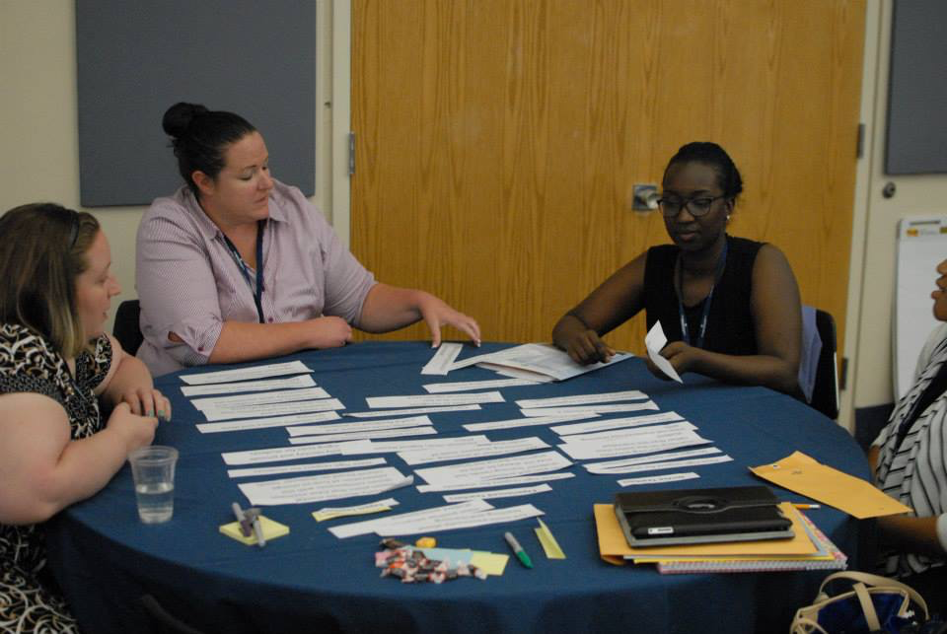
Annual Working Conference

Slide 23

Florida Atlantic University
Department of Educational Leadership and Research Methodology
School Leaders Program
The FAU Principal Preparation Initiative Grant

Slide 24



Leadership key to student learning
“Leadership is second only to classroom instruction among all school-related factors that contribute to what students learn at school.”
-- How Leadership Influences Student Learning,
Universities of Minnesota and Toronto,
2004 and 2010
“Principals are multipliers of effective teaching.”
-- Developing Excellent School Principals to Advance Teaching and Learning: Considerations for State Policy. Paul Manna, The Wallace Foundation,
2015

Slide 25
What Wallace Reports found
District leaders are largely dissatisfied with the quality of principal preparation programs, and many universities believe that their programs have room for improvement.
Strong university-district partnerships are essential to high-quality preparation but are far from universal.
The course of study at preparation programs does not always reflect principals’ real jobs.
Some university policies and practices can hinder change.
States have authority to play a role in improving principal preparation, but many are not using this power as effectively as they could.

Slide 26
The University Principal Preparation Initiative
The Wallace Foundation selected seven universities and their state and district partners to participate in a $47-million initiative.
Over the the next four years the initiative will:
  Redesign principal preparation programs by building on research and exemplary programs.
  Build stronger connections between universities and districts.
  Ensure that states create policies that support high quality preparation.
Albany State University Florida Atlantic University
North Carolina State University San Diego State University
The University of Connecticut Virginia State University
Western Kentucky University

Slide 27







Florida Atlantic University Principal Preparation Initiative – FAUPPI

Slide 28
Where the resources will be directed
The State
  $$ for the State to review policies
  State will pilot a Level 2 Certification Assessment
The Districts
  Leadership Tracking Systems
  $$ to Co-develop continuum
  AASA, The Superintendents Association Consult
The University
  $ for district-specific programs
  $ for partner provider to help support efforts
  UCEA Consult / University of Denver Consult

Slide 29
Example: Building District-Specific Leadership Standards
FAU PhD students are developing, administering, and analyzing qualitative and quantitative research centered on:
  What does each district perceive to be an effective and successful school and effective and successful school leadership?

Slide 30
Example: Tying Participant Performance to Student Achievement
Mentored by principal, participant develops a plan and leads the team through a year-long professional learning community (PLC)
Focused on the school’s identified area of need. Evaluation conducted at the end of the project by PROPEL administration.

Slide 31
TABLE ACTIVITY
  Select a scribe
  Process what you just heard, share what you just heard.
  Are there any ideas here that relate to what you are doing that you could share?
FINAL EXERCISE: SHARE YOUR TABLE’S MAJOR POINTS
What specific ideas and strategies that I heard would I and could I implement?

