Slide 1
Center for Community Partnerships and Nursing Innovation
Sara Day, PhD, RN, FAAN
Wendy Likes, PhD, DNSc, APRN-Bc, FAANP

Slide 2
Presentation Overview
Development of Center
Highlight of Partnerships & Goals/Metrics for Success:
Methodist Le Bonheur Healthcare
Shelby County Health Department
St. Jude Children’s Research Hospital
Regional One Health
Challenges and Lessons Learned

Slide 3
Development of Center for Community Partnerships and Nursing Innovation

Slide 4
Center for Community Partnerships and Nursing Innovation: Mission
Develop sustainable academic practice partnerships with health systems to advance the profession of nursing and improve health outcomes:
Where?
Memphis
Mid-South
Globally
Achieving mission requires embracing a new vision for academic nursing
Created 2017

Slide 6
Academic Practice Partnerships
Partnerships in alliance with:
American Association of Colleges of Nursing’s: Advancing Health Care Transformation: A New Era for Academic Nursing
Institute of Medicine’s: Future of Nursing Recommendations

Slide 7
Highlight of Partnerships Goals/Metrics for Success

Slide 8
Methodist Le Bonheur Health Care Partnership: Nurse Scholars Program
Program designed to promote a culture of inquiry in clinical care and generate research to advance nursing practice and nursing science.
Partnership: December 2017
Goals:
Conduct and advance nursing research to promote quality nursing care
Complete two system wide research studies
Meet Magnet requirement to generate new knowledge through research and clinical innovation
Promote involvement of clinical nurses in EBP and research
Improve the integration of nursing research into clinical settings

Slide 9
Methodist Le Bonheur Scholars

Slide 10
Methodist Le Bonheur Nurse Scholar Program Metrics
14 nurse scholars representing 6 Methodist Le Bonheur hospitals started the program in December 2017
Research Studies:
A New Graduate Nurse Residency Program: Factors Impacting Retention: Dissemination underway
Predictors of Uncompleted Emergency Department Care: Patients Who Leave against Medical Advice: Analysis underway
Scholars are all Co investigators
EBP: projects are in implementation phase
Developed Shared Governance Nursing Research Council

Slide 11
Program Impact
National
Institution
Area of Practice
Individual

Slide 12
Shelby County Health Department Partnership: Public Health Nurse Residency Program
12 month program designed to:
Achieve PHN core competencies
Recognize nursing’s key role in advancing practice
Develop & implement EBP initiatives relevant to SCHD’s needs
Advance leadership skills

Slide 14
Shelby County Health Department Partnership: Public Health Nurse Residency Program Metrics
7 nurses started the program May 2017, all graduated June 2018
Public Health Nurse Residency EBP Projects:
Screening for Adverse Child Hood Experiences in a Public Health Department Clinic
Evaluation of Existing Latent TB Infection Policy for Local and Government Employees.
Assessing Barriers to HPV Vaccination by Public Health Nurses
Improving Wait Times in a Local Health Department Clinic
Improving Latent Tuberculosis Infection Treatment Completion in a Local Public Health Department Clinic
Improving Recruitment and Retention of PHN in a Local Public Health Department Clinic

Slide 15
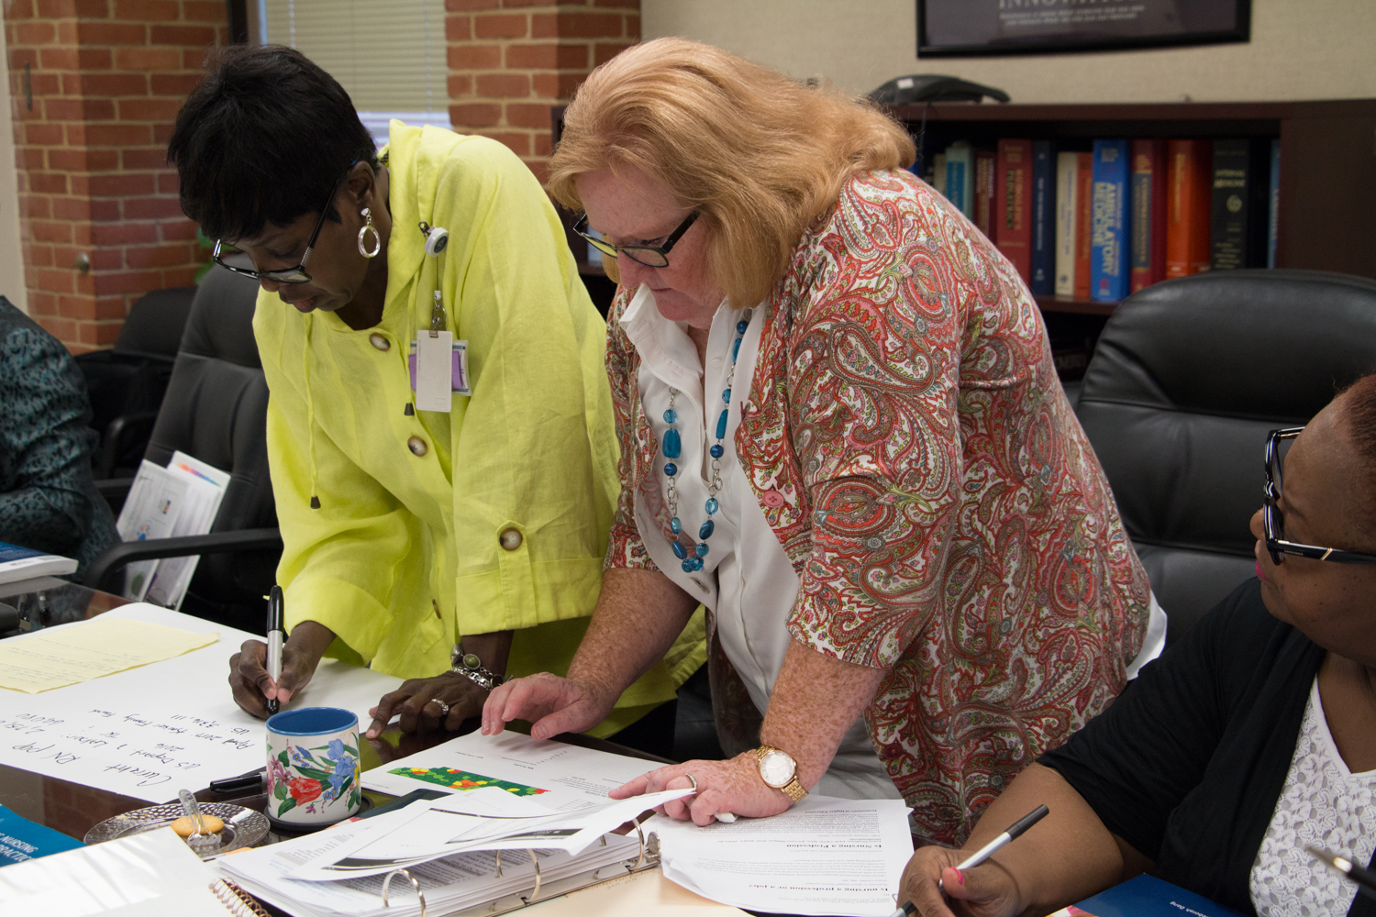

Slide 16
Shelby County Health Department Partnership: Public Health Nurse Residency Program Metrics
Three of the residents’ abstracts were accepted by the Tennessee Public Health Association Annual Conference in Nashville held on September 11-12, 2018.
Assessing Barriers to Human Papillomavirus (HPV) Vaccination by Public Health Nurses, Rudolph Gray, BSN, RN; Judy C. Martin, PhD, FNP-BC; Alisa R. Haushalter, DNP, RN; Ernestine B. Small, EdD, MSN; Sara Day, PhD, RN, FAAN
Evaluation of Existing Latent Tuberculosis Infection: Policy for Local Government Employees,Phyllis Crump, MSN, FNP - BC; Judy Martin, PhD, FNP – BC; Alisa R. Haushalter, DNP, PHNA-BC, RN; Ernestine Small, EdD, MSN; Sara Day, PhD, RN,FAAN
Improving Recruitment and Retention of Public Health Nurses in a Local Health Department, Tina R. McElravey, MPH, BSN, RN, NHDP-BC; Alisa R. Haushalter, DNP, RN, PHNA-BC; Sara Day, PhD, RN, FAAN; Judy Martin, PhD, MSN, FNP-BC; Ernestine Small, EdD, RN

Slide 17
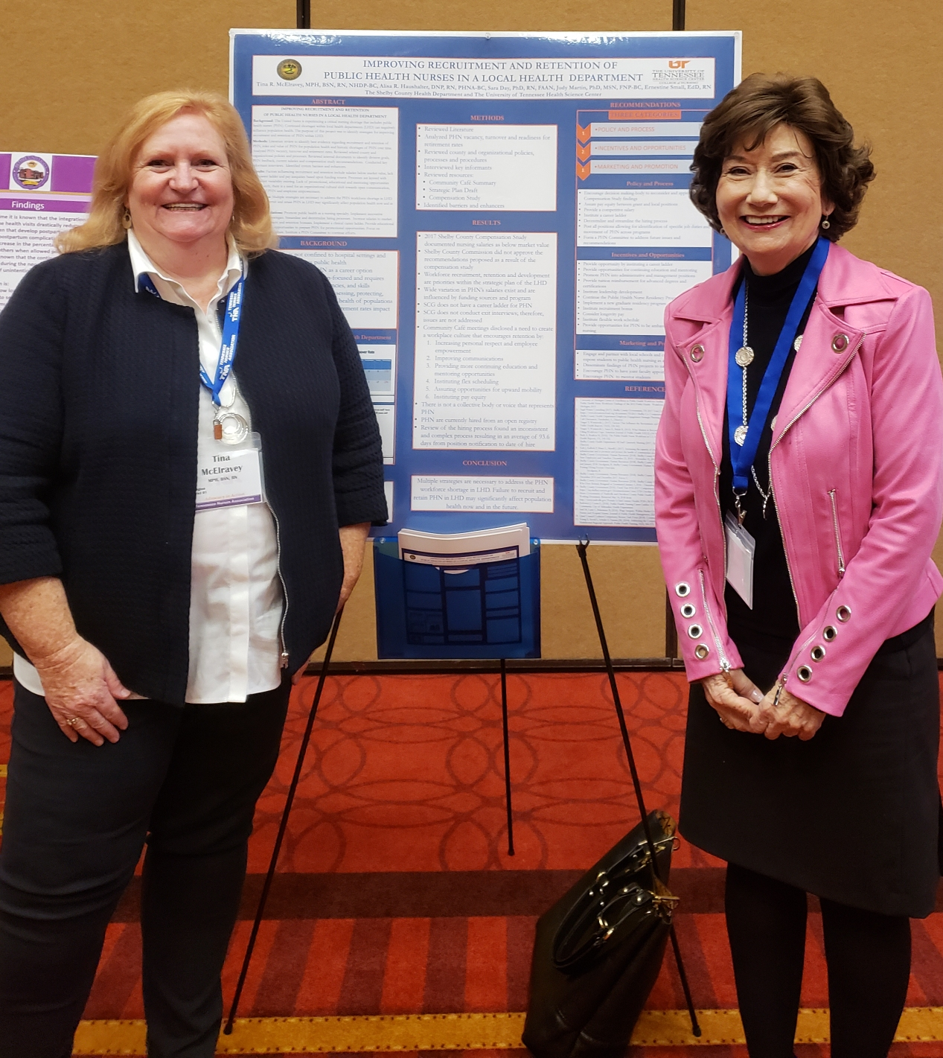

Slide 18
Shelby County Health Department Partnership: Public Health Nurse Residency Program Metrics
Partnership Expansion for Year 2
Develop a 12 month new graduate nurse residency program
Develop a post masters/doctorate public health nurse fellowship
Current Nurse Residency program will become Nurse Scholars Program, new cohort start in 2019

Slide 19
Regional One Health Partnership
Partnership goal: implement and evaluate classroom education and simulation to teach new graduate nurses, experienced nurses and nursing students verbal de-escalation to curtail potentially violent situations.
Grant funded by Tennessee Promise of Nursing

Slide 20
Regional One Health Partnership Metrics
A train the trainer approach used to implement classroom education.
A three-day in-house instructor course provided by Management of Aggressive Behavior (MOAB)
Training to six Regional One Health nurses and two UTHSC, College of Nursing faculty.
All nurses who completed the train the trainer course:
passed a 20-question written exam that focused on the theory portion of the program, which included verbal de-escalation skills.
completed a proficiency test, demonstrating proficiency in all physical skills techniques.

Slide 21
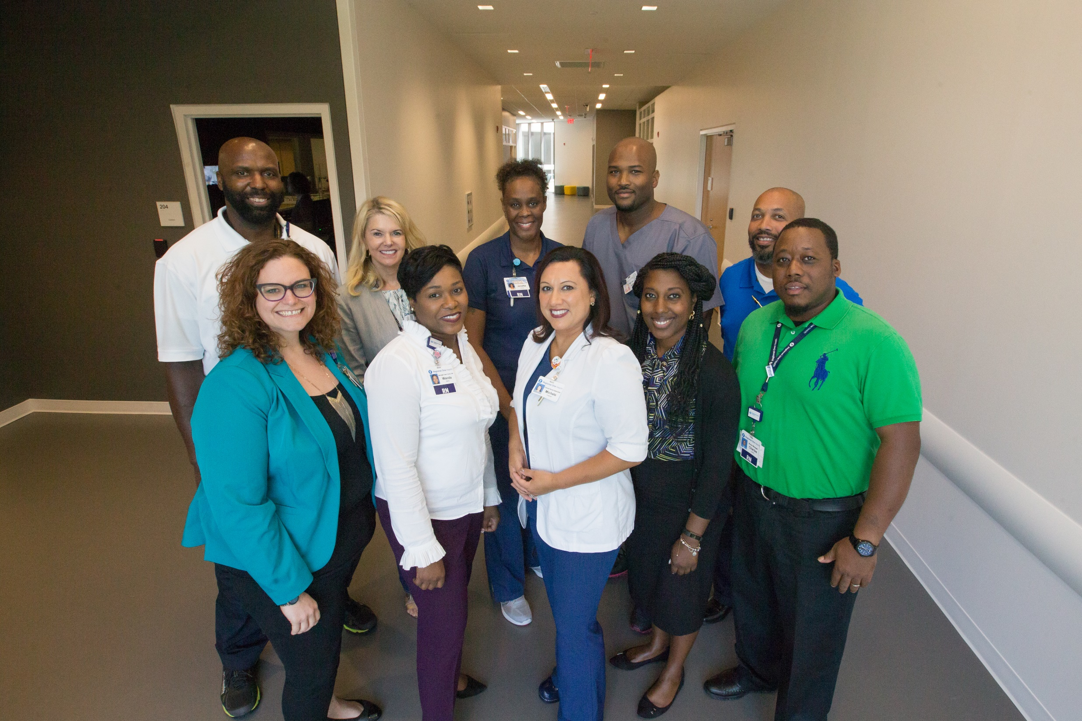

Slide 22
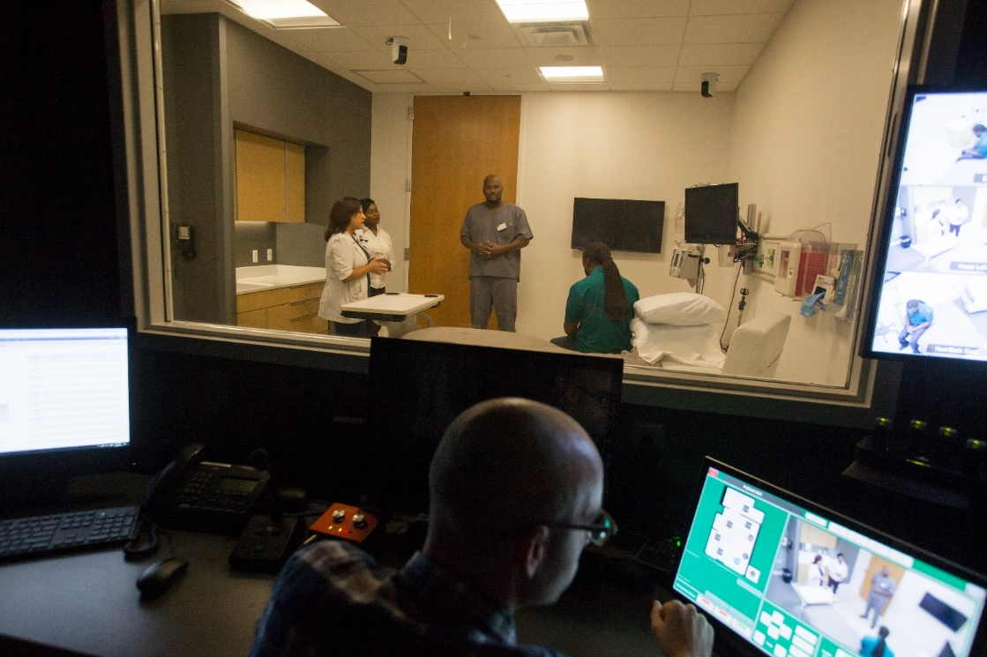
Regional One Health Partnership Metrics
Simulation Training: case scenarios for management of aggressive behaviors were developed and involved the use of standardized patients.
Training occurred on July 11, 2018 at the Center for Healthcare Improvement and Patient Simulation.
De-escalation simulation was videoed and is used to teach the staff
First two de-escalation training sessions for Regional One ER staff were successfully completed on September 14th and September 28th.

Slide 23
St. Jude Children’s Research Hospital Global Partnership
The academic partnership with St. Jude Children’s Research Hospital, Department of Global Medicine provides support for developing and implementing a comprehensive nursing research program.
Partnership Goals:
identify and disseminate opportunities for research funding
present scholarly work at national, and international meetings
publish scholarly work on a regular basis
develop and mentor nursing staff related to research

Slide 24
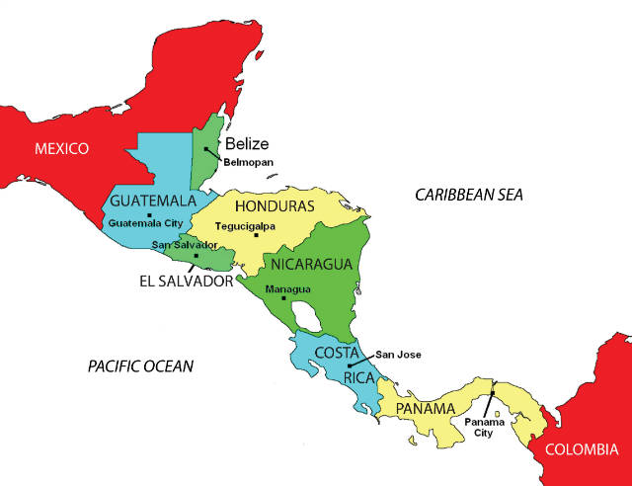
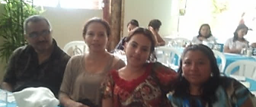
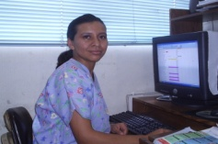
Latin American Center for Pediatric Oncology Nursing Education
México
2008 Tijuana
2010 Monterrey
2010 Culiacán
2013 Teletón
2014 Guadalajara
2015 La Paz
Honduras
2012 (SPS)
2015 (Teg)
Rep. Dominicana
2012 (Santiago)
2016 (Santo Domingo)
Nicaragua
2016
Guatemala
2007
2010
2013
2016 (2)
El Salvador
2007
Colombia
2009 Bogotá
Costa Rica
2013
16 hospitals, 8 countries
Notes:
26 nurse educators (including both trained at El Salvador) from :
8 countries
16 hospitals (Tijuana, Monterrey, Culiacán, Teletón, Guadalajara, La Paz, Santiago, Santo Domingo, El Salvador, Costa Rica, Guatemala, Tegus, SPS, Colombia, Nicaragua, Chile)

Slide 25
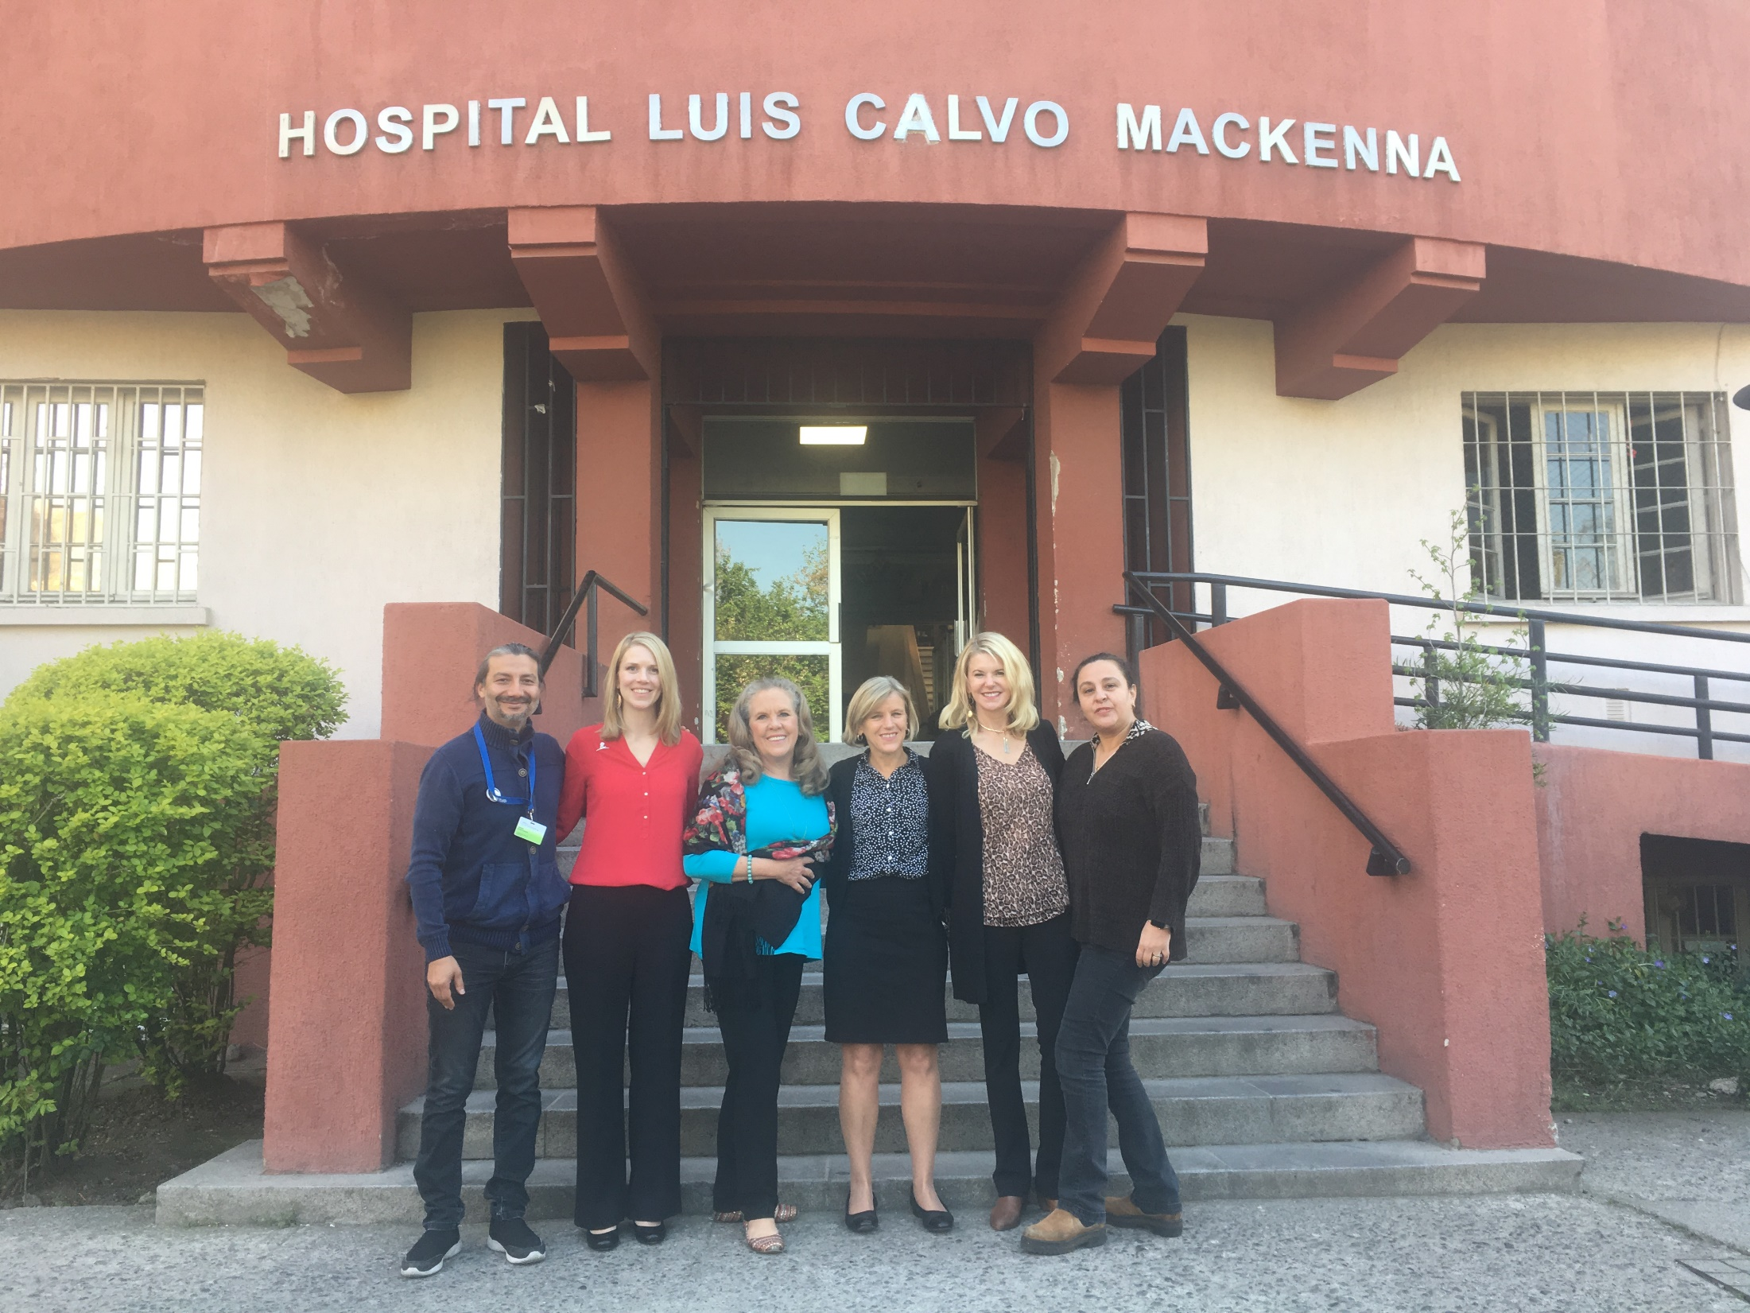

Slide 26
Challenges & Lessons Learned

Slide 27
Challenges
Resistance to culture change:
nursing in Mid South primarily managed by medicine
academic support often not understood
nursing’s impact on clinical outcomes not appreciated
trust with sensitive issues
Need more resources to continue partnership expansion

Slide 28
Lessons Learned
Clarify role of partner site staff designated to support program
Ensure buy in of partner site leadership
Align with partner site strategic plan
Have meaningful joint appointments
Clearly define partner site goals and timeline for achievement
Don’t overcommit!

Slide 29
References
American Association of Colleges of Nursing(2016). Advancing Health Care Transformation: A New Era for Academic Nursing; Retrieved from https://www.manatt.com/getattachment/d58fee3a-2eb1-4490-82d5-94b94d0d5331/attachment.aspx
Institute of Medicine (2010) Future of Nursing Recommendations. Retrieved from https://www.nursingworld.org/practice-policy/iom-future-of-nursing-report

