Slide 1

New Technologies, quality and distance education
Measuring quality in a disruptive world

Slide 2
Presented to SREB-SARA
Regional Steering Committee Meeting June 5, 2019
Elise Scanlon, ESQ

Slide 3
U.S .Students are moving online
Students Enrolled in at Least One Distance Course
Ground Students
Percent Students Enrolled in at Least One Distance Course
25.9%
27.9%
29.2%
31.2%
33.1%
Percent Students Enrolled Exclusively in Distance Courses
11.9%
13.6%
14.0%
14.7%
15.4%
SOURCE: US National Center for Education Statistics (NCES)
3

Slide 4
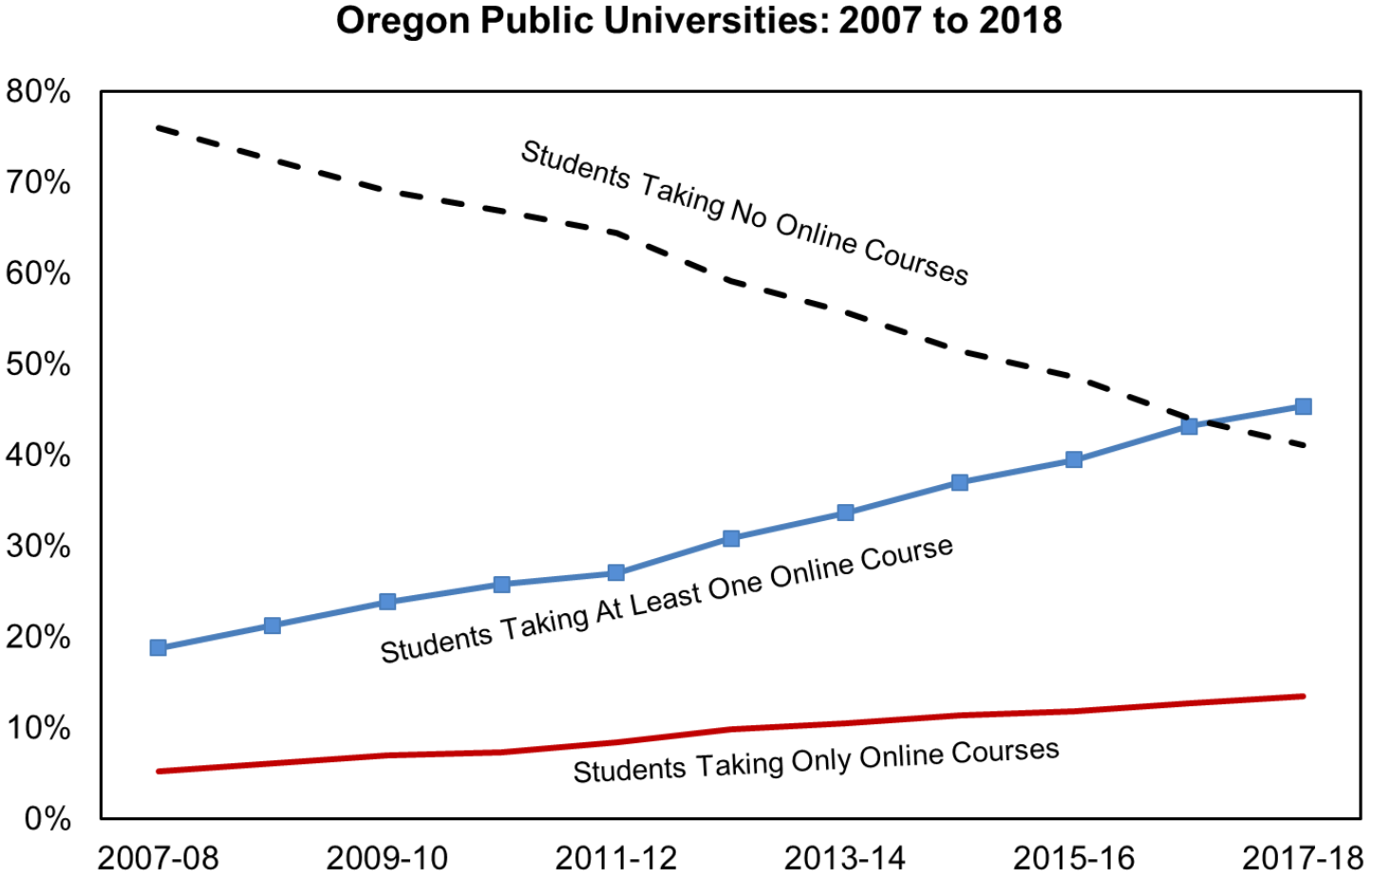
Evidence found at one u.s. university
SOURCE: Oregon Higher Education Coordinating Commission; Office of Research and Data
4

Slide 5
More evidence of Distance Education Growth in the U.S.
Just 5 online universities enroll nearly 500K students

Slide 6



authenticating student work in online learning is Essential to quality assurance
There is a wide variety of authentication technologies commercially available
Selected Authentication Methods
Live ID
Test-taker presents identification to proctor with video recording
Mobile ID
Mobile biometrics authenticate test-taker
Dual log-in technologies (mobile and PC)
Auto ID
Biometrics including keystroke matching, facial recognition, knuckle recognition, and voice recognition
6

Slide 7
Micro credentials – new major trend
Important to watch
89%
#1
70%
51%
Engagement a Priority
Millennials
Skill-Based Hiring
Skill-based Learning
Demand for machine-readable, actionable data about employees & learners
89% HR pros: a recognition system at work improves the employee experience. Lifts productivity & the bottom line.
Almost 75% of workforce, they rank learning & growth as top priority in job selection.
Reduces cost-to-hire by 70%, time-to-train by 50%; Companies organize around skills, not job titles.
51% employers already moving to competency-based microlearning.
$1.6T
81%
85%
43%
Portable, digital, verified achievements
Debt
Certifications Growing
Lack of Trust
Gigs & Freelancing
$1.56T in US student debt and degree half life is short; other credentials are on the rise.
81% of adults with a non-degree credential say it’s very useful for getting a job.
85% of employers found a lie or misrepresentation on a resume or job application.
43% of workforce by 2020 will be free agents, driving demand for trusted skill indicators.
SOURCE: Credly

Slide 8



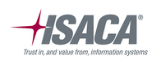





























Credly is a marketplace that houses and verifies micro credentials
20M+ credentials documented
10M+ people; 195 countries
400+ providers and schools
Partners include corporations, training providers, and certification associations
SOURCE: Credly

Slide 9




What about blockchain?
Distributed Ledger
System of record with new transactions propagated to entire network
No single point of failure
Centralized data bases prone to tampering or physical damage
Transparent
Immutable record of all transactions
Secure
Economically impractical and physically challenging to hack
Blockchain – a continuously growing list of records, called blocks, which are linked and secured using cryptography
9

Slide 10
What is the impact to quality assurance?
Regulatory framework must be updated
Universities must focus on the quality of outcomes
Universities must adopt new learning verification models
Online programs require modern quality assurance standards
Accreditation needs to consider the rising tide of the credentialing market place
Online Program Management Systems (OPMs) are dominating university delivery systems

Slide 11
Thank you
Questions/Discussion

