Slide 1
The Institute on Teaching and Mentoring
SLOAN SCHOLARS

Slide 2
The Institute on Teaching and Mentoring
Korie A. Grayson
Biomedical Engineering
Cornell University
Graduation date: May 24, 2020
Dissertation title: Cellular Delivery of TRAIL to Treat Metastatic Castration-Resistant Prostate Cancer
Dissertation chair: Michael R. King, PhD
Current status: Postdoctoral Research Fellow at the University of Michigan

Slide 3
The Institute on Teaching and Mentoring
Darya Marchany-Rivera
Applied Chemistry-Biophysics
University of Puerto Rico, Mayaguez Campus
Graduation date: June 2020
Dissertation title: Crystal structures of hemeproteins: Sulf and H2S Myoglobin derivatives and Lucina pectinata Oxy(HbII-HbIII) and Oxy(HbIII-HbIII) systems
Dissertation chair: Dr. Juan Lopez-Garriga
Current status: Postdoctoral Research Scholar at the Biodesign Center for Immunotherapy, Vaccines and Virotherapy, School of Life Sciences-Arizona State University, Tempe, AZ

Slide 4
The Institute on Teaching and Mentoring
Brittany Nkounkou
Computer Science
Cornel University
Graduation date: August 17, 2020
Dissertation title: Certified Software for Designing Asynchronous Circuits
Dissertation chair: Ross Tate
Current status: Seeking teaching position for 2021

Slide 5
The Institute on Teaching and Mentoring
Toyya A. Pujol
Industrial Engineering
Georgia Institute of Technology
Graduation date: August 6, 2020
Dissertation title: Analytics and Machine Learning for Healthcare Data
Dissertation chair: Nicoleta Serban, PhD
Current status: Assistant Professor at Purdue University

Slide 6
The Institute on Teaching and Mentoring
Jamesa Latanya Stokes
Material Science and Engineering
The Pennsylvania State University
Graduation date: December 21, 2019
Dissertation title: Molten Silicate Reactivity with Environmental Barrier Coatings for Gas Turbine Engine Applications
Dissertation chair: Douglas E. Wolfe
Current status: Materials Research Engineer at NASA Glenn Research Center

Slide 7
The Institute on Teaching and Mentoring
SREB SCHOLARS

Slide 8
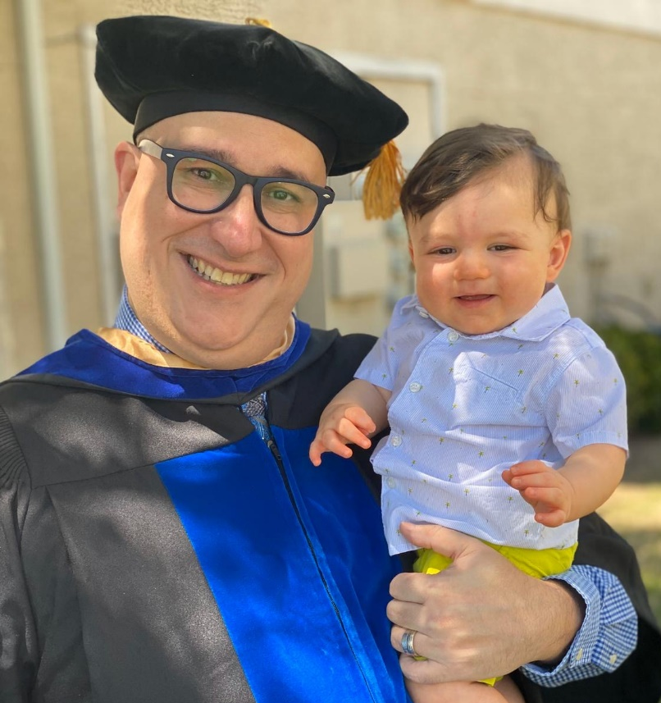
The Institute on Teaching and Mentoring
Carlos David Acosta-Ponce
English Language and Literature
The University of Tulsa
Graduation date: May 8, 2020
Dissertation title: Identity, Oppression, and Upheaval in the British Invasion: The Comics of Alan Moore, Neil Gaiman, Peter Milligan, and Jamie Delano
Dissertation chair: Dr. Robert A. Jackson
Current status: Post-Doctoral Fellow at the University of Tulsa

Slide 9
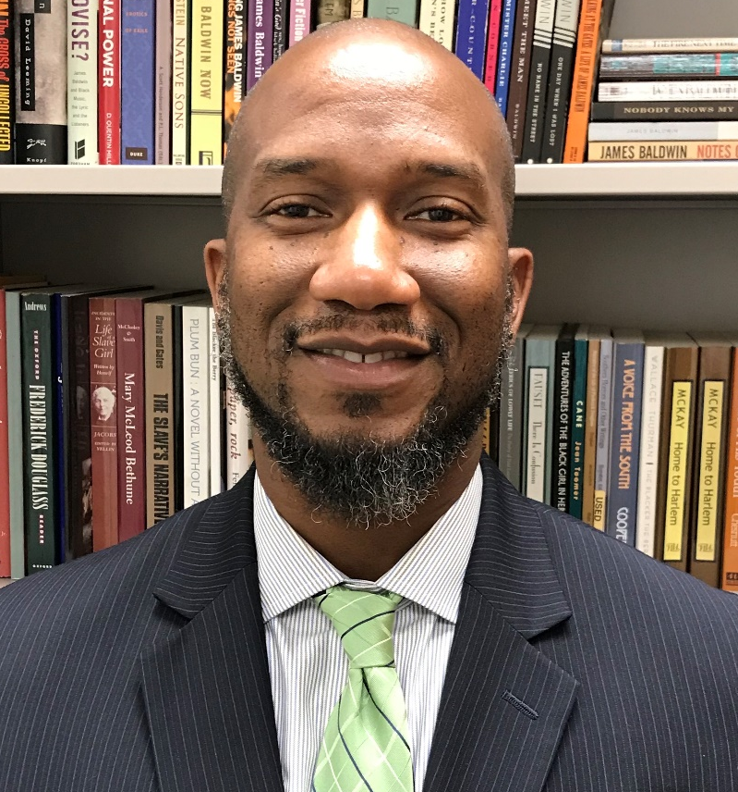
The Institute on Teaching and Mentoring
Ezell Wesley Allen
Educational Psychology and Research
University of Memphis
Graduation date: May 9, 2020
Dissertation title: Performance Beyond Ability: Exploring the Relationship Between Motivation and Mathematics Achievement at Community Colleges
Dissertation chair: Dr. Leigh Harrell-Williams
Current status: Full-Time Mathematics Faculty (Tenure Track)

Slide 10
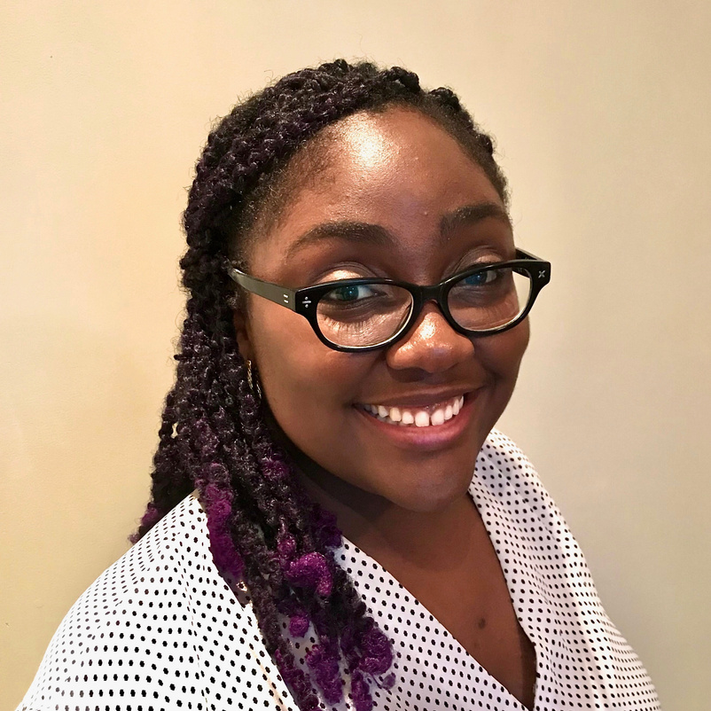
The Institute on Teaching and Mentoring
Keisha April
Clinical Psychology
Drexel University
Graduation date: June 13, 2020
Dissertation title: Let's "Talk" About the Police: The Role of Race and Intergenerational Transmission of Police Legitimacy Attitudes in the Legal Socialization of Youth
Dissertation chair: Naomi Goldstein, PhD
Current status: Postdoctoral Fellow, Department of Applied Psychology, NYU

Slide 11
The Institute on Teaching and Mentoring
Lizzette D. Cambron
Cellular and Molecular Biology
North Dakota State University
Graduation date: August 7, 2020
Dissertation title: Factors Affecting Metabolism During. Non-Feeding Stages in Insects
Dissertation chair: Dr. Kendra J. Greenlee
Current status: applied for a USDA postdoctoral fellowship at Penn State

Slide 12
The Institute on Teaching and Mentoring
Carmen A. Carrion
Educational Psychology
Georgia State University
Graduation date: May 5, 2020
Dissertation title: Do students gain scientific inquiry knowledge and practices by participating in a school garden inquiry unit?
Current status: Research Scientist, Georgia Institute of Technology, Department of Biomedical Engineering

Slide 13
The Institute on Teaching and Mentoring
Henry Dwight Castillo
Chemistry
Indiana University Bloomington
Graduation date: June 2020
Dissertation title: Self-assembly at Solution/Solid Interfaces: Fundamental Assembly Mechanisms and Novel Molecular Design to Program Structure
Dissertation chair: Dr. Steven L. Tait
Current status: Working for Intel as a Technology Development Lithography Module Engineer

Slide 14
The Institute on Teaching and Mentoring
Myron C. Duff Jr.
Urban Education and Leadership
Indiana University-Purdue University-Indianapolis
Graduation date: September 30, 2020
Dissertation title: Adult Learning in the Urban Context: Community Engagement from the Voices of Four Adult Black Males
Dissertation chair: Dr. James J. “Jim” Scheurich
Current status: Associate Director of Admissions/Director of Multicultural Recruitment, Franklin College

Slide 15
The Institute on Teaching and Mentoring
Ikenna Q. Ezealah
Higher Education Leadership
Clemson University
Graduation date: December 18, 2019
Dissertation title: The role of self-reflection in the spiritual quest to make meaning of experiences
Dissertation chair: Dr. Michelle Boettcher
Current status: Instructor

Slide 16
The Institute on Teaching and Mentoring
E’Lisha Victoria Fogle
Parks, Recreation and Tourism Management
Clemson University
Graduation date: May 7, 2020
Dissertation title: Rising Black Voices of the Global South: Understanding Locals' Relationship with Tourism in Livingstone, Zambia
Dissertation chair: Dr. Lauren N. Duffy
Current status: Tenure Track Assistant Professor, The Collins College of Hospitality Management, California State Polytechnic University, Pomona

Slide 17
The Institute on Teaching and Mentoring
Stephanie Fortune-Taylor
Economics
Tulane University of Louisiana
Graduation date: December 2019
Dissertation title: Subgroup Heterogeneity in the Wake of Unpredicted Change
Dissertation chair: Steven Sheffrin
Current status: Economist, United States International Trade Commission

Slide 18
The Institute on Teaching and Mentoring
Kirnel Daniel Grishby
School Psychology
Georgia State University
Graduation date: May 2020
Dissertation title: Preparing Effective Urban Practitioners: The Study of Two Urban-Focused School Psychology Graduate Training Programs
Dissertation chair: Stephen D. Truscott, Psy.D.
Current status: Post Doctoral Fellow

Slide 19
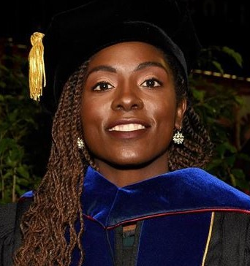
The Institute on Teaching and Mentoring
Miranda Hill
Health Promotion and Behavior
University of Georgia
Graduation date: December 2019
Dissertation title: Characterizing the social networks and ART adherence behaviors of transgender women living with HIV
Dissertation chair: Nathan Hansen
Current status: Postdoctoral Scholar-Fellow, Traineeship in AIDS Prevention Studies (NIH T-32), Center for AIDS Prevention Studies, University of California, San Francisco, Contract Ethnographer & Evaluation Lead, Georgia HIV Surveillance, Georgia Department of Health

Slide 20
The Institute on Teaching and Mentoring
Whitney Nicole McCoy
Teacher Education and Learning Sciences
North Carolina State University
Graduation date: May 8, 2020
Dissertation title: Black Girls Accepting the Grand Challenge: A Qualitative Exploration of a Summer Engineering Program’s Influence on Black Girls’ Racial Identity, Engineering Identity, and STEM Self-Efficacy
Dissertation chair: Jessica T. DeCuir-Gunby, Ph.D.
Current status: Postdoctoral Research Associate

Slide 21
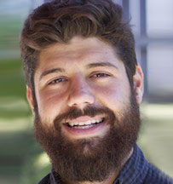
The Institute on Teaching and Mentoring
Timothy P. Monreal
Doctorate of Philosophy, Foundations of Education
University of South Carolina
Graduation date: August 2020
Dissertation title: Hecho en South Carolina: Latinx teachers made in, and remaking, El Sur Latinx
Dissertation chair: Dr. Kara Brown
Current status: Assistant Professor of Teacher Education, California State University, Bakersfield

Slide 22
The Institute on Teaching and Mentoring
Ian D. Parker
Education Administration and Policy
University of Georgia
Graduation date: May 8, 2020
Dissertation title: "Dissatisfaction": A Case Study of Black Middle Class Parents and Private Preschool Choice in Atlanta, Georgia
Dissertation chair: Dr. Sheneka Williams
Current status: on the job market

Slide 23
The Institute on Teaching and Mentoring
Jasmine Denice Parnell-Peake
Molecular & Cell Biology & Genetics
Drexel University College of Medicine
Defense date: June 19, 2020; Virtual Graduation: August 28, 2020
Dissertation title: Characterization of acetaldehyde-induced genomic instability during DNA replication in esophageal keratinocytes
PI: Dr. Eishi Noguchi Committee Chair: Dr. Karen Berkowitz
Current status: PennPORT Postdoctoral Fellow, University of Pennsylvania

Slide 24
The Institute on Teaching and Mentoring
Katrina Black Reed
Philosophy in Parks, Recreation and Tourism Management
Clemson University
Graduation date: December 18, 2019
Dissertation title: The role of out-of-school time programming in predicting Critical reflection and positive outcomes in marginalized youth
Dissertation chair: Edmond Bowers, PhD
Current status: Assistant Professor in Recreation, Parks, and Tourism Management at Penn State Abington

Slide 25
The Institute on Teaching and Mentoring
Mayra A. Román-Rivera
Geography, Coastal Geomorphology
University of South Carolina
Graduation date: December 16, 2019
Dissertation title: Innovative Approaches Using Multispectral Imagery to Detect Nearshore Bars and Elucidate Beach-Dune System Dynamics
Dissertation chair: Dr. Jean T. Ellis
Current status: Research Assistant Carolinas Integrated Science and Assessment University of South Carolina; Co-founder of Good World/Buen Mundo Non-Profit

Slide 26
The Institute on Teaching and Mentoring
Henry Rubén Tarco-Carrera
Romance Languages-Spanish
University of Alabama
Graduation date: July 31, 2020
Dissertation title: En búsqueda del Sumak Kawsay: Hacia un nuevo cine indigenista ecuatoriano del siglo XXI (In Search of Sumak Kawsay: Toward a New Indigenista Ecuadorian Cinema for the Twenty-first Century)
Dissertation chair: Sarah Moody (Chair) and Marie-Eve Monette (Co-Chair)
Current status: Postdoctoral Fellow in Spanish at Belmont University

Slide 27
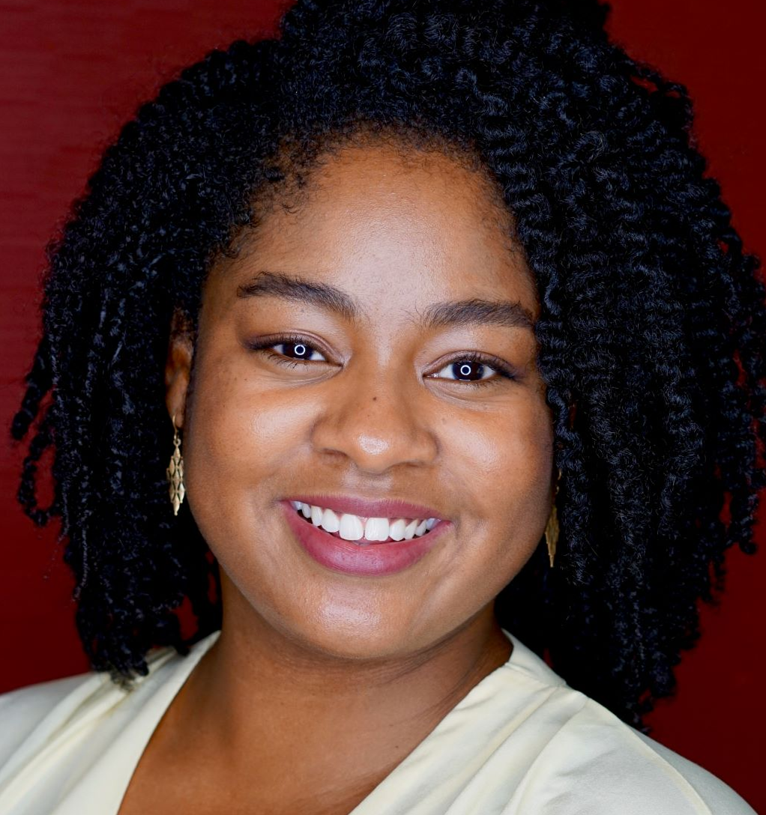
The Institute on Teaching and Mentoring
Naomi Thompson
Learning Sciences
Indiana University
Graduation date: June 2020
Dissertation title: Weaving Together: Exploring How Pluralistic Mathematical Practices Emerge Through Weaving
Dissertation chair: Dr. Kylie Peppler (director)
Current status: Postdoctoral Scholar, School of Education and Social Policy, Northwestern University

Slide 28
The Institute on Teaching and Mentoring
Morika Danielle Williams
Comparative Biomedical Sciences concentration Pharmacology
North Carolina State University
Graduation date: May 9, 2020
Dissertation title: Long-Term Effects of Neonatal Pain on Chronically Painful Conditions
Dissertation chair: Dr. B. Duncan X. Lascelles
Current status: Clinical Fellow in the Division of Comparative Medicine at the University of North Carolina at Chapel Hill

Slide 29
The Institute on Teaching and Mentoring
Francesca Arielle Willaimson
Science Education and Inquiry Methodology
Indiana University, Bloomington
Graduation date: June 30, 2020
Dissertation title: Using Applied Conversation Analysis and Membership Categorization Analysis to Study STEM Graduate Student Teaching Development
Dissertation chair: Jessica Nina Lester and Gayle Buck (co-chairs)
Current status: Postdoctoral Fellow for STEM Education Research at the Center for Urban Ecology and Sustainability at Butler University

Slide 30
The Institute on Teaching and Mentoring
Graduates
Devin Banks
Candace Bethea
Jerquil (JC) Campbell
Isadora Lima Coelho
Eric Corbett
Zola Donovan
Kortney Floyd
Loretta Hsueh
Heather Jeffers
Chartese Jones
Deproux Kadji
Travis Smith
Kofoworola Williams
Jatia Wrighten
Brandon Young
Josh McLoud
Myles Moody

