Slide 1
Electronic Campus
State Partner Meeting
September 13, 2016

Slide 2



SREB’s Electronic Campus
2015
2004
1998
Notes:
Introductions
Name Tents – mal hiccup
What’s Student Access Programs and Services
What's in your packet?
Logistics –
will have hotel checkout break
restrooms
SARA, State Authorization and DOE regulations addressed this afternoon. Will touch on impact of current SARA as it relates to a couple of SAPS programs

Slide 3
SREB Update
Annual Meeting
Electronic Campus State
Partners’ Annual Meeting | New Orleans
Joan Lord
Vice President, Education Data,
Policy Research and Programs
September 13, 2016

Slide 4

First grade readiness
Early grades
Middle grades
High school graduation
Postsecondary credentials
Lifelong learning

Slide 5
SREB’s Focus
Responding to state needs
Working with state partners
Undertaking funded efforts with key partners
Carrying our commissions

Slide 6
SREB’s Focus
Responding to state needs
  Contracts with states
  Ongoing research
    Fact Book on Higher Education
    State progress reports
    Benchmarking policies

Slide 7
SREB’s Focus
Working with state partners
  Doctoral Scholars Program
  Go Alliance & Go Alliance Academy
  Electronic Campus
  SARA
  Academic Common Market
  State Data Exchange
  Electronic Technology Cooperative

Slide 8
SREB’s Focus
Undertaking funded efforts with key partners
  Literacy Design Collaborative
  Math Design Collaborative
  College readiness transition courses
  Educator effectiveness

Slide 9
SREB’s Focus
Carrying out Board commissions
  Literacy -- middle grades and high school
  High school accountability
  Middle grades mission
  College completion
  Early learning
  Career technical education
  Community college
  Computer science
  College affordability
  Teacher preparation

Slide 10
Refreshed Goals
  Early learning
  Career technical education
  Community college

Slide 11
Affordability Is Essential for Student Access and Completion
SREB Annual Meeting and Legislative Work Conference | Little Rock, Arkansas
Cheryl Blanco
Vice President, Postsecondary Education
June 27, 2016

Slide 12

Challenge Goal for Postsecondary Education
Sixty percent of working-age adults will have a postsecondary credential: an associate or bachelor’s degree, or a career certificate.

Slide 13
College affordability is a regional concern
For working-age adults with a credential of value, many Southern states are below the national average.
43% in the region vs. 45% in the U.S.

Slide 14
By 2020, 65% of U.S. jobs and 62% of jobs in the SREB region will require postsecondary education
 | 2020 Percent of jobs needing higher education credential |  | 2020 Percent of jobs needing higher education credential
Alabama | 62% | Mississippi | 51%
Arkansas | 59 | North Carolina | 67
Delaware | 63 | Oklahoma | 64
Florida | 65 | South Carolina | 62
Georgia | 65 | Tennessee | 58
Kentucky | 62 | Texas | 62
Louisiana | 56 | Virginia | 67
Maryland | 69 | West Virginia | 55
Source: Georgetown Center for the Workforce, A Decade Behind: Breaking Out of the Low-Skill Trap in the Southern Economy, 2012.

Slide 15
Many state policies impact college affordability
Readiness for college-level work
Accelerated Options (Early College, dual enrollment, AP)
Time- and credits-to-degree
Statewide guaranteed transfer
Affordable baccalaureate degrees
Pathways from certificates to degrees
Prior learning credit and competency-based learning
Program credit hour caps

Slide 16
Foremost among state policies
Tuition
Appropriations
Financial aid

Slide 17
Resources
Commission report: Shared Responsibility for College Affordability
Individual state affordability profiles
Regional affordability profile
Policy review
College Affordability: Promising State Policies and Practices

Slide 18
SREB Fact Book information
Tuition and fees
Family income needed to pay for tuition and fees
Pell Grants
Federal campus-based financial aid
Federal student loan programs
State scholarships, grants, and other financial aid funds
Debt

Slide 19
SREB Update
… a quick look at your state progress reports
Joan Lord
joan.lord@sreb.org

Slide 20
ETC 2016
Wanda Barker, Director
Educational Technology Cooperative
Notes:
Thank you, Mary, for the opportunity to talk about the Educational Technology Cooperative. For so many years, the Electronic Campus and the ETC have worked together on numerous issues toward improving education in the SREB region. I’m so excited to see all of you, reconnect with familiar faces and get to know the new members.

Slide 21
ETC Core Values, Keys to Success
Engage
Transform
Connect
Engage ETC reps.: events, publications, webinars
Engage education leaders, policy-makers and practitioners
Advocate for PreK-20 educational technology environment that is:
Learner-centered, Adaptive, Innovative and Sustainable.
Shape the technology environment and the educational culture
Promote 10 issues
Help states understand and implement best practices, processes, and policies
Collaborate/Network with ETC reps. and stakeholders
Develop innovative technology solutions together
Cultivate the culture and policies that support technology enhanced learning
http://www.sreb.org/educational-technology-cooperative
Notes:
The vision for the ETC is “advancing education through technology.” We strive to create a culture of collaboration in order to improve education through technology research, best practices, and policy alignment. The ETC core values are to Engage, Transform, and Connect -- Engaging the right people through different forums, transforming the environment or ecosystem for technology innovation, and connecting people, technology, policies, and best practices for an innovative, solution oriented culture.

Slide 22
Initiatives and Accomplishments
10 Issues – Revised for 2016
Spring and Summer Workshop Series
Participation in Computer Science Commission
State Networking Visits
Communication (Listserv, WON, website, social media)
Publications
Research Brief – Direct from the Inside, 2015
Policy Brief – Data Privacy and Security, 2016
Notes:
Some of the highlights of the work of the ETC this year include: revising the 10 Issues. Last fall our ETC members chose the new 10 issues and we have been working on defining the issues and will have publications ready soon on the initial phase for the issues. We conducted both a spring and summer workshop series this year. Our summer series was focused on ADA compliance and assistive technologies to help students with special needs to have the same engaging experiences in distance education as a traditional student has. This year I’ve participated in the Computer Science Commission and we should have a publication in the near future for recommendations for states to improve recruitment and graduation of students in IT and Computer Science fields. Another initiative is the Intrastate Networking visits, where I’ve been convening education agency leaders from K-20 and their educational partners from research and education networks, technology centers, longitudinal data system partners, public broadcasting agencies, state or agency library systems, and others who are involved in education. We hope to improve collaboration and networking across agencies and across states to create technology efficiencies and to discuss state’s needs or initiatives, as well as to replicate successful models in other states. The visits have been great fun and great conversation and have been wonderful for getting to know the ETC members much better. We have also been working toward better communication with ETC members through our listserv, Worthy of Note, our new and improved website, and social media posts. Another important part of ETC is publication of research and policy briefs. Our two most recent brief, Direct from the Inside, and Data Privacy and Security, have been published on our website if you’re interested.

Slide 23
Want to be Involved?
Agency Membership
Associate Membership
Contact Wanda Barker for details:
Wanda.Barker@SREB.org
404-879-5558
Notes:
Any questions, ideas, suggestions or comments? If you would like to become involved with the ETC, please give me a call or send an email message. We have agency level memberships for each state, but have also recently opened up associate memberships to other agencies that report to coordinating boards or councils, or departments of education, as well as supportive organizations like the research and education networks or other partners in public education. I’ll be happy to send you details if you would like more information.

Slide 24

Student Access Programs and
Services Updates
Accessibility for students with long standing SREB programs Academic Common Market and Regional Contract Program
Academic Common Market
  Students & Uncommon Programs
  Tuition Savings
Regional Contract Program
Adult Degree Completion and TheAdultLearner.org
Phil Moss, Sr. Policy Advisory, TheAdultLearner.org
Notes:
RCP
Over 700 hundred students a year
Dental, Medical, Osteopathic, Optometry, Podiatry, Vet Med
States participating for students: Arkansas, Delaware, Georgia, Kentucky, Louisiana, Mississippi, South Carolina

Slide 25
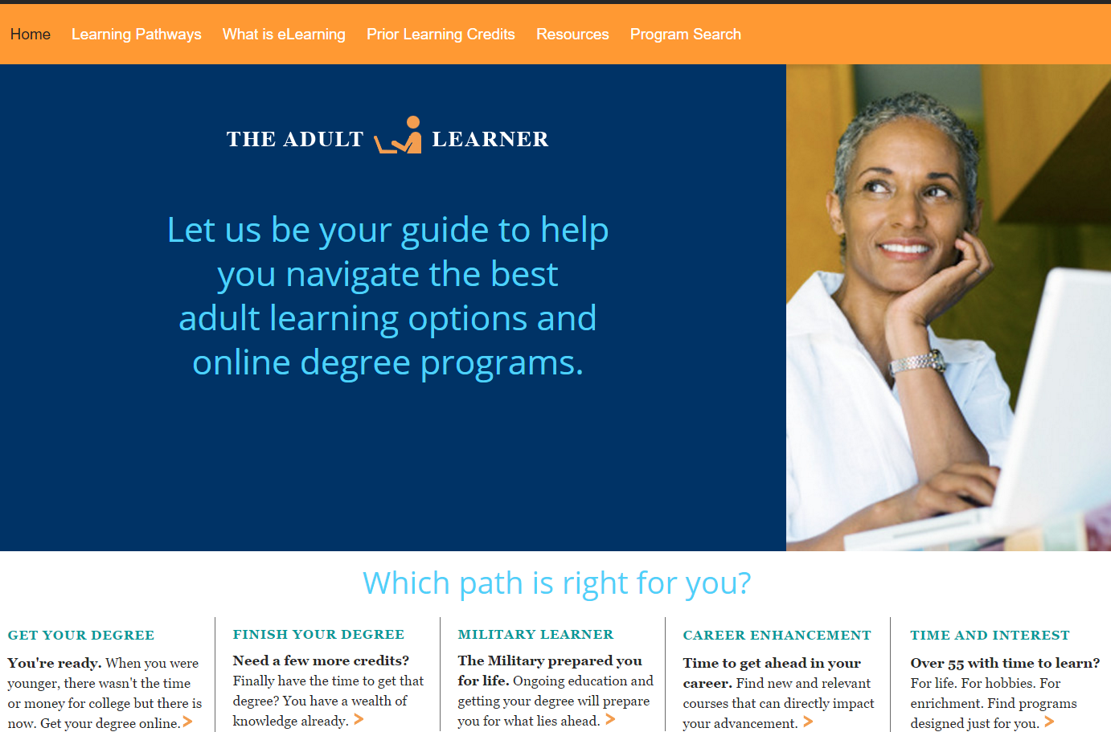
www.TheAdultLearner.org

Slide 26
State Reports
Adult Degree Completion
Statewide Online Initiatives

Slide 27
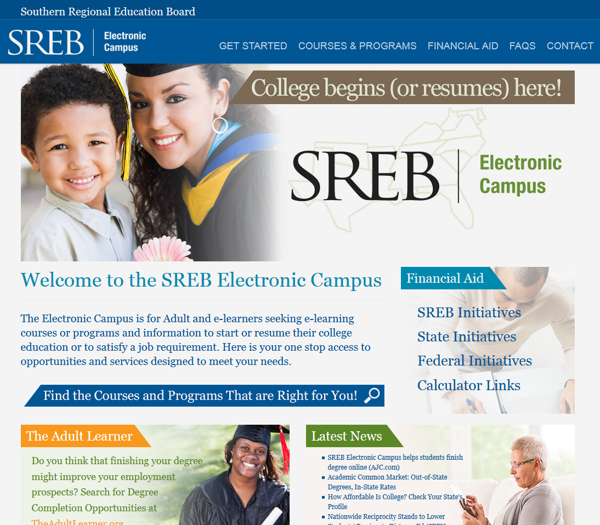
Electronic Campus

Slide 28
SREB’s Electronic Campus - Why
The driving force creating the Electronic Campus was reciprocity for the courses and programs listed on the EC – because they met the Principles of Good Practice and Common Standards
SREB's Electronic Campus Regional Reciprocity Agreement (SECRRA)
Notes:
What was the policy implication for EC creation? State Authorization
The driving force creating the Electronic Campus was reciprocity for the courses and programs listed on the EC – because they met the Principles of Good Practice and Common Standards
SREB's Electronic Campus Regional Reciprocity Agreement (SECRRA)

Slide 29
SREB’s Electronic Campus (EC)
Launched in 1998 with 100 courses.
More than 4,500 programs
Institutions are regionally accredited,
not-for-profit and chartered in a SREB
State review and approval
Institutions meet Principles of Good Practice

Slide 30
SREB’s Electronic Campus Regional Reciprocity Agreement (SECRRA)
All16 SREB states participate in SECRRA
Voluntary for states and institutions
Institutions participate only if state joins
Limited to for-credit online courses and programs activated on the Electronic Campus
SECRRA was the only regional reciprocity agreement in the nation until 2014
Notes:
RECIPROCAL…states not agreeing to participate will be required to seek approval in other SREB states

Slide 31
SECRRA to SARA
Consistent Use of Physical Presence
All degree-granting postsecondary institutions from all sectors
Student Complaint Process formalized
Institution approved
  Not specific courses and programs
Reduced authorization “costs”
Notes:
RECIPROCAL…states not agreeing to participate will be required to seek approval in other SREB states

Slide 32

SECRRA to SARA
SREB is fully supportive of the national State Authorization Reciprocity Agreements (SARA)
Cannot have a ‘competing’ reciprocity process
Will impact Academic Common Market/Electronic Campus and Regional Contract Program (RCP)

Slide 33
When – The Specifics
June 30, 2017.
    Non-SARA and SARA institutions – to maintain student coverage - SECRRA institutions will continue to maintain SECRRA and reciprocity with the other SREB states.
    Non-SARA institutions in SREB SARA states will need to seek authorization from all states including the SREB region.
    Institutions in SREB Non-SARA states will need to seek authorization from all states including the SREB region.
Notes:
Start Now!

Slide 34
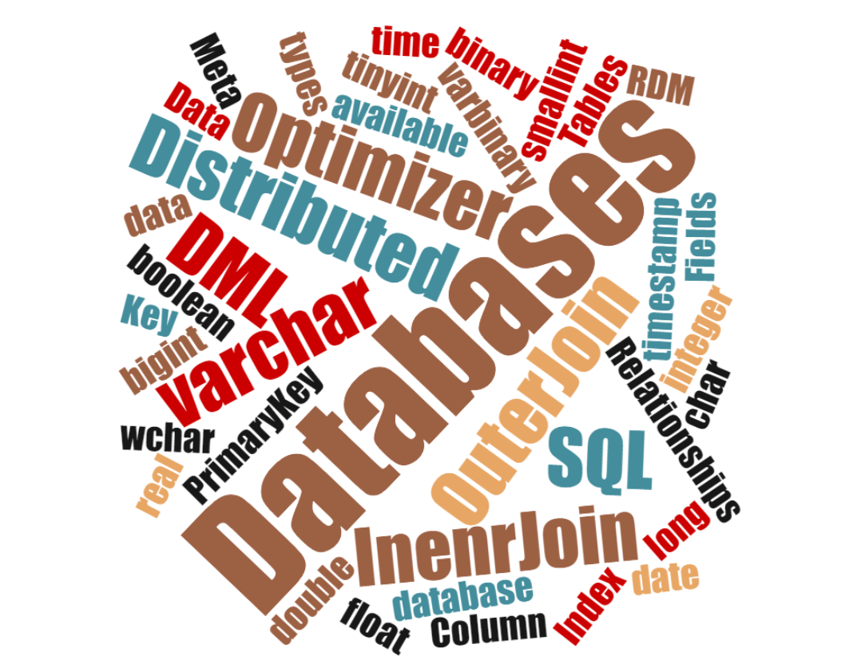
Notes:
Data Type - The basic kind of data that can be stored in a column. The data types that are available in RDM SQL are: char, wchar, varchar, wvarchar, binary, varbinary, boolean, tinyint, smallint, integer, bigint, real, float, double, date, time, timestamp, long varbinary, long varchar, and long wvarchar.
Column – A single unit of named data that has a particular data type (e.g., number, text, or date). Columns only exist in tables.
Distributed Database – A database in which its data is distributed among multiple computers or devices (nodes) allowing multiple computers to simultaneously access data residing on separate nodes. The Internet of Things (IoT) is frequently considered a vast grid of data collection devices, requiring distributed database functionality to manage.
DML – Database Manipulation Language. In SQL, such statements as UPDATE, INSERT and DELETE are considered DML.
Index – A separate structure that allows fast access to a table’s rows based on the data values of the columns used in the index. RDM supports two indexing types: hash and b-tree. A SQL key (not foreign key) is implemented using an index.
Meta-data – “Data about data.” In a DBMS context, data stored in columns of a table have certain attributes to them such as the type, length, description or other characteristics that allow the DBMS to process the data meaningfully, or the users to understand it better
Join -oin – An operation in which the rows of one table are related to the rows of another through common column value
Optimizer – A component of the SQL system that estimates the optimum, (i.e., fastest) method to access the database data that requested is by particular SQL SELECT, UPDATE, or DELETE statement.
Outer Join – A join formed between two tables that in addition to including the rows from the two tables with matching join column values will also include the values from one table that do not have matching rows in the other.
Primary Key – A column or group of columns in a given table that uniquely identify each row of the table. The primary key is used in conjunction with a foreign key in another (or even the same) table to related the two tables together. For example, the primary key in an author table would match the foreign key in a book table in order to relate a particular author to that author’s books.

Slide 35
SREB EC to SARA EC
Anticipated…………July 1, 2017
  Programs - Fewer Fields
All SARA Participants
Student Focused including Military
Expands Access with Greater Depth of Programs
Adult Degree Completion Programs
    Meeting 4 Guiding Principles
Quality Standards Remain
Sharing Resources – Across the Nation
Notes:
Programs must be offered in an online or blended (hybrid) format
Program courses must be offered in an flexible academic format
Institutions offering degree completion programs must be “adult-friendly” (ALFI Principles)
Institutions must provide options for Prior Learning Assessment (PLA) and should recognize and apply previously earned credits toward eligible degree programs.
Prior Learning Assessment is not just one method or tool
Prior Learning Assessment is more than the acceptance of transferable credits.

Slide 36
SREB EC to SARA EC
What worked?
What didn’t?
What should have been included?
Notes:
RECIPROCAL…states not agreeing to participate will be required to seek approval in other SREB states

Slide 37
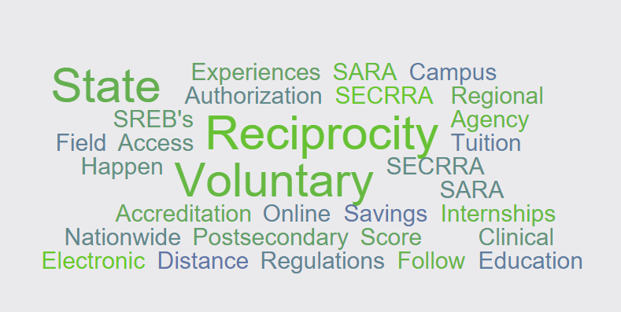
For more information: www.nc-sara.org
  To receive the SREB State Authorization e-mail mary.larson@sreb.org
  SREB SARA Websites www.sreb.org/SARA

Slide 38
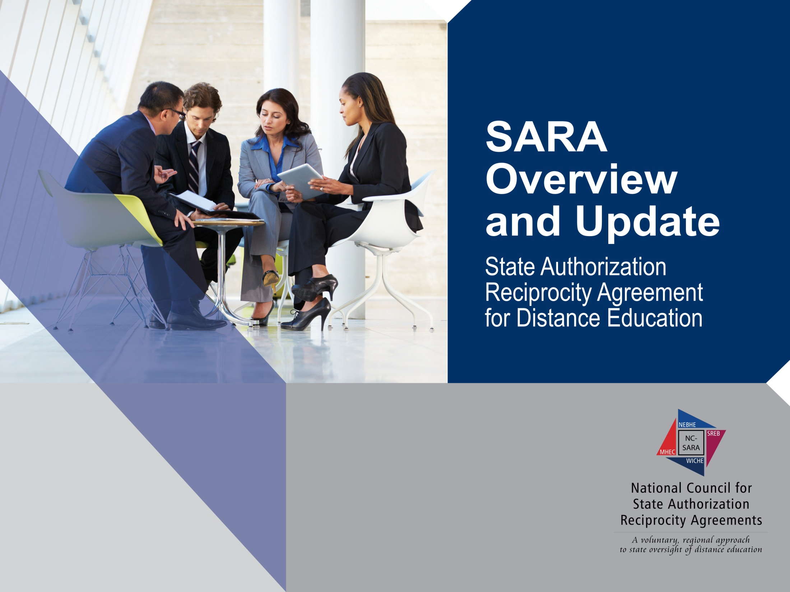
John Lopez, PhD
Deputy Director, NC-SARA
SREB, Electronic Campus Meeting
New Orleans, Louisiana
September 13, 2016

Slide 39

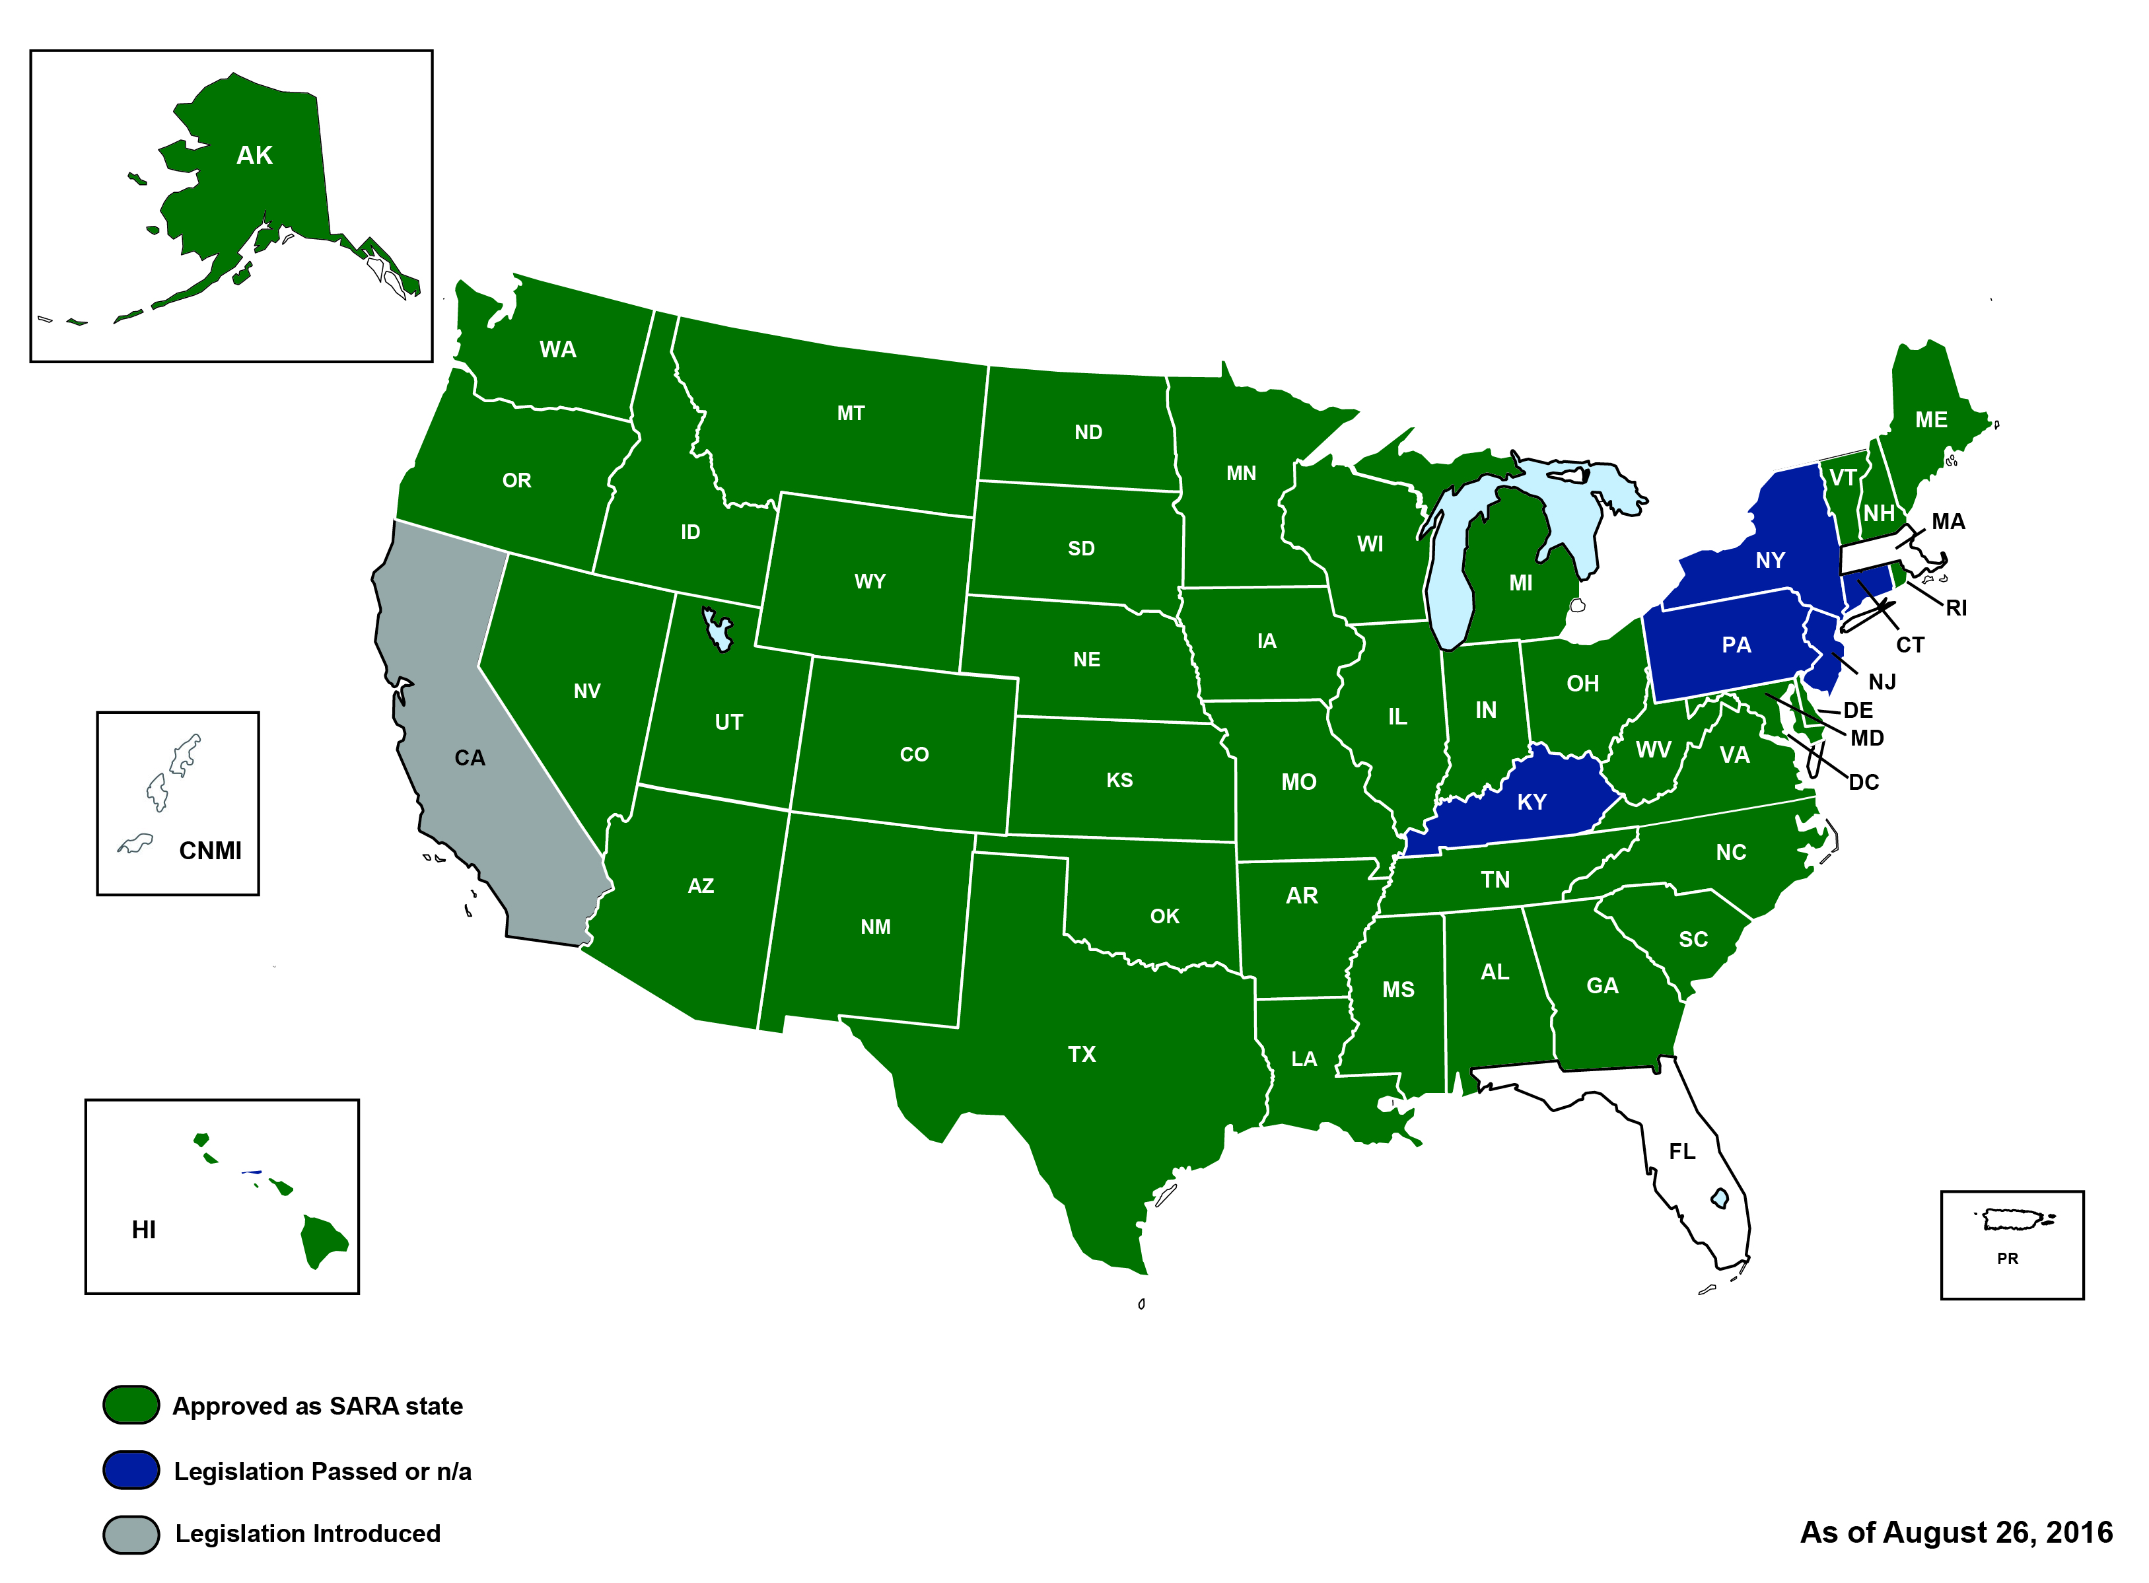
The Current SARA Landscape

Slide 40

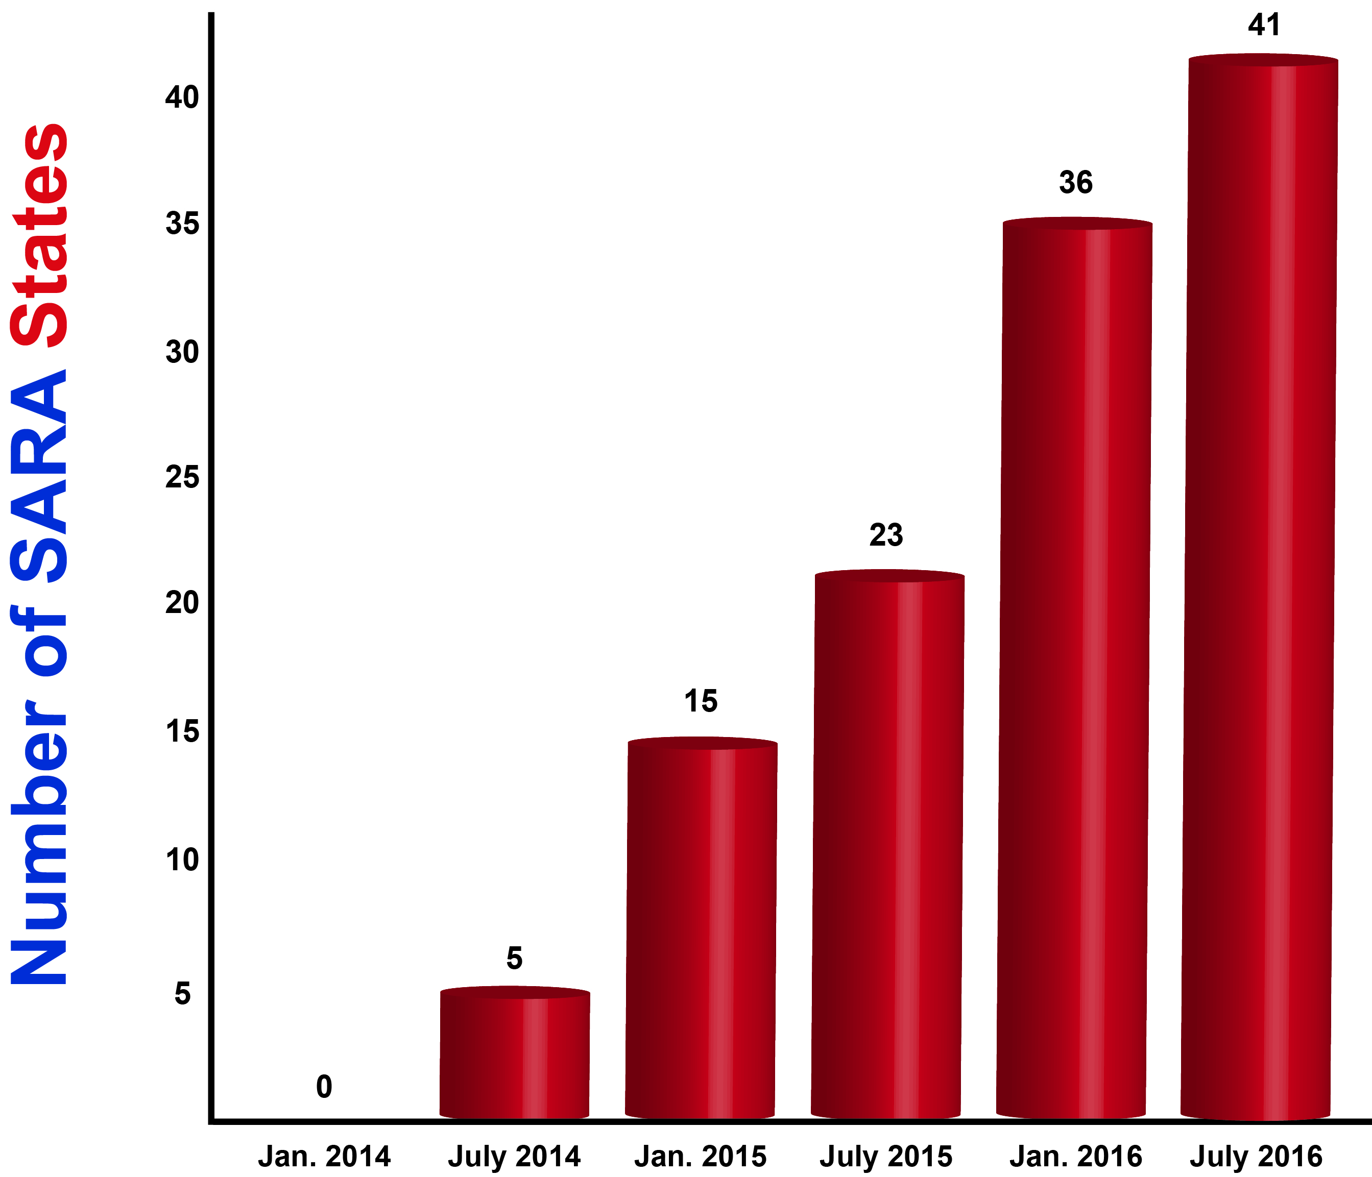
Participating States

Slide 41
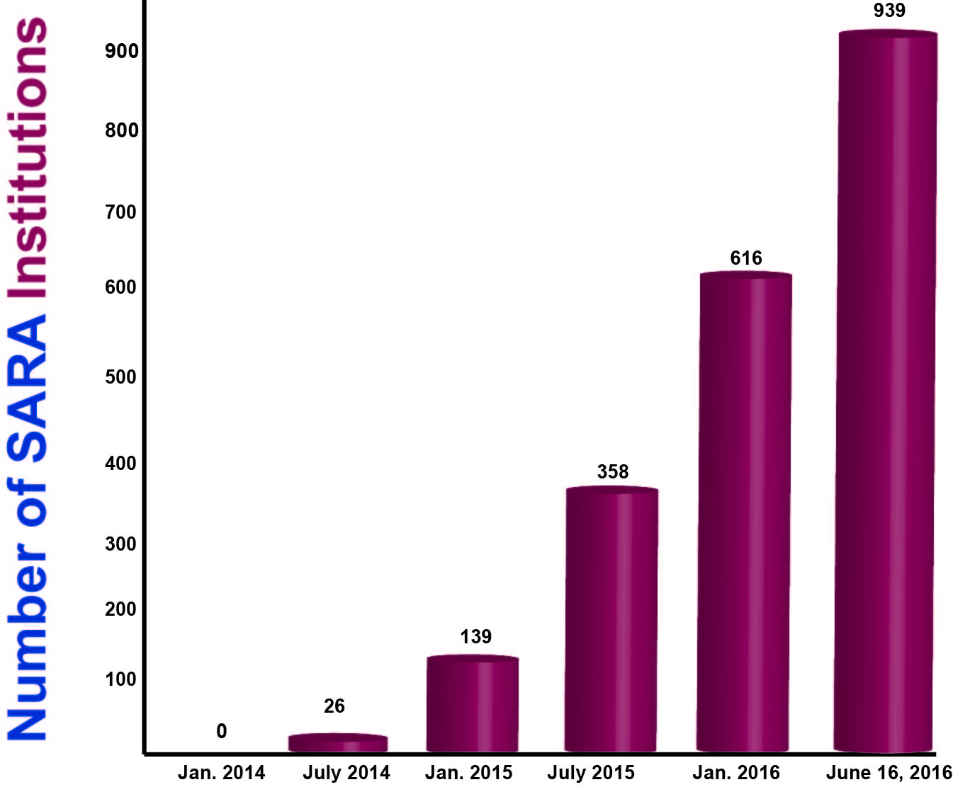
Participating Institutions

Slide 42

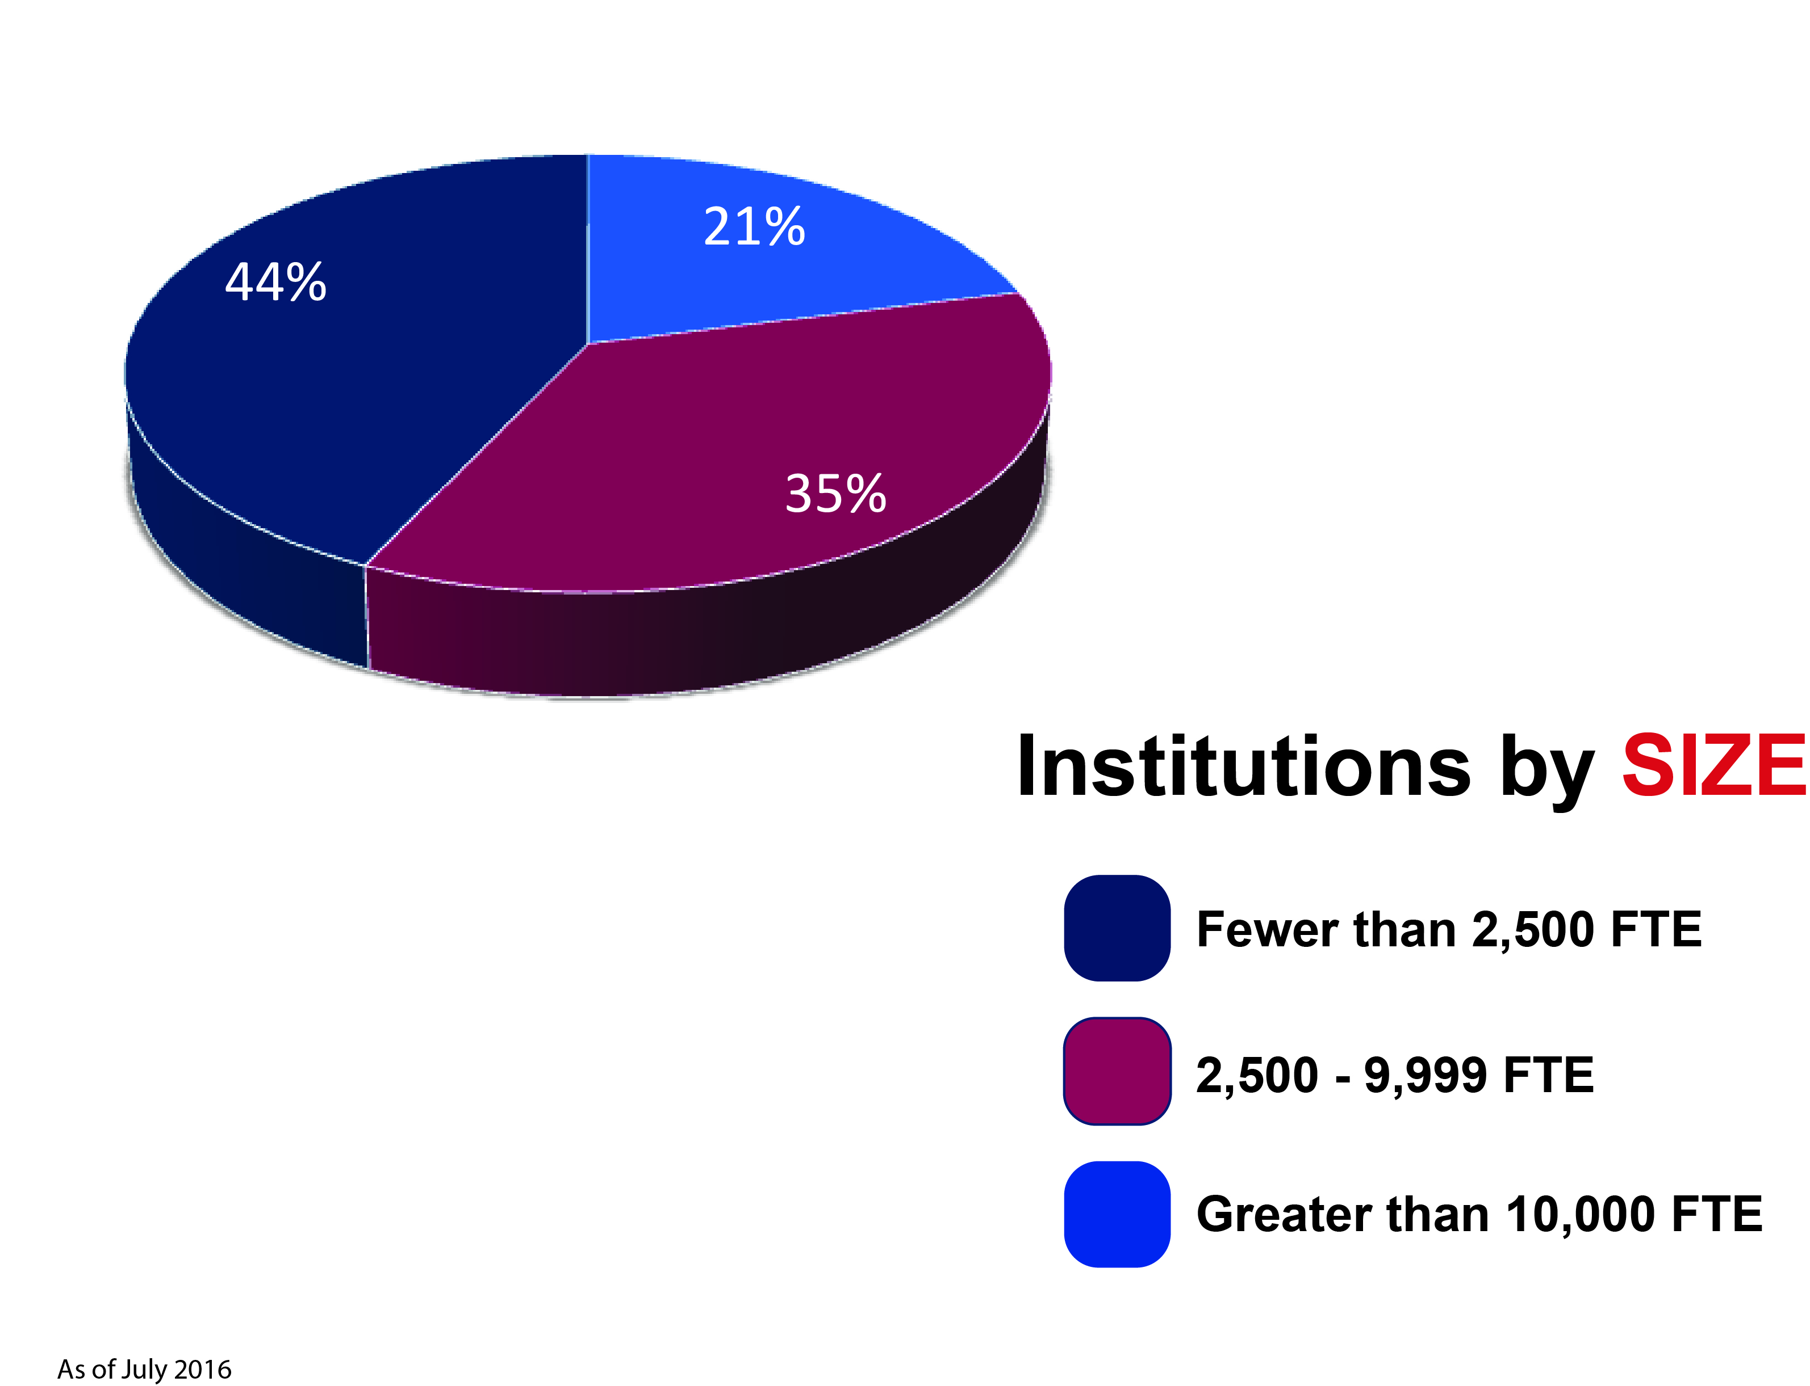
Participating Institutions
As of July 2016

Slide 43
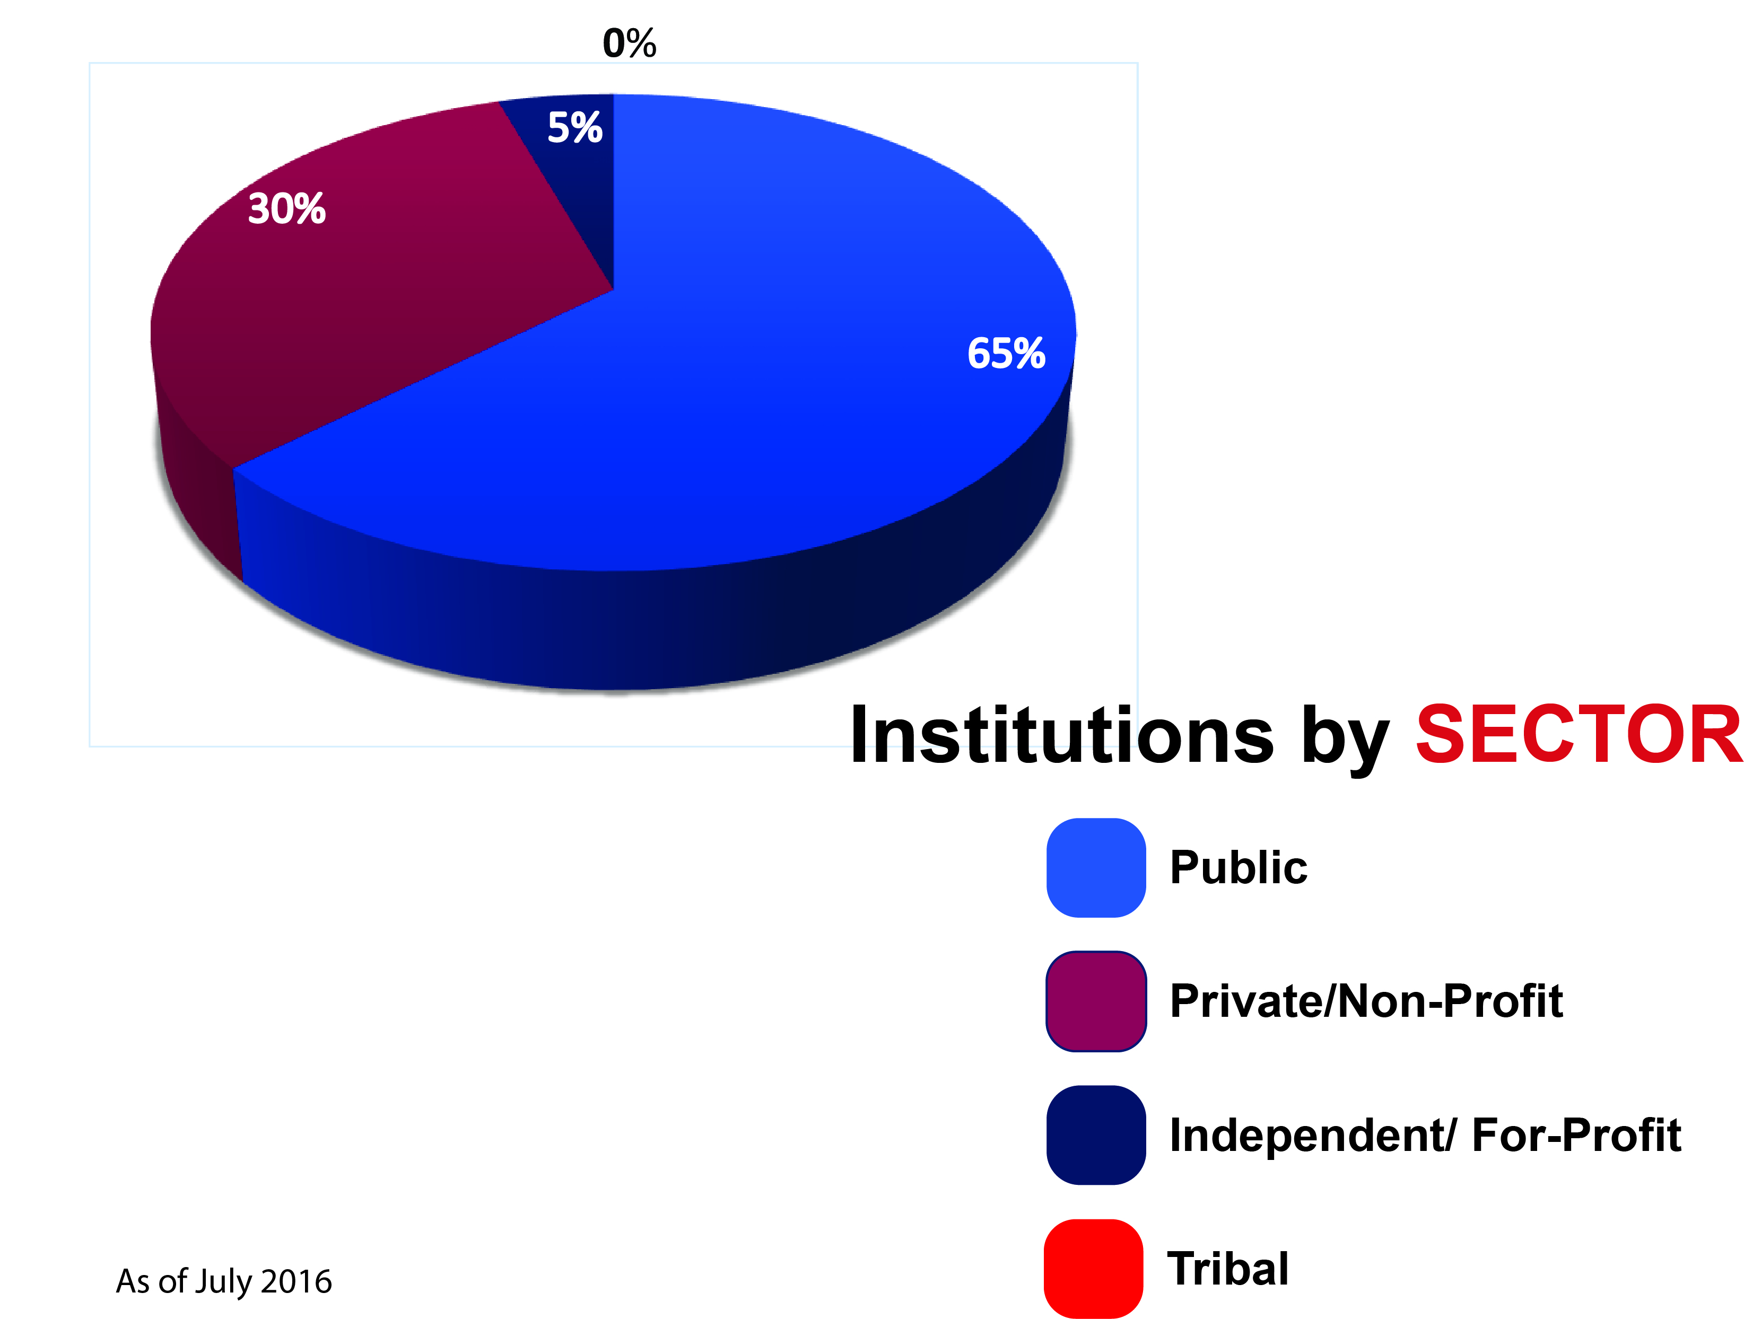
Participating Institutions
As of July 2016

Slide 44
Relevant Topics
ED draft regulations re state authorization of distance ed
CA, CT, FL, KY, MA, NJ, NY and PA
Policy interpretations (scenarios)
Enrollment and complaint reporting
State and institutional renewals
Composite score working group
Consortium agreements working group
SARA EC
NC-SARA as a 501(c)(3)
ACICS accreditation and SARA

Slide 45
Questions?
Mary Larson, mary.larson@sreb.org
John Lopez, jlopez@nc-sara.org

Slide 46
Update on Federal Regulations and WCET/SAN Activities
Russ Poulin
Director of Policy and Analysis, WICHE Cooperative for
Educational Technologies (WCET)
Frontiers. Trekking through the e-learning policy and practice wilderness
https://wcetfrontiers.org/

