Slide 1
Key Takeaways:
PreK-12 Educator Compensation Data
Trends and Highlights from Our Latest Analysis
through the 2023-2024 Academic Year

Slide 2


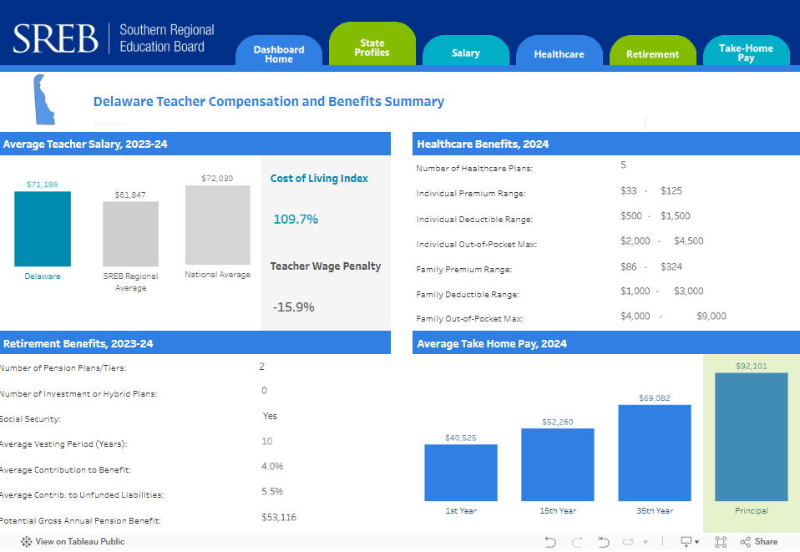

EDUCATOR
COMPENSATION
DATA
  SREB STATES
SREB.org/TeacherCompensation

Slide 3
Teacher compensation is about more than just salaries.
Each year, SREB tracks and analyzes teacher compensation data across 16 states in the SREB region to help inform one aspect to recruiting and retaining teachers.
This work is part of a broader set of data and research efforts by SREB to help policymakers, district and school leaders and other advocates improve the attractiveness of the education profession
This deck presents highlights from our most recent educator compensation analysis of the 2023-2024 academic year.

Slide 4
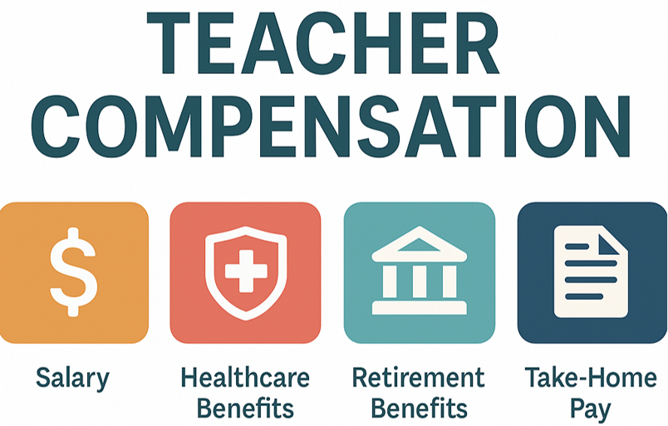
Compensation: A Package Deal
Educators, like all other workforces, are compensated for their work through a package of financial (and non-monetary) benefits. Key package elements include base salaries, bonuses or incentive pay, health and life insurance, retirement, paid time off, and generally satisfactory working conditions.
SREB examines the regional data for these four elements:

Slide 5
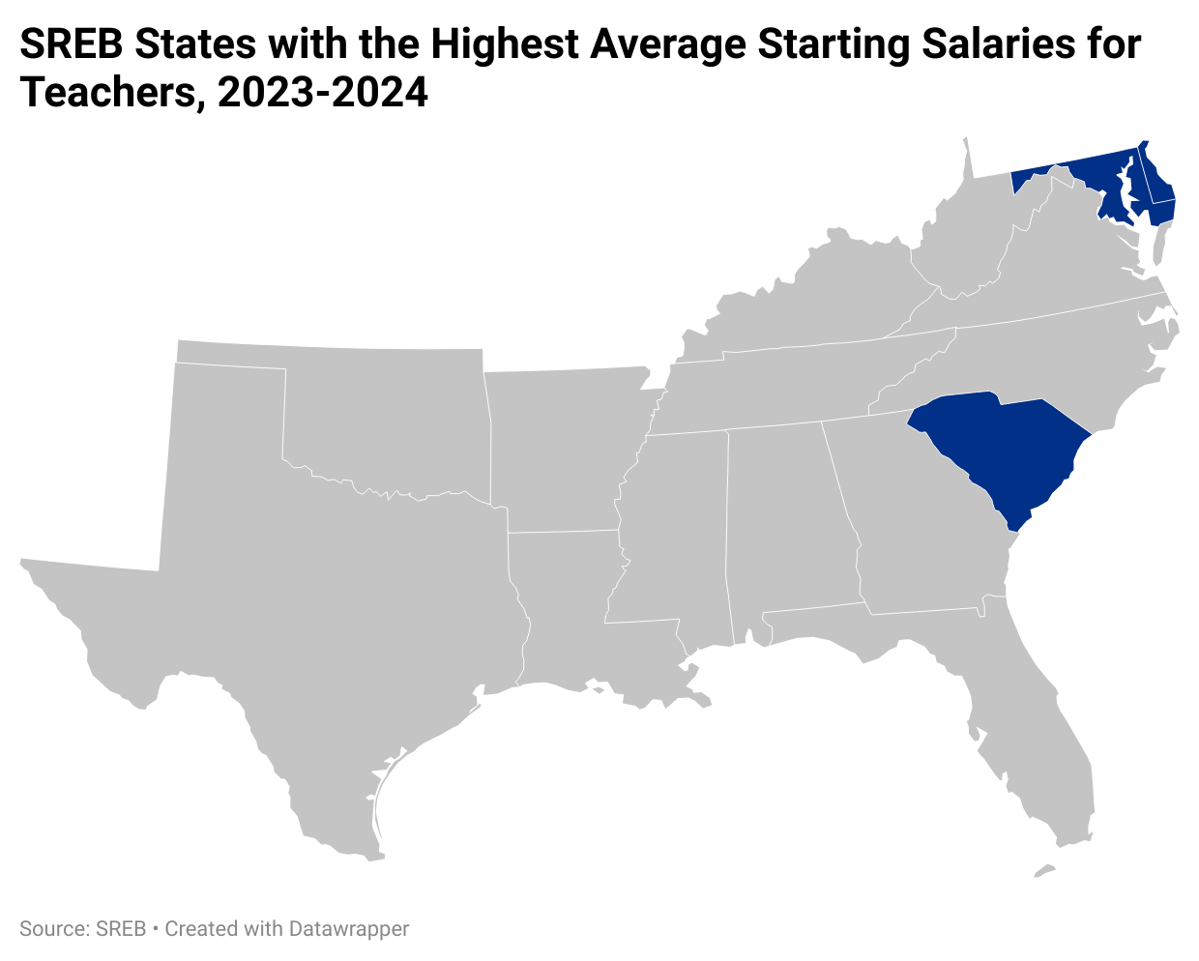
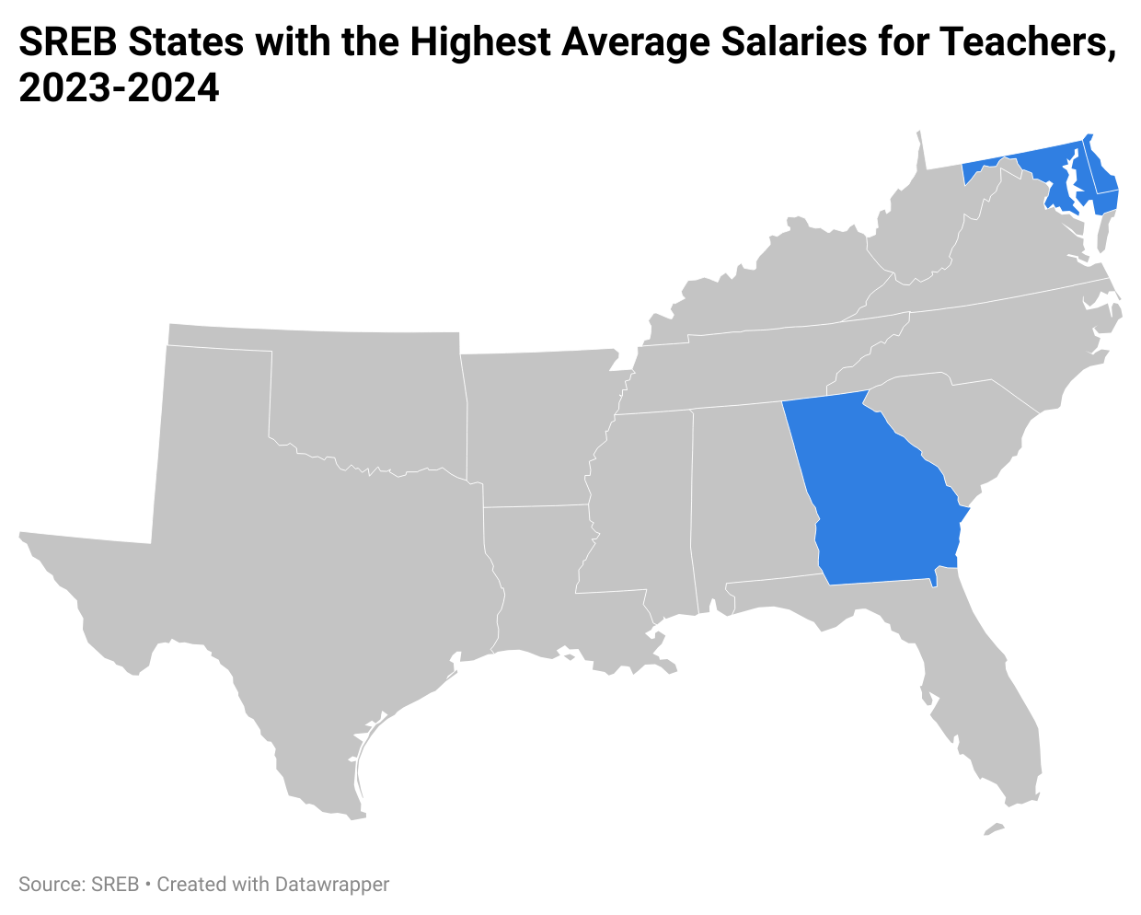
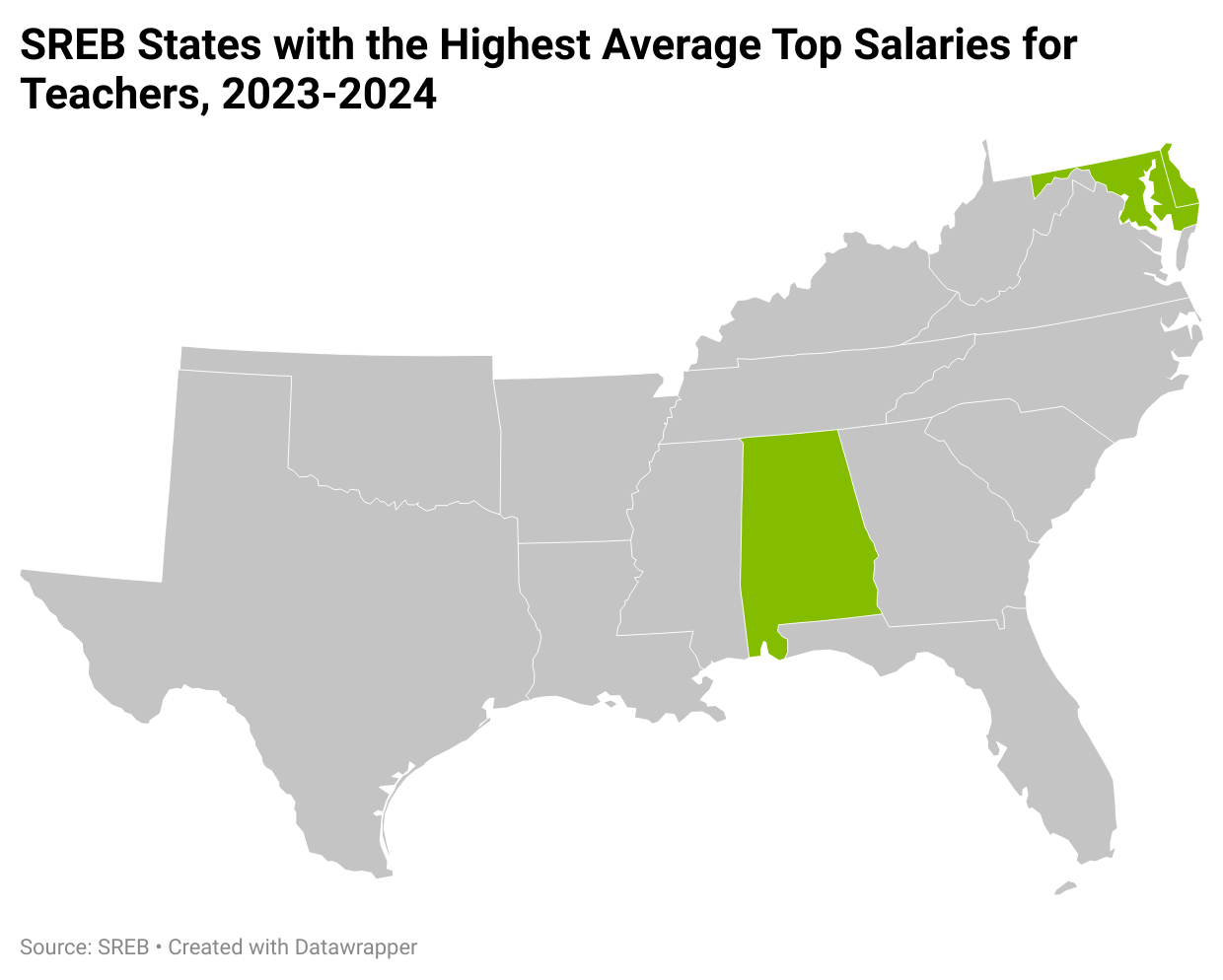
Average K-12 Educator Salaries
Maryland and Delaware consistently offer the highest starting salary, average salary, and average top salary. Salary varies across the SREB region.

Slide 6
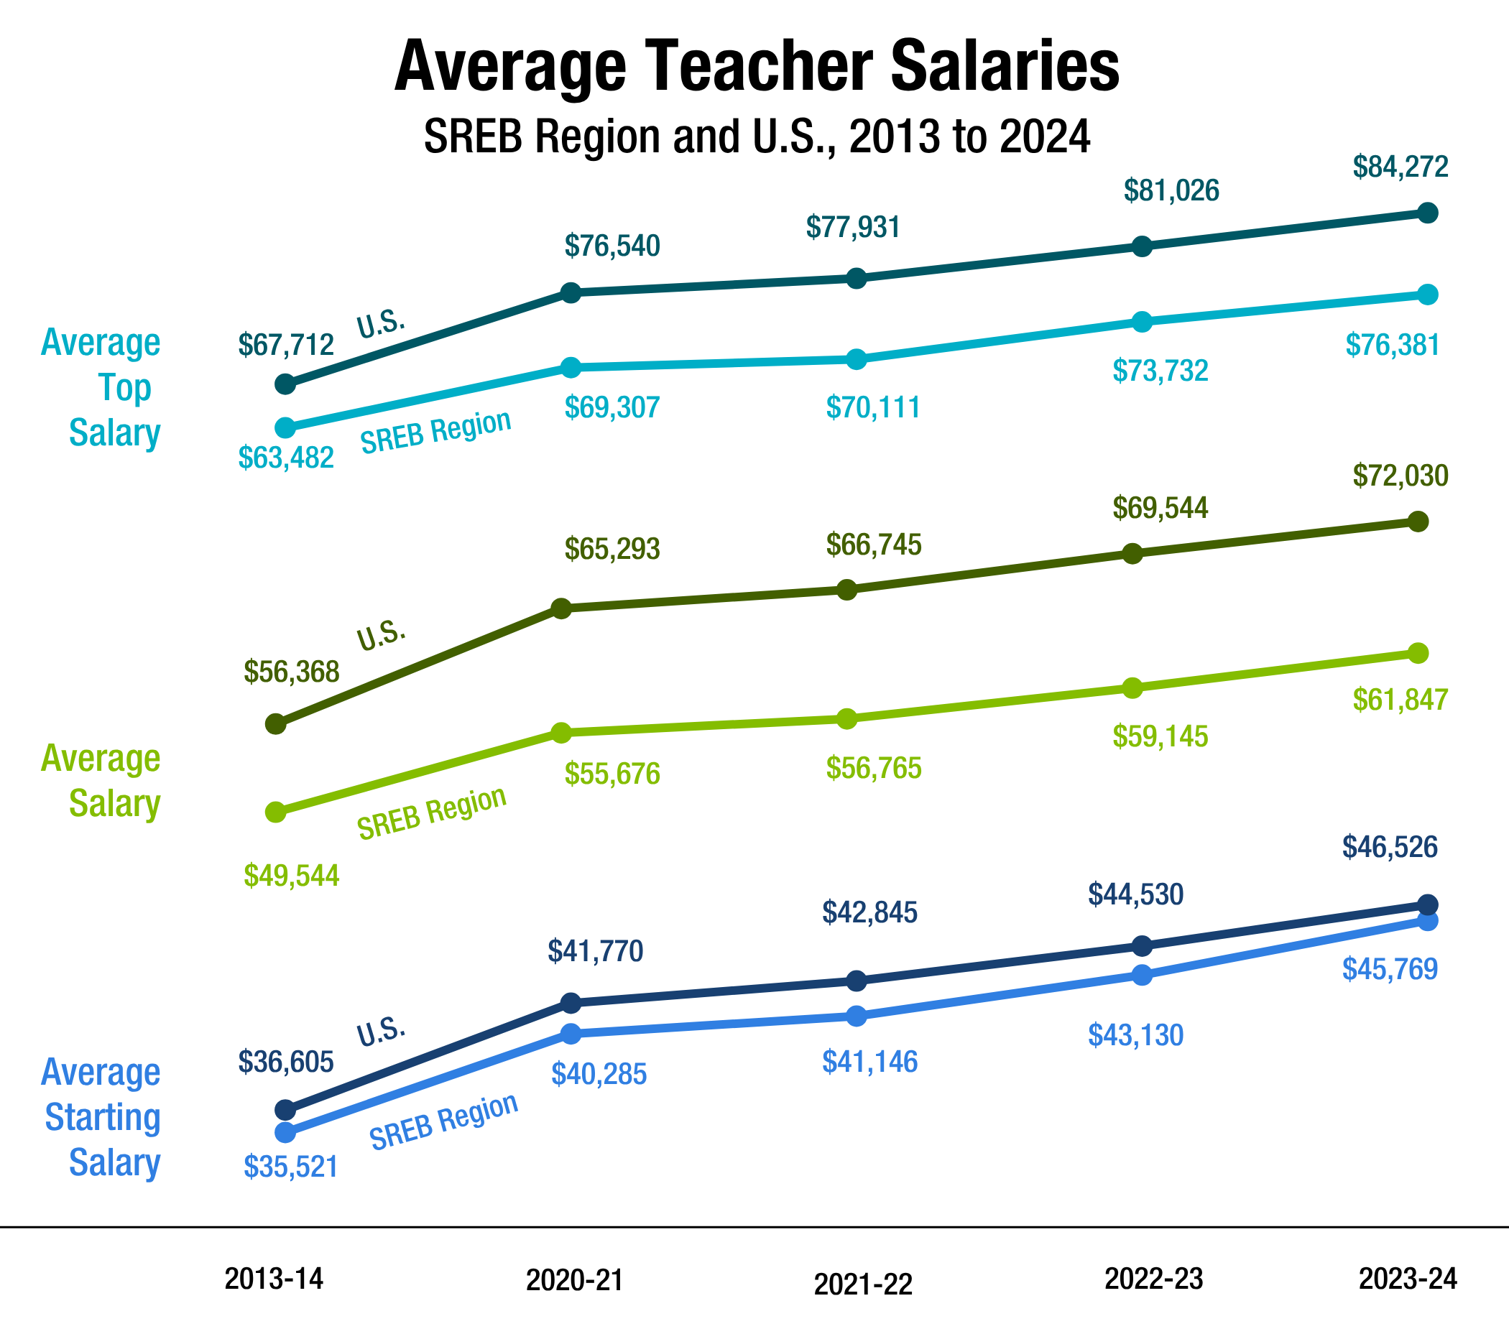
Despite a cost-of-living index that averages 98.7% in 2024 (compared to 100% for the nation), the South lags significantly behind the nation in overall teacher salaries — paying 15% less than the national average.

Slide 7
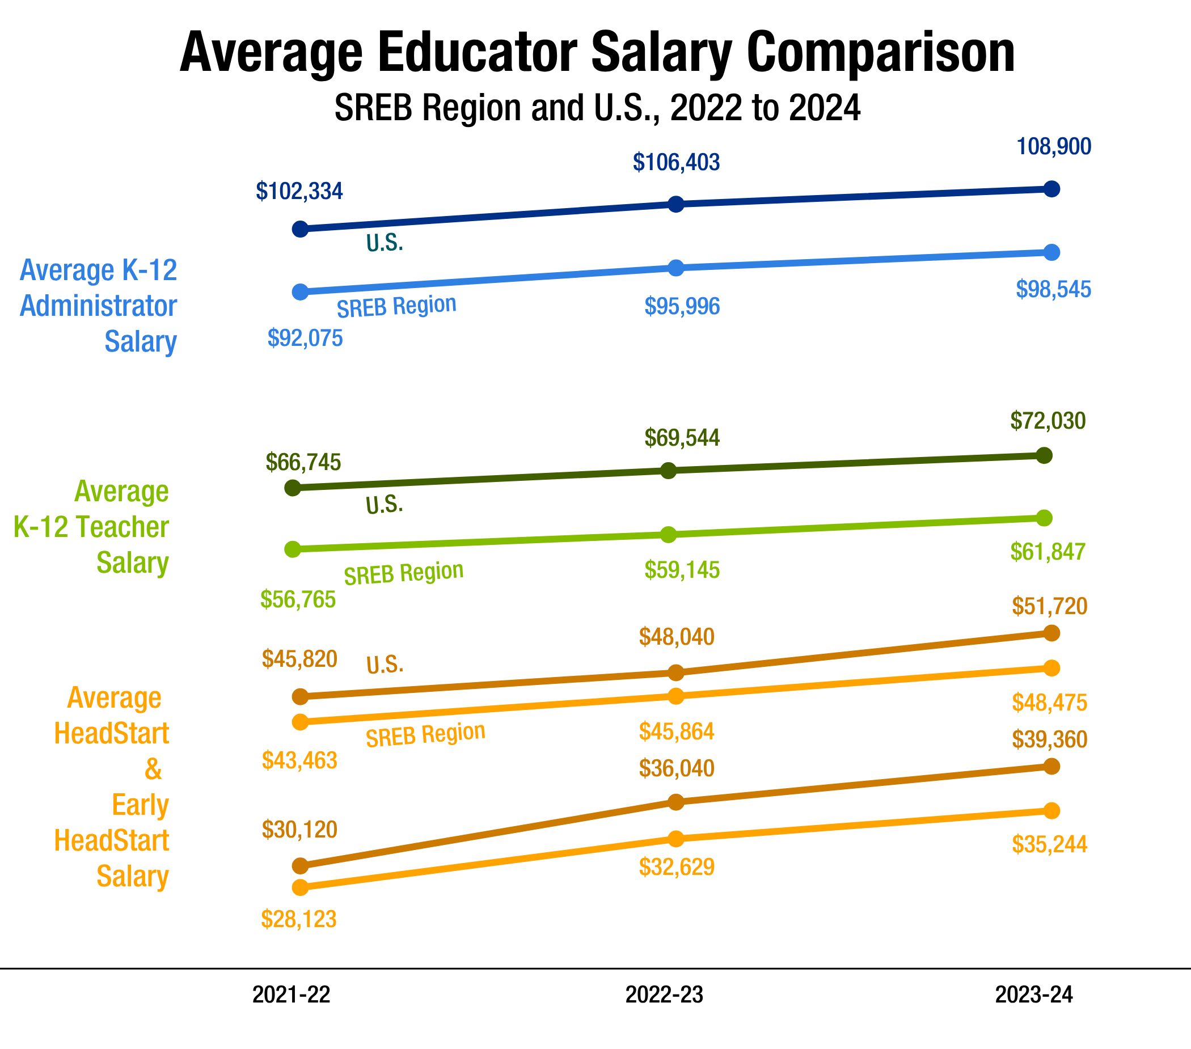
In fact, average pay across all roles lags in the South compared to the national average.
K-12 school leader pay lags by 11%, and Head Start and Early HeadStart educator pay lags 7% and 11% respectfully.

Slide 8
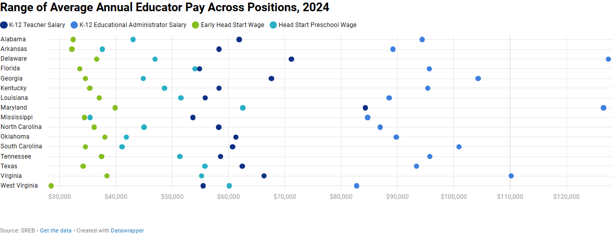
Despite working a year-round schedule without a summer break, early Head Start and Head Start preschool teacher pay is significantly lower compared to their K-12 counterparts.
Average annual salaries for K-12 educational administrators vary significantly within the position and across positions in K-12 schools.

Slide 9
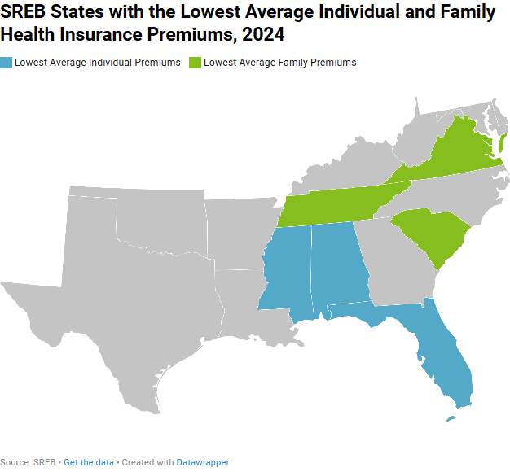
K-12 Educator Health Benefits
In 2024, SREB states increased average premiums for both employee-only and family health plans.

Slide 10
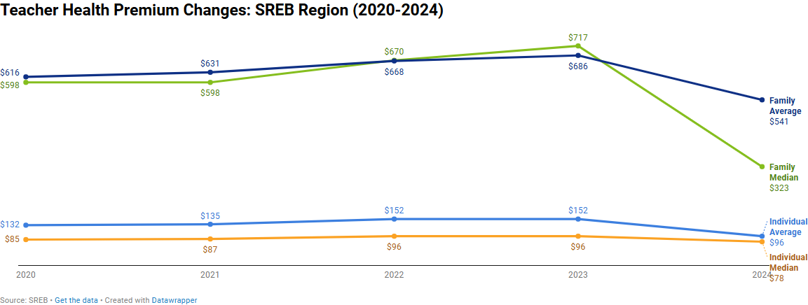
Health insurance packages vary significantly in cost for both employee-only and family plans.
While some states offer low premiums for individual plans, and a few even have reasonable costs for family plans, other states may have a much larger range of costs.
Note: These costs are the average price of all health care plans available to teachers in each SREB state.

Slide 11
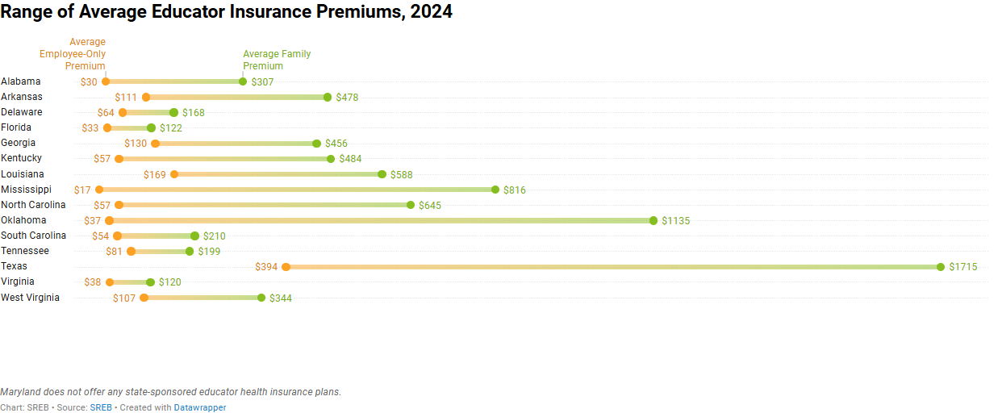
This graphic demonstrates the average range of costs educators pay in different states depending on their health coverage choices.

Slide 12
K-12 Educator Retirement Benefits
All states offer pension plans to teachers, and most SREB states have pension tiers with varying benefits for newer teachers. All but two states in the region have lower pension benefit formulas for newly hired teachers, which reduces newer educators’ gross benefit earning capability.
Six states now have portable investment or hybrid plan options for some teachers, allowing younger teachers to save more over time. These plans also serve as a cost-saving measure for state budgets by lowering their total unfunded liabilities.

Slide 13
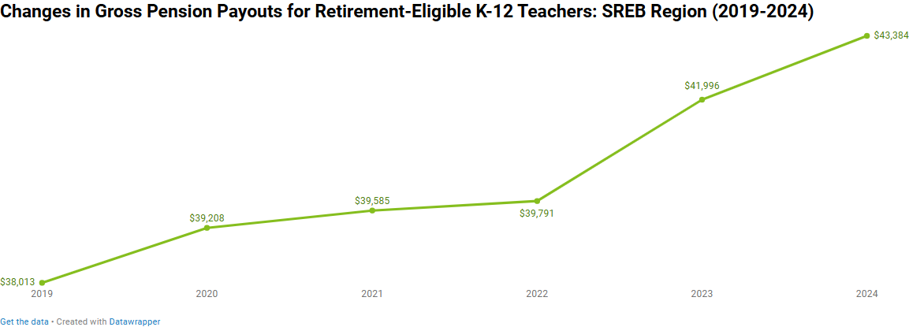
SREB calculates a gross annual pension benefit for teachers for each plan by state. This chart shows the changes in the regional average gross annual pension benefits for teachers currently at retirement.
Note: SREB calculates the typical gross annual pension benefit for a teacher in each state at age 65 with 30 years of service (not including Social Security). SREB is unable to calculate potential gross annual investment or hybrid plan benefit due to the high number of variables related to investments and returns.

Slide 14



Take-Home Pay
K-12 Teacher Net Pay
Average Annual in Region, 2024
$34,089
SREB calculates typical take-home or net pay for teachers in each state at different stages of their career.
$42,004
$52,300
K-12 Education Administrator
Net Pay
Average Annual in Region, 2024
$67,544
Note: SREB calculates typical net pay for teachers in each state at different stages of their career (gross salary minus benefit costs and taxes) using standard assumptions for age, family, tax status and health needs.

Slide 15
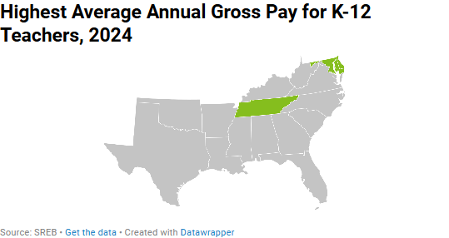
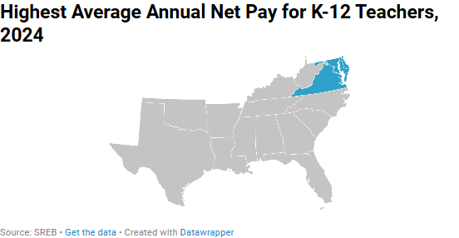
Maryland and Delaware continuously lead in average gross and net pay in the region.

Slide 16
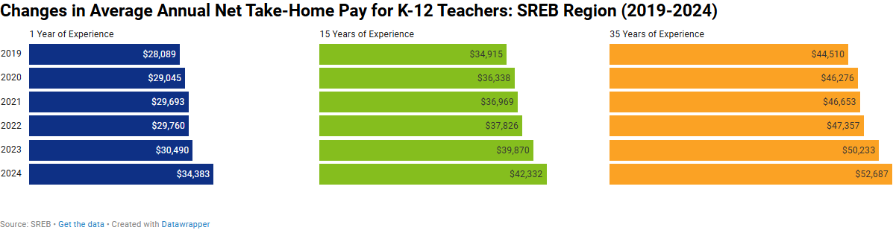
Average annual net take-home pay for K-12 teachers has risen incrementally for the past five years.

Slide 17
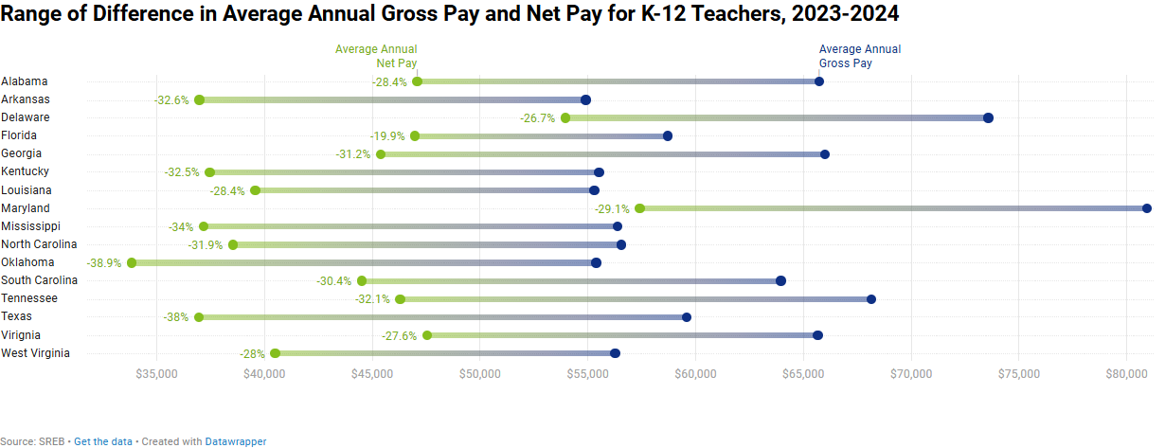
This chart demonstrates the percent of income spent on retirement contributions, health insurance premiums, and taxes to constitute average K-12 teacher’s net pay in each state.

Slide 18
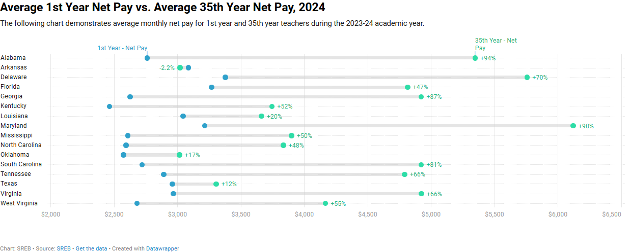
This chart compares the increased net pay of retirement-eligible teachers to first year teachers in the same year. Due to high out-of-pocket costs for family benefits, veteran teachers in some states see similar take-home pay as their new colleagues.

Slide 19
Observations from the research
Many current pay structures are “backloaded” — teachers typically don’t hit peak pay until their 50s, which discourages retention early in the career and contributes to turnover.
Health-benefit costs have risen faster than salaries: since 2018, health costs increased 45% versus 10% for salaries — effectively reducing teachers’ real compensation.
Pension funding is in trouble: a large share (75%) of pension contributions now go toward paying off pension system debt rather than funding future benefits — meaning pensions are diverting resources away from salaries and classroom needs.
Net pay + benefits are declining in real value. Many teachers are getting a weaker overall compensation package than in previous decades.
Redesigning compensation can help: Consider differentiated pay (not just pay based on years/degree), align pay/benefits sustainably, offer more flexible health & retirement options, and consider additional package elements like (child-care subsidies, housing/transportation allowances, loan forgiveness, etc.).
Source: SREB's report Historical Lessons and Modern Teacher Compensation

Slide 20

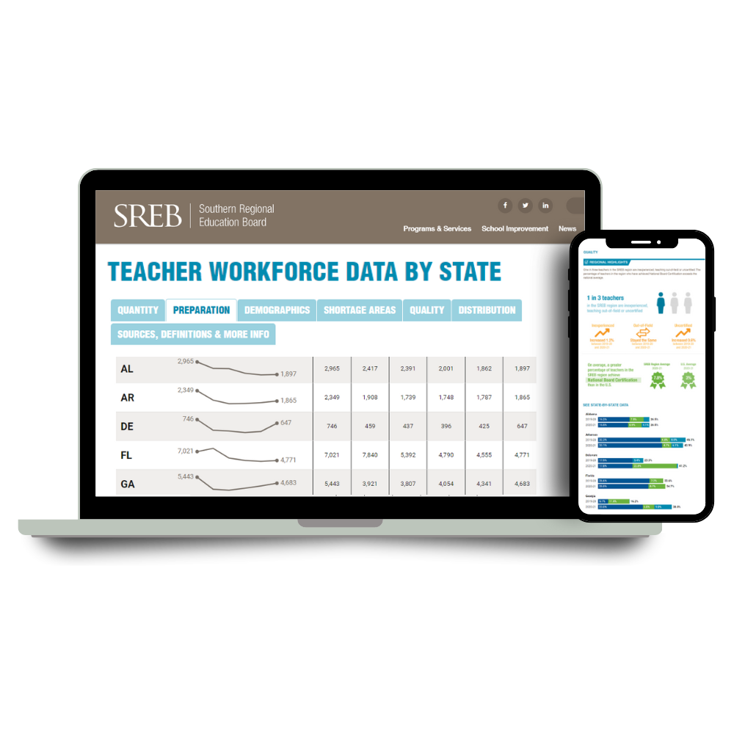


SREB Resources
K-12 Teaching Support
SREB.org/powerful-instructional-practices
SREB.org/professional-development-instructional-coaching
SREB.org/induction
Educator Workforce Data
SREB.org/TeacherWorkforce
Research and recommendations
State-by-state data and regional highlights
Educator Compensation Dashboard
Postsecondary
Faculty Support
SREB.org/doctoral-scholars-program
Launching September 2023: New SREB Center for Innovative Faculty Development
Higher Education Data
SREB.org/fact-book-ed-data
Comprehensive Fact Book of comparative data

Slide 21



Explore more regional and state-by-state data in our updated Educator Compensation Dashboard
Find our compensation reports, blogs and videos at SREB.org/topic-educator-compensation
Slide deck prepared by the Educator Workforce Policy team at SREB:
Megan Boren, director
Sheniqua Pierce, analyst II
Jessica Nadzam, research and policy associate

