Slide 1
P-12 Educator Workforce Data by State Takeaways
Educator Workforce

Slide 2


SNAPSHOT: EDUCATOR WORKFORCE DATA State-Specific Data + Regional Trends and Spotlights From Across the South
Teacher Quantity
Teacher Preparation
Teacher Demographics
Teacher Shortage Areas
Teacher Quality
Talent Distribution
Early Childhood Educators
Principals & School Leaders
SREB.org/TeacherData
Notes:
Megan

Slide 3
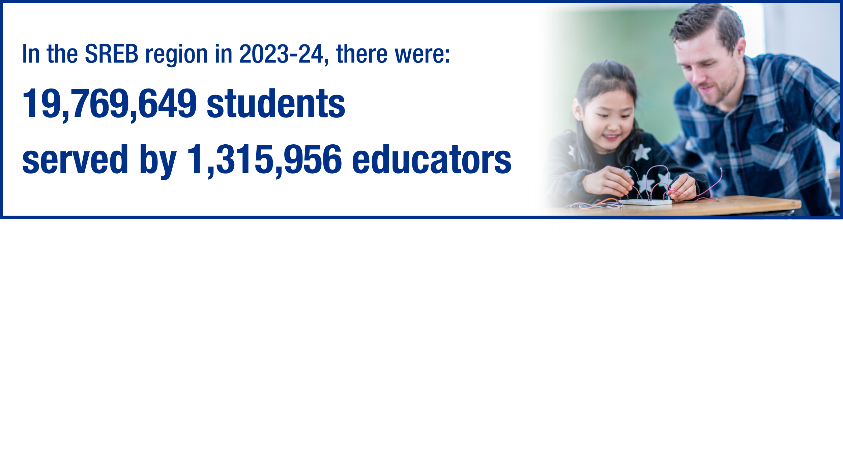
Teacher Quantity Data
In 2023-24, the number of students decreased by nearly 1,000 compared to 2022-23, while the number of teachers increased by approximately 1,000, leading to a slightly reduced student-to-teacher ratio.
Meanwhile, the teacher turnover rate in the South decreased by 2.9 percentage points to 15.6%, but this rate is still 3.3% higher than it was five years ago.

Slide 4
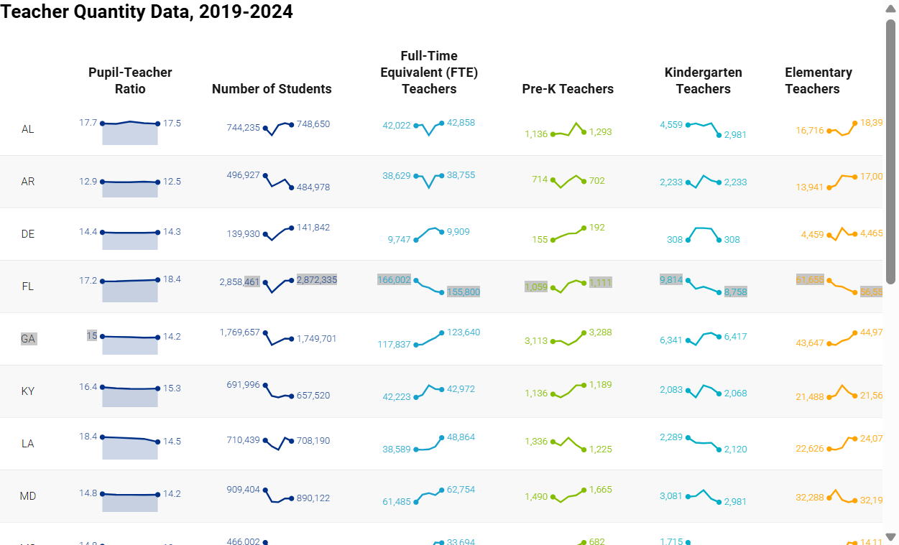
Notes:
**There’s an app in PPT where I can embed DWs – do this for all DWs throughout presentation that are interactive

Slide 5
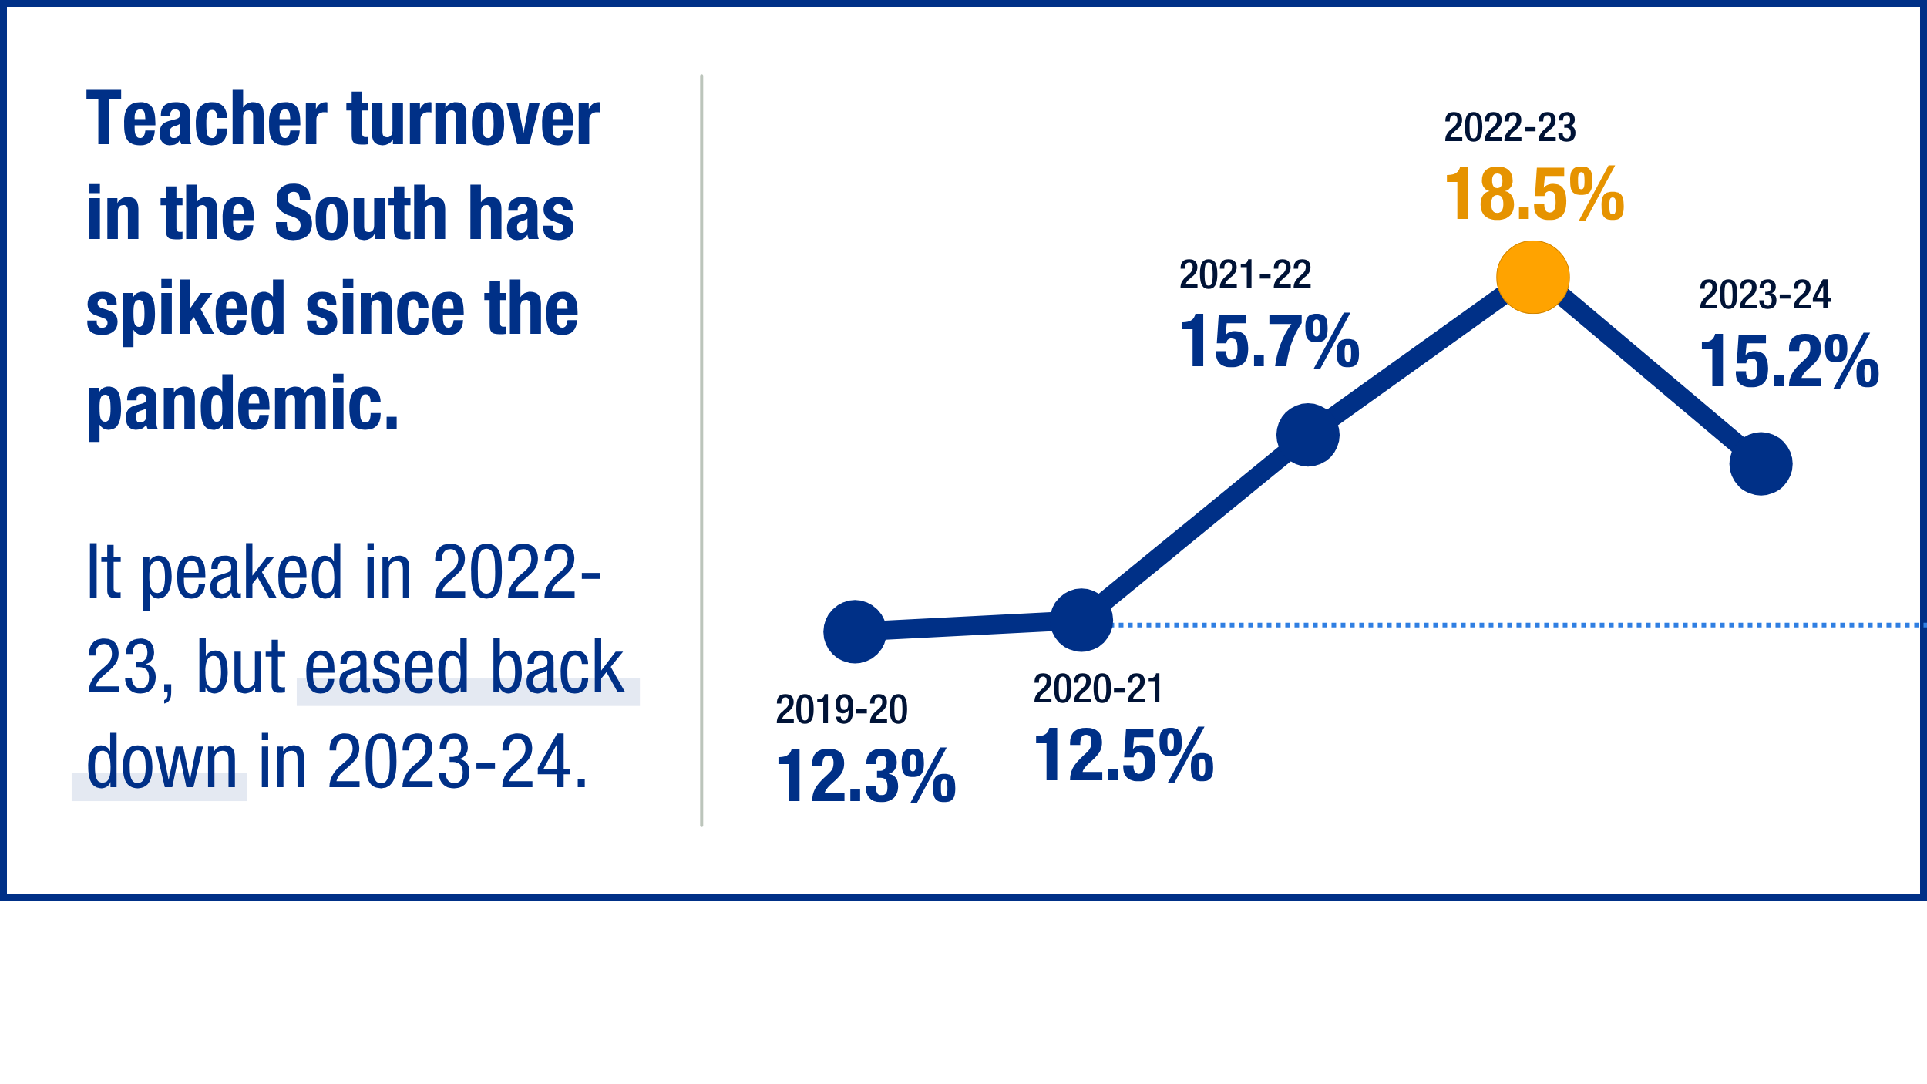


Teacher turnover is costly
Average amount it costs districts to replace each teacher by district size
$9k -24k
Source: Cost analysis by Learning Policy Institute 2024
Notes:
Fix dollar amount graphic - done

Slide 6
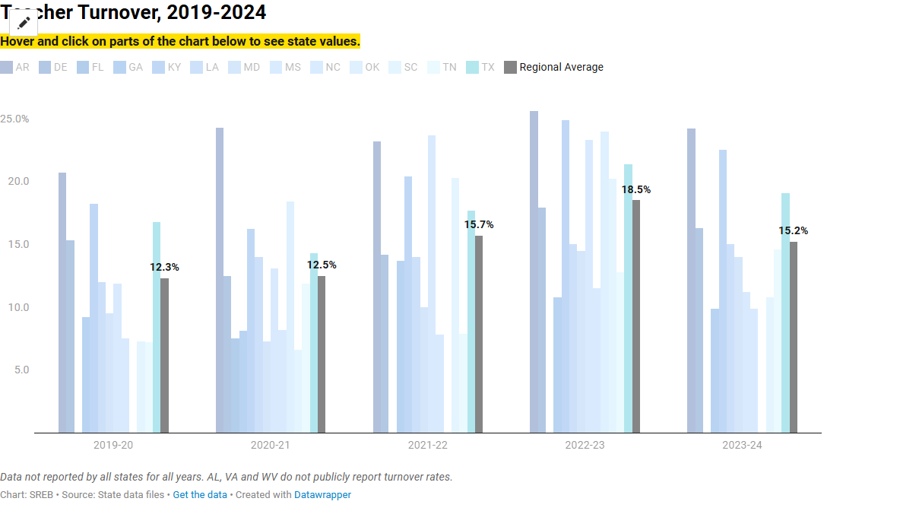

Slide 7
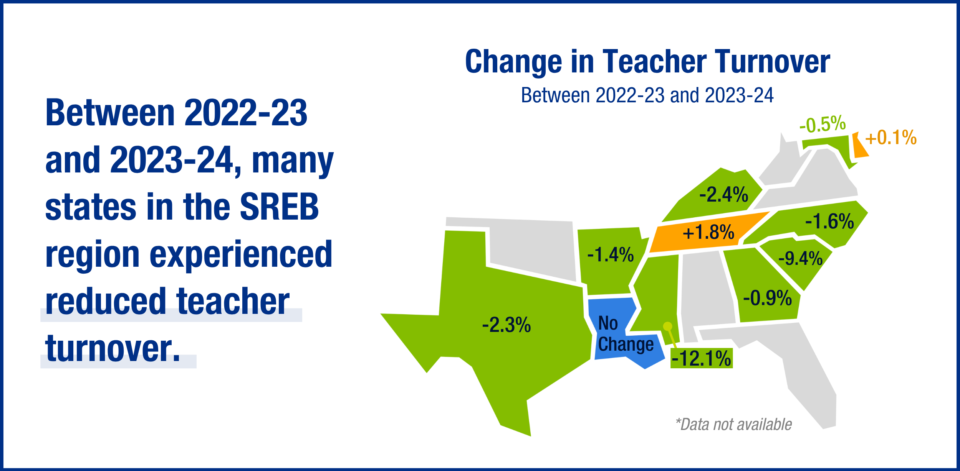
Notes:
Crop the extra white and center this graphic

Slide 8
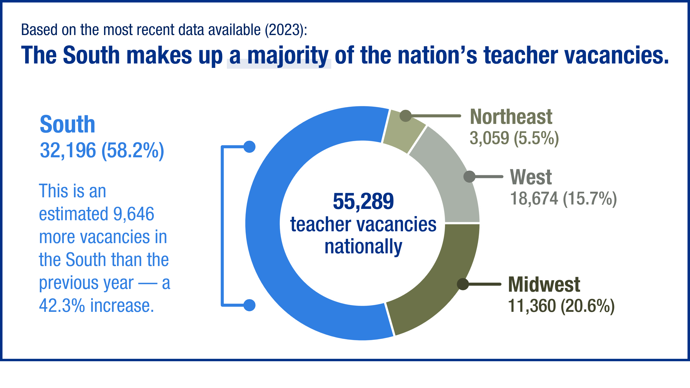
Notes:
Crop white and center the graphic - done

Slide 9

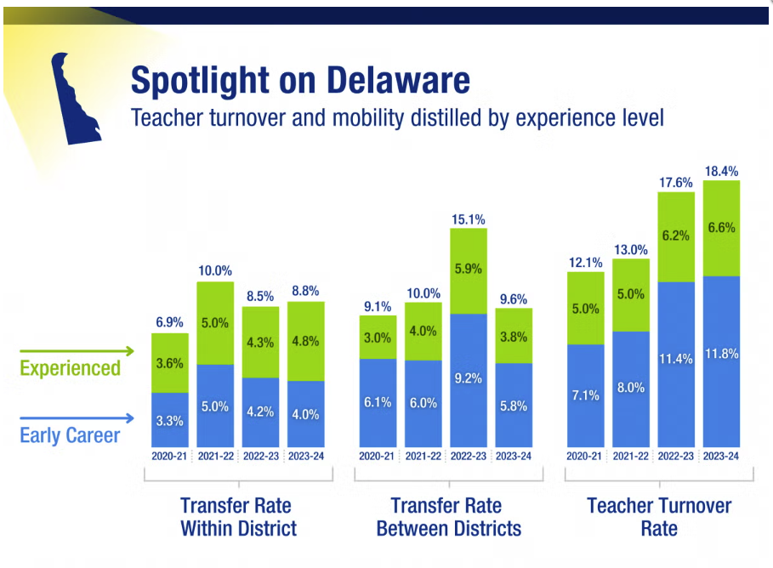
See more state spotlights in our data portal
Notes:
Add the link to see the additional spotlight to bottom corner

Slide 10
Teacher Preparation Data
Teacher preparation program completers in the South increased for the first time in nearly a decade during 2020-21; however, it declined again in 2021-22 and 2022-23.
The small decreases in candidates over time between 2012-2013 and 2022-23, 17,337 fewer candidates completed teacher preparation programs, a significant 25% decline.
During the same time frame, the proportion of candidates who completed a teacher preparation program through an alternative pathway (vs. a traditional pathway, such as a four-year undergraduate degree) have increased.

Slide 11
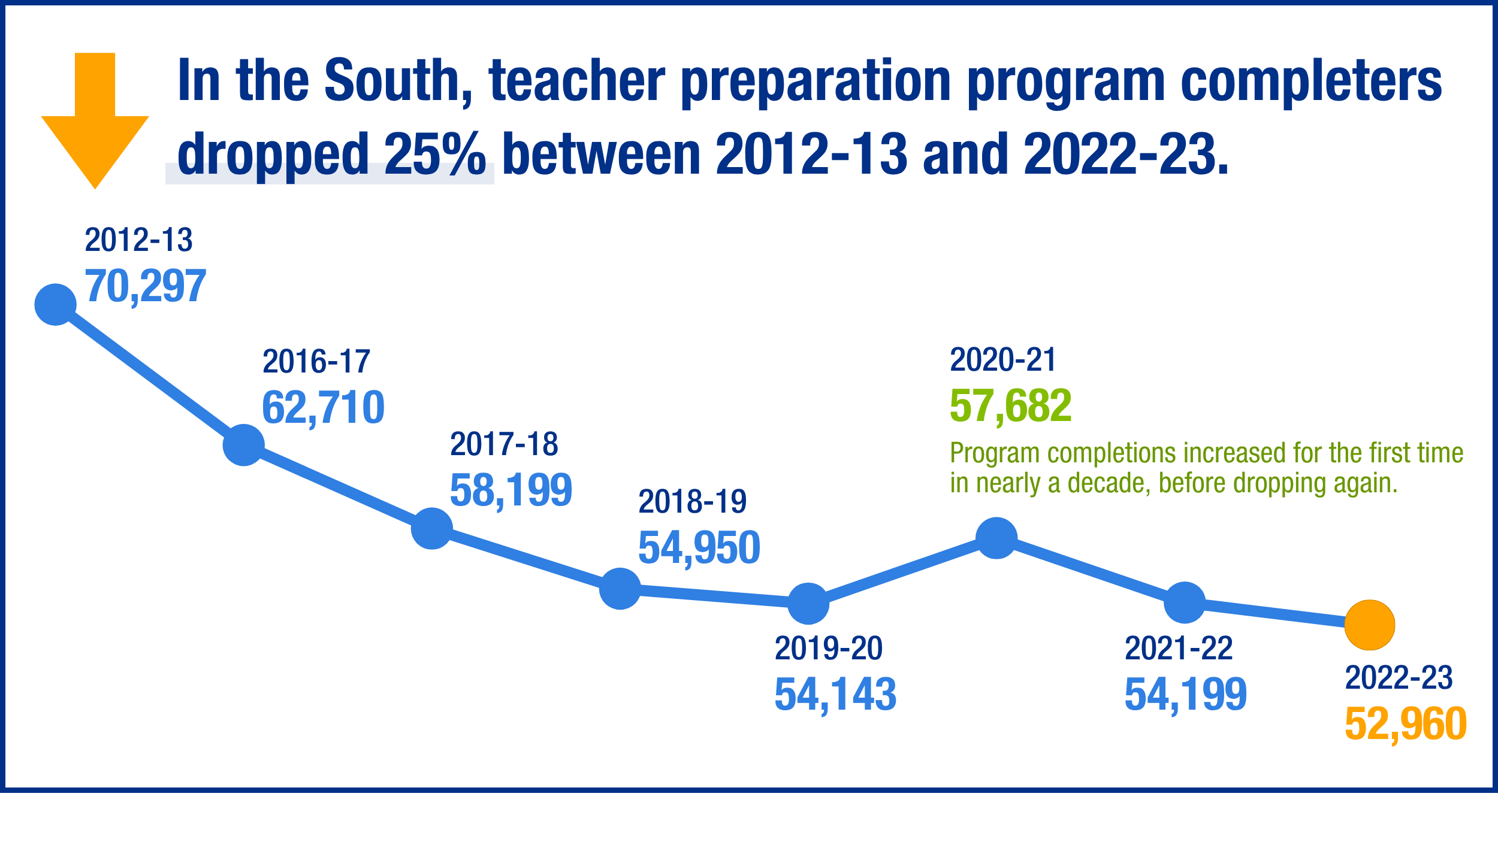
Notes:
Crop and center

Slide 12
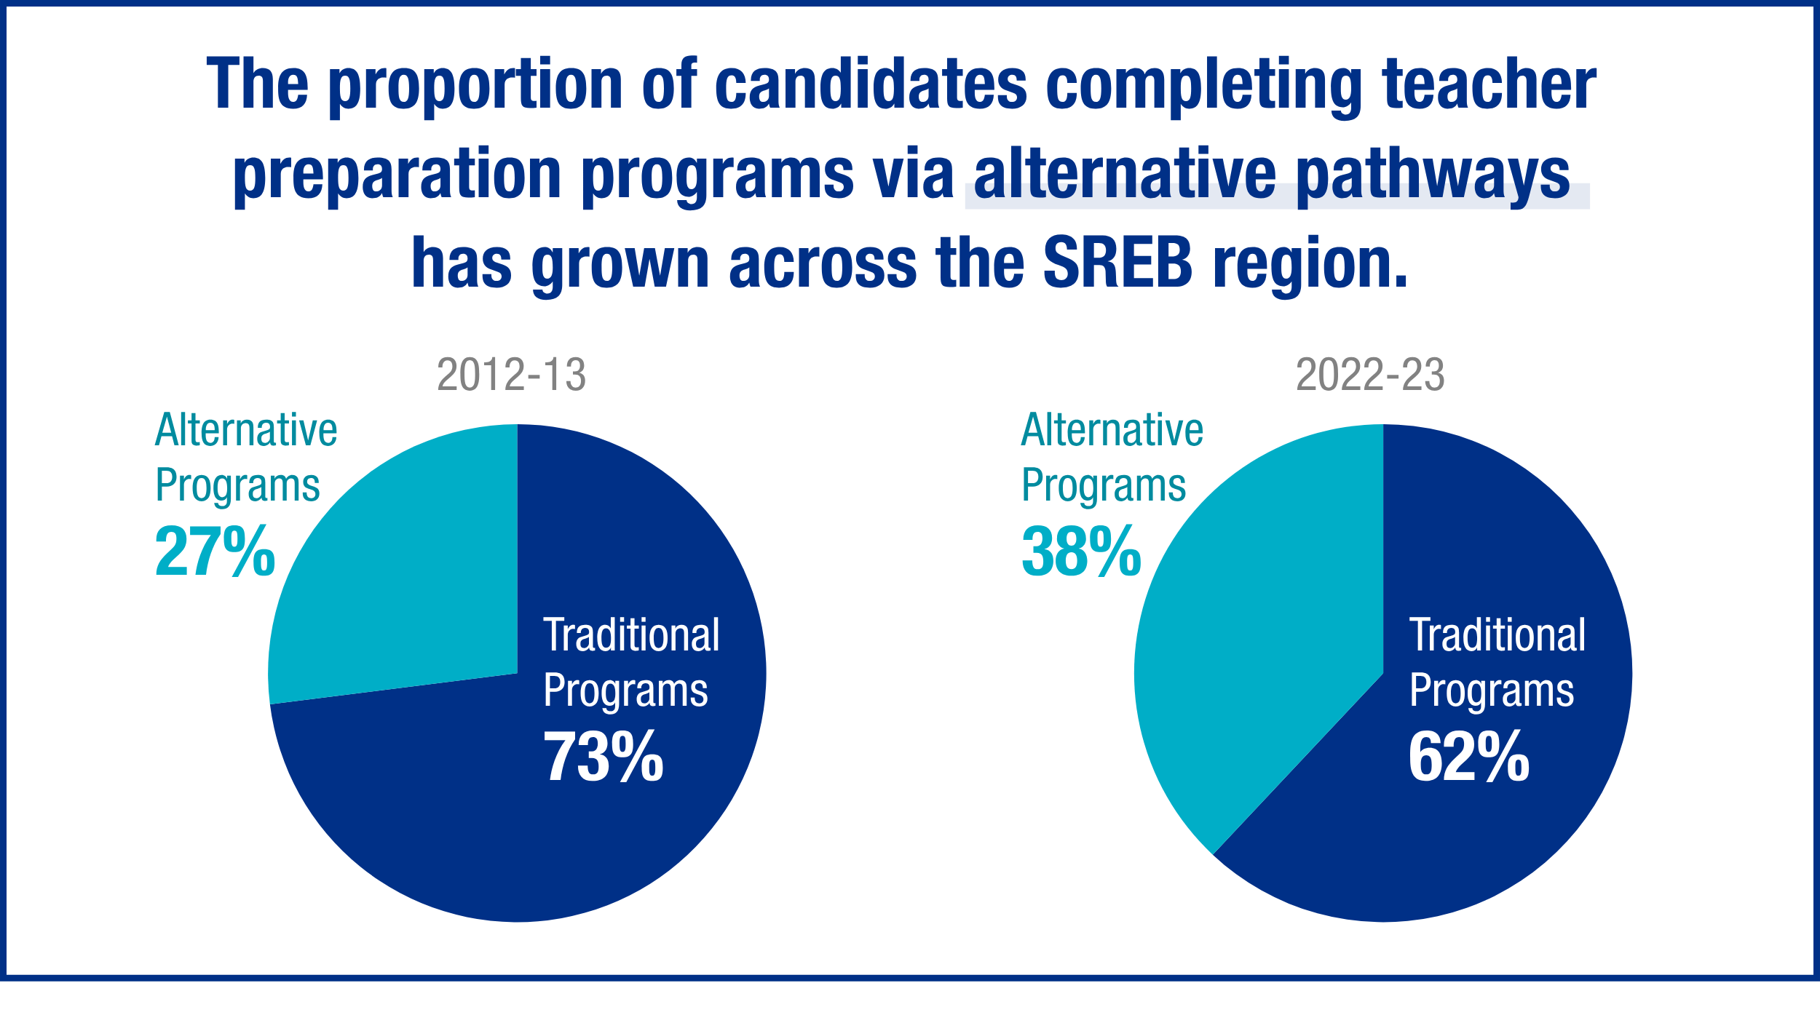

Slide 13
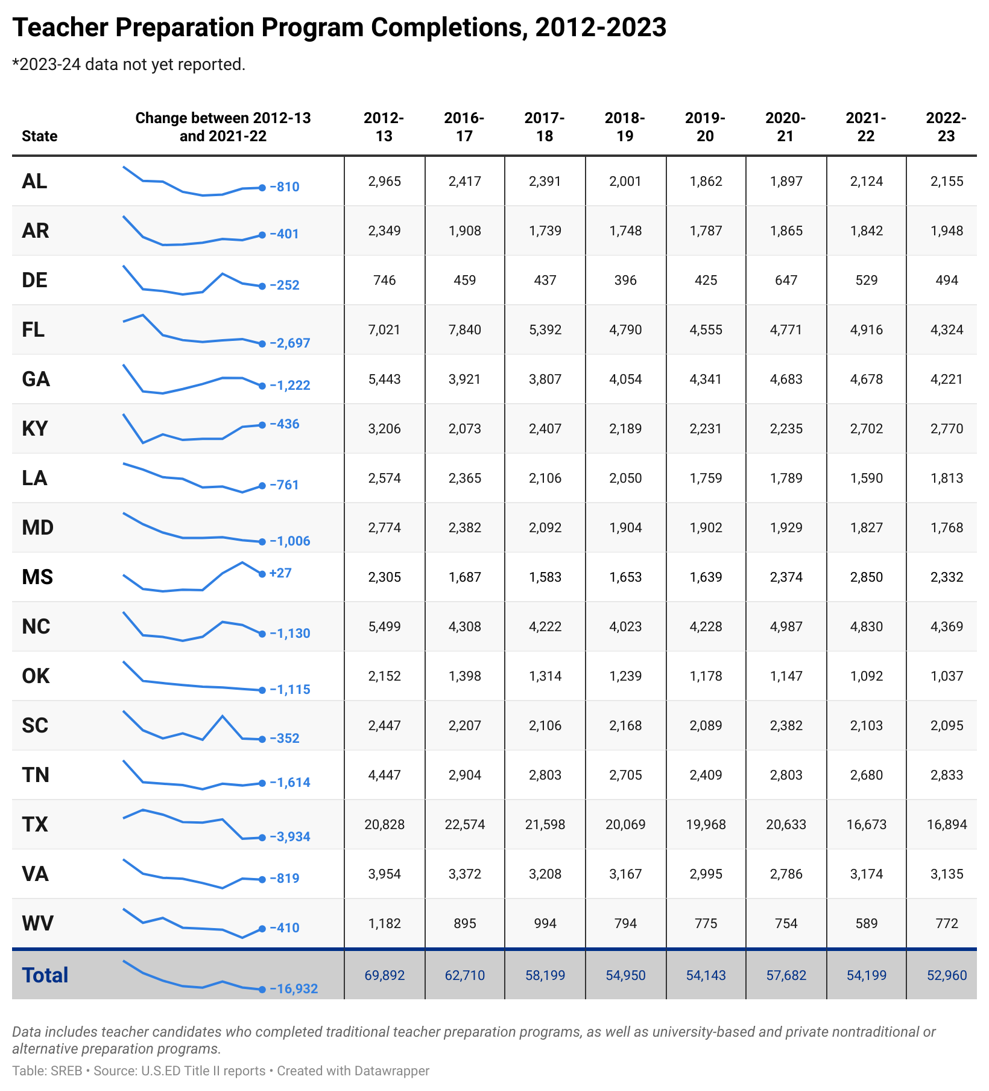

Slide 14
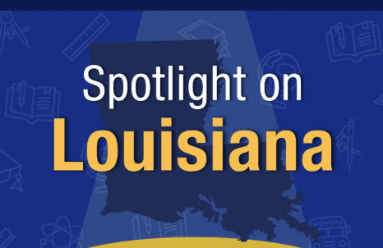
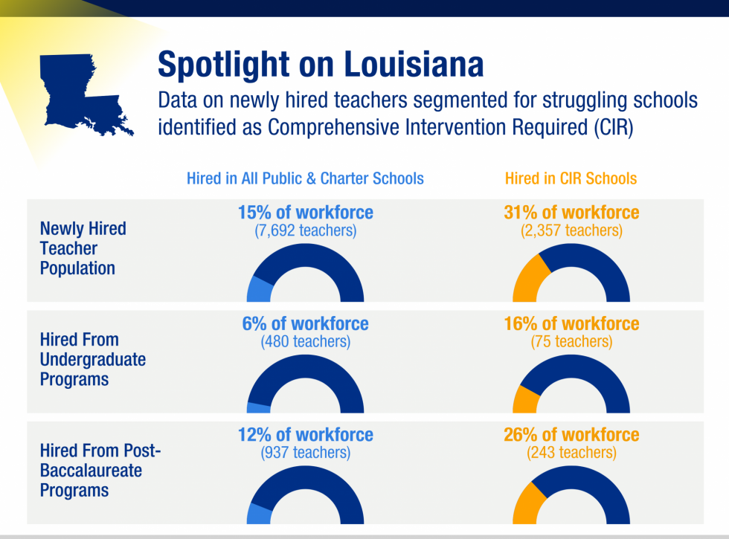
See more state spotlights in our data portal
Notes:
Add the link to see the additional spotlight to bottom corner

Slide 15
Teacher Demographic Data
During the 2023-24 school year, the teacher workforce across the SREB region remained predominantly female. Despite becoming slightly more racially and ethnically diverse, the teacher workforce in the South does not reflect the overall diversity of the student population.
The percentage of teachers with master’s degrees increased slightly in 2023-23, while the percentage with associate degrees or advanced degrees (beyond a master’s) decreased. The percentage of teachers in the South with a bachelor’s degree remained the same.
Notes:
Move this section right after quantity or prep first

Slide 16
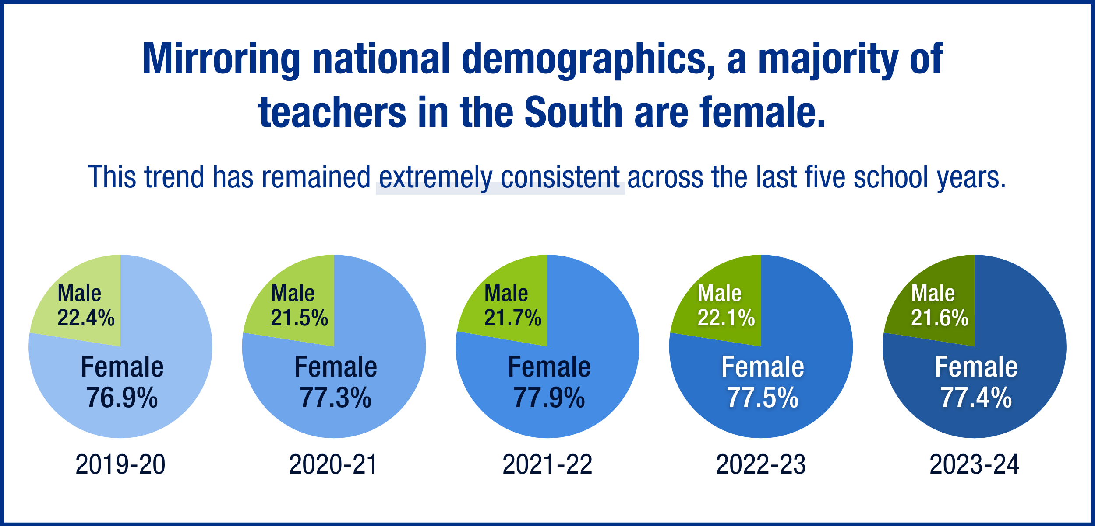
Notes:
Crop and center

Slide 17
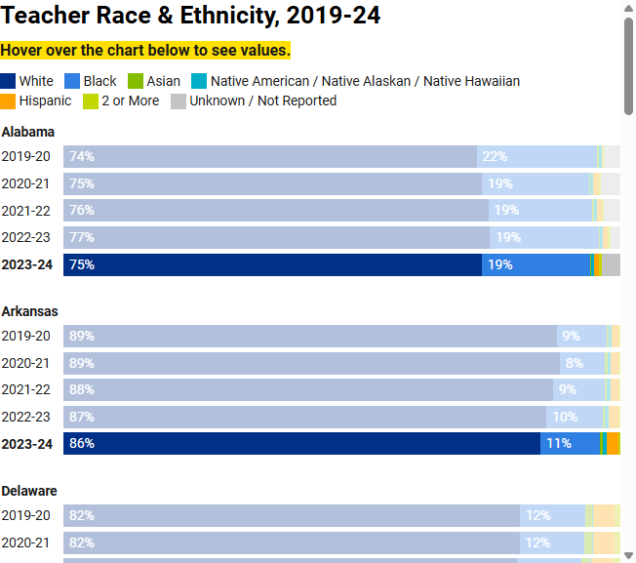
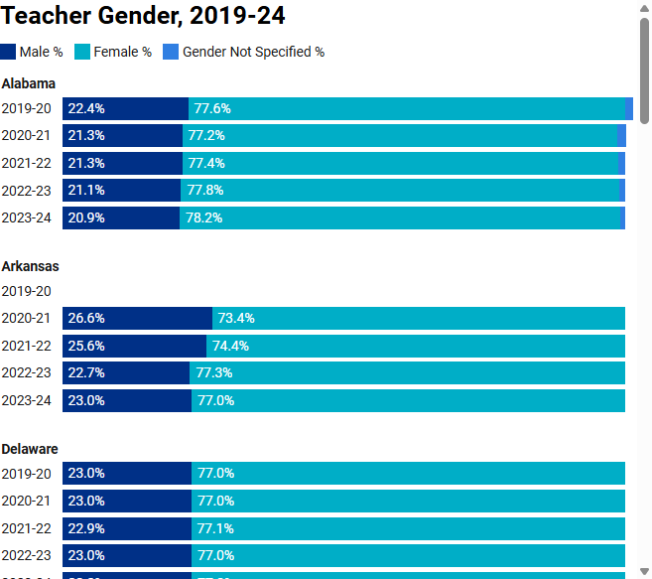
Demographics by State
Notes:
Interactive DWs

Slide 18
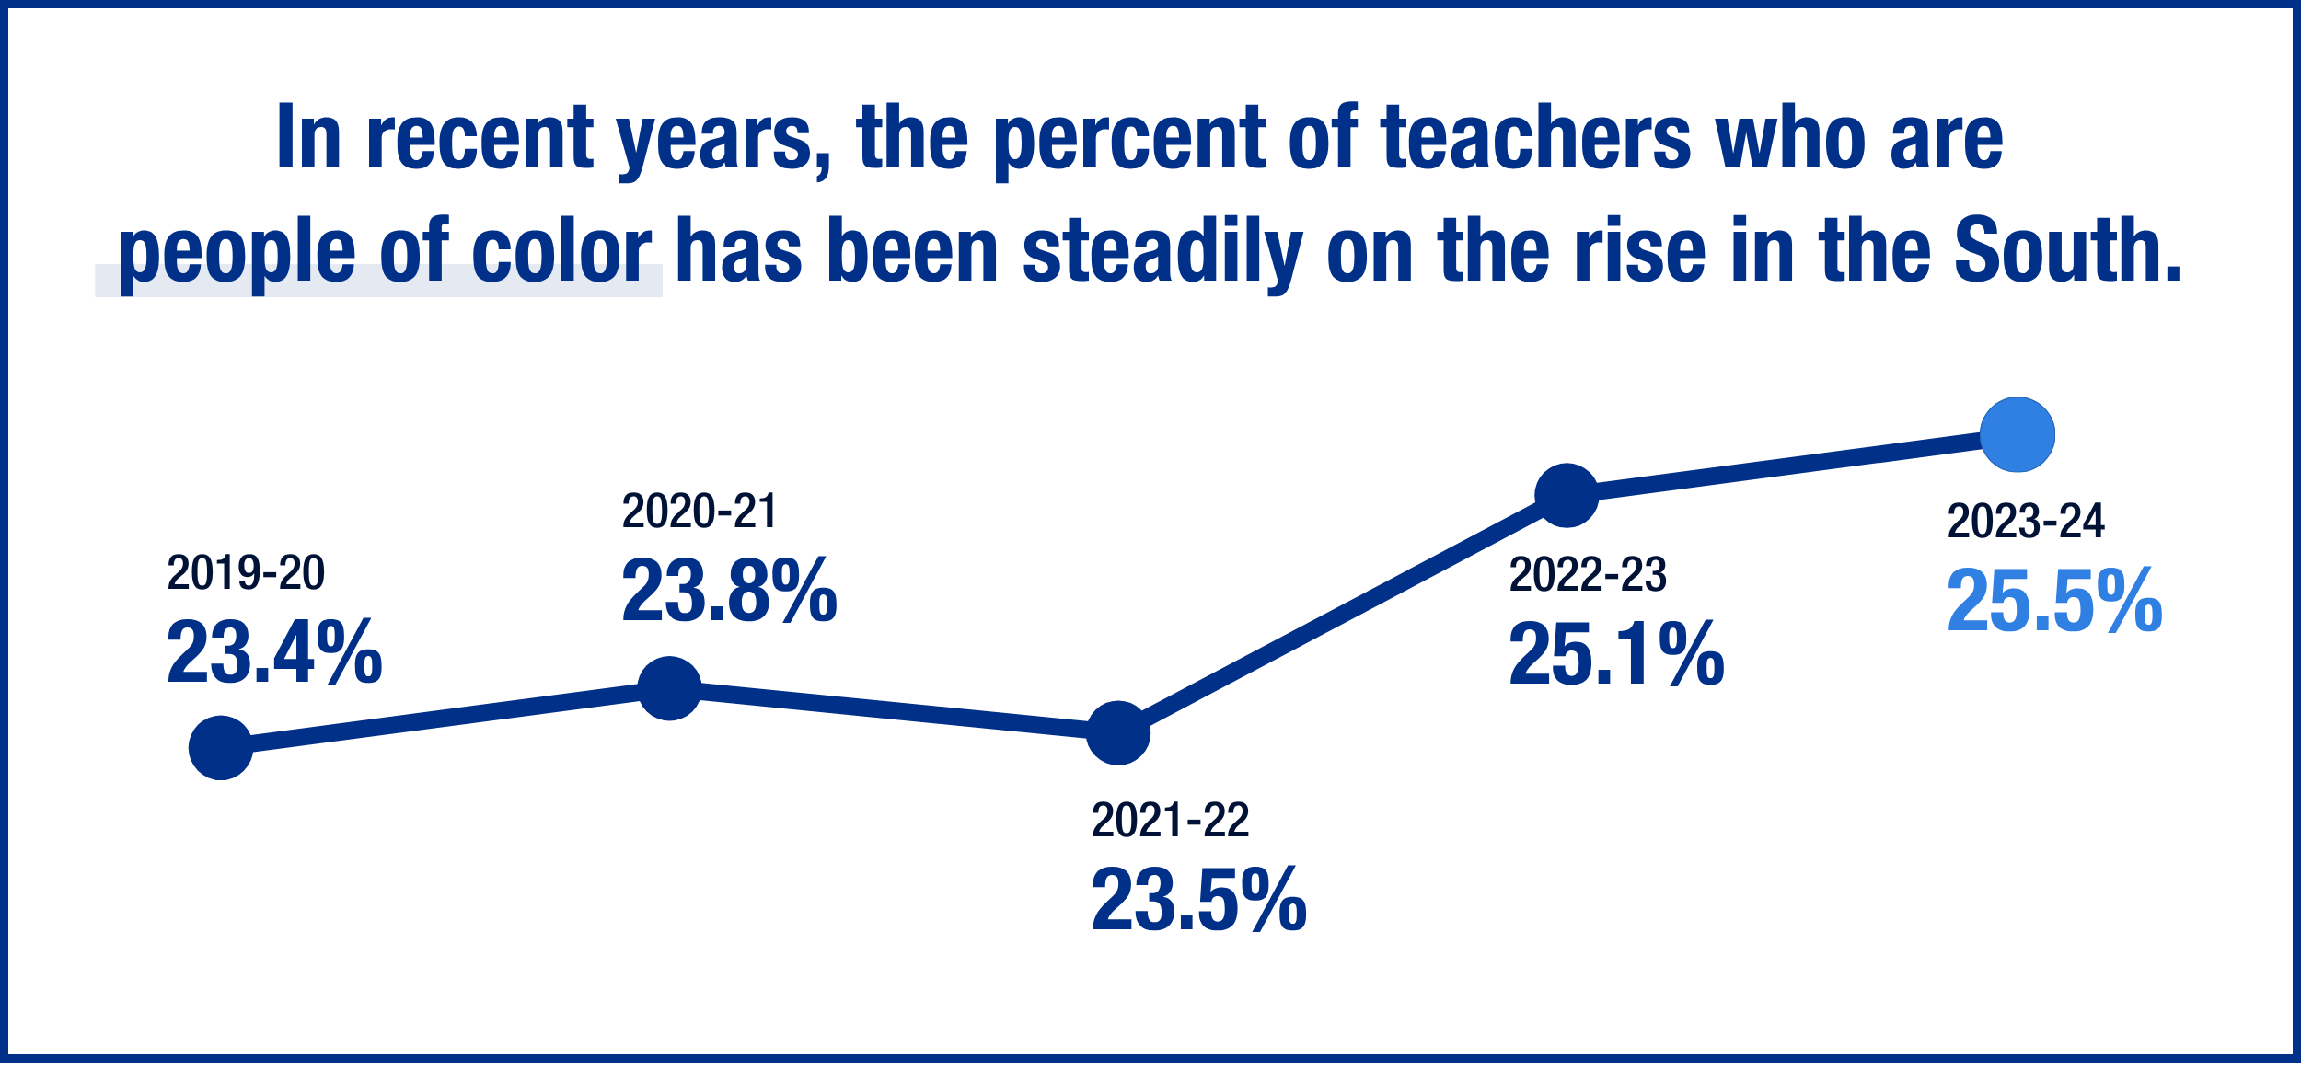
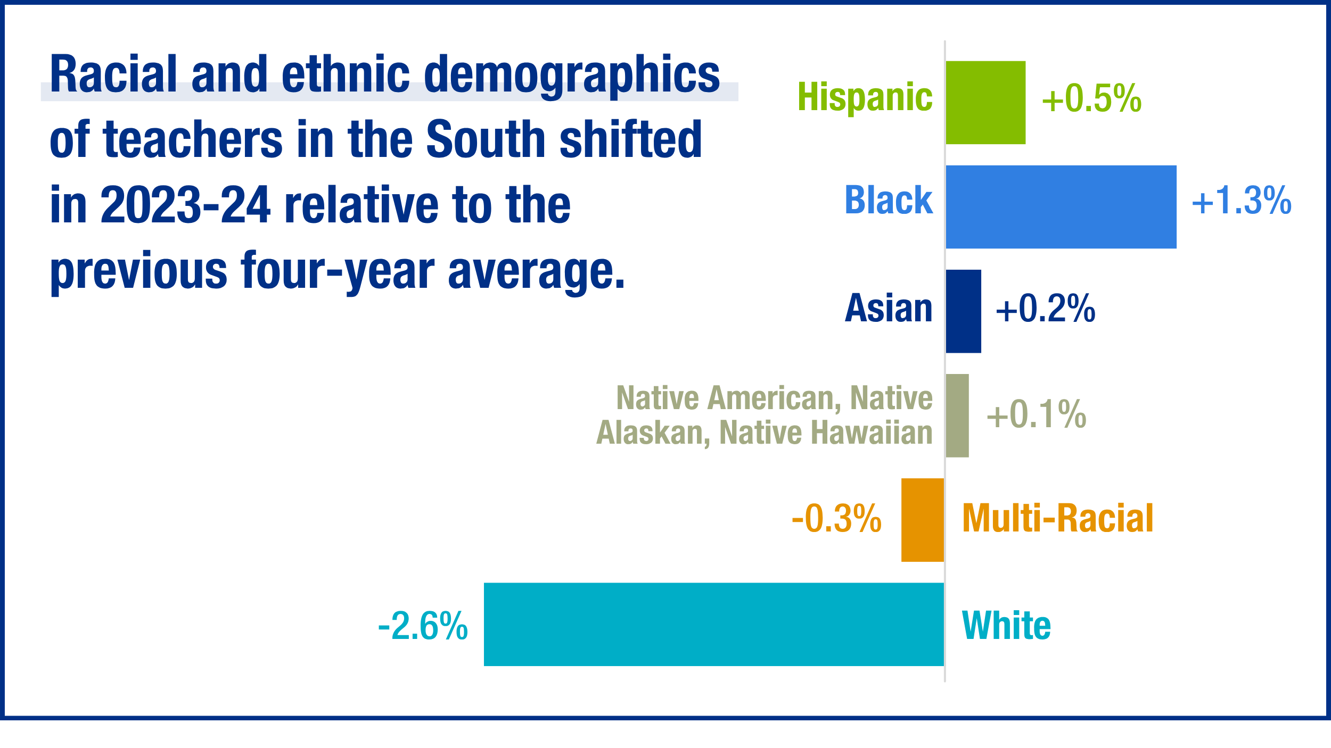
The percent of teachers from different racial and ethnic backgrounds in the South steadily increases.

Slide 19
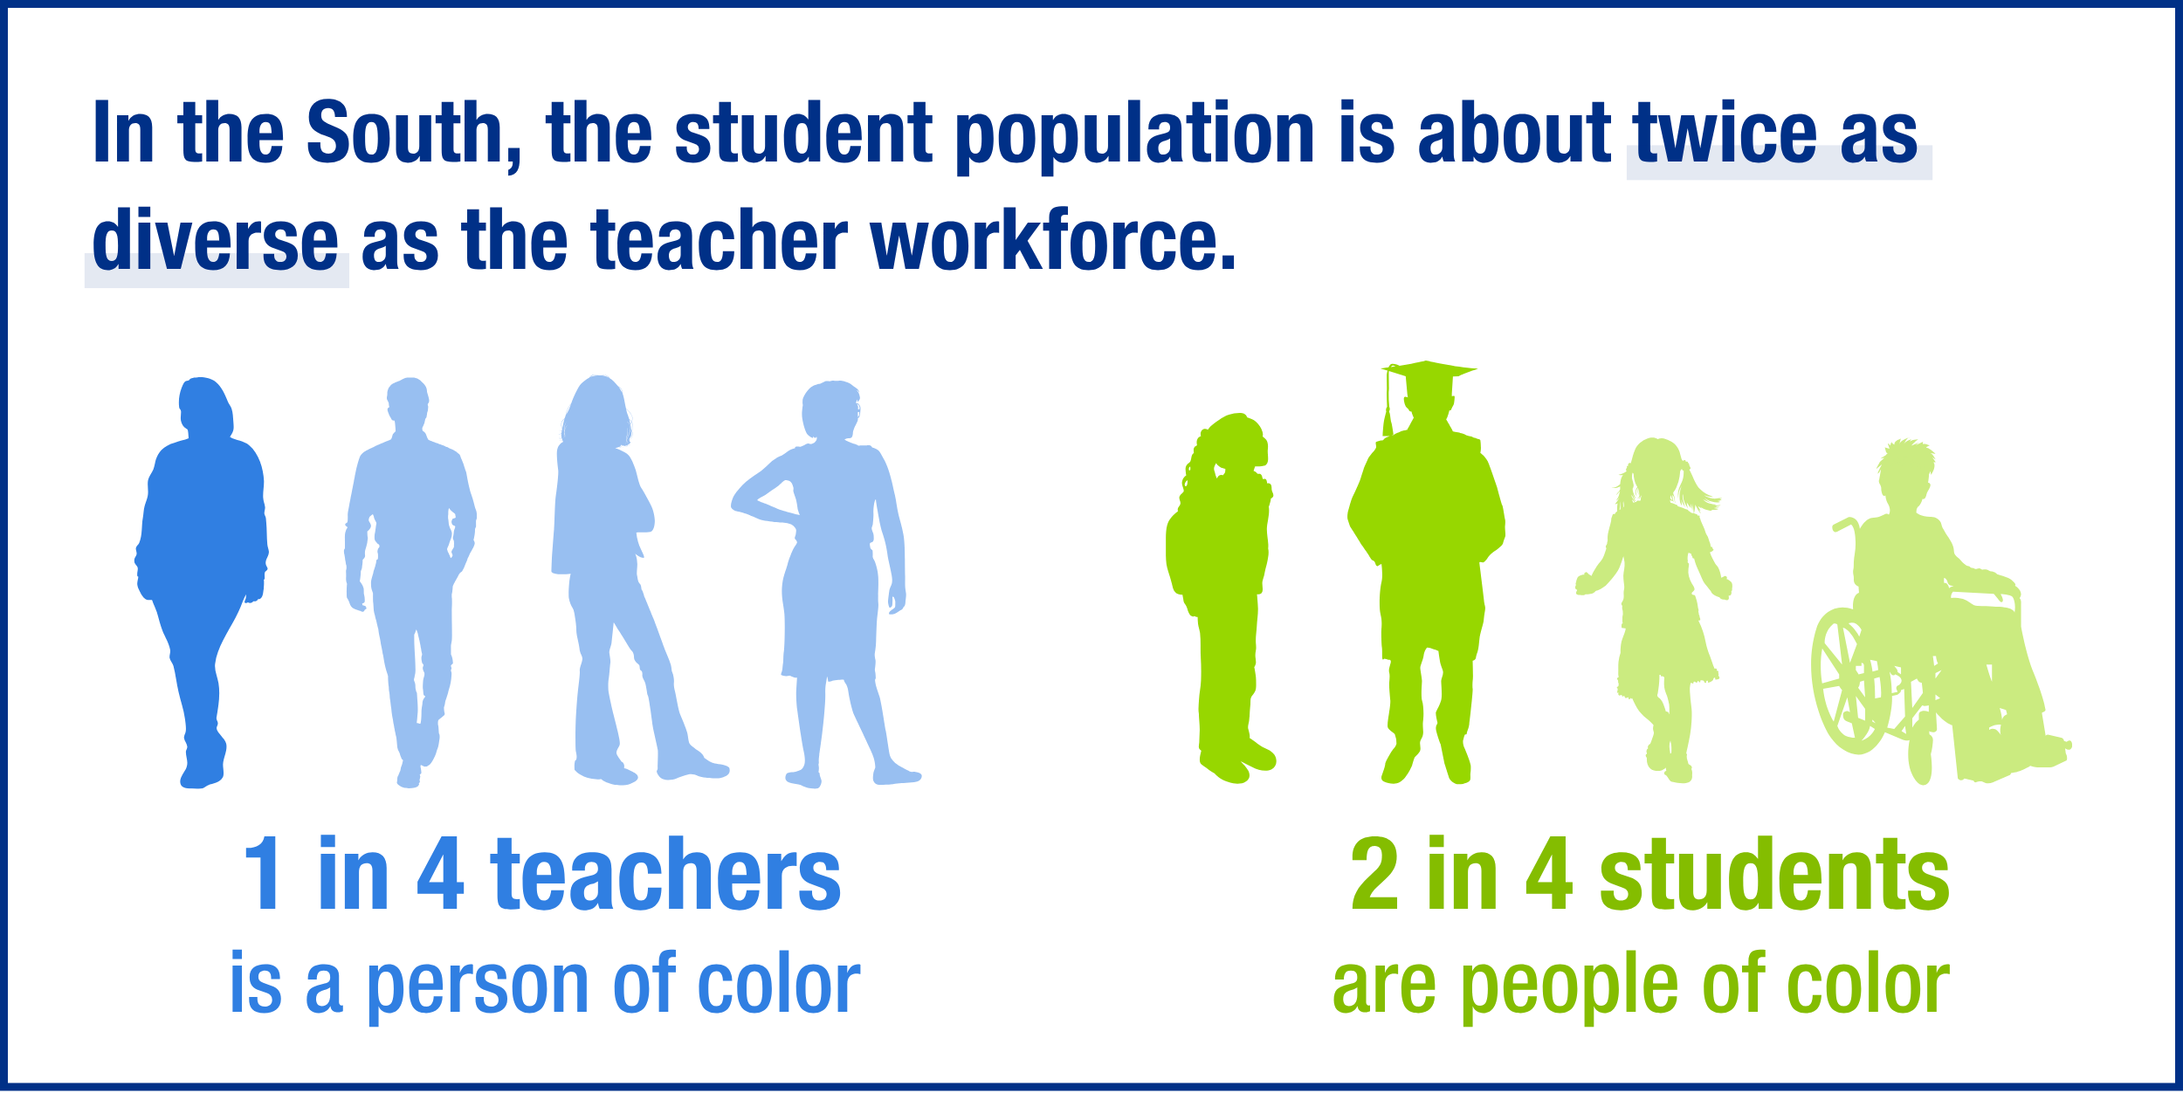
Notes:
Center and crop

Slide 20
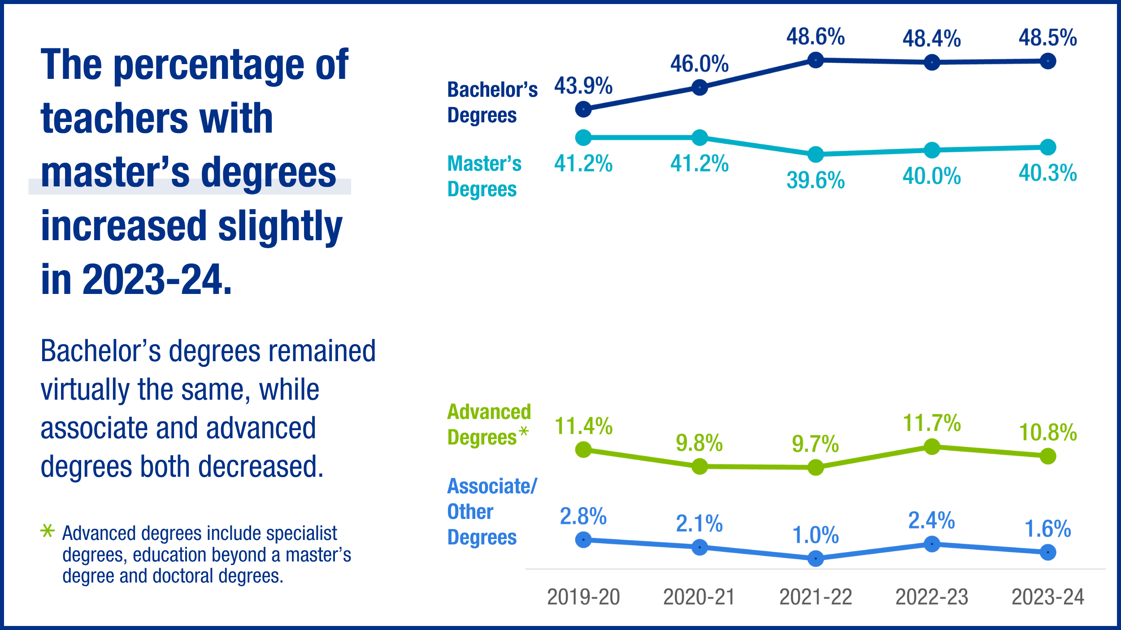

Slide 21
Teacher Shortage Data
Every state in the SREB region has experienced teacher shortages in multiple subject areas over the last six school years (2019-20 to 2024-25).
Across the SREB region, during the 2024-25 school year, fewer states experienced shortages in English language arts, math, science, and social studies.
The states with shortages in special education, English as a second language, and career and technical education remained steady between 2023-24 and 2024-25.
On average, over the last six school years, math, science, and special education are the subject areas with the most widespread teacher shortages
Notes:
3 funding mechanisms common: formula weighting, compliance-linked, or general allotment/local discretionary mix
Some states require or encourage educator certificates or endorsements
Few states require universal screening in elementary grades
Consider looking at Virginia’s plan, advisory, report framework, Georgia’s funding weight, Maryland’s universal screening/identification approach, and North Carolina’s oversight cycle. Taken together, these state policies may provide innovative examples that could help support comprehensive, talented and gifted education programs.
Delivery approaches: separate, integrated, hybrid
The most effective approach is likely a combination of integrated and separate models, using different strategies based on the students' needs and the subject matter.
A flexible model that allows for both pull-out programs for specific subjects of the highest advancement for students and enrichment activities within the regular classroom may be the most beneficial.
Ultimately, the success of any gifted education program hinges on the quality of the curriculum and instruction provided to students, regardless of the setting.

Slide 22
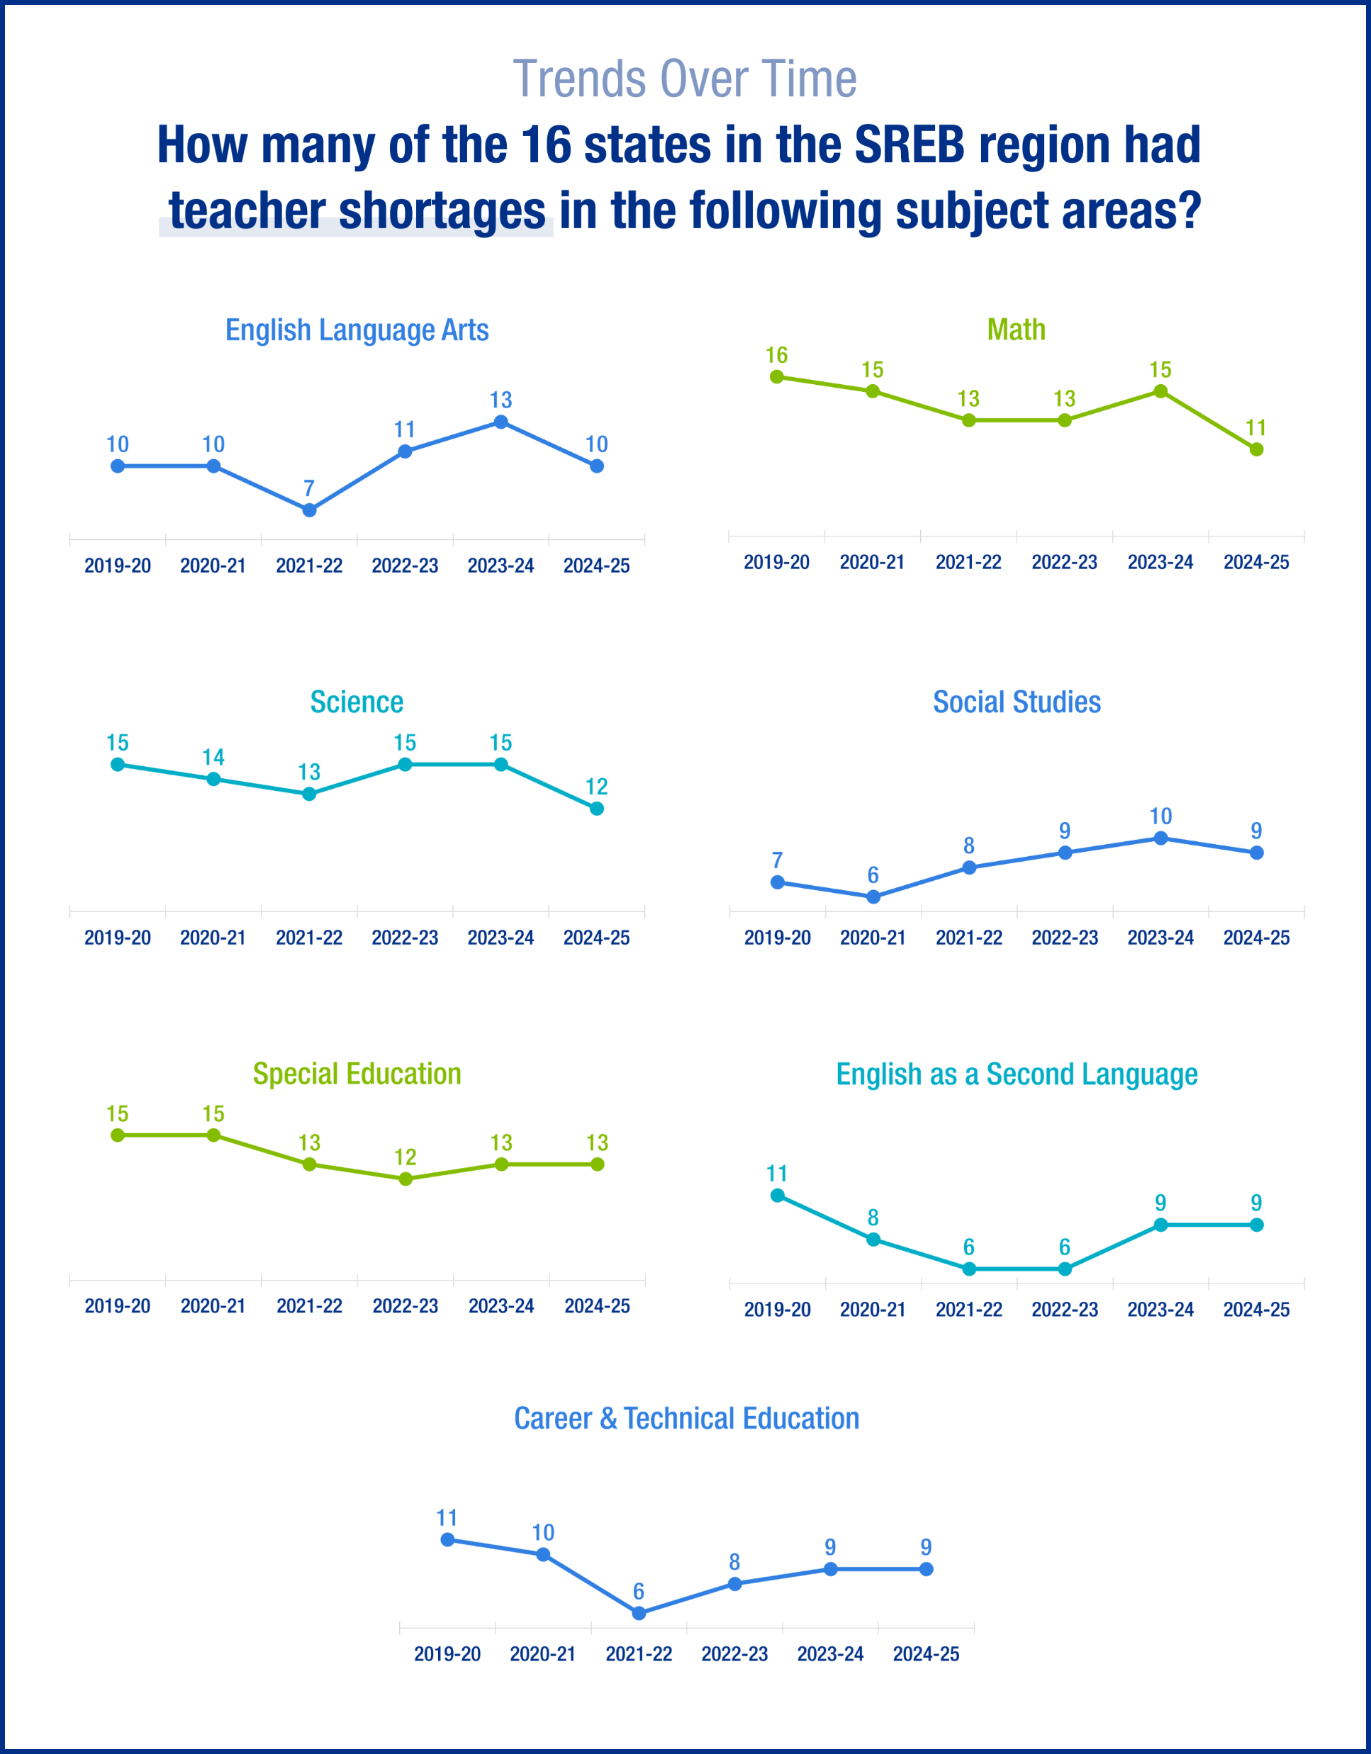
Notes:
Cut this graphic up in chunks so the text is more visible, so all the pieces are separated

Slide 23
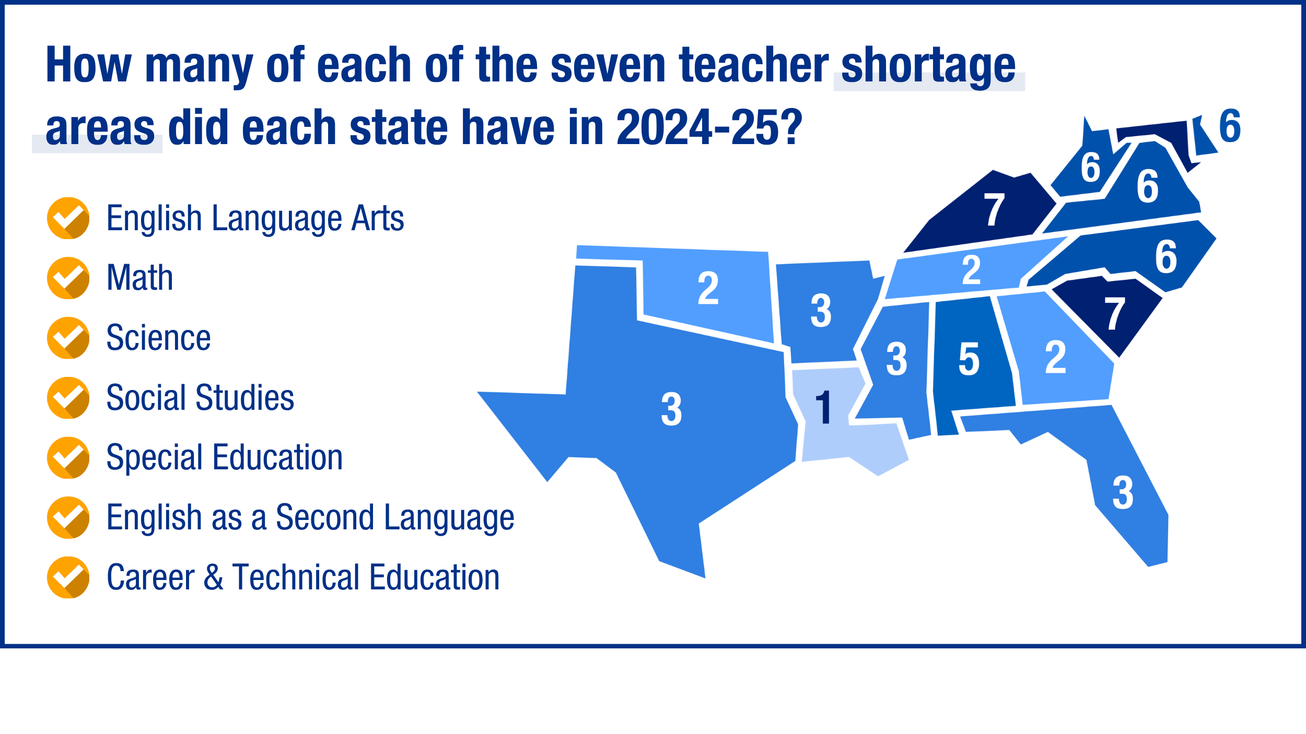
Notes:
Crop and center

Slide 24
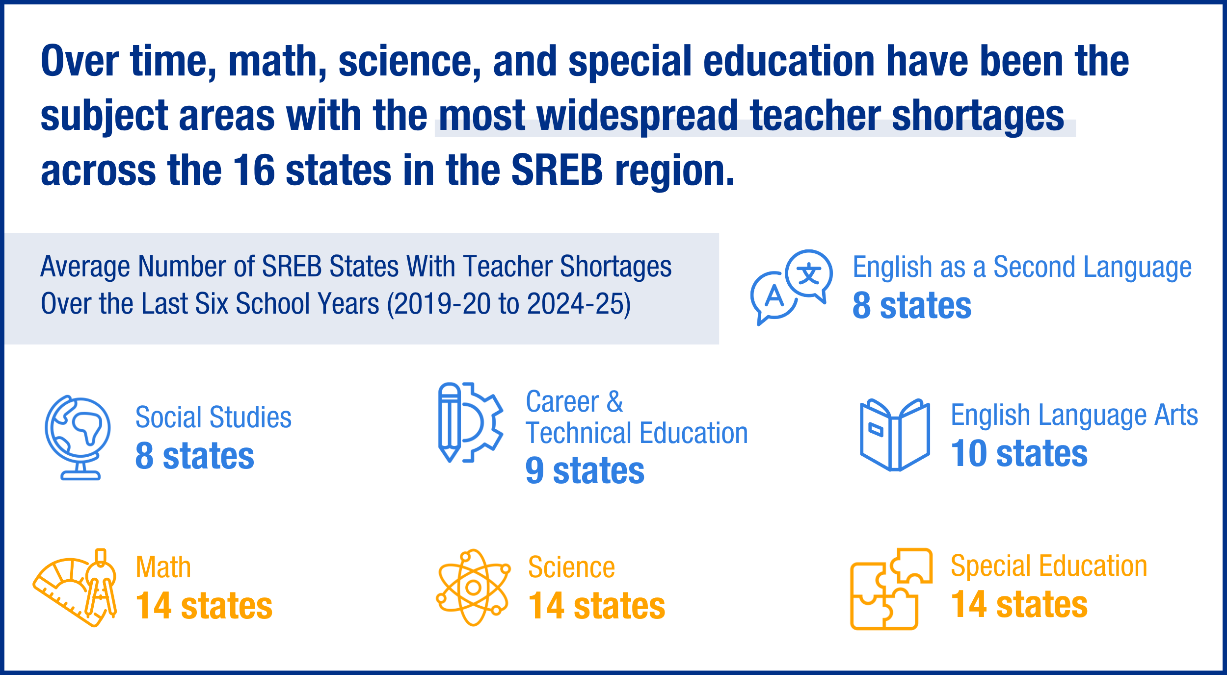
Notes:
Crop a little more of the white off

Slide 25
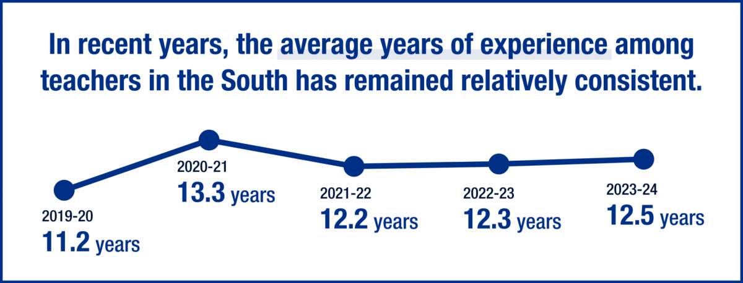
Teacher Quality Data
Measuring teacher quality is difficult, so states and researchers rely on proxy measures like years of experience and certification status.
Notes:
Economic issue + student prep issue

Slide 26
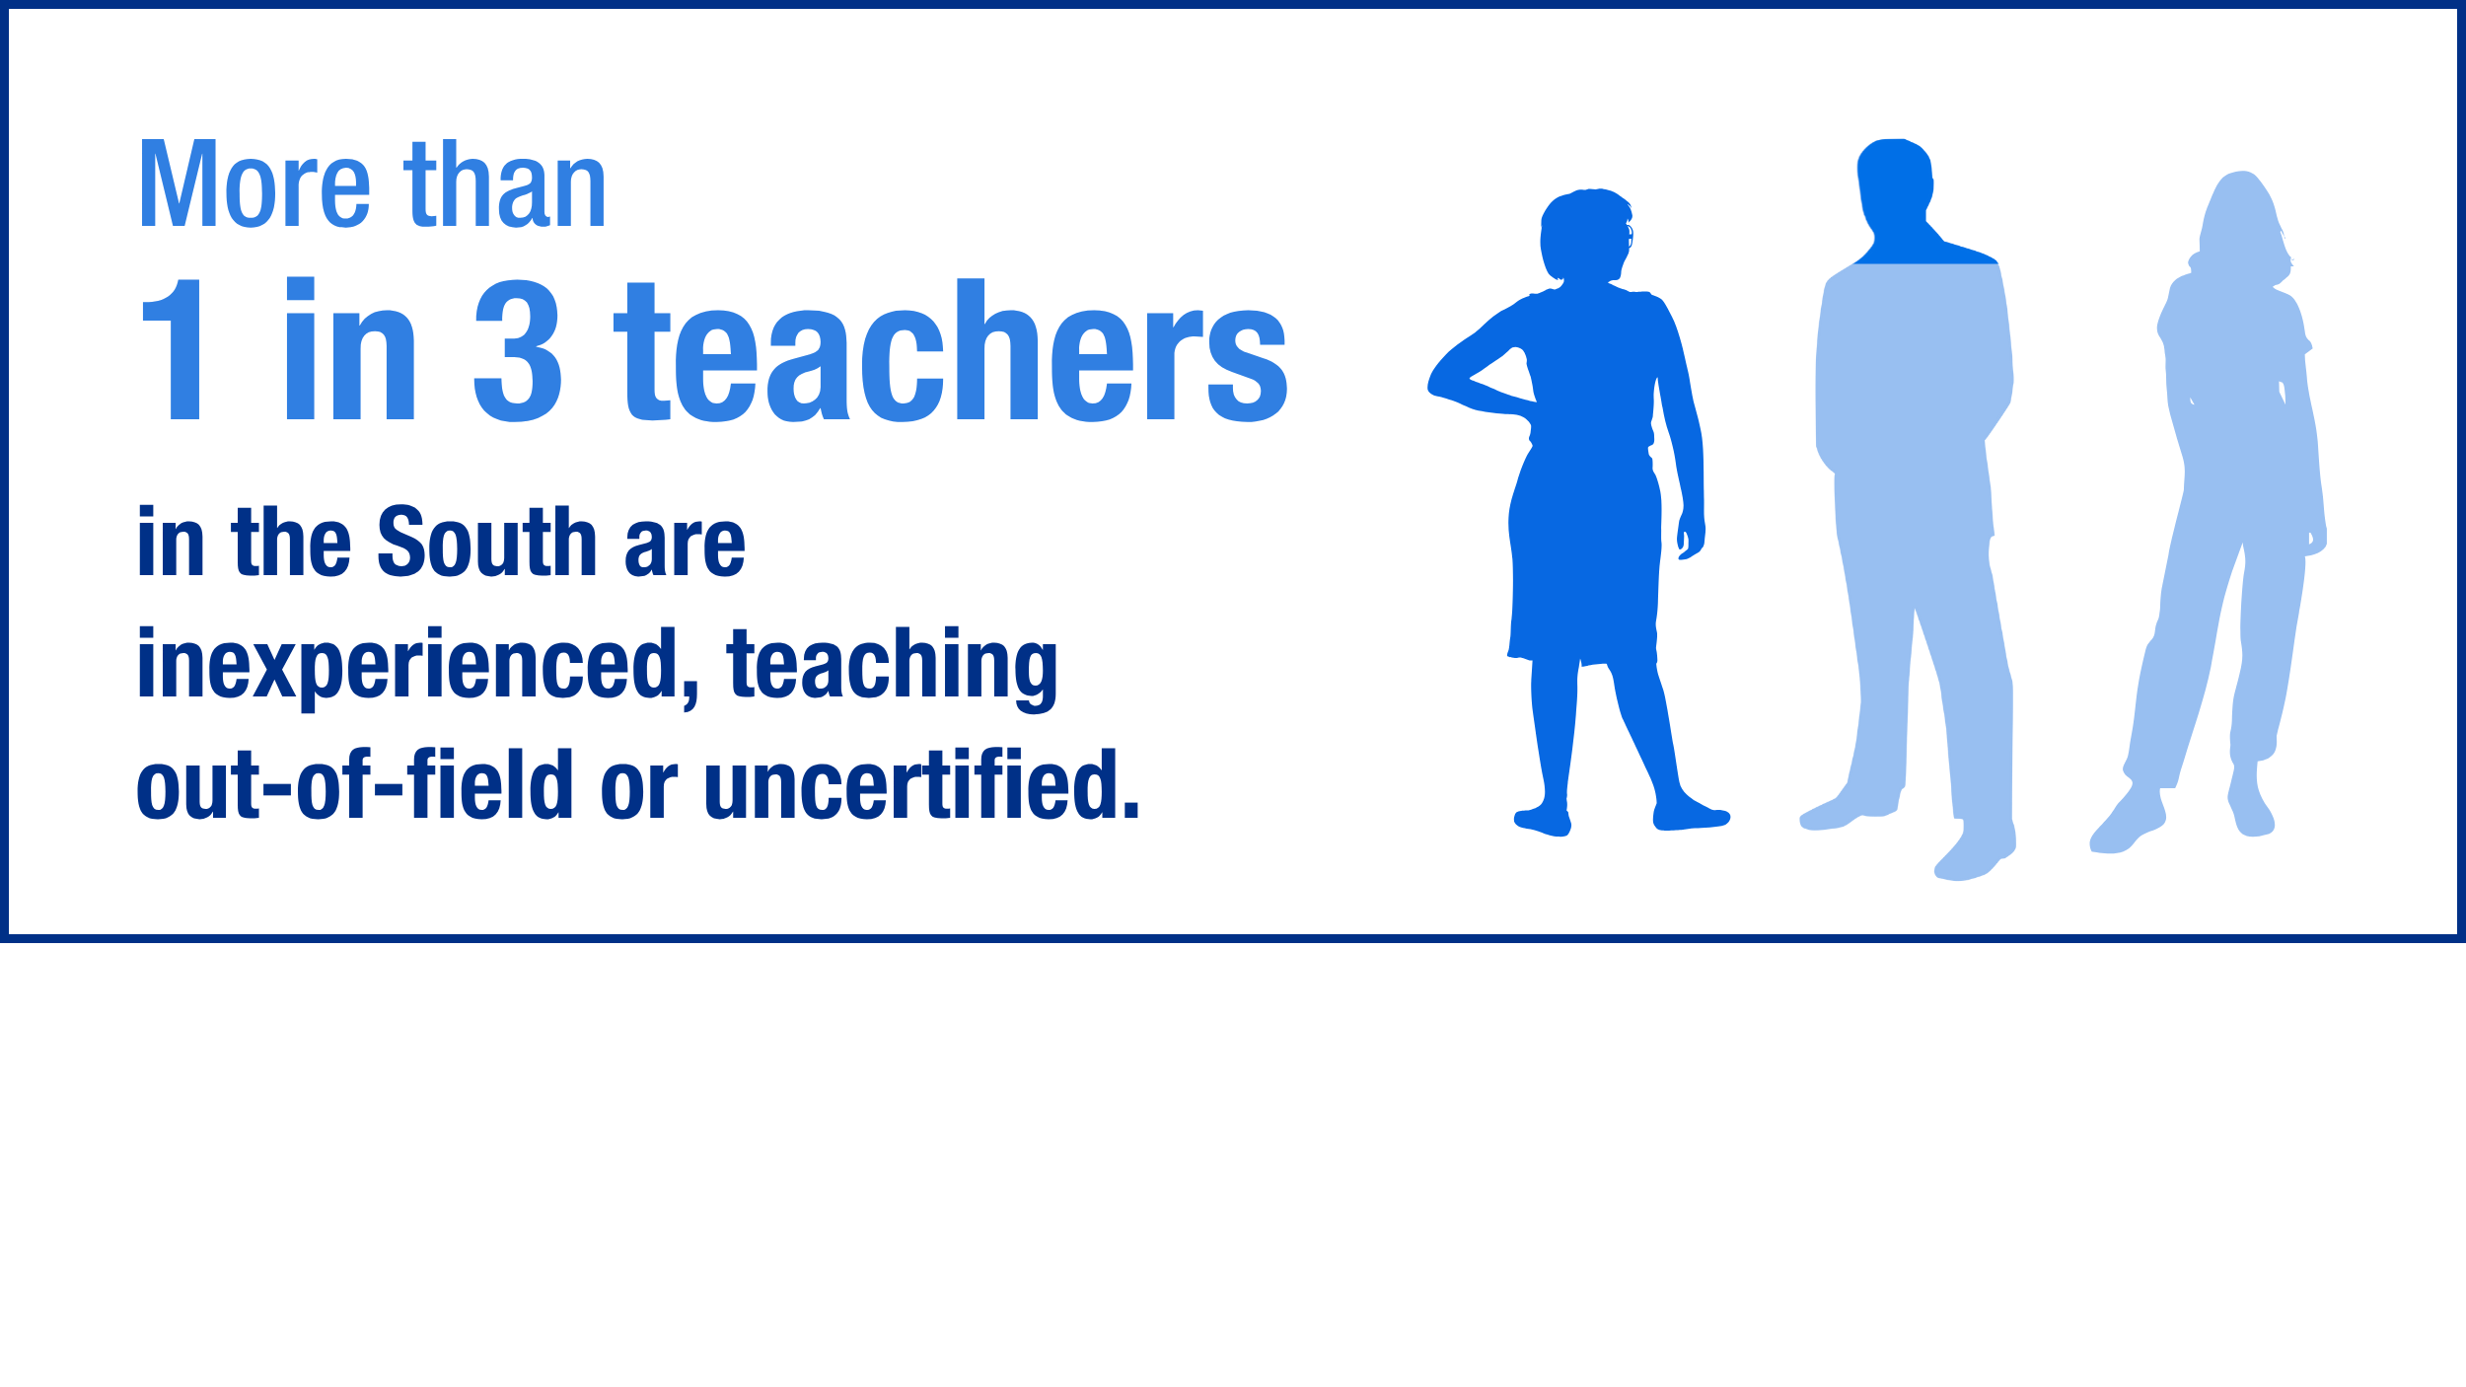
About 35.6% of teachers in the South were inexperienced, out-of-field or uncertified in 2023-24, a 1.4% decrease from the previous school year, but a 7.3% increase from the 2019-20 school year.
Notes:
Crop and center and then move sentence up – left aligned

Slide 27
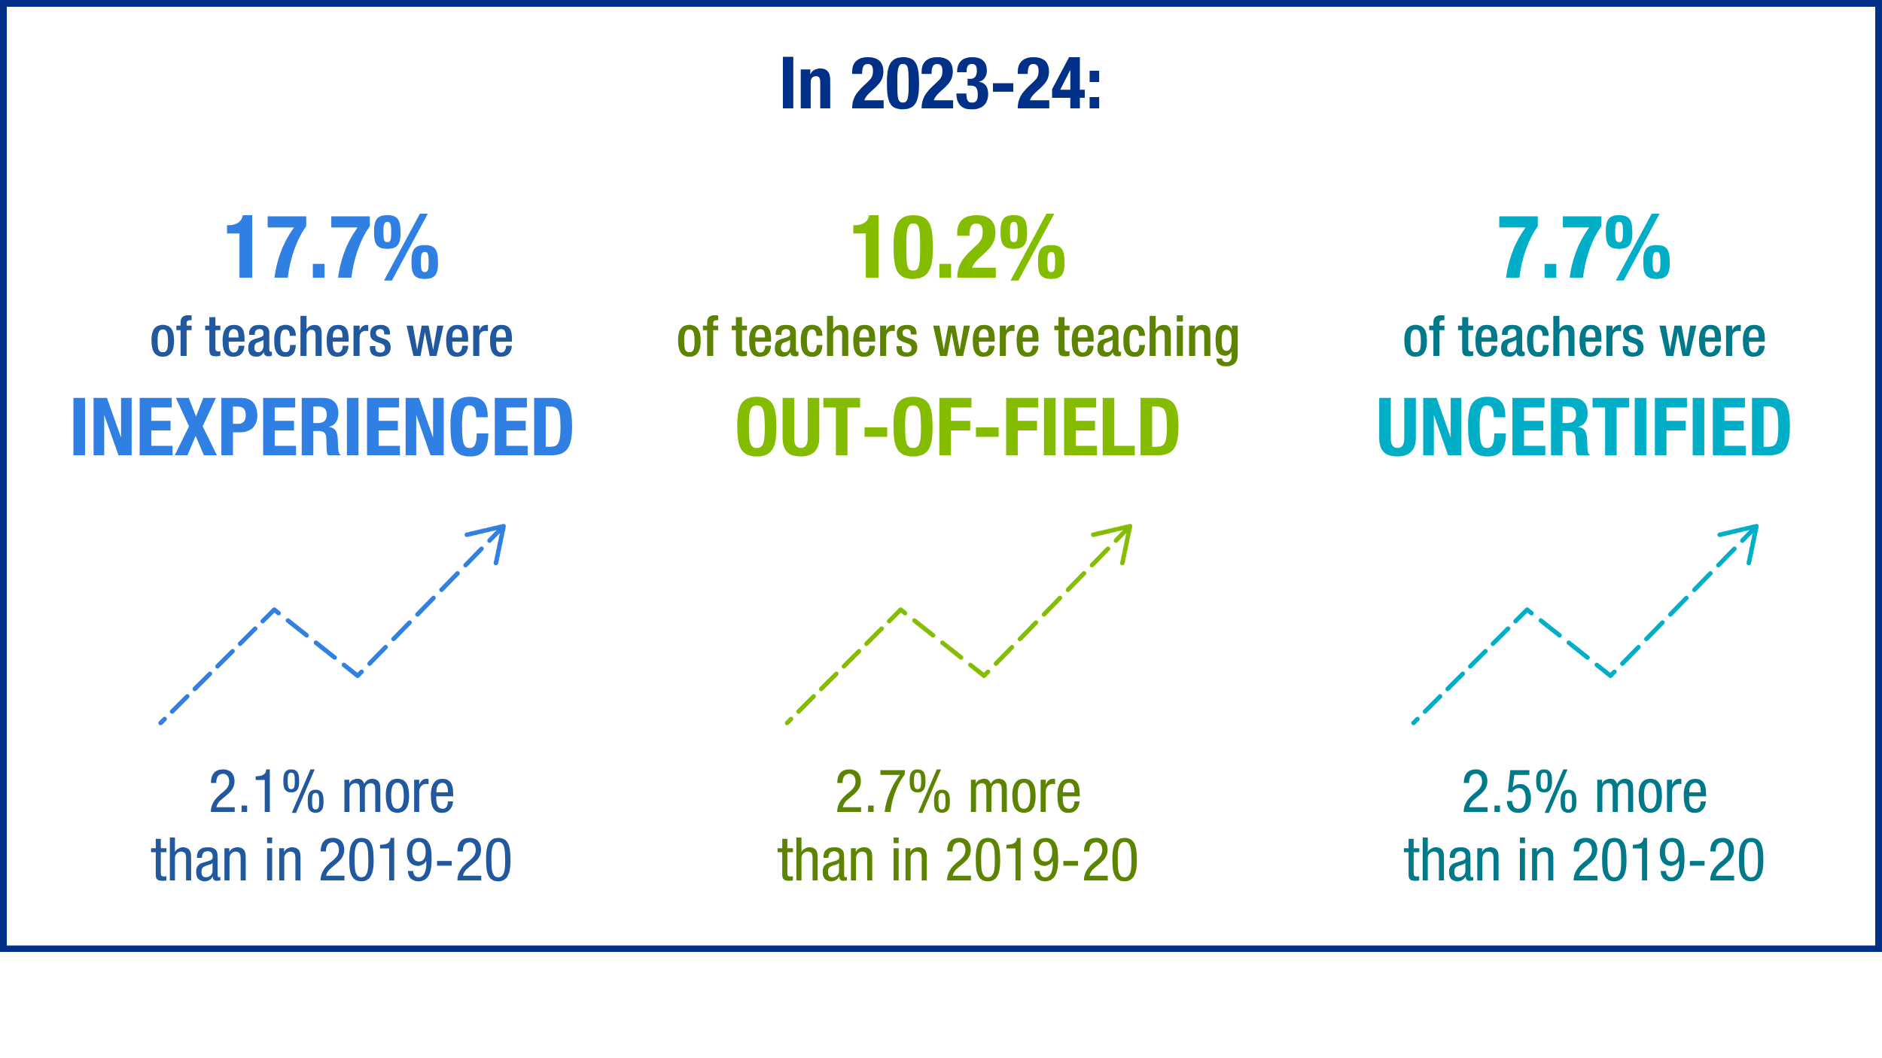
Notes:
Crop a little more off

Slide 28
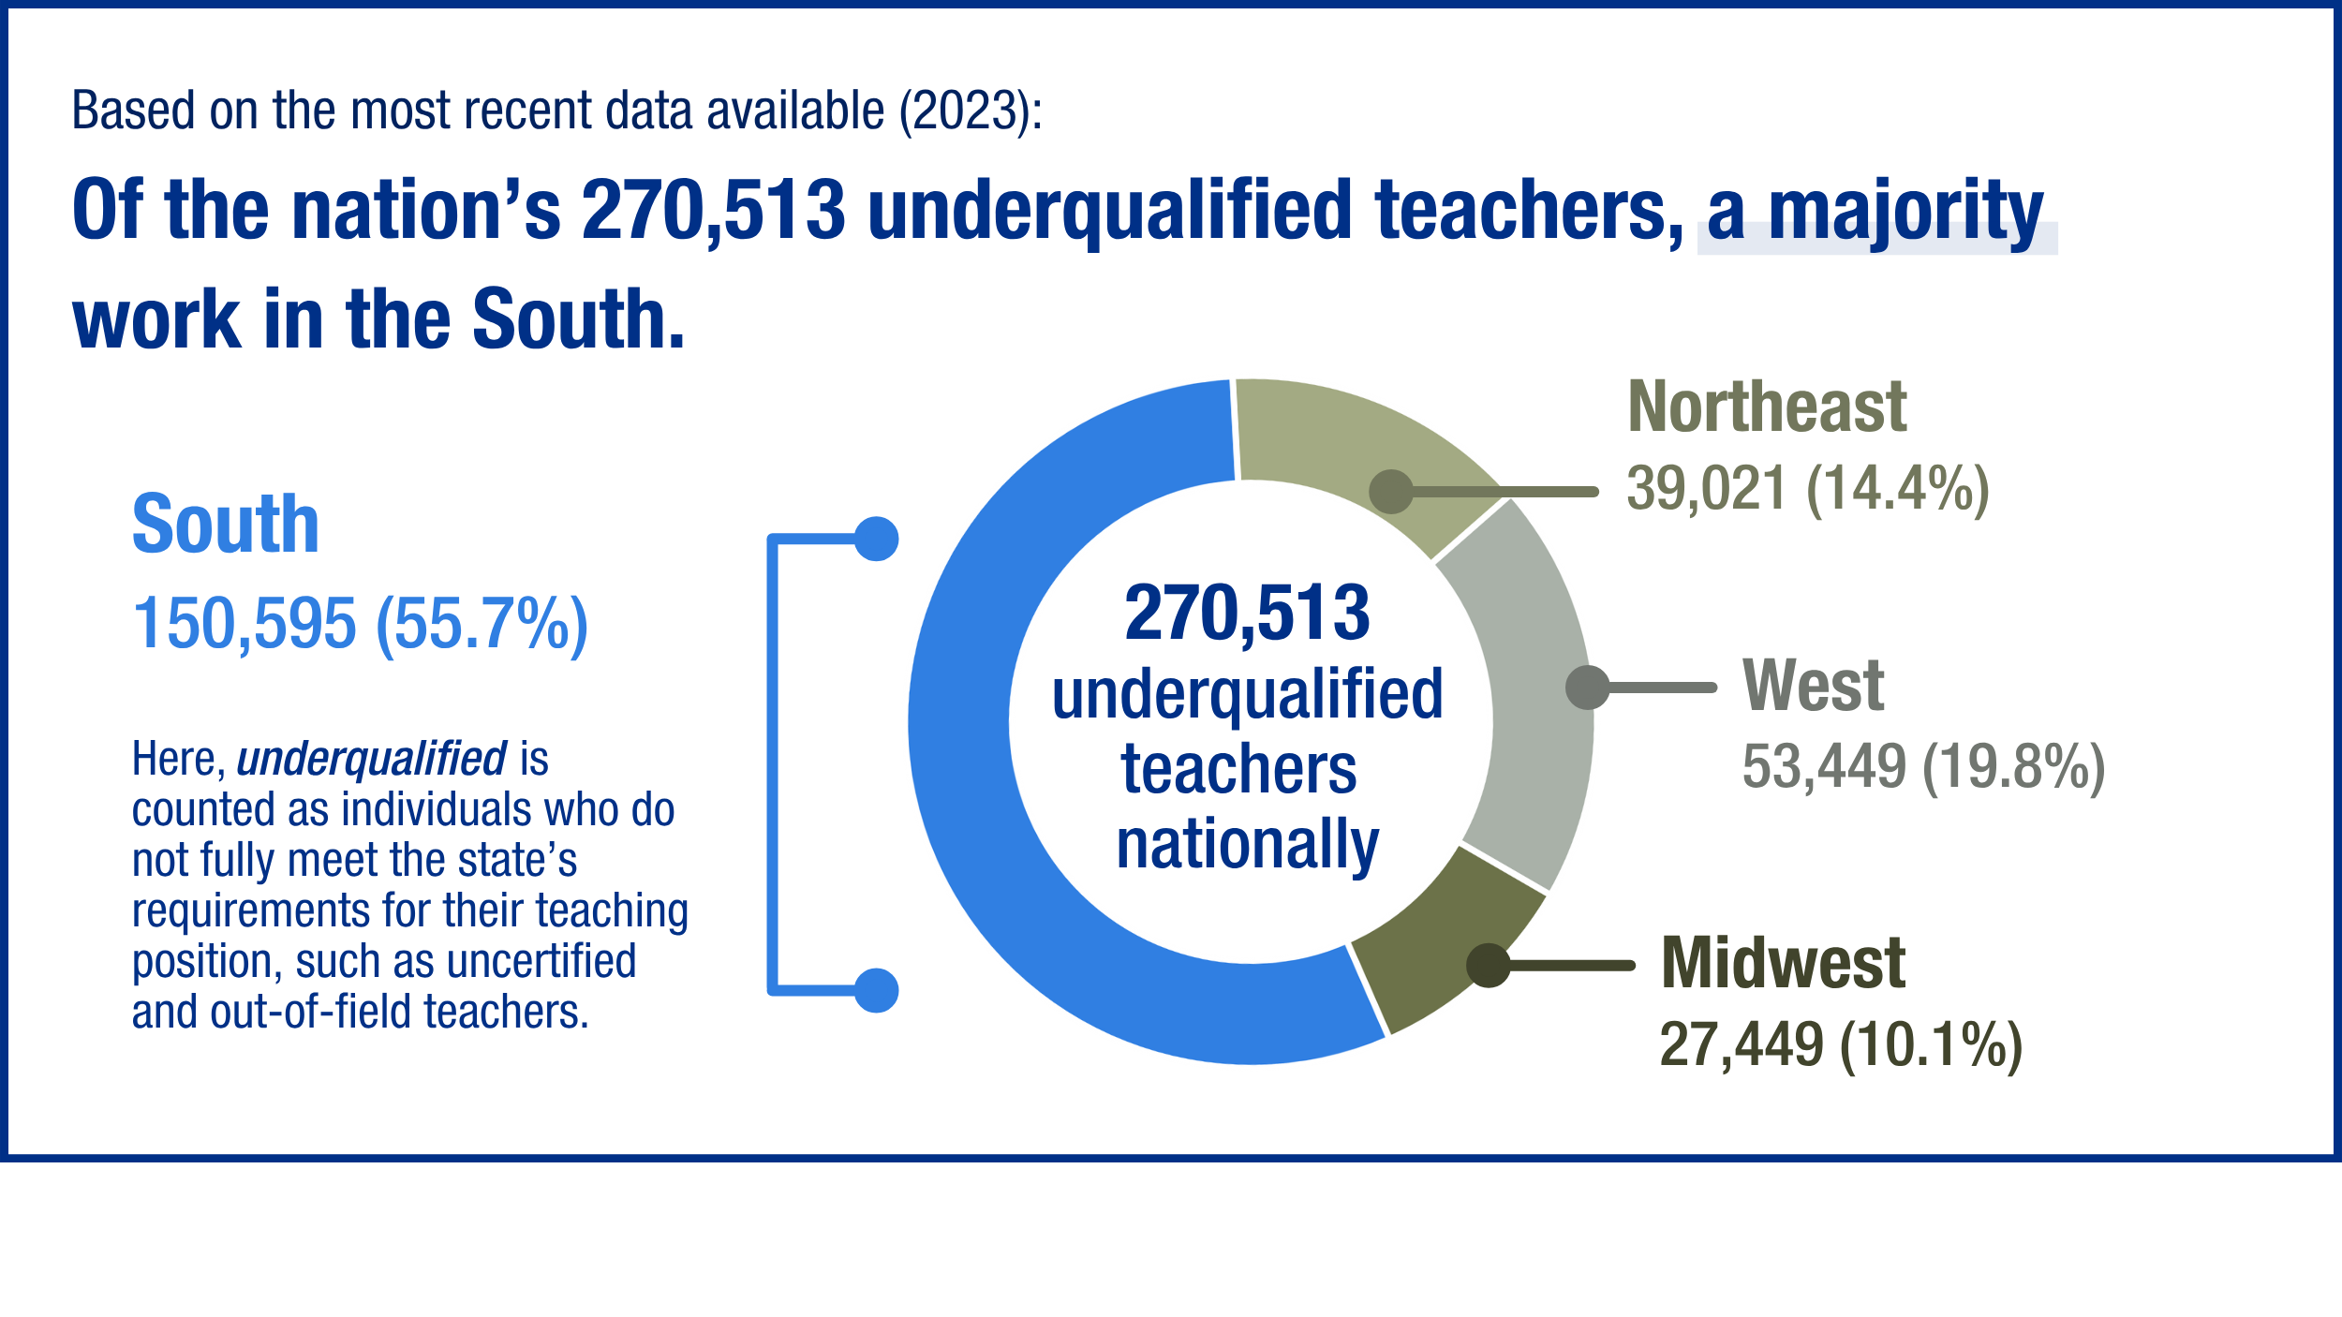
Notes:
Crop off more white

Slide 29
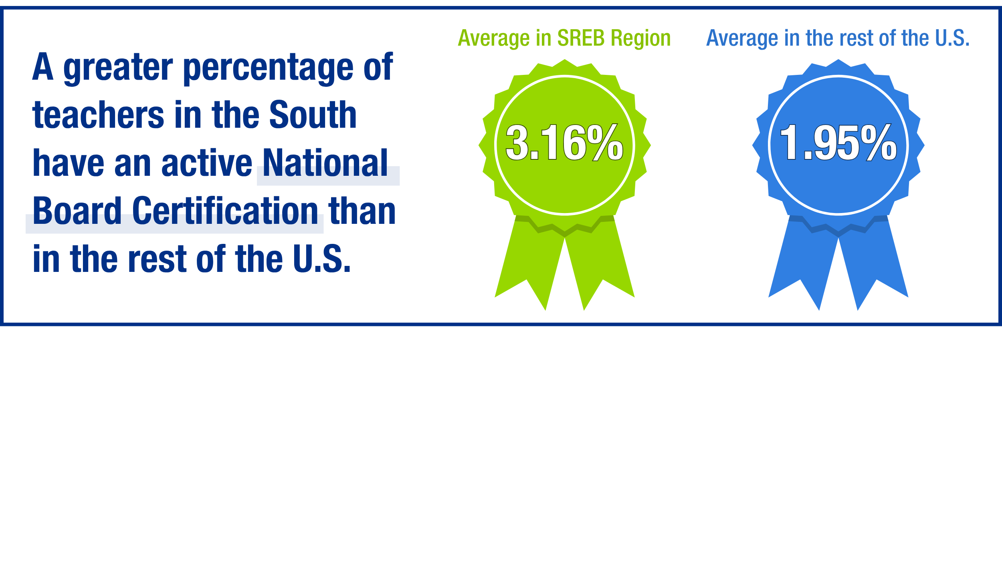
Notes:
Crop and center

Slide 30
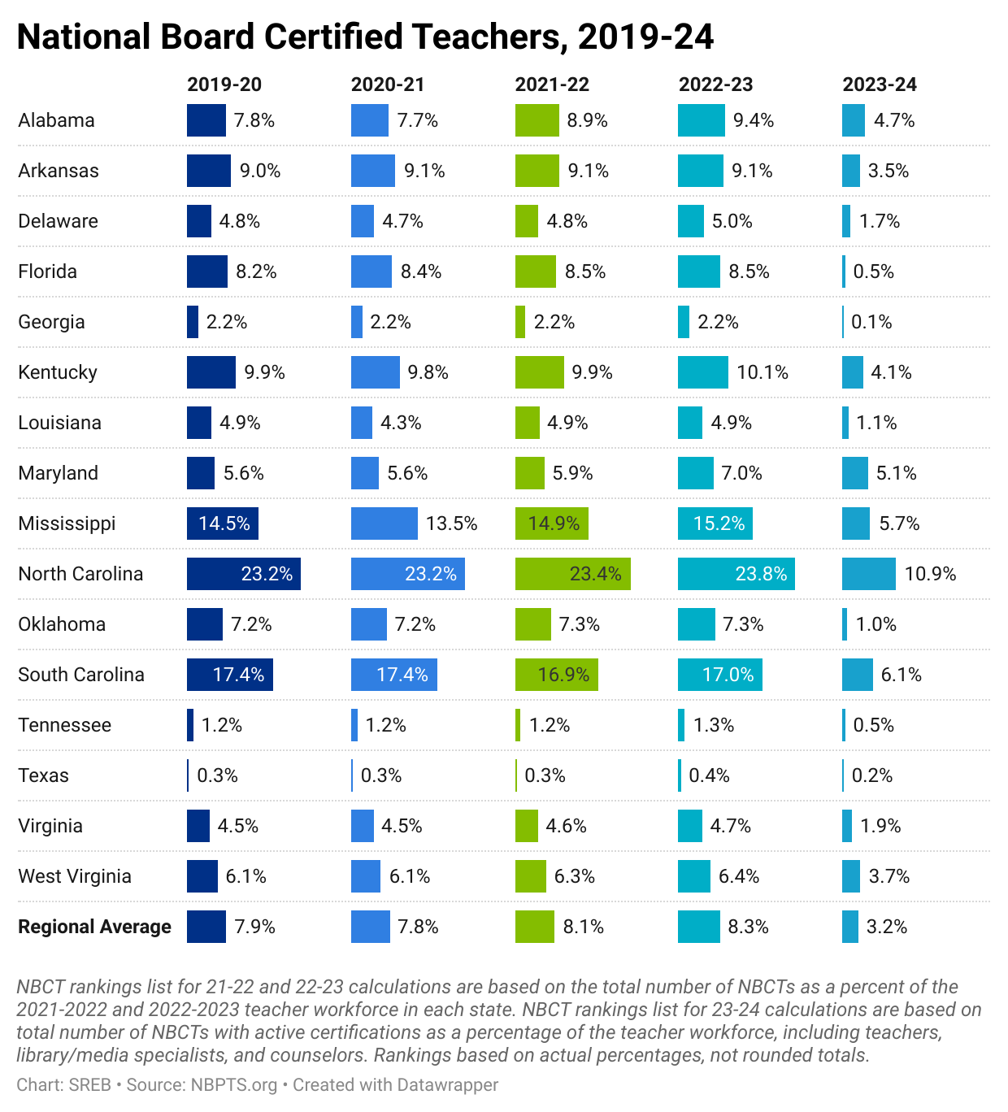
Since 2019-2020, North Carolina continues to lead the Southern region with the largest percentage of NBCTs.

Slide 31
Teacher Talent Distribution
Across the South, students attending higher poverty (Title I) schools are more likely to have inexperienced, out-of-field and uncertified teachers than their peers at more affluent schools.
While proxies for quality, underprepared and inexperienced teachers more often yield lower student growth on average than their prepared and certified counterparts.

Slide 32
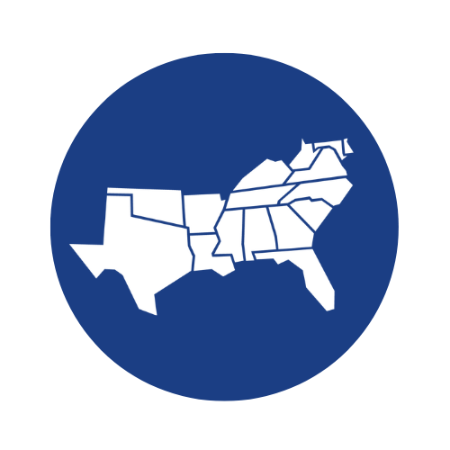
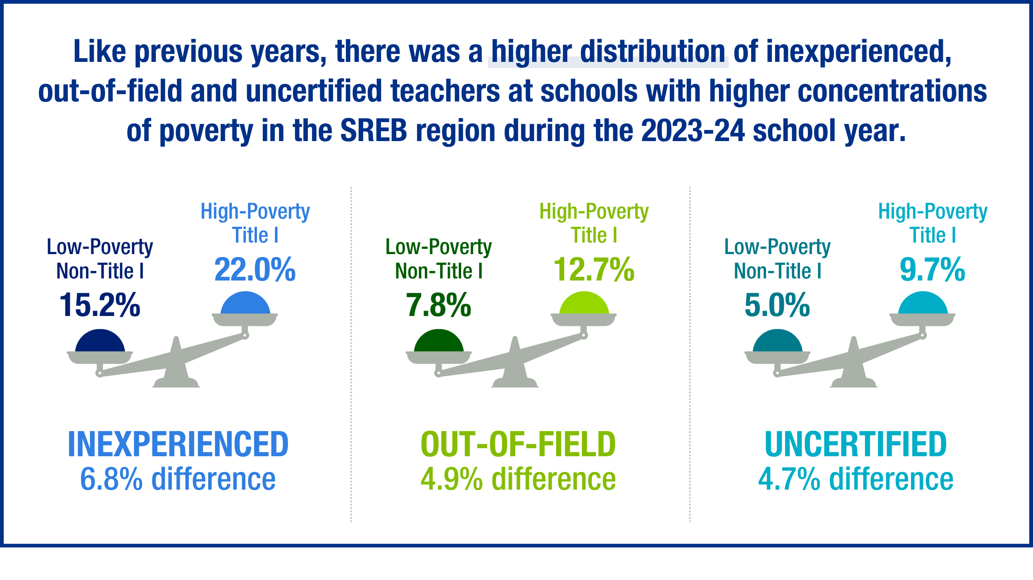
SREB STATES
2023-2024
A student attending
a HIGH POVERTY school is
1.5x more likely
to have an inexperienced or underqualified teacher than their peers.
Notes:
Yet, if teachers are the #1 factor for affecting student learning growth and achievement, that may be where we want to pay the most attention.
Teachers who are qualified, trained and supported have more positive impact with students – there is little dispute to the countless studies on this.
But Title I schools are demonstrated to have the most teachers in our proxy measures of inequality – more inexperienced, more uncertified and more out-of-field teachers than in non-Title I schools.
So how do we attract, recruit, grow and support educators in Title I schools so we can provide more great teachers to students in poverty?
My colleague Amanda Merritt has a few insights on this before getting thoughts from our panel....

Slide 33
High Poverty School Data
SREB STATES
2021-2022
72% of schools are Title I eligible (24,974) enrolling
51% of public-school students (10.1 million)
44%
47% - DE
27% - MD
76% - DC
Percent of students enrolled in Title I Eligible schools:
31%
74%
36%
59%
NA
58%
66%
39%
71%
55%
44%
51%
33%
Sources: NCES 2022
Notes:
When we think about teacher quality and shortages, we must pay attention to differences across not only having enough teachers in each class, each subject, having a quality teacher in each room – but we must look at the differences across schools. Data shows us there are more acute shortages in rural schools and high-poverty urban schools and that Title I schools have significant shortages compared to schools with lower concentration of students from poverty.
Schools enrolling at least 40% of students from low-income families are eligible to use Title I funds for schoolwide programs or targeted assistance for at risk students.
Out of the 35,532 public and charter schools in the SREB region, 62% offer Title I programs or assistance and 10% more are Title I eligible.
51% of students in the region attend these Title I eligible schools.
Numerous reports (from the Brookings Institute, George Mason University, and others) argue that despite this increased funding, little to no gains in achievement or closing learning gaps between children from backgrounds of poverty and their middle-class peers. Some sight the added bureaucratic issues allowing the funding to make a different, the subsidizing of non-phonics based instruction for 3 ½ decades, etc.

Slide 34
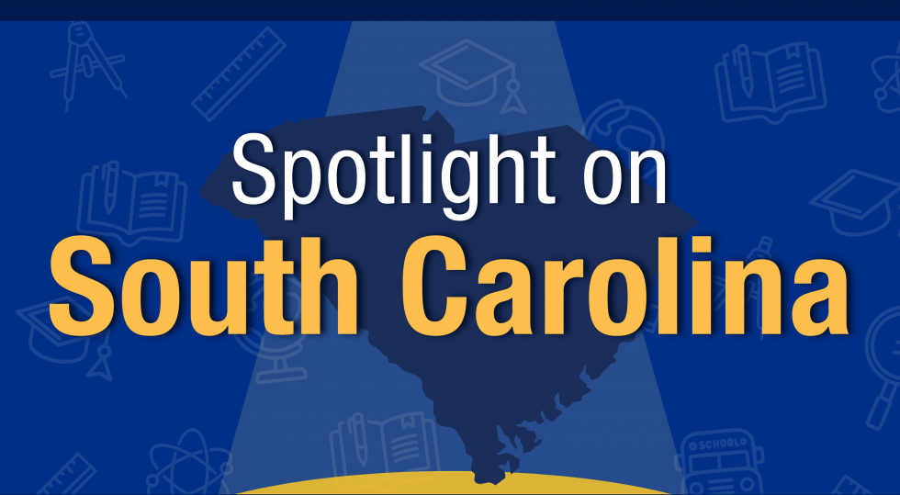
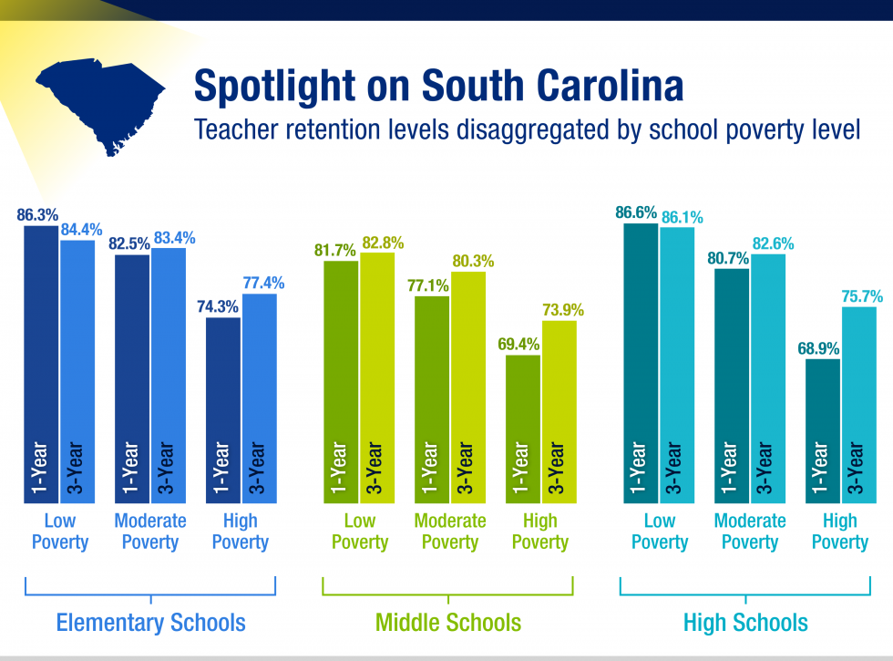
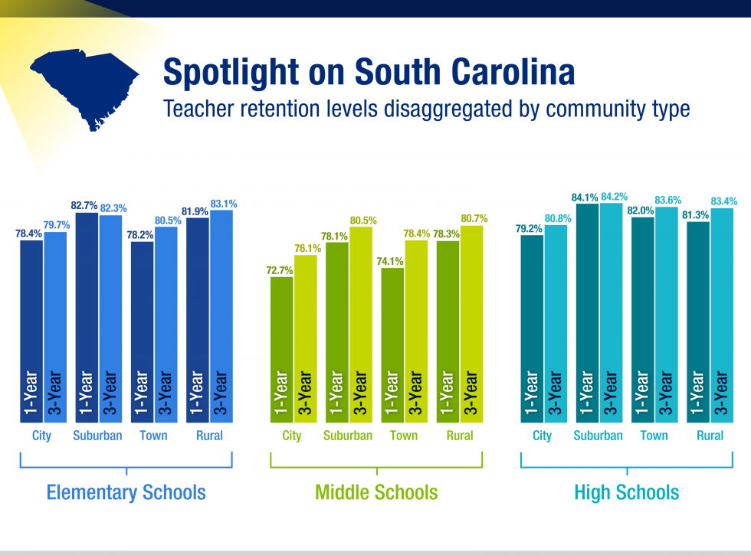
See more state spotlights in our data portal
Notes:
Add the link to see the additional spotlight to bottom corner

Slide 35
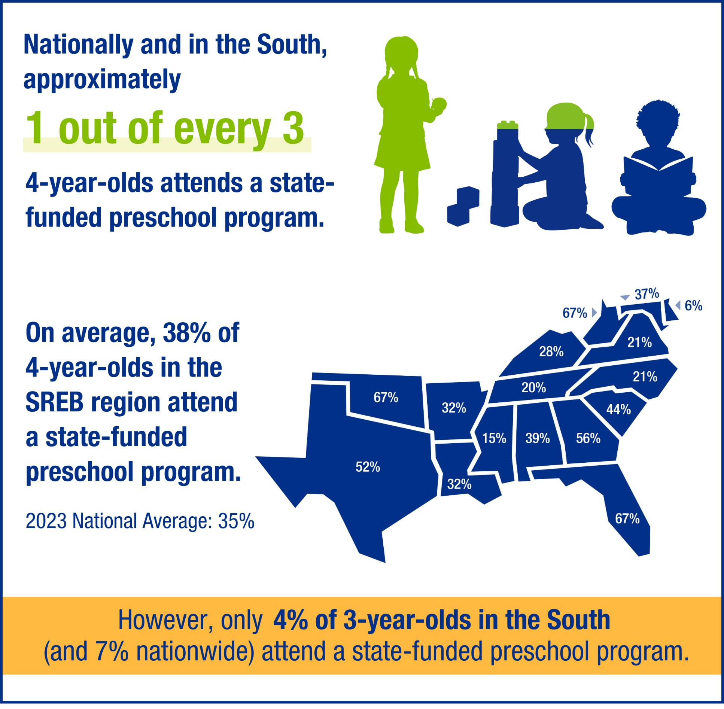
New Data Early Childhood Education in the South
In the South, 38% of 4-year-olds and 4% of 3-year-olds were enrolled in state-funded preschool in 2023, rates that are relatively similar to national trends.

Slide 36
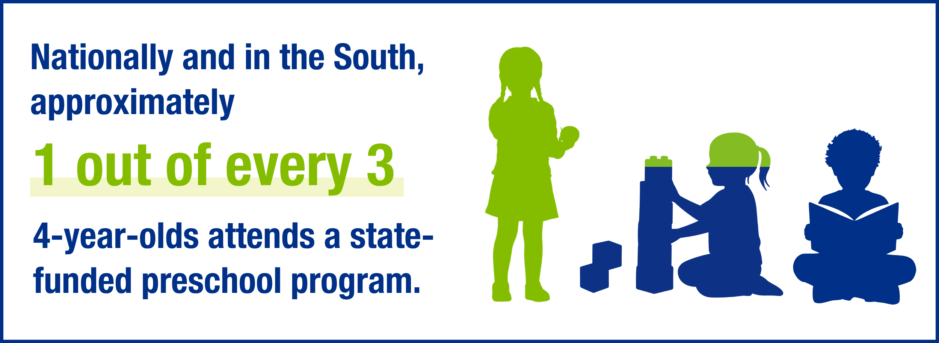
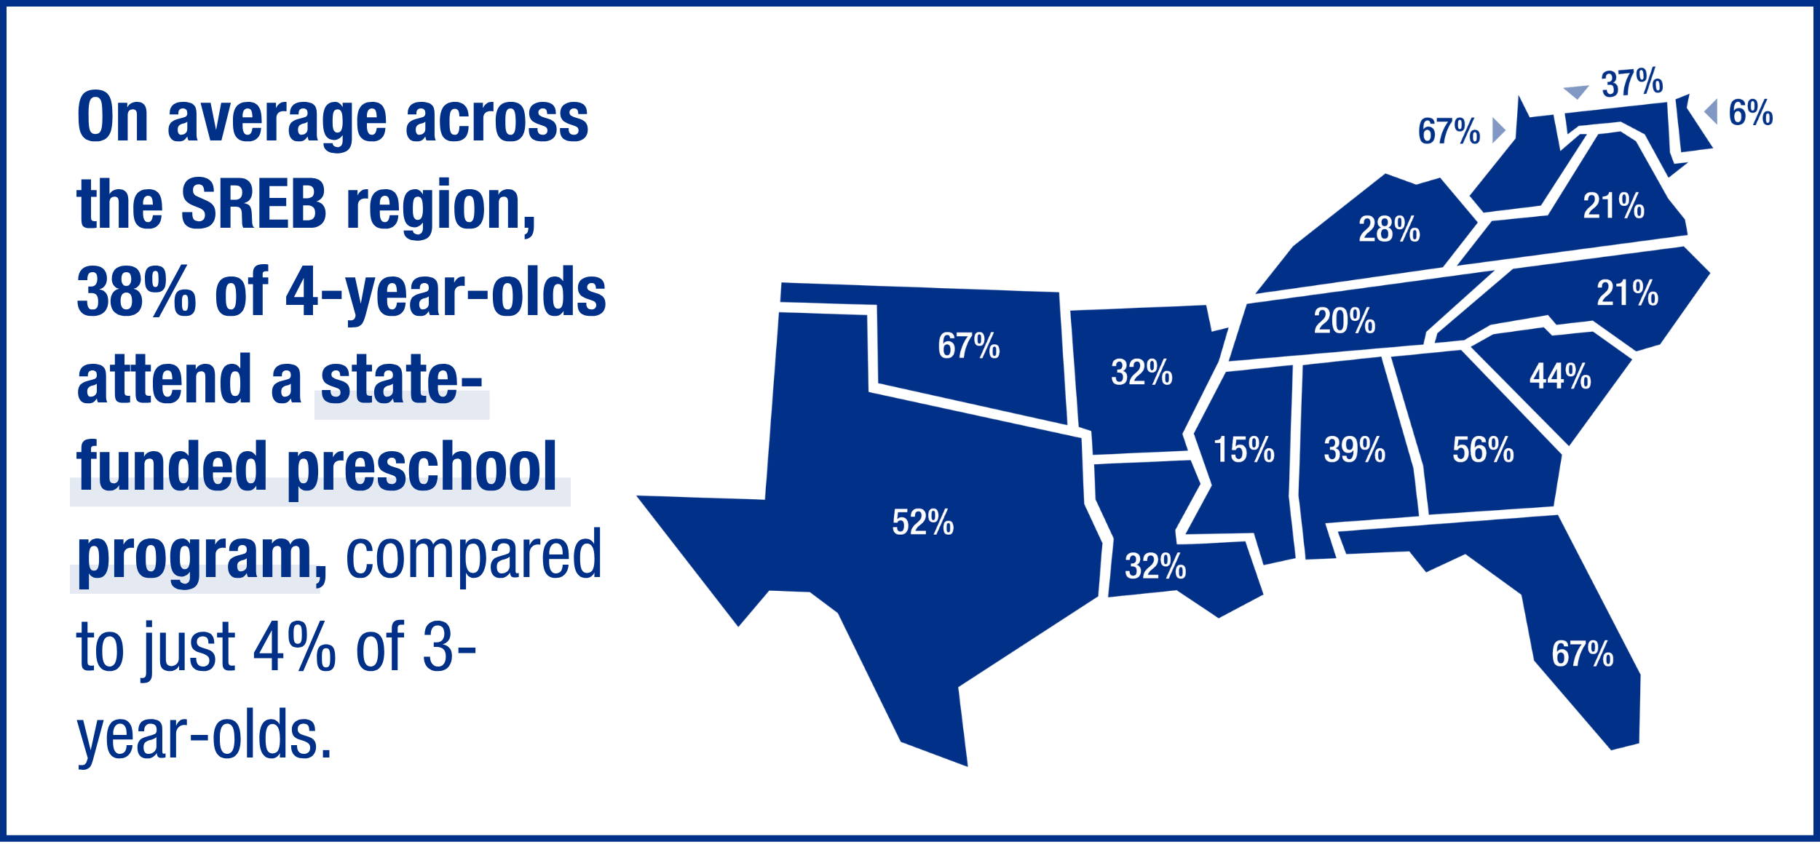
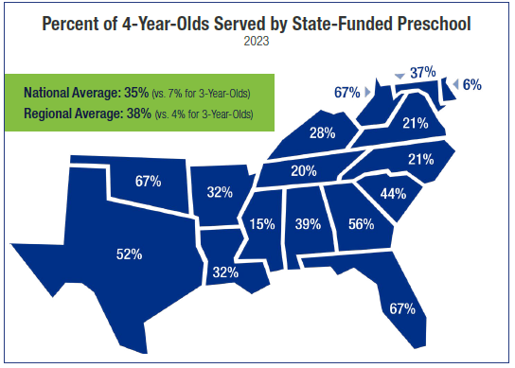
Notes:
Make top graphic smaller and smaller one a little bigger

Slide 37
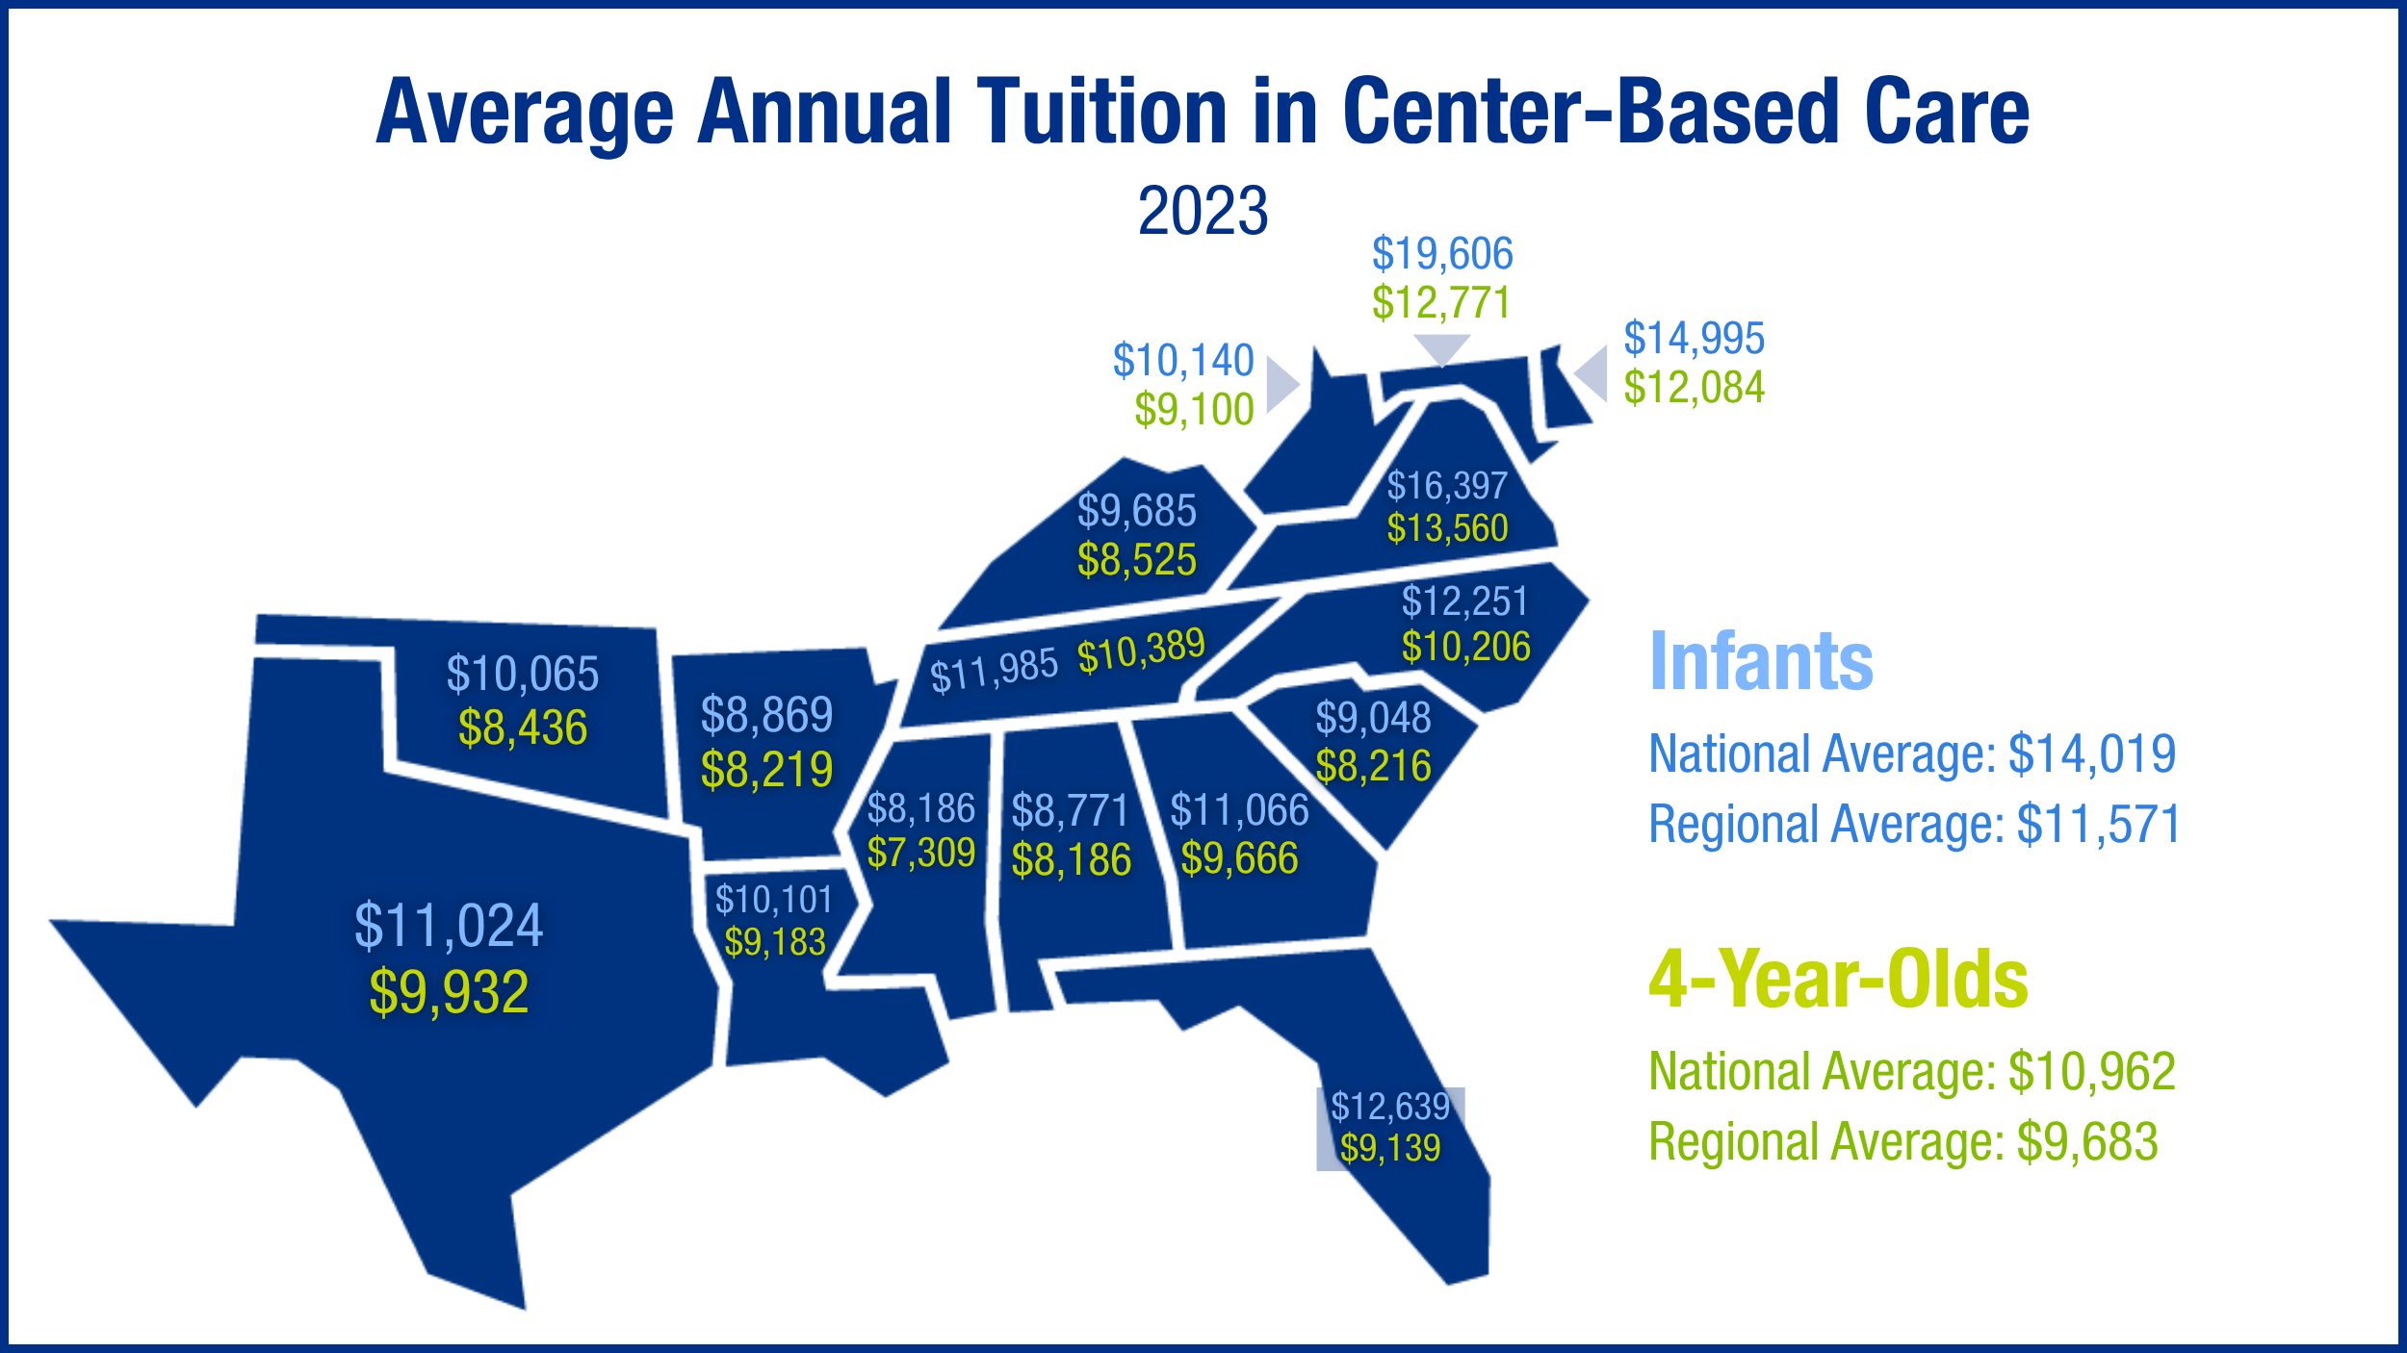

Slide 38
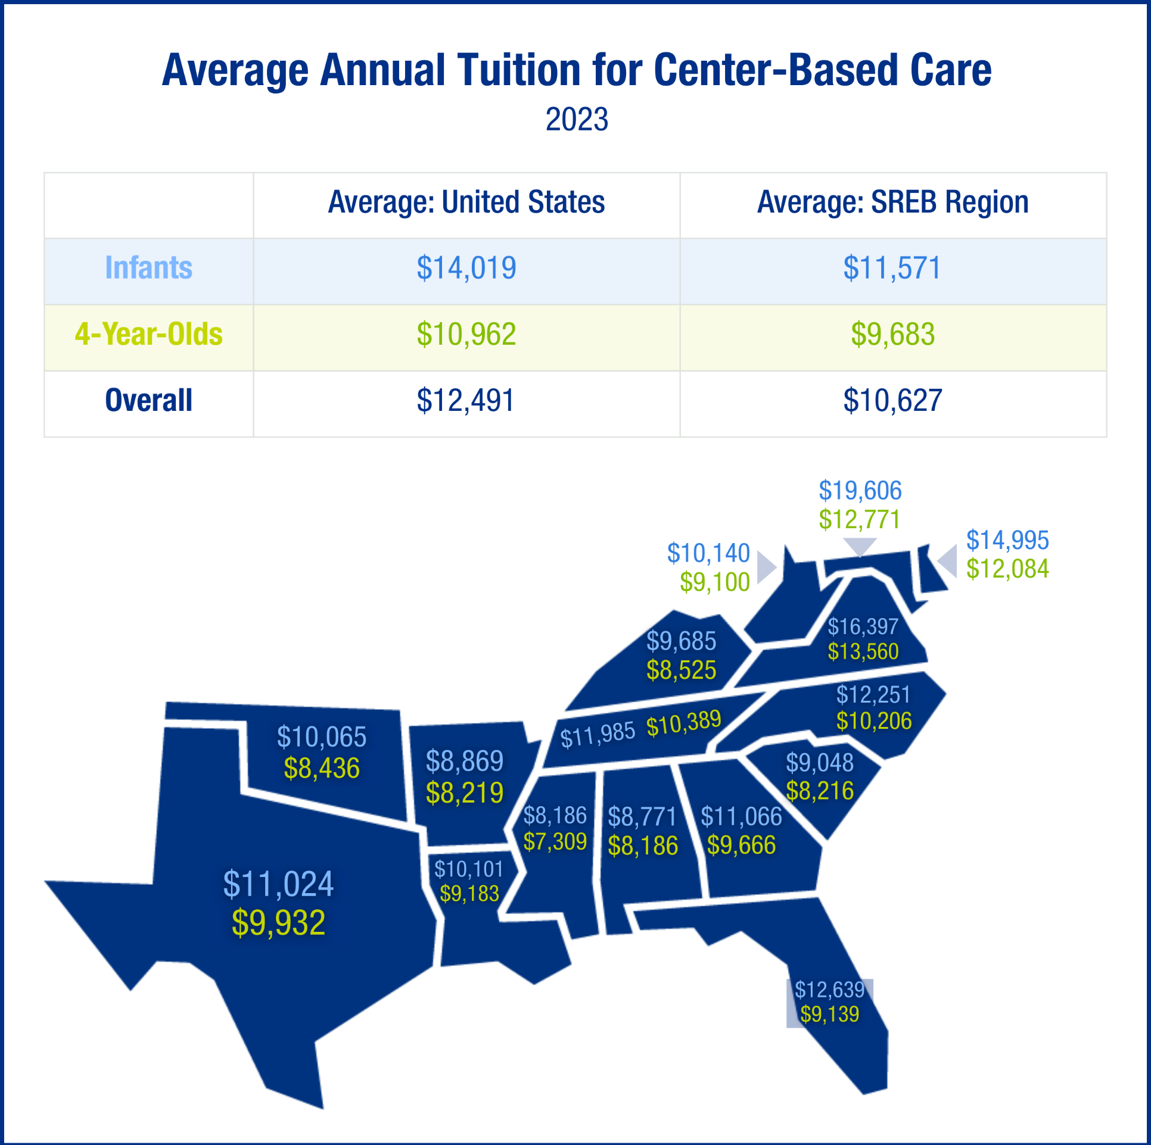
Notes:
Crop the table and map and then put them side by side

Slide 39
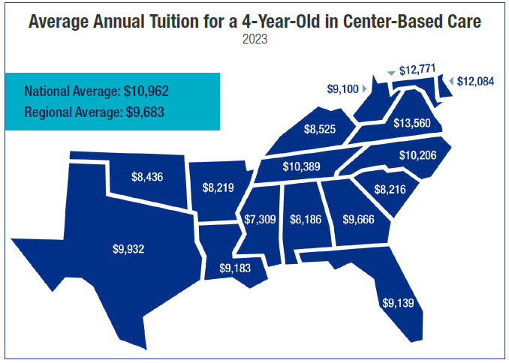

Slide 40
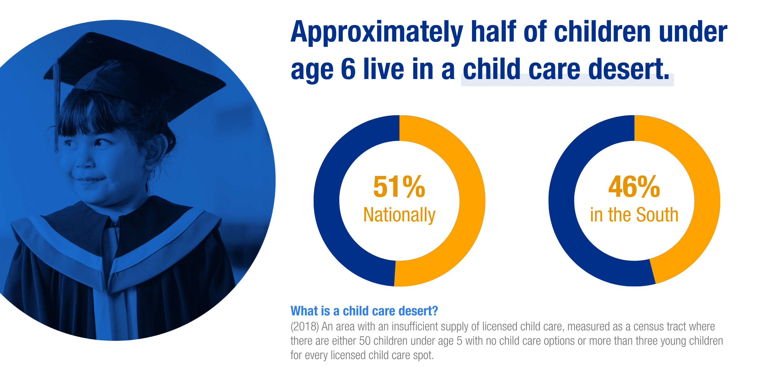
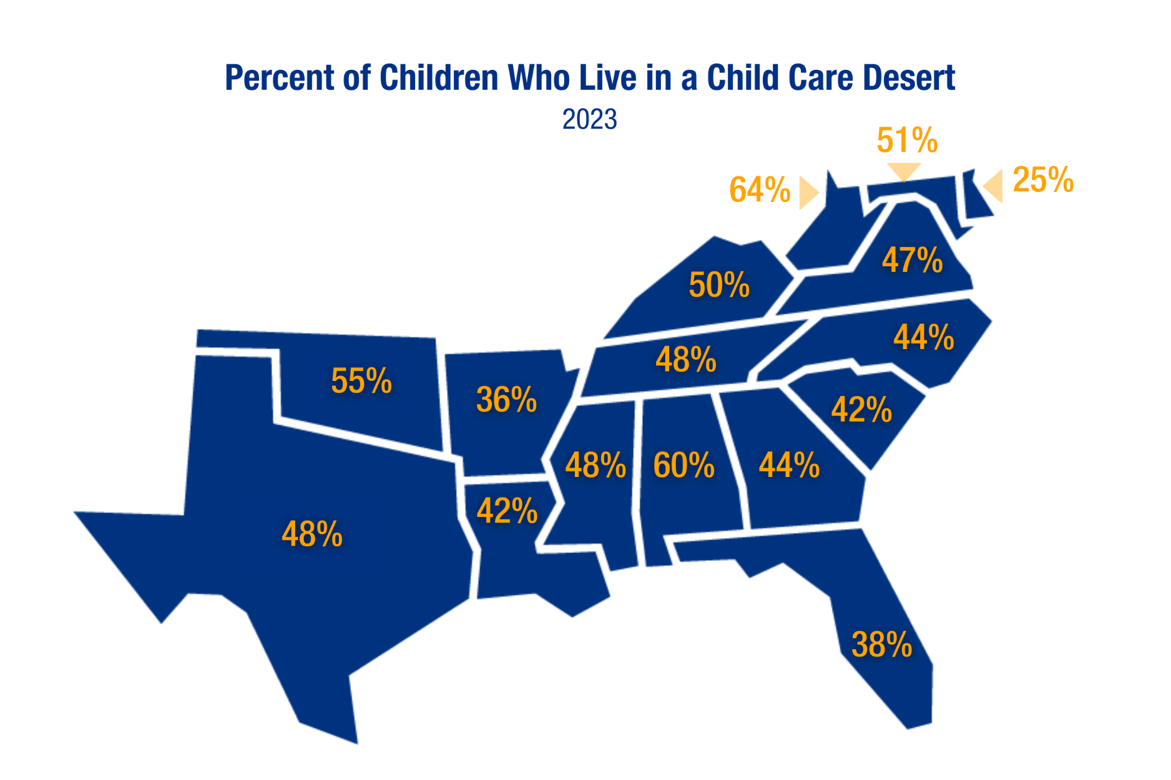

Slide 41
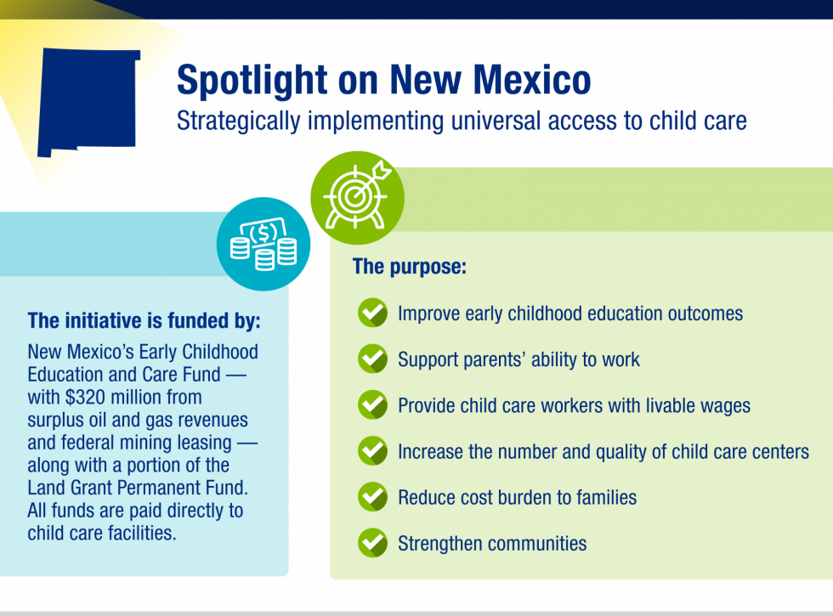
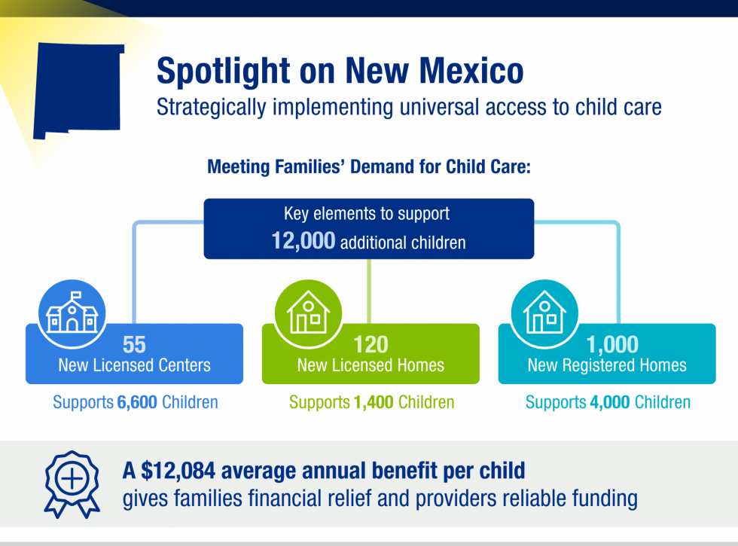
Non-SREB State Feature
Notes:
Crop this graphic into 2

Slide 42
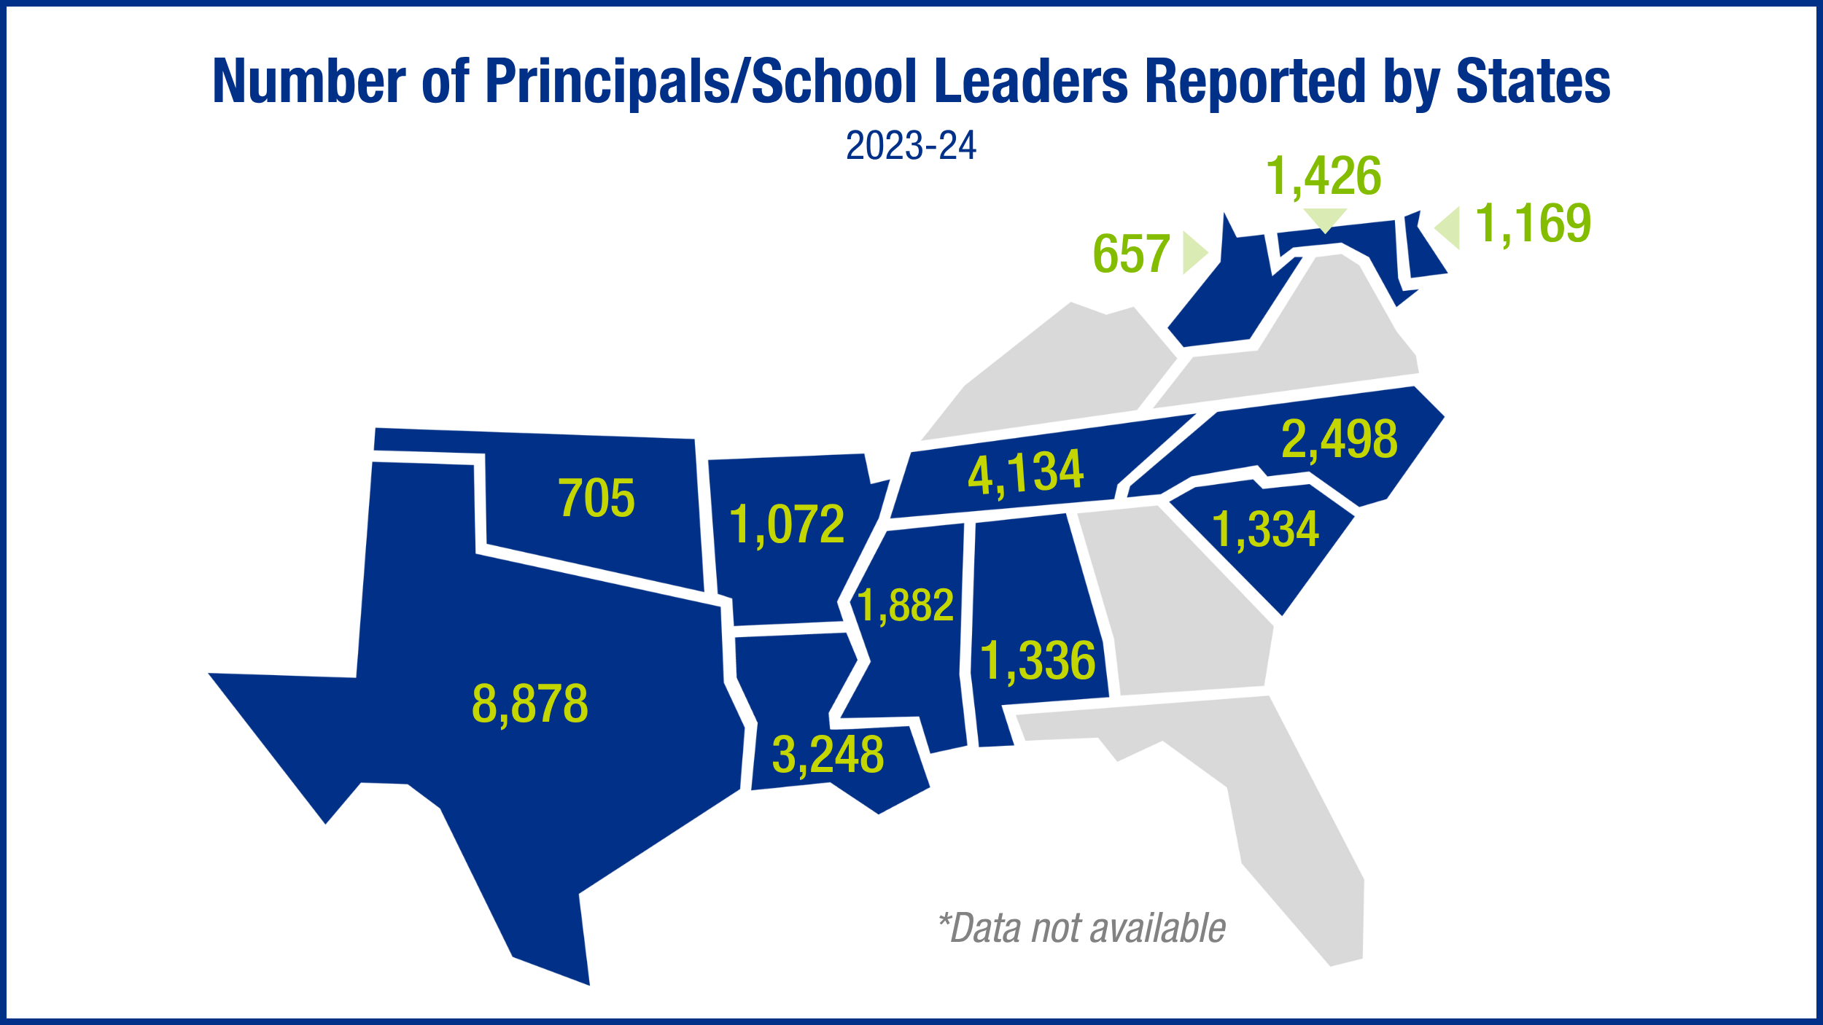
New Data K-12 school leadership workforce

Slide 43
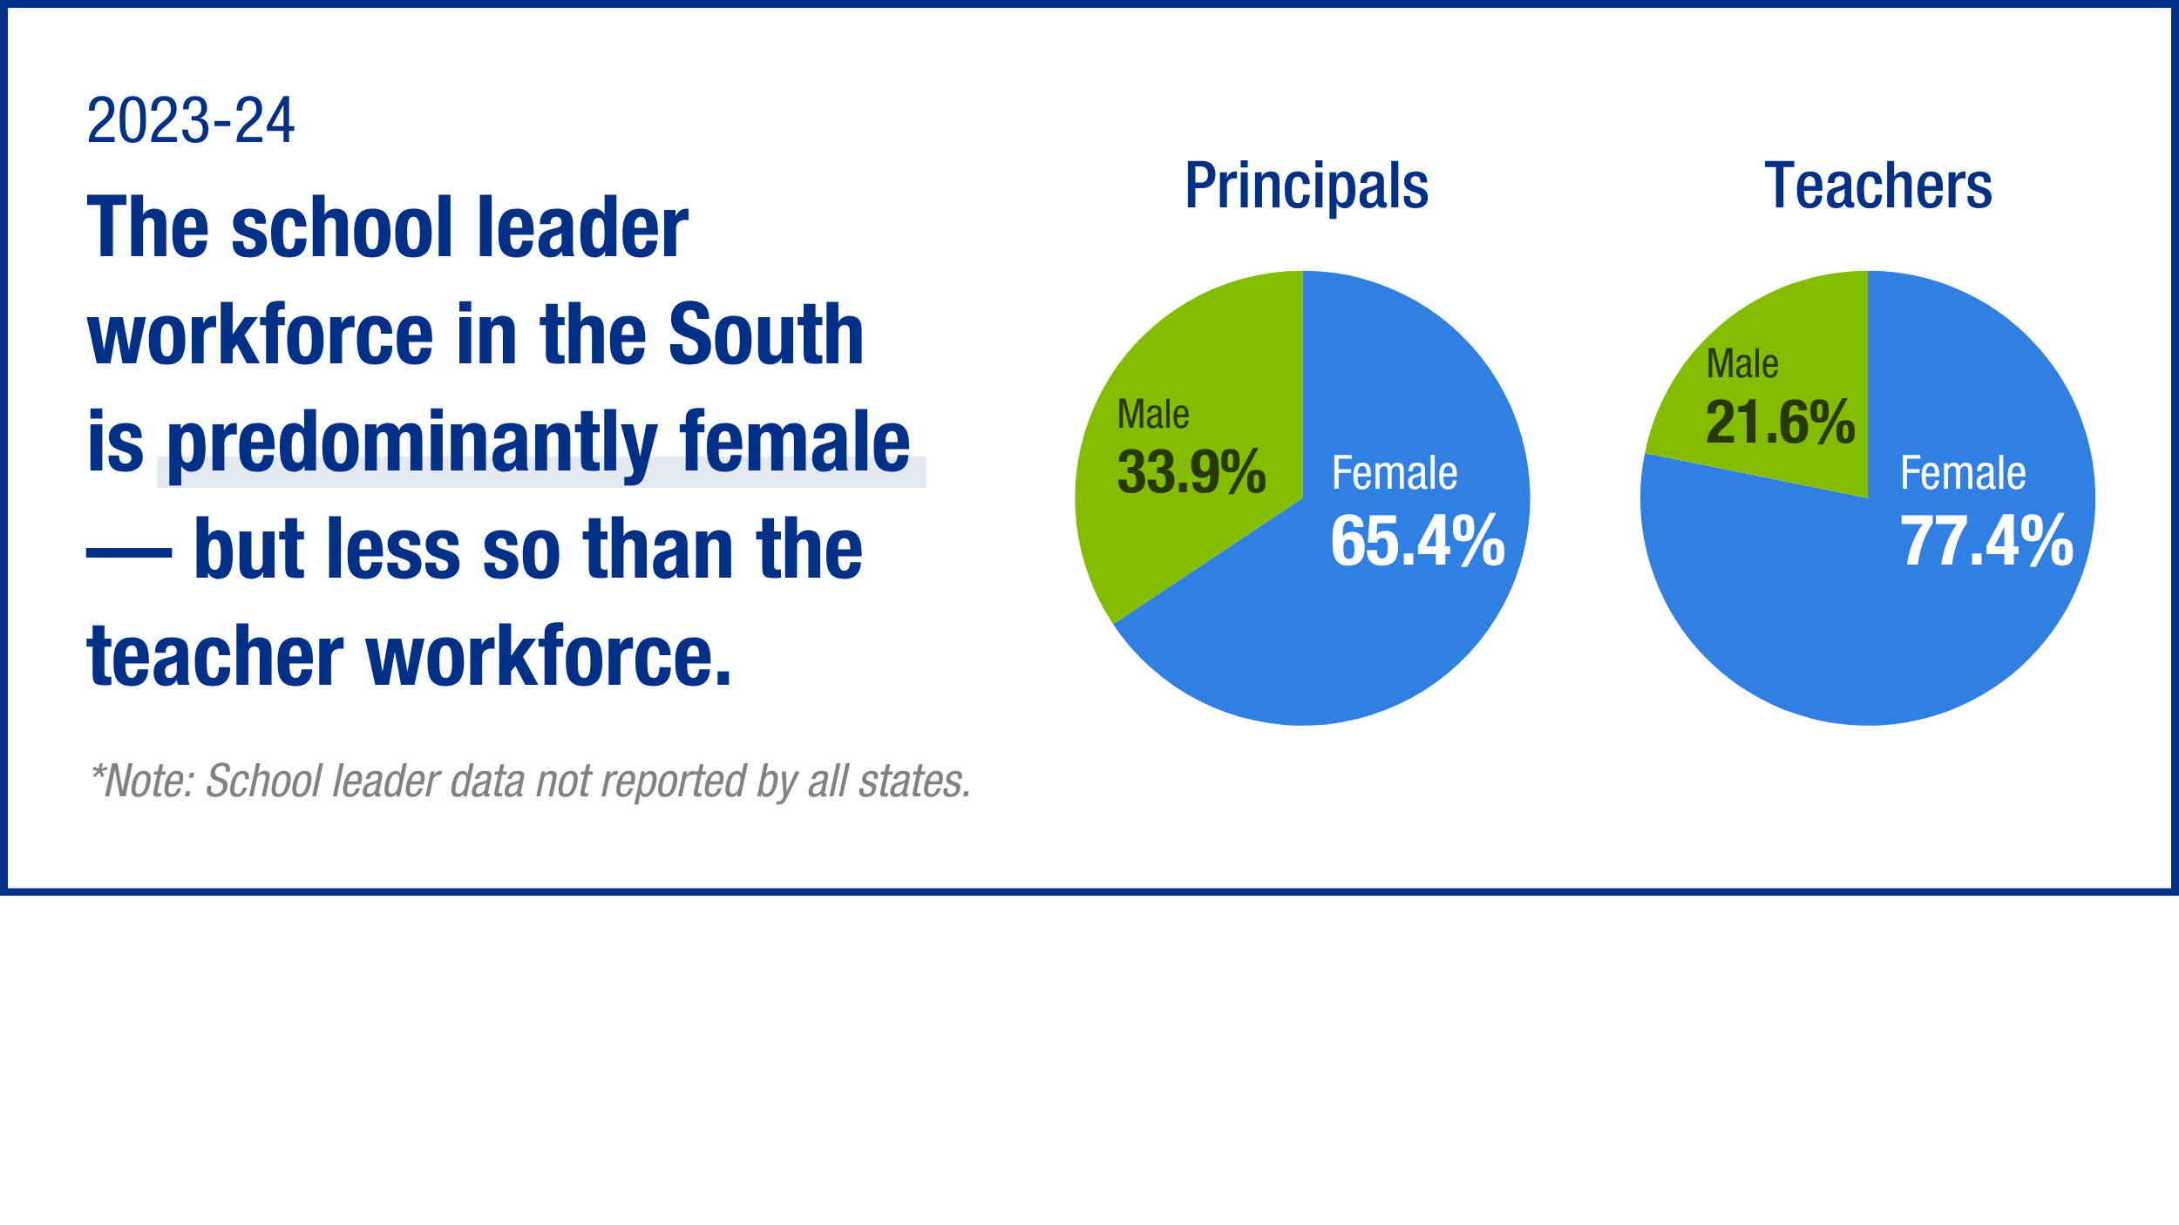
According to available data, the school leader workforce was 65.4% female — 12% less than the teacher workforce in the region.
Notes:
crop

Slide 44
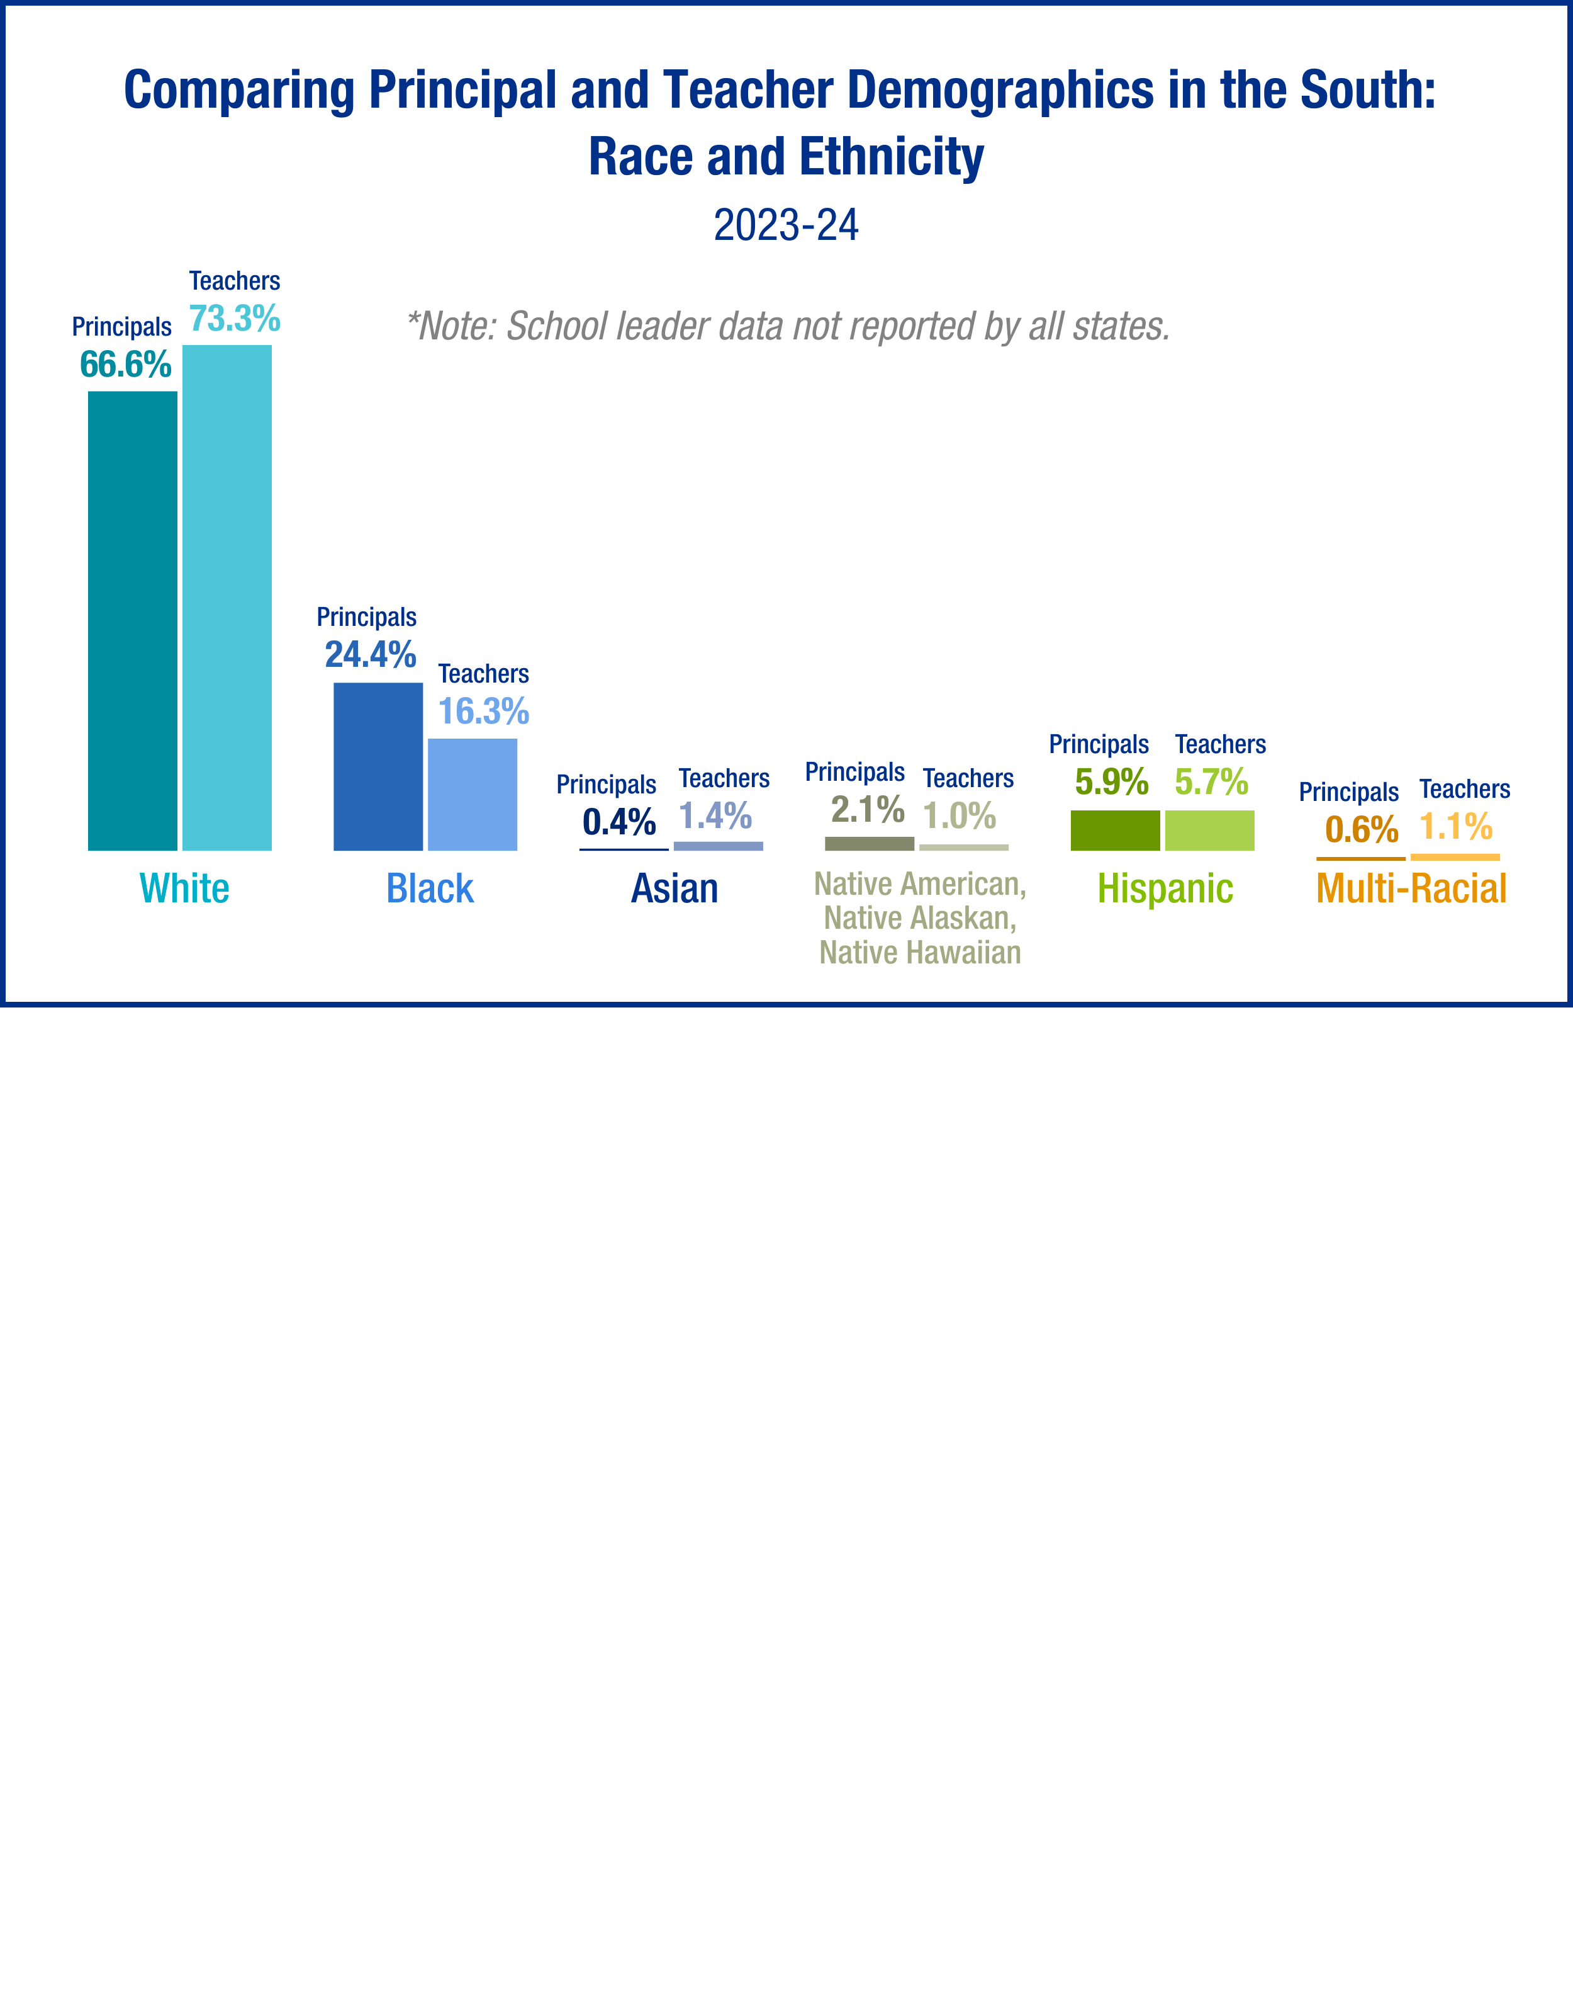
Approximately 33.4% of school leaders in the SREB region are people of color.

Slide 45
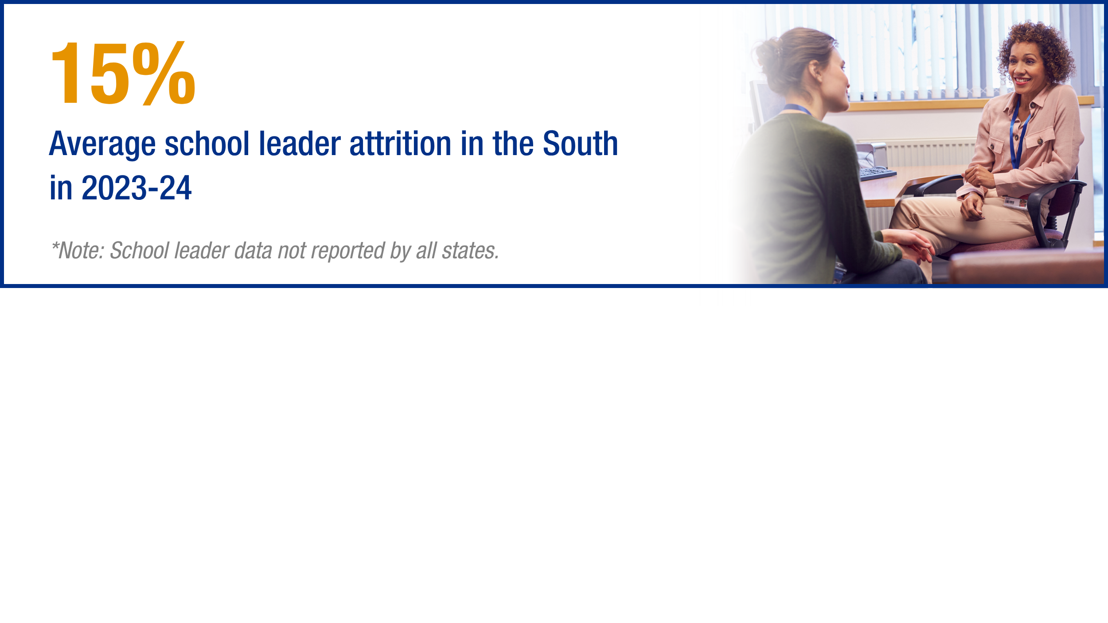
Notes:
Crop and make bigger; add a sentence here with a callout about states not providing this data and how this is a missed opportunity.

Slide 46
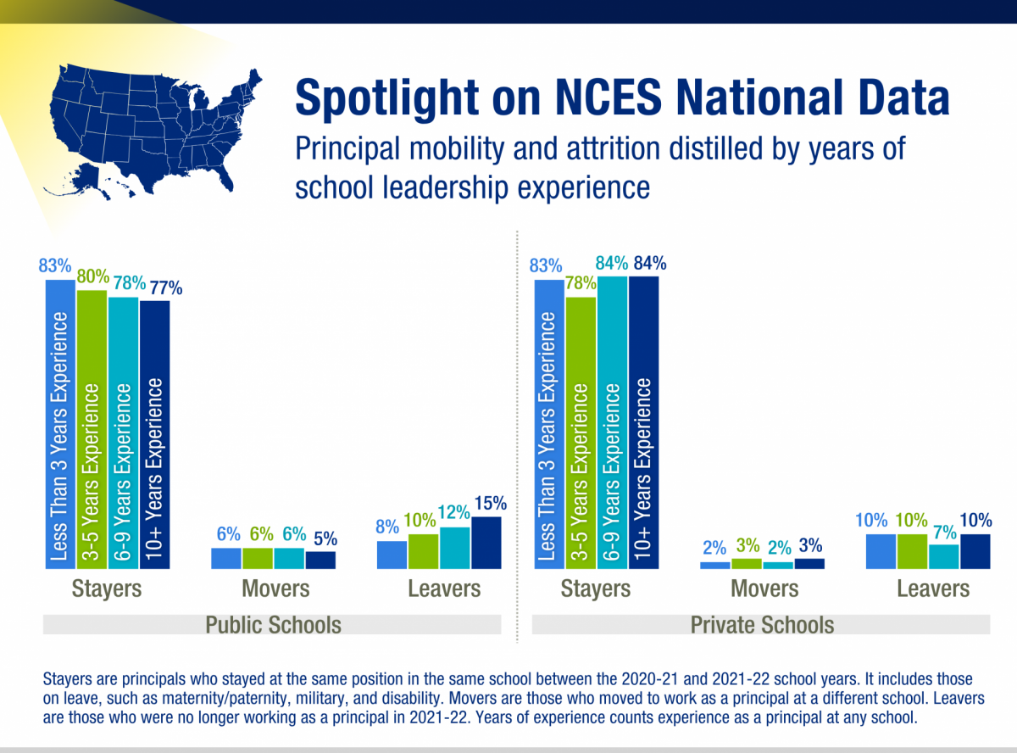
Notes:
Make bigger

Slide 47
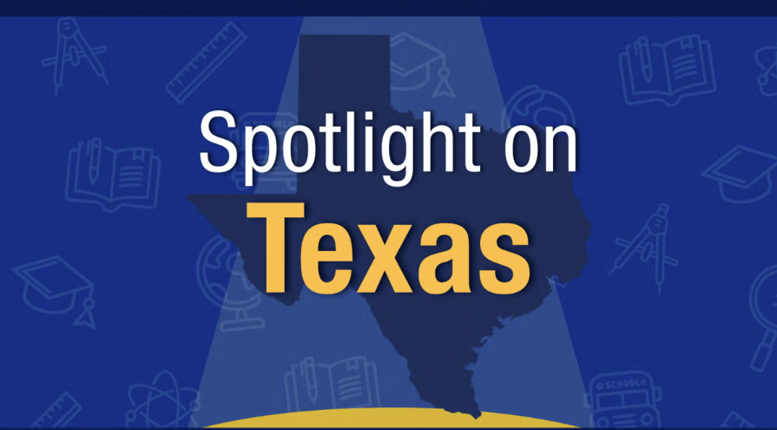


See more state spotlights in our data portal
Notes:
Add the link to see the additional spotlight to bottom corner

Slide 48


See more state spotlights in our data portal
Notes:
Add the link to see the additional spotlight to bottom corner

Slide 49
POLICY IMPROVEMENT CONSIDERATIONS EDUCATOR WORKFORCE
Increase the attractiveness of the profession
Incentivize and support the best part of preparation – a residency year
Provide many types of support to educators, tiered by experience and need
Create flexibility for districts to create career ladders with support and pay
Notes:
Anything missing here – leadership and early childcare – strong leadership development and support & go back to early childcare slides to see if I want to add any other bullets or an additional slide

Slide 50
State-funded PreK
Access & Affordability
Increase funding to provide more access to high quality childcare, and cover more children from low-income backgrounds
Set expansion targets in childcare deserts
Provide incentives for high-quality private centers to join state-funded program
Raise provider reimbursement rates to account for rising costs
Shift funding into the public-school funding formula to be jointly funded by state, local and federal dollars
Increase Quality
Continuously monitor services, curriculum and instruction of all centers
ECE workforce
Increase educator compensation to be competitive with public schools
Provide incentives like free or low-cost childcare for educators’ children

Slide 51
Important Notes about the Educator Workforce Data
The teacher workforce data is currently a collection of imperfect and sometimes proxy measures.
This data provides a glimpse of information about the status of the profession related to quantity, preparation, demographics, shortage areas, quality, and the distribution of talent.
For state reported data, SREB pulled the most comparable data available.
Certain states do not report all data points or define certain data points differently. These are noted in graphs.
Some percentage totals are off due to inconsistencies in data reporting or rounding errors in data files.

Slide 52

Teacher Turnover
SREB STATES
2022-2023
Source: State Data Reports; SREB Analysis; Learning Policy Institute
Notes:
$21,000 turnover cost per teacher was estimated in 2018 – in 2024 analysis redone to show 12k, 16k and 24k by district size

Slide 53

Teacher Turnover
SREB STATES
2022-2024
Source: State Data Reports; SREB Analysis
Notes:
$21,000 turnover cost per teacher was estimated in 2018 – in 2024 analysis redone to show 12k, 16k and 24k by district size

Slide 54

Teacher Turnover
SREB STATES
2022-2023
Teacher turnover is costly
Average amount it costs districts to replace each teacher
Average Teacher Turnover by State
$21,000
NA %
7.2% - DE
14.2% - MD
NA
24.9%
12.8%
11.5%
24%
25.6%
21.4%
20.2%
For Example:
Mississippi’s Turnover Costs
7,766 teachers leaving cost districts nearly
$163.1 million
23%
NA
*13,7%
15%
NA
Source: State Data Reports; SREB Analysis; *GA Teacher turnover 21-22 as 22-23 not yet reported; Learning Policy Institute
Notes:
$21,000 turnover cost per teacher was estimated in 2018 – in 2024 analysis redone to show 12k, 16k and 24k by district size

Slide 55
Teacher Vacancies
UNITED STATES
2022-2023
2022-23 SREB Count:
Estimated vacancies in
the South
39,700
Source: K-12Dive / Annenberg Institute at Brown University 2022 EdWorkingPaper No. 22-631; SREB Analysis of State reported vacancies

Slide 56
Teacher Shortages
SREB STATES
2024-2025
Mississippi’s
Shortage Areas:
Math,
Science,
Special Education
Source: U.S.ED Teacher shortage areas report, 2025

Slide 57


Teacher Quality
SREB STATES
2019-2024
Regional Averages 2023-24
17.7% 10.2% 7.7%
Mississippi Averages 2023-24
24.9% 3.4% 3.3%
Sources: SREB analysis of state data files
Notes:
MS’s numbers
4.7% uncertified
25.2% inexperienced
3.3% out of field

Slide 58

Teacher Quality
SREB STATES
2022-2023
Source:
Notes:
MS’s numbers
4.7% uncertified
25.2% inexperienced
3.3% out of field

Slide 59
SNAPSHOT: TEACHER PIPELINE DATA
SREB.org/TeacherData
Notes:
Megan

Slide 60

Future Educators
SREB STATES
2012-2023
Mississippi
1% more
program completers in 2022-23 (2,332) than 2012-13 (2,305)
Source: USDOE Title II reports 2023
Notes:
2,332 completers in MS in 22-23
2,305 in 2012-13
All other states had an overall decline of at least 14% to 52%

Slide 61
Future Educators
SREB STATES
2012-2023
Mississippi’s Data
47%
Alternative programs
53%
Traditional programs
Source: U.S.ED Title II reports 2024

Slide 62




Gen Z and Teaching
Top reasons cited nationally by Gen Z as to why teaching is unattractive:
Interest in teaching among current high school students in the South is down to average of 4%.
Low pay
Lack of career advancement
Lack of flexibility, collaboration & support
Lack of voice & respect
Sources: ACT, Vanderbilt University
Notes:
SREB, with Vanderbilt, is conducting research on Gen Z interest, attraction and retention. Report on this to come out in 2024.

Slide 63





The risk for novice teacher turnover increases with certain conditions.
Teaching in -
Low performing schools
High poverty schools
Secondary schools
Lower starting salary
Younger starting age
Less supportive preparation +
Less effective instructional abilities
Sources: SREB & Vanderbilt University, 2025

Slide 64


Teaching residencies and on-the-job support can improve student learning.
8th grade level in math
7th grade level in reading
12th grade level
$120,551 increase in lifetime earnings per graduate
when taught by 10% more fully prepared teachers — increasing the tax revenue base for communities and states
Sources: SREB analysis, based on data from Kirksey, J., 2025

Slide 65

Induction can save schools, districts and states millions of dollars.
Five-Year Novice Teacher Replacement vs. Growth Cost
U.S., 2024
$12,750 savings
per novice teacher
Example:
Mississippi could save $106.9 million every 5 years
Sources: SREB analysis, based on data from Kirksey, J., 2025; Learning Policy Institute, 2024; National Center for Teacher Residencies, 2024; New Teacher Center, 2024
Notes:
With 24.9% of MS educators in their first 3 years on the job, a conservative estimate is that the state could save $107 million every five years.

Slide 66




SREB Resources
K-12 Teaching Support
SREB.org/powerful-instructional-practices
SREB.org/professional-development-instructional-coaching
SREB.org/induction
Teacher Workforce Data
SREB.org/TeacherWorkforce
Research and recommendations
State-by-state data and regional highlights
Educator Compensation Dashboard
Postsecondary Faculty Support
SREB.org/doctoral-scholars-program
Launching September 2023: New SREB Center for Innovative Faculty Development
Higher Education Data
SREB.org/fact-book-ed-data
Comprehensive Fact Book of comparative data
Notes:
Not only do we have data and resources on the teacher workforce, but we also have a plethora of data in our Factbook on Higher Education, which looks at the college faculty workforce, affordability and other topics.
We also want to help you implement change through programs and services that go beyond policy to help K-12 teachers, school instruction, and leadership AND postsecondary educators, including our Doctoral Scholars Program that helps minorities finish their doctorate and move into education. We also have a new Center launching at SREB this fall – the Center for Innovative Faculty Development to help grow and develop postsecondary teaching faculty to lead more students to success in college and beyond.

Slide 67



Explore more regional and state-by-state data in our updated Educator Workforce Data Portal
Read our educator research studies, co-authored by Vanderbilt University
Slide deck prepared by the Educator Workforce Policy team at SREB:
Megan Boren, director
Sheniqua Pierce, analyst II
Jessica Nadzam, research and policy associate

