Slide 1

Notes:
STEPHEN:
We know today we are facing an unprecedented state of education post-pandemic: student absenteeism is chronic, student emotional health is at crisis, student learning is behind especially for low-income students and students of color, teacher morale dipped to an all-time low, teacher turnover and vacancy rates are higher than before, newly prepared teacher counts are still down, I can go on.
It’s a big problem and without great teachers to lead us out, our children and our economy are in trouble.
At SREB we believe in looking comprehensively at issues rather than looking at individual components of an issue. So when we say teacher shortages, we mean viewing the workforce from four key areas:
Quantity: how many teachers we have, how many we are preparing, turnover, vacancy rates, new applications
Quality: how well-trained, how impactful, how experienced, how supported are our teachers
Demographically: how diverse is the teacher workforce by gender, race/ethnicity, age, degree-level
And by distribution of talent: does every child in every school have access to quality educators?
Today we will explore and discuss the state of our teacher workforce in the South, what we know and don’t know, why we are having the challenges we are having and what can we do to better support our teachers – a key group to ensuring we have a thriving economy. We have a group of guests and experts here today to help us with these discussions including:
Two NC teachers of the year – Maureen Stover and Leah Carper
Chief HR Officer from Gwinnett Public schools up the road here in Georgia, Cathy Hardin
National experts in supporting teachers, students and schools – Victoria Van Cleef from The New Teacher Project and Bryan Hassel from Public Impact
(click to next slide)

Slide 2




Teacher Workforce Data in the South
Quantity
Supply and demand — the proportion of teachers entering and exiting the profession
Demographics
Teacher gender, age, race and ethnicity, education level and background
Quality
Teacher preparation and development, support, certification, experience, impact or effectiveness and teacher leadership
Distribution of Talent
Distribution of teaching talent across different schools, districts or subject areas
June 2023
Notes:
Shortages are defined by 4 key categories.
Together, these show a comprehensive view of the teacher pipeline. I’ll address some of the causes of shortages throughout, but they are many and range from: lack of respect, lack of instructional mentorship or collaboration, lack of strong leaders, lack of autonomy and trust, high stress, decreases planning time, high student caseload, lack of funding and compensation levels that cause financial stress.

Slide 3
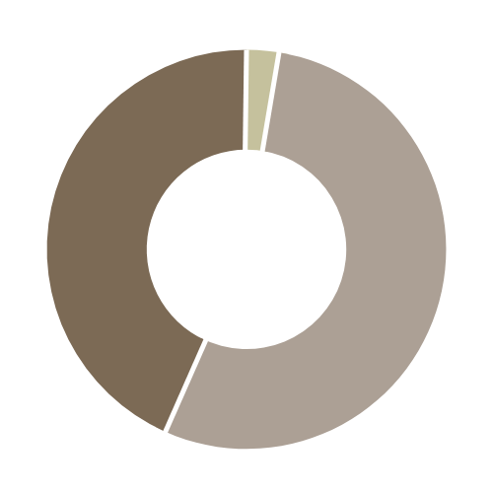
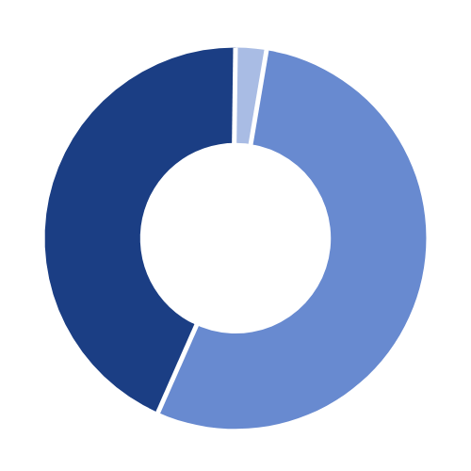
QUANTITY:
Teacher & Student Counts
2019-20
2020-2021
1.281 million teachers serving
19.9 million students across 16 states
1.283 million teachers serving
19.4 million students across 16 states
15.5 students : 1 teacher
15.1 students : 1 teacher
Pre-K 2.6%
Pre-K 2.7%
Secondary 43.3%
Secondary 43.5%
Elementary 54.1%
Elementary 53.9%
Source: NCES State Nonfiscal Public/Elementary/Secondary Education Survey 2019-20 & 20-21
Notes:
There is good news and bad news throughout the data as well.
Let’s start with Quantity.
OK example – Class size averages 41 students in elementary (except PK and K), approx. 30 in middle school and 20 in HS.

Slide 4
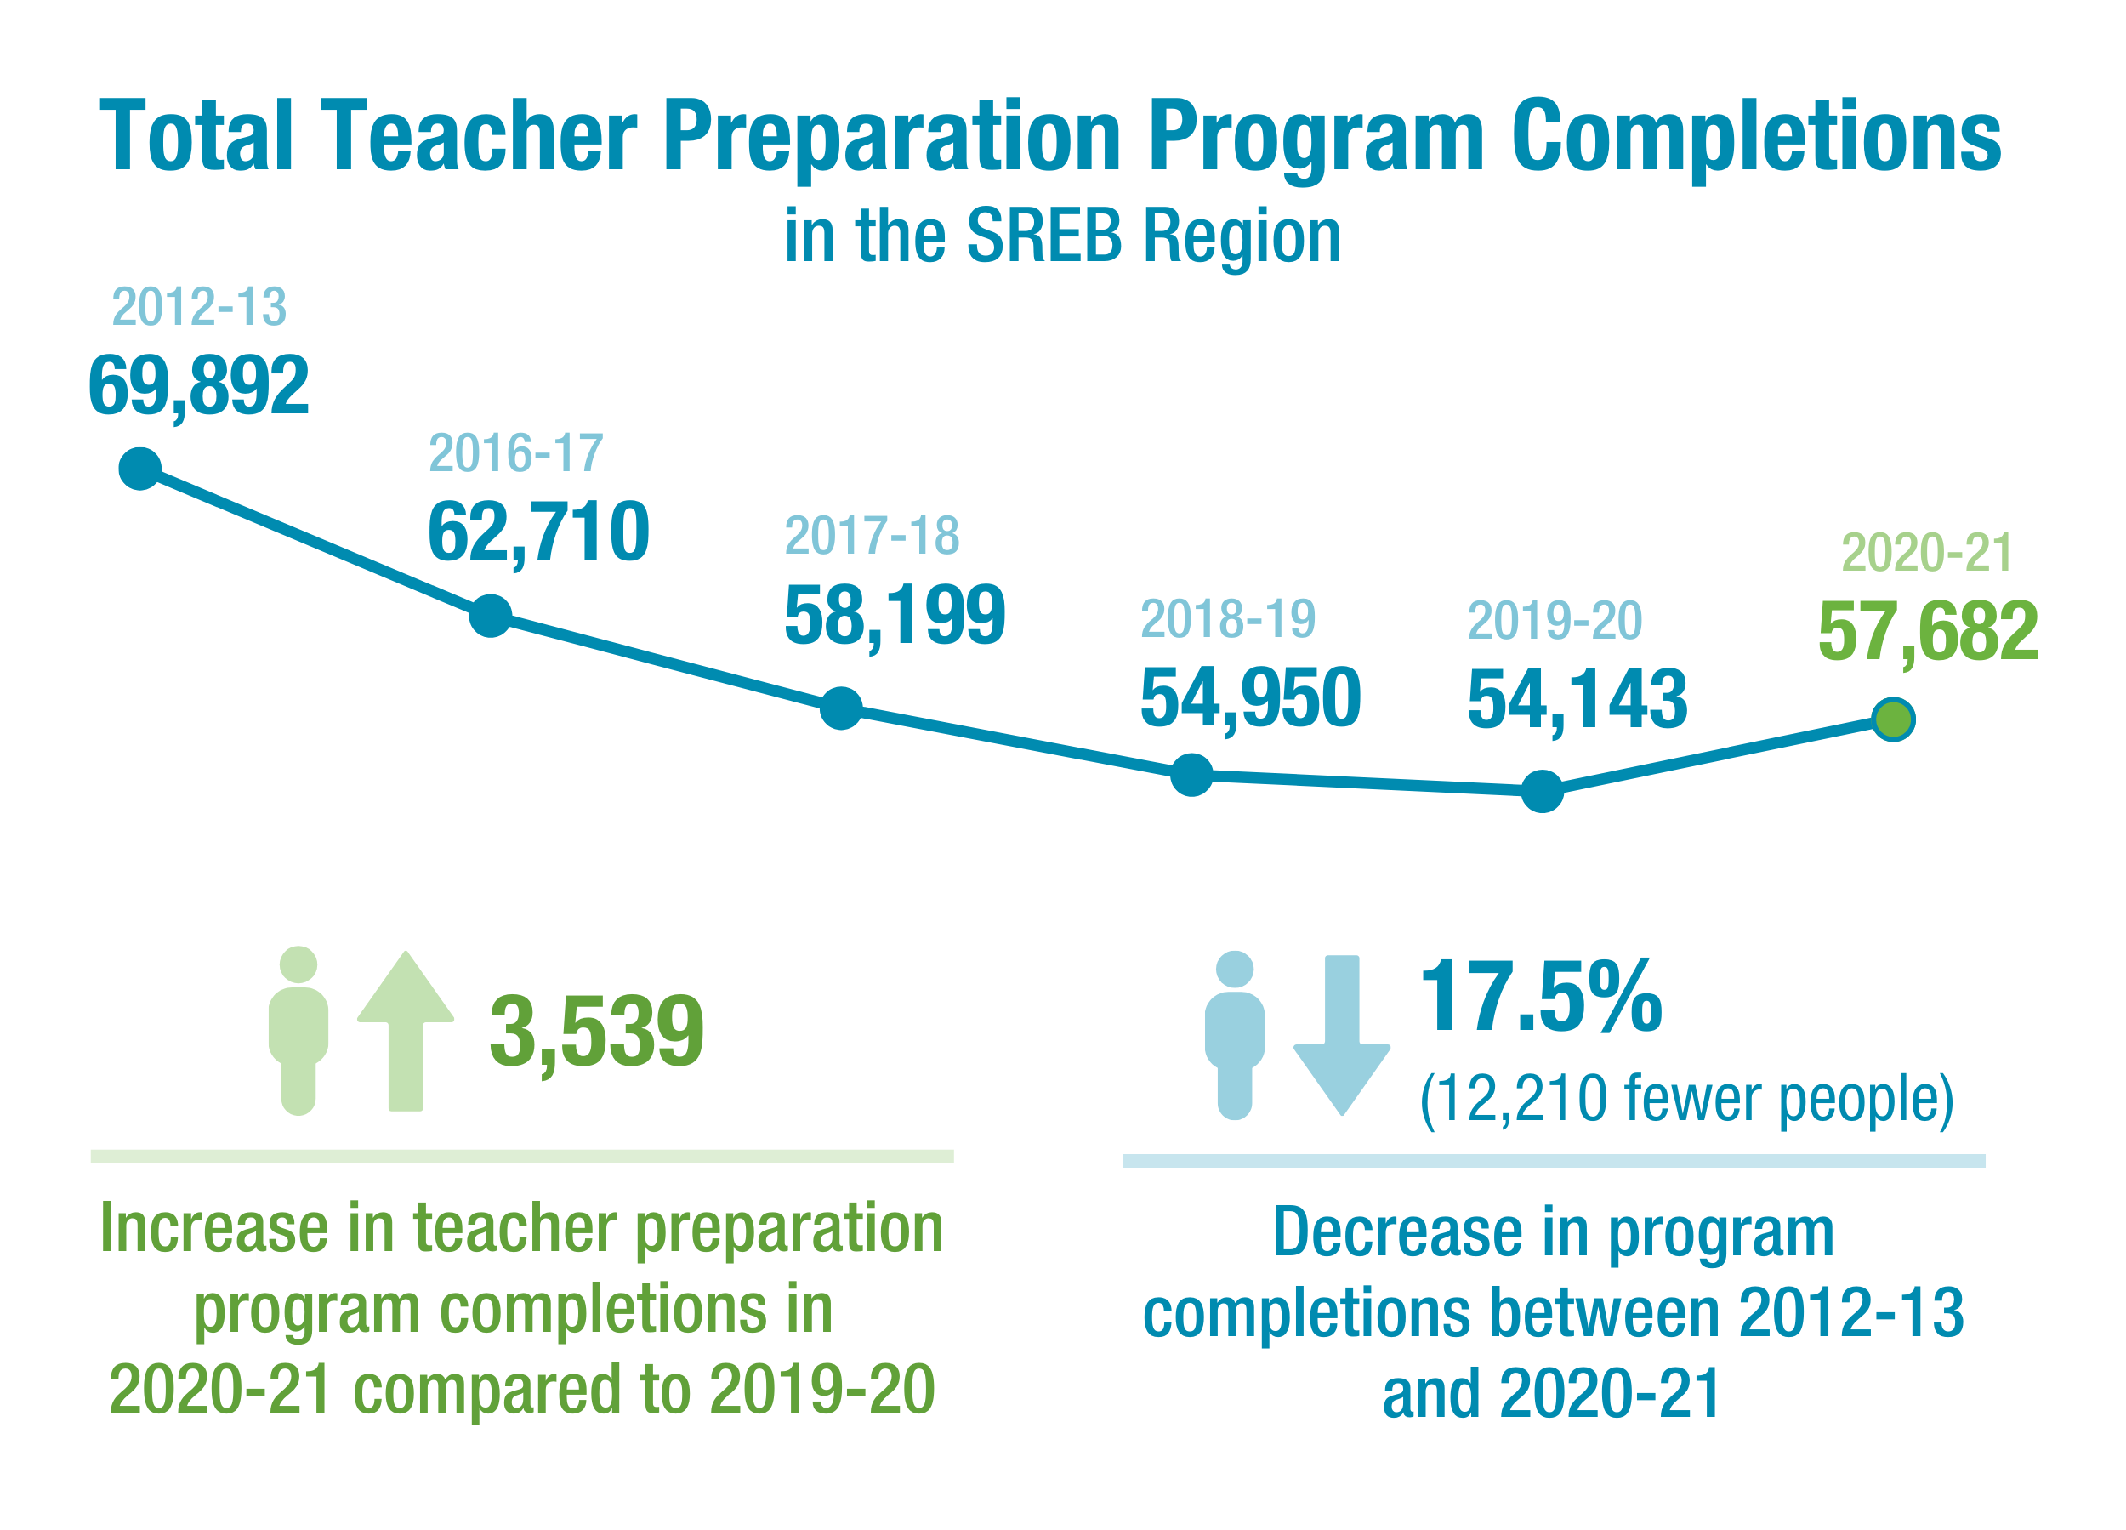
QUANTITY:
Teacher Preparation
The 2020-21 school year showed the first increase in nearly a decade in the number of people who completed a teacher preparation program.
Source: USDOE Title II reports 2021

Slide 5
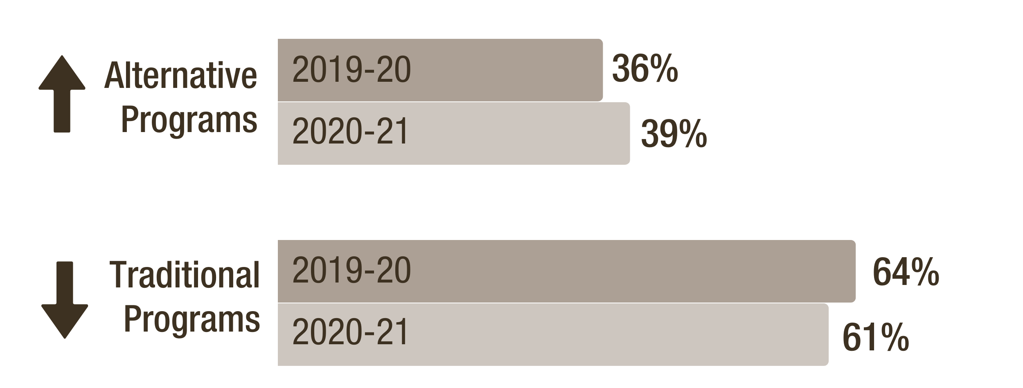
QUANTITY:
Teacher Preparation
The proportion of people completing teacher preparation programs
via alternative programs is growing.
Source: USDOE Title II reports 2021

Slide 6




QUANTITY:
Gen Z Interest
Top reasons cited by Gen Z as to why teaching is unattractive:
Interest in teaching among current high school students in the South is down to average of 4%.
Low pay
Lack of career advancement
Lack of flexibility & collaboration
Lack of voice & respect
Source: ACT
Notes:
SREB, with Vanderbilt, is conducting research on Gen Z interest, attraction and retention. Report on this to come out in 2024.

Slide 7

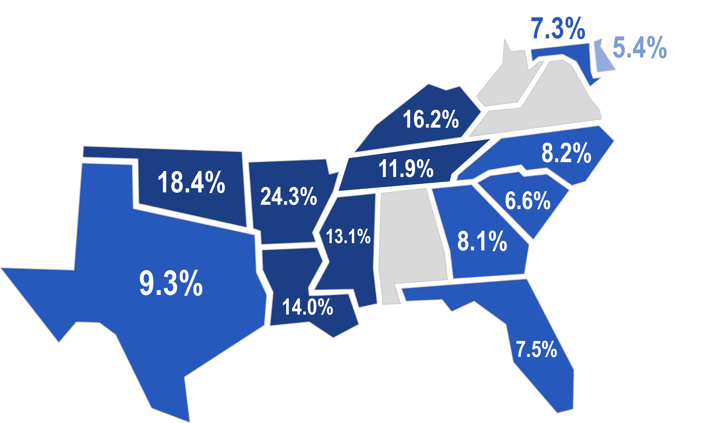
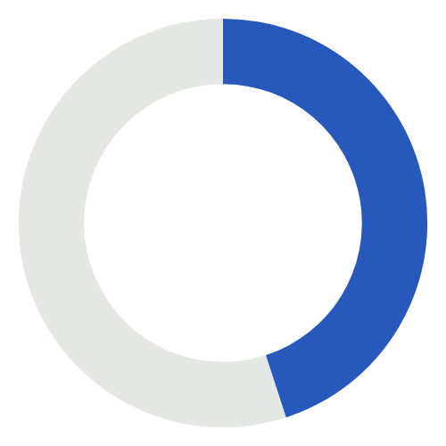
QUANTITY:
Turnover
2020-21
Average Teacher Turnover by State
Average turnover rate
in the SREB region:
2019-20: 11.4%
2020-21: 11.6%
Average turnover rate
in the South among teachers with 5 or fewer years’ experience
45%
Source: State Data Reports; SREB Analysis; Learning Policy Institute
Notes:
19-20 Turnover was 11.4% with corrected data.

Slide 8




QUANTITY:
Turnover
Teacher turnover is costly
Average amount it costs districts to replace each teacher
2020-21
Average Teacher Turnover by State
$21,000
For Example:
Delaware’s Turnover Costs
531 teachers leaving cost districts nearly
$1.2 million
Source: State Data Reports; SREB Analysis; Learning Policy Institute
Notes:
$21,000 turnover cost per teacher was estimated in 2018 and is not adjusted for current inflation.

Slide 9
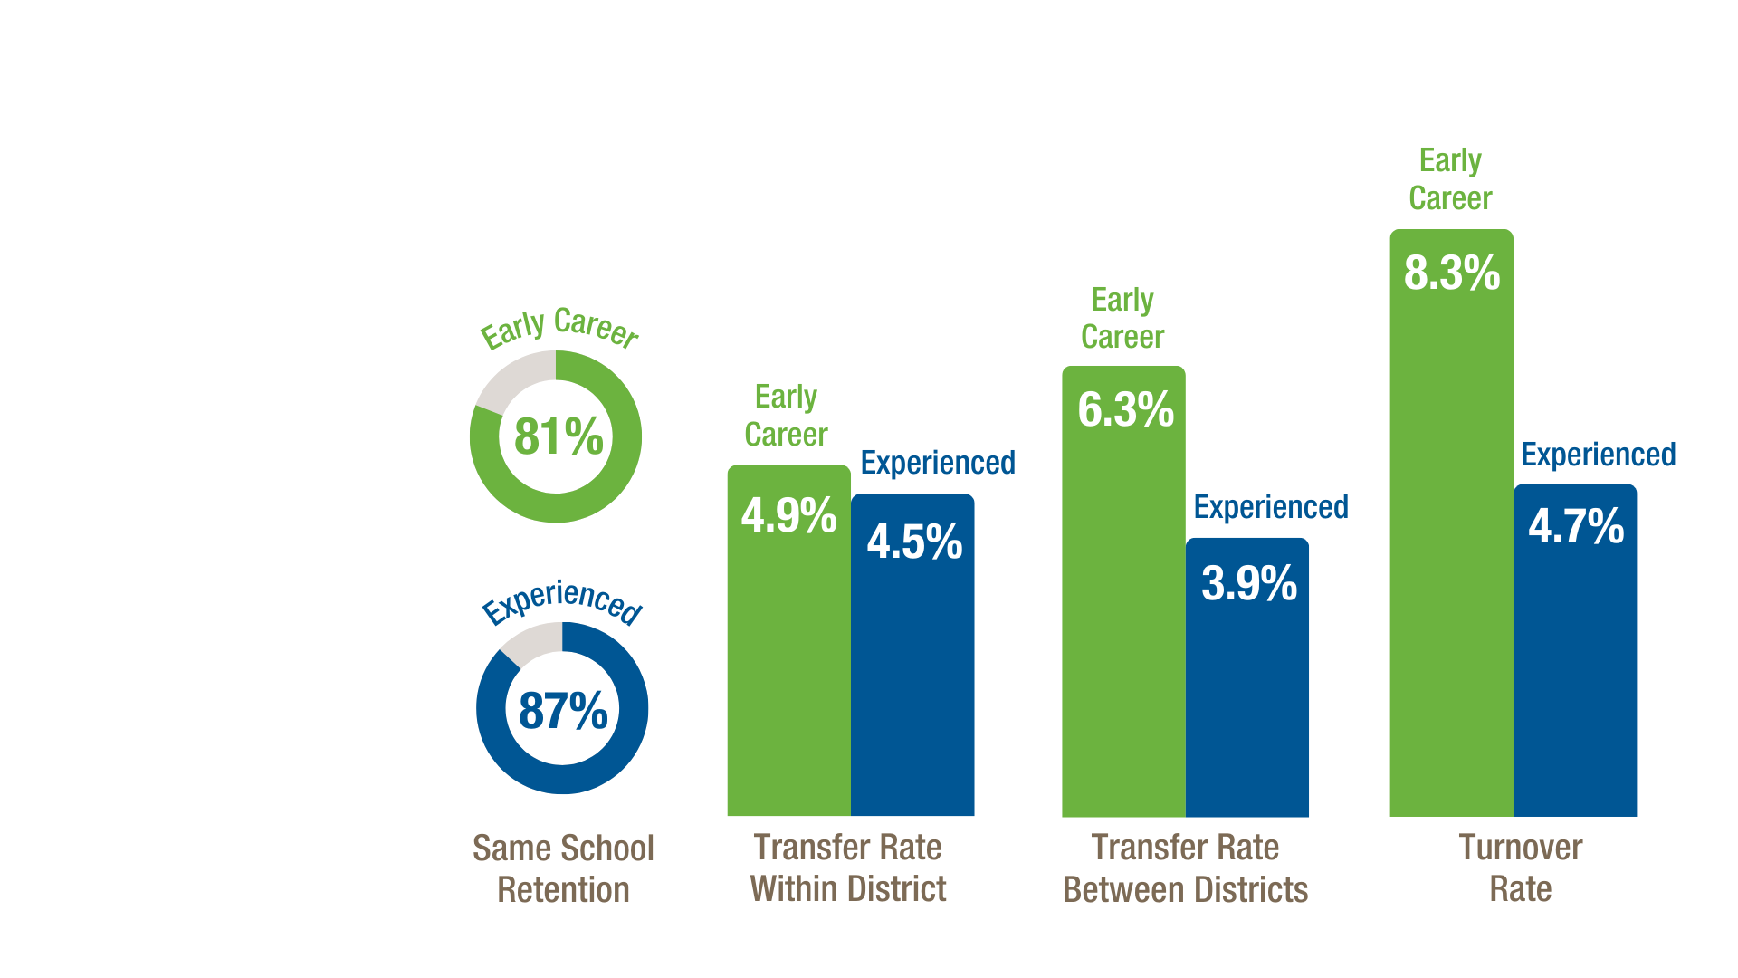
QUANTITY:
Retention & Mobility
Delaware
collects and shares data about teacher retention, mobility and turnover at different points in a teacher’s career
Source: State Data Reports

Slide 10
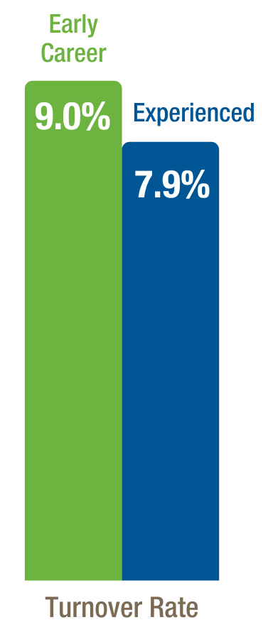

QUANTITY:
Retention & Mobility
Attrition by 8 Regions
Sandhills region has highest turnover at 9.2%
NW has the lowest at 6.5%
Most Difficult to Staff Subject Area
K-5 core classes
North Carolina
also distills teacher turnover data by level of experience
NC Teacher Category | % Attrition in Category 2021-22
Experienced, professionally licensed | 6.9%
Residency licensed | 11.9%
Beginning teacher | 13.06%
Teach for America | 25.3%
Visiting International | 88.7%
Source: State Data Reports

Slide 11
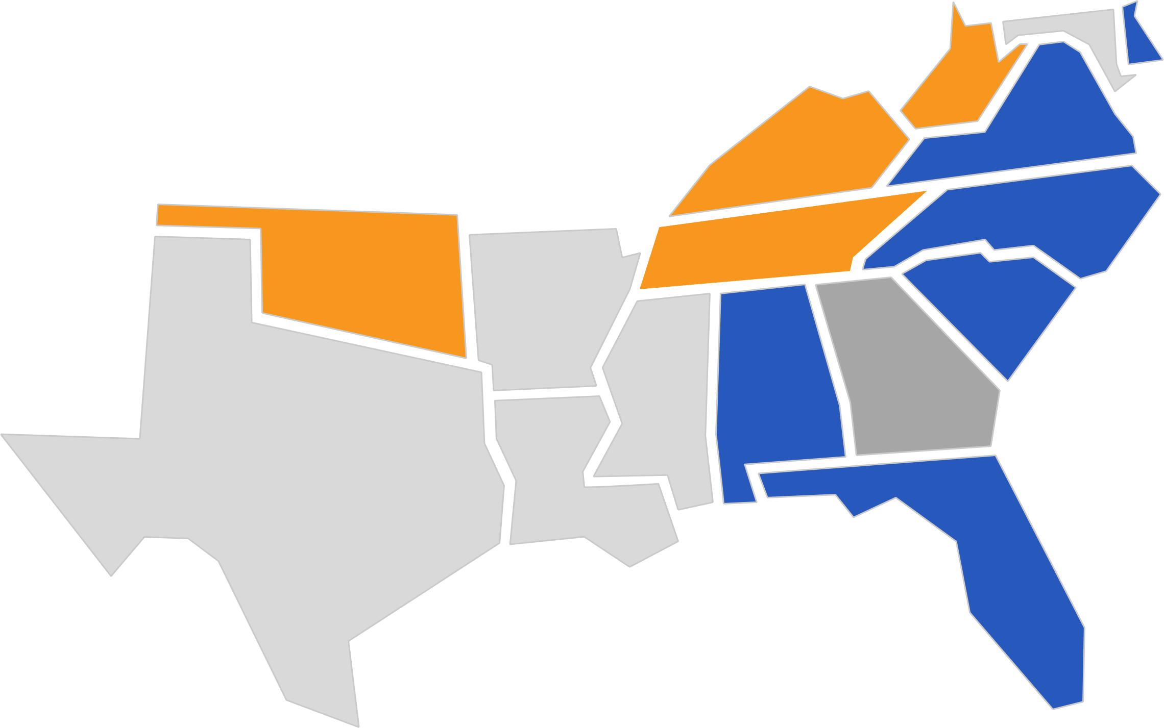
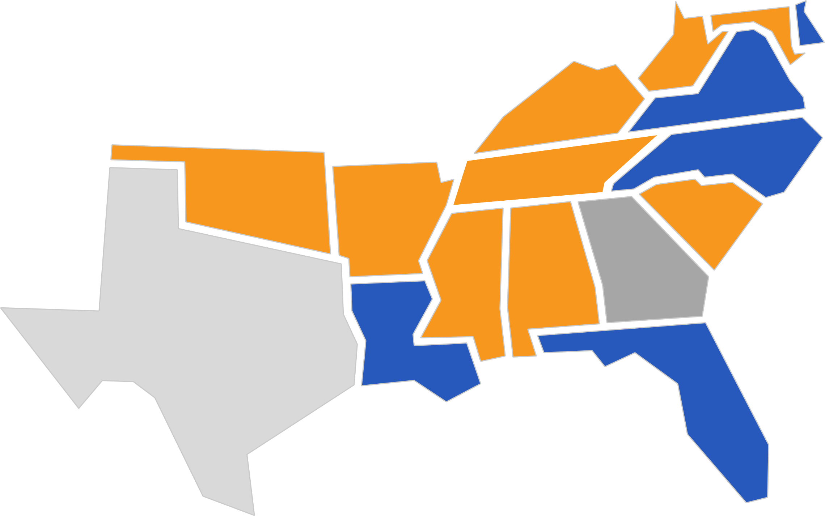
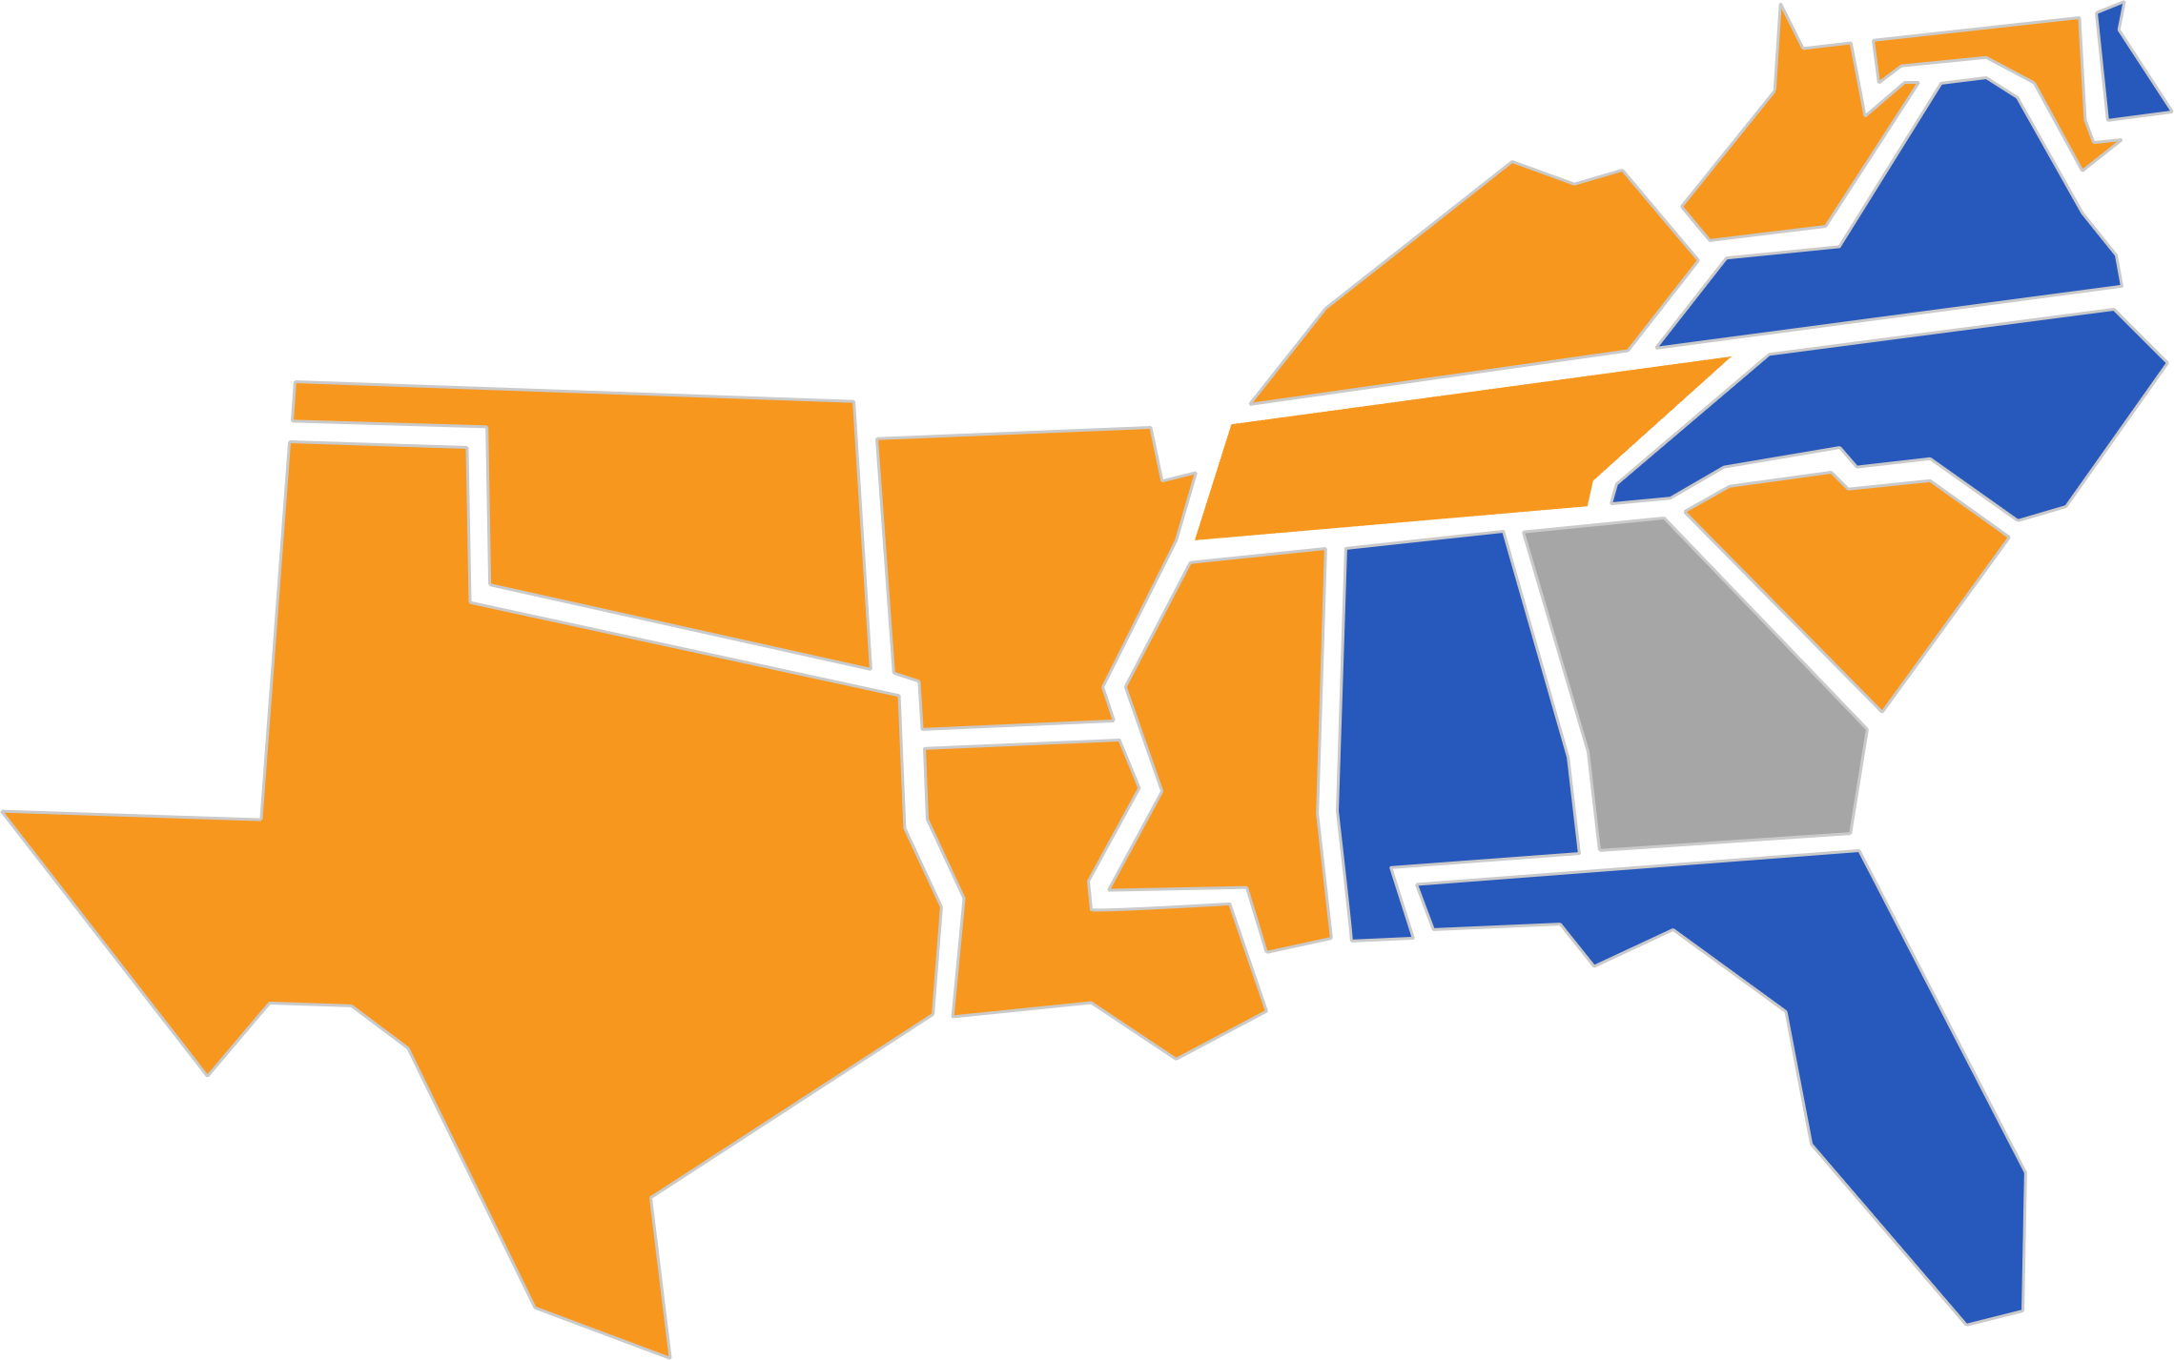
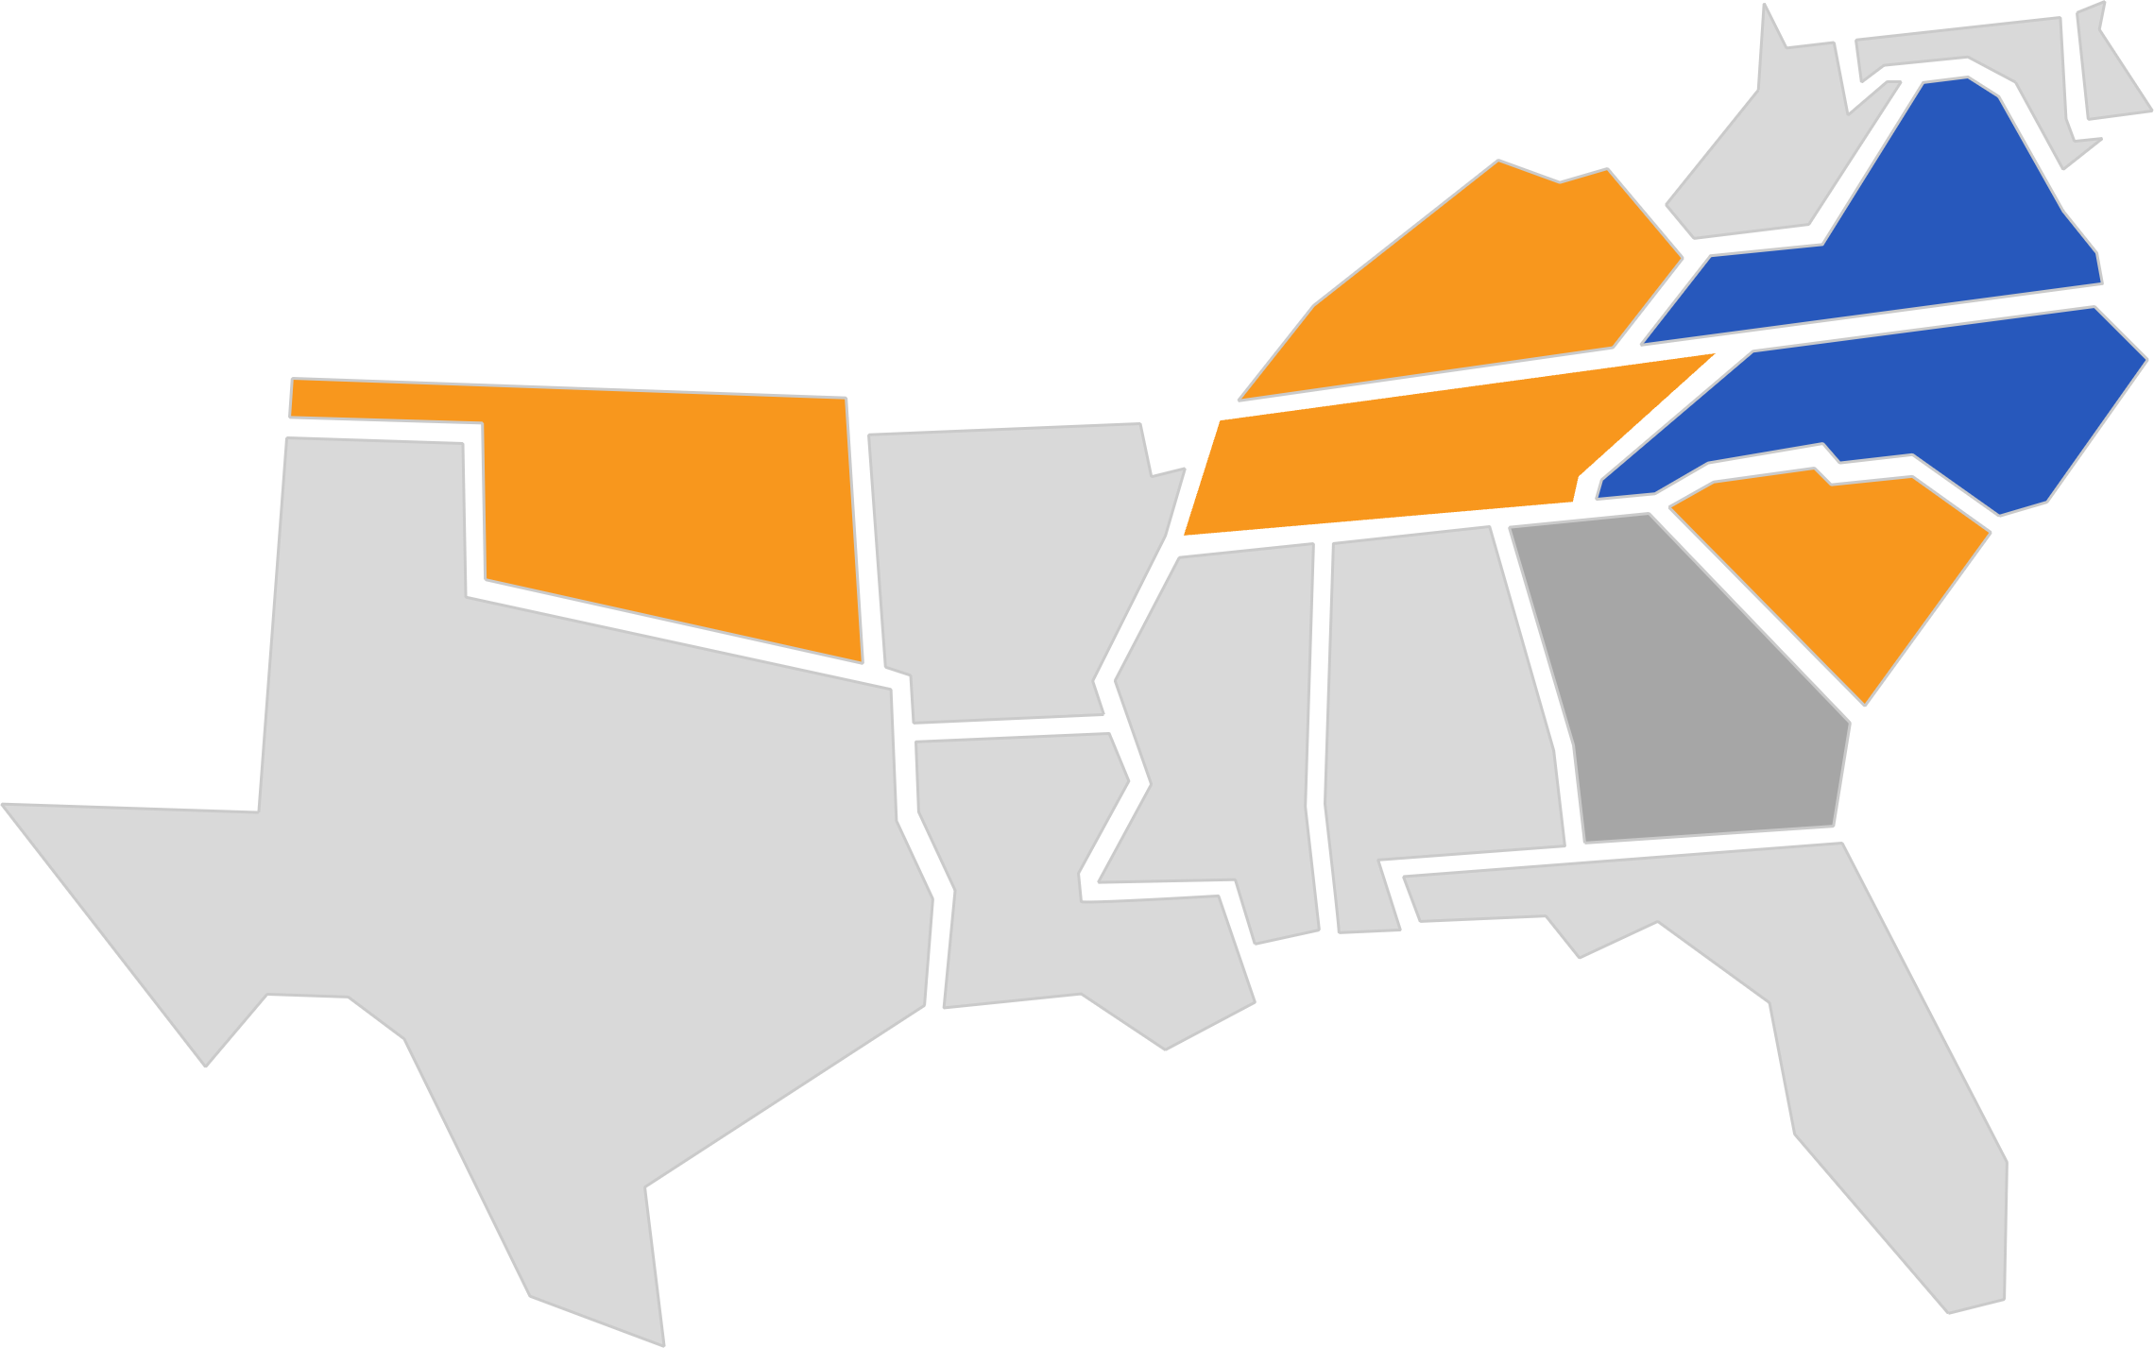
QUANTITY:
Shortages by Subject
English Language Arts
Science
Shortage across all grade levels
Shortage primarily in
elementary grades
Math
Social Studies
Shortage primarily in
secondary grades
Source: USDOE, Teacher Shortage Areas Report. 2020-21; No report from GA for this SY
Notes:
English – 10 states
Math – 15 states
Science – 14 states
Social studies – 6 states

Slide 12
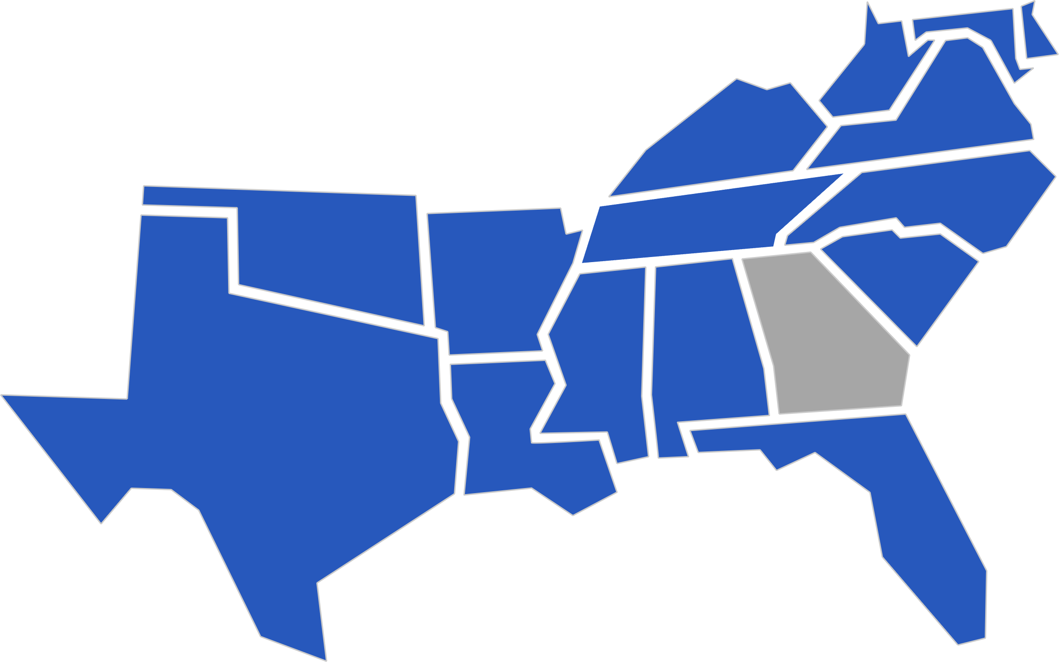
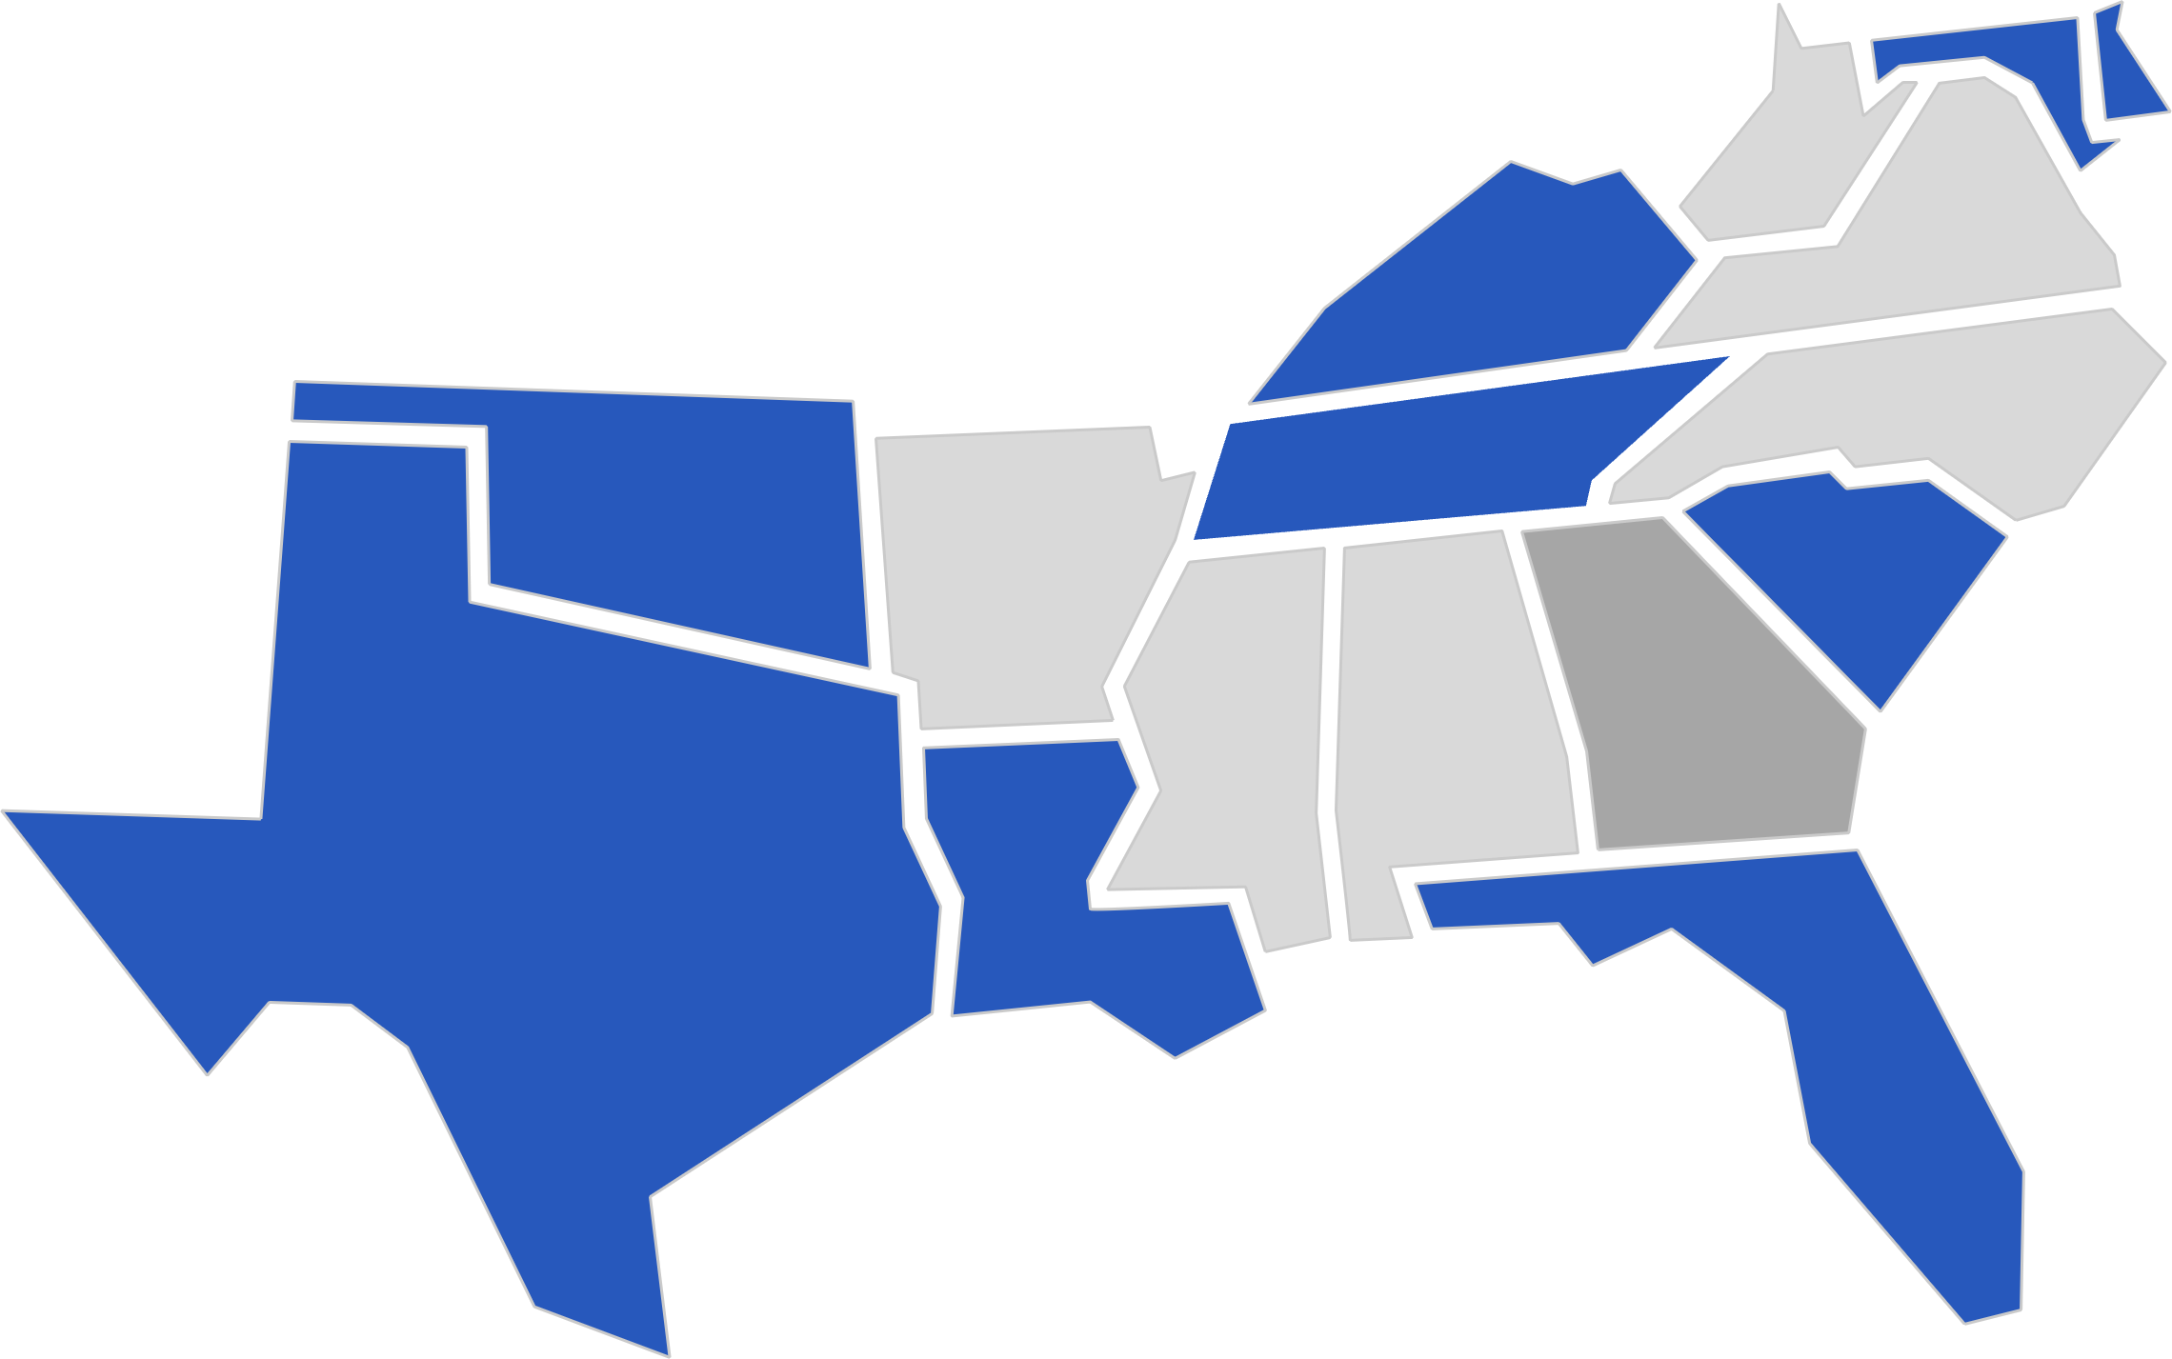
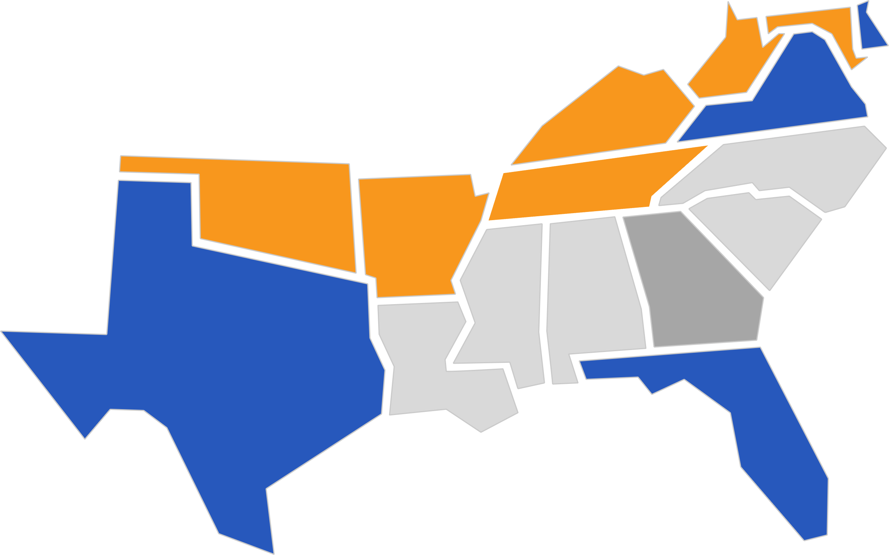
QUANTITY:
Shortages by Subject
Special Education
English as a Second Language
Shortage across all grade levels
Shortage primarily in
elementary grades
Shortage primarily in
secondary grades
Career & Technical Education
Source: USDOE, Teacher Shortage Areas Report. 2020-21; No report from GA for this SY
Notes:
Special Ed – 15 states
ESL – 8 states
CTE – 10 states

Slide 13
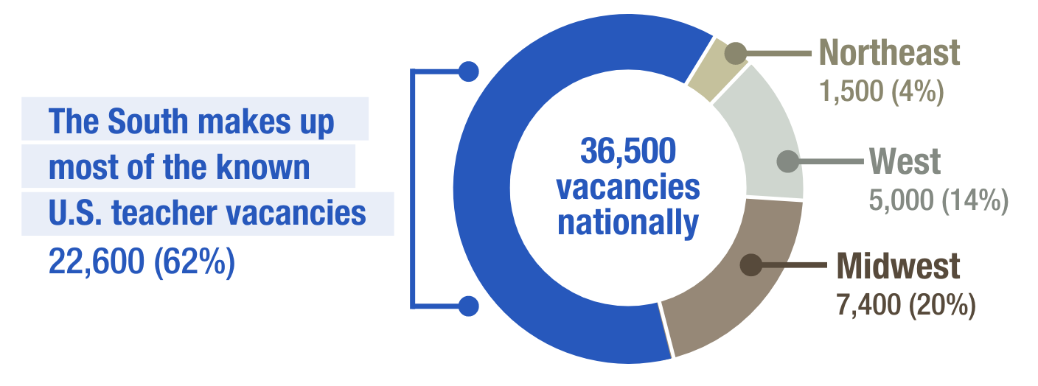
QUANTITY:
Vacancies
2021
There were an estimated 36,500 teacher vacancies nationwide — and another 163,000 positions held by underqualified teachers.
2022-23
The estimated vacancy in
the South increased to
39,700
Source: K-12Dive / Annenberg Institute at Brown University 2022 EdWorkingPaper No. 22-631; SREB Analysis of State reported vacancies

Slide 14
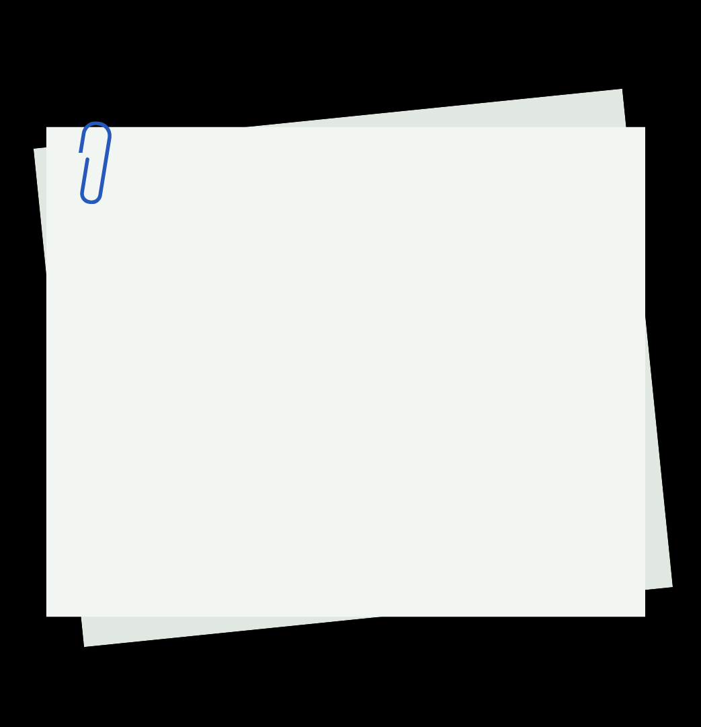
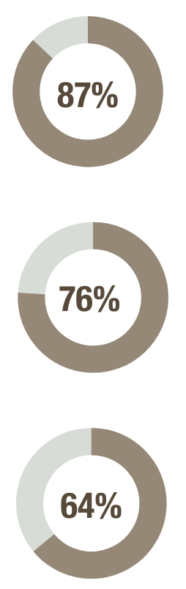
QUANTITY:
What are educators saying?
Teachers who feel staffing shortages are a serious problem at their school
Educators & leaders note:
Vacancies are harder to fill
Teacher absenteeism is up
Staff shortages are increasing stress and affecting student learning
Chief talent officers who say resignations are higher than in previous years
Teachers who were asked to cover another class at least once per week
Source: Educators for Excellence, 2022
Notes:
NCES School Pulse Survey (22-23 SY) shows that 74% of schools in the South say there are too few candidates applying and 69% say there is a lack of qualified candidates applying.

Slide 15
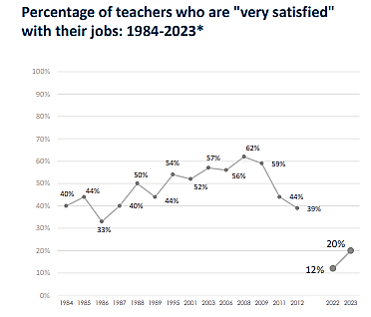
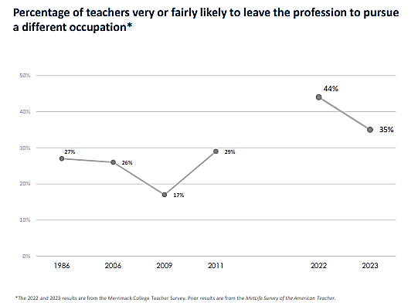
QUANTITY:
What are educators saying?
Record highs
Record lows
Source: Merrimack College, 2023: Is Teacher Morale on the Rise? Results of the Second Annual Merrimack College Teacher Survey

Slide 16
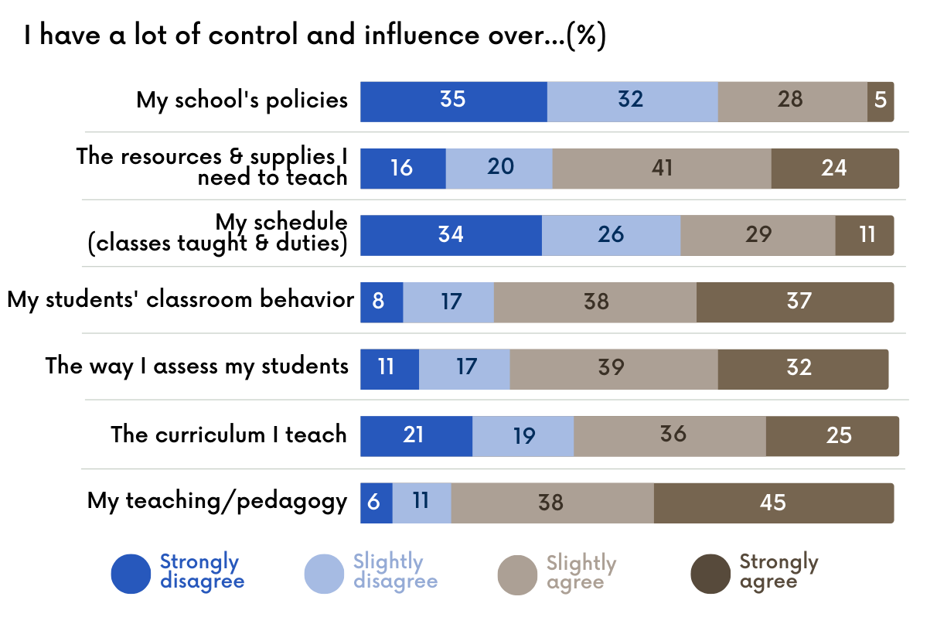
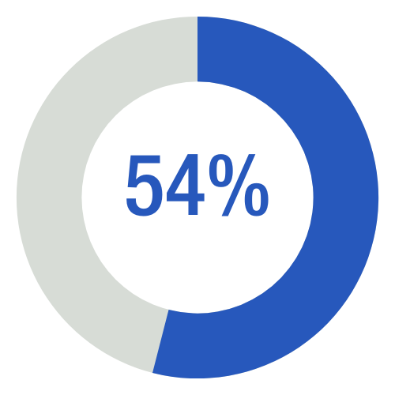
QUANTITY:
What are educators saying?
Teachers note a lack of autonomy, especially around school policies
And less than half say they would advise their younger self to pursue a career in teaching
(just 17% said very likely)
Source: Merrimack College, 2023: Is Teacher Morale on the Rise? Results of the Second Annual Merrimack College Teacher Survey
Notes:
A lack of autonomy and voice continue to contribute to dissatisfaction. Over half of current teachers say they would tell their younger self to pursue a different career.

Slide 17
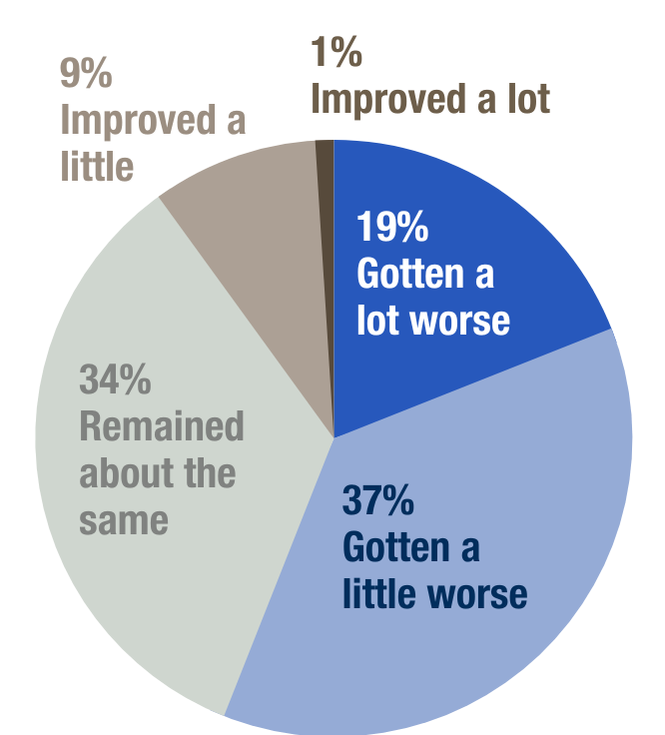

QUANTITY:
What are educators saying?
Teachers’ mental health and wellness continue to affect morale.
Next to pay raises or bonuses,
smaller class sizes and more/better support for student discipline were the steps teachers were most likely to say would improve their mental wellbeing.
Since the beginning of the current 2022-23 school year, the mental health/wellness of the teachers in my school has…
Source: Merrimack College, 2023: Is Teacher Morale on the Rise? Results of the Second Annual Merrimack College Teacher Survey
Notes:
Mental well-being of students is at an all time low and of great concern. Similarly, teachers report that their own mental well-being and that of their colleagues is also causing issues. The stress of their own financial security and being stretched too thin and overstimulated by the growing list of student needs and discipline issues are the top factors affecting their mental well-being

Slide 18
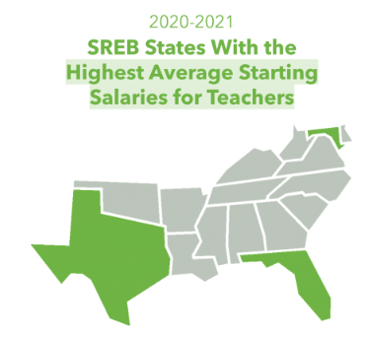
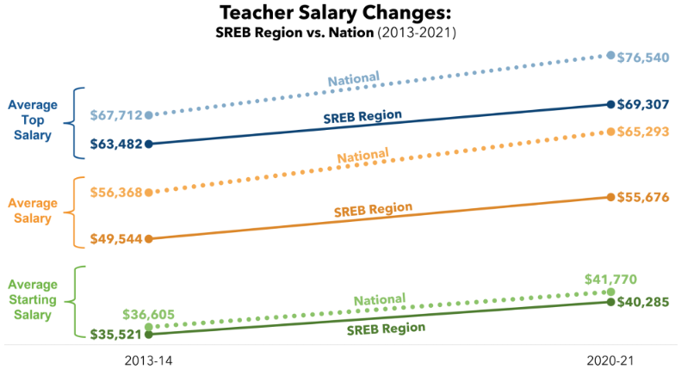
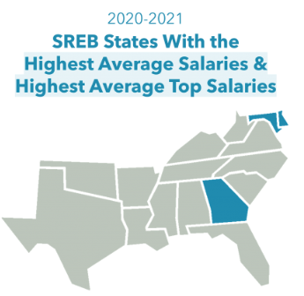
QUANTITY:
What are educators saying?
Funding and compensation continue to affect recruitment and retention.
Source: SREB Teacher Compensation Dashboard

Slide 19
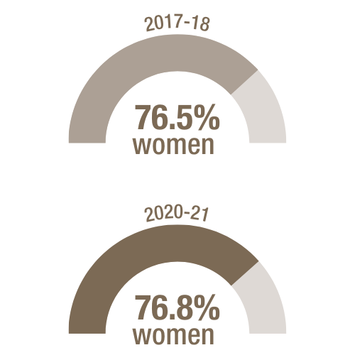
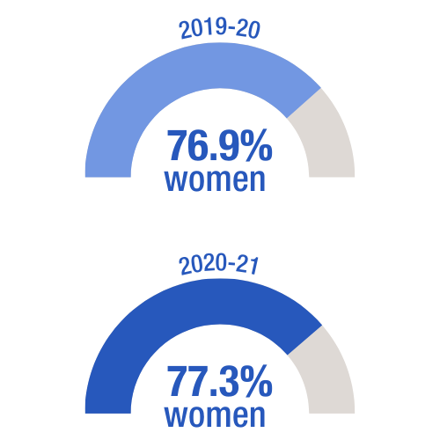
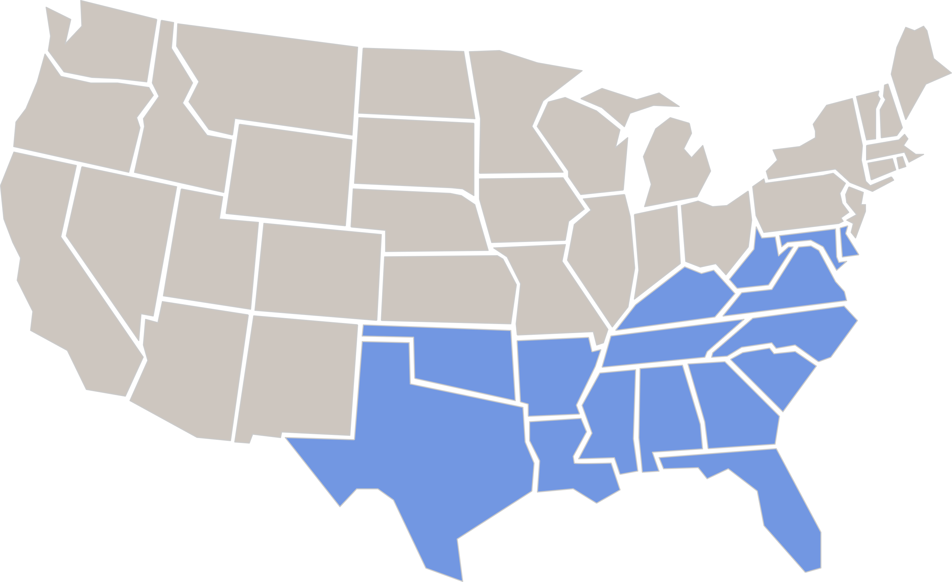

DEMOGRAPHICS:
Teacher Gender
In the United States…
In the South…
Source: State Data Reports, NCES National Teacher and Principal Survey 2017-18; 2020-21

Slide 20


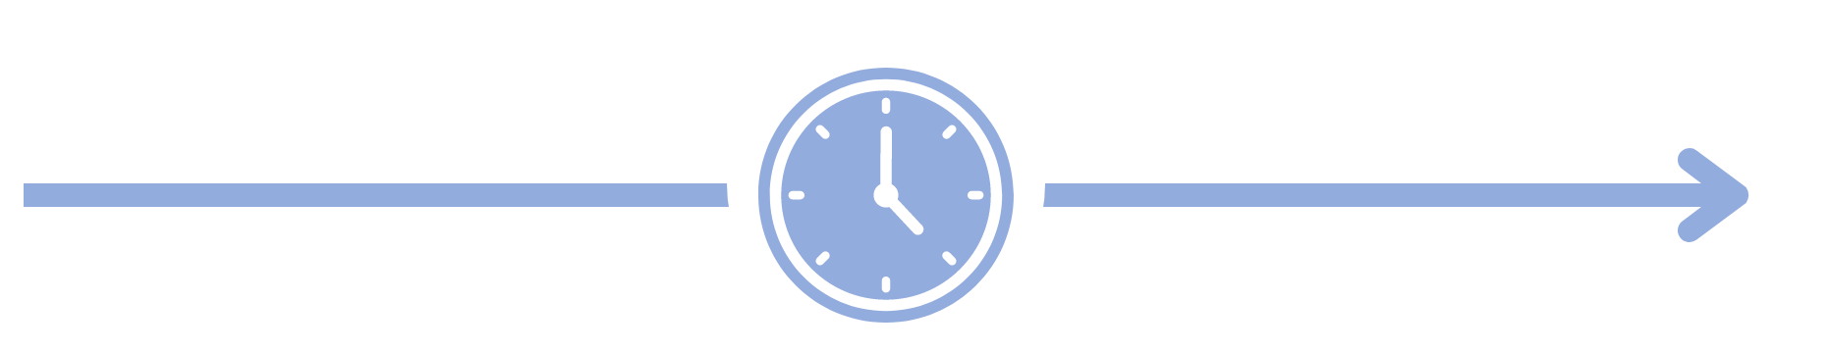
DEMOGRAPHICS:
Teacher Age
Average age of teachers in the U.S.
2017-18: 42.4
2020-21: 42.9
Source: State Data Reports, NCES National Teacher and Principal Survey 2017-18; 20-21

Slide 21

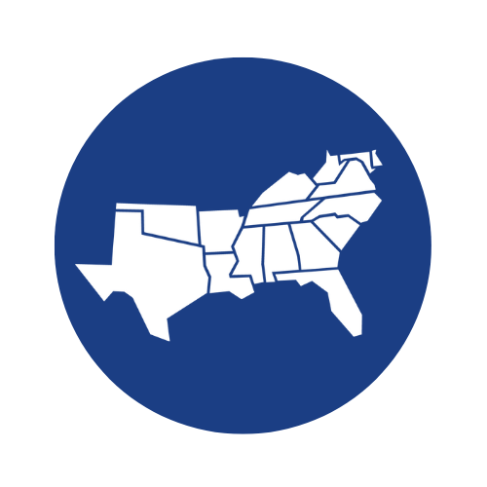
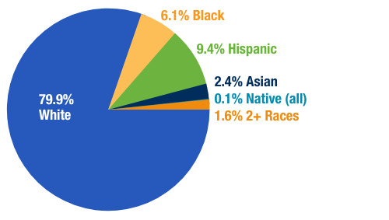
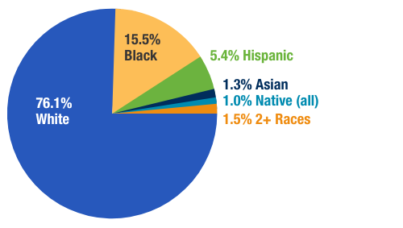
DEMOGRAPHICS:
Race & Ethnicity
The teacher workforce in public schools is more diverse in the South.
  UNITED STATES
  SREB STATES
Source: State Data Reports, NCES National Teacher and Principal Survey 2020-21

Slide 22
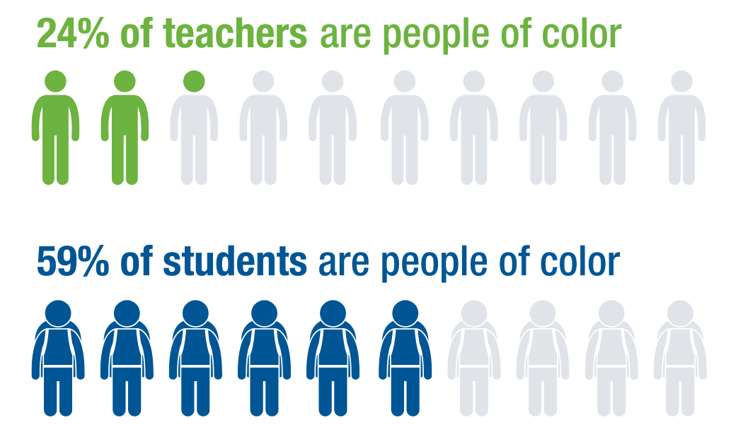
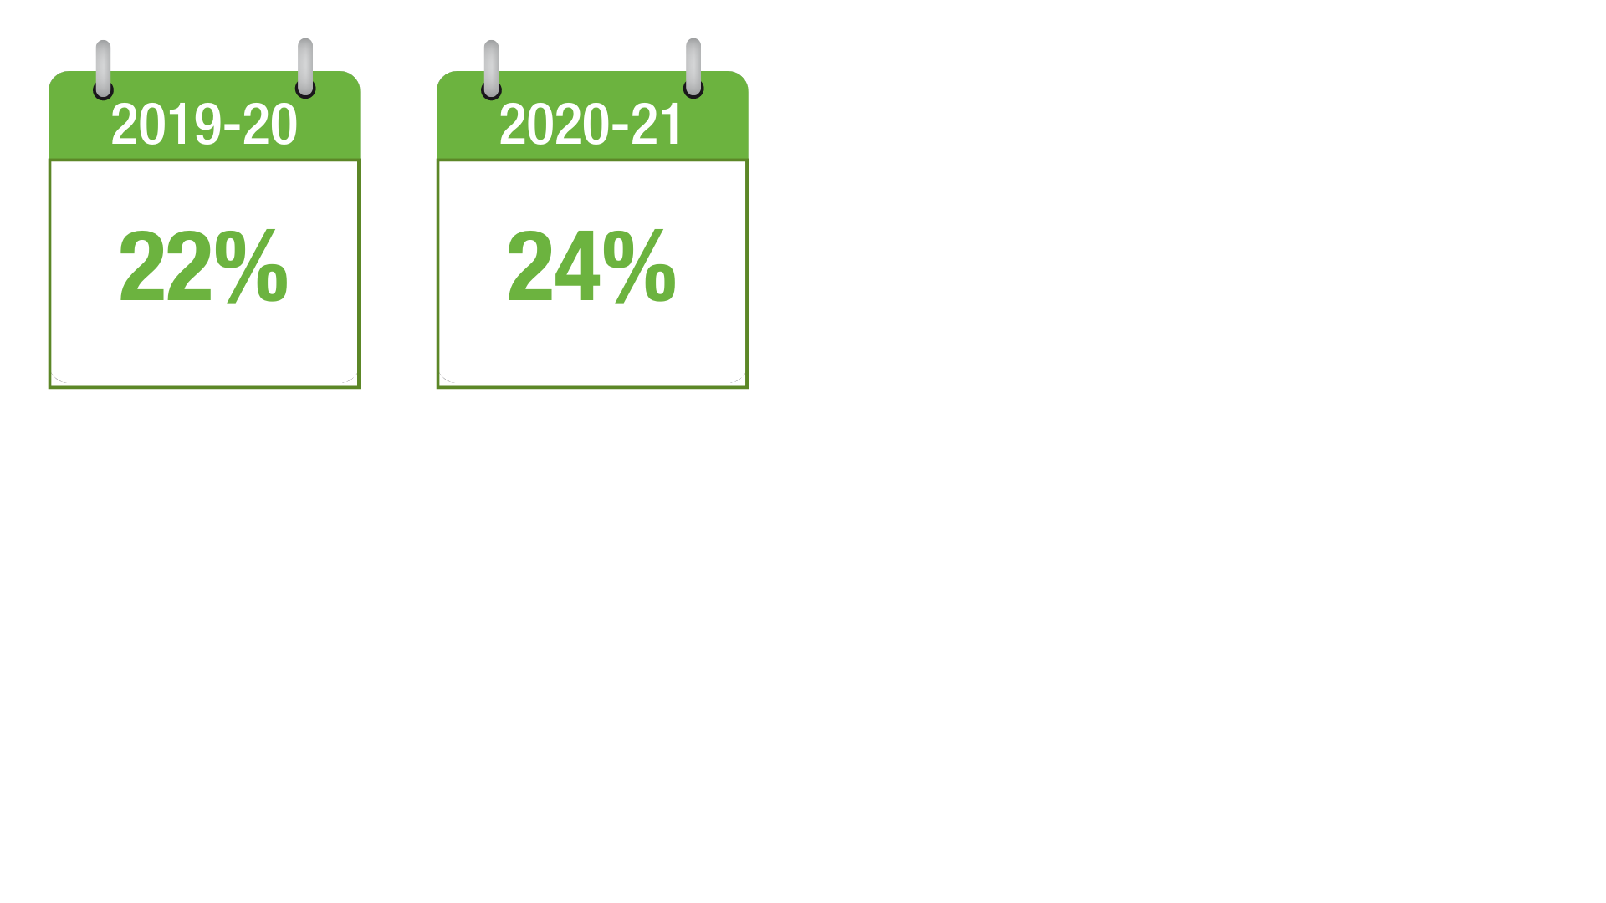
DEMOGRAPHICS:
Race & Ethnicity
The teaching workforce in the South is growing more diverse — but doesn’t reflect the student population.
Teachers of color:
Source: State Data Reports, NCES National Teacher and Principal Survey 2020-21

Slide 23
DEMOGRAPHICS:
Education Level
SREB States
Percent of Teachers With Graduate Degrees
2019-20: 57.6%
2020-21: 57.1%
Source: State Data Reports, 2020-21
Notes:
Note: A review of the literature/research shows that having a master’s degree does not equate to higher quality with the exception of having a master’s degree in the CONTENT the teacher teaches.

Slide 24
TEACHER QUALITY:
Proxy Measures
On average, among teachers in the SREB region in 2019-20 …
7.9% are National Board Certified
16.4% are inexperienced (≤ 3 years)
4.5% are uncertified or emergency certified
11.0% are teaching out-of-field
Average Years of Teaching Experience:
10.8
in the South
Source: State Data Reports
Notes:
Proxy measures for Quality: Experience, Certification, and inconsistently applied effectiveness systems

Slide 25
TEACHER QUALITY:
Proxy Measures
On average, among teachers in the SREB region in 2020-21 …
7.8% are National Board Certified
17.6% are inexperienced (≤ 3 years)
5.1% are uncertified or emergency certified
11.0% are teaching out-of-field
Average Years of Teaching Experience:
12.4
in the South
14.5
in the U.S.
Source: State Data Reports
Notes:
Proxy measures for Quality: Experience, Certification, and inconsistently applied effectiveness systems

Slide 26
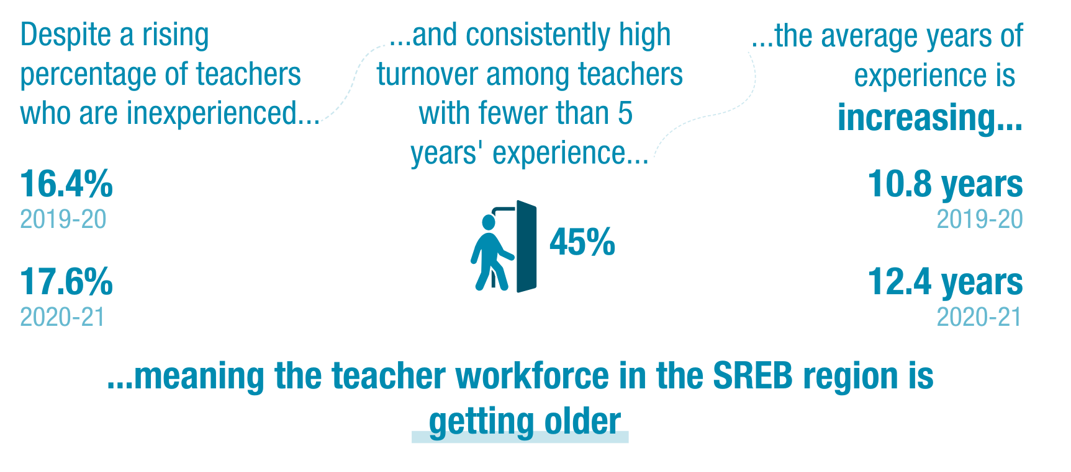
TEACHER QUALITY:
Proxy Measures
Source: State Data Reports
Notes:
Proxy measures for Quality: Experience, Certification, and inconsistently applied effectiveness systems

Slide 27

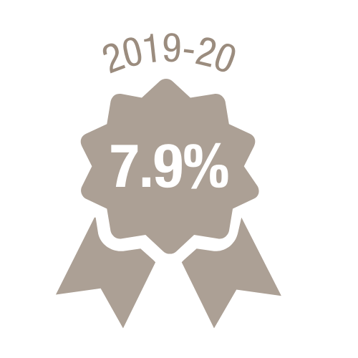
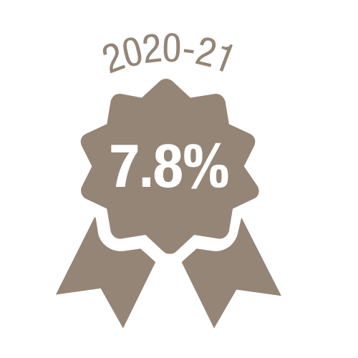
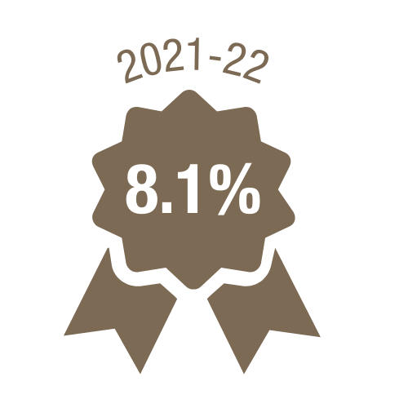
TEACHER QUALITY:
National Board Certification
National Ranking | State | % NBCT
#1 | NC | 23.4%
#3 | SC | 16.9%
#4 | MS | 14.9%
#6 | KY | 9.9%
#7 | AR | 9.1%
#8 | AL | 8.9%
#9 | FL | 8.5%
#10 | OK | 7.3%
#13 | WV | 6.3%
#14 | MD | 5.9%
#17 | LA | 4.9%
#19 | DE | 4.8%
#20 | VA | 4.6%
National Average = 3%
#31 | GA | 2.2%
#37 (tied) | TN | 1.2%
#49 | TX | 0.3%
The SREB region
leads the nation in the
percent of teachers who are
National Board Certified.
SREB Regional Average:
Source: NBPTS, 2022
Notes:
Note: TN is tied at #37 with PA.

Slide 28


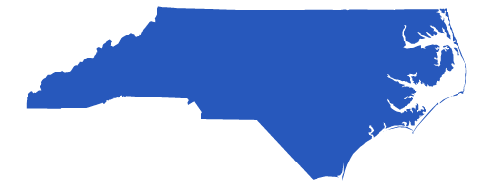
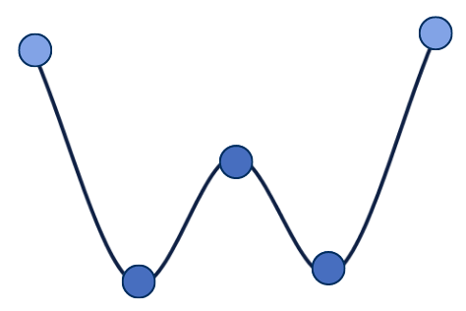
TEACHER QUALITY:
Effectiveness: State Examples
2020-21
2 Takeaways from North Carolina:
Teacher Effectiveness, Experience & the Pandemic
2021-22
2 Takeaways from Tennessee:
Distribution of Scores
AVG. COMPOSITE SCORES IN TN
#1 Educators’ composite scores were relatively consistent across subject areas, with literacy and math teachers scoring slightly higher.
OVERALL
3.04
#1 On average, the pandemic had less negative impact on learning for students with teachers who had previously been identified as effective.
LITERACY
3.02
NUMERACY
3.03
SCIENCE
2.96
SOCIAL STUDIES
2.98
#2 Compared to effectiveness, teacher experience level played a negligible role in mitigating the negative impacts of the pandemic — district and school leaders should consider placing their strongest (not necessarily most experienced) teachers where they can have the most impact, such as K-3 reading and middle school math/science.
1: LEAST EFFECTIVE
519
5: MOST EFFECTIVE
544
#2 Schools’ composite effectiveness ratings tend to cluster at
the low and high ends of the
spectrum.
3: AVERAGE
356
# OF SCHOOLS
IN TN AT EACH
RATING LEVEL
4: ABOVE AVG.
170
2: APPROACHING AVG.
154
Source: State Data Reports; NC OLR White Paper; TN TVAAS Report
Notes:
Proxy measures for Quality: Experience, Certification, and inconsistently applied effectiveness systems
Not included here:
North Carolina (2020-21) had 15.3% of teachers rated as needs improvement in EVAAS (the most differentiation we see in our region to date)
Louisiana (2020-21) VAM scores show 9% of educators as ineffective
Effectiveness composite school rating
Total # of schools with composite rating in TN
Level 5- Most effective 544 or 31%
4- Above average effectiveness 170 or 10%
3- Average 356 or 20%
2- Approaching average 154 or 9%
1- Least effective 519 or 30%

Slide 29
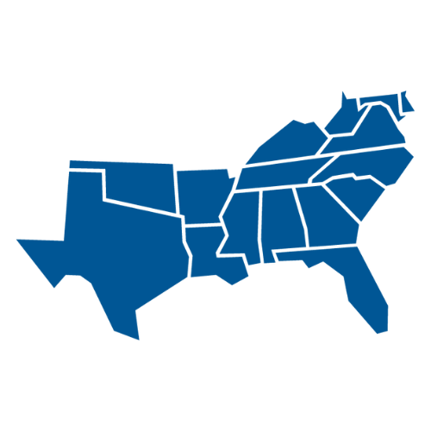
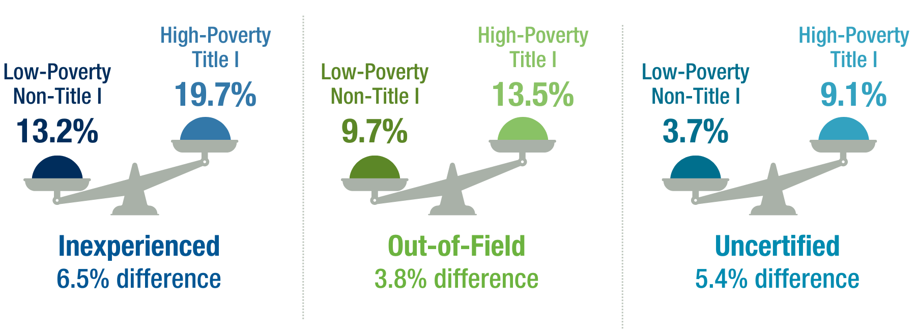
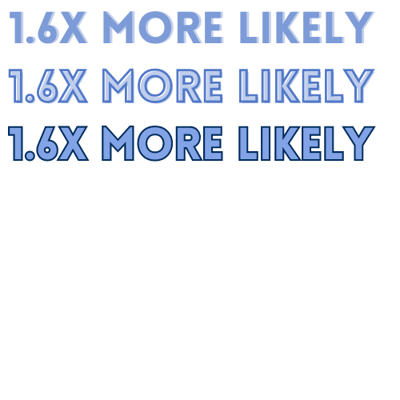
DISTRIBUTION OF TALENT:
Poverty Level
2020-21
High-poverty districts and schools have higher rates of less experienced and less qualified teachers.
In the SREB region, a student attending a high-poverty school is
to have an inexperienced, out-of-field or uncertified teacher than their peer at a more affluent school.
Source: State Data Reports
Notes:
SREB, with Vanderbilt, is conducting more research to better understand Covid’s effect on teaching talent and distribution thereof across school/district/student types.

Slide 30
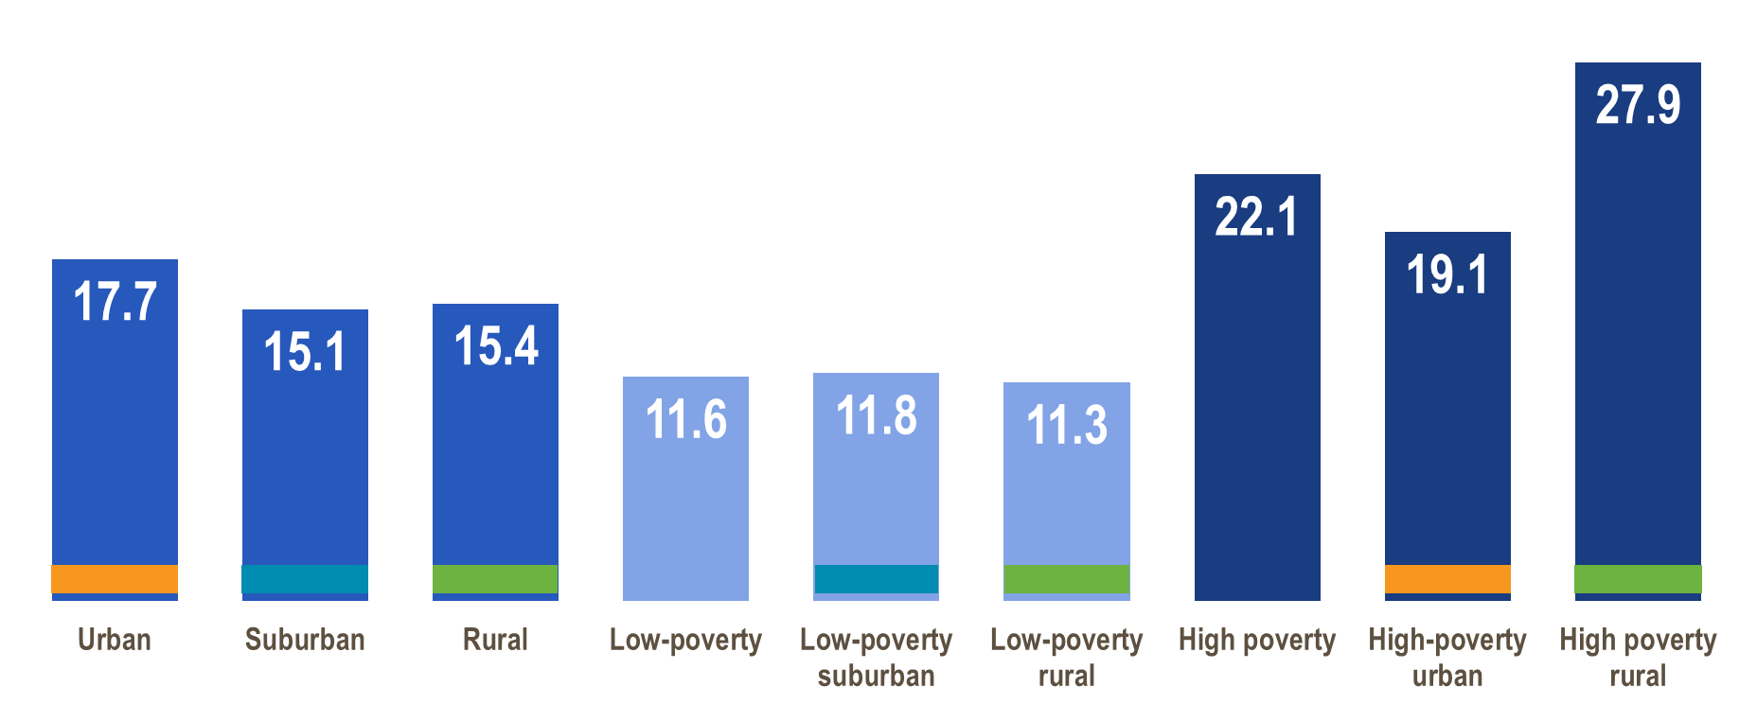
DISTRIBUTION OF TALENT:
Poverty Level
2018
Percent Teacher Turnover (Migration and Attrition) by School Location and Poverty Level
Source: Ingersoll Teacher Shortages and Turnover in Rural Schools in the US:
Notes:
High poverty schools see far more turnover than the average, whereas low-poverty schools see less turnover. Other state reports that have further investigated teacher turnover showed us that early career and uncertified teachers are turning over at higher rates than professionally licensed teachers – meaning the leaky pipeline/vacancy rate is worse for high poverty districts.

Slide 31
Data Conclusions: States need to...
Quantity
Increase the attractiveness of teaching to Gen Z and others who are qualified to fill vacancies (autonomy, support, incentivize quality)
Demographics
Encourage and support more males and people of color in the profession
Quality
Fully prepare and support professional licensure – and continuously support and reward collaboration and instructional development
Distribution of Talent
Attract and retain strong leaders and teaching talent, especially in high poverty schools
Notes:
Shortages are defined by 4 key categories.
Together, these show a comprehensive view of the teacher pipeline. I’ll address some of the causes of shortages throughout, but they are many and range from: lack of respect, lack of instructional mentorship or collaboration, lack of strong leaders, lack of autonomy and trust, high stress, decreases planning time, high student caseload, lack of funding and compensation levels that cause financial stress.

Slide 32



Sources
Federal and national data sources and reported are noted on individual relevant slides. State data source links and additional notes are listed below.
KENTUCKY
Kentucky Department of Education. School Report Card; Data Sets – 2020.
Kentucky Department of Education. School Report Card; Data Sets – 2021.
Kentucky Department of Education. School Report Card; Faculty, Staff and Community – 2020.
Kentucky Department of Education. School Report Card; Faculty Staff and Community – 2021.
LOUISIANA
Louisiana Department of Education. State Report Card 2020-21.
Louisiana Department of Education. Workforce Attributes.
Louisiana Department of Education. State Profile: Educator Workforce Snapshot.
Louisiana Department of Education – Report to the House and Senate Committees on Education of the Louisiana Legislature. 2020-21 Teacher Exit Survey Report.
Notes: Louisiana’s data is incomplete due to the state receiving a 2020-21 ESSA waiver. See more here. Louisiana calculates attrition rate for teachers and staff together.
MARYLAND
Maryland State Department of Education. Educator Qualifications (2021).
Maryland State Department of Education. Maryland’s Teacher Workforce: Supply, Demand, and Diversity.
Maryland State Department of Education. Professional Staff by Type of Degree and Years of Experience.
Maryland State Department of Education. Professional Staff by Assignment, Race/Ethnicity and Gender.
MISSISSIPPI
Mississippi Department of Education. Accountability Data: 2020-21.
Mississippi Department of Education. Teachers and School Leaders: 2020-21.
Note: The Mississippi Department of Education shared additional teacher data per SREB’s public data request.
NORTH CAROLINA
North Carolina School Report Cards. State Report: 2021.
North Carolina Department of Public Instruction. Highlights of the North Carolina Public School Budget: 2021.
North Carolina Department of Public Instruction and State Board of Education – Report to the North Carolina General Assembly. 2020-21 State of the Teaching Profession in North Carolina.
NC.Gov – North Carolina Public Schools Statistical Profile. Public School Full-Time Personnel; State Summary 2020-21.
National Center for Education Statistics. Characteristics of 2020-21 Public and Private K-12 School Teachers in the United States.
Note: North Carolina separates public school teachers and charter school teachers. SREB recorded the data for public school teachers only in this report.
OKLAHOMA
Oklahoma State Department of Education. Emergency Certifications.
Oklahoma School Report Cards. Teachers.
Oklahoma State Department of Education. 2021 Oklahoma Educator Supply & Demand Report.
SOUTH CAROLINA
South Carolina School Report Card. Overview 2020-21.
South Carolina Department of Education. Teacher Data.
South Carolina School Report Card. Classroom Environment 2020-21.
Center for Educator Recruitment, Retention, & Advancement. South Carolina Annual Educator Supply & Demand Report 2021.
SC Teacher. South Carolina Teacher Retention Rates for the 2020-21 Academic Year: One-Year and Three-Year Averages.
Notes: The percent of inexperience and out-of-field teachers are for core classes only; South Carolina does not report the total in all classes. South Carolina did not have emergency or provisional licenses available in the 2020-21 school year.
TENNESSEE
Tennessee Department of Education. Data Downloads & Requests.
Note: Spreadsheets are missing for the 2020-21 school year. The Tennessee Department of Education did not respond to SREB’s request for data.
TEXAS
Texas Education Agency. Educator Reports and Data.
Texas Public Education Information Resource (TPEIR). Teacher Certification.
Texas Education Agency. Teacher Retention Demographics by 2015-16 through 2020-21.
Texas Equity Toolkit. Frequently Asked Questions.
Texas Education Agency. 2021 Federal Report Card.
Texas Education Agency. Teacher Retention by Preparation Route 2015-16 through 2020-21.
Texas Education Agency. Employed Teacher Demographics 2015-16 through 2021-22.
VIRGINIA
Virginia Department of Education – School Quality Profiles. Teacher Quality.
Virginia Department of Education. Statistics & Reports.
Virginia Department of Education. Education Workforce Data & Reports.
Virginia Department of Education. 2020-21 Number of Educators by Division, Race, and Ethnicity. (downloads automatically)
WEST VIRGINIA
West Virginia Department of Education. ZOOMWV PK-12 Data Dashboard.
ALABAMA
Alabama Department of Education Report Card. Educator Demographics.
Alabama Commission on the Evaluation of Services. Teacher Workforce: Recruitment & Retention Evaluation.
ARKANSAS
Arkansas Department of Education Data Center. 2021 School Report Card.
Arkansas Department of Education Data Center. State Profile.
Arkansas Department of Education Data Center. 2020-21 Report.
Notes: Arkansas reports the total count of teachers differently between different state data sets.
The percent of specialist degrees includes all advanced degrees above master’s.
DELAWARE
Delaware Department of Education. State Report Card – Educator Retention.
Delaware Open Data. Education Level.
Delaware Open Data. Educator Characteristics.
Notes: Delaware reports the percentage of teachers with “less than a bachelor’s degree.” This percentage is recorded in the associate’s degree column.
Delaware defines inexperienced (early career) teachers as less than four years of experience.
FLORIDA
Florida Department of Education. PK-12 Public School Data Publications and Reports – Instructional Staff Reports.
Florida Department of Education. Performance Evaluation.
Florida Department of Education. State Report Card.
Note: Florida reports out-of-field teachers as the percent of classes taught by an out-of-field educator.
GEORGIA
The Governor’s Office of Student Achievement. Georgia K-12 Teacher and Leader Workforce Report.
The Governor’s Office of Student Achievement. State Report Card and Data Dashboards.
Note: Georgia reports inexperienced teachers as those who have one year of experience or less.

Slide 33


FUTURE ACTIONS — FINDING A BETTER WAY FORWARD:
A Blueprint to Solve Teacher Shortages
Notes:
STEPHEN:
Solutions can be tricky as we all know. Solutions are built on great ideas. But they work best when they solve the root cause of the problem that you’ve identified by collecting a lot of information.
To date, a great deal of the solutions to the teacher shortage issue have been trying out ideas, fixing immediate threats to having a teacher in each classroom. What is working and what isn’t working to help reinforce the teacher pipeline from early interest in teaching to preparation, early years of leading your own class, being a professional and being a leader in a school?
Last year we introduced to you a Blueprint recommendation – to work toward a full-scale plan, foundation to roof, to rebuild the teaching profession in policy and practice. We stand firm with this recommendation. Not only do we need a blueprint in policy, we need a blueprint in every district to support educators – incoming through retirement.

Slide 34
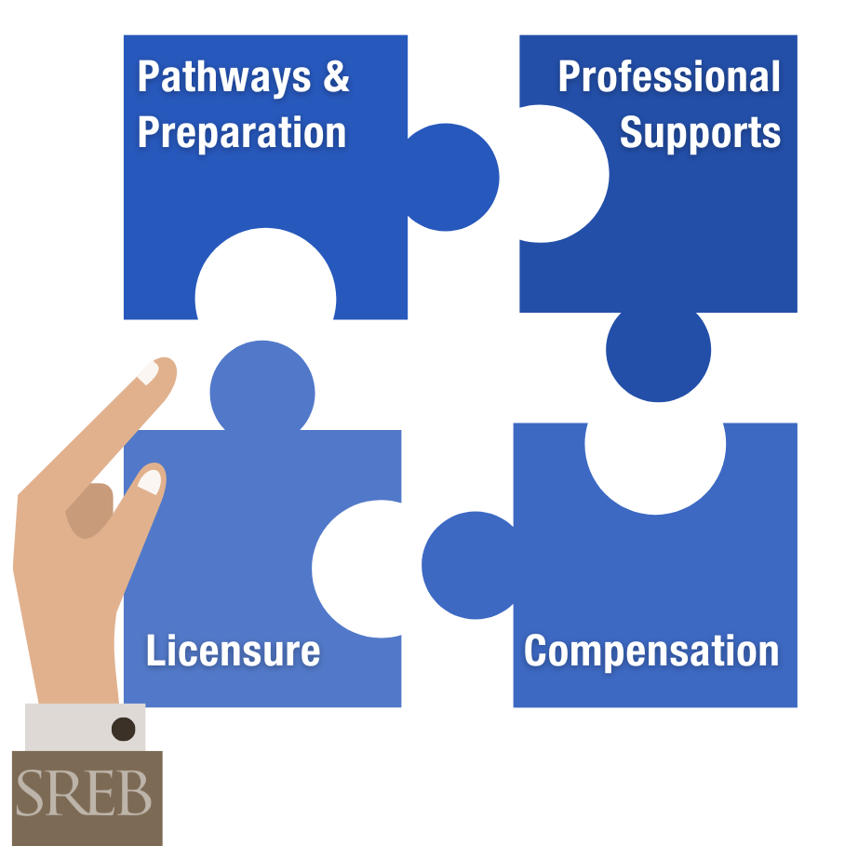
Elements of a Strong Blueprint
Improving teacher workforce policy and practice requires a comprehensive approach.
These four elements work together as an interlocking system.
Notes:
STEPHEN:
The shortage is caused by several key things that have worked overtime to erode the beauty, the gift, the art that is teaching. If we listen to educators, they tell us what is wrong and the data in fact backs up what they are telling us. Without trust, some autonomy to lead students, a supportive team of instructional leaders to help each other grow and pick each other up on tough days, and without enough money to run the school and enough money for teachers to pay their bills, we will see fewer and fewer adults enter the teaching profession.
Four elements have to be embedded in a solution blueprint. The elements should not be studied in a vacuum but researched, debated and redesigned as one seamless, interdependent whole. Changing teacher licensure policies alone will not affect great change, for instance, nor will simply increasing compensation. It takes all four elements together, and all stakeholders working together, to elevate and support teachers.

Slide 35

Elements of a Strong Blueprint
Pathways & Preparation
Professional Supports
A variety of entry points into teaching that share common high standards
Opportunities for strong teachers to maximize and share their talents via well-supported teacher-leadership roles
Preparation programs attuned to teachers’ real-life needs, such as classroom management and the science of reading
The flexibility, class sizes and support staff needed for teachers and their students to succeed
Licensure
Compensation
Licensure systems that scaffold up based on teachers’ skills, competencies and impact — and align with the pay and ongoing support they receive
Salary structures that avoid stagnation and reward teachers’ skills, knowledge, impact and leadership
Health and retirement benefits that are high-quality and affordable
Notes:
STEPHEN:
Blueprint action plan
Must tackle the core root-causes of the issue: improve prep and make more pathways to recruit into the profession.... more accessible but still high bar; create career advancement in licensure; embed teacher supports in policy and incentivize positive culture/staff changes; restructure teacher compensation for new pathways and provide better full package of benefits.

Slide 36



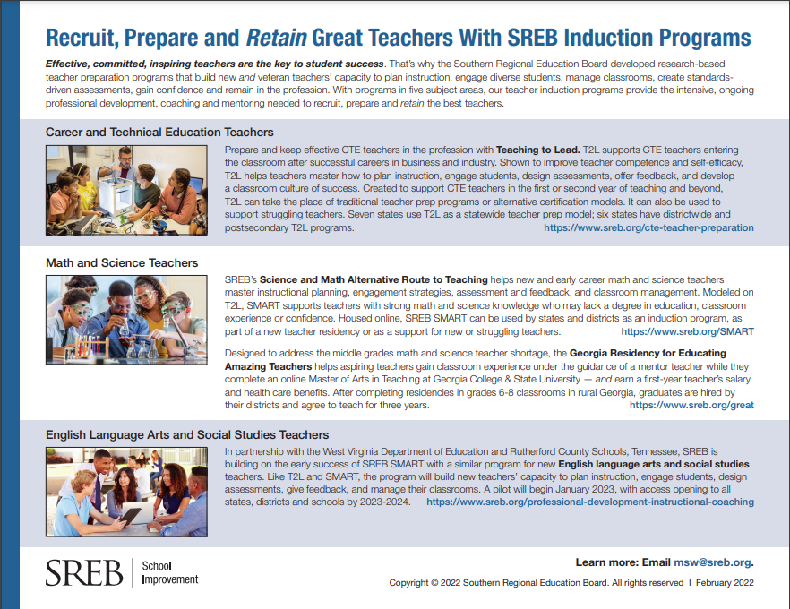

Promising Practices
Pathways & Preparation
Recruit, Prepare & Retain Great Teachers with SREB Induction Programs
Federally-approved registered teacher apprenticeship — Tennessee, West Virginia, Delaware, Arkansas
Combined “Grow Your Own” and accelerated learning pathway in West Virginia
Teacher residency — Louisiana, West Virginia, Mississippi, Texas
SREB’s Teacher Preparation Commission Report
Notes:
MEGAN:
WV grow your own: The Grow Your Own Pathway gives students a fast-track into the education field through a combination of dual enrollment/Advanced Placement courses and an accelerated pathway. Students can then graduate with a bachelor's degree in just three years. Ties directly with the Federally registered teacher apprenticeship path. Plus WV also requires a year-long residency for all pathways.
-------------
Arkansas is latest state in our region to receive federal approval for teacher apprenticeship and will implement in the 23-24 SY
Louisiana became the first state in our region to require yearlong residencies for teachers
MS Teacher residency: MTR) is a graduate program that combines college coursework and job-embedded training to prepare prospective educators for the teaching profession in geographical critical shortage areas. The program will enroll up to 200 candidates for each school year to work toward their graduate degree and Mississippi teacher certification. The MTR is part of a statewide strategy to expand and diversify the teacher pipeline,
TX residency pilot – US Prep and Public Impact models combine to support improved preparation of teachers, local partnerships and a 1 year paid residency in K-12

Slide 37

Promising Practices
Professional Supports
Licensure
Rigorous standards of entry no matter the pathway in Maryland
Quality induction programs for new teachers — Maryland and North Carolina
Statewide teacher mentor training program in Louisiana
Tailored, rigorous professional development that includes coaching for success — Arkansas Quest and Oklahoma’s Professional Learning Focus
Professional Advancement Account proposal in North Carolina
Maryland’s Blueprint: Revised schedules for planning
and collaboration time and a new system of PD tied
to the career ladder
Support to districts in shifting teaching roles and responsibilities — Arkansas and North Carolina
Tiered licensure from pre-service to advanced teaching roles — Arkansas, Georgia, Maryland, Oklahoma
Advanced teacher roles pilot and professional pathways licensure framework in North Carolina
Notes:
MEGAN:
Licensure and professional supports should be interconnected in policy to make sure we are supporting teachers to reach professional status. Licensure can be scaffolded with appropriate yet rigorous measures for different levels of teachers striving for professional, quality licensure. And then for teachers to continue to grow and take on leadership roles mentoring colleagues or supporting more students. Having these scaffolded roles, instituted properly, means there is a web of support for all teachers in the building. Opportunity Culture model is a great working example of this that yields incredible results. NC is moving toward the principles of this model across the state. Induction, mentoring, paid quality professional development, instructional coaching from direct colleagues, and time to allow these colleagues to be in each others rooms – this can all be set up and enabled by a scaffolded licensure system.

Slide 38

Align with the Career Continuum
Advancement Options
Mentor Teacher
Routes into teaching
Master Teacher
Flexible career mobility to achieve professional licensure
Professional Teacher
College & University
Industry Experience
Beginning Teacher: Skills Advancement
Beginning Teacher: Partial Skills
Beginning Teacher: Skills Acquisition
Resident or Apprentice
PATHWAYS & PREP
LICENSURE
PROFESSIONAL SUPPORTS
COMPENSATION
Notes:
MEGAN:
Provide different routes into teaching that all lead to the same rigorous standards of professional teaching
Allow for flexible career growth
Provide supports at every level
Incentivize growth in skills/knowledge/impact as well as taking on increased workloads/coaching/mentoring

Slide 39
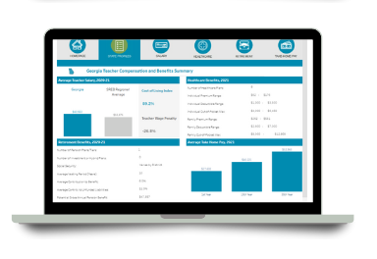


Promising Practices
Compensation
Maryland’s Blueprint provides an initial salary increase of 10% by 2023 and raises starting pay to $60k by 2026
Check out SREB’s Teacher Compensation Dashboard
The Opportunity Culture model revises district salary structures to include paid residencies and substantial advanced teacher supplements
Average teacher salaries and salary schedules by state
Heath and retirement benefits in each state
Average take-home pay across the South
Teacher Incentive Allotment fund to retain effective teachers in rural and high needs areas in Texas
TEAMS Act to recruit and retain STEM teachers in Alabama
DASHBOARD
Notes:
MEGAN:
TX- The Teacher Incentive Allotment (TIA) was established with a stated goal of a six-figure salary for teachers. TIA allotment funds help Texas school systems reward, retain and recruit highly effective teachers. The funding formula prioritizes high needs and rural campuses. Districts can now create compensation plans based on teacher effectiveness and student equity. This new model creates a path for outstanding teachers to earn a six-figure salary–thus, reducing the desire for highly effective teachers to leave the classroom.
AL- the TEAMS act offers STEM teachers up to $20,000 more per year to teach math or science in hard-to-staff areas of Alabama, ensuring that our teachers can make more making a difference.

Slide 40

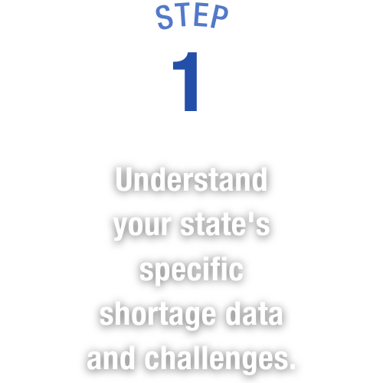
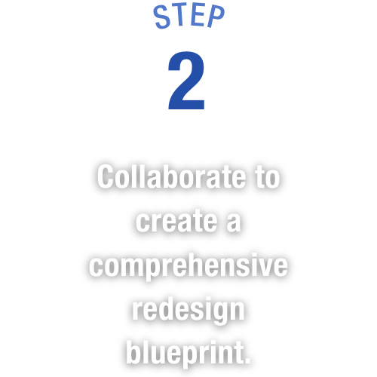


Actions to Create & Implement Your State’s Blueprint
Notes:
STEPHEN:
How do we do this?
States need to carry out 4 action steps:
Collect and analyze data to know your state shortage issues and why – not just aggregate level data, but break it down to identify real problems (annual occurrence)
bring key leaders and educators together to collaborate on a comprehensive solution blueprint (3-5 years)
Commit to long-term systemic change and implement the blueprint changes (10+ years)
Make a continuous investment in your state’s future (10+ years) – for both K-12 and higher ed to bolster the talent pipeline, support students and grow the workforce/economy

Slide 41


SREB works with states to improve education.
Analyze & Publish
We share promising practices and provide reliable data and research to inform strategy.
Convene & Engage
We help leaders collaborate and share resources.
Support Action
We help policymakers and state agencies navigate policy and practice.
SREB.org/TeacherWorkforce

