Slide 2
Now is the Time to Prepare Future Nurses for Disasters
Kathleen Eid-Heberle, MSN, RN, NHDP-BC, CNE
Janice Smith, PhD, RN, CNE, ANEF
Eleanor Wade Custer School of Nursing
Shenandoah University

Slide 3
Objectives
Participants will be able to:
Articulate the importance of integrating disaster education into the nursing curriculum.
Examine innovative pedagogical methods of disaster education across the nursing curriculum.

Slide 4
Nurses in the United States
are inadequately prepared to
respond to disasters.
Veenema, et al., 2016

Slide 5
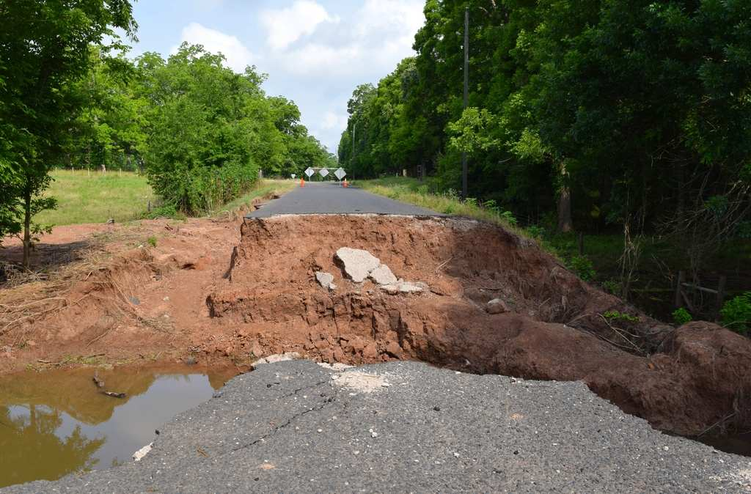
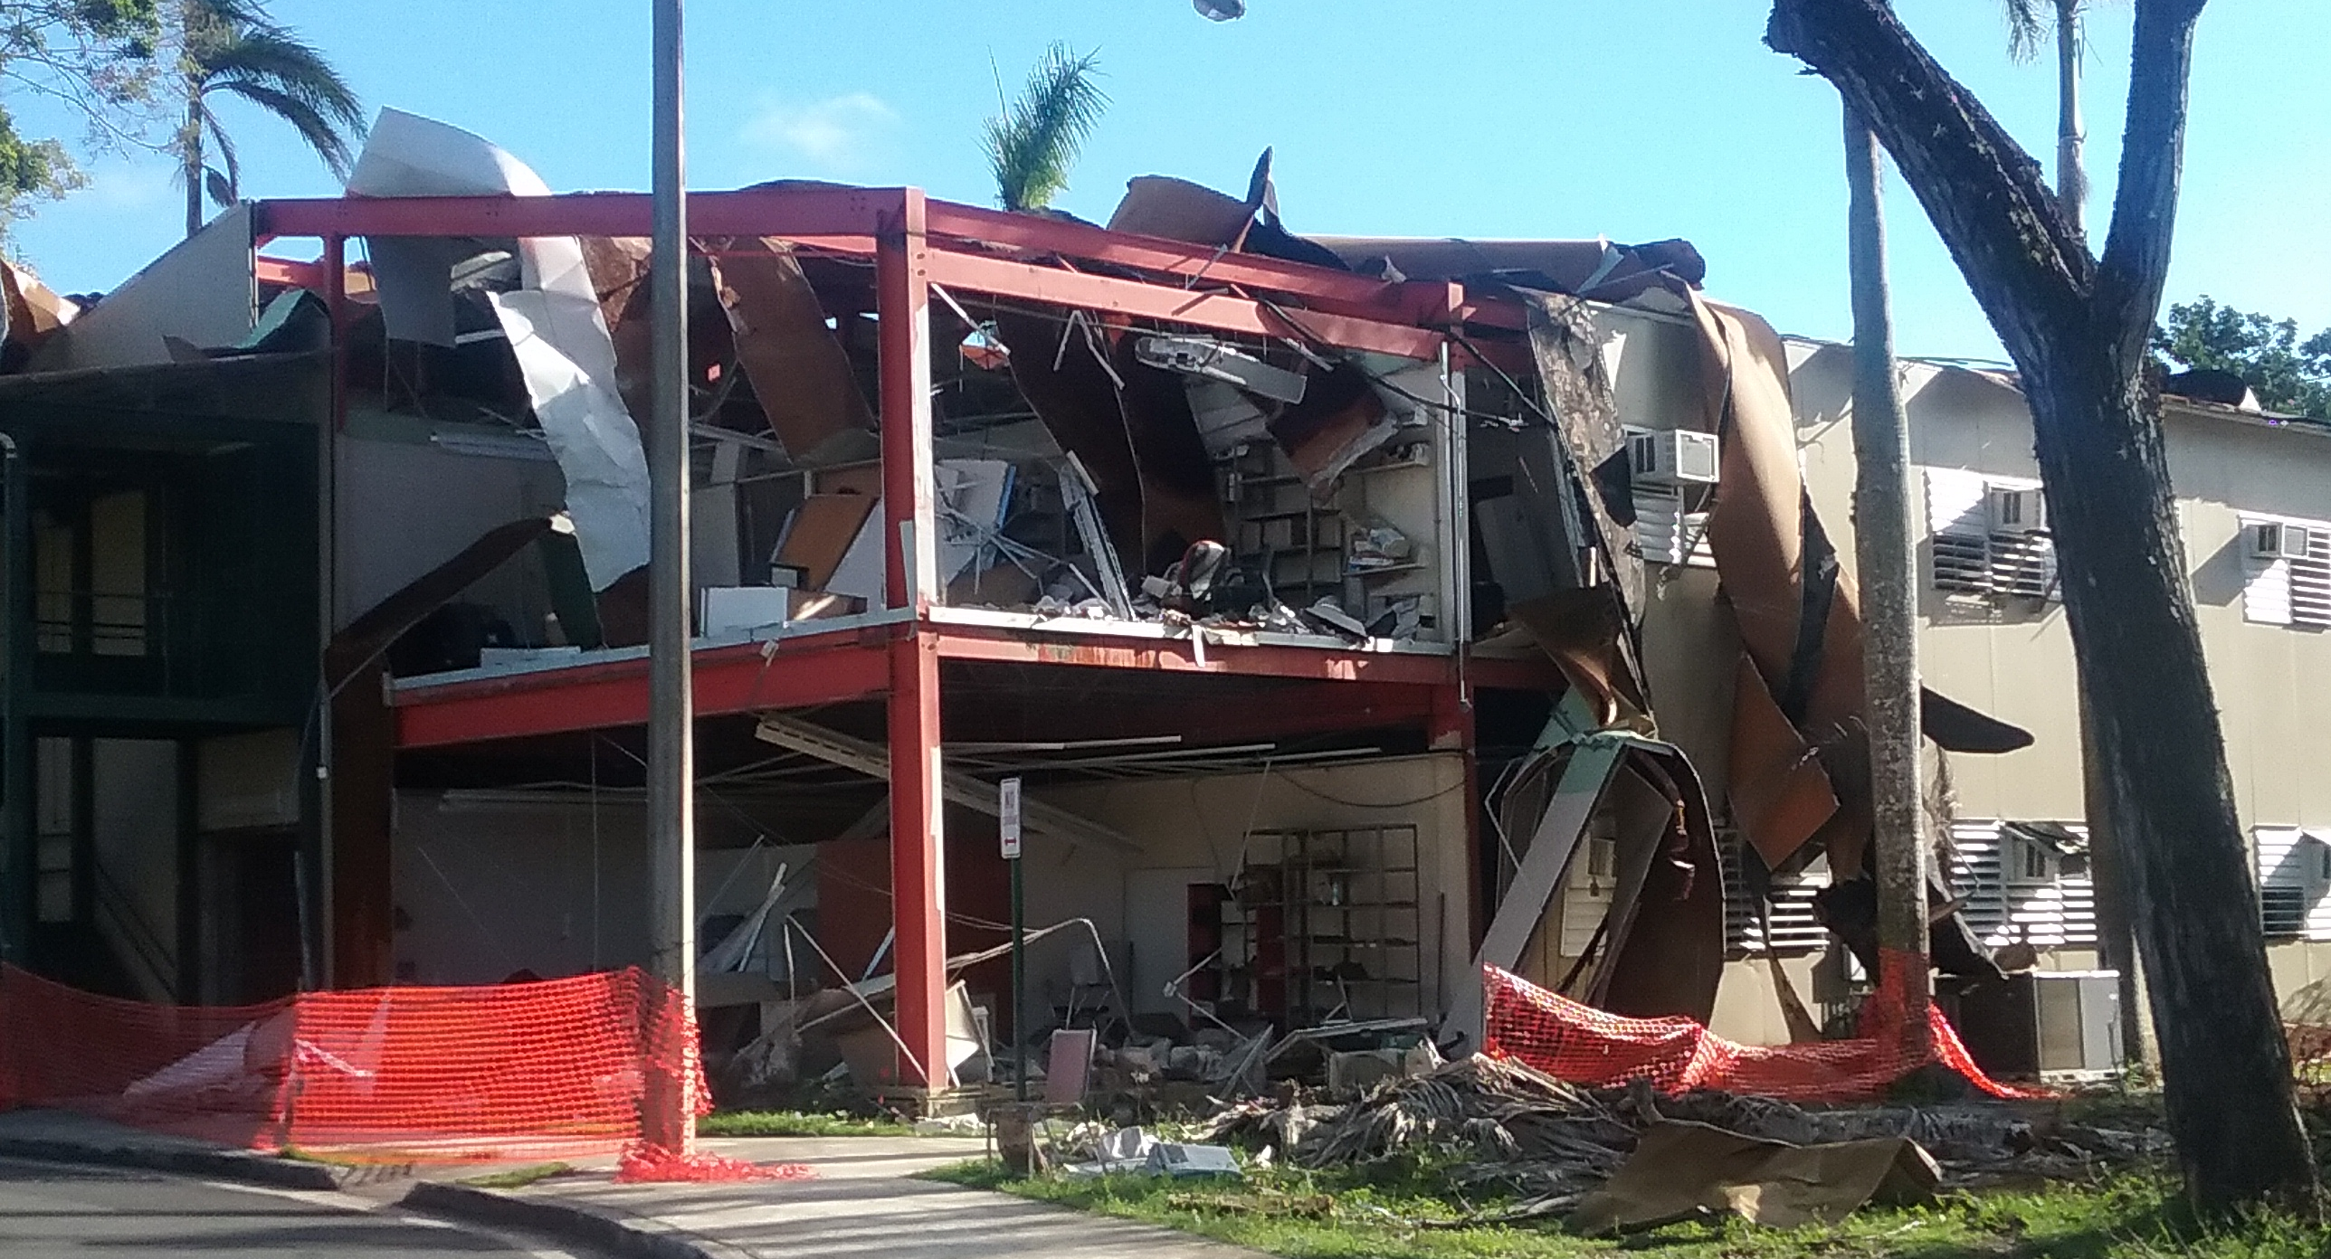
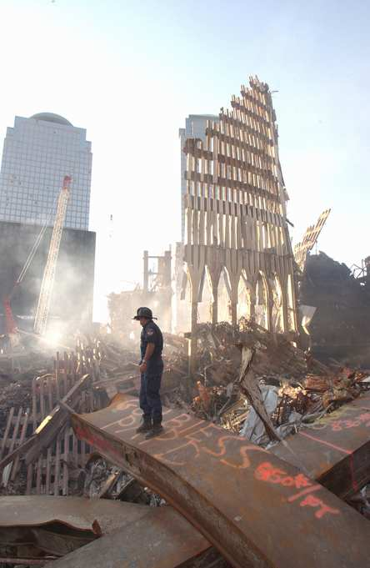
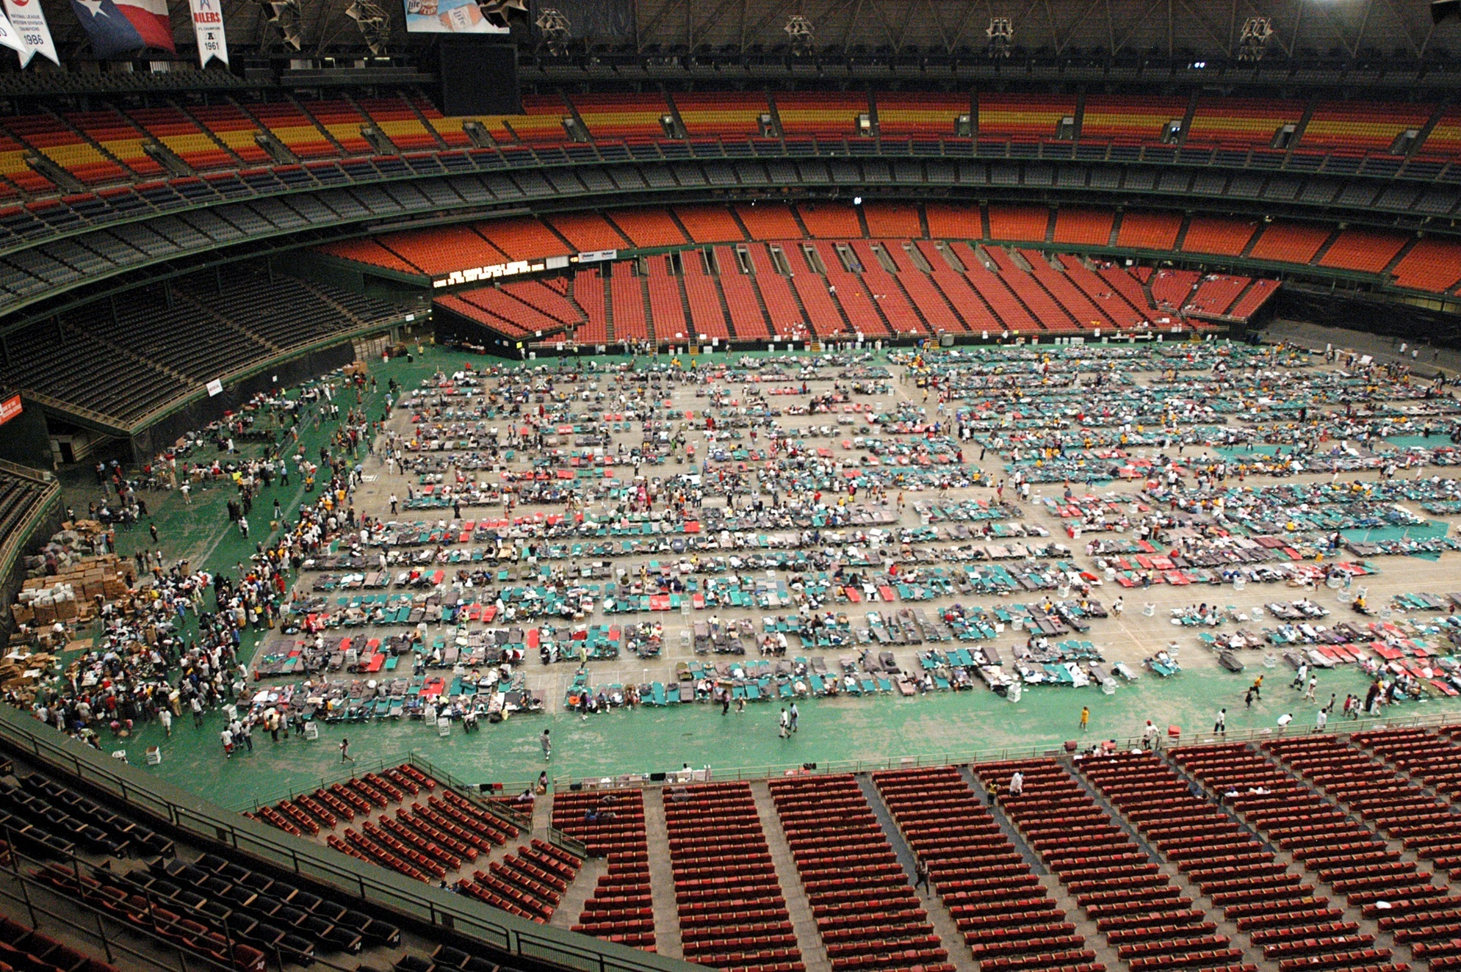
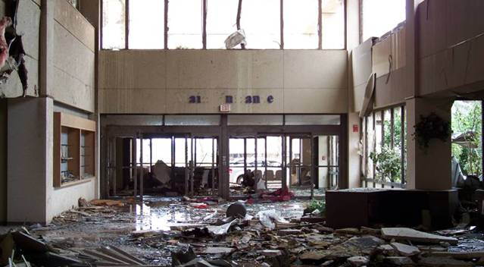
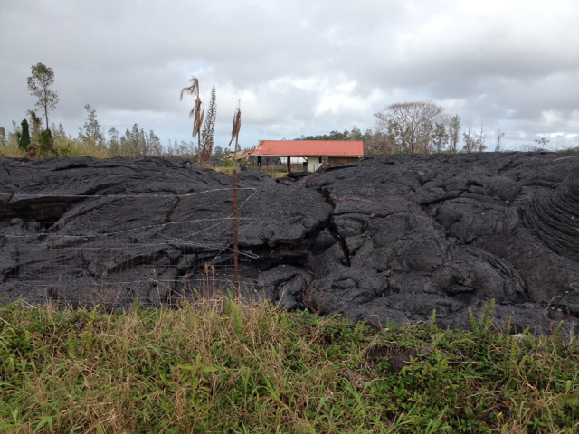
Disasters
Hurricane Maria - Puerto Rico, 2017 (K. Eid-Heberle)
Floods - Texas, 2016 (FEMA News Photo)
Volcano Eruption - Big Island of Hawaii, 2015 (FEMA News Photo)
Terrorism - New York, 2001 (FEMA News Photo)
Tornado – Joplin, MO, 2011
Houston Astrodome 2005
(American Red Cross)

Slide 6
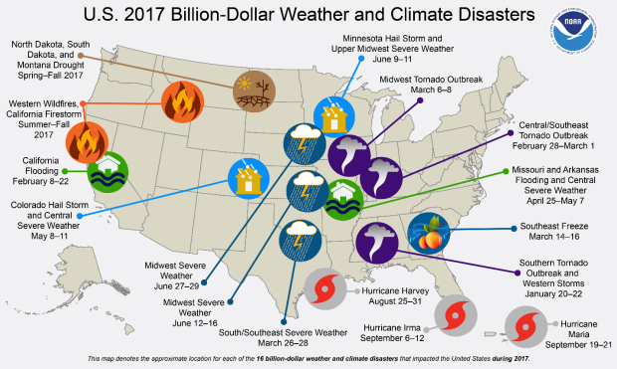
Billion Dollar Disasters
Smith, 2018

Slide 7
Goals of the Disaster Curriculum
The goals of the disaster curriculum are to:
Ensure nurses are personally prepared for a disaster so they can report to work when called upon.
Enable students to transition into nursing practice with basic disaster knowledge and capabilities to effectively and safely respond to an event.
Ensure nurse practitioners possess the knowledge and skills to appropriately assess, diagnose, and treat individuals affected by disasters.
Provide nurse leaders with the knowledge to prepare for and manage a disaster incident impacting their institution.
Recognize the importance of collaborating with other agencies before, during, and after a disaster.

Slide 8
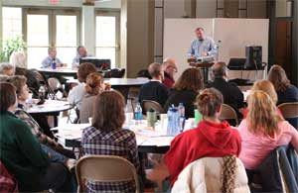
Disaster Content Across the Curriculum
Role of the Nurse:
Disaster Planning, Response, Management, and Recovery
Working with Government and Non-Government Agencies
Natural, Chemical, Biological, Radiological, Nuclear, and Explosive
Decontamination
Alternate Care Sites
Vulnerable Populations
Ethical, Legal, and Moral Issues

Slide 9
On-Line Learning
Enhanced learning through on-line modalities:
Federal Emergency Management Agency (FEMA)
IS-100.c: Introduction to the Incident Command System
IS-200.HCA: Applying ICS to Healthcare Organizations
IS-700.b: An Introduction to the National Incident Management System (NIMS)
American Red Cross
Disaster Cycle Services: An Overview
Disaster Health Services Fundamental 1
Disaster Health Services Fundamental 2

Slide 10
Mobile Applications
The Weather Channel
Local Alert System
American Red Cross
First Aid, Disaster Preparedness, Shelter Finder, Volunteer, etc.
Federal Emergency Management Agency (FEMA)
Disaster Preparedness, Disaster Safety Tips, Disaster Recovery Centers, etc.
National Institute of Health (NIH) - Wireless Information System for Emergency Responders (WISER)
Chemical Hazards Emergency Medical Management (CHEMM)
Radiation Emergency Medical Management (REMM)
Hazardous Substances Data Bank (HSDB)
WMD Response Guidebook

Slide 11
Transforming Teaching
Application of didactic content is achieved through experiential learning opportunities and interprofessional experiences.
Personal Disaster Plan and Kit
Tabletop Exercises
External Learning Opportunities
Local and State Disaster Drills
Agency/Organization Disaster Plan
Interprofessional Disaster Simulations
Virtual Reality Technologies

Slide 12
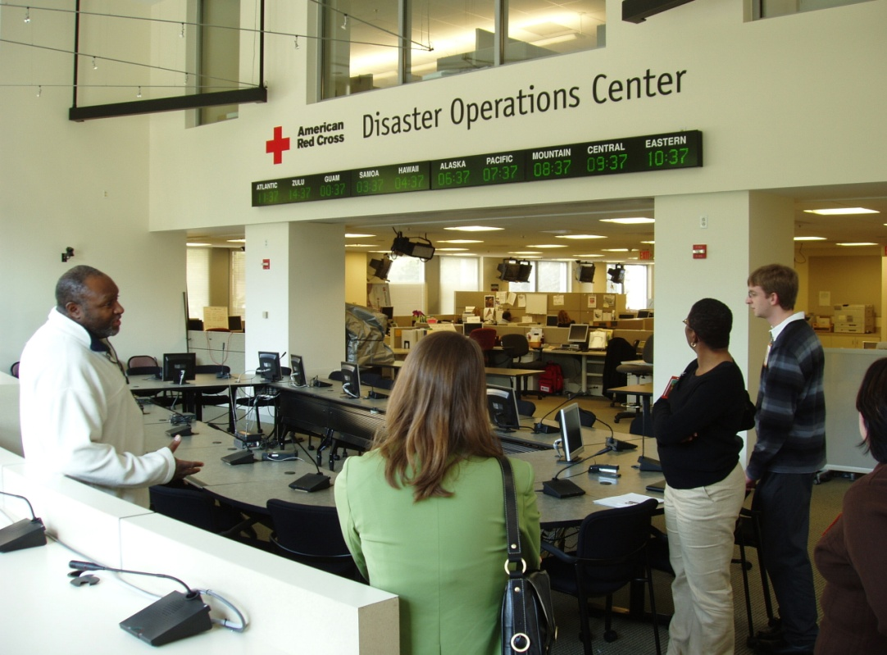
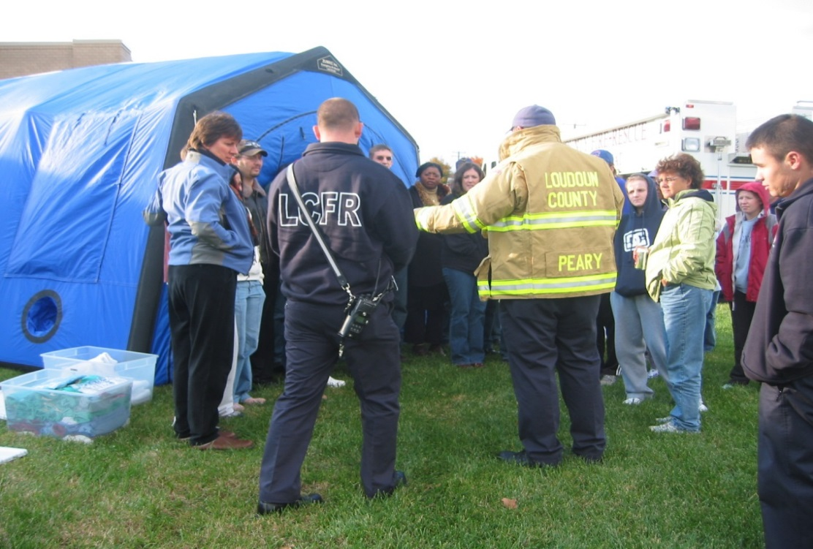
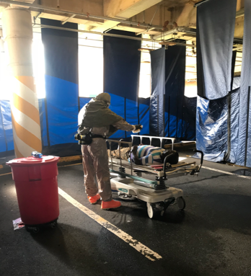
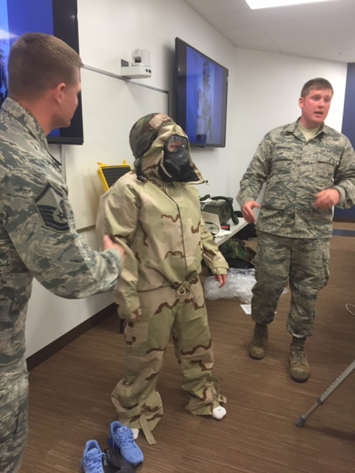
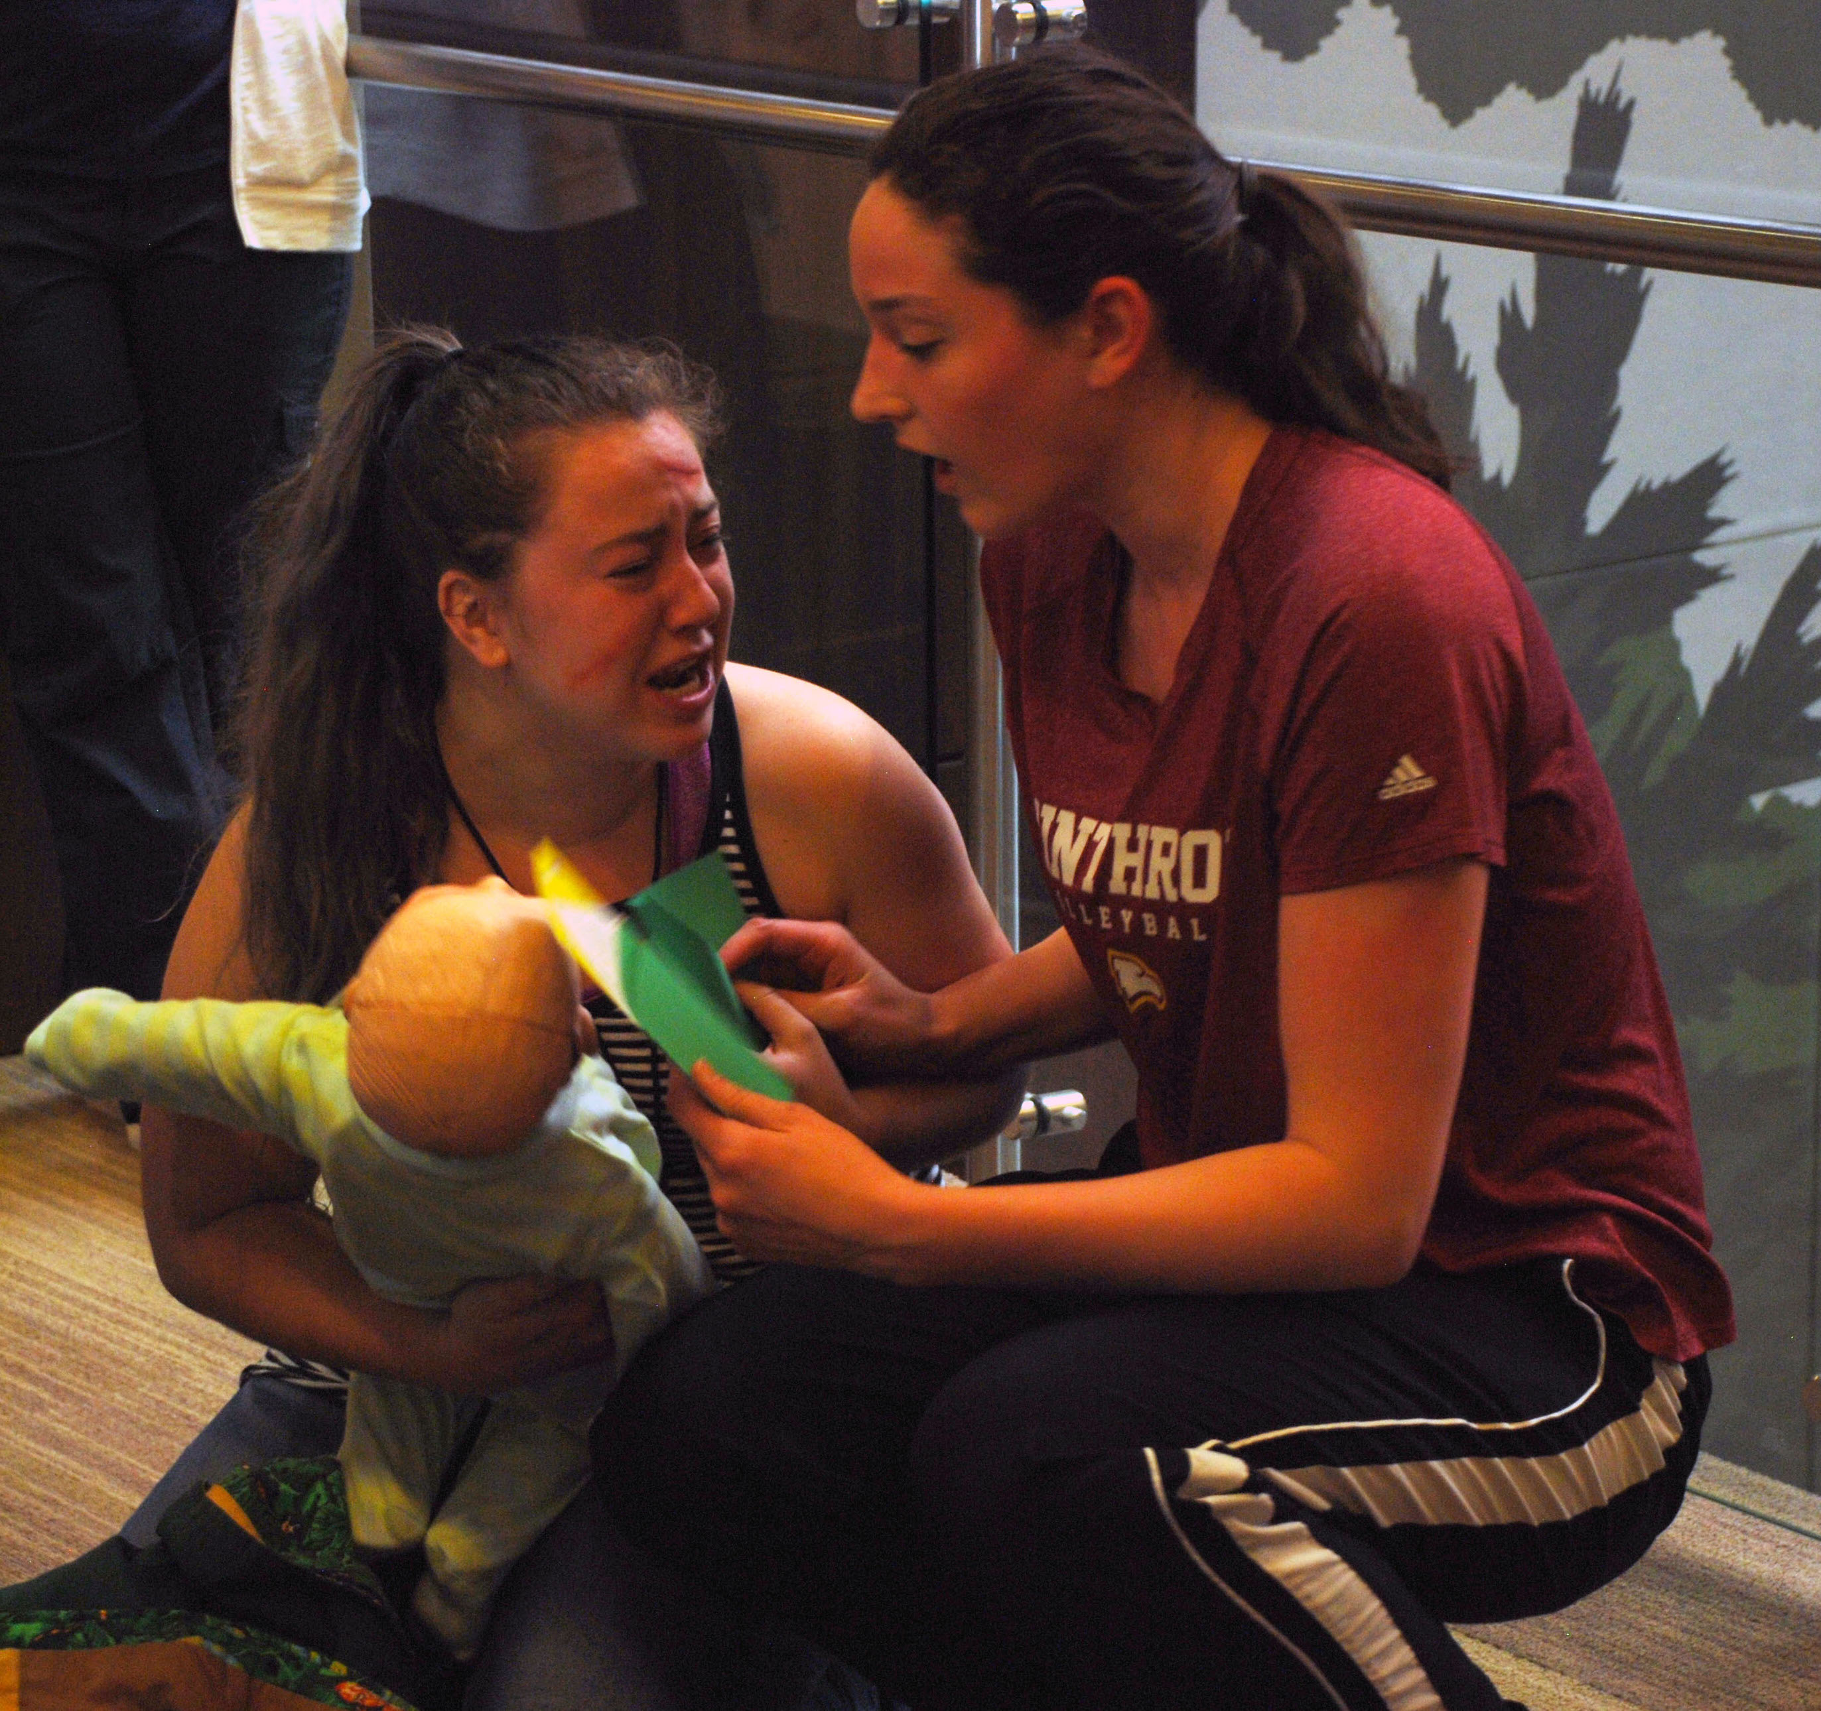
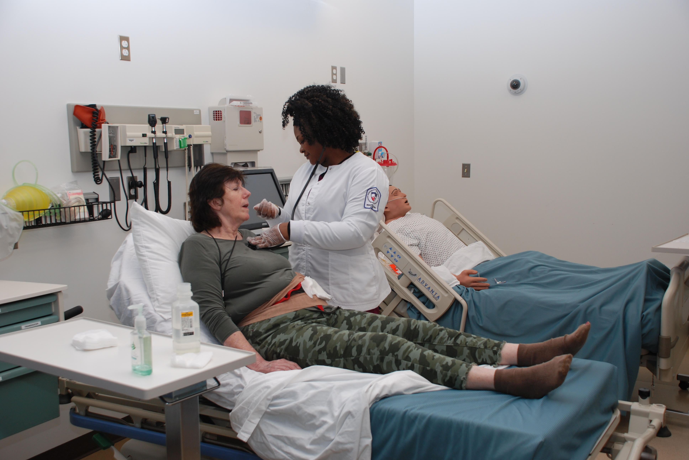
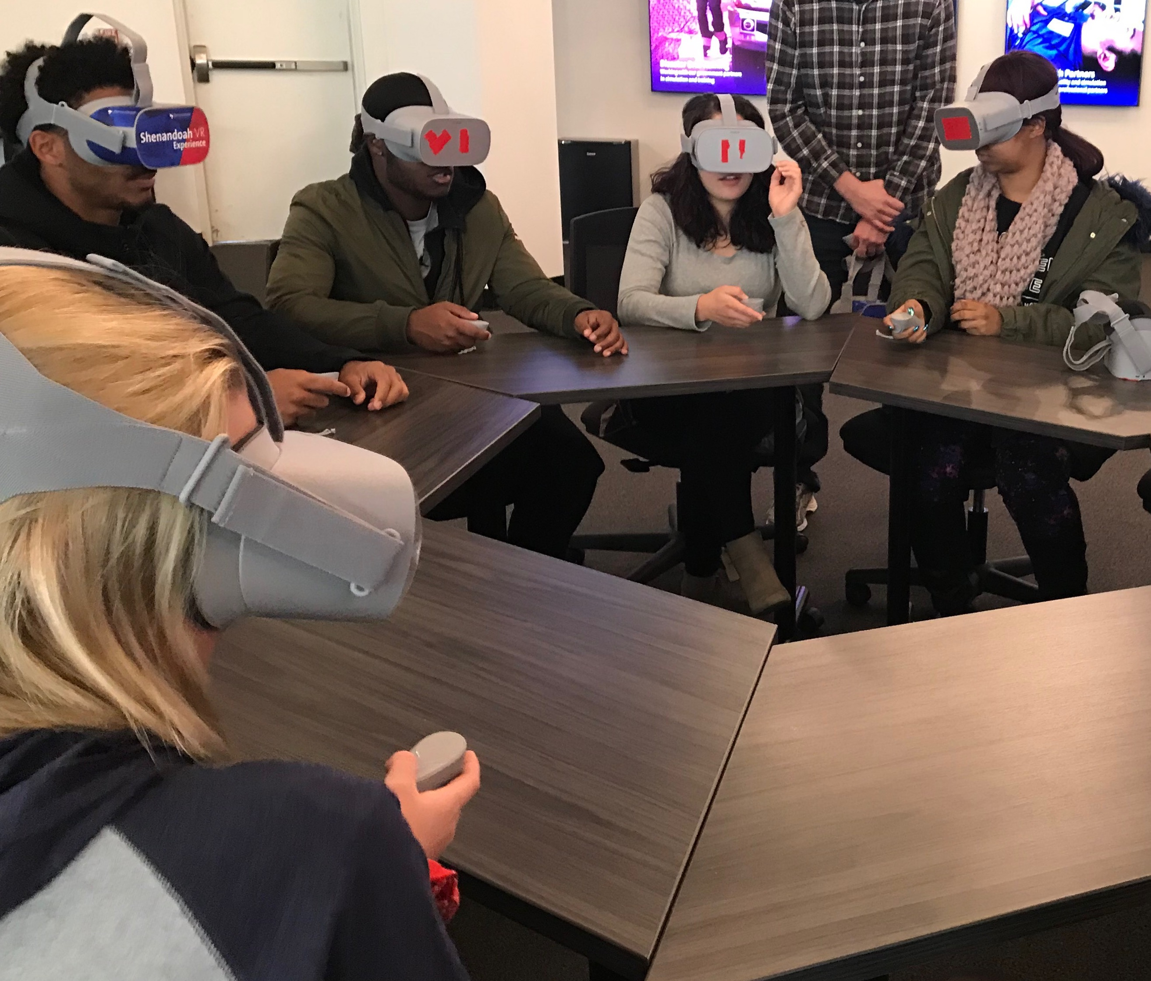
Disaster Operation Center - American Red Cross, National Headquarters, Washington, D.C.
Decontamination Exercise -
Loudoun County, VA
Hospital Decontamination Drill -
Fairfax County, VA
Guest Presenters - Air National Guard, Winchester, VA
360 Virtual Reality – Winchester, VA
Interprofessional Disaster Simulation – Winchester, VA

Slide 13
Program Outcomes - Undergraduate
American Nurses Association (ANA)
American Association of Colleges of Nursing (AACN) - Essentials of Baccalaureate Education for Professional Nursing Practice
Essential VII: Clinical Prevention and Population Health
Essential IX: Baccalaureate Generalist Nursing Practice
National Council of State Boards of Nursing (NCSBN)
2016 NCLEX-RN Detailed Test Plan
Safety and Infection Control

Slide 14
Program Outcomes - Graduate
American Nurses Association (ANA)
American Association of Colleges of Nursing (AACN) - Essentials of Master’s Education in Nursing (2011)
Essential III: Quality Improvement and Safety and Essential VIII: Clinical Prevention and Population Health for Improving Health
American Association of Colleges of Nursing (AACN) - Essentials of Doctoral Education for Advanced Nursing Practice (2006).
Essential VII: Clinical Prevention and Population Health for Improving the Nation’s Health
Family Nurse Practitioner Board Certification Examination
Section I-D: Clinical Prevention and Population Health for Improvement of Outcomes

Slide 15
A Call To Action
Nurses in all specialties are key players in all types of local, national, and global disaster responses.
Veenema, et al., 2016

Slide 16
References
American Association of Colleges of Nursing. (2008). Essentials of baccalaureate education for professional nursing practice. Retrieved from http://www.aacnnursing.org/Portals/42/Publications/BaccEssentials08.pdf
American Association of Colleges of Nursing. (2006). Essentials of doctoral education for advanced nursing practice. Retrieved from https://www.aacnnursing.org/Portals/42/Publications/DNPEssentials.pdf
American Association of Colleges of Nursing. (2011). Essentials of master’s education in nursing. Retrieved from https://www.aacnnursing.org/Portals/42/Publications/MastersEssentials11.pdf

Slide 17
References
American Nurses Association. (n.d.). Be competent: Education. Retrieved from https://www.nursingworld.org/practice-policy/work-environment/health-safety/disaster-preparedness/be-competent-education/
American Nurses Credentialing Center. (2016). Family nurse practitioner certification. Retrieved from https://www.nursingworld.org/~4acd24/globalassets/certification/certification-specialty-pages/resources/test-content-outlines/familynp-tco.pdf
National Council of State Boards of Nursing. (2016). 2016 NCLEX-RN detailed test plan. Retrieved from https://www.ncsbn.org/2016_RN_DetTestPlan_Educator.pdf

Slide 18
References
Smith, A. B. (2018). 2017 U.S. billion-dollar weather and climate disasters: A historic year in context. Retrieved from https://www.climate.gov/news-features/blogs/beyond-data/2017-us-billion-dollar-weather-and-climate-disasters-historic-year
Stanley, S., & Wolanski, T. (Eds.). (2015). Designing and integrating a disaster preparedness curriculum: Readying nurses for the worst. Indianapolis, IN: Sigma Theta Tau International.
Veenema, T. G. (Ed.). (2019). Disaster nursing and emergency preparedness for chemical biological, and radiological terrorism and other hazards (4th ed.). New York: Springer Publishing.
Veenema, T., Griffin, A., Gable, A., MacIntyre, L., Simons, N., Couig, M., …… Larson, E. (2016). Nurses as leaders in disaster preparedness and response: A call to action. Journal of Nursing Scholarship, 48(2), 187-200.

Slide 19
Contact
Kathleen Eid-Heberle, RN, MSN, NHDP-BC, CNE
Shenandoah University - Eleanor Wade Custer School of Nursing
(704) 578-9648
keidhebe@su.edu
Janice S. Smith, PhD, RN, CNE, ANEF
Shenandoah University - Eleanor Wade Custer School of Nursing
(540) 665-5504
jsmith9@su.edu

