Slide 1
July 23, 2020
Borrowing While Black: Understanding What Makes Student Debt a Crisis for Black Students
Dr. Tiffany Jones, Senior Director of Higher Education Policy, @tiffanyjonesPhD
Victoria Jackson, Senior Policy Analyst, @VWJackson00
Jaime Ramirez-Mendoza, Policy Analyst, @JaimeRamirezMe7
© Copyright 2020 The Education Trust @EdTrust /edtrust edtrust www.edtrust.org

Slide 2
Agenda
(Un)affordability at public colleges
Disproportionate impact on Black borrowers
Systemic injustices perpetuating the student debt crisis for Black students
Recommendations
Notes:
Gracias for that introduction Alice.
Before we begin, I'd like to go over our agenda for our presentation. First, we will go over why public colleges have become unaffordable for students and how that disproportionately impacts Black borrowers. We will then discuss systemic injustices perpetuating the student deb crisis for Black students, and end with state and federal recommendations to help alleviate the Black student debt crisis. (next slide)

Slide 3
(Un)affordability of College
Notes:
JRM:
So first up is the unaffordability of college (next slide)

Slide 4
Large Increases in Cost of Attendance
Public 4-years:
  Between 1989 and 2020, average tuition, fees, and room/board increased from $9,730 to $21,950
Public 2-years:
  Between 1999 and 2020, average tuition, fees, and room/board increased slightly from $10,300 to $12,720
  But tuition is only 20% of the cost for students staying off-campus
Notes:
JRM: *Numbers are in 2019 dollars
Over the last several decades, there have been large increases in costs to attend college
For example, at public 4-years, between 1989 and 2020, average tuition/fees/R+B has more than doubled, from $9,730 to nearly $22,000
This increase is also seen at the public 2 year sector, just at a smaller scale. Between 1999 and 2020, average tuition/fees/R+B increased from $10,300 to $12,720
However one must keep in mind that tuition is only 20% of the cost for students staying off-campus.
Often times at CC, tuition is not the main issue for students, it’s the non-tuition costs that they cannot afford, such as housing, books, child care, and transportation costs (next slide)
Tuition source: https://research.collegeboard.org/pdf/trends-college-pricing-2019-full-report.pdf

Slide 5
Polling Question #1: Pell Grant
Notes:
JRM:
Before we move on, we will have our first polling question. Alice can put that up please? (read below)
Poll question: In 1975, the Pell Grant covered 79% of the cost of college at a public university. How much did it cover in 2019-20?
A. 50%
B. 28%
C. 45%
D. 37%
We will give y'all about 20 seconds to respond, and then show the results.... couple more seconds for some last minute submissions... okay, Alice can you show the results? Hm. We got a mixed back of results (brief analysis). The correct answer is that in 2019-20, the max PG covered 28% of the cost of college at a public university. Next slide, please.

Slide 6
Financial Aid Not Keeping Up
Diminishing purchasing power in the Pell grant
  1975 it covered 79% of the cost of college at a public 4-year university compared to just 28% today
  Drop coincides with an increase in enrollment among students of color
Less aid going to students who need it the most
  From 2001–2017, public four-year universities spent nearly $32 billion on students who lack financial need
    About $2 out of every $5 these public universities provided went to non-needy students
Notes:
JRM:
As our polling questinos suggests, another reason college has become unaffordable is that FA is not keeping up with the increases in costs.
On example of that is the PG. And this extreme decline of its purchasing power coincided with an increase in enrollment among Black, Latinx, Asian, Pacific Islander, and Native american students.
And as this was happening, institutions were providing less need-based aid to students who needed it the most (next slide)
Pell Grant: https://ticas.org/wp-content/uploads/2018/07/Overall-Pell-one-pager.pdf
Less aid: https://www.newamerica.org/education-policy/reports/crisis-point-how-enrollment-management-and-merit-aid-arms-race-are-destroying-public-higher-education/

Slide 7
College Becomes Unaffordable for Students
Ed Trust affordability report found that for low-income students:
  Affordability gap = amount students owe after grants, scholarships, and earnings from working 10 hours per week
  At public 4-years:
    Students on average still owe slightly more than $6,500
    Needs to work 26 hours to pay gap
  At public 2-years:
    Students on average still owe slightly more than $2,600
    Needs to work 16 hours to pay gap
Notes:
JRM: *10 hr/wrrk at the state's minimum wage, low income students = first-time, full-time degree or certificate-seeking undergraduates who received Title IV aid and are from families earning $30,000 or less
The diminishing purchasing power of the PG + less need-based aid has put the burden of cost on students. This was seen in our ET affordability report that focused on low-income students.
The report used term affordability gap, which is...
Using the affordability gap, our analysis found that even after financial aid help + working, public colleges are still unaffordable for students.
At public 4-years, students still owed ….
This translates to students needing to work 26 hours to pay the difference
When you consider the fact that studies have found working more than 15 hours per week can slow student's progress towarda a college degree, these numbers become even more troubling (next slide)
ET Affordability Brief: https://s3-us-east-2.amazonaws.com/edtrustmain/wp-content/uploads/2014/09/18122721/How-Affordable-Are-Public-Colleges-in-Your-State-for-Students-from-Low-Income-Background-December-2019.pdf

Slide 8
…. Even More So for Black Students
58% of undergraduate Black students are recipients of Pell
Average net price comprised 40% or more of the median household income for Black families in 17 states
More likely to attend less selective, under-resourced institutions with less aid
Results in Black students borrowing more than any other race or ethnic group
Notes:
JRM:
Opener: Hopefully by now we have provided some solid factors as to why the cost of college has skyrocketed. But while college is becoming unaffordable for all students, this is especially true for Black students.
For example, the decline in the Pell Grant has disproportionate impact b/c nearly 6 out of 10 undergradute Black students are recipients.
When looking at average net price (published tuition and fees, room and board, and books and supplies minus the average aid received by a student)… total average net price compromised....
In addition, a disproportionate amount of Black students attend less selective community colleges & public 4 year institutions, who due to policy decisions, receive less funding, resulting in Black students having less access to resources necessary to complete their degree.
Last point/transition: all these factors contribute to Black students borrowing more than any other race/ethnic group. Unfortunately, borrowing more is just the tip of the iceburg of how student debt has become a crisis for Black students. To get a better sense of the impacts of borrowing while Black, I'll pass it on to my colleague Victoria Jackson.
Pell Grant source: https://nces.ed.gov/pubs2019/2019487.pdf
Net price –median income source: https://www.cbpp.org/research/state-budget-and-tax/state-higher-education-funding-cuts-have-pushed-costs-to-students

Slide 9
The Impact on Black Borrowers

Slide 10
Black Students Borrower More Than Any Other Racial/Ethnic Group
Borrowing among 2015-16 bachelor’s degree recipients
Borrowing among 2015-16 associate’s degree recipients
All degree recipients
  48% borrowed an average of $18,501
Black degree recipients
  67% borrowed an average of $22,303
All degree recipients
  69% borrowed an average of $29,669
Black degree recipients
  86% borrowed an average of $34,010

Slide 11
Polling Question #2: Paying down debt
Notes:
Polling question, True or false: A study found that after 12 years, Black borrowers were able to pay down a portion of their federal loans.

Slide 12
Black Students Owe More Than What They Borrowed
Median ratio of original balance still owed on federal loans 12 years after beginning college (cohort of 2003-4)
  Total: 80%
  Black men: 111%
  Black women: 113%
  White men: 56%
  White women: 72%

Slide 13
Black Borrowers Have the Highest Default Rate
Consequences of defaulting on loan
  Ruins credit
  Prevent them from getting an apartment or a job
  Collection of paychecks, tax refunds, or Social Security payments
Percent of borrowers who started college in 2003-4 and defaulted on a loan within 12 years
  Total: 28%
  Black women: 45%
  Black men: 55%
  White women: 20%
  White men: 21%
Black college graduates default at a higher rate than White drop outs with debt
75% Black students who leave a for-profit with no degree default on their loans

Slide 14
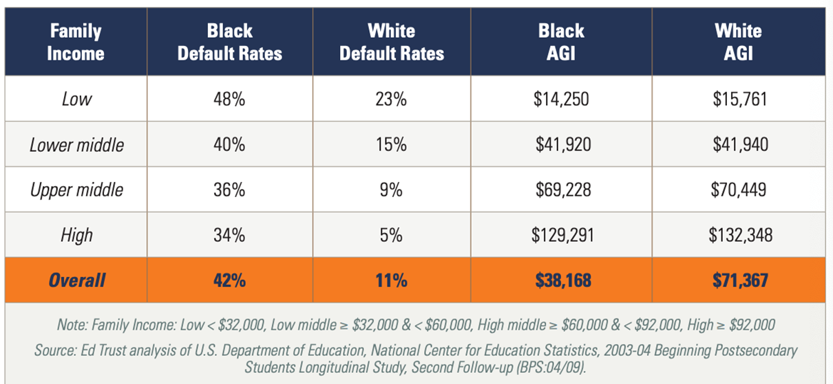
Twelve-Year Default Rates and Average Adjusted Gross Income (AGI) by Race/Ethnicity for Dependent Full-Time, First-Time Students at Four-Year Institutions
Notes:
This disparity in default rates for Black students is seen in every income bracket

Slide 15
Black women disproportionately impacted
Women hold nearly 2/3 of total student loan debt, with Black women finishing their undergraduate education with more debt than other group
Borrow more on average than any other racial/ethnic group + gender
Owe 13% more of what they borrowed (higher than any other race/ethnicity + gender)
Nearly 1 in every 2 default after 12 years, tied for highest among women across all race/ethnicities
Pay Gap: on average, Black women were paid 61% of what White men were paid in 2018.

Slide 16
"We have a crisis in which Black students are more likely to borrow, borrow more, owe more than their original loan amount, struggle with repayment, and have higher default rates even among those who earn a college degree and come from high-income families”

Slide 17
Why are Black student borrowers disproportionately affected?

Slide 18
Employment Discrimination
Black folks have higher unemployment rates, fewer good job opportunities, lower pay, poorer benefits, and less job stability.
Examples:
  Résumés with White-sounding names receive 50 percent more callbacks than those with Black names
  "last hired, first fired"
  Double Gap – caused by gender and racial discrimination – had Black women involuntarily forfeit as much as $50B in wages in 2017
Notes:
CAP Article on systemic obstacles Black folks face to get jobs: https://www.americanprogress.org/issues/economy/reports/2019/12/05/478150/african-americans-face-systematic-obstacles-getting-good-jobs/
continue to face systematically higher unemployment rates, fewer job opportunities, lower pay, poorer benefits, and greater job instability. These persistent differences reflect systematic barriers to quality jobs, such as outright discrimination against African American workers,1 as well as occupational segregation—whereby African American workers often end up in lower-paid jobs than whites2—and segmented labor markets in which Black workers are less likely than white workers to get hired into stable, well-paying job
Resume source: https://www.povertyactionlab.org/evaluation/discrimination-job-market-united-states
Double Gap source: How Gender and Racial Discrimination Lead to a Double Wage Gap for African American Women

Slide 19
Housing Discrimination
3 out of 4 neighborhoods that were “redlined”—an institutionalized system of discriminatory mort­gage lending toward Black people—on govern­ment maps continue to struggle economically.
  Important b/c homeownership is a key avenue to accumulate wealth.
This impacts not just Black borrowers but also Black communities.
  For example, majority-Black neighborhoods (de­termined by zip code) have higher student loan balances and default rates than majority-White neighborhoods. This translates into Black communities having fewer resources to invest in local businesses and schools.
Examples + impact:
  Still trouble getting loans approved
  Black homeownership rate hasn't changed much from the late 1960s
Notes:
Redlining source: https://www.washingtonpost.com/news/wonk/wp/2018/03/28/redlining-was-banned-50-years-ago-its-still-hurting-minorities-today/
Impact on Black communities: https://libertystreeteconomics.newyorkfed.org/2019/11/just-released-racial-disparities-in-student-loan-outcomes.html
Homeownership + wealth: https://www.urban.org/urban-wire/homeownership-still-financially-better-renting#:~:text=Homeownership%20has%20traditionally%20been%20an,has%20household%20wealth%20of%20%245%2C200.&text=Many%20families%20lost%20their%20homes,which%20had%20negative%20wealth%20effects. ; https://www.jchs.harvard.edu/sites/default/files/hbtl-06.pdf
Examples + Impact: https://www.washingtonpost.com/business/2020/06/04/economic-divide-black-households/

Slide 20
Polling Question #3: Wealth Gap
Notes:
Poll question, T/F question: White households with a high school diploma or less have more wealth than Black households with a bachelors degree or higher

Slide 21
Racial Income and Wealth Gap
Income: typical White HH has $61,200 vs $35,400 for Black HH
Wealth: typical white HH has nearly 10x the wealth than Black HH
  This is true even among those college degrees:
    White HH with a high school diploma or less still have more wealth than Black HH with a bachelor's degree or higher.
Notes:
Income source: https://www.federalreserve.gov/econres/notes/feds-notes/recent-trends-in-wealth-holding-by-race-and-ethnicity-evidence-from-the-survey-of-consumer-finances-20170927.htm
Wealth source: https://www.americanprogress.org/issues/race/reports/2019/08/07/473117/simulating-progressive-proposals-affect-racial-wealth-gap/

Slide 22
Inequitable Education Funding
K-12 system
  non-White school districts received $23 billion less than White school districts even though they served the same number of students
  Black students are concentrated at under-resourced K–12 schools that are less likely to have college-prep courses and have less qualified teachers who have lower expectations of them
Notes:
$23B Source: https://edbuild.org/content/23-billion
College prep + teacher source: https://uncf.org/pages/k-12-disparity-facts-and-stats
Higher Edu Source: https://www.americanprogress.org/issues/education-postsecondary/reports/2018/04/05/448761/gaps-college-spending-shortchange-students-color/

Slide 23
Inequitable Education Funding
Higher Education
  Policies & practices disproportionately send Black students to less selective colleges that have less resources.
  Impact: spending $1,000 less per student on Black and Latinx students than their White peers, amounting to ~ $5 billion less annually.

Slide 24
Polling Question #4: Black students at for-profits
Notes:
Poll question: Despite making up 13% of undergraduates at public institutions, Black students make up [blank] of the undergraduates at for profits.

Slide 25
Disproportionately Enrolled at For-Profits
Despite making up 13% of undergraduates at public institutions, Black students make up 29% of the undergraduate population at for-profit colleges OR Ten percent of black undergraduates attend for-profit institutions—more than twice the share of any other group enrolled in that sector
2015-16: half of doctoral students attended for-profits
For-profit enrollment leads and worse labor market outcomes.
  Third Way analysis found 51% of for-profit institutions leave majority of their students earning less than a high school graduate, even 10 years after they enrolled in the institution.
3 in 4 Black borrowers who attended a for-profits and did not complete their degree defaulted on their loans.
Notes:
Black students are more than 2x as likely to attend a for-profit college than a public college AND Black students are more than 2x the share of any other group enrolled in for-profits
FP Black population source, Pg. 32 https://research.collegeboard.org/pdf/trends-college-pricing-2019-full-report.pdf
FP Doctoral Black students: https://www.acenet.edu/News-Room/Pages/ACE-Unveils-New-Resource-on-the-Status-of-Race-and-Ethnicity-in-Higher-Education.aspx
Default rates: https://www.demos.org/research/debt-divide-racial-and-class-bias-behind-new-normal-student-borrowing
ROI on FP Degrees: https://www.thirdway.org/report/price-to-earnings-premium-a-new-way-of-measuring-return-on-investment-in-higher-ed?utm_source=Third+Way+Subscribers&utm_campaign=30db526372-EMAIL_CAMPAIGN_2019_04_15_02_26_COPY_01&utm_medium=email&utm_term=0_8952c391fb-30db526372-194286389

Slide 26
Federal Higher Education Policy
Failed protections against for-profits
  Repealing gainful employment rules, which protected students from programs that did not provide enough economic returns
  Vetoing borrower defense rules, making it harder for defrauded borrowers to cancel their debt
Pell grants have not kept up with the increasing cost of attendance
Income-driven repayment changes
Notes:
Pell Grants:
Gainful employment: https://www.insidehighered.com/quicktakes/2019/07/02/devos-issues-final-repeal-gainful-employment + https://ticas.org/wp-content/uploads/2019/08/what_to_know_about_GE_fact-sheet-1.pdf
Borrower defense ruling: https://www.studentloanborrowerassistance.org/part-1-departments-2019-rules-go-into-effect-today-putting-relief-out-of-reach-for-many-borrowers-taking-out-new-loans-after-july-1/

Slide 27
Black Student Debt Crisis
Inequitable K-12 + Higher Ed Funding
Racial Income + Wealth Gap
Failed Federal Policies
Overrepresentation at For-Profit Colleges
Housing Discrimination
Employment Discrimination

Slide 28
Where do we go from here?

Slide 29
Recommendations
Improve the Pell Grant
Equity-focused student debt cancellation
Improve income-driven repayment
What states can do
  Borrower bill of rights
  Pause payments
  Protections for private loans
  Protect borrowers from predatory colleges
  Close spending gaps
  Invest in need-based aid
Notes:
Pell Grant: At least 2x the Pell Grant, index it to inflation, grant access to justice-impacted students
Stu debt cancellation:
highest legislationwe’ve signed was for $30k
Race-and-wealth conscious student debt cancellation (I.e. rec #9 from Hard Truths?)
Close gaps in spending by race in K-12 and public higher education as a requirement for state-federal partnership
Invest in need-based aid

Slide 30
What do you think?
Notes:
Using the chat option:
Policy A: Federal government should at least double the Pell grant
Policy B: States closing spending gaps by race in K-12 and higher education
Policy C: Federal and state governments cancelling all student debt or targeted cancellation for student debt
Policy D: Changes to repayment options

Slide 31
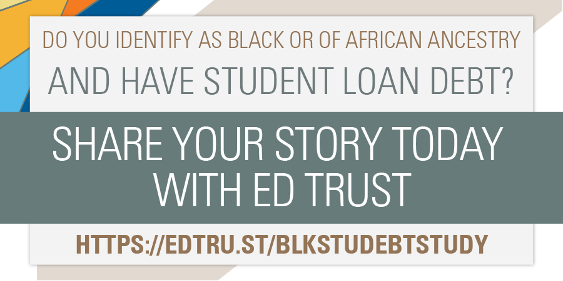
Ed Trust's National Study on Black Student Debt
https://www.youtube.com/watch?v=fn7AUW6P4KU

Slide 32
Q/A
Tiffany Jones
Senior Director of Higher Education Policy
TJones@edtrust.org //@TiffanyJonesPhD
Victoria Jackson
Senior Policy Analyst
Vjackson@edtrust.org //@VWJackson00
Jaime Ramirez-Mendoza
Policy Analyst
jramirezmendoza@edtrust.org // @JaimeRamirezMe7

Slide 33
Thank You!
Tiffany Jones
Senior Director of Higher Education Policy
TJones@edtrust.org //@TiffanyJonesPhD
Victoria Jackson
Senior Policy Analyst
Vjackson@edtrust.org // @VWJackson00
Jaime Ramirez-Mendoza
Policy Analyst
Jramirezmendoza@edtrust.org // @JaimeRamirezMe

