Slide 1
Lessons Learned About Principals and School Improvement
Gene Bottoms, Senior Vice President
Southern Regional Education Board
gene.bottoms@sreb.org

Slide 2
Great Principals
Do not engage teachers in achieving minimum goals | but instead, | Engage the entire faculty in achieving bold goals

Slide 3
Set Bold Goals for 21st-Century High Schools
90% or more of students entering grade nine ready for challenging high school studies
95% or more of students entering grade nine graduating from high school
80% of students leaving high school college ready, career ready or both
65% earning a credible credential or degree by age 25
Notes:
Only about 35 percent or less of students leave grade eight with literacy and math foundational skills to succeed in challenging academic classes in high school. In the future, we need to approach 90 percent of students entering grade nine ready for challenging high school studies, and 95 percent or more of these students entering grade nine graduating from high school.
It is not unrealistic to expect that 80 percent of students will leave high school college or career ready or both — 60 percent earning a credible credential or degree by age 25.
These are bold goals. There are rapid changes in the requirements and a mix of skills needed to obtain a middle-class job, and the percentage of individuals who need those skills is increasing much faster than we are acquainting students to these opportunities.
An example of a principal achieving bold goals is John Tucker. When Georgia eliminated its graduation test, John and his faculty required students to pass each of four end-of-course exams — math, science, social studies and English/language arts — at least at the developmental level. Last year, Camden County HS graduated 92 percent of its students; 88 percent of the African American students, 90 percent of the Hispanic students. They set this bold goal, but then provided support to help students meet the bold goals. In The Jacksonville Times newspaper on Monday’s Op-Ed page, you will see a brief scenario of this high school.

Slide 4
MMGW Bold Goals
MMGW helps middle grades schools ensure that students:
Enter ninth grade ready for college-preparatory academic courses and challenging career pathway courses.
Enter ninth grade with the literacy skills needed to read, analyze and comprehend texts in all subject areas.
Enter ninth grade having successfully completed Algebra I or ready for college-prep math.
Earn enough credit as first-time ninth-graders to enter 10th grade.
Notes:
When I think of a middle school principal that bought into bold goals, I am reminded of Minor Middle School in Jefferson County, Alabama.
A new principal, Taki Sarhaan, transformed a failing middle school in one year. Scores were poor, discipline infractions were the second highest in the district. The perception of teachers was that these students couldn’t learn. The school had high staff turnover.
In one year, the environment changed. Staff turnover rates diminished. Student discipline infractions reduced greatly, and student achievement scores have increased dramatically from 28 percent who met the benchmark in the fall of 2016 on reading to 58 percent in 2017; from 9 percent of the students benchmarked on math to 52 percent.
The principal committed to a schedule design that provides teachers in each discipline area one full day per month for departmental collaboration planning in each discipline area around rigorous assignments using literacy-based assignments on math powerful practices.
A team consisting of non load-bearing educators taught the classes. The Plus-day curriculum included:
Powerful standards for literacy and math
Students advisor curriculum
Academic and career counseling lessons provided directly by the school counselor
Opportunities for tours into schools, community colleges and other places
Extra help and support effort to help students catch up and master content standards
Great principals can lead a faculty in one year to turn a school around.

Slide 5
Great Principals
Do not prepare students for yesterday’s opportunities | but instead, | Create schools designed to prepare students for tomorrow’s opportunities
Notes:
What percent of today’s students leave high school without the foundational skills needed to earn a middle-class income?
I am reminded of the principal at POLYTECH High School in Delaware:
Lowest achieving school in 1992
Converted to a full-time technical high school
Serving students from similar socioeconomic backgrounds
Within five years became one of the highest achieving schools in the state
Summer program before ninth grade

Slide 6
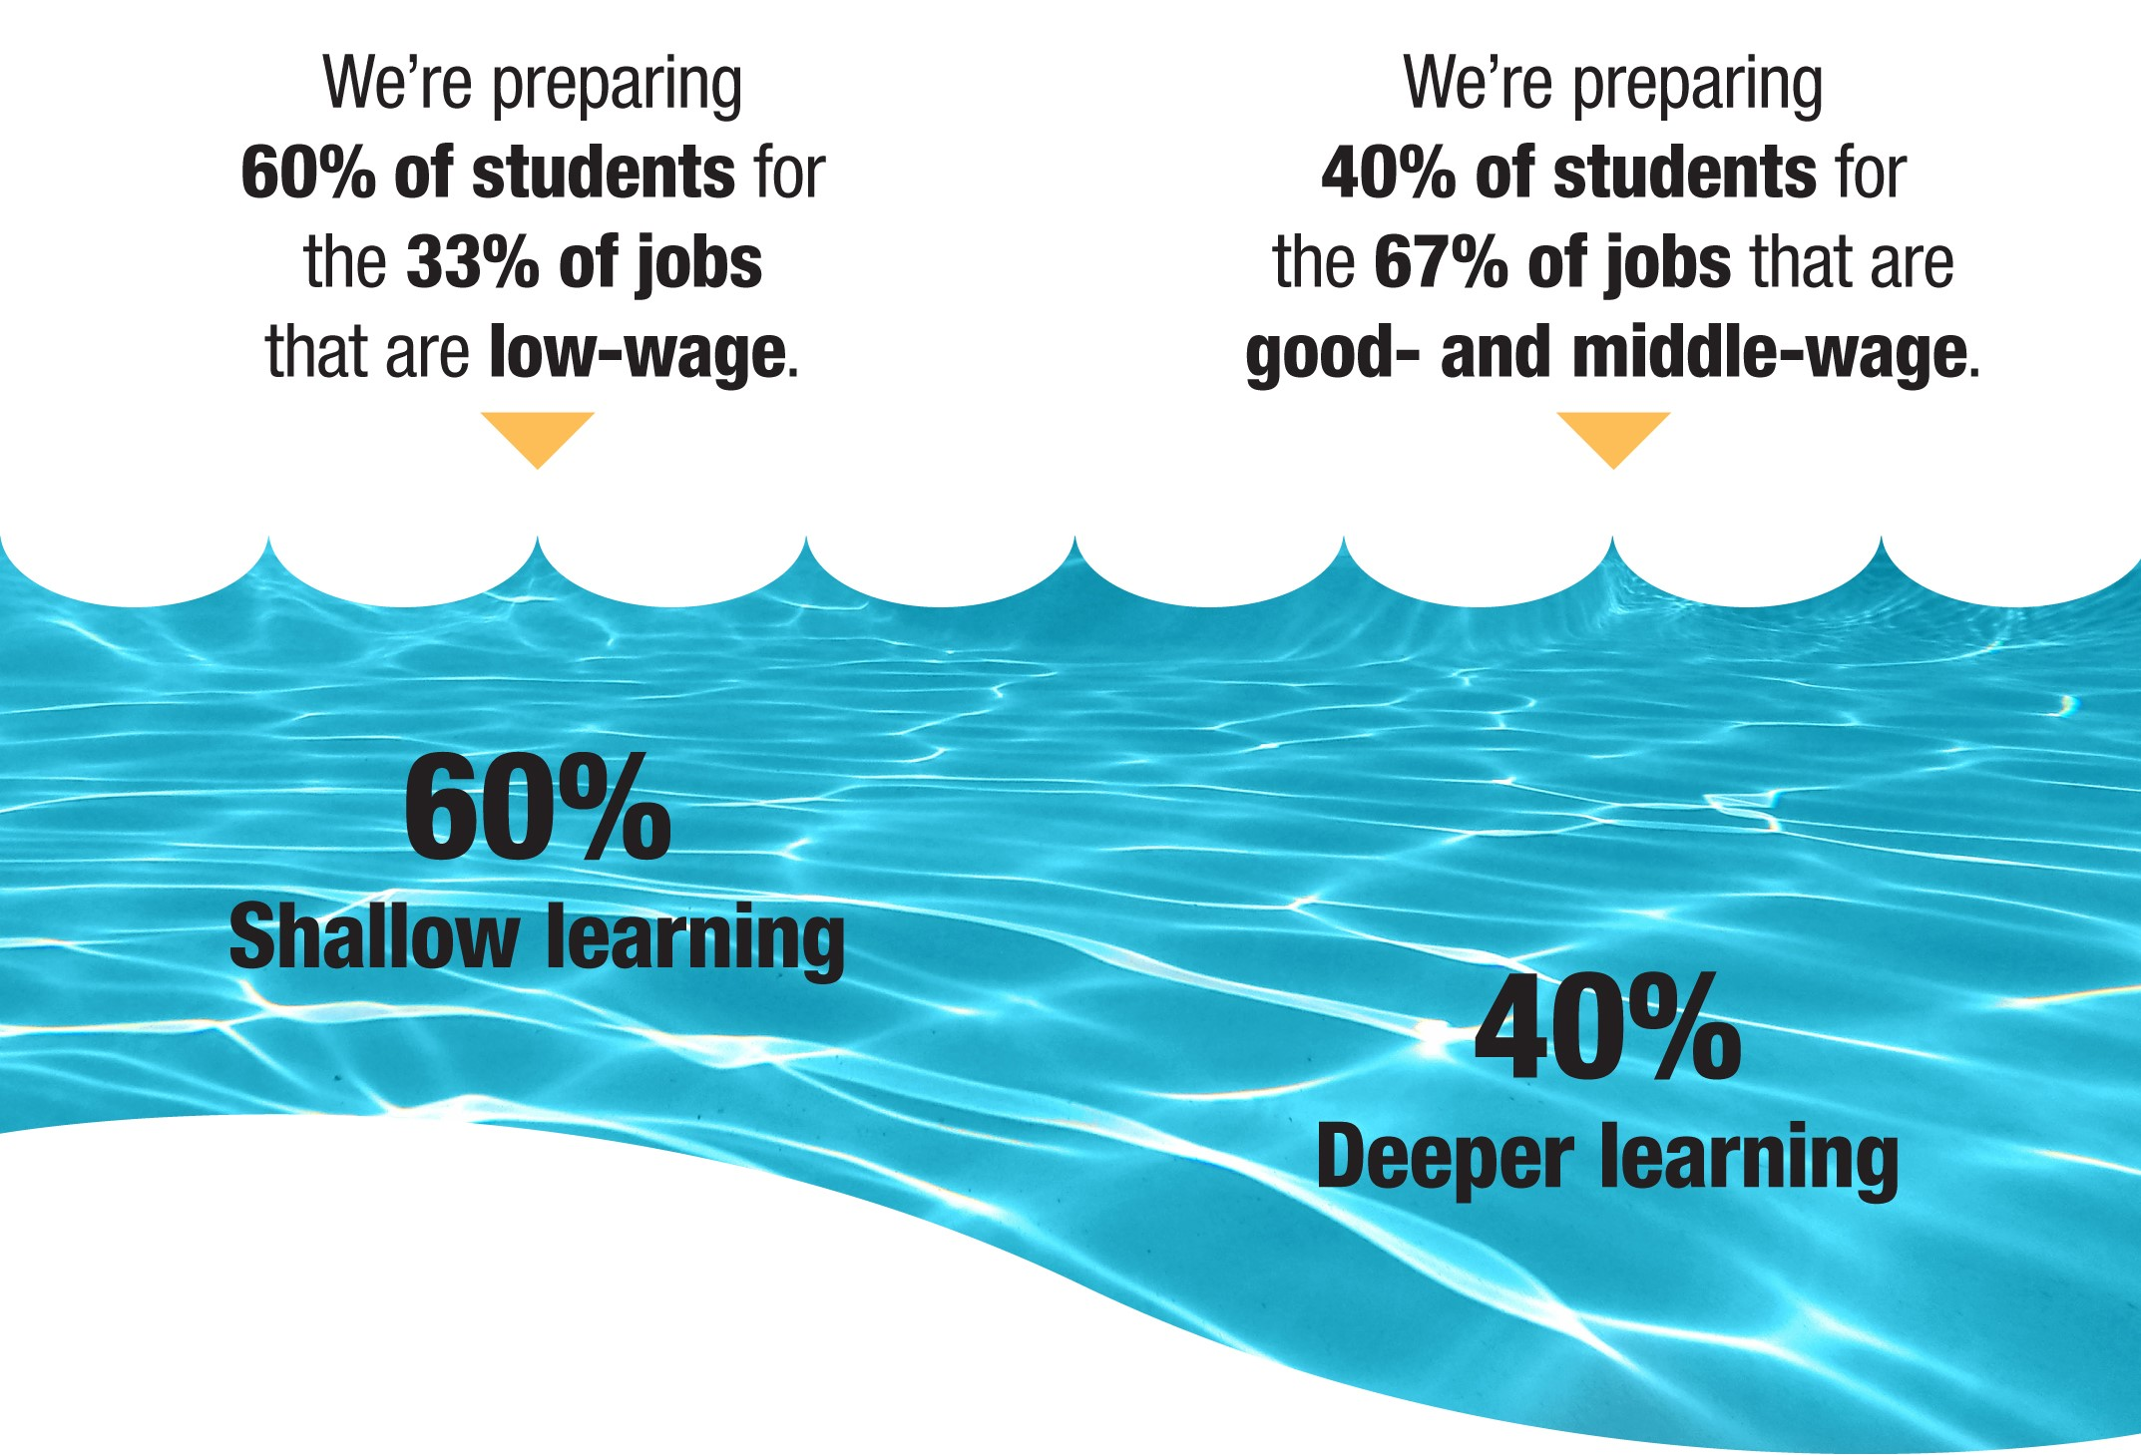
Why join a college-ready core with intellectually demanding career pathway courses?
2018 Leadership Forum 04-26-18
6
Notes:
In 1972, 72 percent of jobs were filled by high school and non-high school graduates. In 2016, 34 percent of jobs, were filled by high school graduates or less.
Sixty-six percent of jobs were filled by holders of bachelor’s and associate degrees or some college.
Many students have the aptitude for new career opportunities in the 21st century; however, they have neither the interest or understanding of their opportunities.
We have too many students stuck in the shallow end of the middle grades and high school curricula.
This results in an over supply of students competing for lower-level jobs, a rising youth unemployment rate - especially for minorities and individuals under 25 years of age.
Too few students enroll in career classes that give them assignments that require them to draw upon college-preparatory academic skills to complete.
6

Slide 7
Comparison of Earnings of Workers With Good Jobs and Those Without Good Jobs by Educational Level
 |  | Percent With Good Jobs | Medium Earnings With Good Jobs | Medium Earnings Without Good Jobs
1. | Less Than a HS Education | 14% | $50,000 | $20,000
2. | HS Graduate | 25 | $52,000 | $26,000
3. | Some College | 36 | $56,000 | $,31,000
4. | Associate Degree | 44 | $56,000 | $34,000
5. | B.A. + workers | 68 | $68,000 | $50,000
Source: Good Jobs That Pay Without a B.A.
Notes:
This slide is not too different from any one of the SREB’s 16 states. We are still preparing too many students for yesterday’s jobs. This is a profile of the educational level and the percent who have medium earnings with good jobs.
A good job is defined as having $35,000 as a minimum earning for those under age 45, and a minimum of $45,000 a year for age 45 and older.
Too many of our school leaders at the elementary, middle and high school levels are still thinking about the old economy.
Note: 44 percent of the persons who left high school without a diploma had a medium earning for a good job of $50,000. But the 86 percent had a medium earning of $20,000 — a big difference.
You might ask yourself: Who were these 14 percent? I suspect they were students who acquired the foundational skills, had a good work ethic, learned on the job and got bored with school.
Note: 25 percent of the high school graduates had a medium earning with good a job of $62,000, but for 75 percent of high school graduates have a $26,000 medium earning. If a student stops at the end of high school, the chance of getting a good job is about 25 out of 100.
Note: Students with some college, 36 percent had medium incomes of $56,000 per year. But the other 64 percent had a medium income of $31,000.
Those with an associate degree had 44 percent chance of having a medium earning of $56,000 per year compared with others of $34,000 for the other 56 percent.
You have already noticed that your chances for a good job goes up as your educational level goes up.
Plus, 68 percent — B. S. degree graduates had good jobs with $68,000 per year. But even minimum earnings without a good job is $50,000.
Great school leaders at each level of education are cognizant of the fact that for students to take advantage of the opportunities, they will need to be prepared at a much higher level.
I am reminded of an elementary principal in a high poverty school in North Alabama, Rhonda Reese. She set a goal to have students on grade level in reading at the end of grade three; worked to support her faculty; put in a very intensive instructional system that resulted in accomplishing the goal she set.
Great principals are driven and work with the faculty on a plan to accomplish the goal.

Slide 8
Great Principals
Work with faculty to teach ALL students as if they are their best students
The faculty shares a core set of values to provide accelerated learning experiences for ALL students.
Notes:
Great principals seem to share with their faculty a common mission to teach all students as if they were their best students.
It is interesting that when you talk to the principal from Minor Middle School, the principal from Camden County High School and the elementary principal from Alabama. They share a set of values to provide accelerated learning experiences for all students.
But in too many schools, 60 percent of students are stuck in the shallow end of the learning experiences in elementary, middle grades and high schools.

Slide 9
Great Principals
Do Not Lead Schools to: | Lead Schools to:
Organize schools by students perceived ability | Teach all students to grade-level standards and above
Provide some students with rigorous assignment | Provide all students rigorous assignments linked to interest, support, persistence
Design remedial curriculum for some students | Provide accelerated learning for ALL students
Notes:
Organizing students by ability often is a sort by socioeconomic class. Great principals who understand the potential of all students lead schools to teach all students to grade-level standards and above.
Last year I spent considerable time in one school district and a lot of time in different high schools. If students wanted to have rigorous assignments, they went into pre AP pathway or honors academic pathway. There are real differences in the descriptions of these courses and the course called college-preparatory courses.
Great principals understand that if you provide all students rigorous assignments, linked to interest, and with support and persistence you will get great results.
We are still in the habit of designing remedial, below grade-level learning experiences for some students. You cannot remediate students to grade level standards!
A minority magnet high school
TA visit — we said to principal who has two high schools in one — one for middle class students and one for the other students
Organize the second high school around relevant and rigorous career studies and connect to a college-ready academic core.
That principal and teachers went to the mountains for a retreat and came back with a plan to give all students rigorous assignments with support.
The school became a high-graduation and high-achieving school for all groups of students.

Slide 10
Great Principals
Do Not | Lead Teachers to
Make failure an option | Re-engage students in learning until standards are met
Focus on just covering content | Engage students in rigorous assignments involving connected learning
Notes:
Great principals work with lead teachers to create re-engagement assignments and lessons until students meet the learning standards.
Formative assessment lessons are great, but too often we fail to re-engage students who do not meet the standards with additional learning experiences. This involves finding time for teachers to re-engage students in new assignments.
That is the lesson that several school principals in Gwinnett County are pursuing — connecting rigorous academic assignments to rigorous assignments in their career pathway class.
In some ways, our test-oriented culture with pacing guides has reduced teaching to covering content.
Students learn from being engaged in rigorous assignments connected to what they previously learned to solve a multistep problem.
Addressing a single standard at a time does not work very well. Assignments with multiple standards help students see the connection to apply what they previously learned in order to complete this new assignment.
Great principals understand this concept of connected learning

Slide 11
What is
Advanced Career?
2018 Leadership Forum 04-26-18
11
Notes:
11

Slide 12
Advanced Career (AC) is:
Nine ready-to-implement curricula made up of four courses each.
AC curricula connect a rigorous academic core with challenging project-based assignments in a career pathway program of study.
AC does for career and technical education (CTE) what AP does for academics.
2018 Leadership Forum 04-26-18
12
Notes:
The AC curricula are a way to get students into the deep end of the swimming pool.
AC links high school academic studies to hands-on project-based learning in real-world assignments. It taps into students’ natural curiosity and helps them align their personal career and educational goals to emerging opportunities locally, statewide and nationally.
SREB and its partner states work closely with postsecondary experts, business and industry leaders to build relevant and challenging projects that bring students’ academic studies to life.
12

Slide 13
Great Principals
Do Not | Provide
Limit options to one pathway to college and career readiness | Optional pathways to meet readiness goal
Notes:
Great principals understand that there is more than one pathway to meeting college and career readiness. Some folks want to limit the pathway to only a traditional academic pathway.
A few years ago, we conducted a study in one of the SREB states. The state had set cut scores on the ACT needed to be college ready. The principals and superintendents were surprised when more than 40 percent of the students who enrolled at the end of the 11th grade met the state’s college- and career-readiness standards.
The lesson learned: If you couple the right academics together with rigorous assignments in pathway courses, you can create an optional pathway to advance credentials, an associate degree or to a bachelor’s degree, and these students are more likely to know why they are going to college and what major they are going to pursue.
Today, many great high school principals, like John Tucker in Camden County, are coupling rigorous CTE programs as an additional pathway to postsecondary studies.

Slide 14
What does an AC assignment look like
in the classroom?
2018 Leadership Forum 04-26-18
14
Notes:
14

Slide 15
Advanced Career: Aerospace Engineering — Bill Vivian, N. C.
What Master Teachers Say
“My biggest success is that other teachers come and ask me how I can get these students to do all these things, and they can’t get anything out of them. I would like to say that it is all me, but it is the program itself.”
“Aerospace is project-driven. Traditionally classes are book-fed in terms of starting with A and ending with Z. AC is blended, free-speaking, free-thinking and collaboration with team members.”
“AC shapes assignments around authentic projects. I have learned that when assignments are challenging and engaging, students will embrace the challenge and engage the content on a deeper level.”
2018 Leadership Forum 04-26-18
15
Notes:
15

Slide 16
Aerospace Engineering – Bill Vivian
Aerospace 2
Project Description - Basic Navigation
Math Involved: Geometry using law of sines and law of cosines, vector diagraming
Research: Finding points using coordinates, reading USGS topographical maps, identifying symbols and locations
Product Produced: Flight plan to multiple coordinates and dead reckoning home
Evaluate the Product: Students plan their course on paper, then utilize flight simulators to determine success.
Results: Teacher adds 10-15 knot winds to challenge the students; it’s all about bearings and knowing your surroundings.
2018 Leadership Forum 04-26-18
16
Notes:
16

Slide 17
Advanced Career: Innovations in Science and Technology — Travis James, Ark.
What Master Teachers Say
“AC changed me as a teacher. I was a biology teacher. I stood and lectured.”
“In AC, students learn how math and literacy are used in real-world situation and why they need it.”
“I had a student who couldn’t see himself going to college. Once we got into 3D Drawing, he found a niche for himself. Because of AC, that student is now working toward the CNC Tool and Dye Specialist Certificate.”
2018 Leadership Forum 04-26-18
17
Notes:
17

Slide 18
Advanced Career: Aerospace Engineering — Kimberly Cortines, W. V.
What Master Teachers Say
“AC is the first curriculum I’ve ever seen where all groups of students are engaged, and everyone appreciates each other and get technical skills and concepts that will help them in the future.”
“The AC curriculum deepens students’ understanding of math. They learn at deeper levels when they are engaged in hands-on assignments.”
“AC students learn how to use math in practical ways; consequently, they gain more appreciation for math and develop a drive to learn it.”
2018 Leadership Forum 04-26-18
18
Notes:
This slide reminds me of a great principal of a shared-time center in Randolph County, West Virginia, that recognized high-quality career studies provided a context for learning algebra. He employed a young lady to teach Algebra I and Algebra II to students at the center that had wanted to place them in general math.
Using the context of 15 different career labs, several students taught over 15 years went on to the University of West Virginia and only three had to take remedial math.
18

Slide 19
Advanced Career: Aerospace Engineering — Kimberly Cortines, W. V.
What Master Teachers Say
“AC students learn that failure is part of the learning process. Students learn from their mistakes. In the beginning, it’s difficult for AP students to accept failure. It was hard for AP students who didn’t build their rockets correctly. But in AC, they find that mistakes are an essential part of learning.”
“I didn’t think I could teach aerospace. I sat in a room of men who said they had all this engineering experience. I thought this is the wrong place for me, but I stayed and learned I could do it, and I loved it.”
“We are short-changing our students with this old, antiquated way of teaching where math, English and science are separate entities.”
2018 Leadership Forum 04-26-18
19
Notes:
Great principals understand the power of Connected Learning.
19

Slide 20
Advanced Career: Clean Energy Technology — Sara Smith, S. C.
What Master Teachers Say
“The curriculum pushes students to do more than they have done before. I have been surprised by their ability to stick with an assignment and do the work.”
“The project assignments motivate students and raise their expectations for the quality of their work. Students learn more through the productive struggle.”
“One student who finished the program is planning to become an environmental engineer in the renewable energy field. The assignments helped him realize that he could go to college, get a degree and get a job in this field.”
“I had an employee to come in and observe a solar panel presentation. He couldn’t believe high school students designed the solar panels themselves, and developed training protocols to train people in underdeveloped nations to make and use solar panels.”
2018 Leadership Forum 04-26-18
20
Notes:
Great principals provide experiences that enable students to learn about their talent and good job opportunities, and how these talents can be applied.
20

Slide 21
Advanced Career: Integrated Production Technologies — Toby Craver, Ark.
What Master Teachers Say
“In retrospect, I underestimated what these high school students could do when given meaningful assignments.”
“Other teachers have said AC students have come out of the ‘blind spot’ of the school and are on a different level. Expectations are higher, and students are thriving. They have become more interested in school.”
“Business leaders are blown away by the level of student work. Some have said that the 11th-grade projects students are doing reflect what they did as juniors in college.”
“The professors are in awe that high school students are giving better presentations than their college students.”
2018 Leadership Forum 04-26-18
21
Notes:
Great principals work with teachers to provide students with intellectually demanding and meaningful assignments that result in a productive struggle for students.
21

Slide 22
Great Principals
Do Not | Lead Teachers to
See literacy as belonging just to English/reading specialists | Ensure all teachers use literacy-based assignments to advance both content and literacy achievement
Notes:
Quote: Business Roundtable report.

Slide 23
The Importance of Instructional Leadership: The Role of the Principal
A 2017 survey of teachers participating in SREB’s literacy-based practices professional development revealed a significant positive relationship between principal involvement and the spread of literacy-based assignments across the school.
Notes:
Teachers in spread schools (schools where at least 80% of staff were actively using literacy-based practices across their curricula) were more likely to have experienced the following:
Frequent scheduled planning time to participate in professional learning communities
Classroom observation with feedback from principals
Conversations with principals on the implementation process
Principal attends professional development with teachers.

Slide 24
Great Principals
Do Not | Support Teachers to
Believe drill-sheet mathematics is sufficient | Engage students in reasoning, understanding and using math to solve complex problems
Just send teachers to workshops to learn how to make instructional shifts | Make desired instructional shifts and attend workshop with them
See Making Math Matter: High-Quality Assignments That Help Students Solve Problems and Own Their Learning, SREB, 2018.
Notes:
Great principals know that just teaching procedural skills in math will not be adequate to solve complex real-world and abstract problems. The students need to be engaged in reasoning, understanding and using math to solve problems. They know instructional shifts will not occur in the math classroom just by sending teachers to workshops. They attend workshops with teachers to support and encourage them in collaboration with other teachers.
Schools that made the great spread in adapting powerful math practices reported their principal:
Encouraged them to adopt the practices
Attended the professional development training with their teachers
Supported groups of math teachers to come together and share successful approaches to spread the math practices
According to teachers, principals are key in spreading powerful math practices to shift from procedural based mathematics to one that focuses much more on reasoning, understanding and use of math to solve complex abstract and real-world problems.

Slide 25
Great Principals
Do Not View | See Themselves
Themselves as just a manager | As instructional leaders of distributive teacher teams with accountability
Quality time for collaborative planning being essential | Providing time for teachers to do collaborative planning within and across curricula
Notes:
Great principals see themselves as an instructional leader of distributive teacher teams with accountability.
You will see this in some of the high schools that have organized their high schools around career-themed academies in which the assistant principal, an academic and career pathway teachers and a counselor become leadership team for that academy.
Teaching is a very isolated profession. Great principals see themselves providing time for teachers to do collaborative planning within and across curricula.

Slide 26
Summary
Any school is one principal away from becoming a high-performing or a low-performing school.
It is important for the principal to value and have knowledge of curriculum and instruction, to engage students in deep learning experiences and to work with faculty to create a high-performance school culture.
Notes:
Any school is one principal away from becoming a high-performing or a low-performing school.
East Tennessee story.

