Slide 1
Using Colored Candies and Google Spreadsheets to Teach Research Concepts
Mary Gaffney, EdD, MSN, RN
University of South Carolina Aiken
School of Nursing
Please prepare for this presentation!
POLLEV.COM/MARYGAFFNEY457
or
PollEverything App and enter user name: marygaffney457

Slide 2
Objectives
Describe the theoretical basis for the learning activity
Provide an overview of the activity
Discuss other research concepts which can be explored using this activity
Present results of statistical analysis
Discuss student-based and logistic barriers to the activity
Describe asynchronous use of the activity
Pollev.com/MARYGAFFNEY457

Slide 3
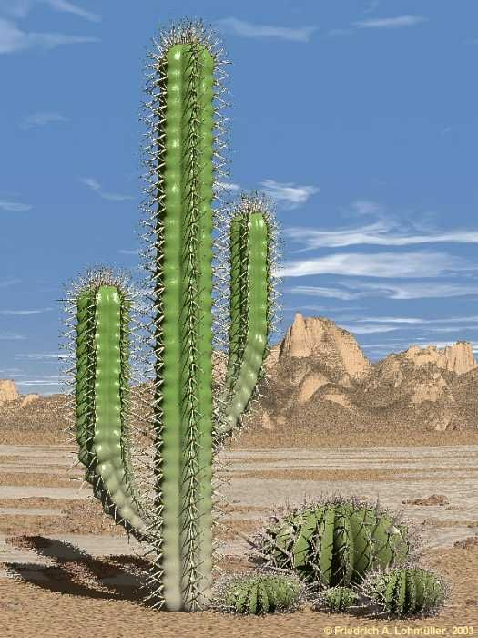
Active Learning in a Research Class?
Research concepts are dry!

Slide 4
Theoretical Basis
Adult Learners
Foundation
Readiness
Need to Know
Self-concept
Motivation
Orientation
Adult Learning Theory
Active learning
Intrinsic and extrinsic motivators
Notes:
Knowles lead the charge

Slide 5
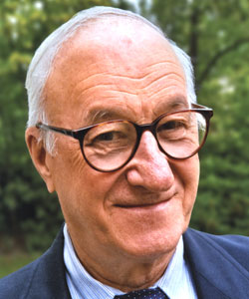
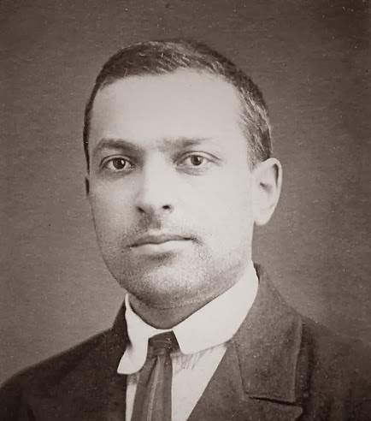
Theoretical Basis
Collaborative learning
Experiential Learning
Notes:
Bandura, Vygotsky, Kolb

Slide 6
Theoretical Basis
Lecture
5%
Reading
10%
Audio-Visual
20%
Demonstration
30%
Discussion Group
50%
Practice by Doing
75%
Teach Others/Immediate Use
90%
Learning styles v. retention/ working knowledge

Slide 7
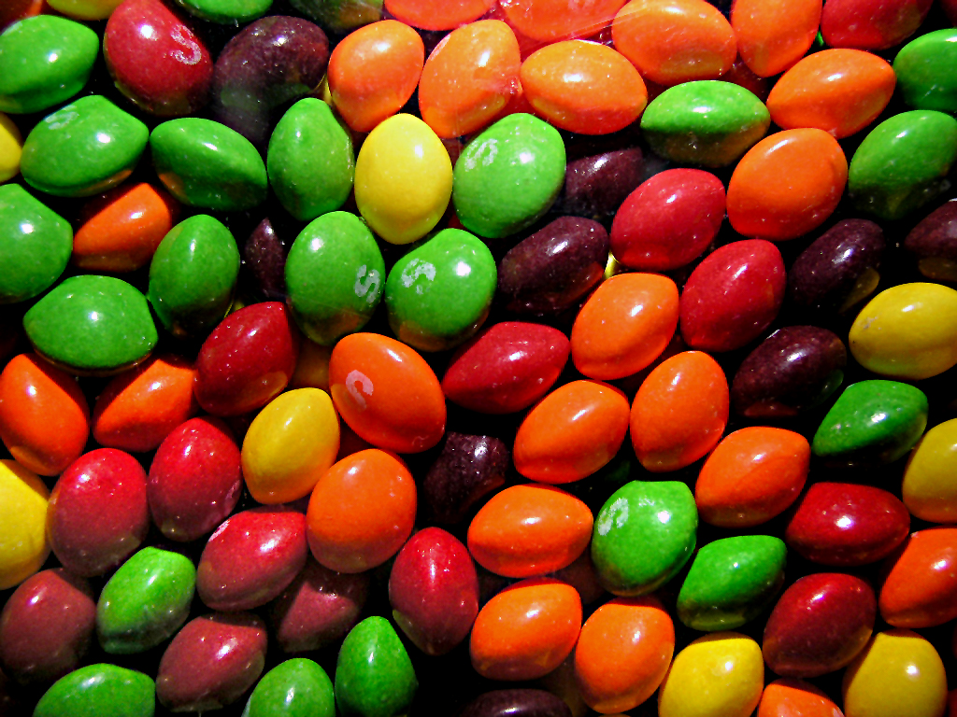
The Scenario
The Skittles company is suspected of packaging unequal quantities of the 5 colors in each bag.

Slide 8
The Activity
Supplies
Skittles or other colored candy (100 for each small container)
Aluminum pan or other workspace able to contain the candies
Smart phones for data entry

Slide 9
Activity Instructions
Divide into groups of 2
Obtain supplies and written instructions
Use smart phones to enter sampling data on Google spreadsheet

Slide 10
Activity Instructions

Slide 11
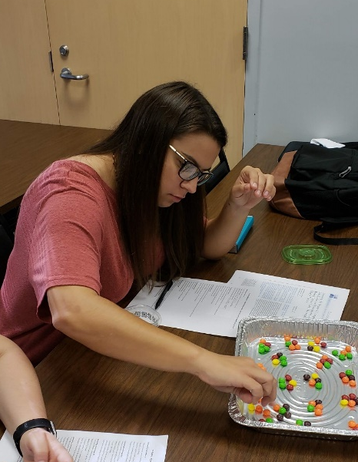
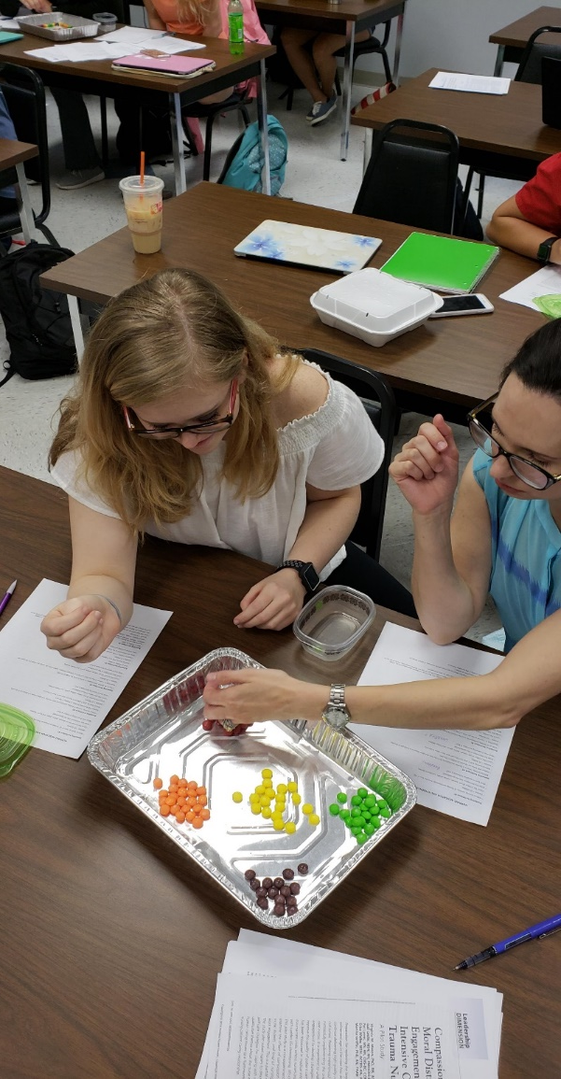
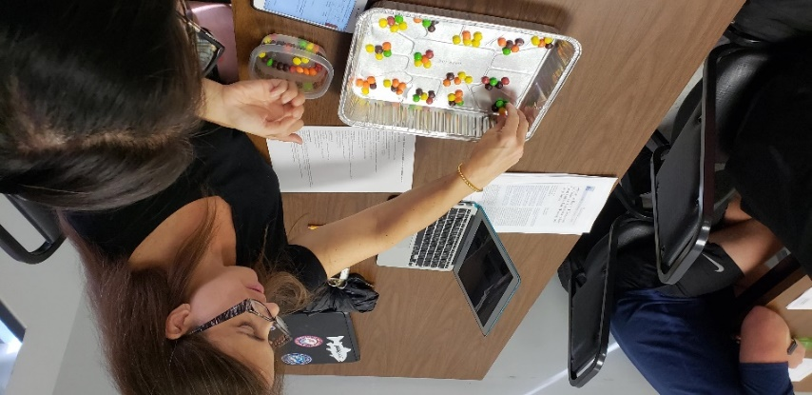
Sampling in Action
Stratified
Cluster

Slide 12
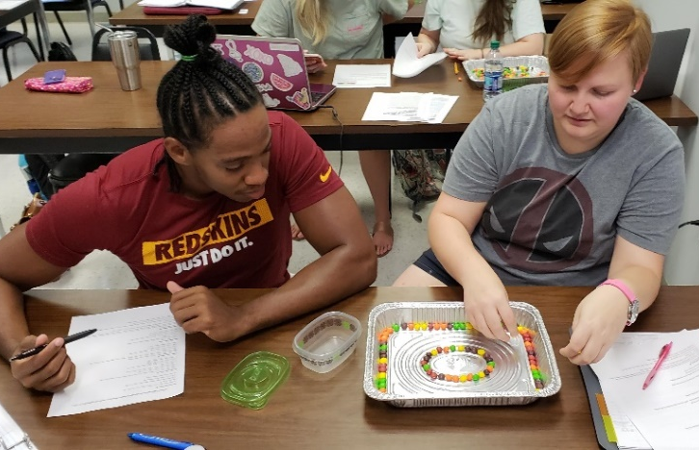
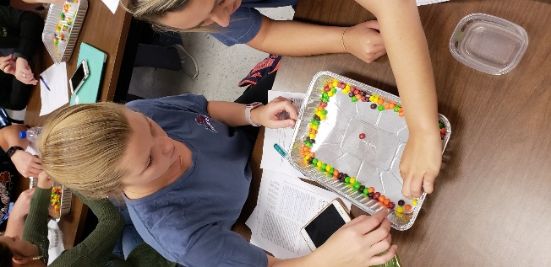
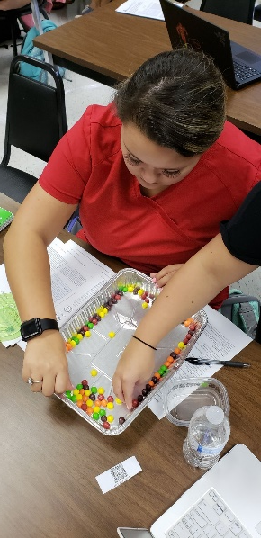
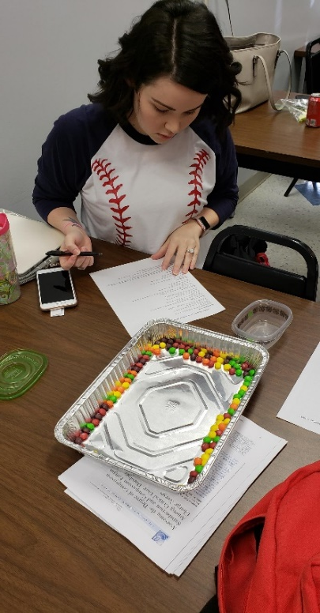
Sampling in Action
Systematic

Slide 13
Debriefing
Sampling techniques
Several others may be introduced or reinforced during this activity
Notes:
Additional research concepts explored
Representation of population
Sample size considerations
Reliability
Attrition
Bias
Ethical concerns

Slide 14
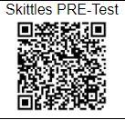
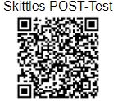
Assessment of Learning
Before-and-after testing with identical questions
Google Forms used to design and administer the test

Slide 15
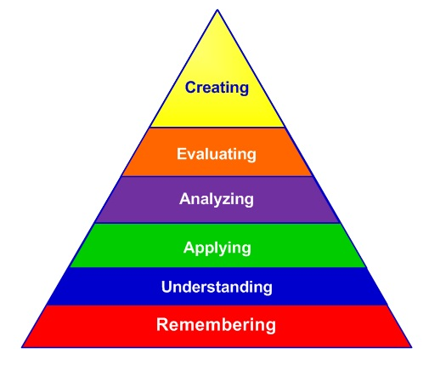
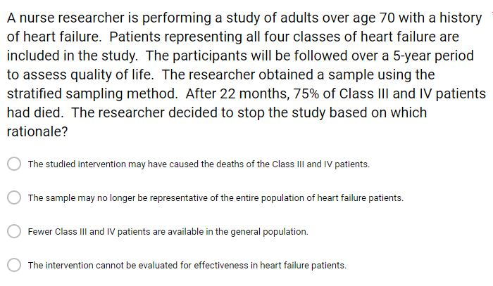
Assessment of Learning
Bloom’s Revised Taxonomy levels
Bloom & Anderson, 2001

Slide 16
Evaluation of Activity
All students taking this course for the 1st time (semester 3 of 5)
14% male/86% female
Ethnic Backgrounds
67% | Non-Hispanic White
23% | Non-Hispanic Black
7% | Hispanic
3% | Asian

Slide 17
Evaluation of Activity
Paired Wilcoxon Test Analysisª
 | Sample v. Population | Sample Types | Bias | Reliability | Attrition | Represent Population | Generaliz-ability | Total Test Score
Z | -2.498^{b} | -3.357^{b} | -2.858^{b} | -2.069^{b} | -2.586^{b} | -1.487^{b} | -2.417^{b} | -2.991^{b}
Asymp Sig* (2-tailed) | .012 | .001 | .004 | .039 | .010 | .137 | .016 | .003
N = 26 a. Wilcoxon Signed Ranks Test b. Based on negative ranks.

Slide 18
End-of-Semester Student Evaluation of Activity
Notes:
15% were neutral or disagree

Slide 19
Barriers to Sampling Activity
Student resistance to change from traditional pedagogy to flipped classroom
Variability in students’ preparation for class
Time (45 minutes)
Technology failures

Slide 20
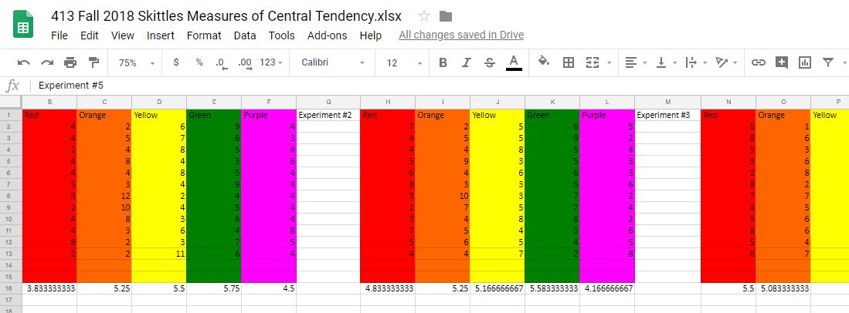
Asynchronous Version

Slide 21
Summary
Experiential, collaborative learning activities
Appeal to multiple learning styles
Serve as a springboard for linking multiple concepts related to a single topic
Improve students’ attitudes toward learning about research
Are effective in asynchronous environments

