Slide 1
Progress is Stalled: Instructional Shifts Needed and School Leaders Who Can Support Teachers to Make the Shifts
2017 SREB Annual Leadership Forum
Gene Bottoms
SREB Senior Vice President
gene.bottoms@sreb.org

Slide 2
Who’s Gained/Lost Ground in the New Economy?

Slide 3
Share of jobs by required education/training, 1973-2020

Slide 4
Who’s Lost Ground?
Men
Young adults
Less-educated adults
Notes:
High school graduates or less

Slide 5
Declining Opportunities for Young Men
Notes:
America’s Invisible crisis — Men Without Work, by Nicholas Eberstadt

Slide 6
Share With at Least Some Postsecondary Education, 1980-2010
Notes:
Women are better prepared to the new economy
Foundational literacy skills
More are pursuing postsecondary studies

Slide 7
What Can We Do?

Slide 8
The BS is not the only way.
30 million good middle-skill jobs
  AAs, certificate, certification, license, apprenticeship
FLIP THE MODEL
  Advanced credentials, certificates, associate degrees, apprenticeship
  For some, a BS degree follows an associate degree
Notes:
Have more students acquire advanced credentials or associate degrees with a career focus, then a job, rather than wander 10 years and winding up at community college at age 28/29.
Lost Decade
Describe three districts.

Slide 9
High school career pathways must be aligned with postsecondary and workforce opportunities.
The number of students choosing CTE career clusters has declined since 2007, especially in high-demand clusters.
There is a disconnect between career pathway enrollments and labor market opportunities.
There are disparities between high school CTE concentrations and postsecondary career clusters.
Notes:
Based on a study conducted by the National Center for Career and Technical Education at SREB, for the U. S. Department of Education in 2016, fewer CTE students than in 2007 are choosing to complete a concentration in a career cluster. This has been a general decline until 2014-15, at which time there was a large decline of CTE participation — a drop by more than 1 million students.
The trend lines for the eight career clusters identified as high-growth occupational areas all had a downward enrollment with the exception being health science, which experienced a slight upward trend. Some of the declines are more dramatic than others. Information Technology and Computer Science declined by 54 percent; manufacturing by 45 percent from 2008-2009. Other career clusters that declined included architecture and construction, business management and administration, and in the skills trades that represents a large portion of blue collar, middle-wage opportunities such as transportation.
Enrollment grew in career clusters having to do with STEM, finance, hospitality, arts, A/V technology and communications.
The take away: There is need to create pathways in demand fields such as manufacturing, IT, computer science and even business. The implication is: redesign career pathway programs more in line with the requirements and the expectations of 21st-century opportunities.
Take Away: There is a disconnect between the career pathway and high-demand, higher-paying fields, and is especially pronounced in computer science and information technology career clusters.
The disparities between the percentage of concentrators in secondary and postsecondary career clusters suggests a lack of joint planning between the two systems.

Slide 10
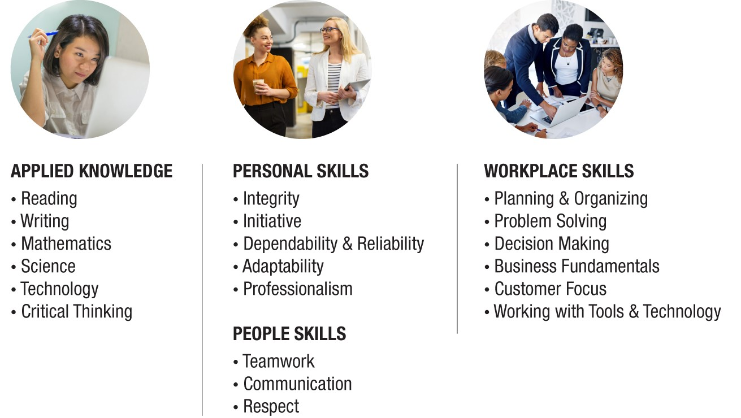
Skills Most Needed to Succeed
in a Changing Workforce
Notes:
Employers want these skills. The Business Roundtable convened a group of representatives from companies to discuss finding individuals with a mix of skills for the modern workplace.
They are looking for employees who exhibit personal skills — dependability, reliability, adaptability and professionalism skills.
They are looking for people skills — team work, communication, respect
Workplace skills — planning and organizing, problem solving, decision making, business fundamentals, customer focus, working with tools and technology (Most CTE program assignments fail to do this.)
Applied Knowledge — reading, writing, mathematics, science, technology and critical thinking.
The AC curricula, through the project-based assignments and assessments, focus on these four sets of skills — Personal, People, Workplace and Applied Knowledge.
Reshape assignments in all CTE classes.

Slide 11
Median Percentage of Eighth-Graders in SREB States Proficient and Above in Reading and Math
 | Reading | Math
SREB States | 30% | 27%
United States | 33 | 32
Source: NAEP Assessment 2015
Notes:
About 30 to 40 percent of students leave grade eight on a projector to meet postsecondary readiness standards on literacy and math.
To close the gap between work needs and current readiness level of high school graduates, we must begin in middle grades to accelerate students foundational skills in literacy and math.
Need school leaders who can lead an effort beyond the traditional test-prep model.

Slide 12
Median Percentage of Students in SREB States Meeting ACT College-Ready Benchmarks
 | SREB | U.S.
English | 58% | 64%
Reading | 41 | 46
Science | 32 | 38
Math | 36 | 42
Met all four | 22 | 28
Percentage of students taking ACT exams | 69 | 59
Source: ACT Assessment, 2015
Notes:
Too few students meet readiness standards for postsecondary studies — reading, math and science.
Based on 69 percent of students I SREB states who took the ACT exam, about 22 percent met college-readiness standards in 2015 in all four areas — 41% reading, 36% math, 32% science.
To close the workforce gap, efforts are needed to engage more students in assignments that align to states’ college- and career-readiness standards.
Applied to 100 percent of graduates, no more than 35 percent have the literacy skills and no more than 30 percent meet math readiness.
Need leaders who can lead the effort.

Slide 13
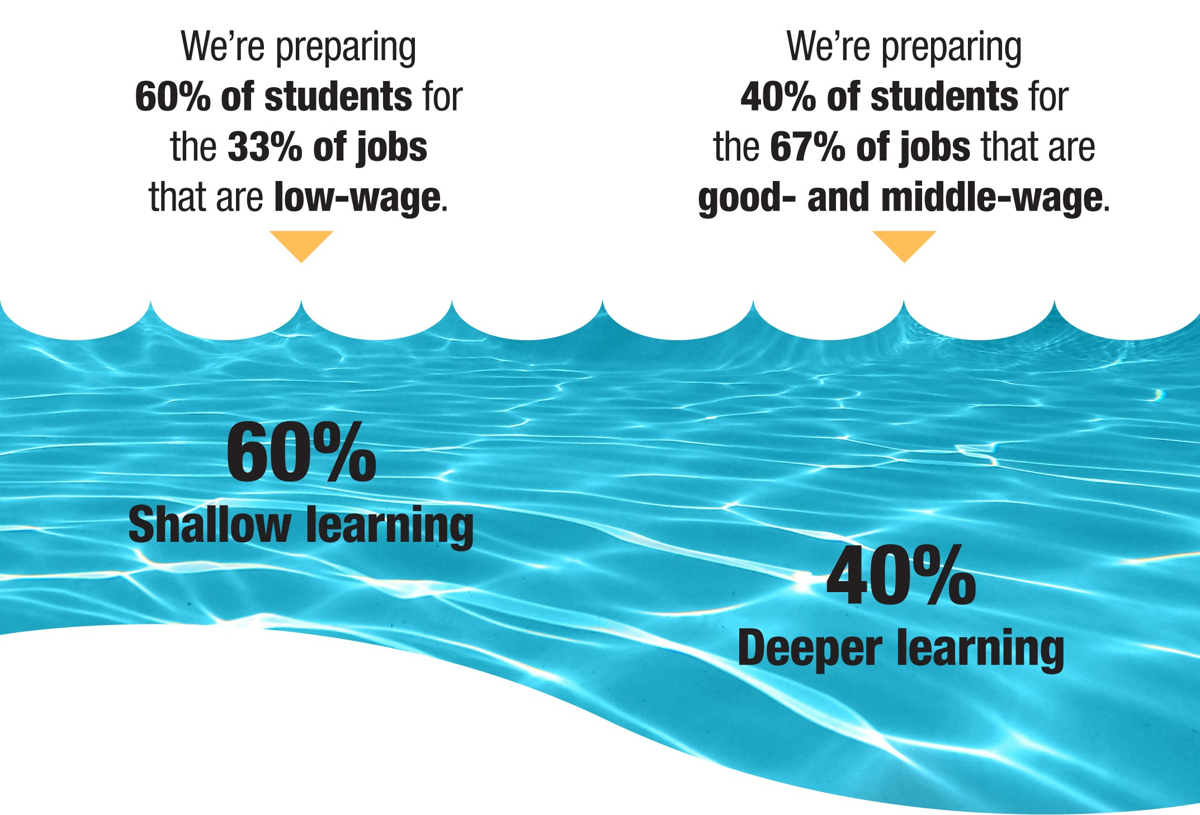
2017 SREB Leadership Forum 04-20-17
13
Notes:
What are the consequences of having too many students stuck in the shallow end of the middle and high school curriculum?
This results in an over supply of students competing for the lower-level jobs and a rising youth unemployment rate and an even higher minority unemployment rate for people under 25 years of age. It also means some persons with some postsecondary education are taking some of the lower-level jobs because they lack the special preparation for some of the middle- and high-wage jobs — such as computer science and related fields.
Why does this exist today? First, too many students are taking their academic core from courses labeled basic and general, which fail to engage students in levels of assignments that would prepare them with foundational literacy and math skills needed for postsecondary studies. Some students are stuck in career and technical pathways that are designed for yesterday’s jobs and some are not connected to postsecondary studies and to new opportunities in the workplace.
The most tracked curriculum in the American high school is English/language arts, yet literacy is foundational to postsecondary and career success. Too many students are stuck in low-level English, science and social studies classes that fail to engage them in reading grade-level texts and expressing their understanding orally and in writing.
Too few students enroll in career classes that give them assignments that require them to draw upon college-preparatory academic skills to complete. Further, too few students are enrolled in a structured career pathway program of study that lays out a map clearly connecting high schools, postsecondary and the work place.
The big take away: Sixty percent of American high school students are still stuck in shallow learning. Only about 40 percent of students are taught to college- and career-readiness standards in the core academic discipline areas.
Hold the swimming pool analysis — shallow learning vs. deep learning — as we look at additional data to make this case.
Leaders who can lad and support faculty in deeper learning.

Slide 14
What can school leaders do?
Make literacy a strategy for learning in all classes.
Achieve a balanced approach to math instruction.
Promote rigorous assignments in CTE classes.
Implement transition courses.

Slide 15
Literacy Goal
Increase students’ abilities to comprehend and analyze grade-level texts and related documents and express their understanding orally and in writing in all subject areas in all discipline areas.
Notes:
Deep learning is giving students assignments in middle grades and high school with support that enable them to read complex grade-level texts in each subject-matter area and related documents and express their understanding orally and in writing.
Too often reading achievement in American schools begins to decline after grades four and five because teachers are not prepared to engage students in literacy-based assignments as a way to advance literacy and content achievement.
Teachers are shocked when they do this. Not only does literacy achievement rise, but so does achievement in their teaching field. Translating informational text into written understandings deepens students’ understanding of the subject matter.
We emphasize reading grade-level texts. We have had this myth for 50 years that you can engage students in reading lower-level texts as a means to develop their ability to read grade-level texts. SREB PD is based on the assumption that students are only going to learn to read grade-level texts by reading grade-level texts.
That means teachers learning certain skills for accomplishing this goal.

Slide 16
Focus of SREB Literacy Professional Development Involves
Teachers using a planning process to:
  Develop major and smaller assignments in science, social studies, English/language arts, and career and technical education (CTE).
  Engage students in applying literacy standards (reading, writing, speaking) to master content standards in academic and CTE courses and to advance students’ literacy skills.
Notes:
The focus of SREB’s Literacy Professional Development is about:
Assisting teachers in using a planning framework to develop three or four major assignments in science, social studies, English/language arts and career and technical education (CTE).
Engaging students in successfully applying states’ college- and career-readiness literacy standards in reading, writing and speaking to master state content standards in academic and CTE courses.
The main concept for you to take away is that the quality of assignments students are given matters. Too many students in high schools and middle grades schools are bored. They are not challenged.
What would such assignments look like?
Need school leaders who can support teachers in shaping literacy-based assignments in all disciplines to add both literacy and discipline knowledge and skills.

Slide 17
Students’ Perceptions of
Literacy-Based Assignments
My teacher assigned me to: | SREB Trained Teachers | Non-SREB Trained Teachers
HS/CTE — create written papers that demonstrated my content knowledge — monthly | 47% | 17%
HS/SS — create written papers and cite evidence from multiple sources — monthly | 50 | 11
HS/SCI — complete a written assignment based on an experiment conducted — a few times a year | 74 | 47
MS/ELA — asked to compare and contrast information from different texts — often | 54 | 35
Source: SREB Surveys
Notes:
The four items illustrate students’ perceptions of the learning experiences they are having in classrooms where the teacher received PD from SREB on framing and facilitating literacy-based assignments. In classrooms in the same discipline, students in non-SREB trained teacher classrooms had different experiences than students in SREB trained classrooms. TAPE
Many students are still receiving “cover the materials” kind of instruction, PowerPoints, worksheets. They are not engaged in assignments that require them to dig deeply into grade-level texts, to express their understanding orally and in writing or to acquire the skills for doing this.
The take away:
This is the type of deep learning is needed to raise students’ literacy skills.
In the deep end of the pool!

Slide 18
Teachers’ Perceptions of Instructional Shift Using Literacy-Based Assignments with School Leadership Support
 | Supported Teachers | Non-Supported Teachers
Adopted strategies to engage students in reading grade-level texts and using writing to demonstrate understanding of content | 89% | 75%
Literacy-based assignments and students’ achievement on state assessments | 54 | 32
Source: SREB Teacher Survey
Notes:
We surveyed teachers and asked them if their principals had participated in the literacy training with them, had observed in their classrooms, had attended PD for principals.
Eighty-nine percent of teachers who felt they had been supported by their principals adopted strategies to engage students in how to read grade-level text and in using writing to demonstrate understanding of the content; compared to 75 percent of teachers who did not believe they have been supported by their principal.
Fifty-four percent of the supported teachers perceive that literacy-based assignments have raised student achievement on state assessments, compared to only 32 percent of the teachers who feel their principals have not been supportive of their efforts. — short time period.
The take away here is simply this. As we look at conditions for PD designed to address critical needs such as the gap in literacy and math, PD should not be provided to teachers unless their principals are supportive and participate in the effort. We cannot expect a teacher to make the kind of instructional shifts needed to provide students with deeper learning and to break beyond a test-prep mentality of instruction unless the principal understands what good teaching and learning looks like, encourages teachers to give quality assignments and supports them in doing so.

Slide 19
Blount County, AL
Gains were made in the percentage of eighth-grade students performing at Proficient level in four schools in Blount County.
Students were taught by teachers using LDC strategies during their eighth-grade year. Over one year, these schools saw significant improvements in student reading scores as measured by the ACT Aspire.
 | 2014-15 (Grade 7) Baseline | 2015-16 (Grade 8)
Appalachian School | 26% | 42%
JB Pennington High School | 20% | 44%
Locus Fork High School | 33% | 45%
Southeastern School | 27% | 42%
Notes:
The schools had engaged leaders
Rural district

Slide 20
Jefferson County, AL
Gains were made in the percentage of eighth-grade students performing at the proficient level at two schools in Jefferson County.
Students were exposed to trained LDC teachers during their eighth-grade year. Following one year of implementation, these schools saw significant improvements in student reading scores as measured by the ACT Aspire.
 | 2014-15 (Grade 7) Baseline | 2015-16 (Grade 8)
Clay-Chalkville Middle School | 21% | 39%
Corner Middle School | 44% | 64%
Notes:
Urban district

Slide 21
North Pike County, MS
Gains were made in the percentage of eighth-grade students meeting Proficient level at Pike County Middle School.
Students were exposed to teachers trained in LDC during their eighth-grade year. These schools saw significant improvements in student reading scores as measured by the ACT Aspire.
 | 2014-15 (Grade 7) Baseline | 2015-16 (Grade 8)
Clay-Chalkville Middle School | 21% | 39%
Corner Middle School | 44% | 64%
Notes:
Small — Black Belt in Alabama

Slide 22
Rankin County, MS
The following graph illustrates the scale score gains made across all high schools in Rankin County.
Following the 2015-2016 school year, the average ACT Reading scale score for the district increased +1.6 points across all eight high schools over the score in 2014-2015. The average state score did not increase.
Notes:
Suburb of Jackson

Slide 23
Rutherford County, NC
Rutherford County provided student growth data as measured by the Educational Value Added Assessment System (EVAAS). The table shows the percentage of teachers whose students were exposed to LDC strategies, on average, did not meet, met and exceeded growth expectations for the past three academic years.
Following implementation of the LDC, the percentage of students meeting expectations each year increased, and the percentage not meeting growth expectations declined each year.
 | 2013-14 | 2014-15 | 2015-16
Did Not Meet Expectations | 20% | 17% | 5%
Met Expectations | 47% | 57% | 67%
Exceeded Expectations | 33% | 26% | 29%
Notes:
2013-2014 was the baseline year. They were teachers who had experienced LDC professional development.

Slide 24
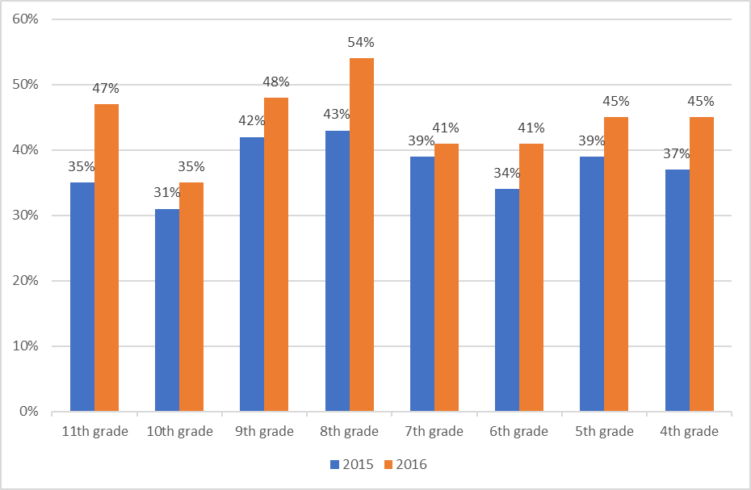
Wetzel County, WV
Achievement data collected from Wetzel County reflected student performance on the state-developed West Virginia General Summative Assessment for ELA. The graph illustrates gains in percentages of students performing at the Proficient level following implementation of the LDC strategies.
After implementing LDC during the 2015-2016 school year, districtwide ELA proficiency increased across all student cohorts.
Notes:
Districtwide approach — that has become for them a district strategy
At the 3:30 breakout session, George Johnson and Gail Dugges will describe in detail the LDC professional development.

Slide 25
Math Goal
Advance students’ mathematical fluency and their abilities to understand, reason and apply math concepts to solving multistep problems — abstract and applied.
Notes:
The goal is to work with math teachers in middle grades and high schools to advance mathematical fluency and to give greater emphasis to students’ abilities to understand, reason and apply math concepts to solve multi-step problems.
The objective during the first year is for each teacher to use six to eight Formative Assessment Lessons (FALs) that best align to their curriculum.
After teachers use about three FALs:
they are shocked with how little students understand about what they covered in class.
they recognize that students enjoy being engaged with math.
Students’ confidence goes up, and performance on end-of-grading period exams improves.
The teachers’ role shifts. Instead of giving students a series of steps to follow to solve problems followed by a worksheet assignment. Instead teachers formulate assignments with complex problems that engage students in working through the problems with teachers asking good questions until students gain sufficient insight to solve the problem on their own.
Understanding of mathematics comes from solving multi-step problems.

Slide 26
Emphasis on Math Practices
Give math assignments that require students to struggle with a problem.
Facilitate students’ conversations using mathematical vocabulary.
Ask students to justify and illustrate mathematics understandings.
Engage students in explaining strategies for solving problems.
Connect math to real-world applications.
Reteaching strategies and reassessing to close understanding gaps
Notes:
Professional Development for teachers focuses on these basic math practices.
The intent of the PD is to help teachers give math assignments that require students to problem solve, and give them time to struggle with problems. There is a place for practice. There is a place for procedural math. But the intent is to achieve balance between problem solving and procedural fluency.
The intent is to get students talking about mathematics, using math vocabulary and explaining their work in the context of the language of mathematics.
Teachers learn a variety of approaches to help students describe and justify their understanding of math including drawing picture, making graphs, creating tables, using appropriate math symbols.
Students present and explain how they solved the problem, their reasoning, their strategies for solving the problem, and they use correct math vocabulary.
Teachers look for problems in the real world that require students to draw upon the math concepts they have learned in the past to solve the problem.
Planning reteaching and reassessing to demonstrate meeting the math standards.

Slide 27
Teachers’ Perceptions of Instructional Shifts in Math Instruction Based on
School Leadership Support
Teachers report that: | Supported Teachers | Non-Supported Teachers
Using FALs enabled them to focus on students’ math understanding | 82% | 62%
Collecting information from FALs allow them to adjust their instruction | 68 | 35
Using math practices learned raised students’ achievement on state assessment | 68 | 47
Notes:
A significantly higher percentage of teachers reported making instructional shifts in their math instruction when the principal or assistant principal observed their classrooms at least three times a year and provided feedback.
Teachers reporting that using FALs has enabled them to focus more on building students’ math understanding — 82 percent who were supported by principals, 62 percent who were not.
Teachers reporting that information collected from FALs allows them to adjust their instruction to meet learning needs of students — 63 percent versus 35 percent.
Using math practices to learn through SREB’s PD raised students’ achievement on state assessments — 68 percent by those teachers who supported by the principal, 47 percent who were not.
The take away is: Teachers are more likely to take PD seriously if it addresses a genuine need, if their principals think it is important, and the principal visits classrooms to observe and provide feedback and support.
If we are serious about getting two-thirds of our students to have the foundational literacy and math skills necessary to meet college- and career-readiness standards, then we cannot do it with principals on the sidelines, who do not understand the shift in instruction that is required and how to frame assignments that result in much deeper learning and increased engagement and motivation of students to learn the material.
Many students are not engaged intellectually in school work, and they are bored.
Students perceive a different trained and non-trained math teacher.

Slide 28
Students’ Perceptions About Their Math Classroom Experiences in SREB- and
Non-SREB Trained Teachers
Students reported classroom experiences | SREB Trained | Non-SREB Trained
MS — often had to explain how I solved a math problem | 65% | 48%
MS — often had to justify reasoning for solving a math problem | 69 | 49
MS — often grouped with students who had similar math skills | 51 | 39
HS — often solved real-world math problems in Algebra I | 48 | 33
Notes:
You can see a comparison of students’ perceptions about their classroom experiences. Those who are in classrooms where teachers have been trained through SREB’s formative assessment lessons and the Non-SREB trained math teachers.
More students in the SREB trained math teachers’ classrooms often had to explain how I solved a math problem to either a teacher or another student.
Students in the trained math teachers classroom often had to justify reasoning for solving a math problem, not simply provide an answer.
Students in the trained math teachers’ classroom often was grouped with students who had similar math skills.
Students in trained math teachers’ classrooms often solved real-world math problems in Algebra I versus non-SREB trained classrooms.
Students’ perceptions of their experiences is certainly evidence that instructional shifts are occurring more frequently in the trained classroom than in the classrooms of teachers who have not received the PD around formative assessment lessons and math practices.

Slide 29
Gravel Hill Middle School
Orange County, NC
Average 10 percent gain in students meeting college-ready benchmark, first and second quarter of 2016-2017 school year compared to the first quarter and second quarter of the previous year.
Non-participating math teachers averaged a decline of one percentage point across both quarters.

Slide 30
Denman Junior High School
Home, Mississippi
Seventh-grade benchmark assessments show for the first and second quarters of 2016-2017 school year an average 15-point gain over the percentage of students meeting Proficiency benchmarks in 2015-2016.
On benchmark assessment for eighth grade, 8 percent more students in the first and second quarters of the 2016-2017 school year met the Proficiency benchmarks compared to 2015-2016 students’ performance.

Slide 31
Jacksonville Commons Middle School,
Jacksonville, NC
A math teacher implementing MDC had 9 percent more students to meet the Proficient benchmark on state assessments for 2015-2016 school year compared to other teachers who had not adopted the MDC mode of instruction.

Slide 32
Blount County, AL
The percentage of students scoring at the Proficient level or higher in seventh-grade math on the ACT Aspire grew by 12 percent compared to an average growth in the state of Alabama of 3 percent.

Slide 33
North Asheboro Middle School, NC
One teacher using MDC strategies whose classroom demographics comprised one-fourth majority students and three-fourths minority students had 100 percent pass the state end-of-course math exam at Level 4 or 5 (college ready).

Slide 34
Doss High School
Louisville, KY
Algebra II teachers implemented MDC formative assessment lessons and math practices. During the 2015-2016 school year, 12 percent of students in 2014-2015 scored at the Proficient and Distinguished level compared to 33 percent in the 2015-2016 school year.
Notes:
At the 3:30 breakout, Kenna Barger will explain indepth the MDC design.

Slide 35
Career Pathways:
Accelerating Access to the Middle Class
Connecting career pathways and college-ready academics have the power to move more students into the deeper end of the employment pool — and into the middle class.
Notes:
What role do middle grades and high school principals play in creating optional pathways that prepare students for postsecondary studies and careers?

Slide 36
Rigorous Assignments in Career Pathway Courses Require Students to:
Perform background research (e.g., read technical articles) to support planning.
Predict outcomes based on observations or information.
Develop logical arguments for a design or solution.
Draw inferences from information.
Complete extended projects that require developing a design, doing the work, testing out results, redoing, planning and presenting results orally and in writing.

Slide 37
Rigorous Assignments in Career Pathway Courses Require Students to: (cont’d)
Use math to solve problems related to assignments.
Apply academic skills to pathway assignments.
Apply technical skills to new situations.
Use software and technology related to a career area to complete assignments.
Work in collaborative teams to complete assignments.

Slide 38
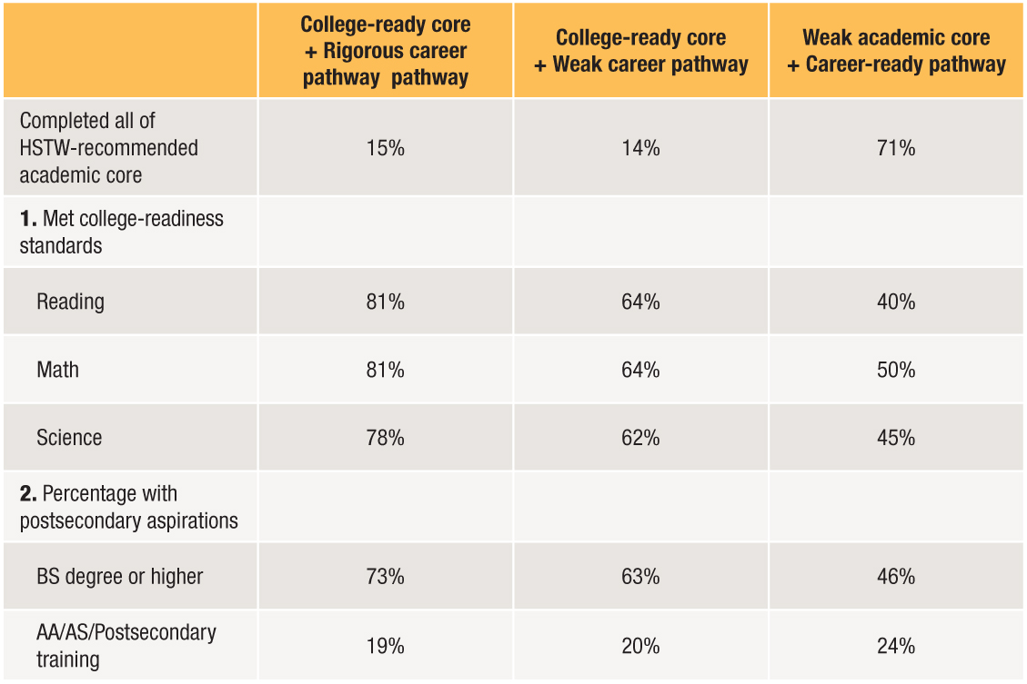

Career Pathway vs. College Readiness and College Aspirations
pathway
Notes:
For many years, HSTW has advocated that students complete a college- and career-ready curriculum pathway that includes four years of college-preparatory English, four years of math and three lab sciences from the college-preparatory strand.
How do college- and career-ready educational experiences impact students? Here’s what HSTW data tell us based on several thousand students assess in 2014. Data based on 24,000 students.
Column A: 15 percent of career-oriented students at HSTW schools completed all parts of the HSTW-recommended academic core, at last four courses in a career pathway and experienced rigorous assignments in their CTE courses. — Explain — 81 percent met reading and math college-readiness standards and 78 percent met science college-readiness standards with 92 percent planning to pursue postsecondary studies.
Column B: 14 percent of career-oriented students at HSTW schools completed the HSTW-recommended college-ready core, at least four courses in a career concentration, based on students surveys, their CTE assignments were not rigorous. Seventeen percent fewer students met college-readiness standards in reading, math and 16 percent in science than did students who had rigorous assignments in their CTE courses.
Column C: 71 percent of career students complete zero, one or only two parts of the college-ready core and 40 percent met college-ready reading; 50 percent math; and 45 percent science, with 46 percent planning to pursue a bachelor degree or higher and 46 percent planning to pursue AS/postsecondary training.
Take away: Completing a college-ready core with quality CTE studies can move many more students into the deeper end of the swimming pool to prepare for higher-wage jobs.

Slide 39
What is Advanced Career?
Advanced Career (AC) is nine ready-to-implement curricula made up of four courses each.
Courses focus on preparing students for college and careers by engaging them in applying academic, technical knowledge, technology and 21st-century skills to complete challenging work-related assignments.
Notes:
The AC curricula are a way to get students into the deep end of the swimming pool — ready for high-wage jobs.
AC transforms high school academic studies into a hands-on learning environment based on real-world opportunities. It taps into students’ natural curiosity and helps them align their personal career and educational goals for the academic standards and emerging opportunities both locally and nationally.
AC consists of specific educational pathways focused on different cutting edge business and industry topics. SREB and its partner states work closely with business and industry leaders to build relevant and challenging coursework that brings students’ academic studies to life.
AC curricula draw from high school’s academic core, employ a range of technologies and software focused on high-skill careers and use work-related projects to develop students problem-solving skills.
Students will leave AC studies with a foundation of critical skills that can be put to use immediately in their education or career. AC integrates with a college-ready academic core which provides an opportunity for literacy, math, science and AC teachers to enable students to connect college-ready content and skills to complete project assignments.
It will result in more students graduating from high school from the deep end of the swimming pool rather than the shallow end.

Slide 40
Why Adopt the Advanced Career Curricula?
Prepare students for a double purpose.
Model assignments that require students to apply a blend of academic, critical thinking, technical, technology and teamwork skills.
Introduce students to career opportunities (often unknown to them).
Create career pathway programs of study that blend a college-ready core with career studies.
Notes:
Today’s economy demands a better educated and more prepared workforce than ever before.
Too often, these candidates are hard to find. The pool of qualified talent isn’t deep enough to fill business and industry needs, and employers frequently have difficulty finding the right applicants. At the current rate, this will lead to several million workers shortfall in employees without some postsecondary education by the early 2020s.
Much of the nation will be left with a large number of individuals who are unprepared for the emerging opportunities.
The Advanced Career curriculum creates optional pathways that blend college-ready core with career studies in high-demand career fields.

Slide 41
Advanced Career Curricula
Aerospace Engineering
Automated Materials Joining Technologies
Clean Energy Technology
Energy and Power
Global Logistics & Supply Chain Management
Health Informatics
Informatics
Innovations in Science and Technology
Integrated Production Technologies
Oil and Gas — two courses

Slide 42

Ten AC Curricula
Ten AC Curricula • 38 courses • 194 projects
Notes:
34 courses developed in 9 career fields
192 projects completed with 125-150 pages of instructional materials for each
Average cost per four courses $800,000
34 course syllabi developed
34 end-of-course exams
Complete all courses by December, 2016
We will have two new courses hopefully coming on some time next year in Oil and Gas. We have worked with Texas on this course; and with Ohio on four courses in Automated Materials Joining Technologies. Ohio will cover the cost for these materials. We will be applying the process we have learned for developing them to complete the work.

Slide 43
Advanced Career Student Survey 2015
72% of AC students say that this AC course helped them in determining a career goal after high school.
88% of AC students find the AC course RIGOROUS.
80% of AC students like the blend of hands-on activities, academics and creative thinking in the AC class.
77% of AC students would recommend this course to a friend.
Over 70% of AC students report frequently using reading, writing and mathematics to complete assignments.
AC pathways draw a mainstream group of students
▼
Over 81% of AC students plan to take all four AC courses
Notes:
The courses are working. Seventy-two percent of students say the first course has helped them to begin to think about a career goal.
AC provides intellectually demanding assignments. Eighty-eight percent of students find AC courses rigorous. Hands-on learning is combined with intellectually demanding academic instruction that allows students to learn how to use new technology.
Eighty percent of students like the blend of hands-on activities, academics and creative thinking in the AC class. Seventy-seven percent of AC students would recommend this course to a friend.
We want AC career pathways to be viewed as an option for further study so students have a sense of purpose and goals in their lives. AC career pathways are drawing a mainstream group of students.
The intent is to have students learn how to work in teams and to acquire 21st-century skills. (Two-thirds of AC students report they work in teams on projects.)
Over 70 percent of AC students report using academic knowledge and skills to learn how to use new technology to complete assignments. More than 80 percent plan to take all four AC courses.
What can principals do to support the project-based learning SREB approach in high schools?

Slide 44
Redesign the Senior Year
Allow ready students to move on
Students ready for:
  Postsecondary studies
  Advanced credentials
  Work

Slide 45
Readiness Courses Prepare Students for College and Careers
Reduce number of students by 50 percent taking remedial or developmental courses.

Slide 46
When principals can lead/support the right instructional shifts, more students are college and career ready.
Literacy-based assignments
Balanced approach to math instruction
Rigorous assignments in career pathway courses
Time for teachers to plan within and across the curriculum
Career pathways connected to academic core, workplace learning and postsecondary studies
Strong counseling for careers and college
Adopt transition courses — middle grades to high school; high school to college

Slide 47
What implications do these instructional shifts have for initial and ongoing preparation of school and teacher leaders?
Notes:
Several sessions will address this question.

