Slide 1
Disaster Simulation: A Method to Educate and Evaluate Disaster Training for Undergraduate Nursing Students
Donna Guerra EdD, RN
Melissa Foster DNP, RN, IBCLC

Slide 2
Objectives
Understand the importance of exposing baccalaureate nursing student to mass casualty events in order to help students appreciate the concepts and care constraints inherent to disaster nursing.
Recognize the process of designing and executing a full-scale disaster simulation in baccalaureate nursing education.
3. Discuss simulation evaluation methods and the inherent challenges associated with evaluating student performance in a disaster event.

Slide 3
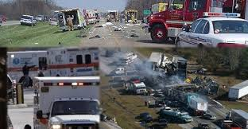
Disaster response… A different focus
Disaster response not common among nurses
Requires knowledge and application of Utilitarianism
Skills to manage situation to minimize mass casualty
(Busby & Witucki-Brown, 2011)

Slide 4
Evidence supporting inclusion of disaster response
Nurses comprise most of health care work force
Important nurses be prepared to respond to disasters using best practices- ideally undergraduate curriculum
Avoid negative impacts on patient care
Equip nurses to deal with personal feelings of decision-making required during disaster situations
(Alim, Kawabata, & Nakazawa, 2015; Busby, Witucki-Brown, 2011; Jose & Dufrene, 2014; Oztekin, Larson, Altun-Ugras, & Yuksel, 2014; Unver, et al., 2018)

Slide 5
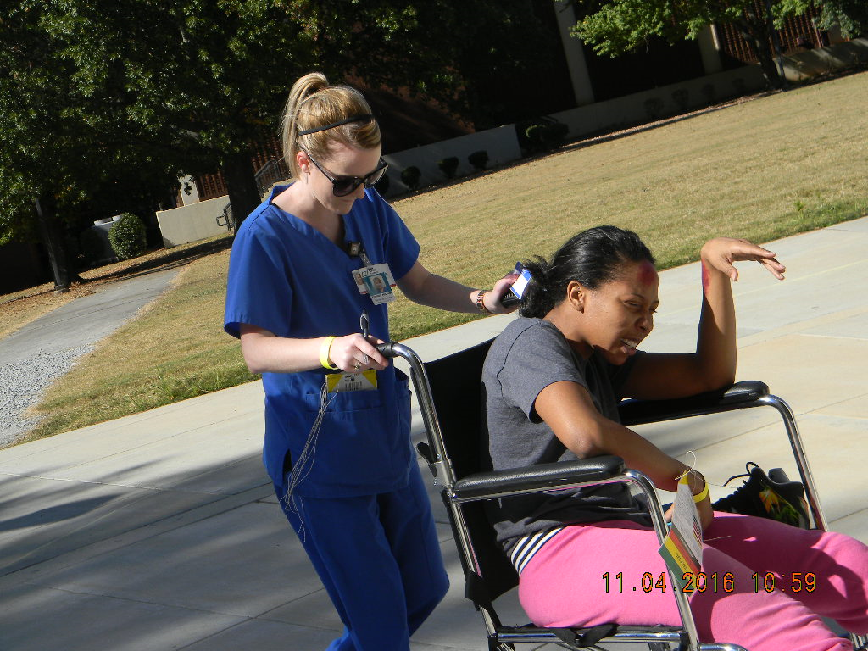
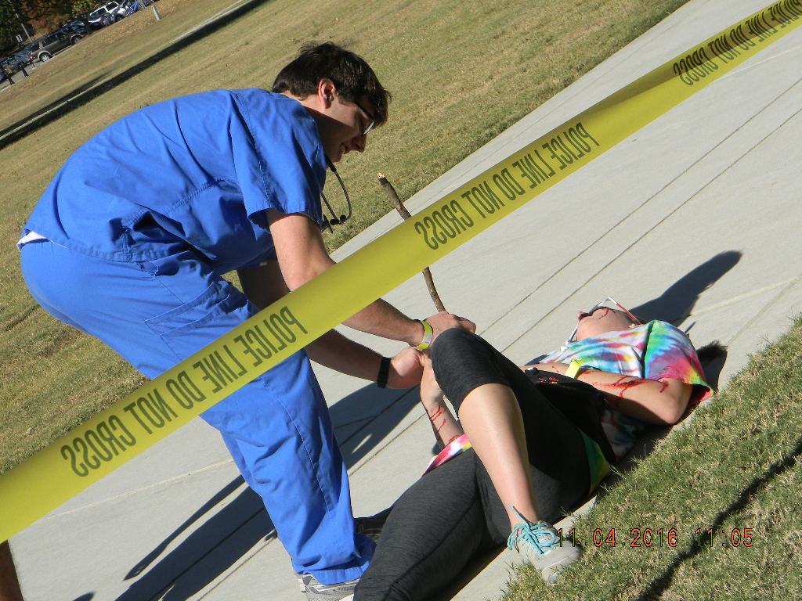
Our story
Annual event- 2006 to present
Full-scale disaster simulation (one day)
University support
Tabletop drill with Risk Management
University Police Department participation
CON support: administrative/financial
Faculty evaluators
Purchase of supplies
Professional grade moulage

Slide 6
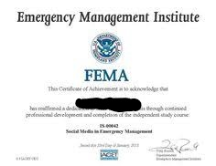
General student preparation
Prep begins on first day of class
FEMA online courses/certificates
Didactic instruction
Textbook readings
Students given survey to request management team or victim role in simulation

Slide 7
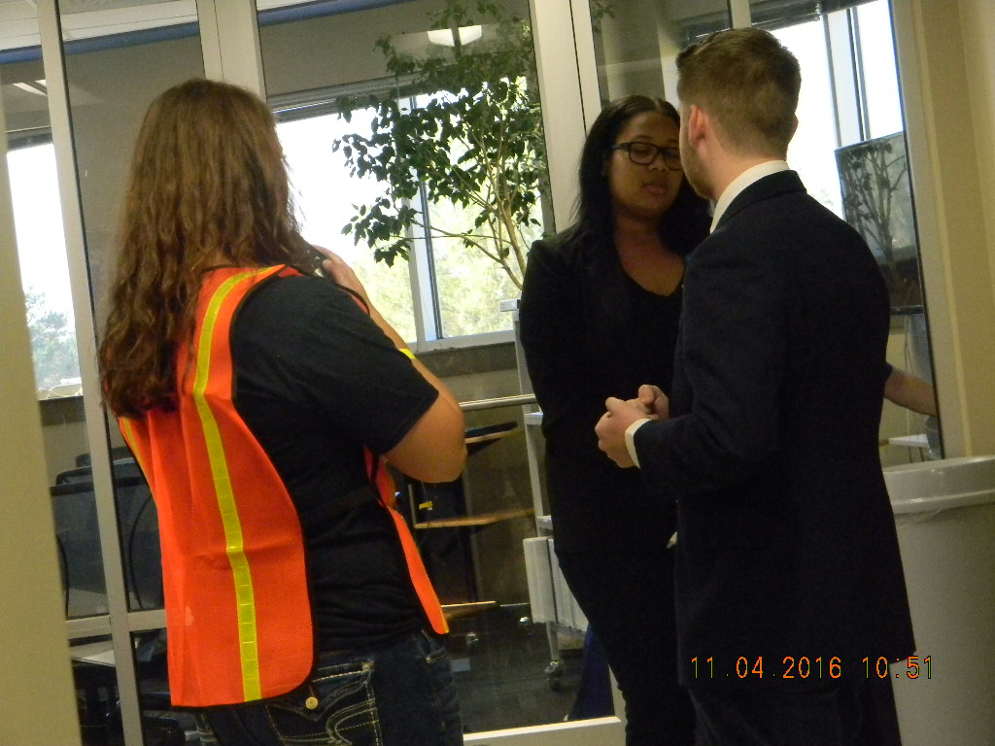
Management Team
Incident Command System (ICS)
Component of National Incident Management System (NIMS)
Student application for desired management position
Once selected, students meet with faculty and peers to discuss roles and expectations for preparation for simulation
Present plan for assigned area/role

Slide 8
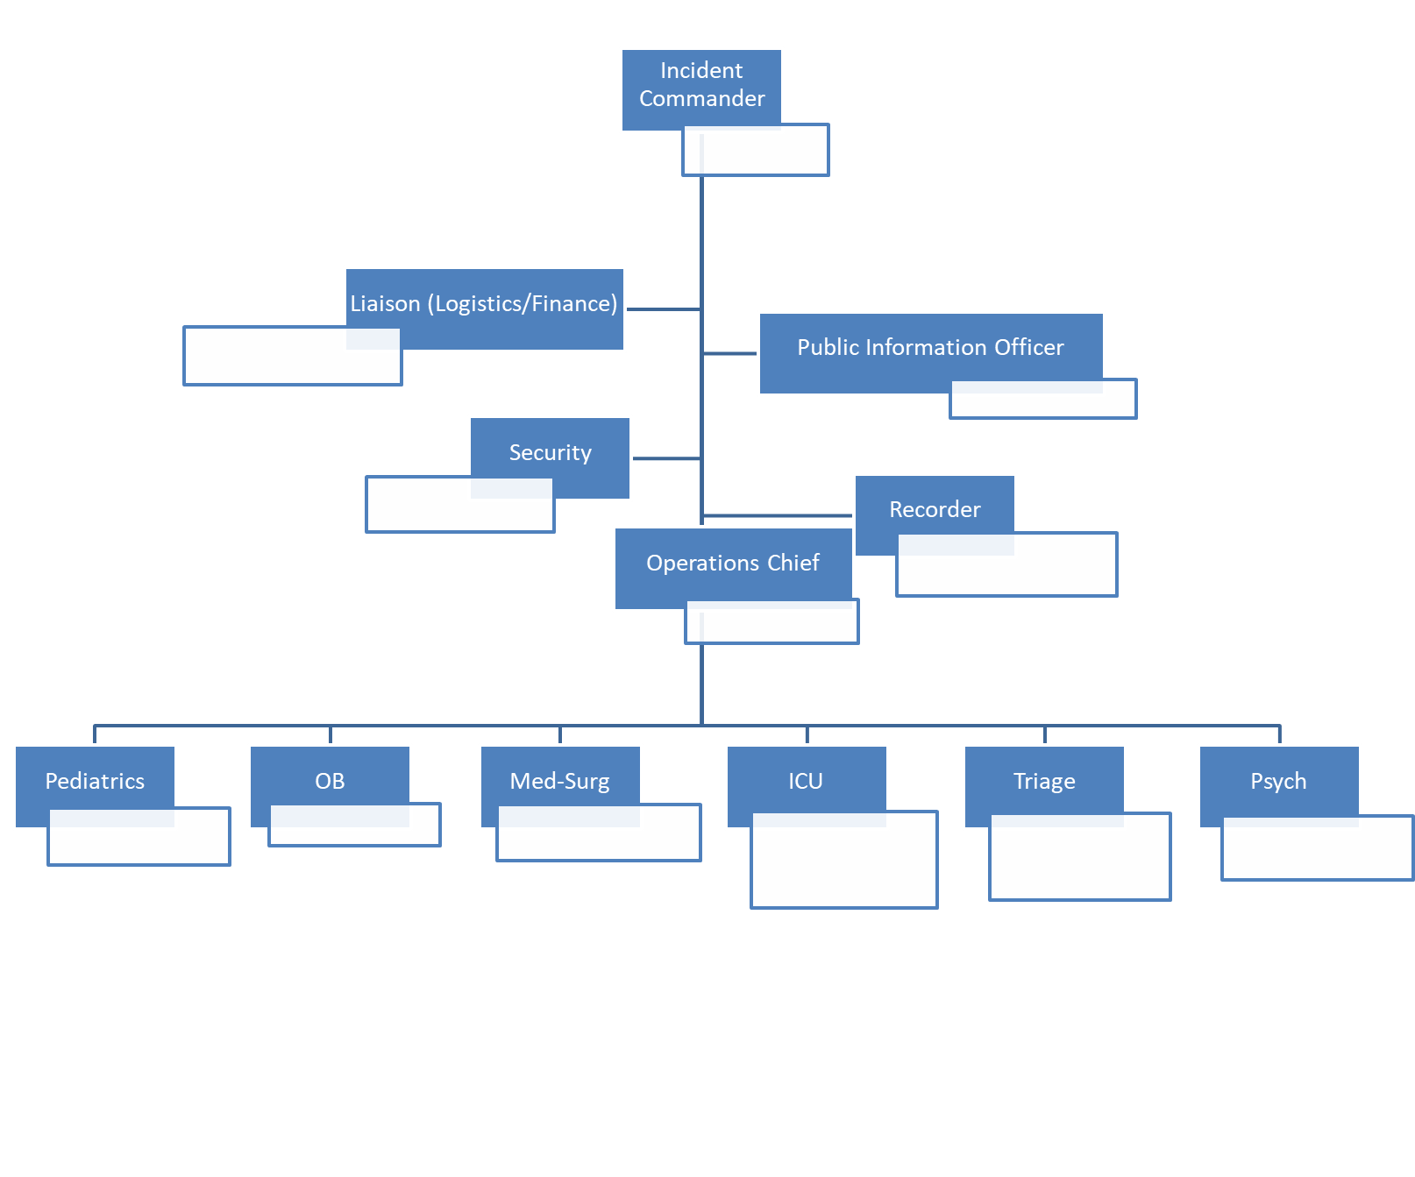

Slide 9
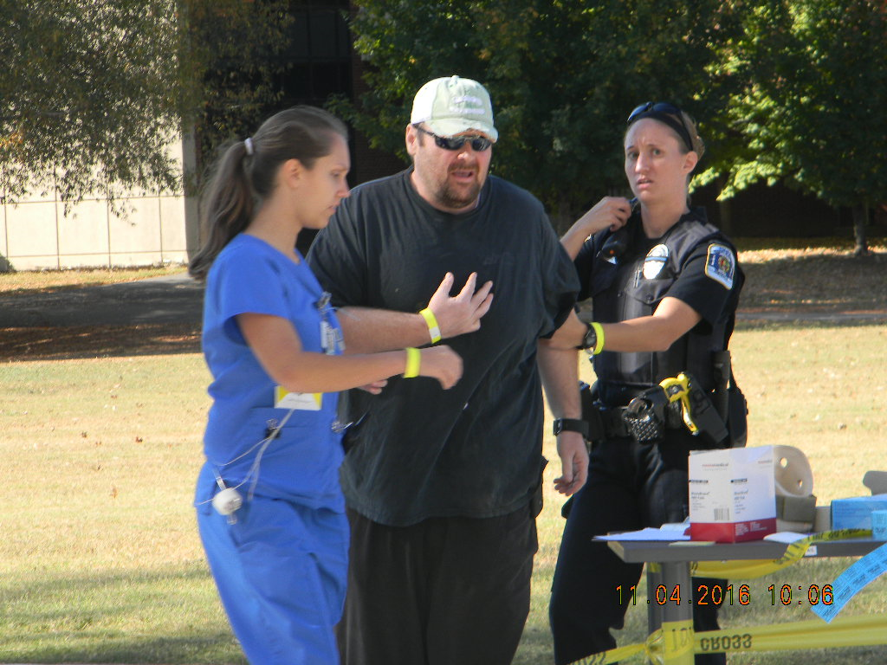
Victim roles
Randomly assigned to students
Students responsible for:
“back story” of victim
Knowledge of injury/illness
Treatment options and appropriate response to treatment provided
Students turn in “victim cards” at conclusion of simulation

Slide 10
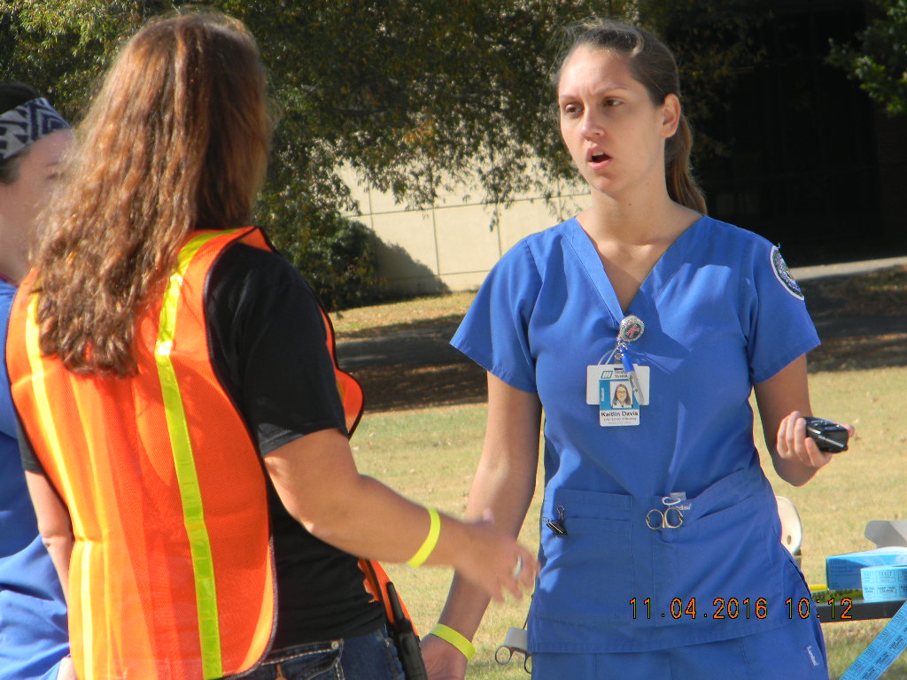
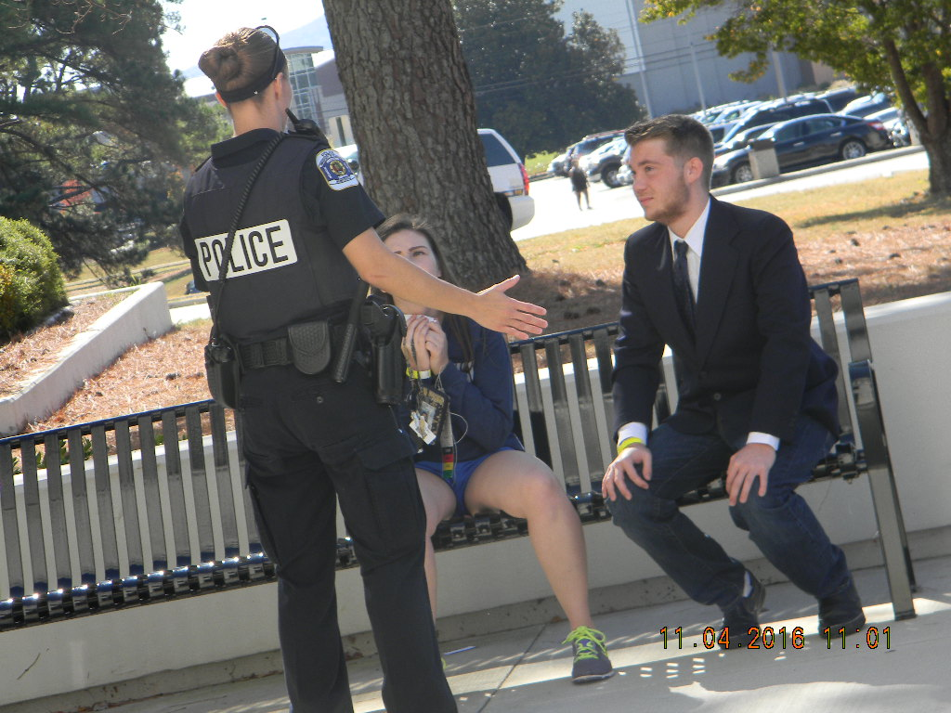
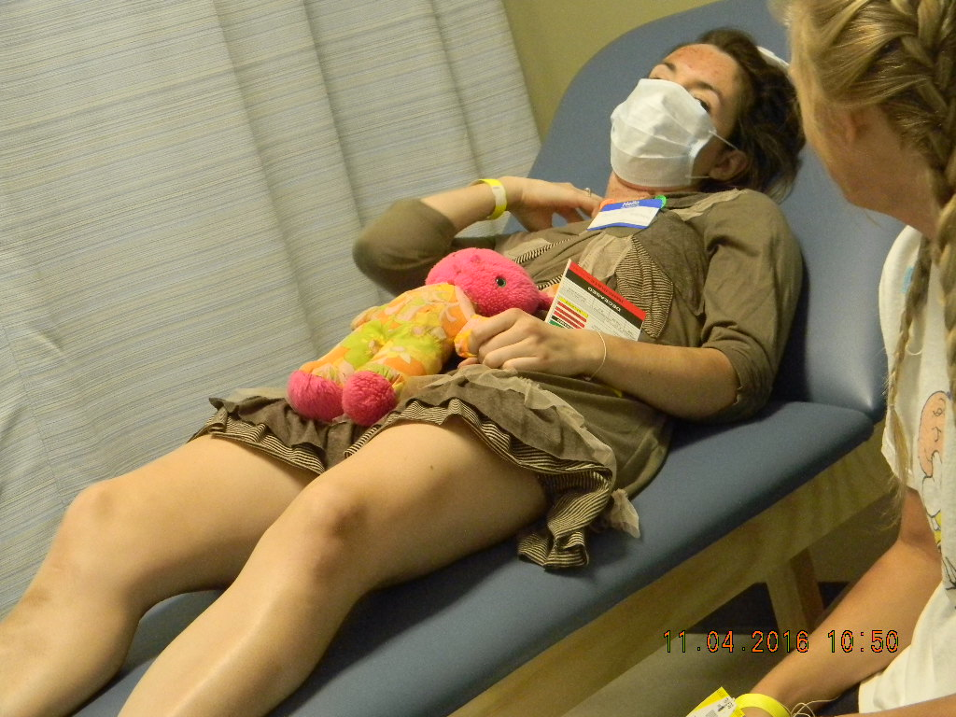
Disaster Day
Simulated Catastrophic event affecting our community
Local hospitals on diversion- CON activated as Mass Casualty Unit (MCU)

Slide 11
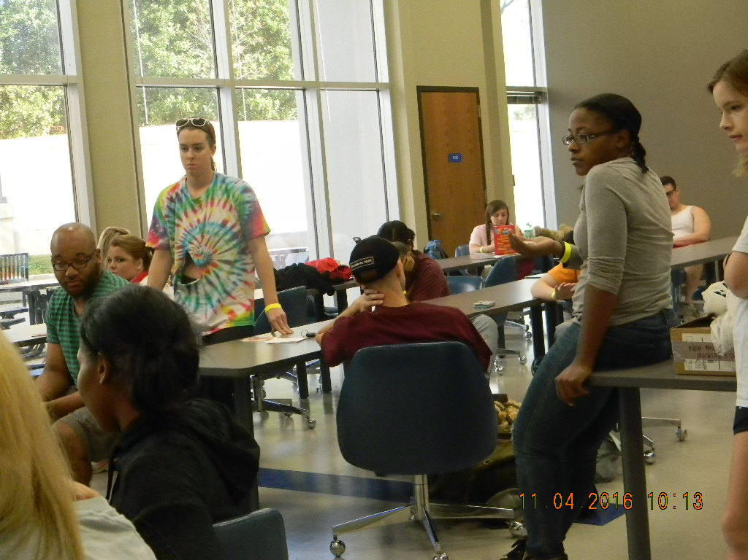
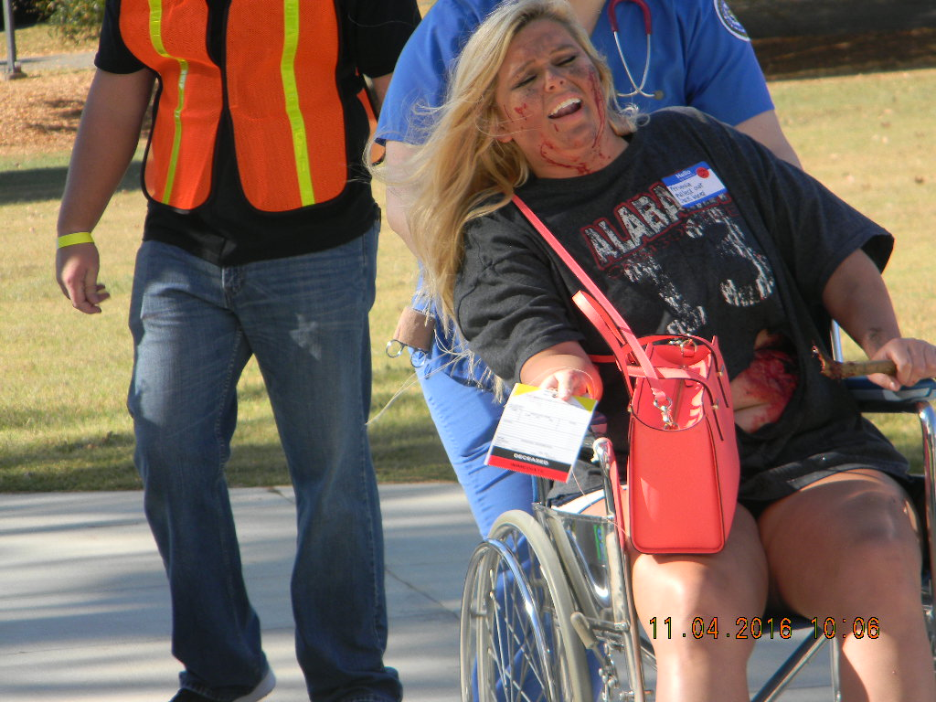
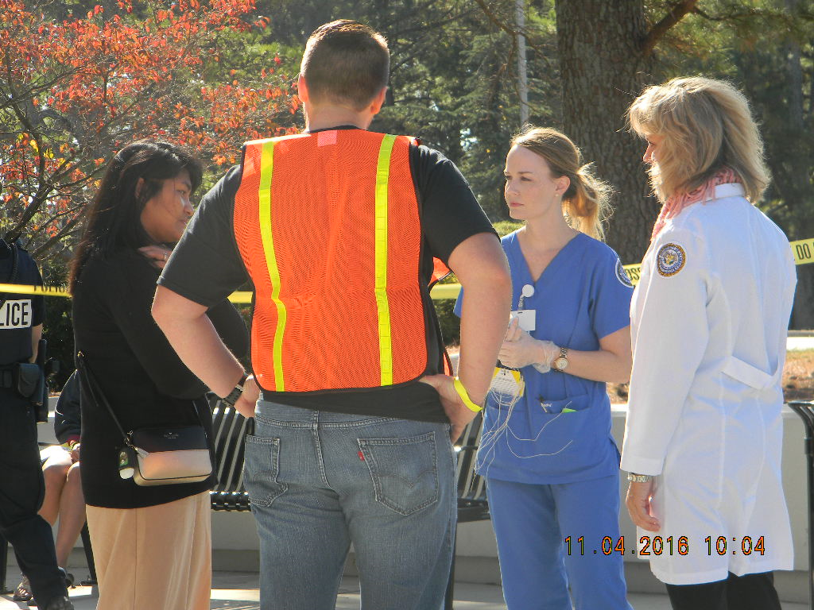
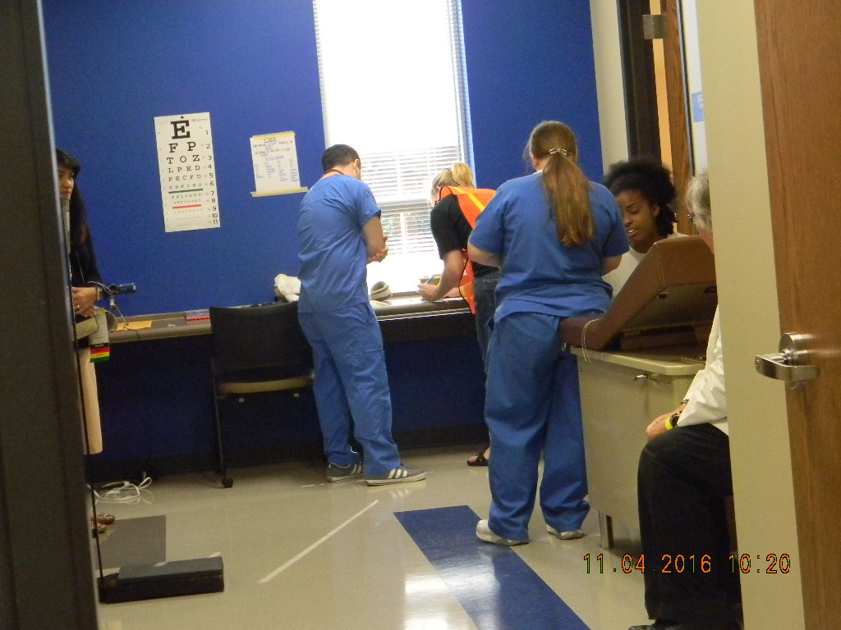
Victim prep
Victims responsible for costuming
Student creativity
Moulage team
Enhanced realism
Victim release scheduling

Slide 12
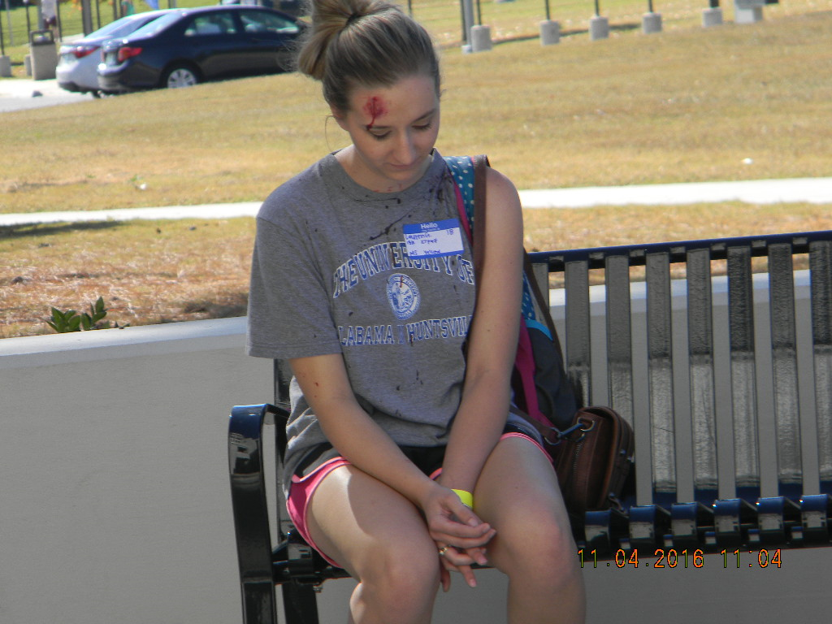
Examples of moulage
Extensive
Gunshot wounds
Impalements
Other traumatic injuries
Minor
Scrapes
Bruises

Slide 14
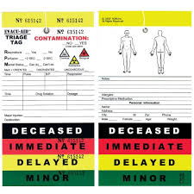
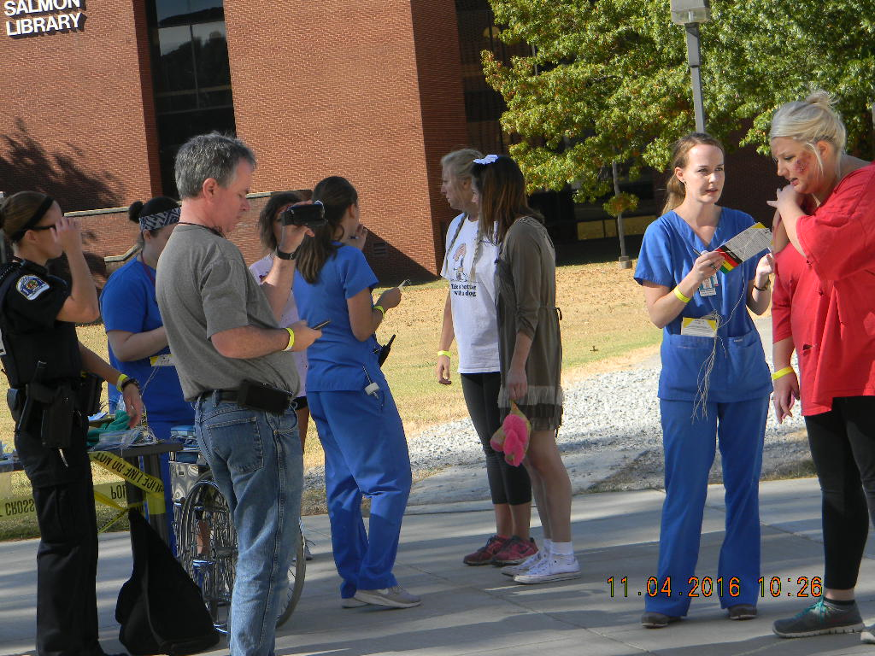
Victim Triage
Triage staff performs triage of victims using START
Simple
Triage
And
Rapid
Treatment

Slide 15
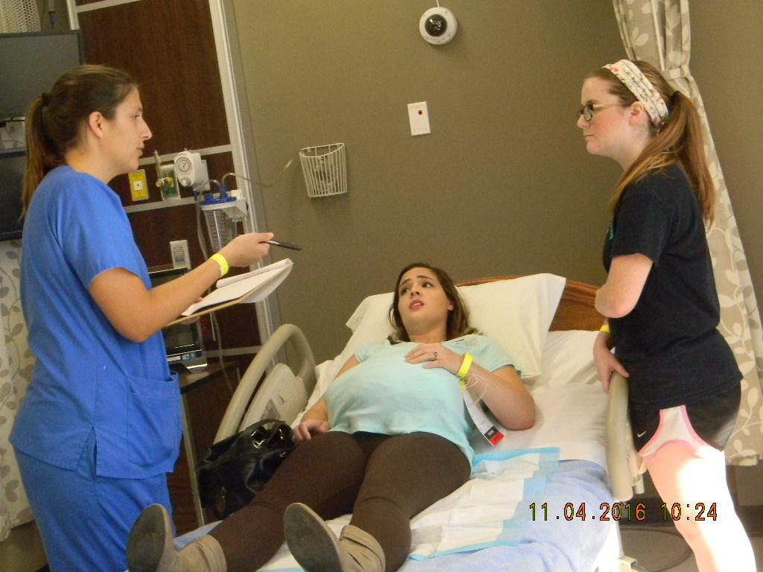
Nursing Units
ICU
Med/Surg
OB
Pediatrics
Psychiatry

Slide 16
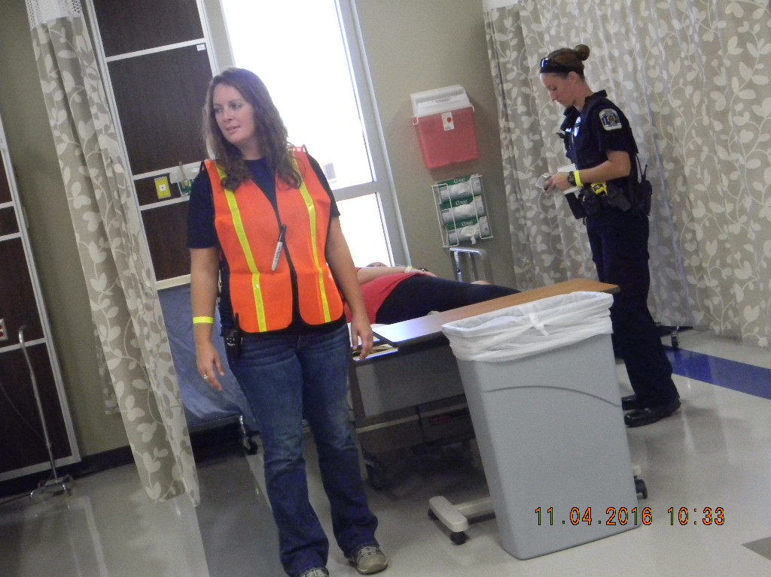
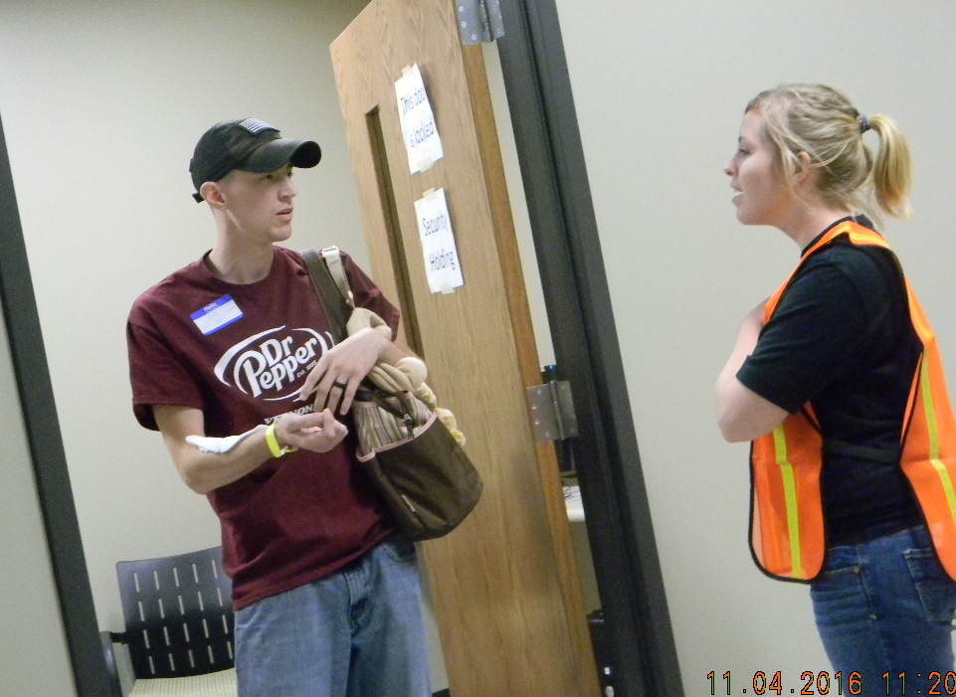
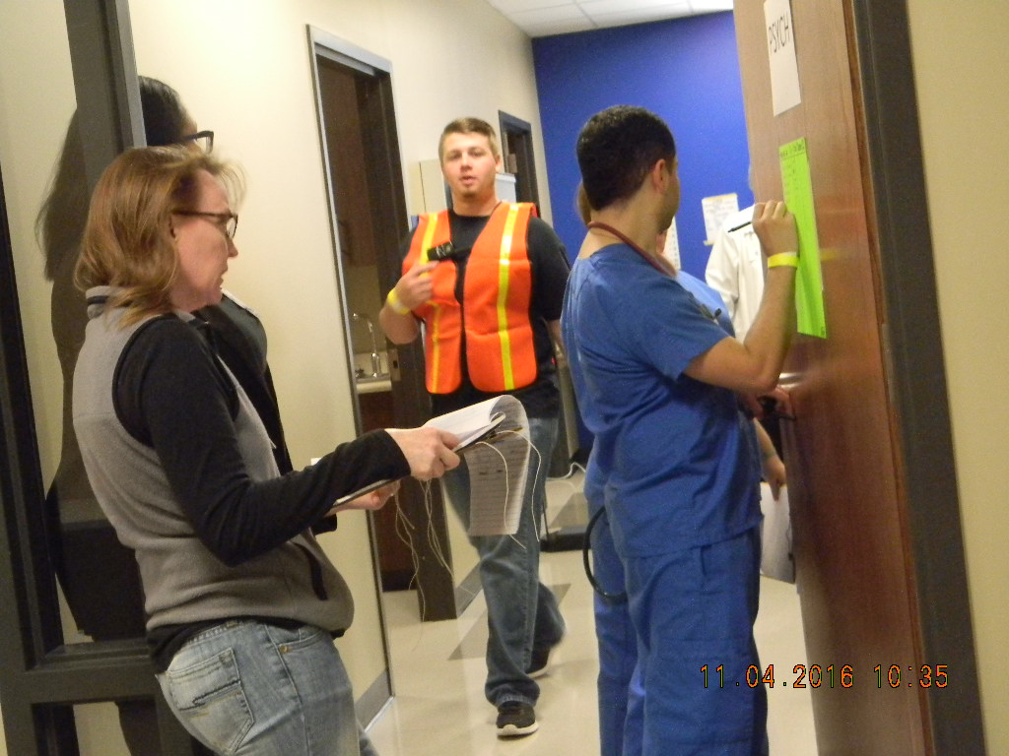
Other areas of interest
ICS Headquarters
Detention area
Morgue

Slide 17
During the simulation
Realistic chaos
Triage activities
Nursing care within the confines of disaster resources
Police enforcement simulation

Slide 18
Debriefing
Best practices in debriefing
INACSL Standards
Reflective process
Understanding of all aspects of simulation
Develop students’ professional roles in disaster response

Slide 19
Evaluation of disaster
Students provide feedback using NLN Simulation Design Scale as a template for Students
Adapted to capture simulation-specific data
Faculty evaluate student performance using Creighton Competency Evaluation Instrument (CCEI)
Students also provide anecdotal feedback following the simulation and after graduation

Slide 20
Evaluation Results
NLN Simulation Design Scale (adapted)
Creighton Competency Evaluation Instrument (CCEI) (adapted)
Anecdotal comments

Slide 21
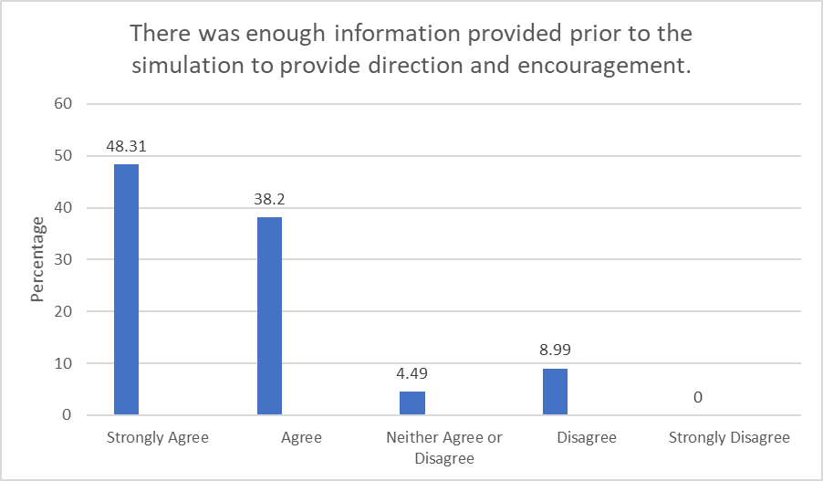

Slide 22
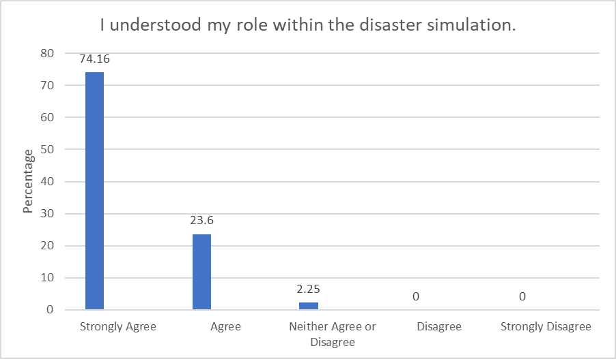

Slide 23
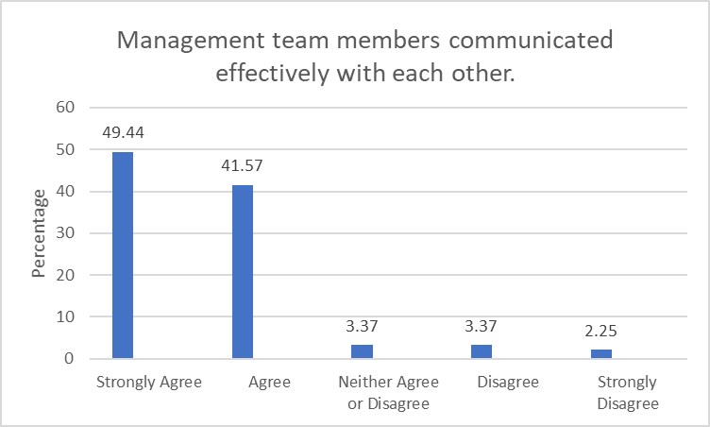

Slide 24
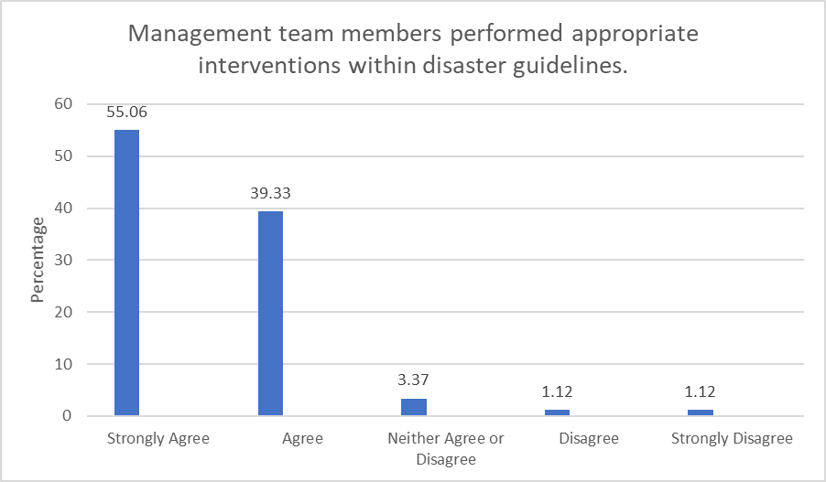

Slide 25
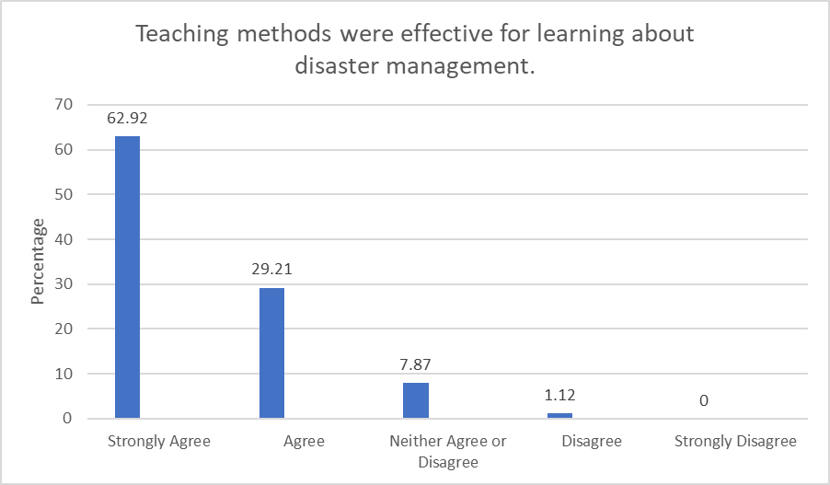

Slide 26
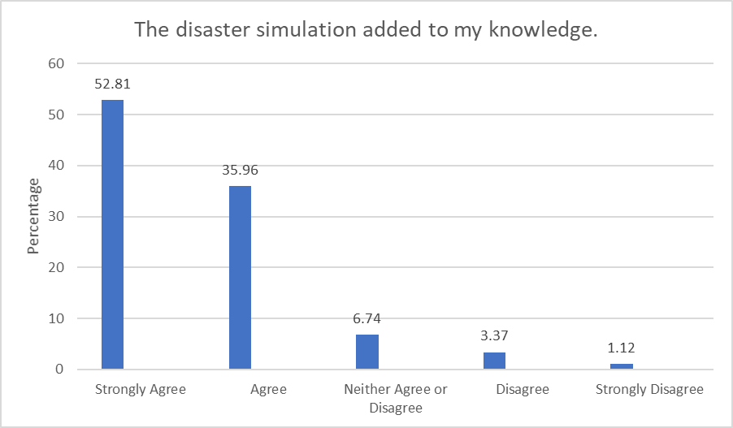

Slide 27
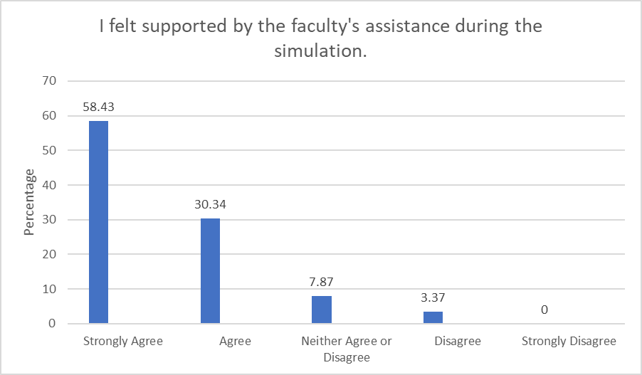

Slide 29
Faculty evaluations

Slide 30
Student comments
“This was a great learning experience for a real disaster. I wasn’t able to see other parts of the management team since I was so busy, but it was an eye opener for the real world. I really enjoyed this and it will be beneficial for future experiences.”
“The preparation the management team had was good and had a positive impact on how the BSN students ran the drill. I loved the disaster drill and think that I was additionally well-prepared having precepted in an ER.”

Slide 31
“I feel that I have learned how fast-paced a disaster is and affects a hospital. I also did not think in terms of basic first aid leading into the drill. I feel that I have gotten most of my anxiety related to dealing with a disaster over with and will be better prepared to go into a disaster with a level head.”
“I believe this preparation of the disaster drill and participating in the disaster drill will help me tremendously in my nursing practice during a disaster. This drill helped me realize what I was good at and what I was weak at. It makes me realize how as a unit nurse I have to change my thinking from doing head-to-toe assessments and taking the time to talk to patients to doing a quick 30-second assessment and figuring out what is wrong with them in a short period of time.”

Slide 33
Faculty comments
Handwashing/gloving issues
Good head-to-toe assessments; could improve systematic approach
Incomplete hand-off reports
Critical thinking skills spot-on
Need to work on patient follow-up during chaos
Situational awareness

Slide 34
Challenges
Deficient number of student participants
20 management team roles
5-7 victims: 1 staff member
100-140 participants needed
Volunteers unreliable
Evaluation of student performance
Limited faculty to participate
Faculty knowledge of disaster response

