Slide 1
Moving Onward & Upward: Income Mobility and Historically Black Colleges and Universities
Robert Nathenson, Ph.D. & Marybeth Gasman, Ph.D.

Slide 2
HBCUs: By the Numbers
102 accredited HBCUs, 51 public, 51 private; 3 non-accredited HBCUs
Enroll 8% of Black college students; 290,000 students
Graduate 14% of African American college students
HBCU Graduation rate: 35%; Black graduation rate overall 41% (overall college graduation rate is 60%)
Percentage of students on Pell Grants: 71%
Faculty diversity: 60% Black (African American, African, Caribbean); 40% non-Black

Slide 3
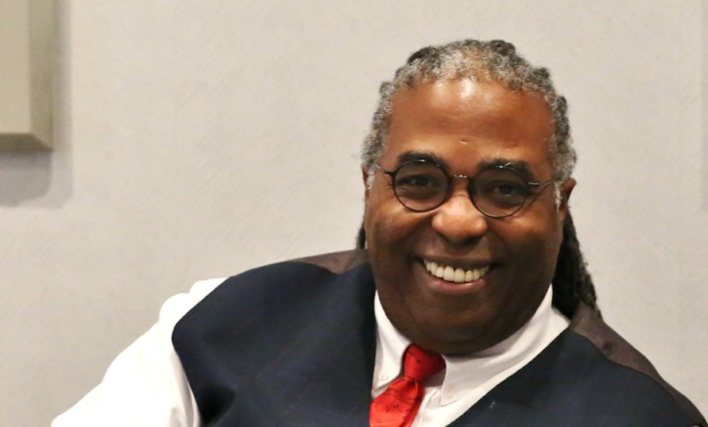
Strengths of HBCUs
High production of undergraduates in science
High production of future graduate and professional students
Safer learning environment in current national climate
Same race and gender role models
Tuition costs at 50% of Predominantly White Institutions
Demonstrated commitment to African American success

Slide 4
Research Aims & Data
Research Aims
Opportunity Insights Data
(1) Examine the intergenerational income mobility experienced by students who recently attended Historically Black Colleges and Universities (HBCUs) and Predominantly White Institutions (PWIs)
(2) Examine variation across HBCUs, including on such measures as upward mobility into the top fifth of income earners.
Internal Revenue Service
  Parent and children’s income, aggregated by postsecondary institution and birth year
National Center for Education Statistics
  Postsecondary characteristics from the Integrated Postsecondary Education Data System (IPEDS)
Notes:
Our key research aims are to (1) examine the income mobility experienced by students who recently attended HBCUs and PWIs and (2) to examine the variation across HBCUs, including on such measures as mobility to the top income quintile and any upward mobility. We compare intergenerational income mobility at HBCUs to the mobility rates at PWIs within the same set of commuting zones. Doing so allows us to compare and contrast student outcomes at the localized institutional level, and to draw plausible generalizations about the tradeoffs students face when deciding which local institution to attend.

Slide 7
Terminology
Income Quintiles
Intergenerational Income Mobility
1^{st:} Bottom Quintile. Bottom 20%.
2^{nd:} Lower-Income.
3^{rd:} Middle Class.
4^{th:} Upper-Middle
5^{th:} Top Quintile. Top 20%. Affluent. High-income
‘Mobility Rate’ – the joint probability
  A holistic picture of the full mobility matrix
‘Success Rate’ – the conditional probability
  Income mobility of students accounting for their origin
Notes:
We examine both the joint and conditional intergenerational (parent-child) income mobility distributions, what Chetty, Friedman, et al. (2017) call the ‘mobility rate’ and the ‘success rate,’ respectively.
The mobility rate is defined as the percent of children who originate in a specific income quintile and end up as adults in a specific (often different) income quintile.
The success rate is defined as the percent of children in a specific income quintile, conditional on their parent being in a specific income quintile.
The former presents a holistic picture of the origin-destination income mobility patterns from parents to students (e.g. what percent of all students were in the top quintile and had parents with incomes in the bottom quintile).
The latter details the income mobility of students given that their parents’ income was in a specific income bracket (e.g. of students who had parents in the bottom quintile, what percent of students achieved income in the top quintile). It is our emphasis on the success rate, specifically, that helps distinguish our work from other research in the area.

Slide 8
Economic Mobility Highlights
HBCUs enroll far more low-income students than PWIs.
More students experience upward mobility at HBCUs than at PWIs.
Nearly 70% of students at HBCUs attain at least middle-class incomes.
Two-thirds of low-income students at HBCUs end up in at least the middle class.
There is less downward mobility at HBCUs than at PWIs.
HBCUs like Xavier University of Louisiana, Dillard University, and Tuskegee University are doing a particularly good job fostering upward mobility for their students.
Children of affluent parents who attended PWIs were 50% more likely to stay affluent than children of affluent parents who attended HBCUs.

Slide 9
HBCUs enroll far more low income students than PWIs.

Slide 10
More students experience upward mobility at HBCUs than at PWIs
Notes:
Nearly 70% of students at HBCUs attain at least middle-class incomes.

Slide 11
Two-thirds of low-income students at HBCUs end up in at least the middle class.

Slide 12
There is less downward mobility at HBCUs than at PWIs.

Slide 13
Highlighting Specific HBCUS (1)
Notes:
HBCUs like Xavier University of Louisiana, Dillard University, and Tuskegee University are doing a particularly good job fostering upward mobility for their students.

Slide 14
Highlighting Specific HBCUS (2)
Notes:
HBCUs like Xavier University of Louisiana, Dillard University, and Tuskegee University are doing a particularly good job fostering upward mobility for their students.

Slide 15
Privilege Perpetuation
Children of affluent parents who attended PWIs were 50% more likely to stay affluent than children of affluent parents who attended HBCUs.
Children of upper-middle class and affluent parents at HBCUs are no more likely than the flip of a coin to end up in a similar income bracket as compared to moving down to the median or below.

Slide 16
Review of Key Findings
Being born into a relatively affluent African American family does not provide the same sort of class safety net as does being born into a white family.
HBCUs are doing an admirable job fostering the upward mobility of their students, especially considering the large share of their students that come from lower-income backgrounds.
HBCUs are furthering upward mobility of their student population, which is drawn from the lower economic rungs than the general college-going population at PWIs.
Specific schools are doing a particularly good job, including Xavier University of Louisiana, Dillard University, Tuskegee University, Florida A&M University, Prairie View A&M University, Spelman College, and Clark Atlanta University.

Slide 17
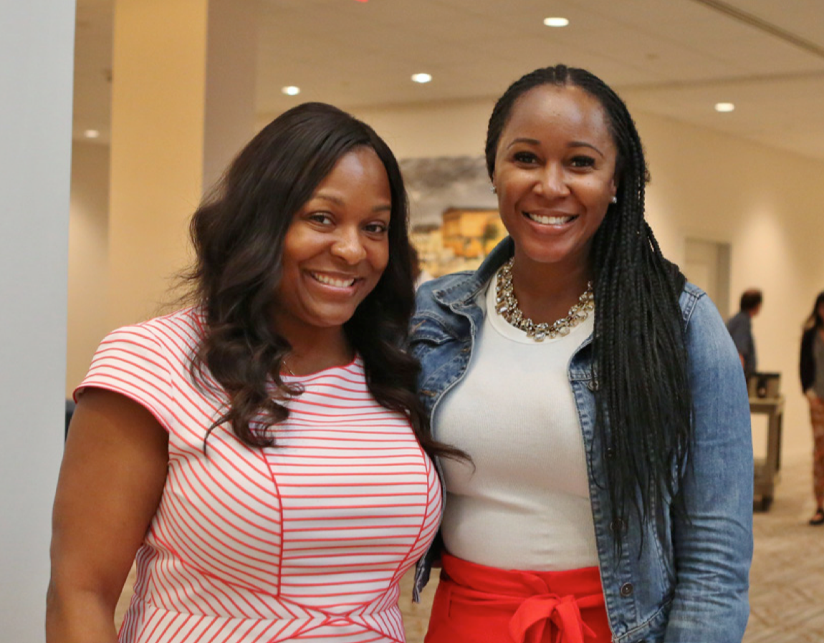
Concluding Thoughts & Questions
You can download the Onward and Upward report at the link below for free:
https://cmsi.gse.rutgers.edu/sites/default/files/EMreport_R4_0.pdf

Slide 18
Nearly 70% of students at HBCUs attain at least middle-class incomes.

Slide 19
HBCU Lessons for All Colleges & Universities
Gather as much data on students as possible in order to bolster student learning; share data with students.
Engage students in culturally relevant assignments.
Encourage collaboration over competition among students in the classroom.
Use peer-to-peer mentoring to assist with learning, especially in science and math
Capitalize on the various aspects of student identities and invite students to bring these identities to the classroom.

Slide 20
Questions & Answers
What else would you like to know about HBCUs?

