Slide 1
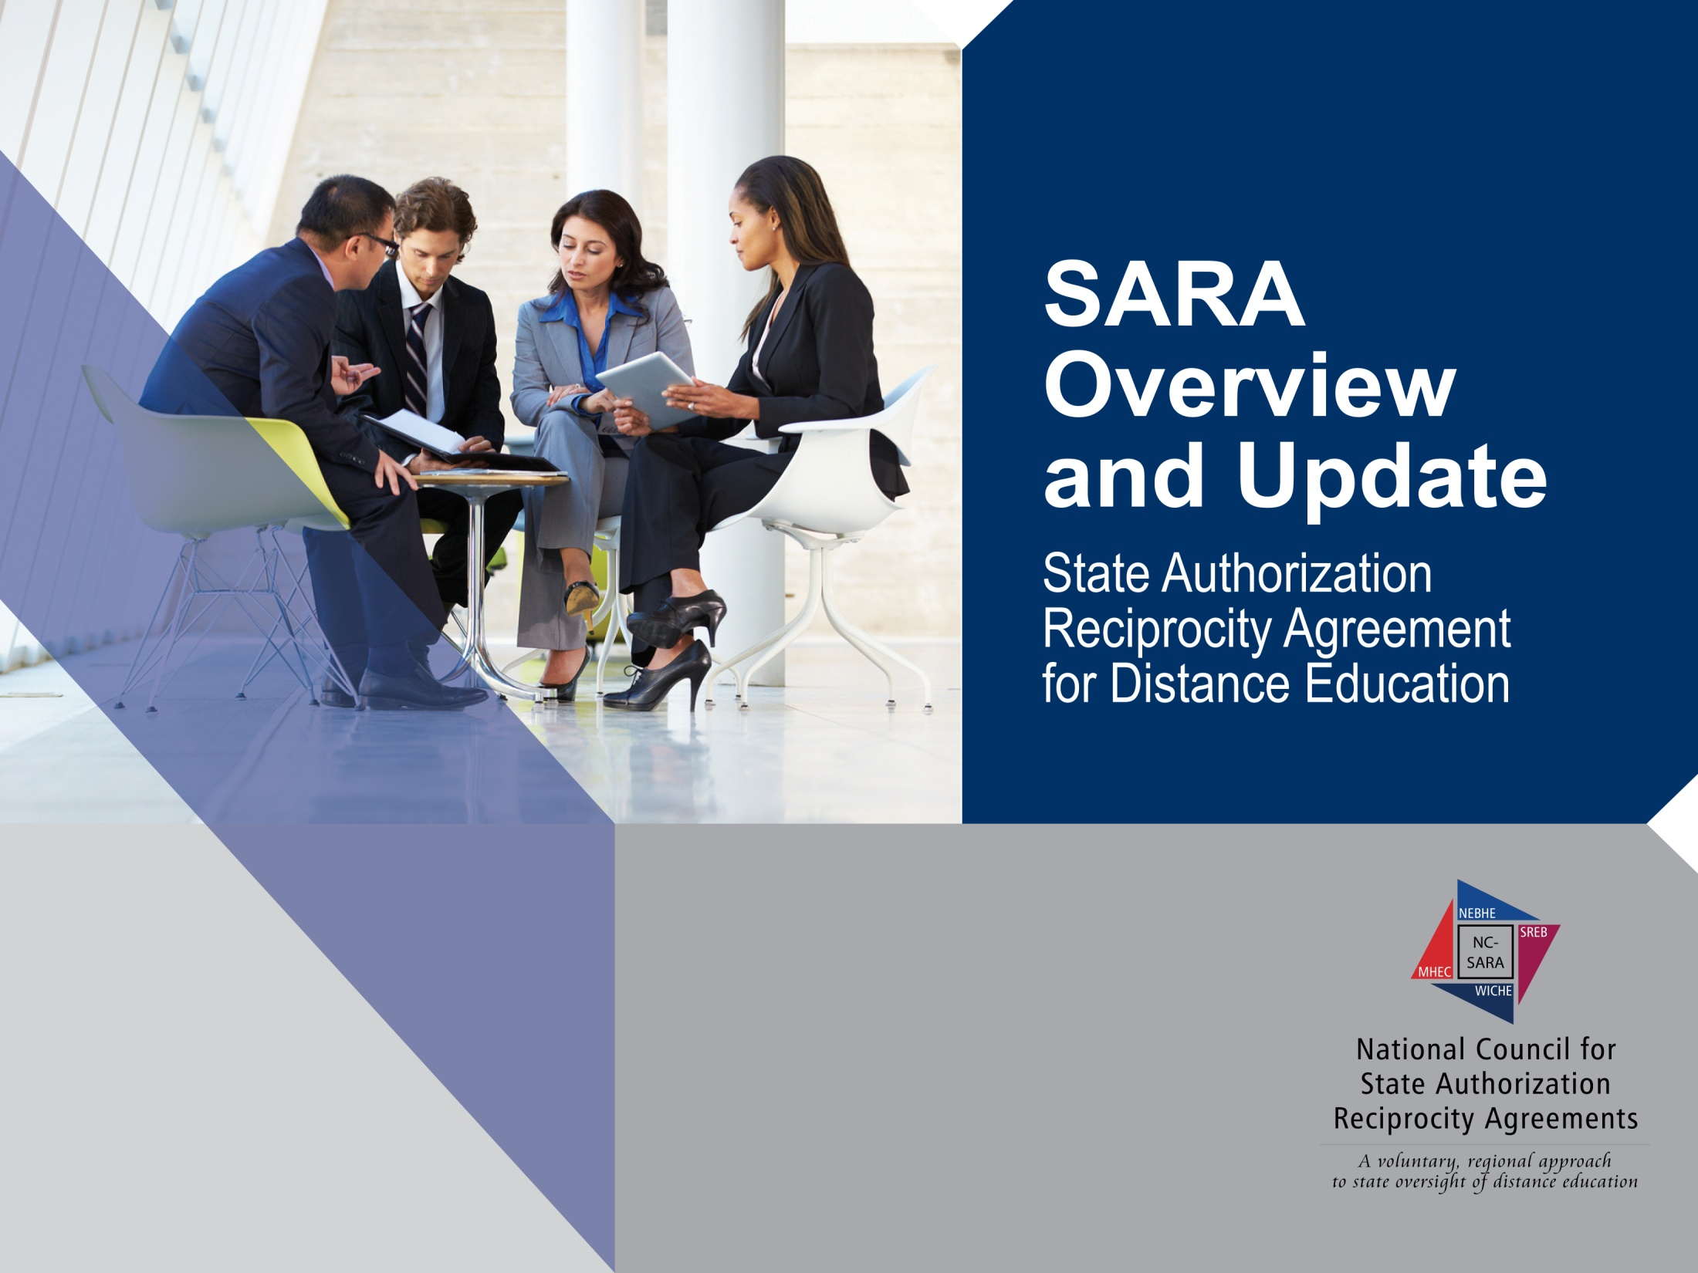
Interservice Voluntary Education Board (IVEB)
June 8, 2016

Slide 2

Presenter
Mary Larson
Director, Student Access Programs and Services
Southern Regional Education Board

Slide 3

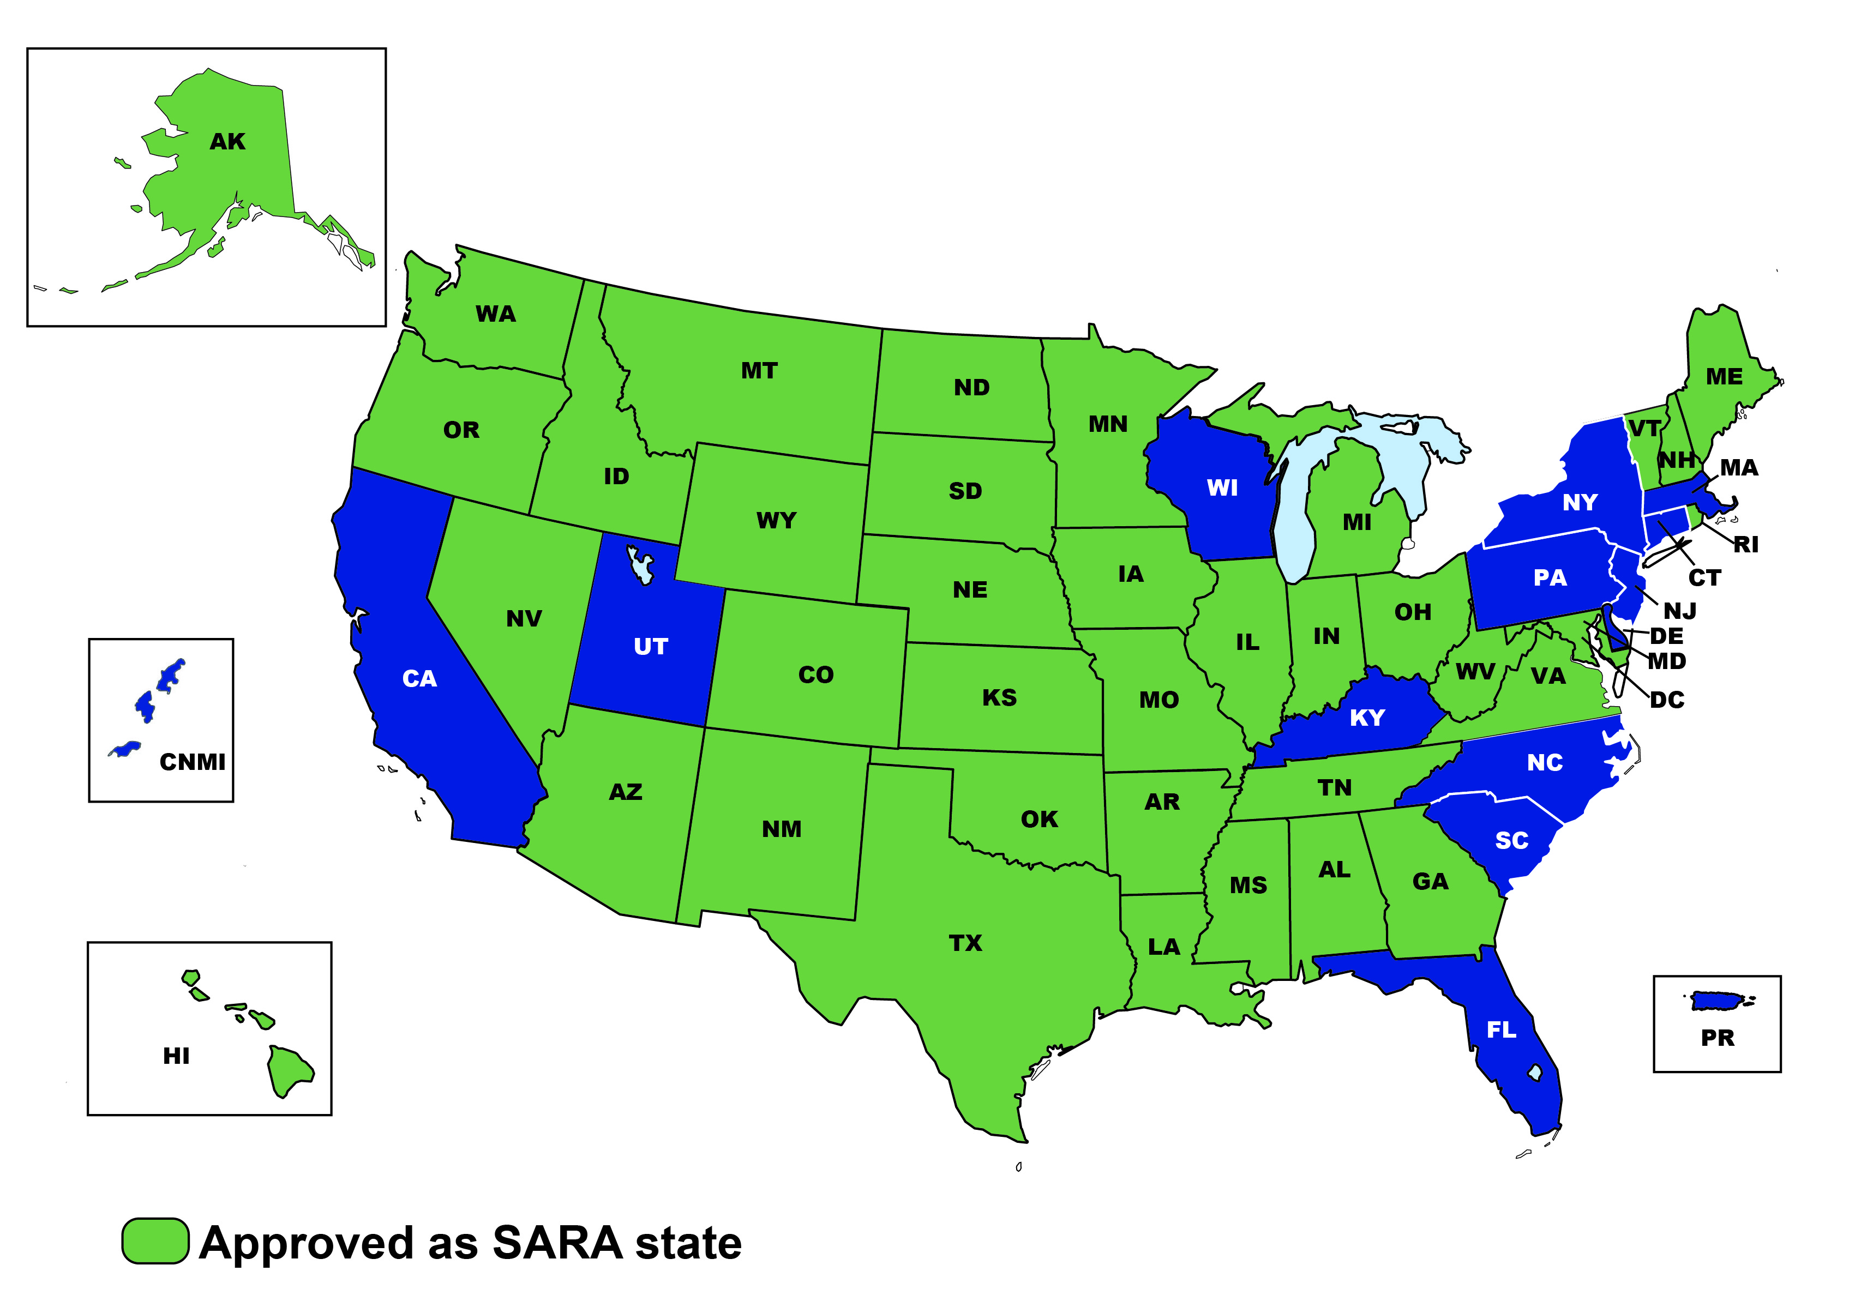
The Current SARA Landscape
Notes:
SARA establishes a state-level reciprocity process that will support the nation in efforts to increase the educational attainment of its people by making state authorization:
more efficient, effective, and uniform in regard to necessary and reasonable standards of practice that could span states;
more effective in dealing with quality and integrity issues that have arisen in some online/distance education offerings; and
less costly for states and institutions and, thereby, the students they serve.
Open to degree-granting postsecondary institutions from all sectors: public colleges and universities; independent institutions, both non-profit and for-profit.
Sets forth a reasonable, uniform set of triggers of “physical presence”.
Preserves state approval and oversight of on-the-ground campuses.
Distance education providers must obtain authorization in every state where students are taking the course or doing field experience!
Do you know where your students are?

Slide 4
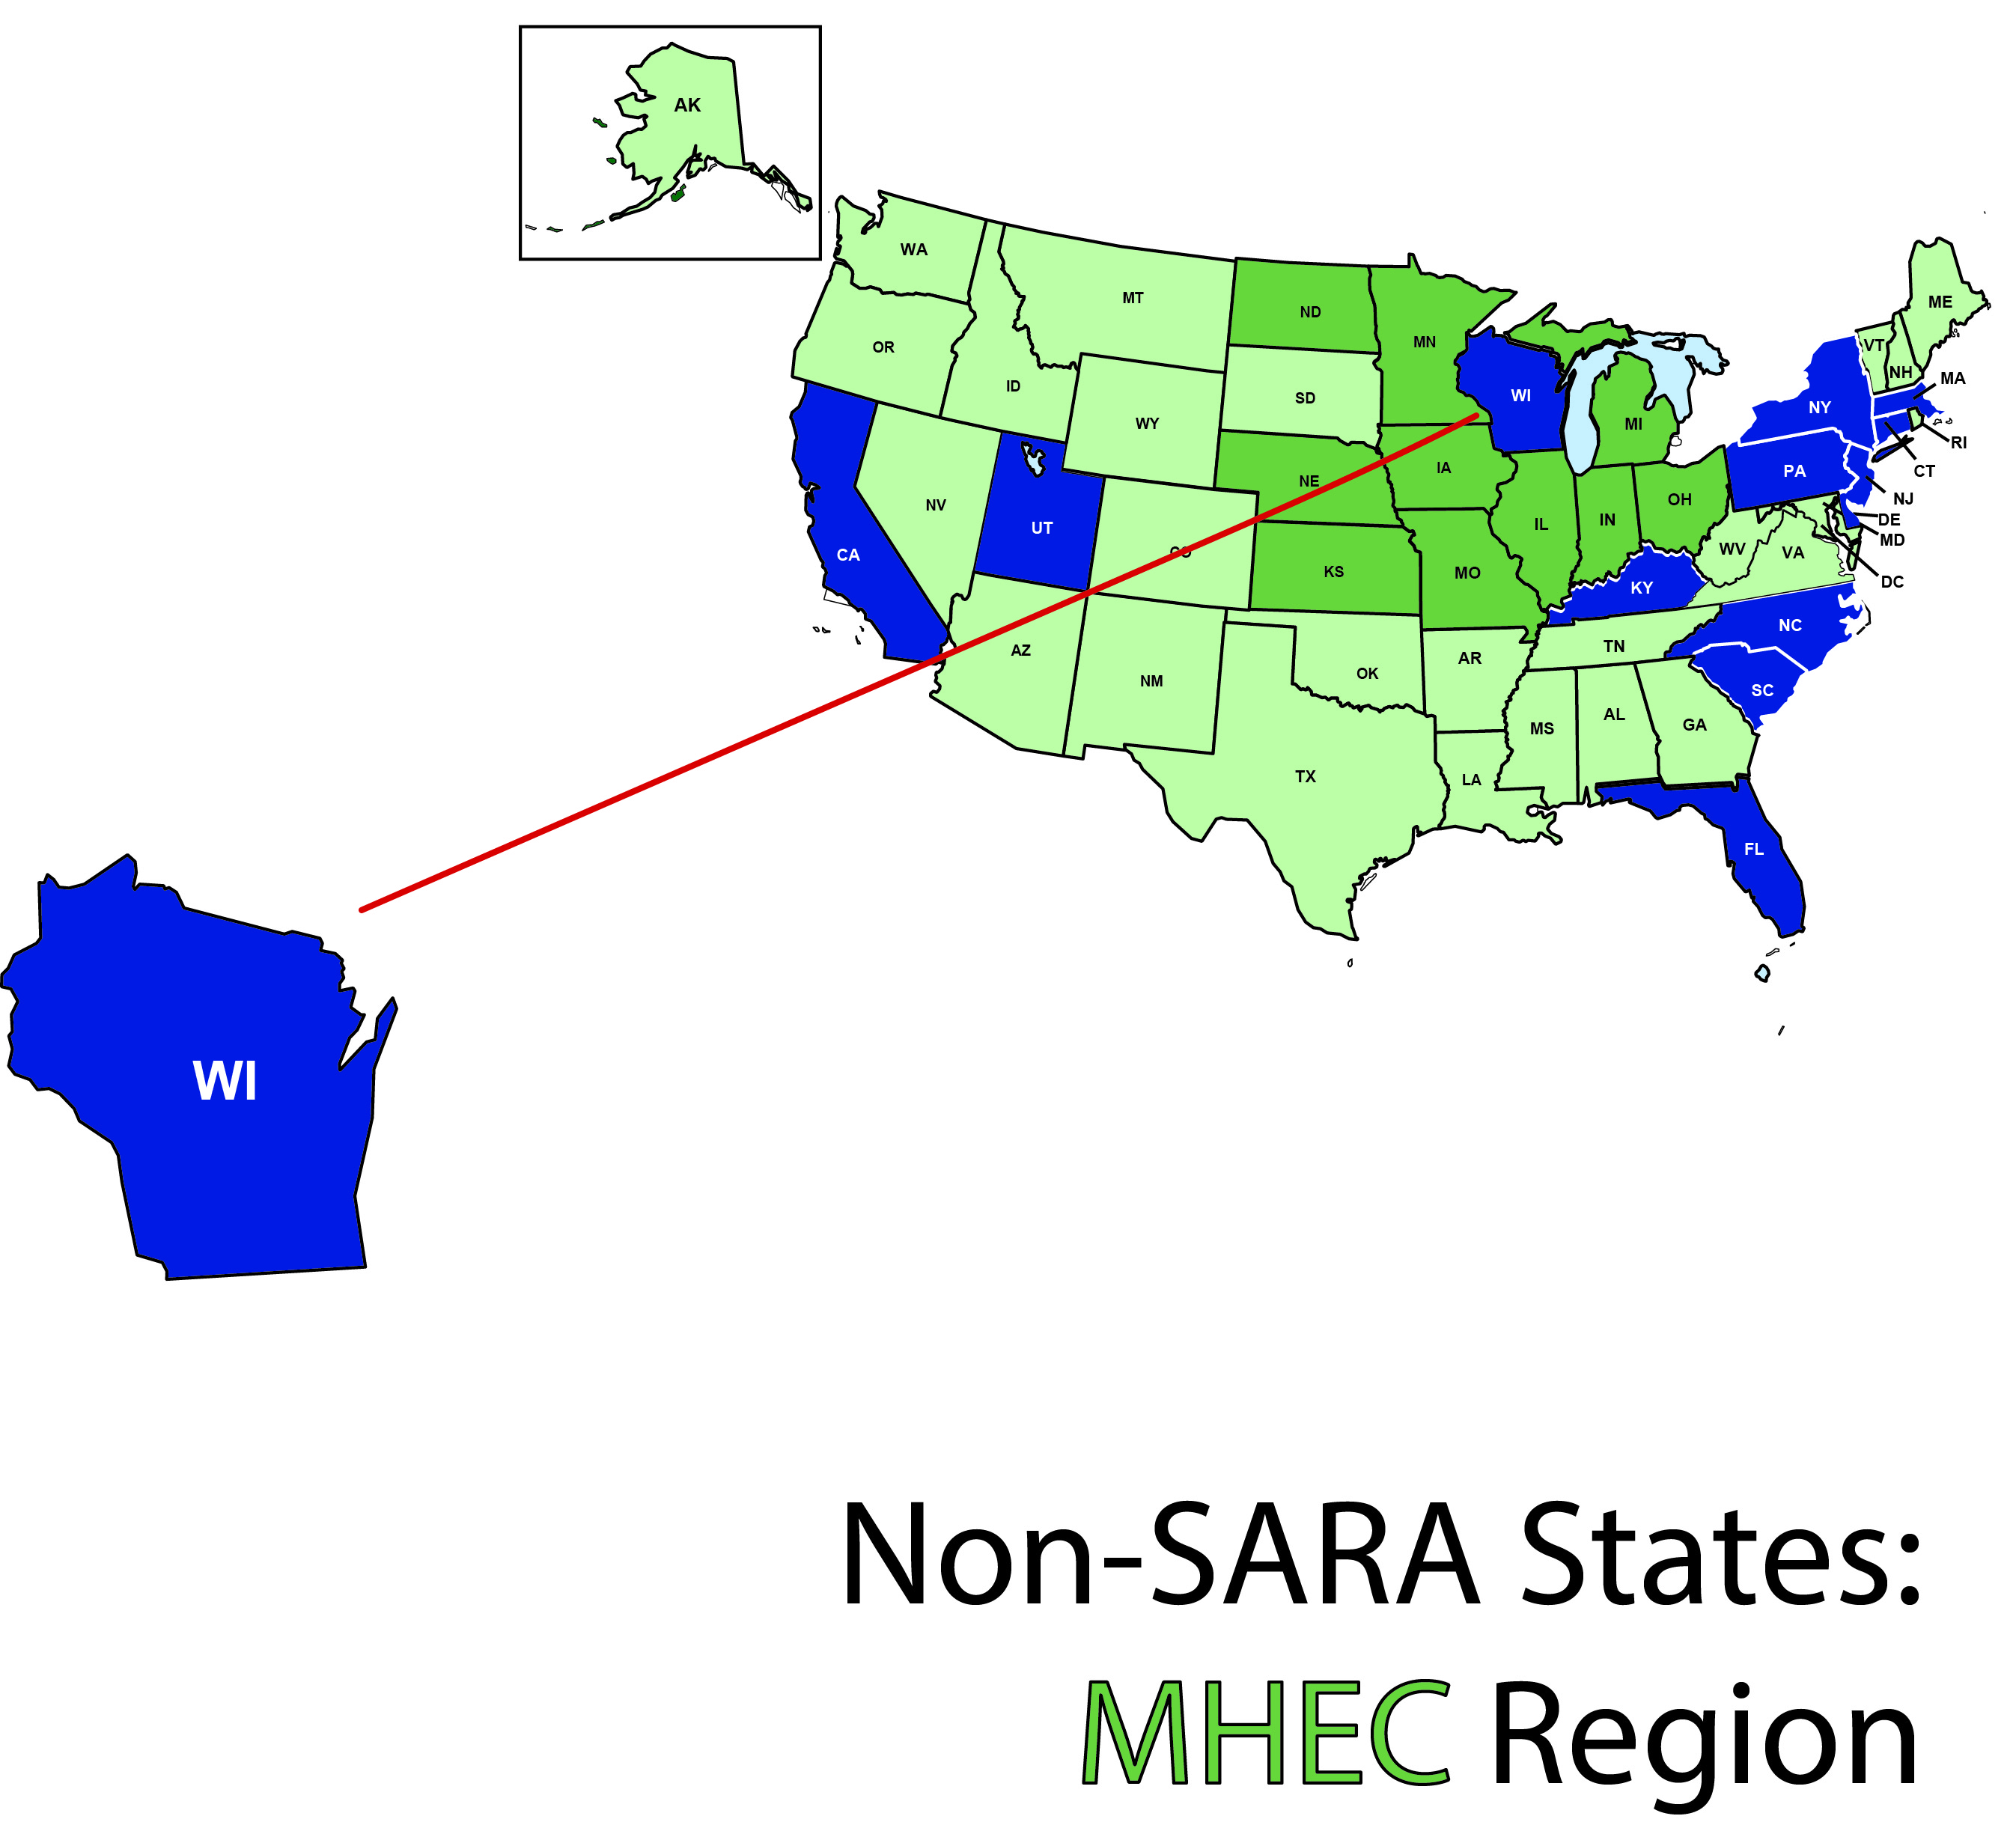
A Closer Look: MHEC

Slide 5

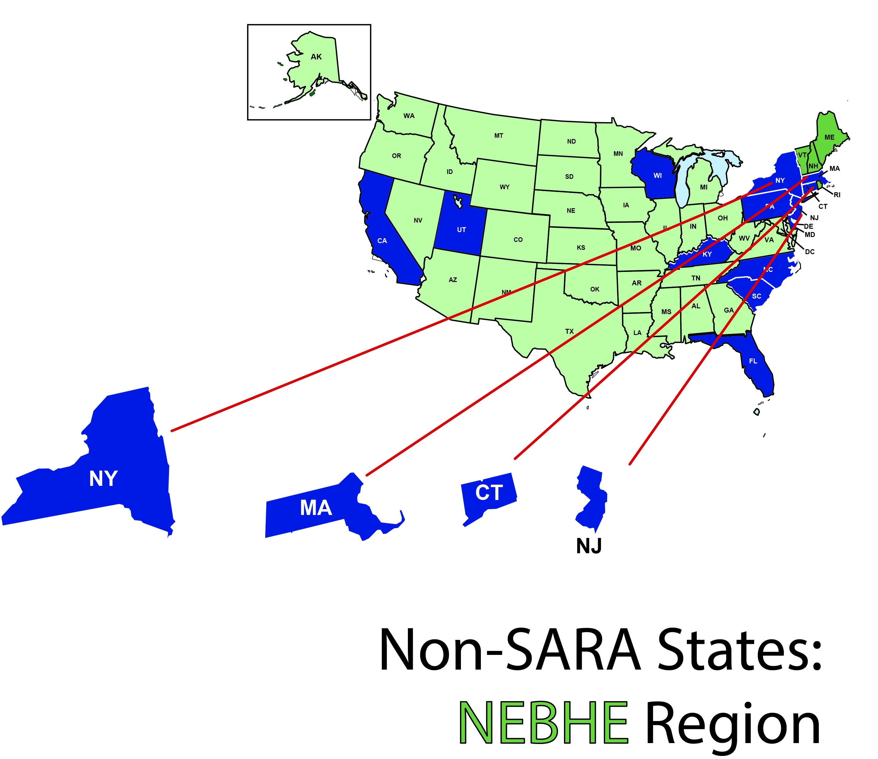
A Closer Look: NEBHE

Slide 6
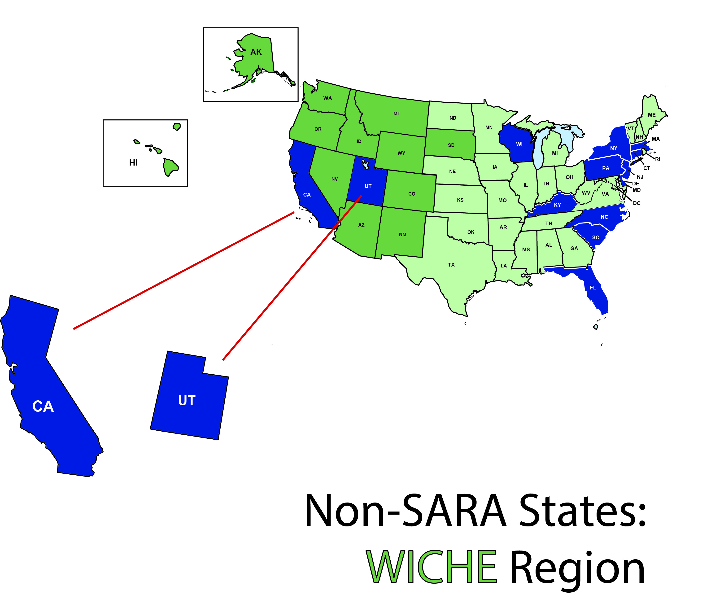
A Closer Look: WICHE

Slide 7
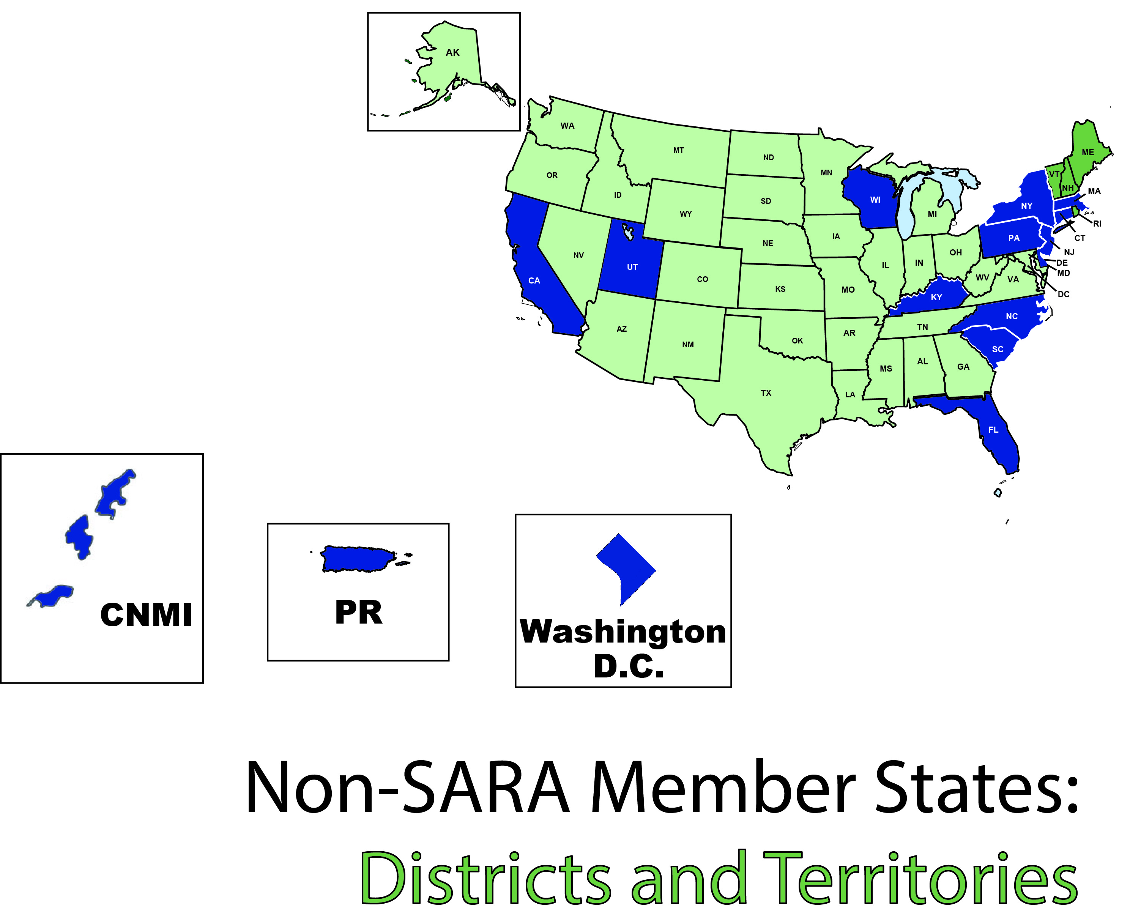
A Closer Look: Districts and Territories

Slide 8

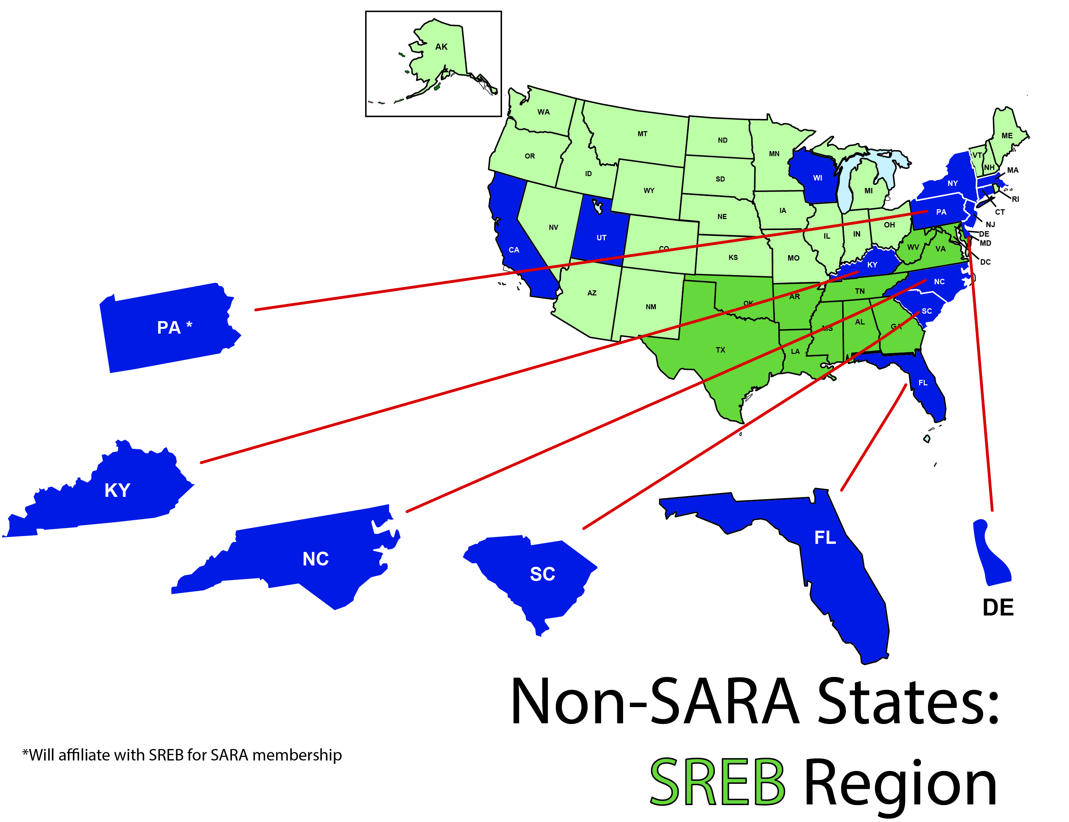
A Closer Look: SREB

Slide 9

SREB’s Electronic Campus Regional Reciprocity Agreement (SECRRA)
All 16 SREB states participate
Voluntary for states and institutions
Institutions participate if state joins
Limited to for-credit online courses and programs activated on the EC
only regional reciprocity agreement until 2014

Slide 10

After June 30, 2017
    Institutions in SREB states that do not join SARA will need to seek authorization from all states including the SREB region.
    Non-SARA institutions in SARA states in SREB region will need to seek authorization from all states including the SREB region.

Slide 11
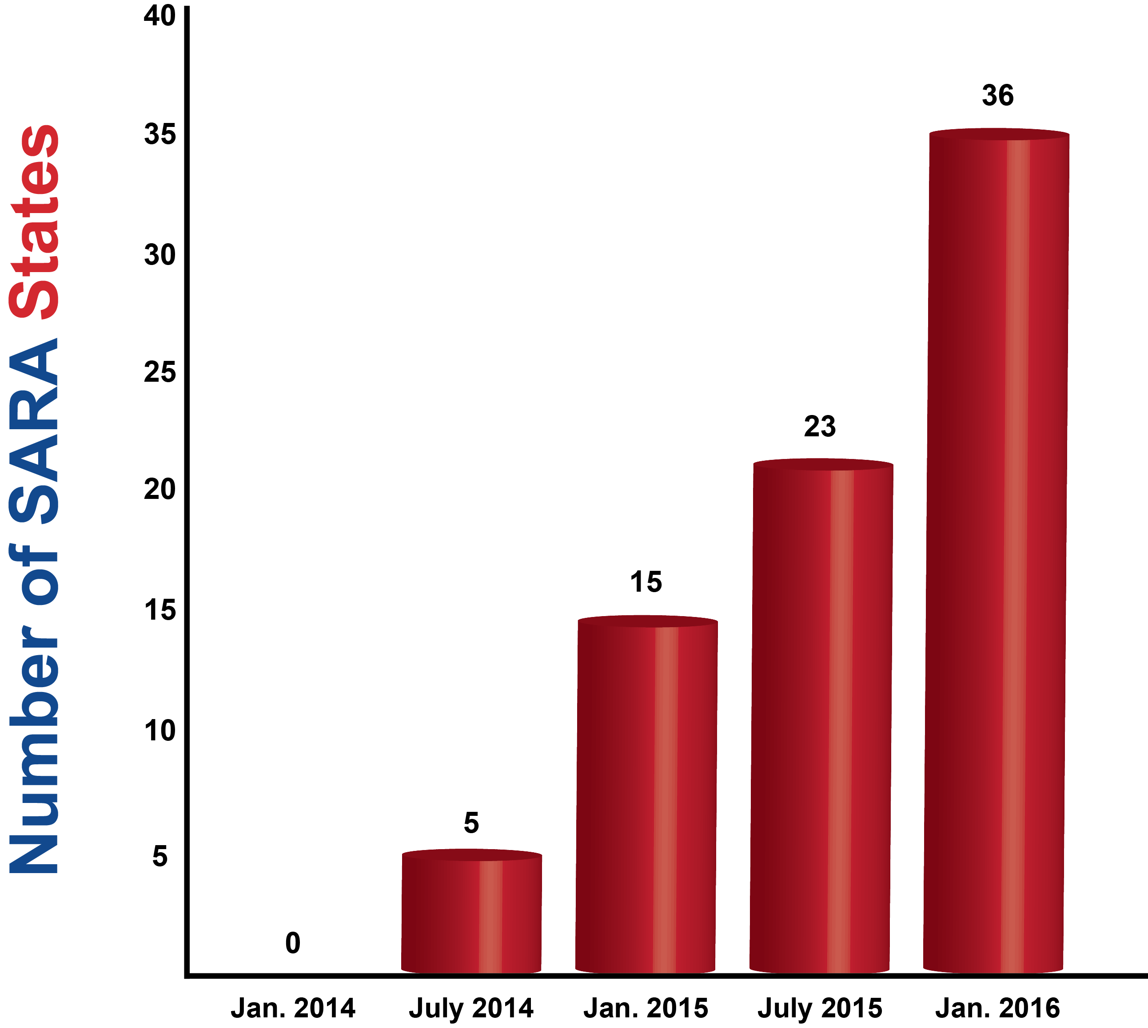
SARA Member States

Slide 12
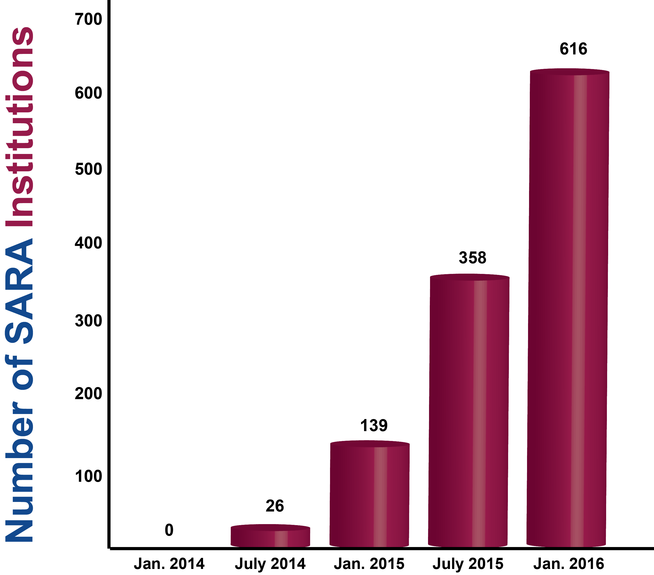
Participating Institutions

Slide 13
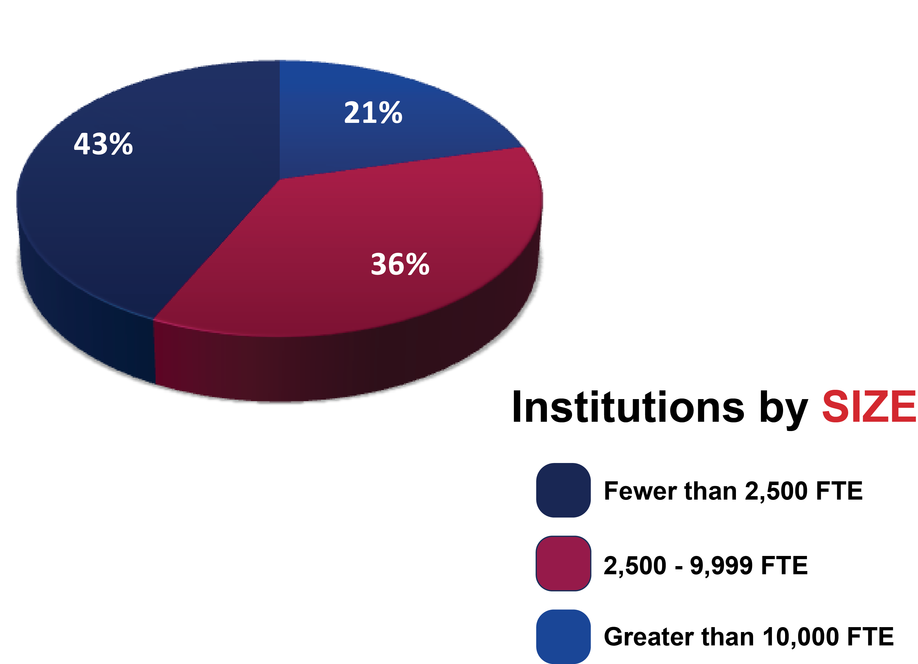
Participating Institutions
As of December 31, 2015

Slide 14
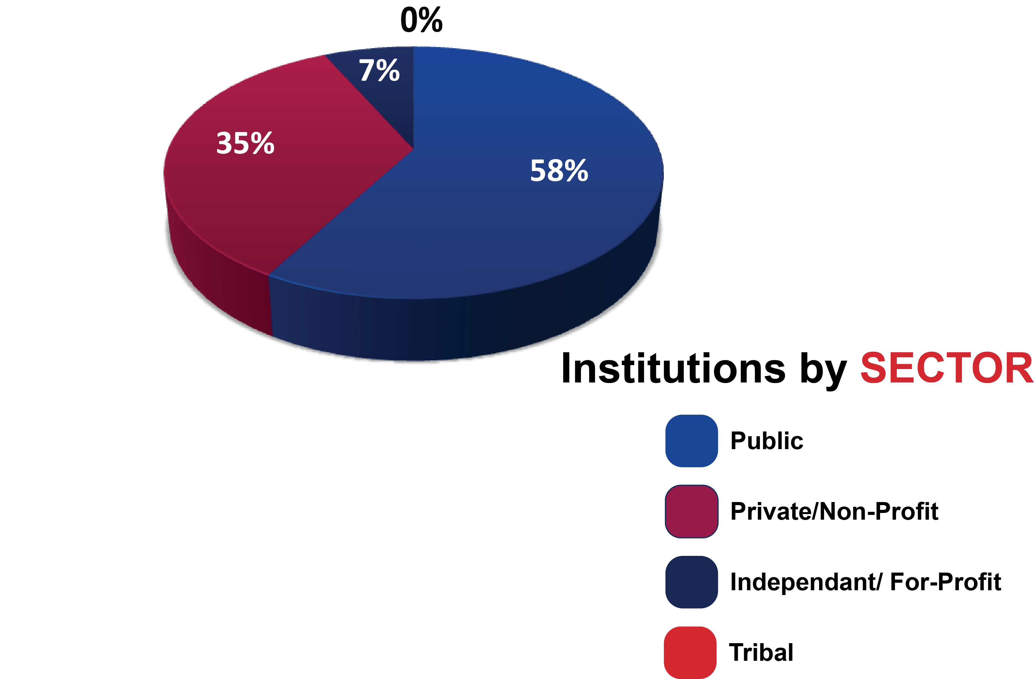
Participating Institutions
As of December 31, 2015

Slide 15
Financial Status of the Sara Initiative
SARA work by all SARA partners (NC-SARA, MHEC, NEBHE, SREB and WICHE) is now almost fully dependent on fee revenue
Current and projected revenues are sufficient to support SARA
Consequently, NC-SARA has determined to keep fees at current levels through June, 2018

Slide 16
What’s Ahead for
SARA?
Complaint and enrollment
reporting and publication:
  Continuation of complaint reporting every quarter;
  SARA institutions will report their out-of-state enrollments in May, 2016, with publication shortly thereafter;
Planned - Database of programs offered by SARA institutions
  NC-SARA’s version of SREB’s Electronic Campus

Slide 17

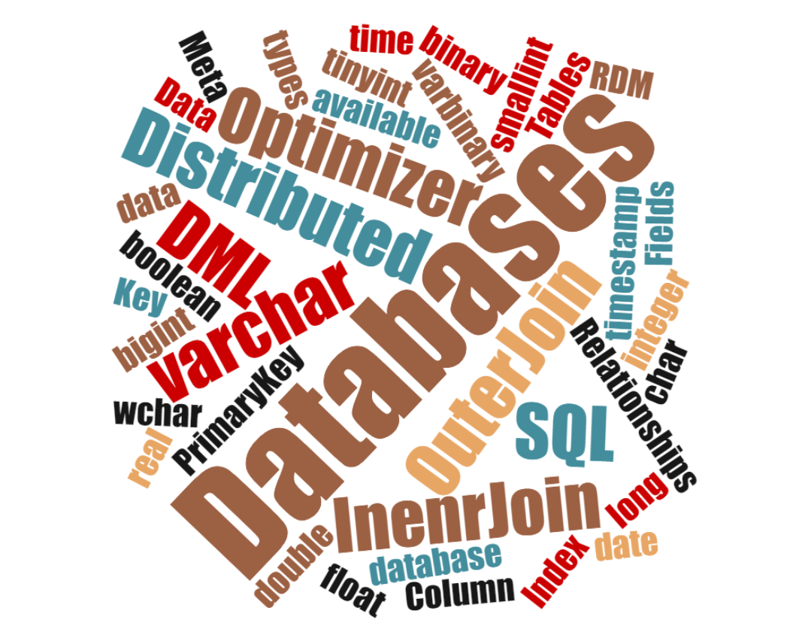
Moving from SREB EC to SARA EC

Slide 18
Now That We’re Past the “Easy” Stuff…
Continue to add states and institutions
Implications and implementation of IRS 501 (c)(3) status for NC-SARA
  Establish independent budgeting, accounting, auditing and IT systems
  Establish appropriate staffing levels
Responding to “down-in-the-weeds” questions and policy issues
  Physical presence
  Experiential learning
  Etc., etc., etc.

Slide 19

SARA: A Negotiated Compromise
Institutions’ goals
Regulators’ concerns
Accreditors

Slide 20


SARA & Professional Licensure
Requirements remain
Increase focus on student notification

Slide 21
June 30, 2017
Reminder
    Non-SARA and SARA institutions – to maintain student coverage - SECRRA institutions will continue to maintain SECRRA and reciprocity with the other SREB states.
    Non-SARA institutions in SREB states will need to seek authorization from all states including the SREB region.
    Start NOW

Slide 22
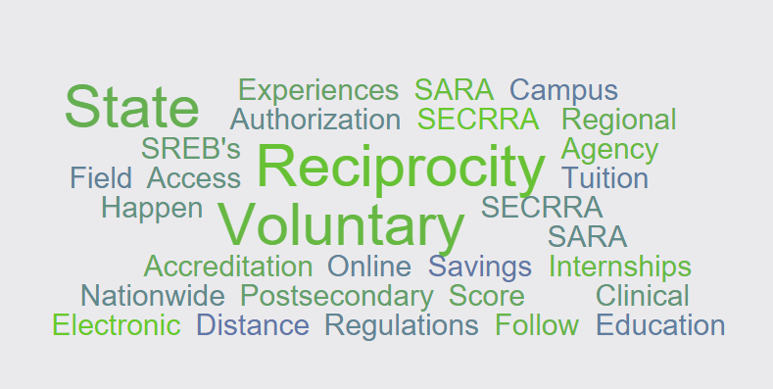
Questions?
As always, feel free to contact information@nc-sara.org with any additional questions or comments
Mary Agnes Larson
Director, Student Access Programs and Services
mary.larson@sreb.org or SARA@sreb.org

