Slide 1
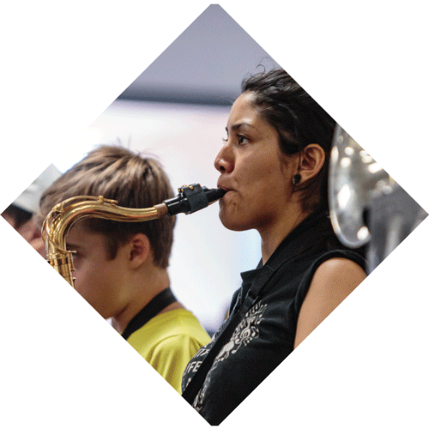
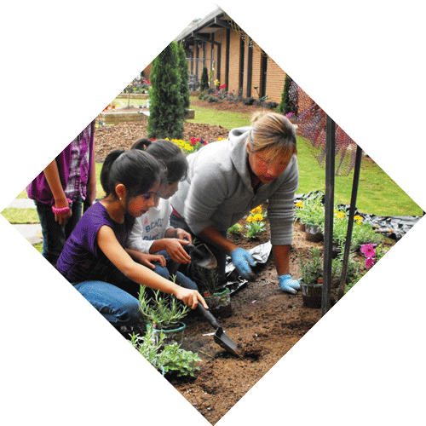
Sustaining Leadership Development
Summit on School Leadership Preparation and Development in Large Districts
April 26, 2018

Slide 2
Why?
Leadership matters.
School leaders account for 25 percent of a school's impact on student learning.
Researchers have not found a case of a struggling school that turned around without a powerful leader.
Principal churn or retention issues are problematic.
Effectiveness of leadership preparation programs is not pervasive.
Other: retirements, growth, …

Slide 3
What is sustainability?
The ability to be sustained, supported, upheld, or confirmed.
A requirement to manage a resource base such that the average quality of life that we ensure ourselves can potentially be shared by all future generations.

Slide 4
The Wallace Foundation says:
From the beginning of an initiative (or program) and throughout its life, scale and sustainability are key aspects.
Even if you succeed at your change goal, it means little if the resulting program does not spread or live on after the initial success.
Sustainability involves the long-term staying power of a program.
Sustainability involves changes in people’s behaviors.

Slide 5
Before you can sustain, you must have:
Evidence of effectiveness or research-based design to gain support
Evidence of high quality
Fidelity to the core elements while being flexible and adapting to stakeholder needs

Slide 6
Factors that contribute to sustainability:
Hard funds (non-grant)
Partnership(s)
Work embedded in the culture
Evidence of a “champion” for the work
Processes, policies, or procedures in place

Slide 7
Implications:
Planning for sustainability should start at the beginning of a project.
Grant funds may conceive the effort but hard or stable dollars sustain it.
Partnerships and learning communities are useful to advance and sustain projects/programs.
Develop strategies to address personnel changes

Slide 8
The Wallace Foundation says:
To ensure that a program is truly “in the water supply,” attitudes and behaviors need to change.
The goal is to convert “best practice” into “common practice.”

