Slide 1
Developing psychiatric nursing in Southern Universities: Historical Perspectives from the SREB.
Dr Kylie M Smith
Assistant Professor
Andrew W Mellon Faculty Fellow for Nursing & the Humanities
Nell Hodgson Woodruff School of Nursing
Emory University Atlanta GA
Notes:
Intro, what are you going to talk about, what will follow in the presentation

Slide 2
Mental health afer WWII

Slide 3
An anxiety riddled age
NIMH 1946
Post war social stability
Are you always worrying?
Therapeutic culture
Cold War, anti-communism, homophobia
More than half of all hospital beds in psychiatric institutions

Slide 4
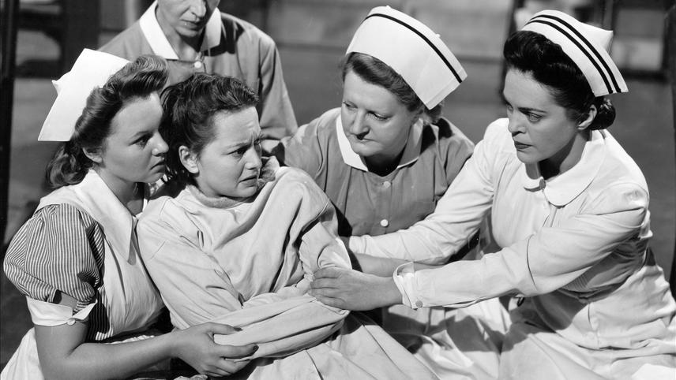
The Snake Pit 1948

Slide 5
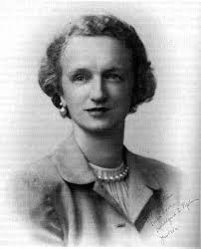
Talking Therapy
Argued that nurses could be therapists
Required specialist knowledge
Interpersonal relations and psychodynamic nursing
How and where should this be taught?
Psychiatric nursing first graduate clinical specialty
Masters programs by 1950 in the North
Hildegard Peplau 1950

Slide 6
The Mental Health Training and Research Project
Southern Regional Education Board 1949-1970

Slide 7
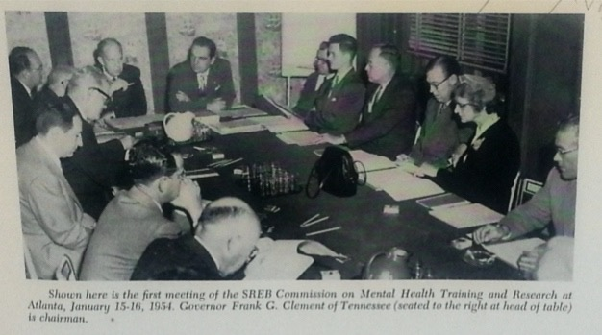
Notes:
Psychiatry, psychology, psychiatric social work, psychiatric nursing

Slide 8
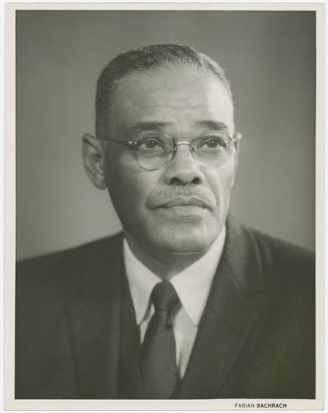
Rufus Clement
Atlanta University
Charles S Johnson
Fisk University
Notes:
The role of psychology in Brown v Board of Education
Fisk University TN
Whitney Young – Dean of Social Work Atlanta University, Executive Director National Urban League
Rufus Clement – President, Atlanta University

Slide 9
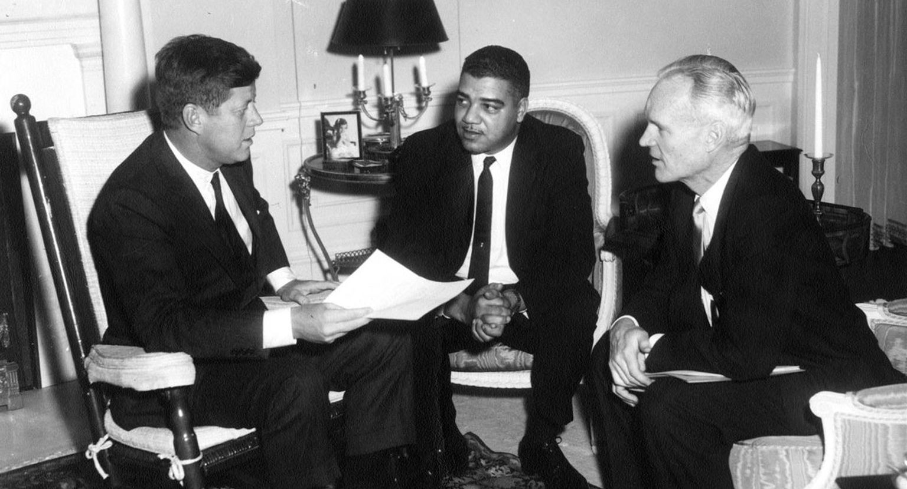
Whitney Young
Dean of Social Work Atlanta University
Executive President National Urban League

Slide 10
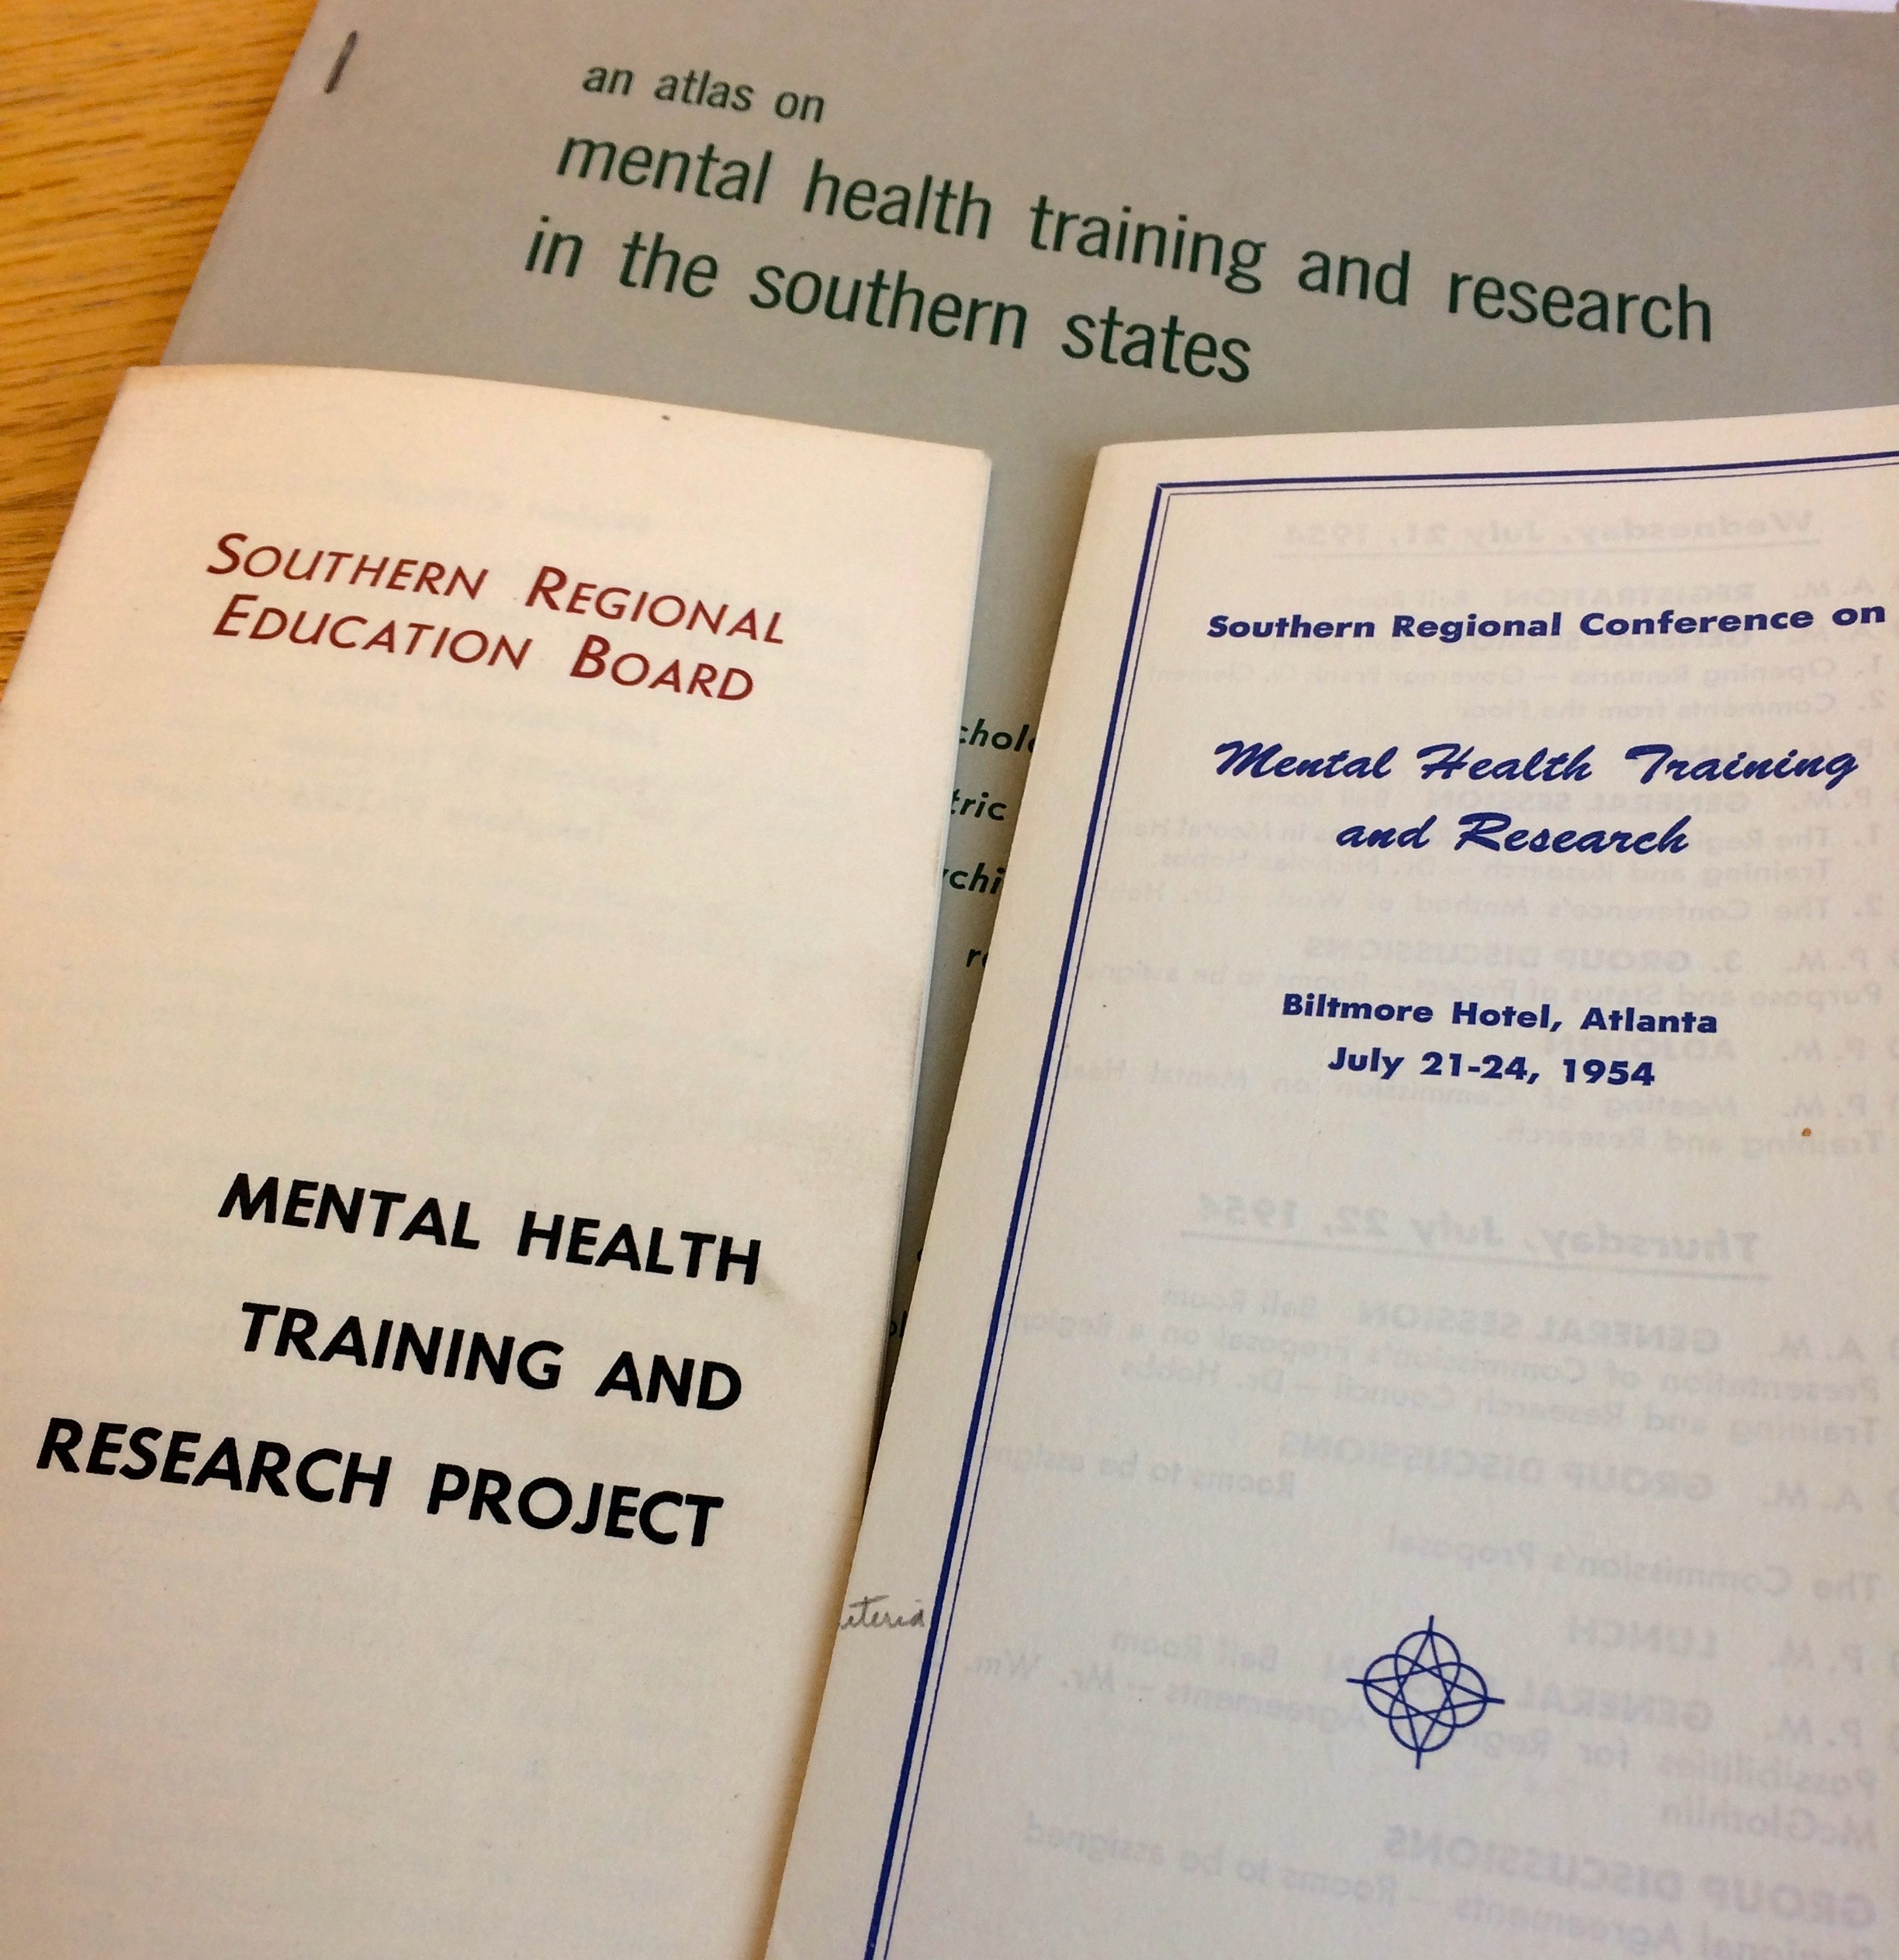

Slide 11
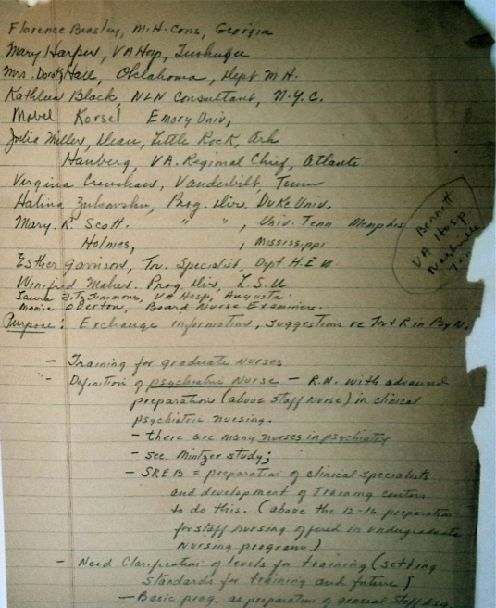
Esther Garrison, Training and Standards branch, NIMH
Kathleen Black, National League for Nursing Education, NYC.
Virginia Crenshaw, SON, Vanderbilt.
Laura Fitzsimmons, Chief Nurse, VA Hospital, August and President GSNA
Hildegard Peplau, Director, Graduate Psychiatric Nursing Program, Rutgers University.
Mrs Mary S Harper, Assistant Chief, Nursing Education, VA Hospital, Tuskegee, Alabama.
Notes:
Florence Beasley, Mental Health Nurse Consultant, Georgia State Health Dept.
Kathleen Black, Psychiatric Nursing Consultant NLN
Virginia Crenshaw, SON, Vanderbilt
Laura Fitzsimmons Chief Nurse, VA Hospital, August and President GSNA
Esther Garrison, Training and Standards branch, NIMH
Dorothy Hall, DON, Oklahoma Dept of Mental Health
Mrs Mary S Harper, Assistant Chief, Nursing Education, VA Hospital, Tuskegee,AL
Marie Haurberg, Area Chief Nurse, Veterans Administration, Atlanta GA
Louise Holmos, Division of Public Health Nursing, Mississippi State Board of Health
Mabel Korsell, SON, Emory
Winifred Maher, Dept o Nursing Education, Louisiana State University
Hilda NYC
Julia Miller, SON, University of Arkansas
Mary Paines Scott, Educational Director of Nursing, Geilor Memorial Hospital, Memphis TN
Halina Zukowksi, Duke U, Durham NC

Slide 12
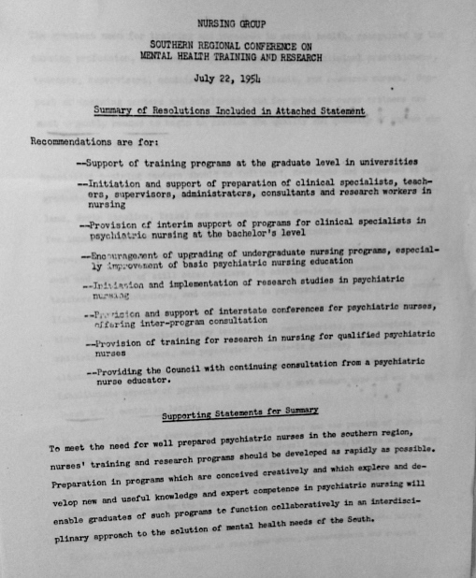

Slide 13
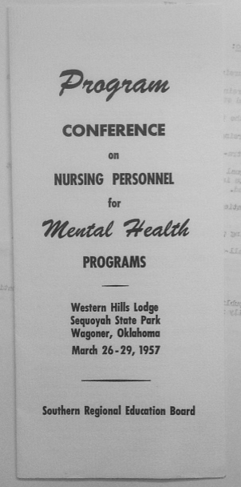
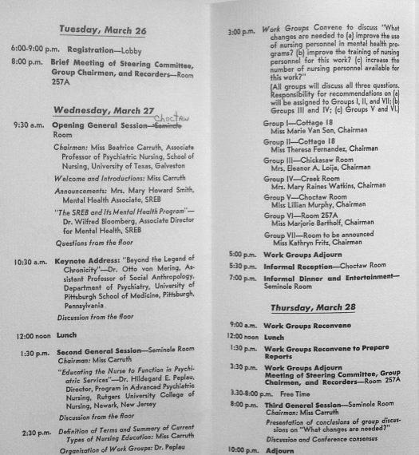

Slide 14
Issues and debates
What states had the greatest need?
Who had the best existing resources, including clinical affiliations?
Who had or could have masters programs?
Should psychiatric nursing be part of general or specialist educations?
What sort of practice ideas and theories should be included?
Who was qualified to teach at this level?
How should programs be arranged to meet all levels of need?
Where would the money come from?

Slide 15
Psychiatry & Nursing in Alabama

Slide 16
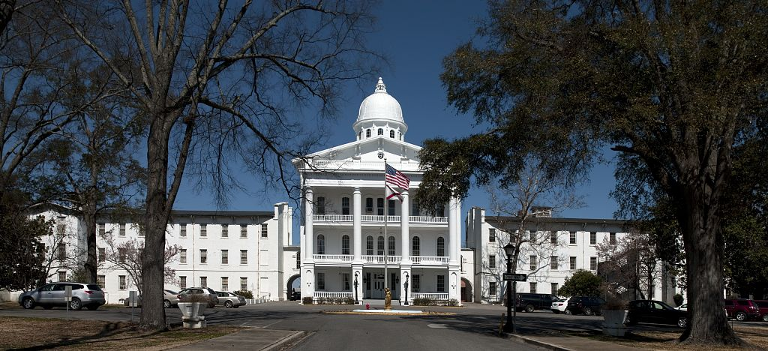
Bryce Hospital Tuscaloosa

Slide 17
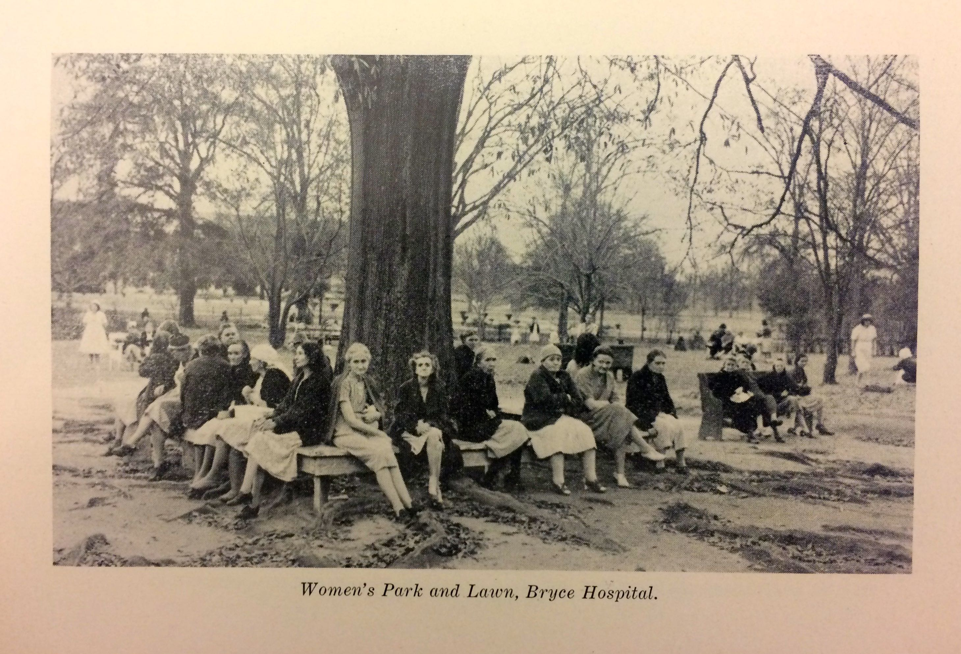

Slide 18
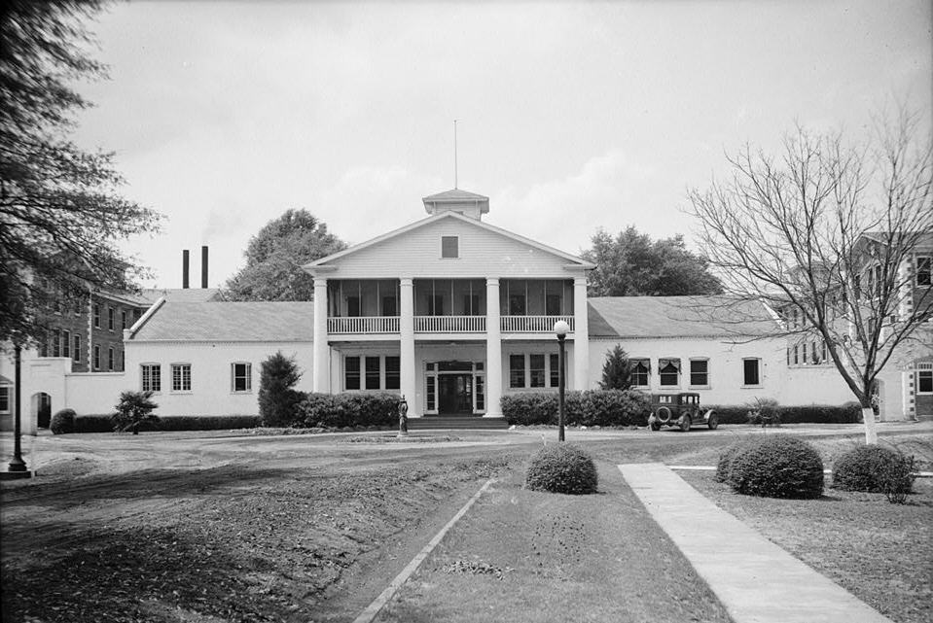
Searcy Hospital Mt Vernon

Slide 19
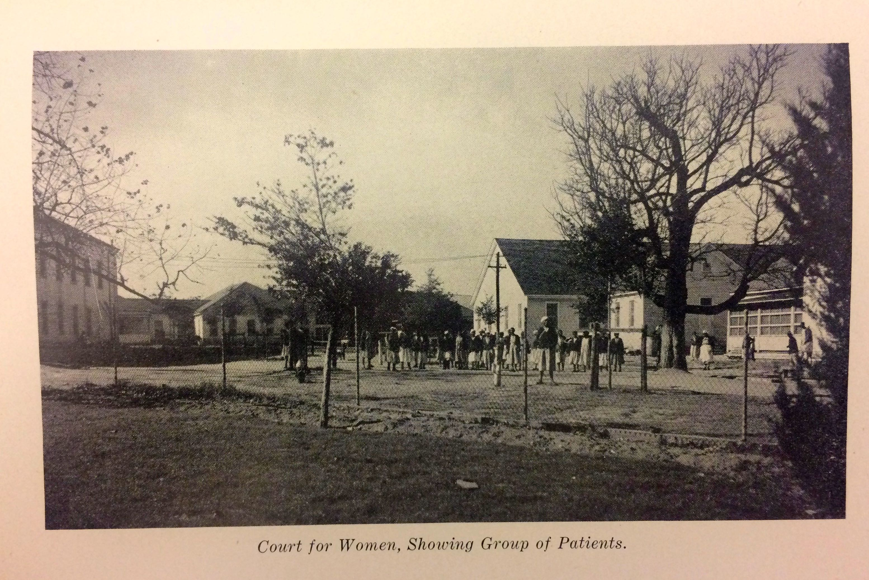

Slide 20
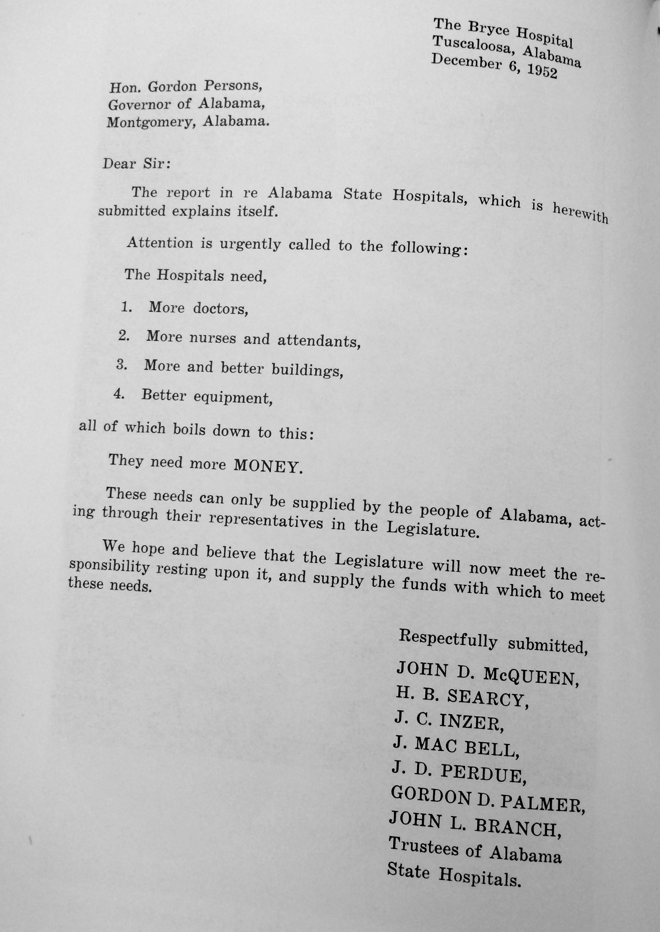

Slide 21
Tuskegee
First baccalaureate in Alabama – 1949
Federal funding through VA
Affiliations at Crownsville State Hospital Maryland
Mental hygiene clinic
Highly skilled psychiatrists
Desegregated patient and workforce

Slide 22
University of Alabama

Slide 23
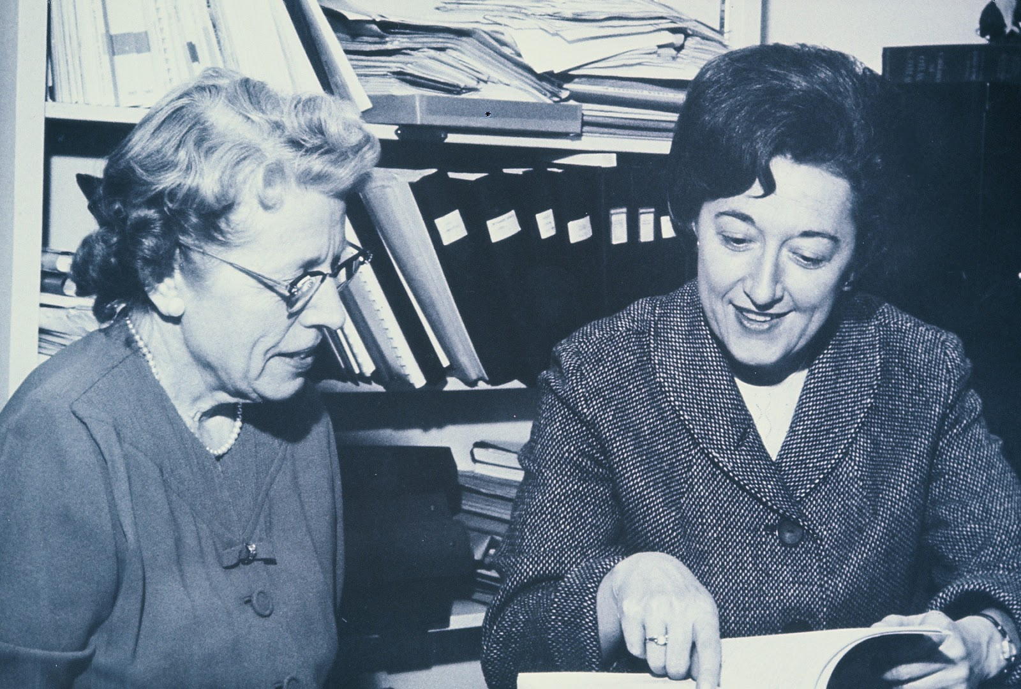
Deans Florence Hixson and Marie O’Koren 1967
Notes:
Various programs at Bryce and University of Alabama
Shifting affiliations: how this effected the whole state
What money they got from NIMH etc

Slide 24
1958
integrating mental health and psychiatric concepts throughout all of the courses in the curriculum.
to help both faculty and students in utilising mental health concepts in the teaching and learning processes and in the nursing care of patients

Slide 25
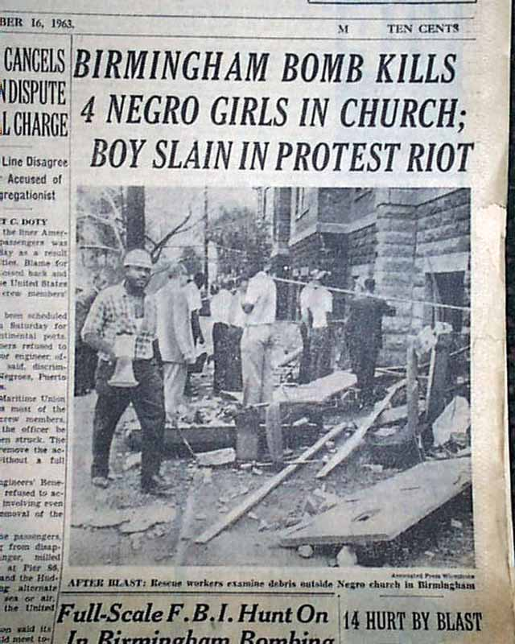
1963
NY Times Sept 16

Slide 26
1966

Slide 27
1971
Masters in Psychiatric Nursing
Arthur Ree Campbell
Eloise Clarke
Cynthia Rector
Notes:
BSN Tuskegee
MSN University of Maryland
Qualified psychotherapist
ELOISE’S ARTICLE

Slide 28
1972
Wyatt v Stickney 1970-2003
Lynch v Baxley 1974
Human Rights Commission
Minimum Standards
NY Times March 26 1972
Peplau Collection, Schlesinger Library

Slide 29
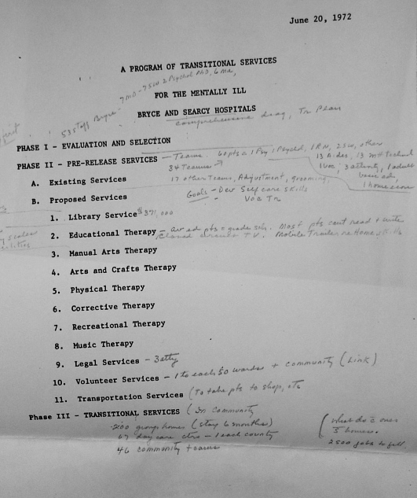

Slide 30
So what?

Slide 31
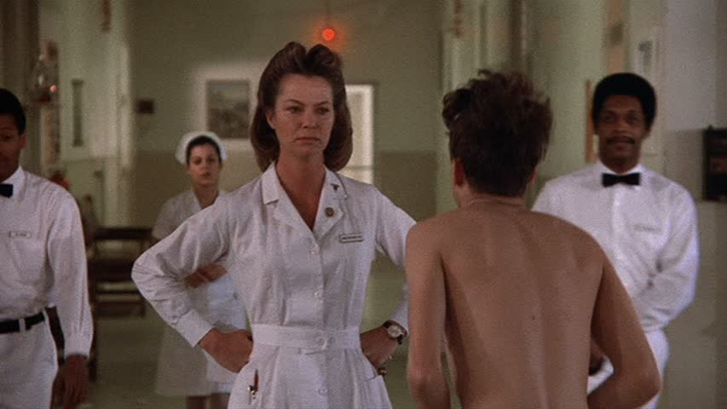
Notes:
Did any of this have an impact?
What has changed in theory and practice of psych/mental health nursing? The impact of psychotropic drugs and community mental health on psych nursing put limits on autonomous practice.
The changing nature of practice settings – from hospitals to community.
Mental illness as a crime– complicates nursing practice and educational demands
Increased mental illness or changing diagnoses as social control?
History as essential to understanding why we do what we do, and how regional, culture and politics continue to influence nursing practice. At least with the SREB there was a co-ordinated approach and a hub for information

Slide 32
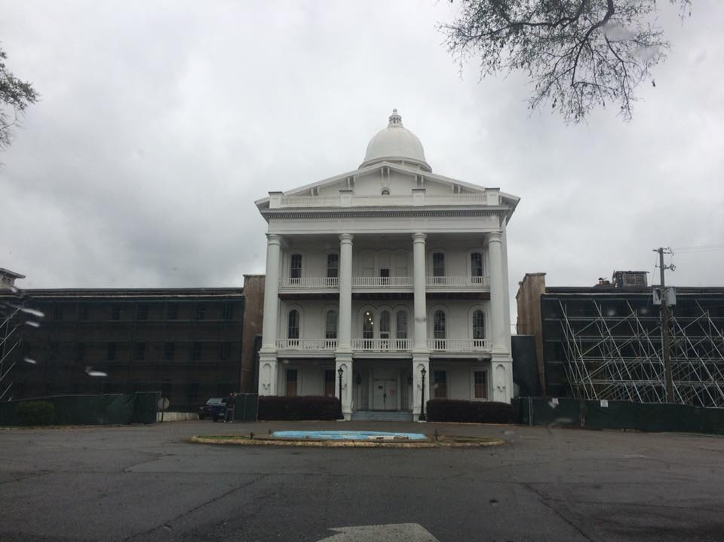

Slide 33
