Slide 1

Leading and Observing for
Instructional Shifts in Literacy
George Johnson, Southern Regional Education Board
george.johnson@sreb.org
Dr. Gail Dugger, Assistant Principal
St Marys Middle School, Camden County, Georgia
gdugger@camden.k12.ga.us

Slide 2

Goals of LDC
To engage students in reading, comprehending, analyzing, interpreting, and responding to complex texts
To align assignments to the College and Career Readiness Standards and to promote collaboration
To help teachers personalize learning so that every student can master the CCRS
To ensure that all students can be college and career ready
To improve literacy instruction in all classes

Slide 3
St. Marys Middle School
Camden County , Georgia

Slide 4
The SREB and SMMS Collaborative partnership
Creation of School Improvement Focus Teams
LDC
MDC
Problem-Based Learning
STEM curriculum: Seeking State STEM Certification

Slide 5
SMMS Before GSE/LDC in ELA
Teachers:
Focused on a single text with a focus on literary
Assigned mostly shorter response writings
Required persuasive rather than argumentative writing
Based writing on prompts rather than a response to reading
Students:
Viewed writing as a Language Arts only activity
Read few informational texts
Wrote mostly about literary elements

Slide 6
SMMS Before LDC science/Social studies
Teachers:
Wrote lesson plans as a series of activities based on a single text
Assigned a limited number of short writing tasks
Delivered predominantly whole-class instruction, lecture, note taking, testing
Conducted whole-group discussion that focused on Q&A around knowledge and recall of facts
Students:
Sat in rows and completed individual seatwork
Engaged in learning activities based on text questions and responding to teacher questions
Became passive learners
Responded only to the teacher’s questions
Completed few, if any written work in content area classes
Participated in limited classroom discussions

Slide 7
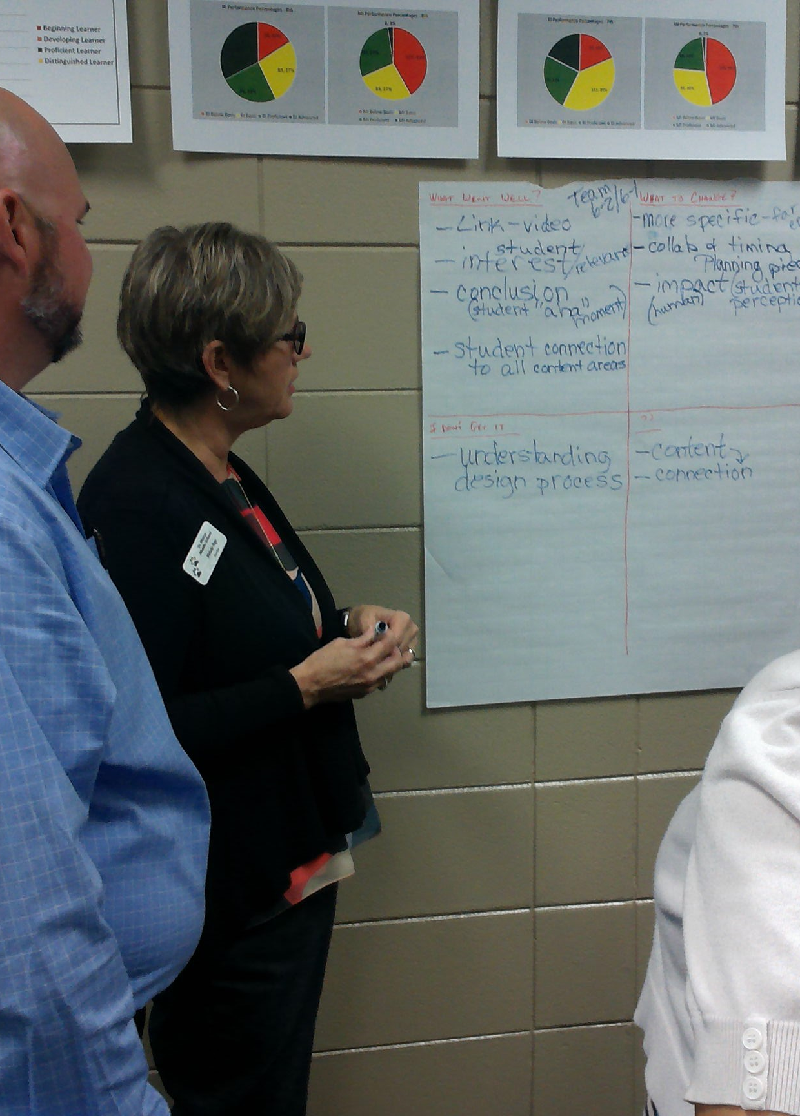
LDC:
Literacy Design Collaborative
Training and Coach-embedded classroom visits:
Year 1: ELA Teachers
Year 2: Science, Social Studies Teachers, Sp. Ed. Teachers
Year 3: LDC embedded in PBL and STEM units

Slide 8
SMMS After GSE/LDC: ELA
Teachers:
Design scaffolded learning modules based on writing as a response to reading
Generate writing prompts that address paired and multiple texts
Build activities that foster independent learning
Create structured paired or group activities allowing more time to focus on individual student needs
Develop lessons required meaningful questioning and discussion (such as Socratic seminar)
Students:
Work in collaborative teams
Engage in active learning activities
Respond to informational texts in both argumentative and expository formats
Engage in independent learning
Create authentic written work in response to authentic texts
Engage in meaningful discussions about their work

Slide 9
SMMS After LDC: Science/Social Studies
Teachers:
Design scaffolded learning modules to build on students’ understanding of reading
Generate writing prompts that are authentic to the content area
Build in activities that foster independent learning and exploration of content
Assign more complex informational texts and are less reliant on course textbooks
Create structured paired or group activities, allowing more time to focus on individual student needs
Students:
Work in collaborative teams
Engage in active learning activities
Become independent learners
Take greater responsibility for their learning
Create authentic written work in the subject area
Engage in meaningful discussions about content centered around student work

Slide 10
Georgia Milestones EOG Comparisons: Percentage Students Proficient and Distinguished
2015 to 2016
Grade/Subject | 2015 | 2016 | Gain Year-Year | Gain Cohort
ELA
6 | 39 | 44 | +5 | --
7 | 38 | 40 | +2 | +1
8 | 43 | 48 | +5 | +10
Science
6 | 39 | 40 | +1 | --
7 | 44 | 47 | +3 | +8
8 | 40 | 34 | -6 | -10
Social Studies
6 | 39 | 44 | +5 | --
7 | 44 | 50 | +6 | +11
8 | 28 | 37 | +9 | -7

Slide 11
How do you know it’s working?
(Regularly and Continuously)
Pre- and Post-assessments in writing?
Standardized Testing?
Teacher Surveys?
Observe Student and Teacher Behaviors in the classroom to identify the shifts in literacy instruction?

Slide 12
3 Questions you expect teachers to answer when they teach a lesson:
What do you want the students to____?
learn
2. What are the students doing to show that they are _____?
learning
3. How do you know that the students have__?
learned

Slide 13
How do teachers move…
From:
The teacher: Provides written questions from teacher/text to demonstrate understanding.
To:
The teacher: Allows students the opportunity to apply the appropriate literacy strategies to learn content and successfully complete the assignment.

Slide 14
How do students move…
From:
The students: Respond to teacher’s questioning; memorize facts; copy notes.
To:
The students: Generate higher-order questions as part of the collaborative learning process leading towards completion of the assignment.

Slide 15
Essential Behaviors When Using LDC
Essential Planning for Literacy-Based Instruction
Preparing for the Task: Launching the Assignment
The Reading Process
Transition to Writing
The Writing Process
Using Rubrics as Instructional Tools
Using Rubrics for PLC Collaboration Around Student Work
(page 2)

Slide 16
Powerful Practices:
A Primer for School Leaders
Planning is an essential component in the design of all literacy instruction, especially for LDC. (page 3)
Essential Classroom Behavior #1: Planning
LDC Performance Indicator (left column)
Document*
Teachers
Criteria for Quality Assignments
Artifacts*
Details (page 4)

Slide 17
Topic:
Critical Focus Question:
Prompt:
Standards for Literacy and Content:
Reading
Pacing | Instruction (prompt) | Student Work (product) | Assessment (scoring guide)
 | Writing
Pacing | Instruction (prompt) | Student Work (product) | Assessment (scoring guide)
 |  |  | Page 12

Slide 18
Powerful Practices:
A Primer for School Leaders
Essential Classroom Behaviors #2-7
Organization of the Behaviors(pages 6-11)
LDC Performance Indicator
“What does it look like?” Components
(page 6, The Reading Process):
Document*
Teachers
Students
Artifacts *
Details/Explanation

Slide 19
Rubric for LDC Powerful Practices
The rubric must:
Reflect the most important components of effective implementation of the LDC Framework
Represent a continuum of performance that identifies the instructional shifts for literacy in the classroom
Be a practical tool for teachers, trainers, coaches and school leaders
Mirror elements of traditional observation tools
Be a growth indicator, not an evaluation tool
Be user friendly

Slide 20
Rubric Indicators page 13
Planning:
A literacy-based assignment which includes an authentic written product reflecting evidence from reading complex texts that are challenging and appropriate to course content.
Descriptors:
Grade level text(s) are appropriate to the content standards and provide credible evidence to produce the authentic writing.
The assignment is designed to engage students in the reading of complex texts leading to a clear, authentic writing product that allows for multiple responses supported by evidence.

Slide 21
Rubric Indicators page 13
Planning:
A lesson sequence that supports/scaffolds the learning of literacy and content standards with explicit instruction that leads students through every part of the learning process.
Descriptor:
Instructional activities are sequenced and tightly aligned to content and literacy standards

Slide 22
Rubric Indicators page 13
Instruction:
Objectives and learning targets have a clear and coherent purpose for students.
Descriptors:
The teacher:
Provides students opportunities to reflect on their level of understanding of the learning target/objective.
The students:
Articulate the learning target/ objective and its connection to the short-term or long-term literacy-based assignment.

Slide 23
Rubric Indicators page 14
Instruction:
Literacy strategies (reading, writing, speaking and/or listening) that are integrated into content-based instruction.
Descriptors:
Independent application of literacy strategies in new situations to synthesize, analyze and evaluate complex texts to create authentic responses.
The teacher:
Allows students the opportunity to apply the appropriate literacy strategies to learn content and successfully complete the assignment.
The students:
Engage in self-selected strategies for reading, writing, listening, and/or speaking that lead to the completion of an authentic writing assignment.

Slide 24
Rubric Indicators page 14
Instruction:
A classroom environment of student discourse that supports ownership of learning and a deeper understanding of important concepts.
Descriptors:
The teacher:
Facilitates and monitors student discussions to gain deeper knowledge of disciplinary text and the development of an authentic written product.
The students:
Generate higher-order questions as part of the collaborative learning process leading towards completion of the assignment.

Slide 25
Rubric Indicators page 15
Assessment:
Use of assessments in all aspects of the teaching and learning process.
Descriptors:
Formative assessments are clearly aligned to identified standards and cognitive demands.
Summative assessments require students to use multiple strategies to demonstrate their understanding of the learning targets and concepts.
The teacher:
Adjusts instruction based on regular checks for understanding that monitor progress.
The students:
Demonstrate understanding through the application of multiple literacy-based strategies to create a sustained writing product.

Slide 26
What’s Next?
Rubric Development Process
Field Testing Experiences
Final Revisions
Implications for LDC Training
Training for Administrators
Questions?

