Slide 1
Developing a Mass Casualty Simulation with Limited Space, Resources, and Personnel
Michele Montgomery PhD, MPH, RN

Slide 2
Background
Incidence of mass casualty events is on the rise.
Nurses lack knowledge, skills and training in mass casualty preparedness and response.
Nurses need to shift focus from individual care to population-focused care.
Simulation allows students to gain knowledge and skills in a safe environment

Slide 3
Goals of Simulation
The simulation was designed to increase students’ ability to:
Identify the different roles utilized in disasters
Explain the criteria for each of the basic mass casualty triage levels
Discuss the possible long-term effects of a mass-casualty event
Identify the legal and ethical issues regarding the role of the nurse in mass casualty management
Identify nursing interventions in treating victims from mass casualty events using limited resources

Slide 4
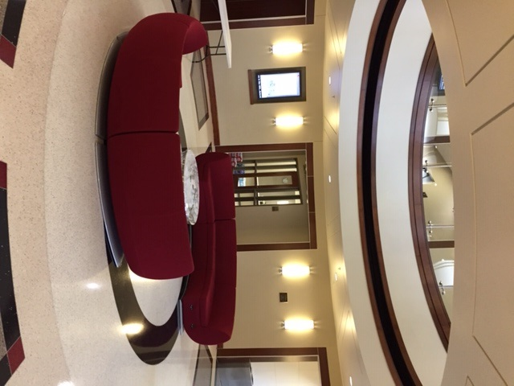
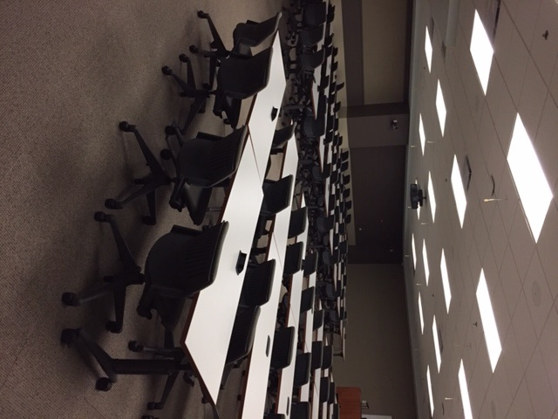
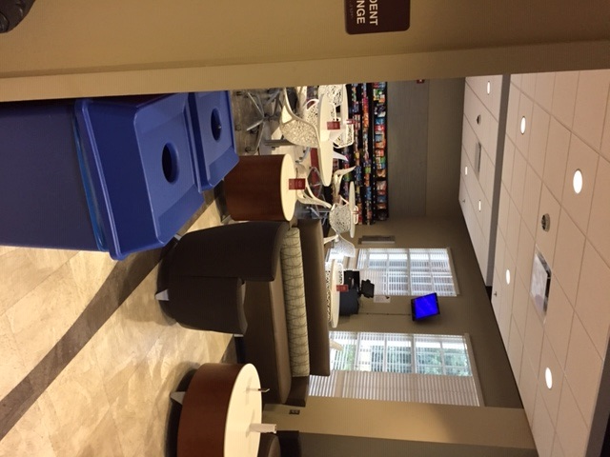
Location of the Program
The University of Alabama Capstone College of Nursing.
The interior and exterior of the building was utilized.

Slide 5
Participants
Senior-level Nursing students (first responders)
Second-semester Fundamentals students (victims)
HOSA students (victims)
Faculty and staff (bystanders, news reporters, police)

Slide 6
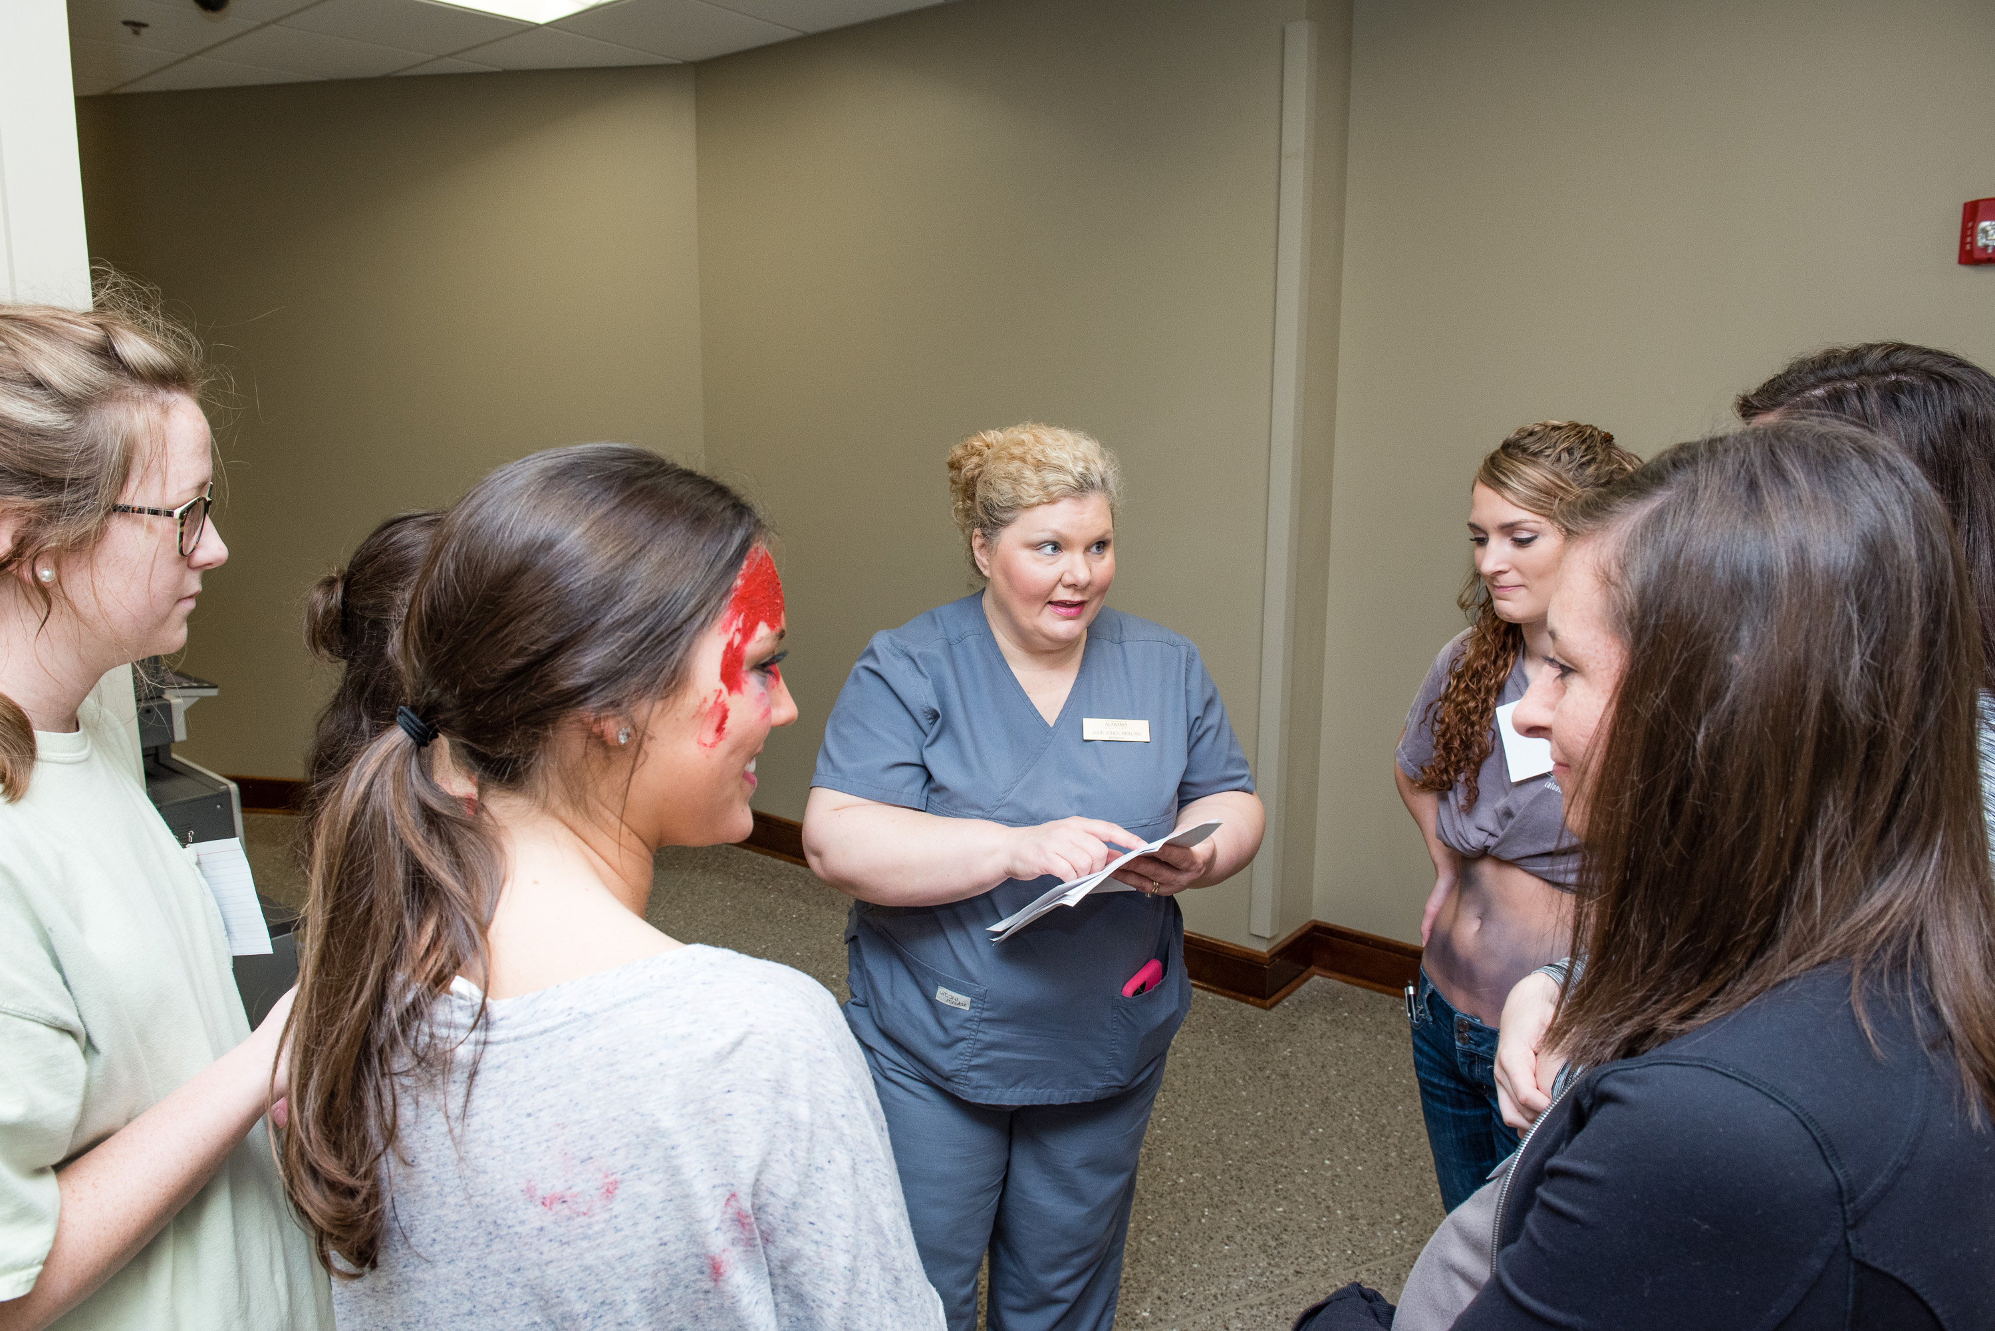
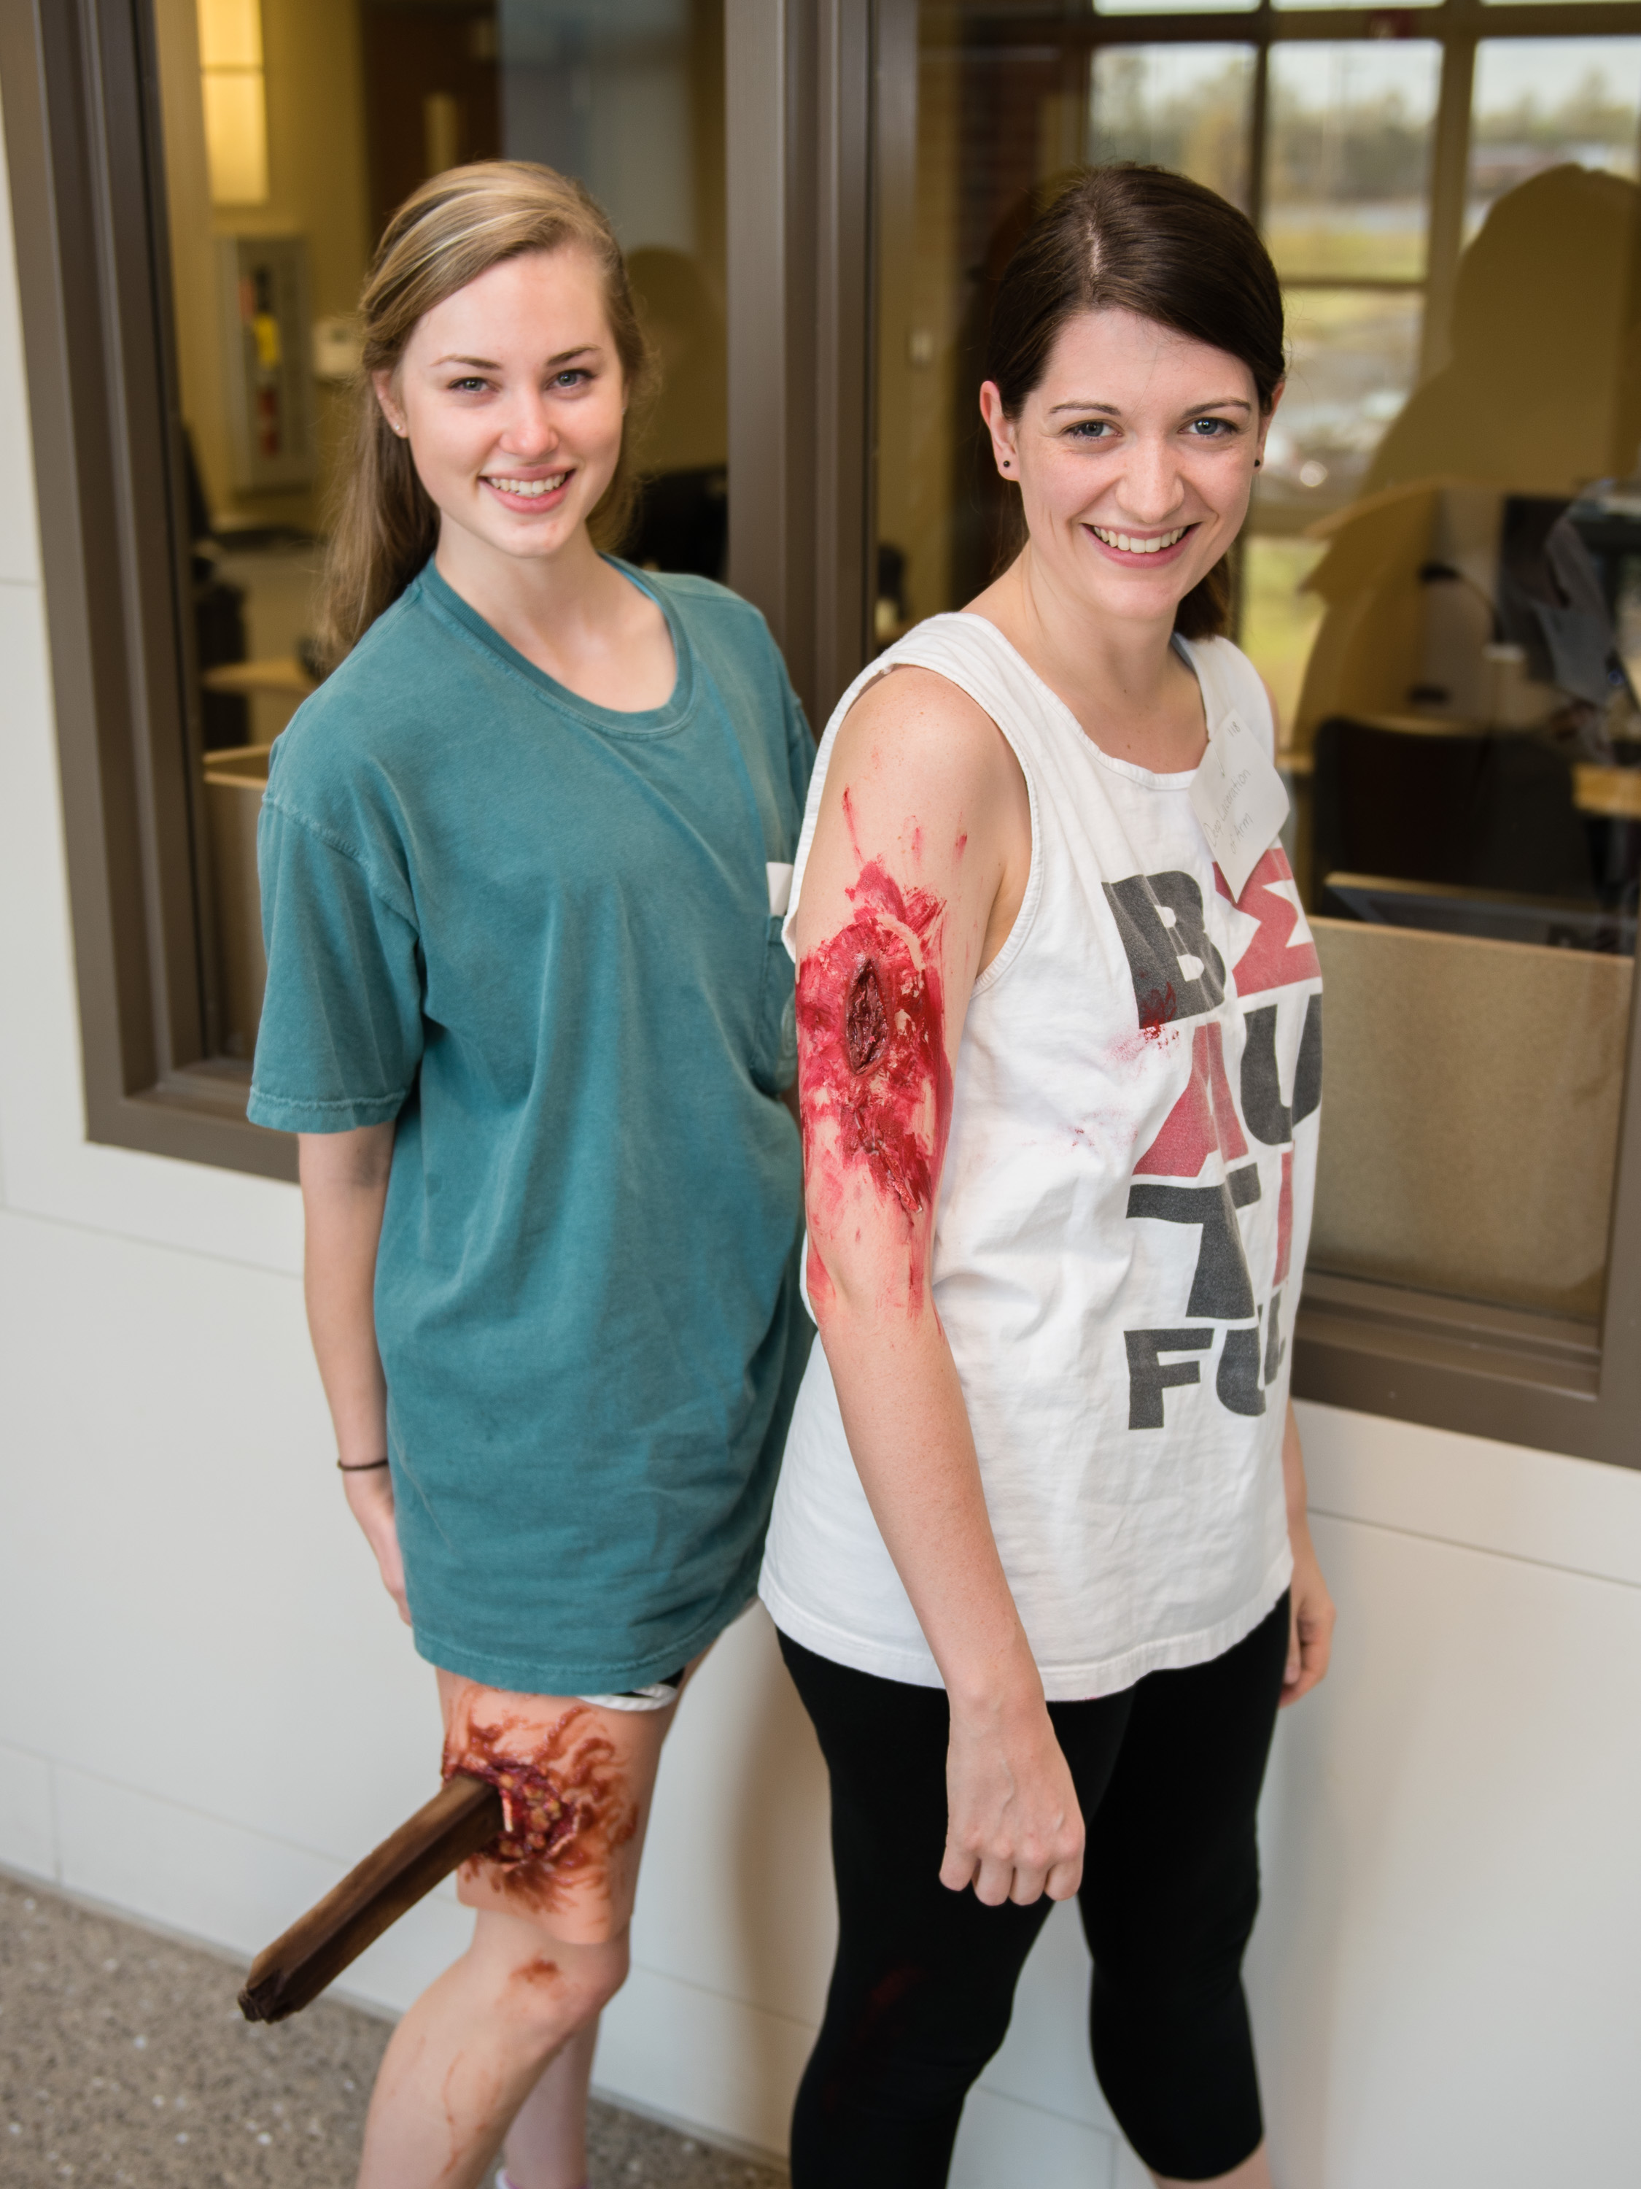
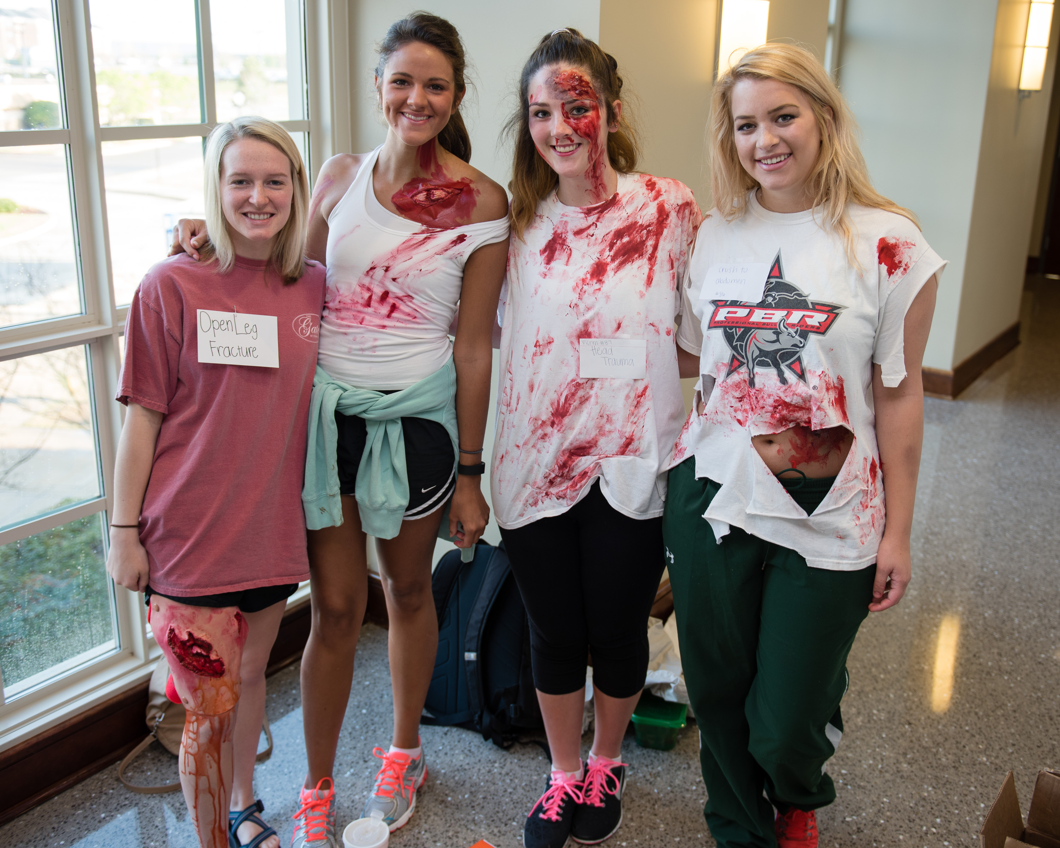
Description of Simulation

Slide 7
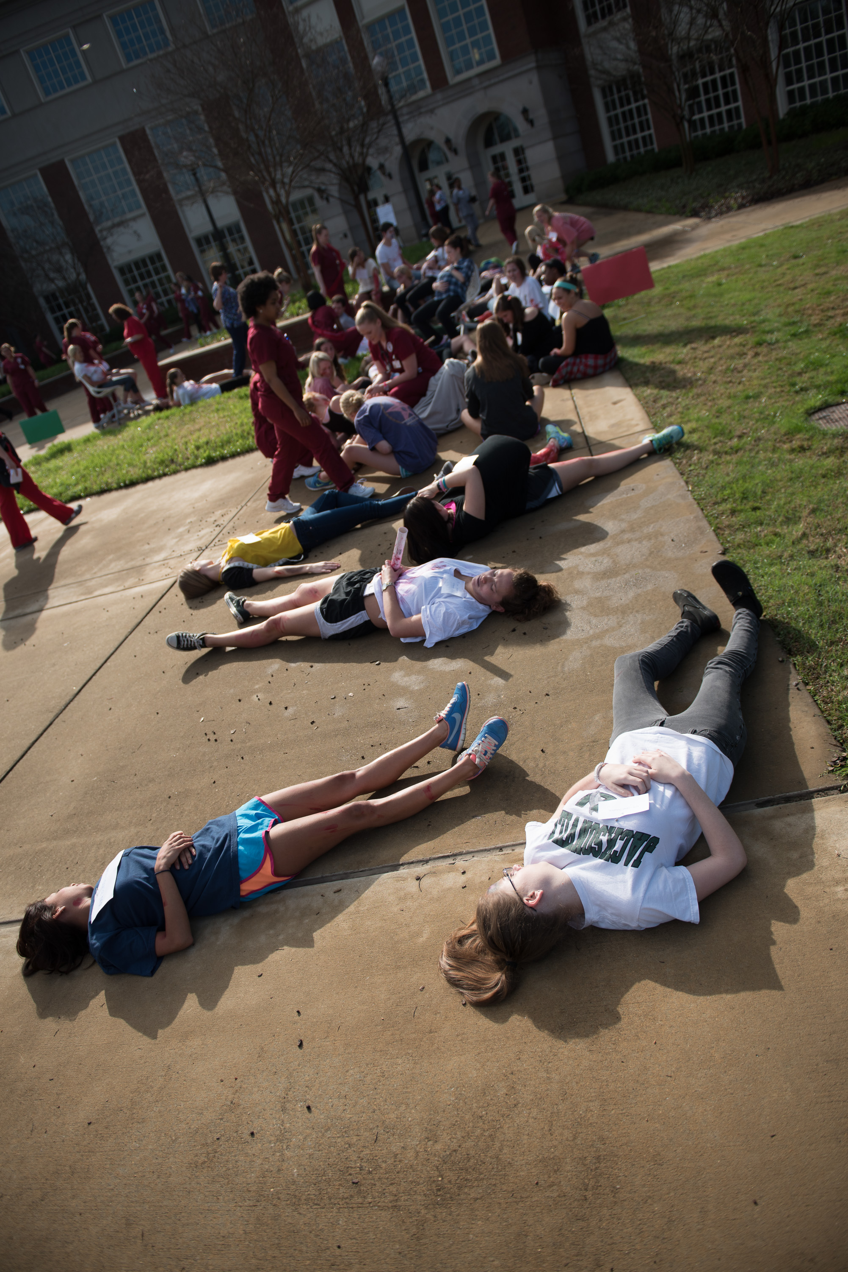
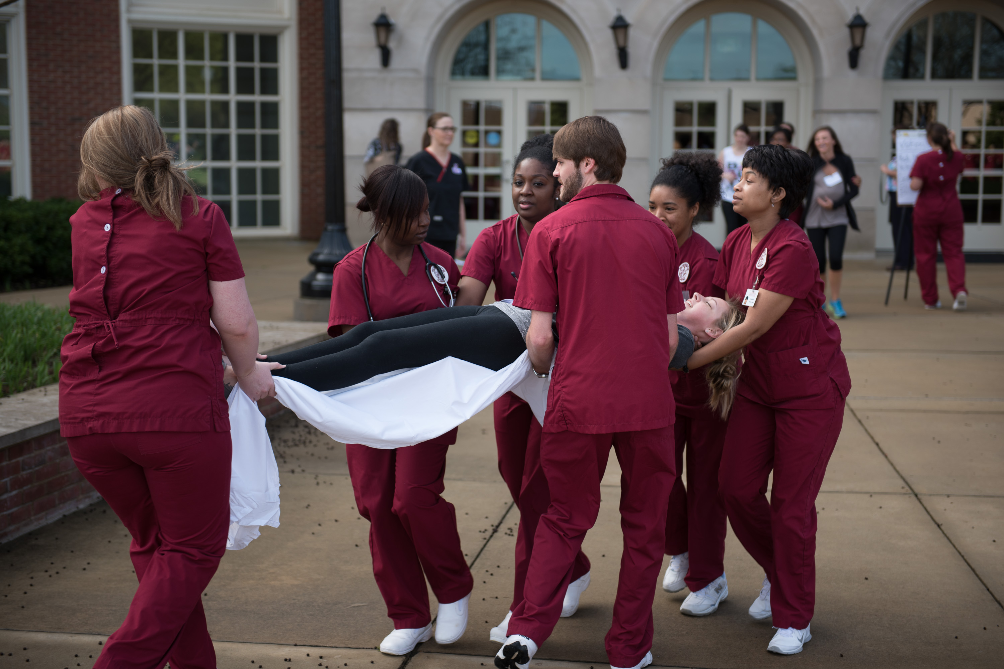
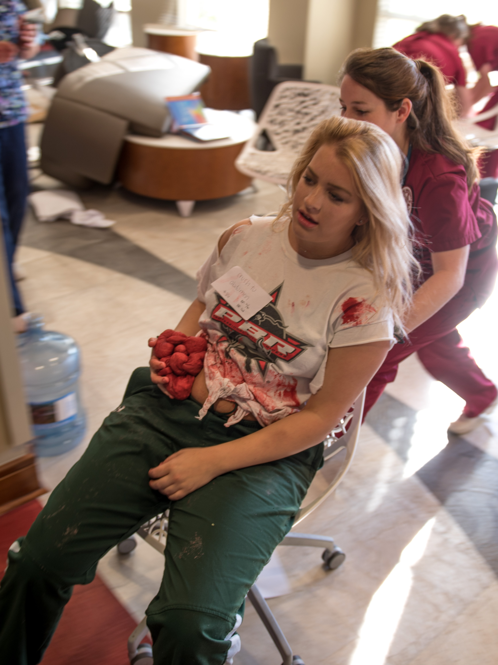
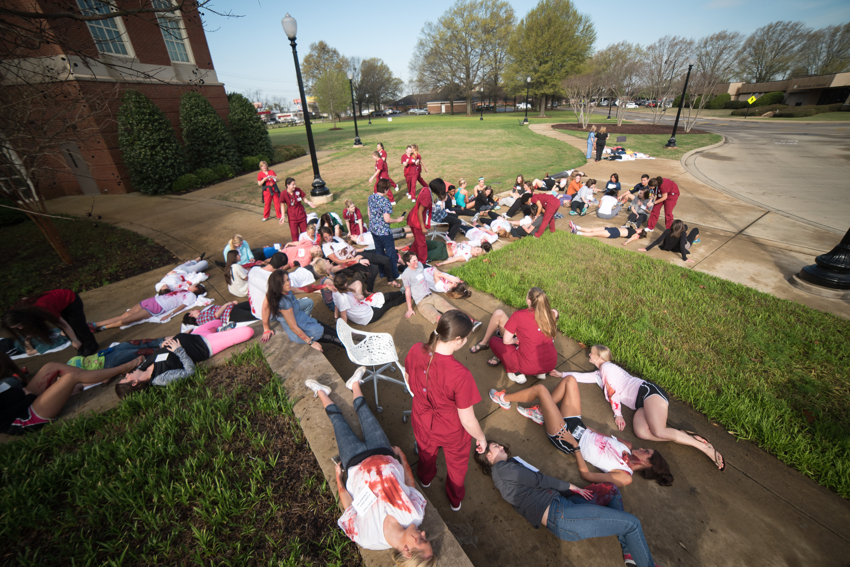
Description of Simulation

Slide 8
Evaluation
Online survey administered to measure effectiveness
58% responded they agree or strongly agree the simulation increased confidence to provide competent care
65% said it was challenging and stimulated their learning
70% responded it helped them learn the didactic material
79% responded the difficulty of the simulation was appropriate for the coursework

Slide 9
Evaluation-Continued
64% agreed or strongly agreed the simulation helped them to meet clinical expectations when caring for real patients
72% responded their learning expectations were met in this simulation
67% responded the simulation allowed them to model a professional role in a realistic manner
80% responded the debriefing helped them to understand the clinical decision-making necessary for this experience

Slide 10
Evaluation-Continued
86% responded it was effective in helping them identify the different roles utilized in mass casualty events
81% responded it was effective in helping them learn the criteria for reach of the basic disaster triage levels
56% responded the simulation was effective in helping them identify the legal and ethical issues regarding the role of the nurse during a mass casualty event
78% said it was effective in helping them identify nursing interventions in treating victims

Slide 11
Questions????

