Slide 1

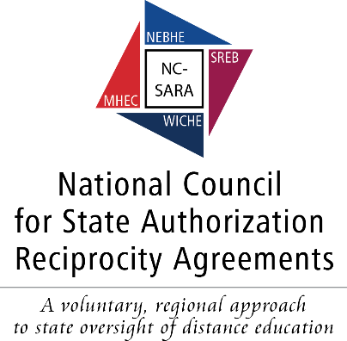
  State Authorization
  Reciprocity Agreement for
  Distance Education
SARA
We’re Way Past the “Easy Stuff” -- The Continuing Evolution of SARA
NASASPS April 5, 2017

Slide 2



Presenters:
Marshall A. Hill
Executive Director, NC-SARA
Mary Larson
Director
Student Access Programs
and Services, SREB

Slide 3

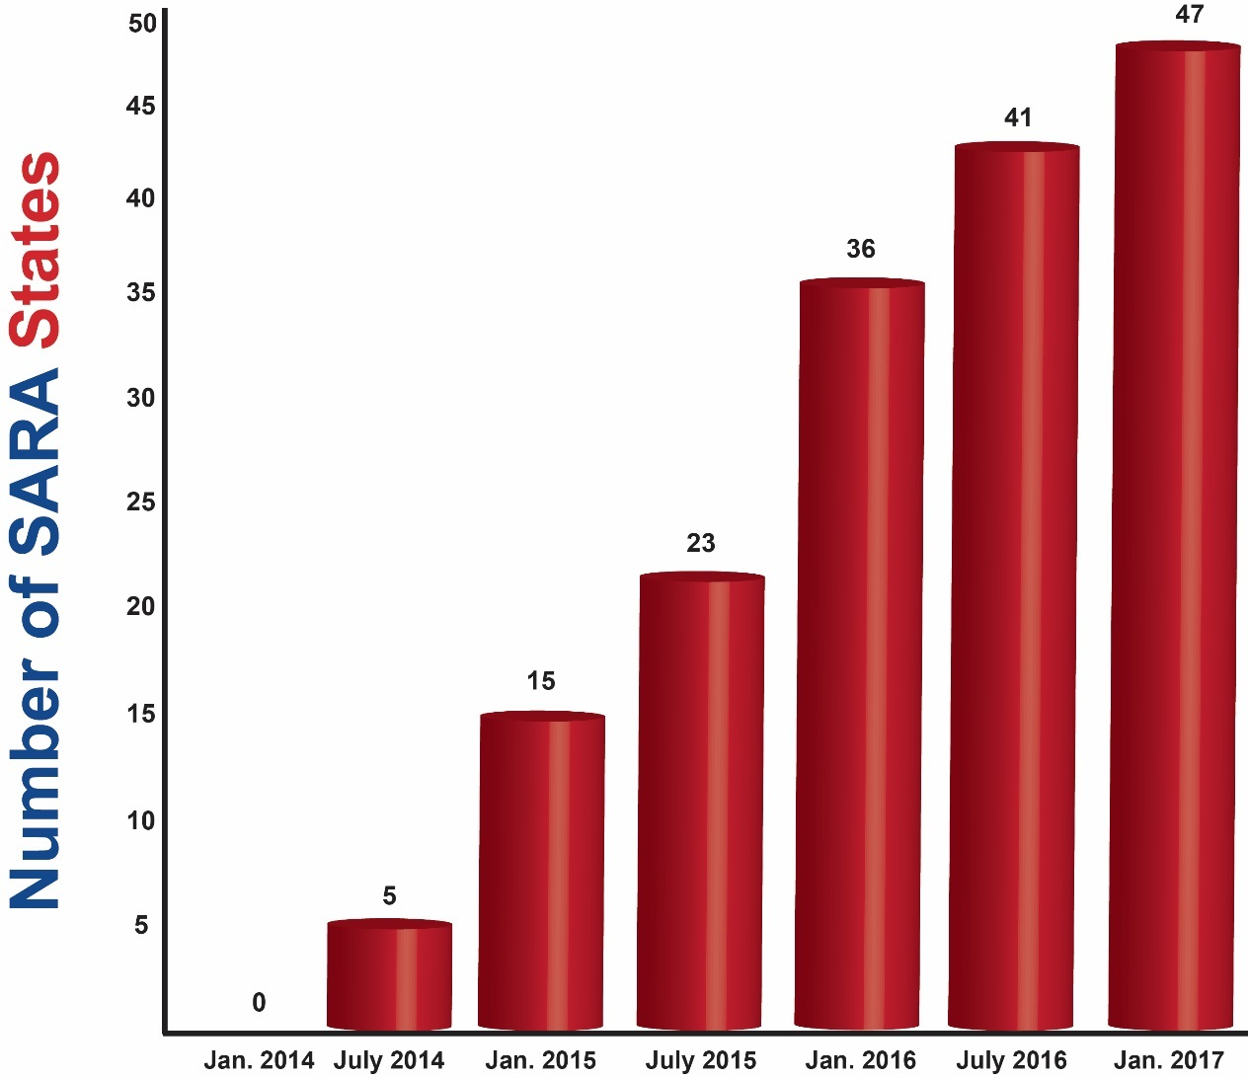
SARA Member States

Slide 4
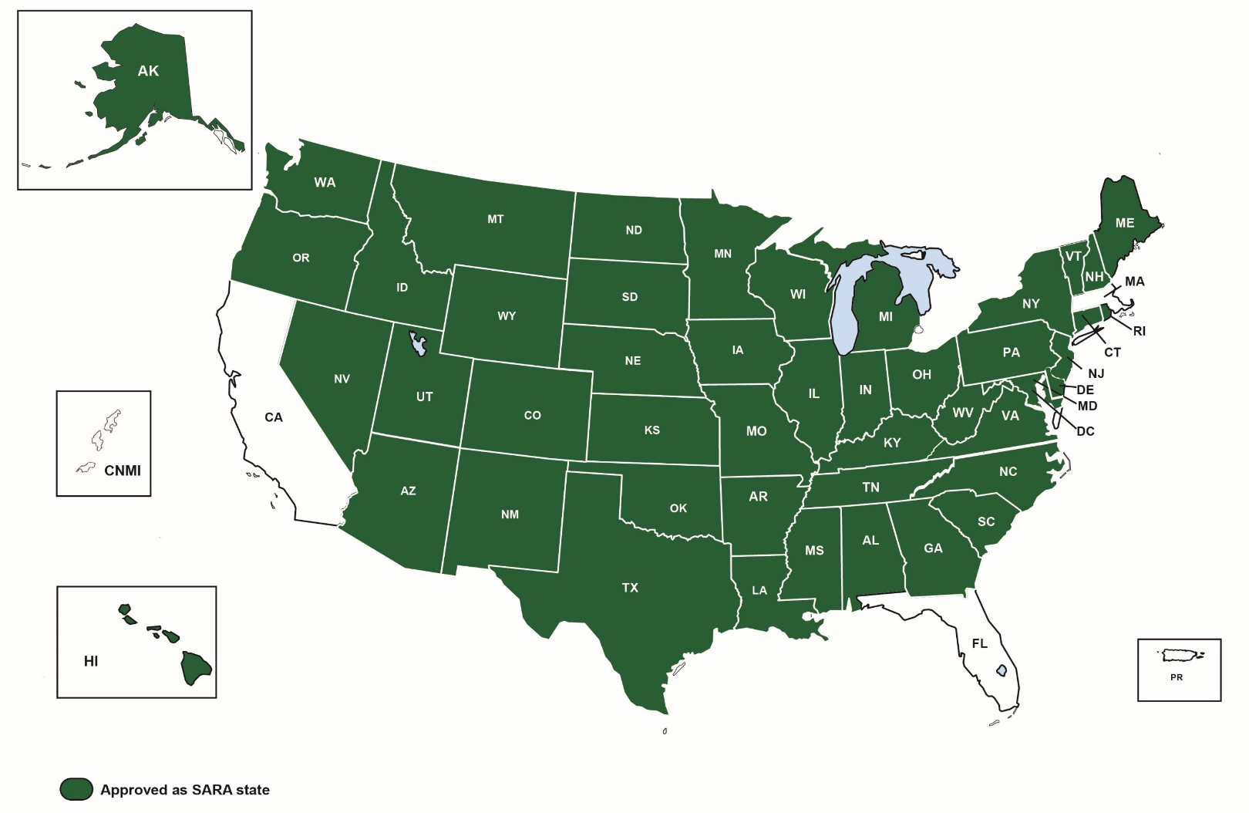
The Current SARA Landscape

Slide 5

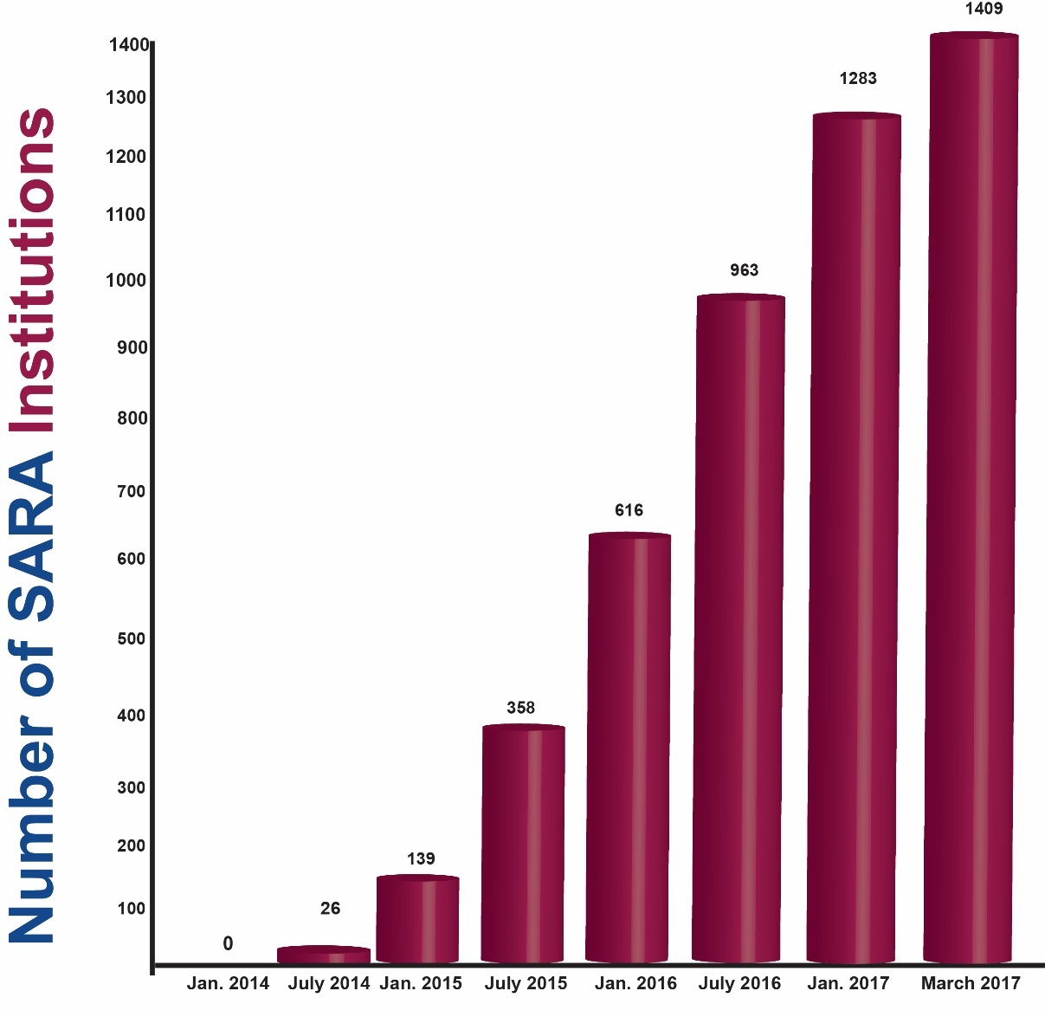
Participating Institutions

Slide 6
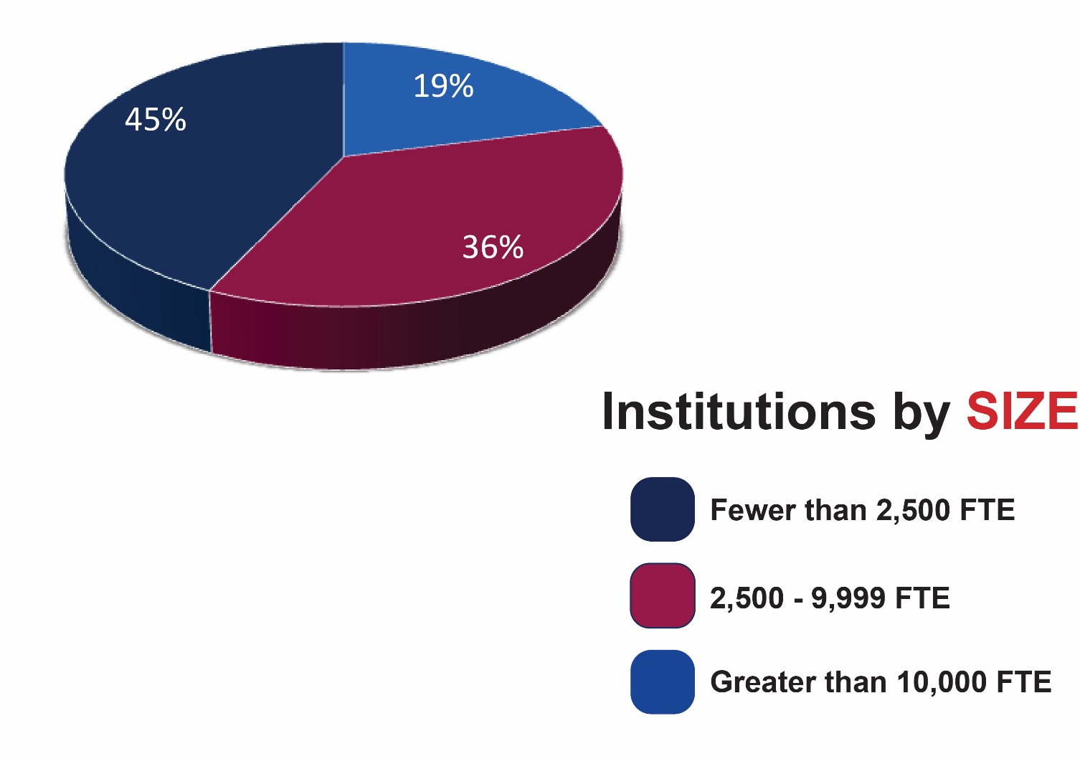
Participating Institutions

Slide 7
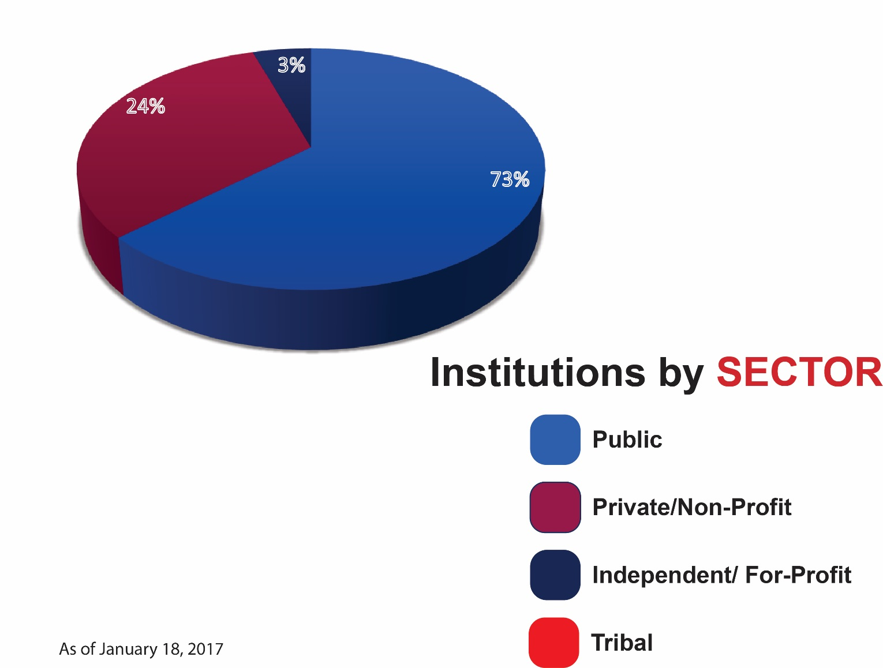
Participating Institutions

Slide 8
Business/Financial Status of the SARA Initiative
NC-SARA is now a free-standing 501(c)(3) non-profit entity, with fully separate business functions
SARA work by all SARA partners
(NC-SARA, MHEC, NEBHE, SREB and WICHE) is now fully dependent on fee revenue
Current and projected revenues are sufficient to support SARA
Consequently, NC-SARA has determined to keep fees at current levels through June, 2018

Slide 9
SARA Goals:
How are we doing?
SARA establishes a state-level reciprocity process that is making state authorization:
  more efficient, effective, and uniform in regard to necessary and reasonable standards of practice that could span states;
  more effective in dealing with quality and integrity issues that have arisen in some online/distance education offerings; and
  less costly for states and institutions and, thereby, the students they serve.

Slide 10
Remember:
SARA reconciles different interests
Institutions’ goals
Regulators’ concerns
Others
Accreditors
Regional compacts
National Commission
US Department of Education

Slide 11
“Past-the-Easy-Stuff” challenges
Reconciling SARA’s physical presence provisions with changing institutional practices – a never-ending issue
  Experiential learning and physical presence
    Why deal with experiential education at all?
      Beneficial for students
      Many states regulate it
      Required for some degree programs (allied health, etc.)
Programs intended to lead to licensure

Slide 12
“Past-the-Easy-Stuff” challenges
Complaint resolution (SARA requirements vs actual state practice)
USED’s 12/2016 rules and their intent regarding their definition of “state authorization reciprocity agreement”
Yes, SECRRA is indeed going away! (June 30, 2017)
Communications
California, Florida and Massachusetts
Some continued objections to SARA’s allowing for-profit institutions to participate

Slide 13
What’s Ahead for
SARA?
Add additional states and institutions
Enrollment reporting and publication:
  SARA institutions reported their out-of-state enrollments in May, 2016; results published in September;
  Spring 2017 reporting set for May 22-June 14
Under consideration
  Student-focused information and assistance
  Voluntary database of distance ed programs offered by SARA institutions

Slide 14
Now That We’re Past the “Easy” Stuff…
Continue to add states and institutions
Implications and implementation of IRS 501 (c)(3) status for NC-SARA
  Establish independent budgeting, accounting, auditing, IT systems, employee benefits plans
  Establish appropriate staffing levels
Responding to “down-in-the-weeds” questions and policy issues
  Physical presence
  Experiential learning
  Etc., etc., etc.

Slide 15
Additional Resources
SARA
www.nc-sara.org
State Authorization http://wcet.wiche.edu/initiatives/state-authorization-network
State contacts http://sheeo.org/projects/state-authorization-postsecondary-education

Slide 16
Questions?
As always, feel free to contact info@nc-sara.org with any additional questions or comments

