Slide 1
SREB SARA RSC Meeting
NC-SARA Updates & Discussion
October 19, 2022
Notes:
MB– Thank you all so much for inviting us to join you. Emily and I are excited to be here with you today to connect, share updates, engage in discussion, and answer any questions you might have for us.

Slide 2
Our Time Together
Welcome & NC-SARA Updates: Marianne Boeke, Ph.D. and Emily Jacobson
SPE Engagement: Resources and Committees: Emily Jacobson
Follow-Up from June Meeting
Questions and Discussion
Notes:
MB– Here’s a quick overview of what we’re planning to cover in our time together today. Please feel free to ask any questions you have along the way and know that we’ll have a brief Q&A discussion following our presentation.

Slide 3
Welcome and Brief Update: Student and Institution Support
Short and Long Range Planning
Evaluate and Enhance or Improve Processes
Evaluate and Enhance or Improve Communications
Student and Institutional Support and CORE Work
Solicit Feedback
Notes:
EJ-Intro and Philosophy of the Work. January-start work on admin forms upates. Discussion on going digital w/these. Info@ switchboard and “jarred” or “canned” responses. Administrative forms (weekly; Wed-Friday timelines, SPE communications). Institutional advisory committee, institutional conference.

Slide 4
NC-SARA Updates
NC-SARA Organizational Chart and CORE Focus
Update and Discussion on Processes
Follow-Up from June Meeting
Q&A
Notes:
M/B

Slide 5
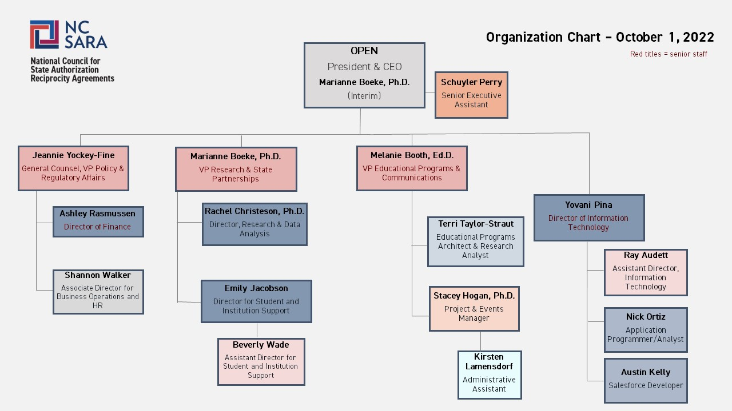
NC-SARA Organizational Chart
Notes:
M/B

Slide 6
NC-SARA CORE Work
Supporting the NC-SARA Board
Supporting Regional Compacts, RSCs, SPEs, and Institutions
Facilitating the SARA Policy Modification Process
Strategic Plan Activities for Year 3
Data Work
Internal Processes
Notes:
M/B

Slide 7
Update and Discussion on Processes
Realignment of SARA Institutional Participation Dates
NC-SARA Auto-Generated Emails to Institutions
Approaching Changes to Applications and Administrative Forms
Institutional Directory and Upcoming Changes
Suggestions for NC-SARA Website Maintenance and Improvement
Notes:
EJ-Progress, timelines and pilot of institutional participation date changes. NC SARA autogenerated emails; revisit in January (tone, feel, direct to resources Ex: SARA 101). North Carolina example.
Approaching changes to applications and administrative forms (overall process). How do we update? Once a year-share w/SPEs. Ex: January through June. SPE conference recommendations.

Slide 8
Follow-Up from June SREB SARA RSC Meeting
Updates to Institutional Applications
Building the SARA Community
Additional Avenues for SARA Updates
Master Calendar
Notes:
MB -These things were brought up at the June Meeting:
When NC-SARA does update the applications a good recommendation from Nikki Bryant (WV) was to:
Make more obvious the link to professional licensure
Consider asking: How many and which programs lead to licensure at your institution?
Building the SARA Community:
Intersection of different groups – across the regions – for example, perhaps all the committees could get together once a year?
Consider a conference for all of SARA community/In the Field Conference
Updates on what is happening (perhaps in the SPE monthly newsletter) in other RSC meetings
Master Calendar – on secure SPE website

Slide 9
Notes:
M/B

