Slide 1
Mary Larson
Director, Student Access Programs and Services
Southern Regional Education Board
UA System State Authorization Network Meeting September 27, 2016

Slide 2
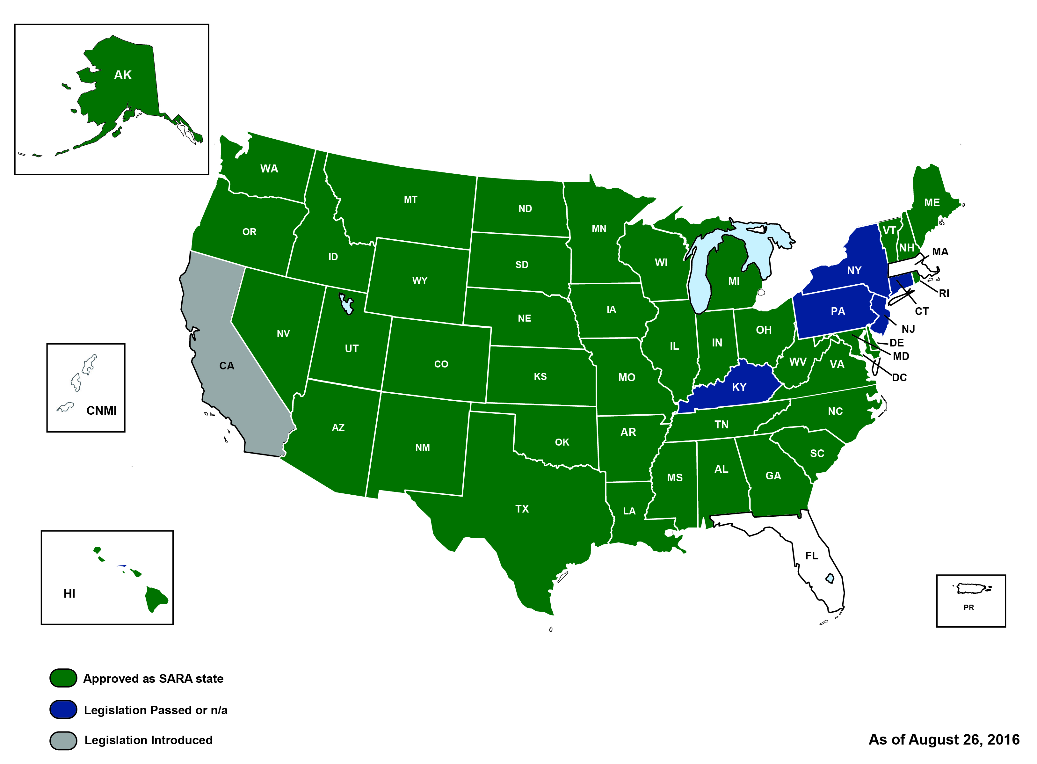
The Current SARA Landscape

Slide 3
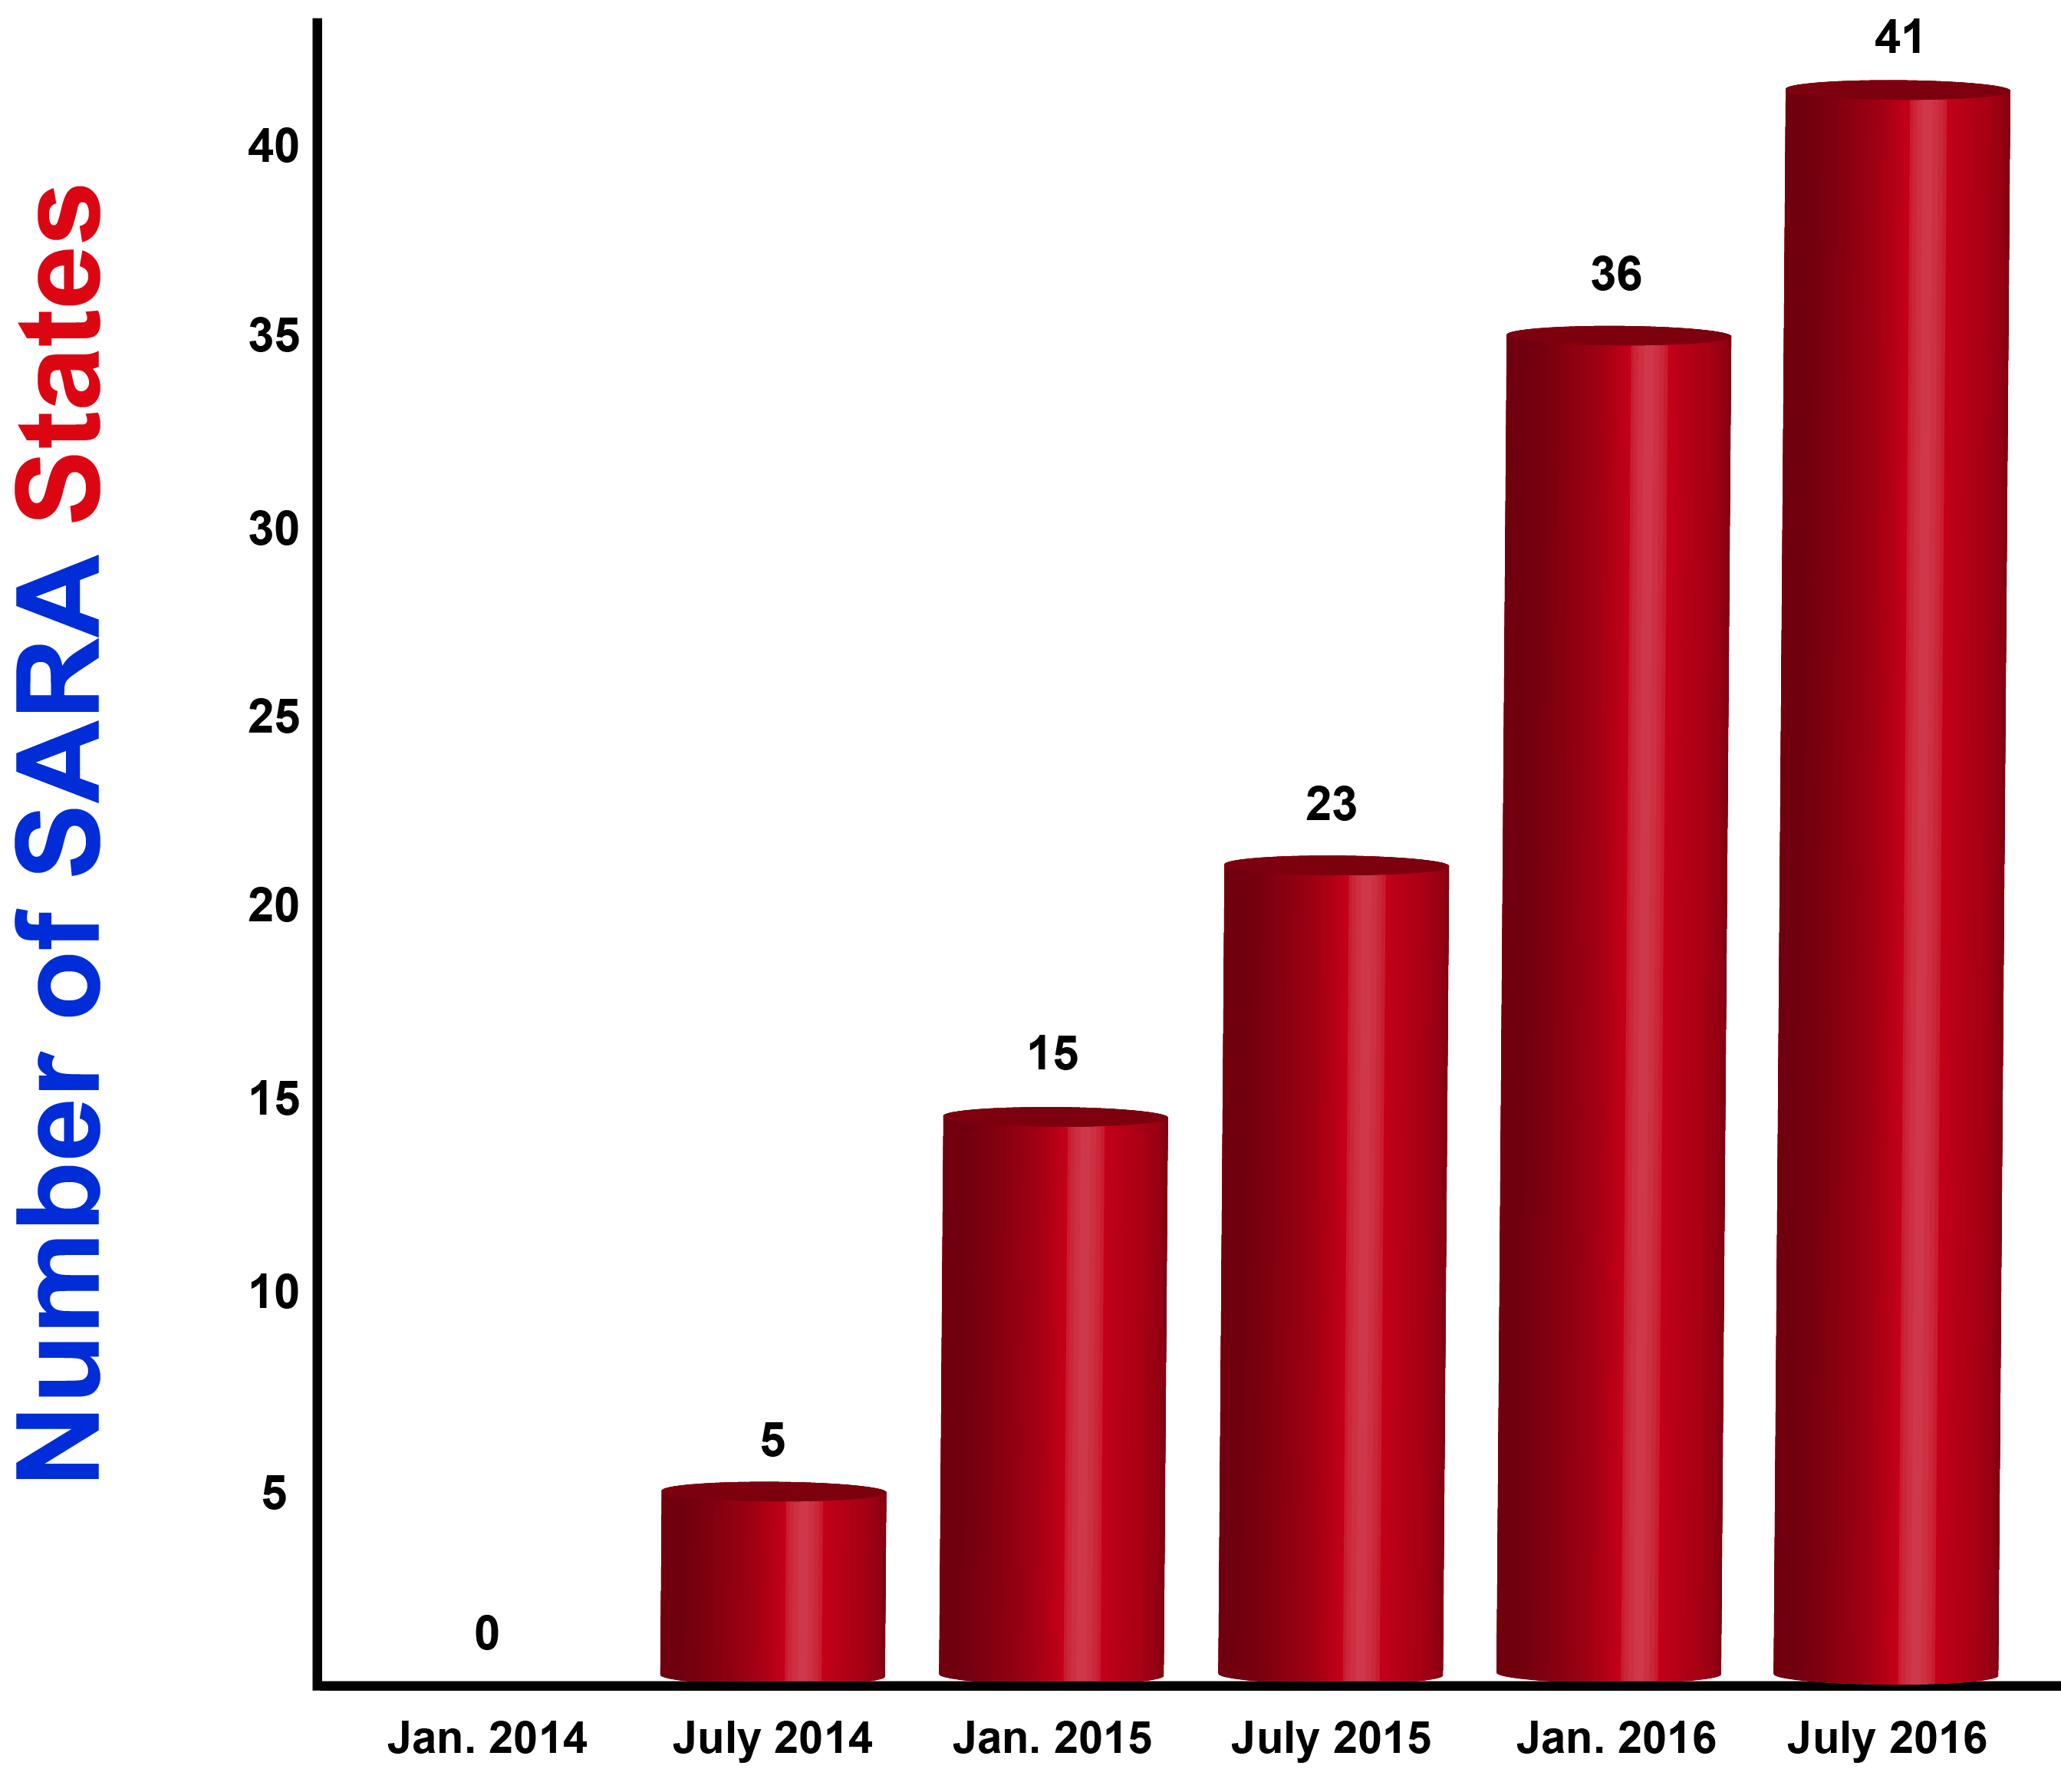
Participating States
Notes:
43 states as of 10.26.2016

Slide 4
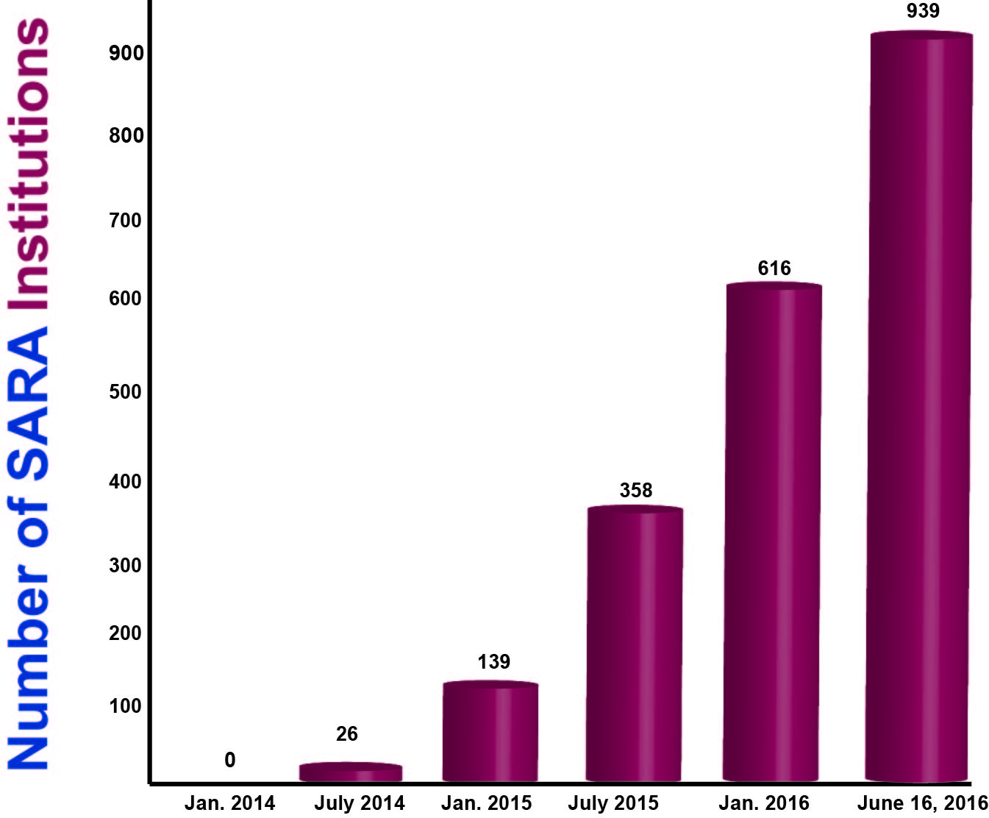
Participating Institutions
Notes:
1,089 institutions as of 10.26.2016

Slide 5
Participating Institutions

Slide 6
Participating Institutions
Notes:
As of 9.26.2016
1,089 total institutions
Public - 740 (67%)
Private - 305 (28%)
For Profit - 44 (4%)
Participation by region
MHEC – 39%
NEBHE – 3%
SREB – 39%
WICHE – 16%

Slide 7
Relevant Topics
ED draft regulations re state authorization of distance ed
CA, CT, FL, KY, MA, NJ, NY and PA
Policy interpretations (scenarios)
Enrollment and complaint reporting
State and institutional renewals
Composite score working group
Consortium agreements working group
SARA EC
NC-SARA as a 501(c)(3)
ACICS accreditation and SARA
Notes:
MHEC – all states are participating
NEBHE – CT has passed legislation; NY Board of Regents voted to join SARA; NJ is moving for with their application
WICHE – CA developing a process for SARA agreements amongst agencies and group working on legislation
SREB – PA & KY applications will be reviewed at the next SERB SARA steering committee meeting; Discussions on going in FL and PR
Institutions agree to report data as requested by NC when they begin participation in SARA.
Working groups include members of steering committees and others in the specific area of discussion

Slide 8
Questions?
Mary Larson, mary.larson@sreb.org

