Slide 1

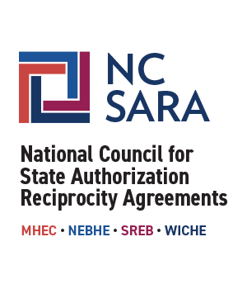
SREB Regional Steering Committee
SARA Meeting
June 3, 2020

Slide 2
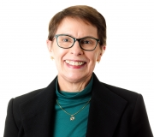
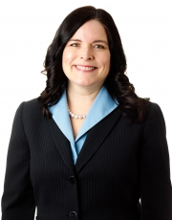
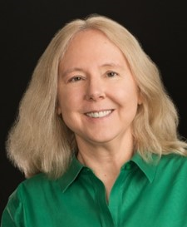
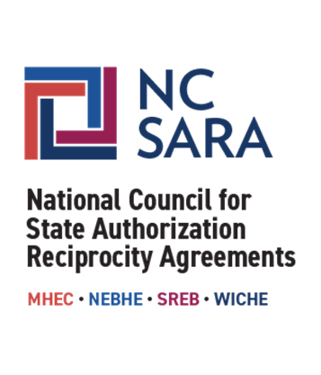
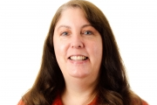
Presenters
Lori Williams, Ph.D.
President & CEO
lwilliams@nc-sara.org
Mary Agnes Larson, M.Ed.
Director for Student and Institution Support
mlarson@nc-sara.org
Jeannie Yockey-Fine, J.D.
Director for Regulatory Relations and Policy Support
jyockey-fine@nc-sara.org
Marianne Boeke, Ph.D.
Director for Policy Research and State Support
mboeke@nc-sara.org

Slide 3
Agenda
SARA Manual Review & Revision Cycle
The Strategic Planning Process
Modifications to Align with Federal Regulations
Data Reporting
Upcoming Trainings & Webinars
Questions and Discussion
Notes:
Lori

Slide 4
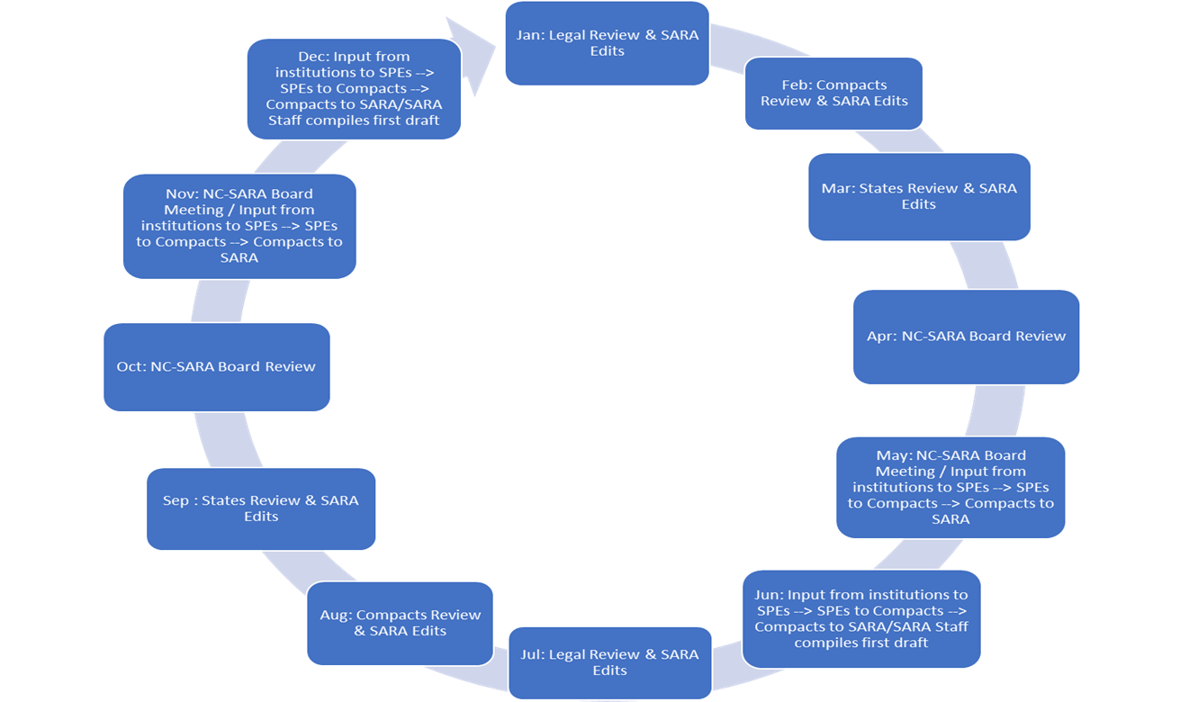
SARA Manual Review & Revision Cycle
Notes:
Lori

Slide 5
The Strategic Planning Process
The Strategic Planning Process
  Worked with Brainard Strategy
  5 month process
  NC-SARA Strategic Planning Steering Committee was established comprising the Executive Committee of the Board & NC-SARA Senior Staff
Environment Scan
  4 Meetings with Committee
    strategize on methodology, share preliminary results, and gather feedback
  Interview Process
    Conducted 65 interviews
  Survey Instrument
    400 surveys
Notes:
Lori

Slide 6
The Strategic Planning Process – Cont.
The Committee developed a three-year plan with the following strategic objectives:
Develop and communicate a clear, compelling message to constituents regarding the value proposition of NC-SARA
Employ NC-SARA’s broad collaborative relationships with accreditors, states, and institutions to promote improvements in distance education program access and quality
Achieve operational excellence
Continuously strengthen the partnership with regional compacts and states to seamlessly align and deliver value
Key performance indicators were also developed by the Committee to provide qualitative and quantitative measures of achievement of the objectives, as well as to mitigate against risks.
Notes:
Lori

Slide 7
Modifications to Align with Federal Regulations
Proposed Language:
5.2 Programs leading to Professional Licensure
SARA has no effect on State professional licensing requirements. Any Institution approved to participate in SARA that offers courses or programs designed to lead to Professional Licensure or certification or advertised as leading to Licensure must satisfy all federal requirements for disclosures regarding such Professional Licensure programs under 34 §C.F.R. 668.43. For SARA purposes, these requirements will also apply to non-Title IV institutions.
For SARA purposes, institutions that are unable, after all reasonable efforts, to determine whether a program will meet state professional licensure requirements shall provide the student or applicant with current contact information for any applicable licensing boards, and advise the student or applicant to determine whether the program meets requirements for Licensure in the State where the student or applicant is located.
Notes:
Jeannie

Slide 8
Data Reporting
Data Reporting Window is May 15 - June 30
  Reporting window has been extended by 2 weeks
  5th year of reporting enrollment
  2nd year of reporting OOSLP
  For data reporting this year:
    For reporting enrollment data - institutions will submit disaggregated fall IPEDS 2019 data.
    For reporting out-of-state learning placement (OOSLP) data - the learning placements reported will be from the 2019 calendar year.
Notes:
Marianne

Slide 9
Data Reporting - SREB
916 total SARA participating institutions in SREB
  Represents 45% of SARA total
For SREB Data Reporting in 2019:
  Total Enrollment WITHOUT In-State Enrollment - 406,980 (32%)
  Total Enrollment WITH In-State Enrollment - 1,199,235 (43%)
  SREB Total OOSLP = 118,474 (44%)
  SREB had 5 of the top 10 Institutions by size of reported enrollment:
    Liberty University
    University of Maryland Global Campus
    Strayer University
    American Public University System
    Ashworth College
Notes:
Marianne

Slide 10
Upcoming Trainings & Webinars
Webinars:
  Board Meeting Summary (May 28)
  Federal Regulations & Disclosures (June 11)
  Heightened Cash Monitoring (June 30)
Trainings:
  SPE Institute
  SARA 101 for States
  Institutional Training
Notes:
Mary

Slide 11

Questions & Discussion
Notes:
ALL

