Slide 1
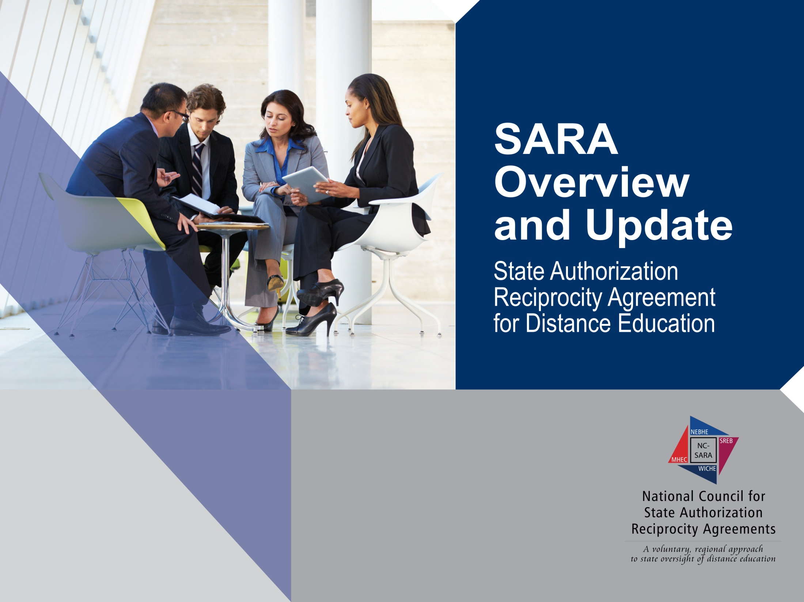
North Carolina Community College System
2016 DL Directors Institute
March 14, 2016

Slide 2

Presenters
Wanda Barker
Director
Educational Technology Cooperative
wanda.barker@sreb.org
Mary Agnes Larson
Director
Student Access Programs and Services
mary.larson@sreb.org or SARA@sreb.org

Slide 3


Today’s Conversation
Quick walk through State Authorization
Fast pace review of the EC & SECRRA
Detailed wander through SARA
Spend some time on institution decision
Wrap with SECRRA to SARA
What’s an institution to do between now and June 30, 2017
Lots of time for your questions

Slide 4


What Is State Authorization?
States have laws and regulations governing the “operation” of higher education institutions within their borders

Slide 5

State Authorization
States have laws and regulations governing the “operation” of higher education institutions within their borders to include out-of-state institutions enrolling residents in distance education courses and programs

Slide 6


State Authorization –
What’s the Problem?
Some states have unique requirements:
  Refund policies
  Disclosures
  Enrollment documentation
  Catalog content
  Externship/clinical sites
  Servers
Includes out-of-state institutions!!

Slide 7


State Authorization Includes
Distance education providers must obtain authorization in every state where students reside – not their residence!
Do you know where your students are?

Slide 8




Electronic Campus
1997 - 2017
1998
2004
2015

Slide 9
SREB’s Electronic Campus (EC)
Launched in 1998 with 100 courses.
Almost 37,000 courses for Fall 2015
More than 3,500 programs
Institutions are regionally accredited,
not-for-profit and chartered in a SREB state
State review and approval
Institutions meet Principles of Good Practice and Common Standards

Slide 10

SREB’s Electronic Campus Regional Reciprocity Agreement (SECRRA)
All 16 SREB states participate SECRRA
Voluntary for states and institutions
Institutions participate if state joins
Limited to for-credit online courses and programs activated on the EC
SECRRA was the only regional reciprocity agreement in the nation until 2014

Slide 11

The SARA Solution
A nation-wide system of reciprocity administered by the four existing regional compacts
MHEC
NEBHE
WICHE
SREB

Slide 12
SARA Goals
SARA establishes a state-level reciprocity process that will support the nation in efforts to increase the educational attainment of its people by making state authorization:
  more efficient, effective, and uniform in regard to necessary and reasonable standards of practice that could span states;
  more effective in dealing with quality and integrity issues that have arisen in some online/distance education offerings; and
  less costly for states and institutions and, thereby, the students they serve.

Slide 13


SARA: A Negotiated Compromise
Institutions’ goals
Regulators’ concerns
Accreditors

Slide 14
Essential Principles of SARA
Open to degree-granting postsecondary institutions from all sectors: public colleges and universities; independent institutions, both non-profit and for-profit.
Sets forth a reasonable, uniform set of triggers of “physical presence”.
Preserves state approval and oversight of on-the-ground campuses.

Slide 15
Benefits to States
Expands educational offerings to residents.
Allows SARA states to focus on their home-state institutions.
Maintains state regulation of on-the-ground instruction offered by out-of-state institutions.
Other SARA states will help resolve complaints.
Reduces costs for institutions.
No fees charged by other states to participate in SARA

Slide 16
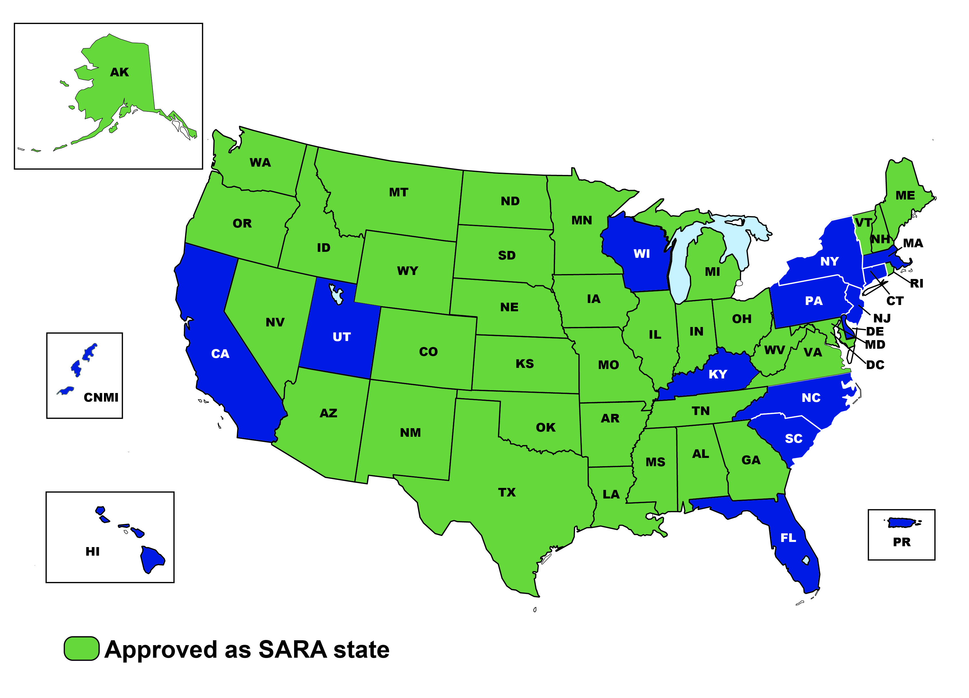
The Current SARA Landscape

Slide 17
The Current SARA Landscape

Slide 18
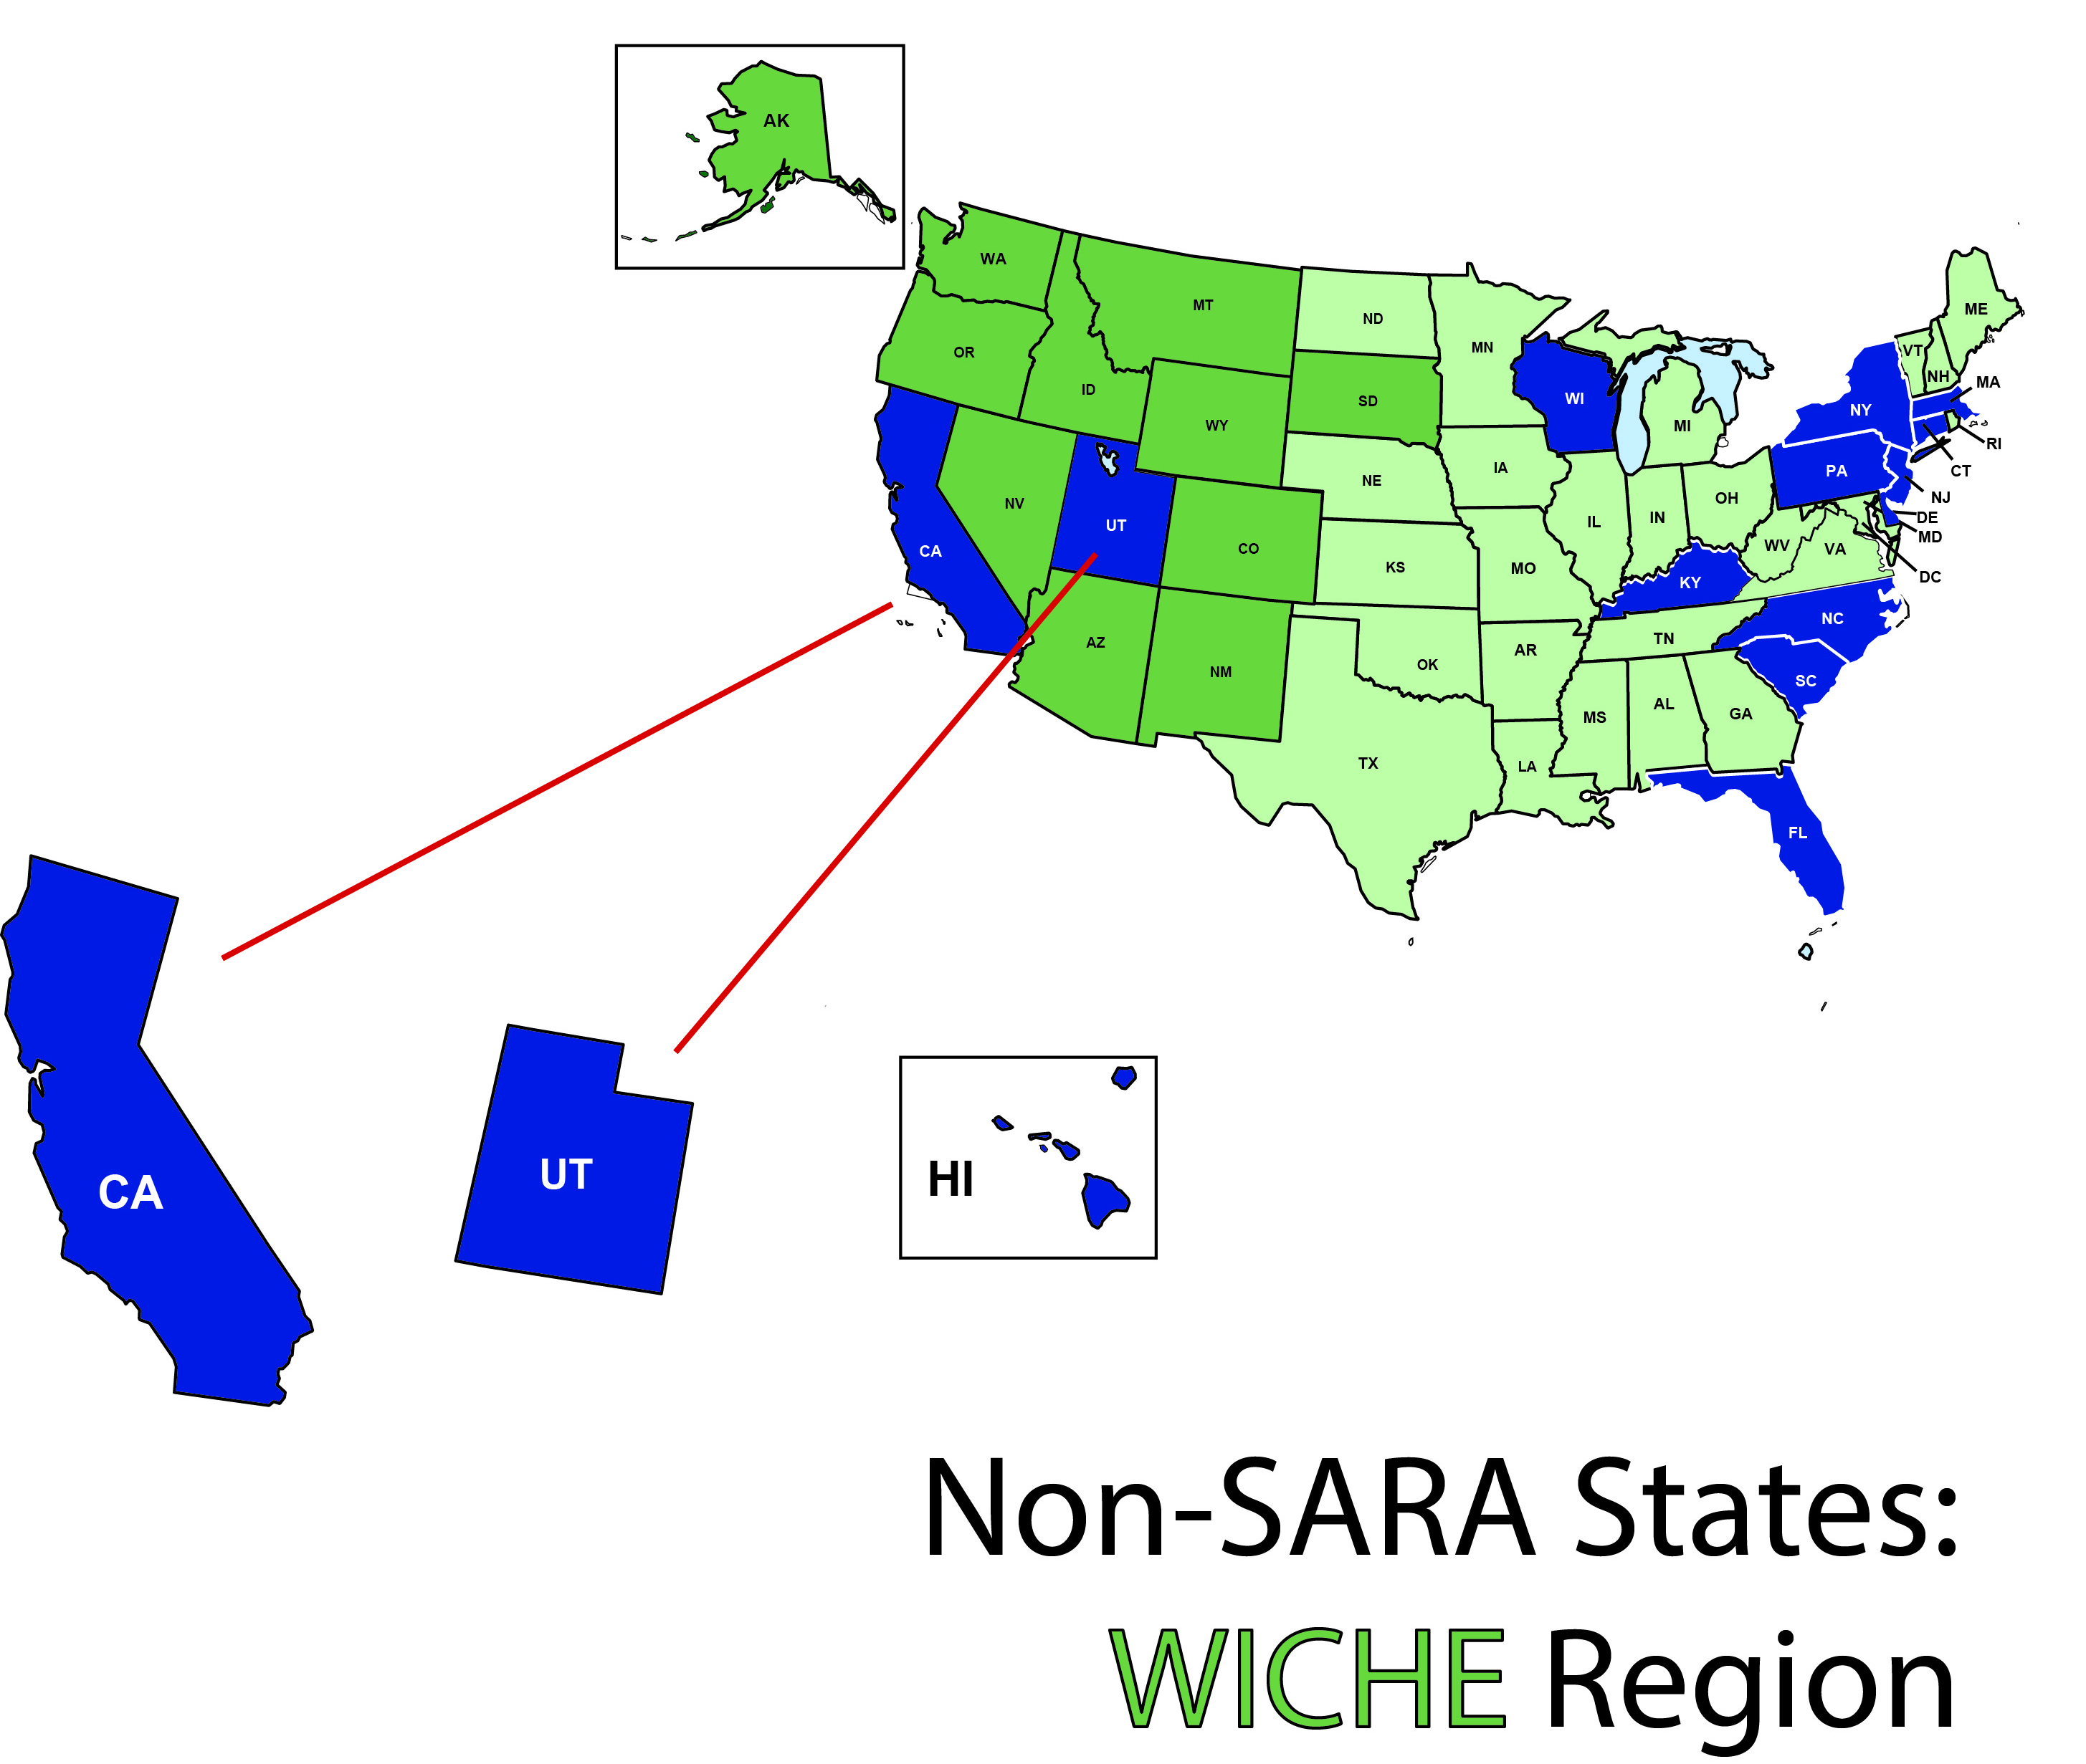
A Closer Look: WICHE

Slide 19
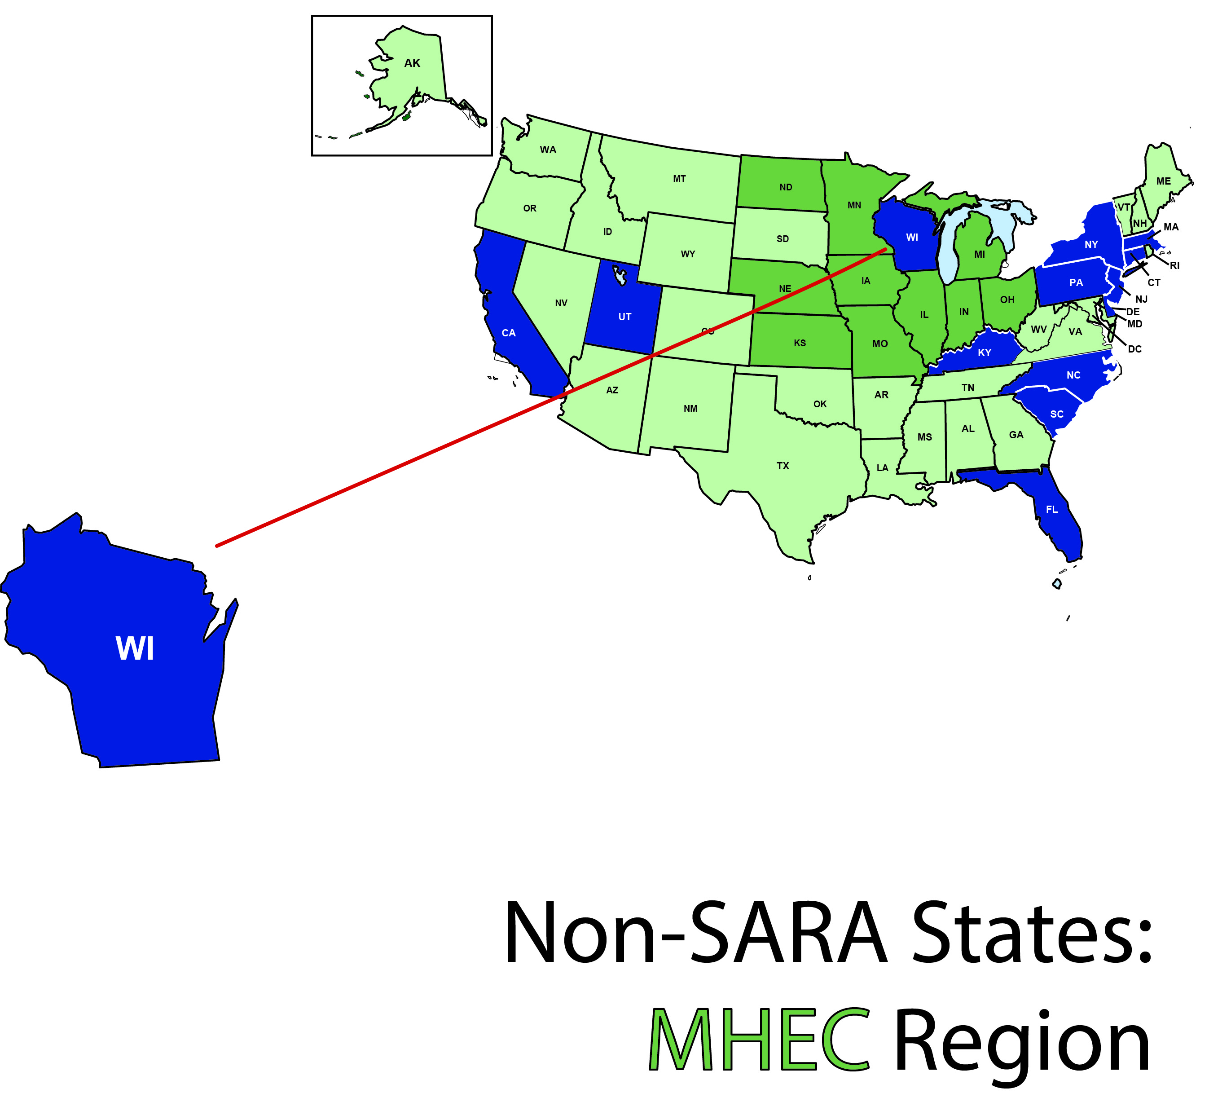
A Closer Look: MHEC

Slide 20
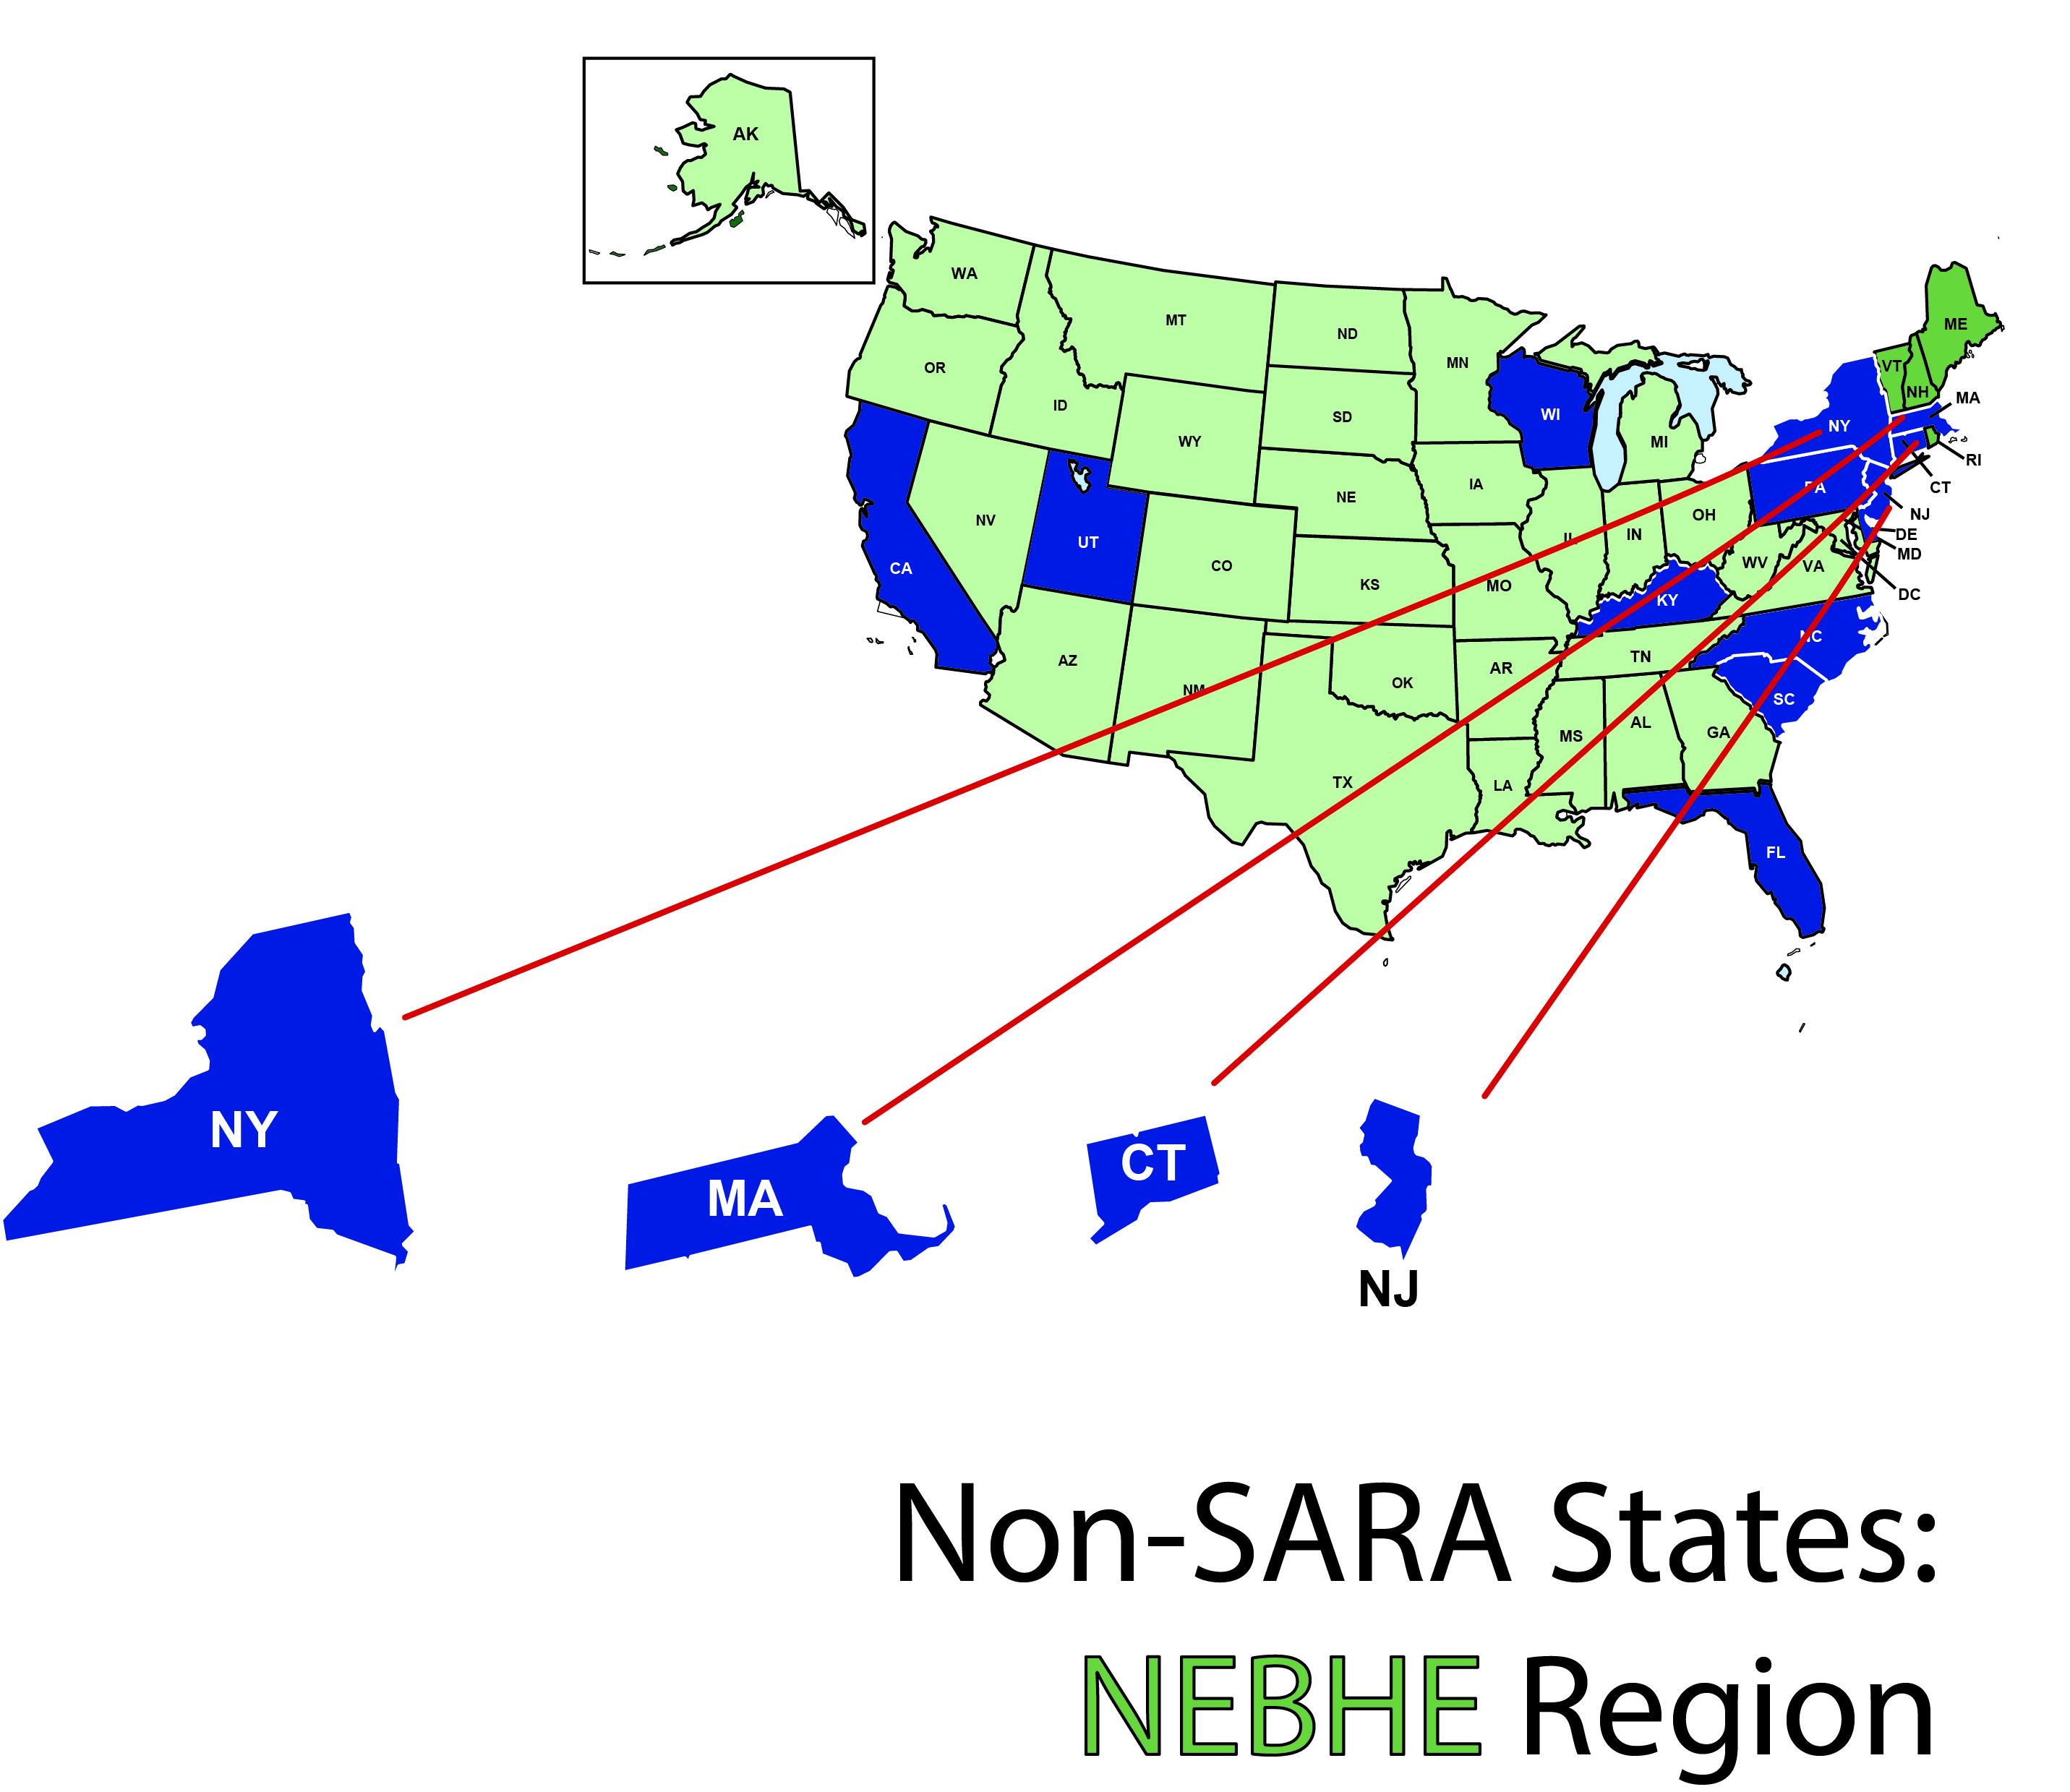
A Closer Look: NEBHE

Slide 21
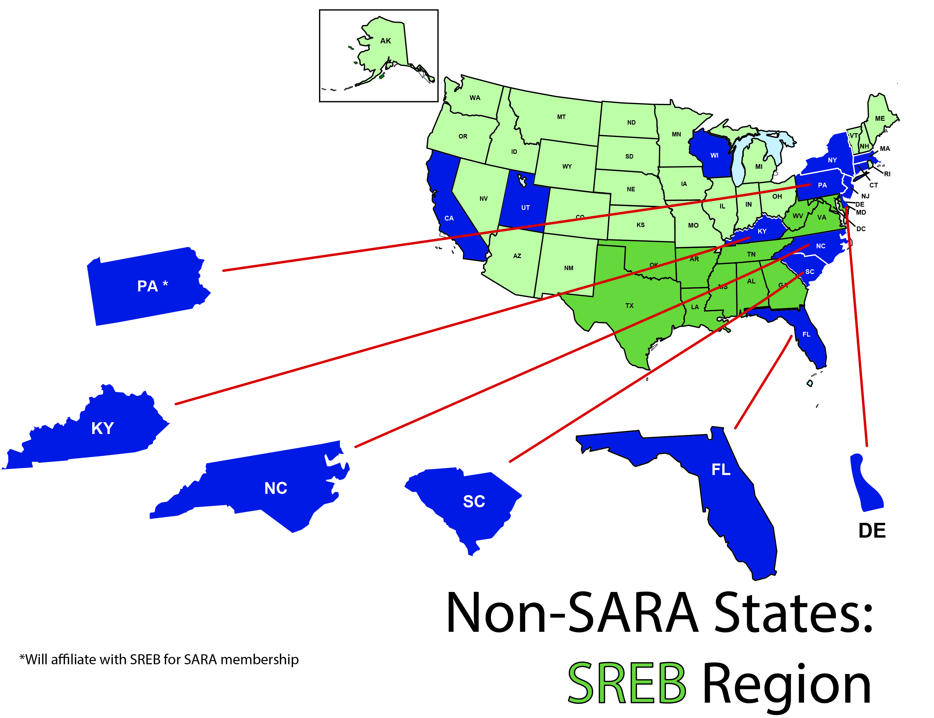
A Closer Look: SREB
*Plans to affiliate with SREB for SARA membership

Slide 22
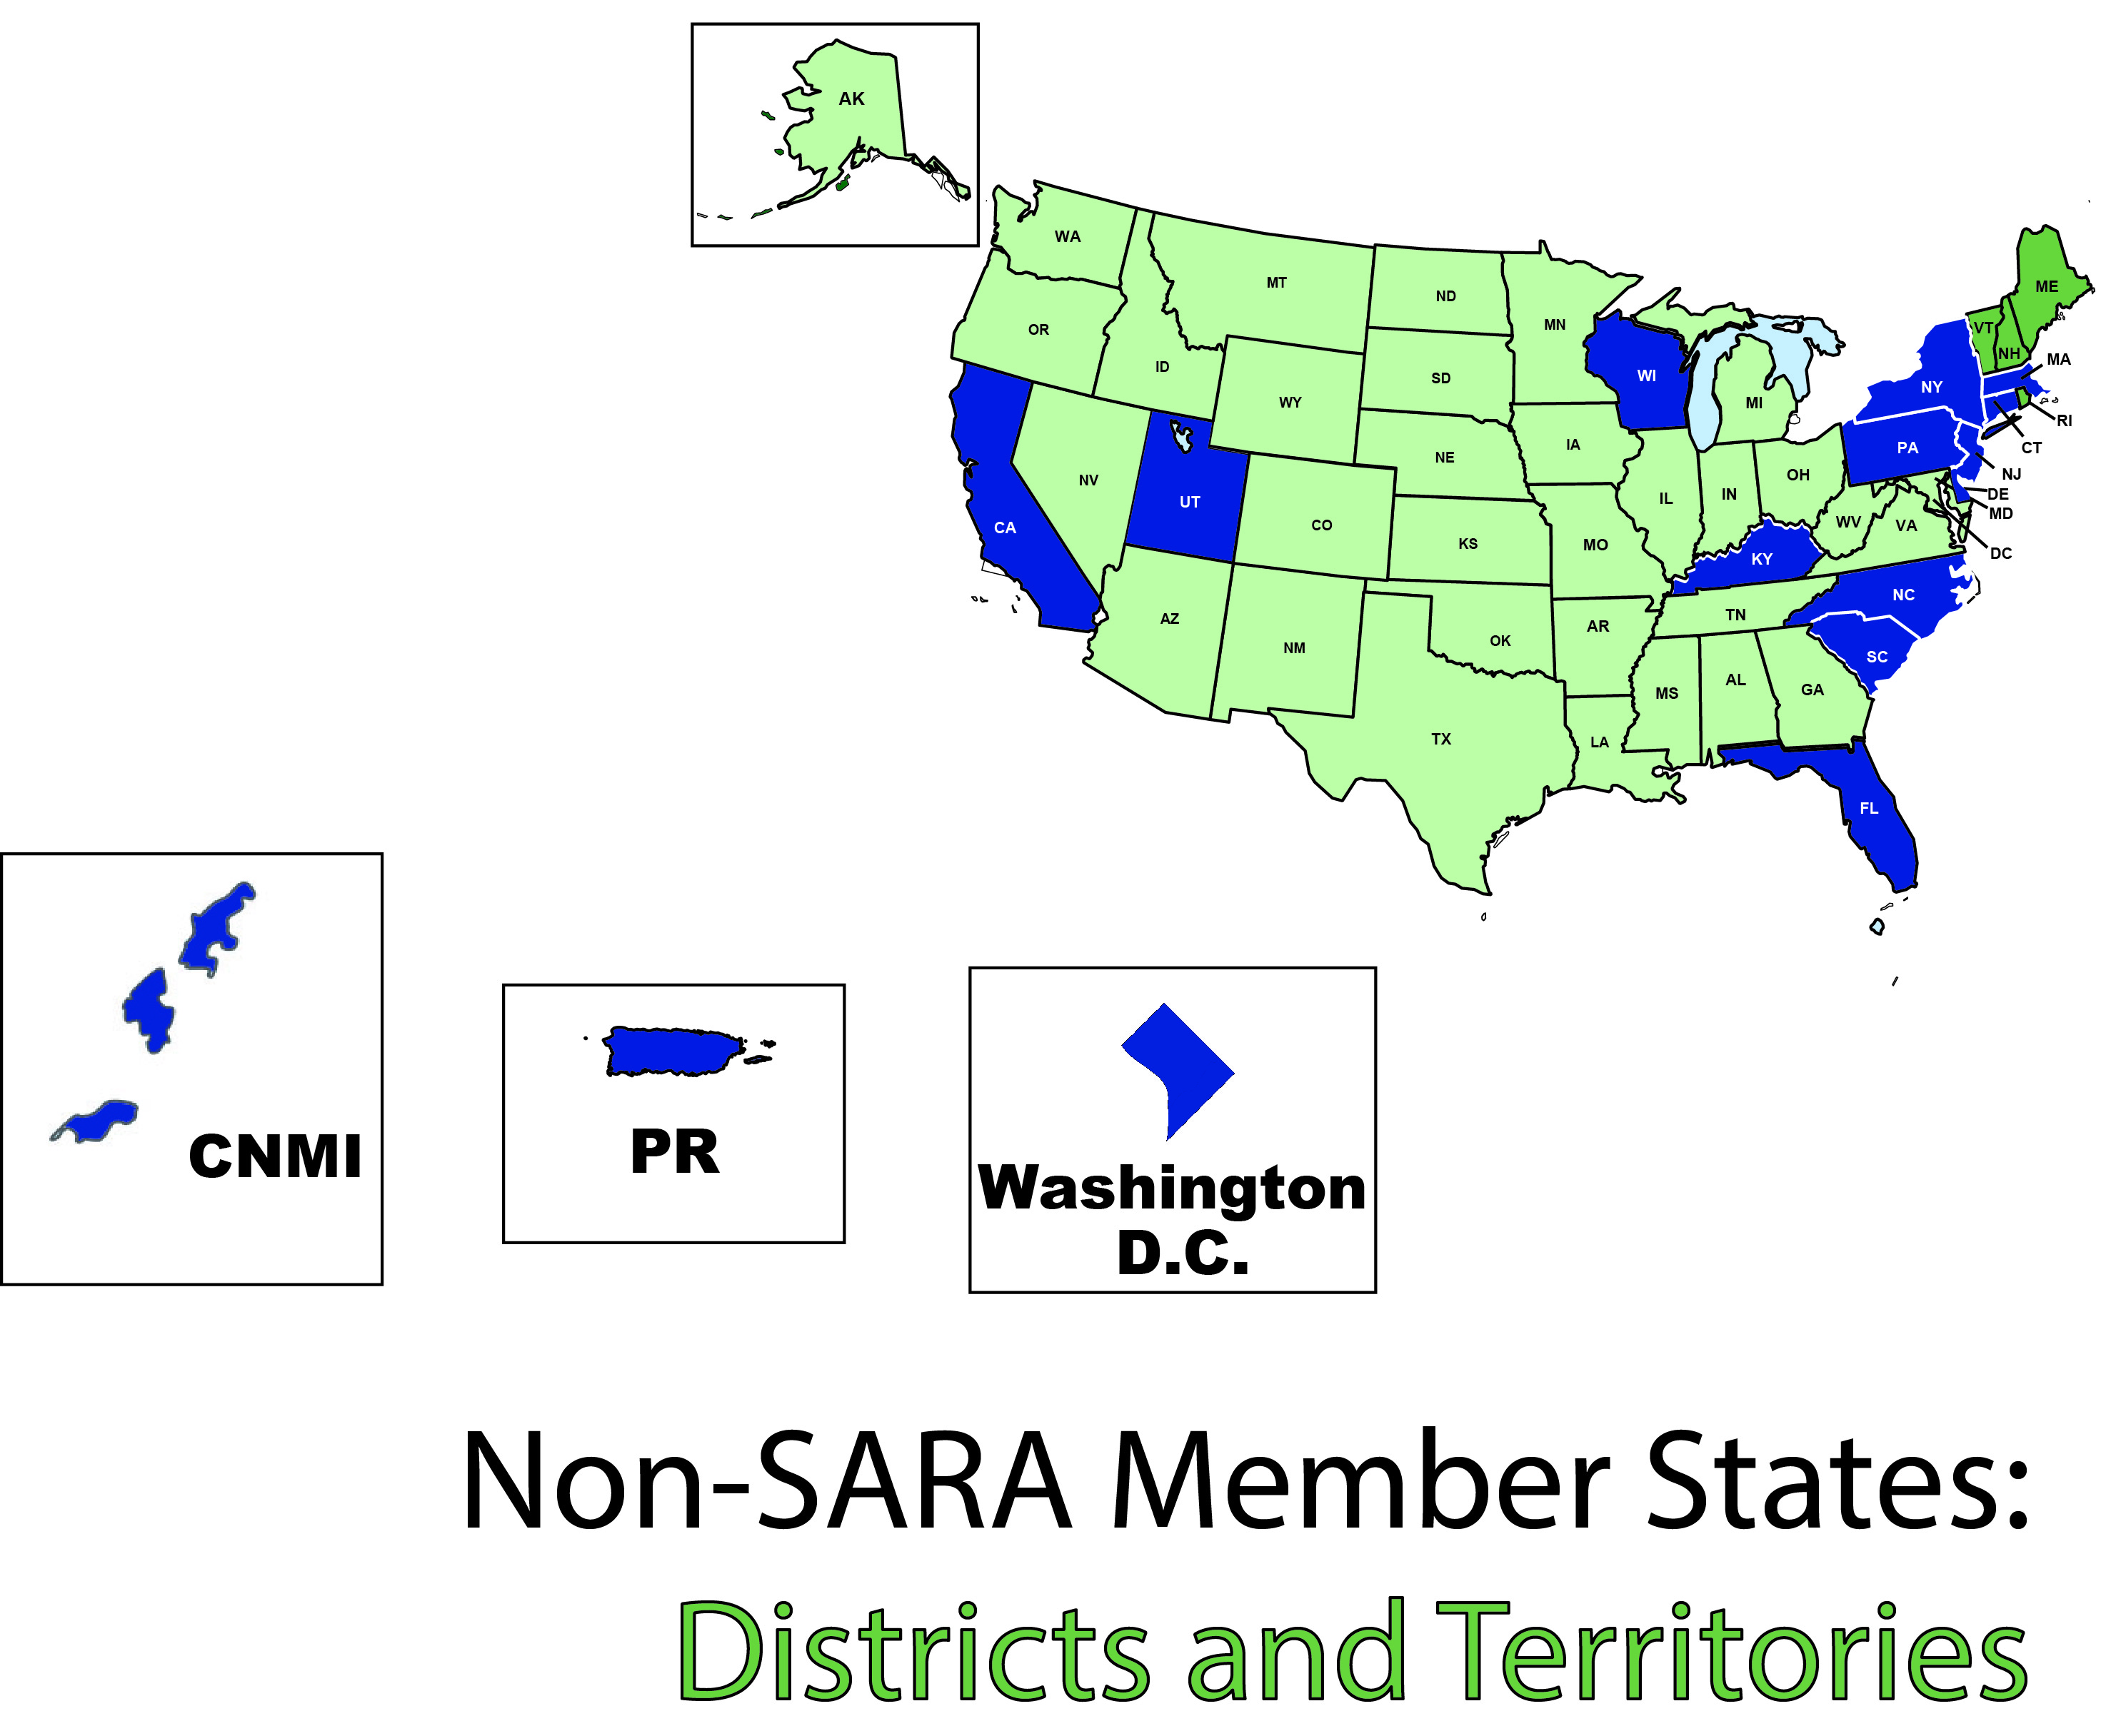
A Closer Look:
Districts and Territories

Slide 23
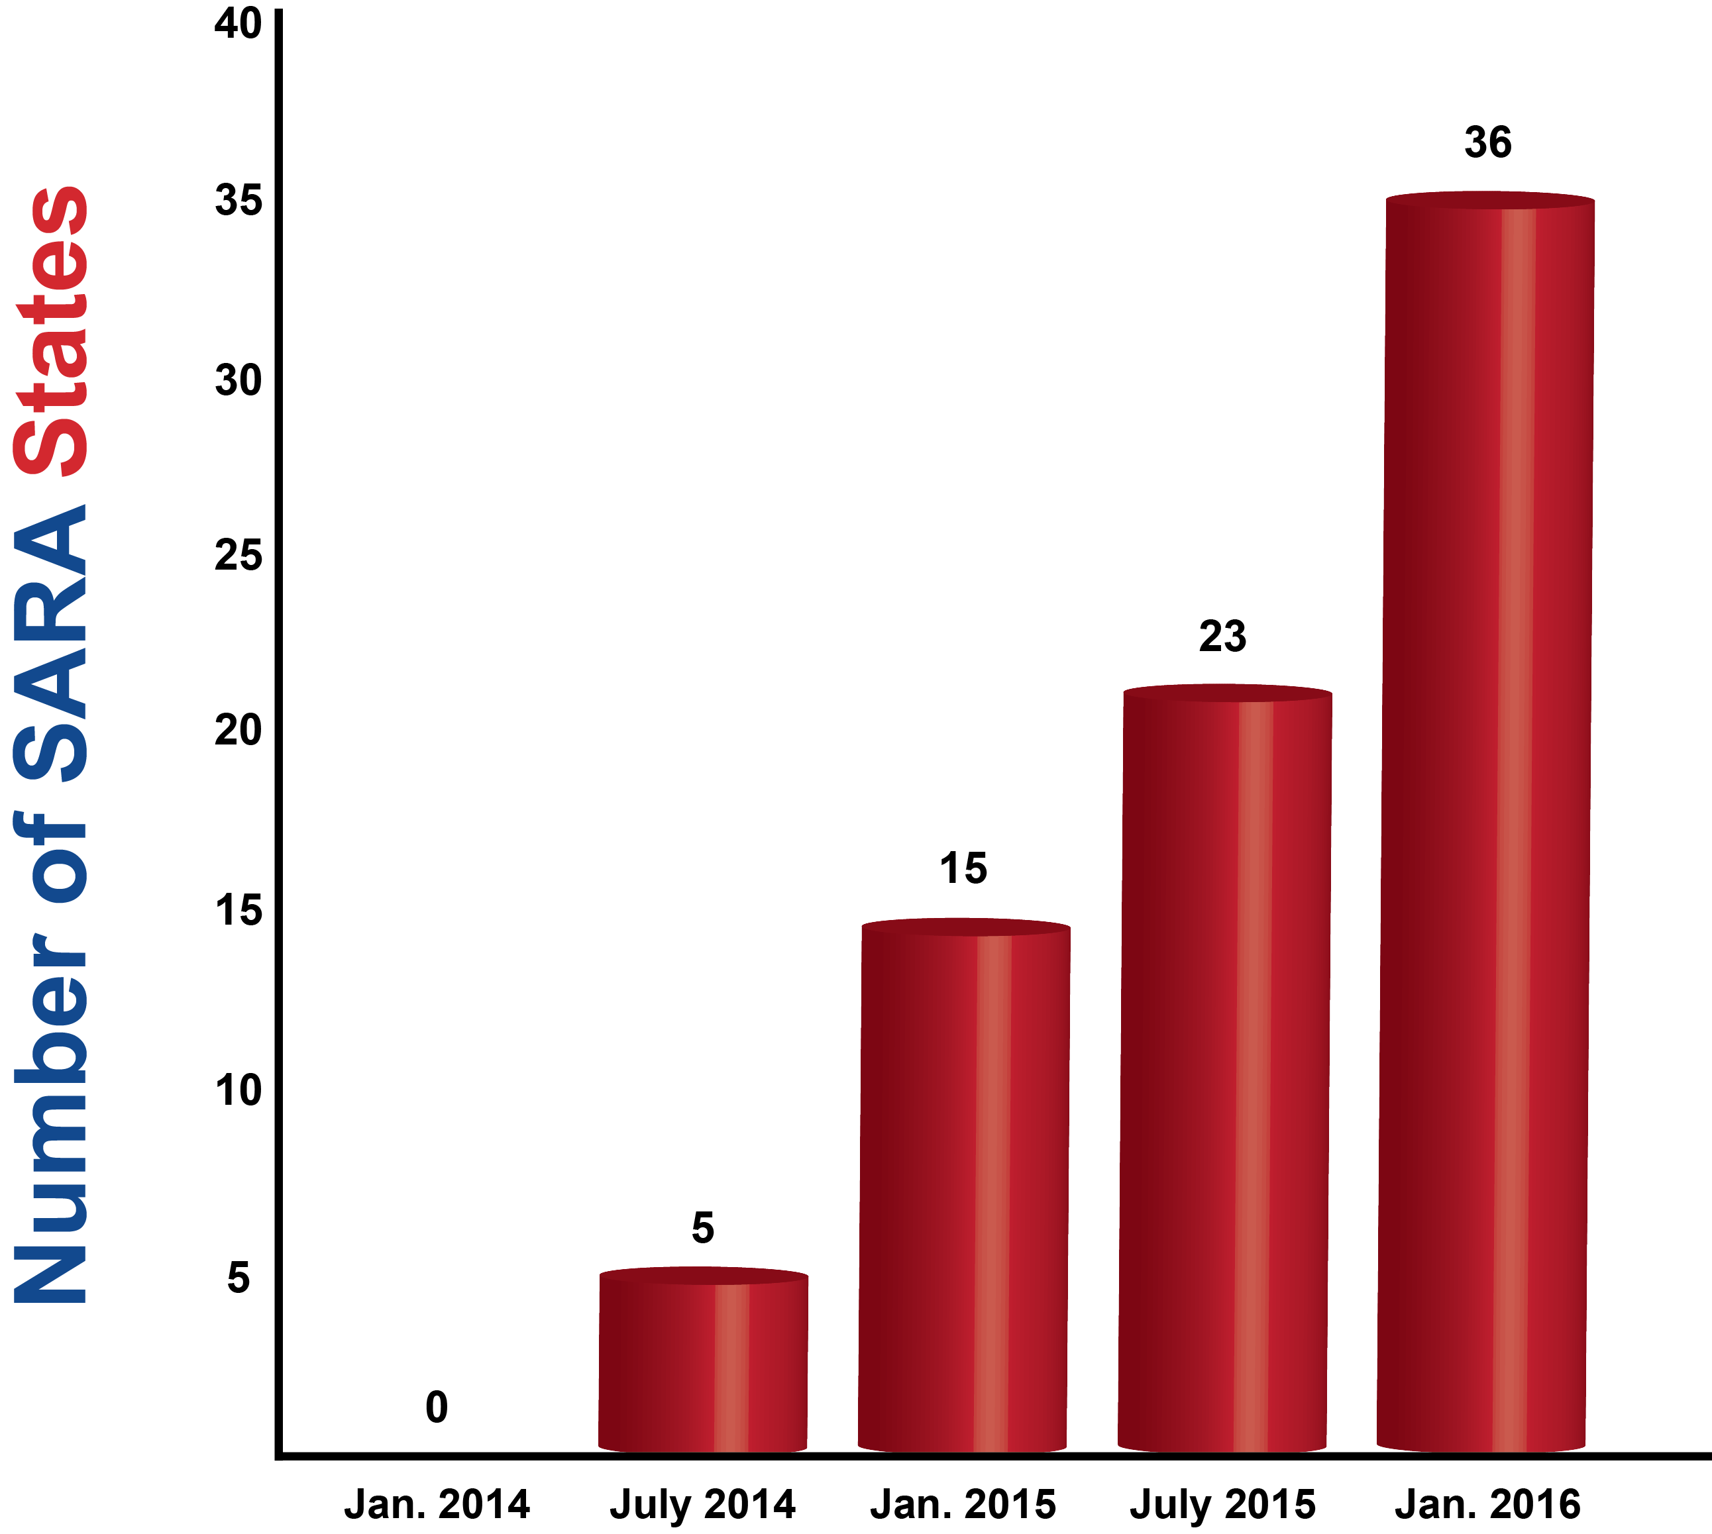
SARA Member States

Slide 24
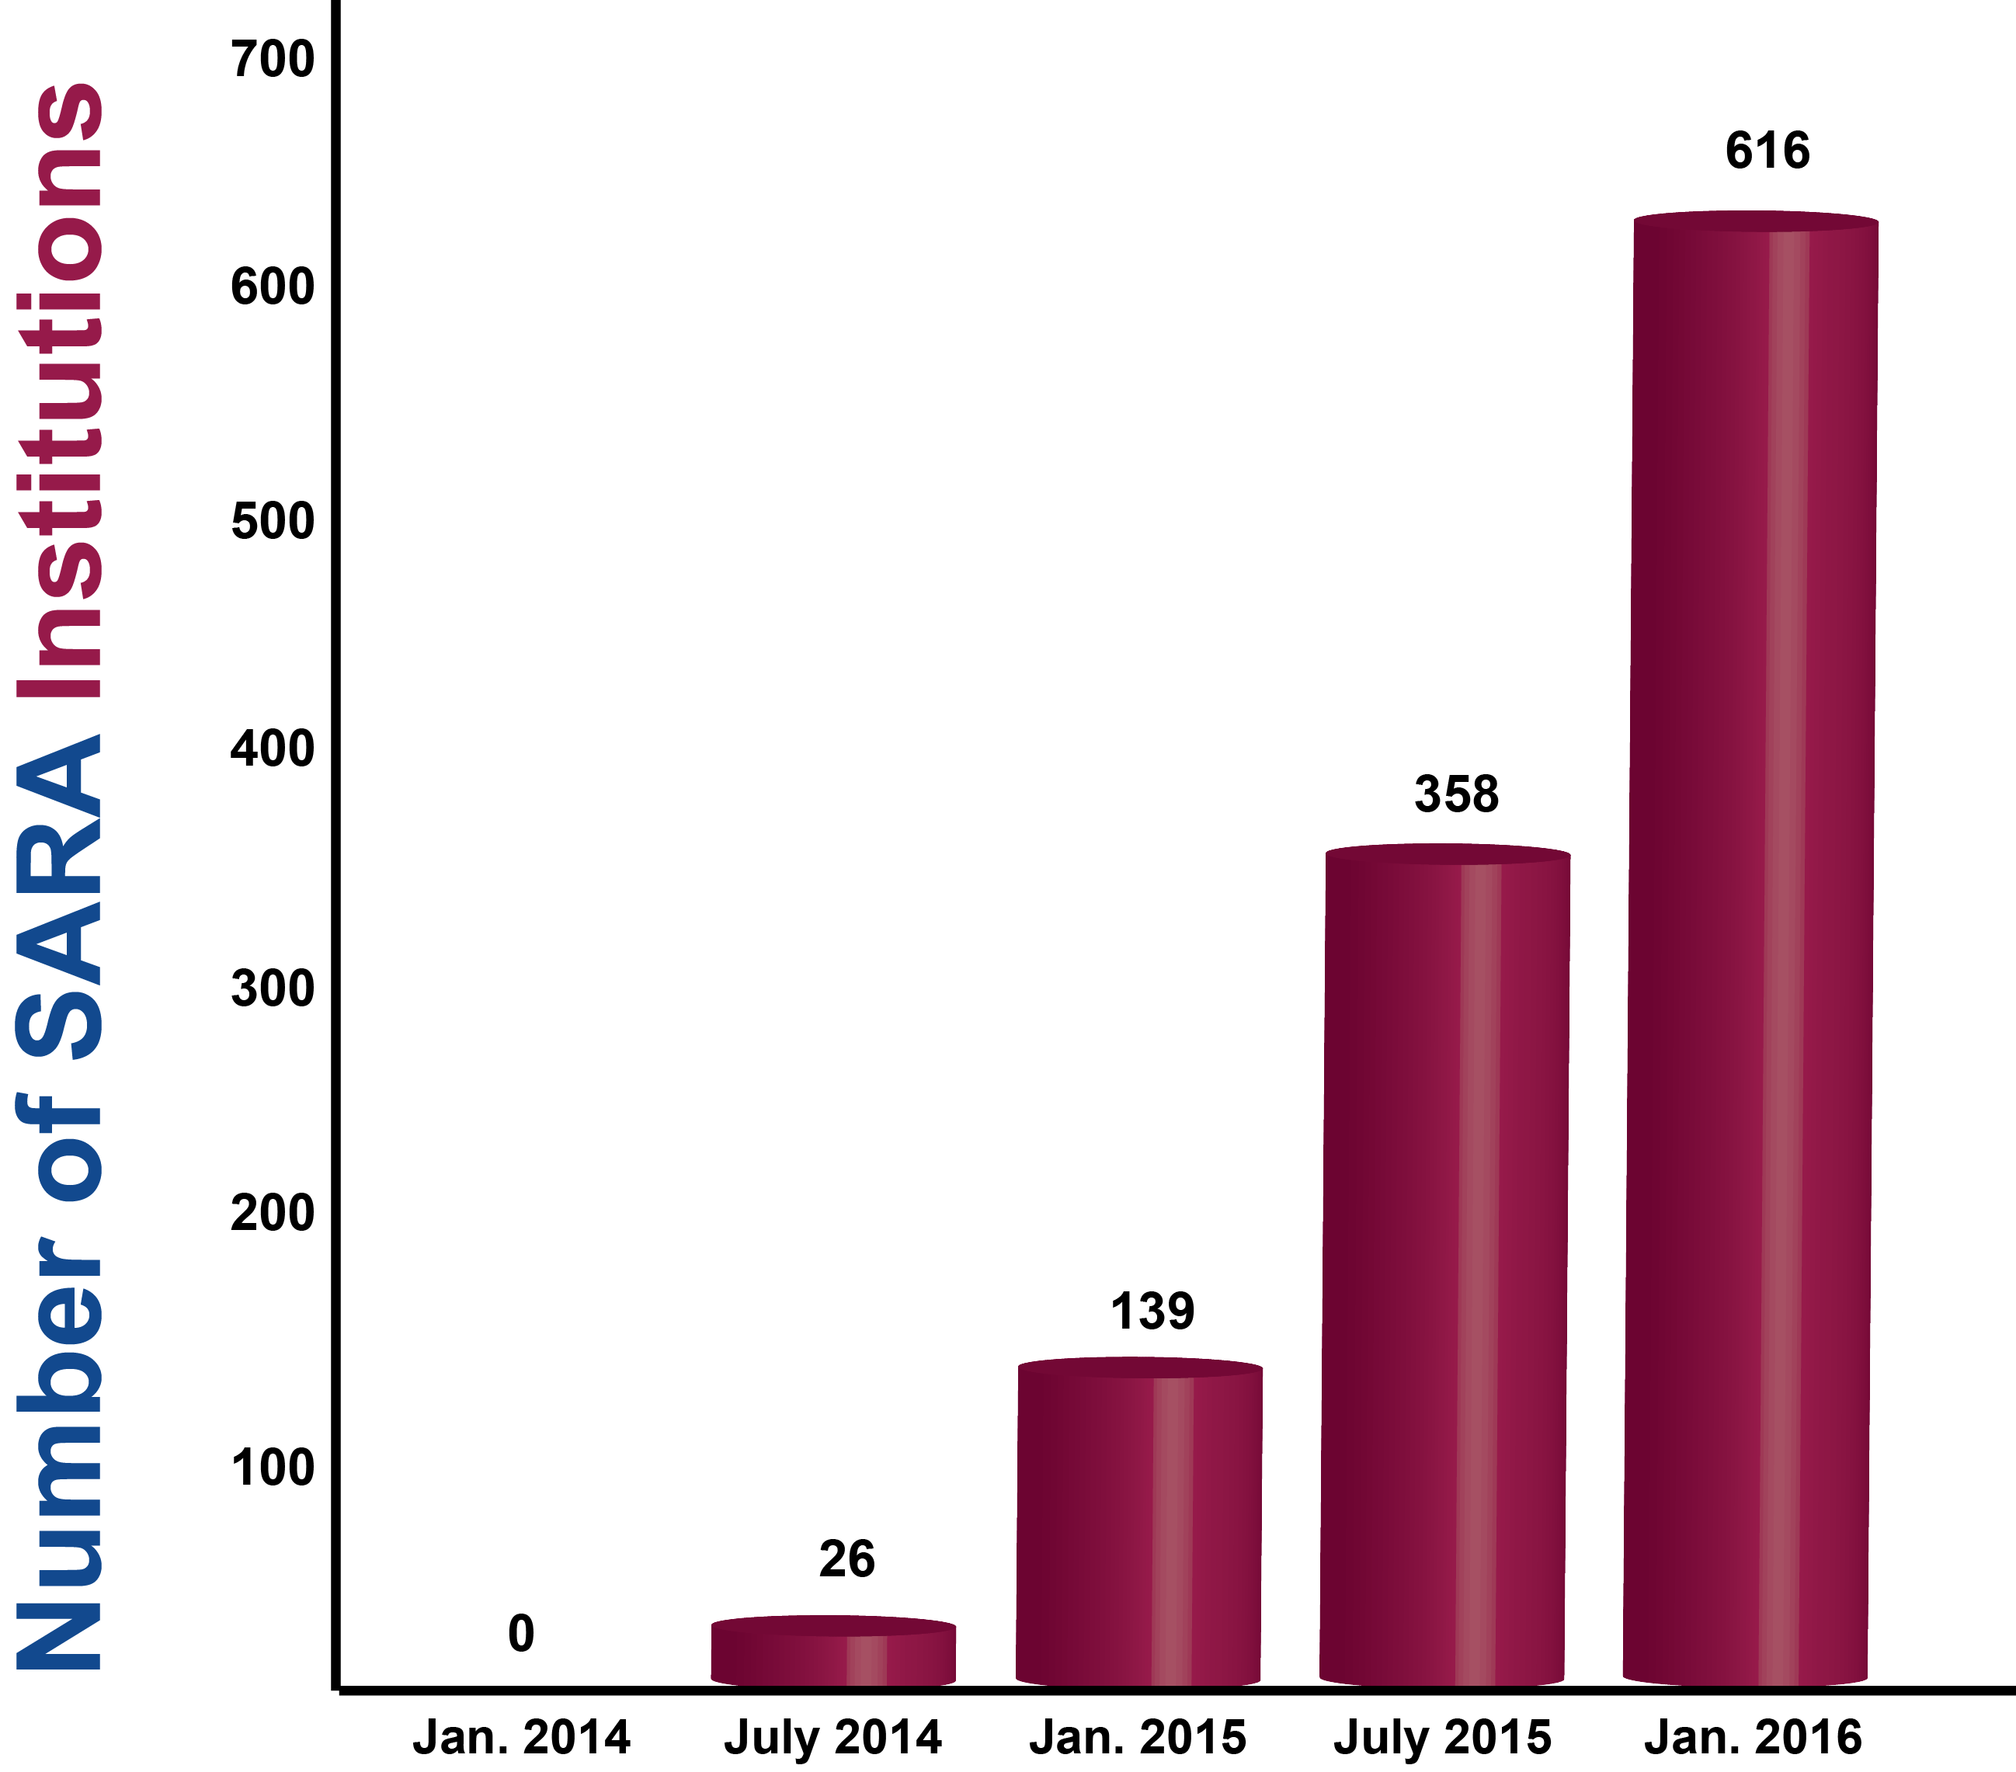
Participating Institutions By Numbers

Slide 25
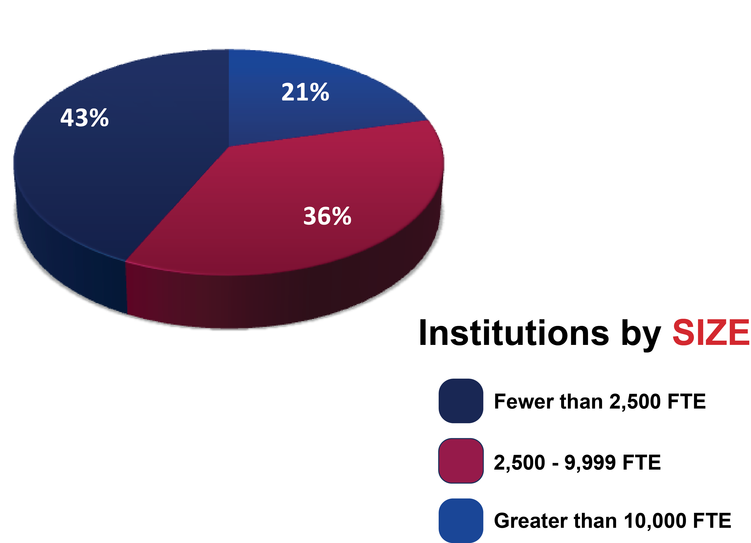
Participating Institutions By Size
As of December 31, 2015

Slide 26
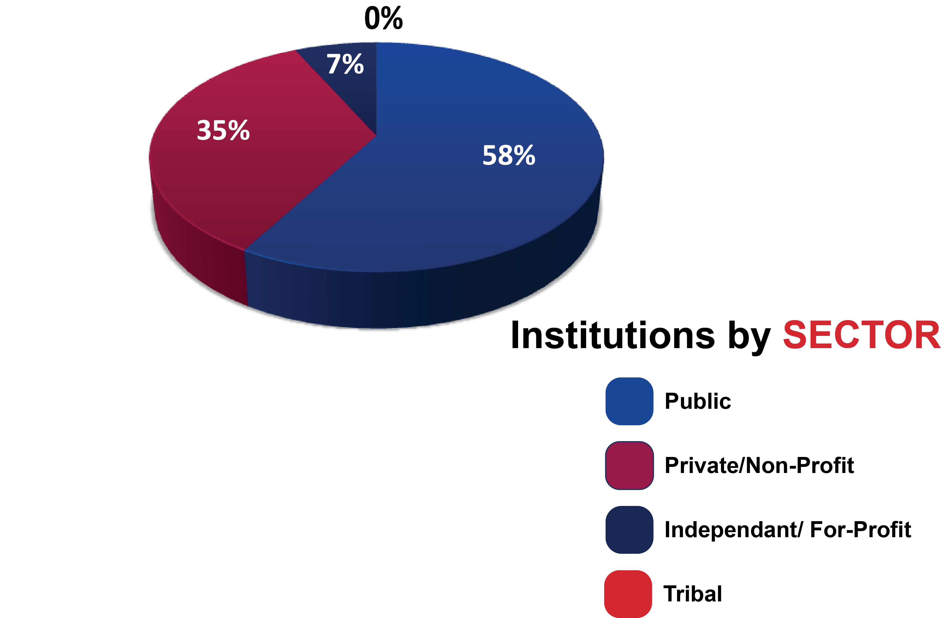
Participating Institutions By Sector
As of December 31, 2015

Slide 27
Current SARA Activities?
State membership and institutional participation and renewal
Data Reporting –
  Student Complaints and Enrollment
State Portal Entity manual
Supervised field experiences discussions
SECRRA to SARA
Electronic Campus
Nationwide all SARA institutions may participate in www.TheAdultLearner.org

Slide 28
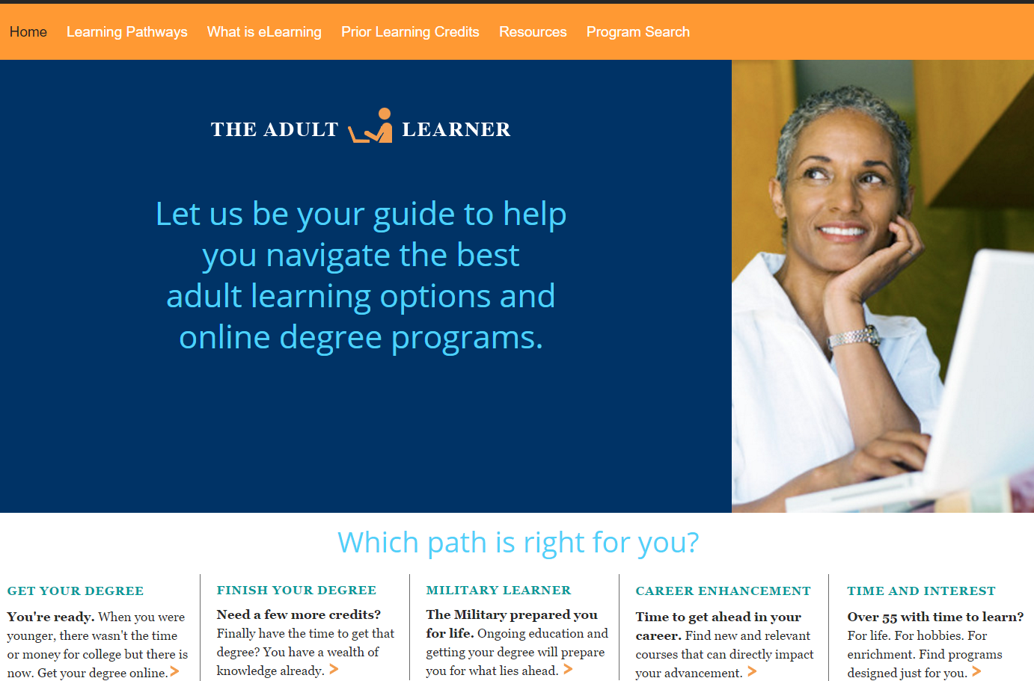
www.TheAdultLearner.org

Slide 29
Financial Status of the SARA Initiative
SARA work by all SARA partners (NC-SARA, MHEC, NEBHE, SREB and WICHE) is now fully dependent on fee revenue
Current and projected revenues are sufficient to support SARA
Revenue collected from institutional fees covers operational cost only at each compact
Consequently, NC-SARA has determined to keep fees at current levels through June, 2018

Slide 30
Benefits to Institutions
Enables more efficient provision of distance education to a broader market.
Reduces number of applications to other states.
Reduces number of other-state regulations to monitor for changes.
Reduces costs.
  Reduced costs = potentially lower fees for students.

Slide 31

NC-SARA
Institution Fees
Fee is based on an institution’s total full-time equivalent (FTE) enrollment:
$2,000/year for institutions with fewer than 2,500 FTE students
$4,000/year for institutions between 2,500-9,999 FTE students
$6,000/year for institutions with 10,000 or more FTE students

Slide 32

What Is Required of Institutions?
Institution Application for participation in SARA
Meet the C-RAC standards
Reporting
Student complaint reporting
Enrollment date reporting
Yearly Institution Renewal

Slide 33
Institutional Application
Institutions CANNOT participate until the state joins
NC targeted to submit state application for June Steering Committee Meeting
SREB President approves and signs
SREB SARA Director notifies State Portal Entity and coordinates press releases
Notes:
.

Slide 34
SARA & Professional Licensure
SARA does not affect/effect Professional Licensure….
SARA is State Authorization…

Slide 35
SARA and Supervised Field Experiences
Ten students
Per program
Per site

Slide 36
Institution Decision
Internal analysis of institution’s online students and activities (for physical presence triggers)
  Where are your online students?
  Where are students doing field experiences?
  Where are online faculty?
  Does your college market or advertise in other states?
Compile students per state and activities by category and by state
Compile costs per state and per year

Slide 37
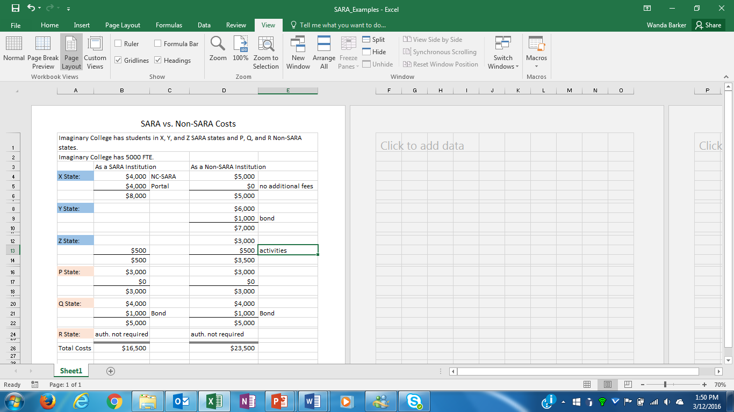
SARA vs. Non-SARA Costs

Slide 38

Now That We’re Past the “Easy” Stuff…
Continue to add states and institutions
Implications and implementation of IRS 501 (c)(3) status for NC-SARA
  Establish independent budgeting, accounting, auditing and IT systems
  Establish appropriate staffing levels
Responding to “down-in-the-weeds” questions and policy issues
  Physical presence
  Experiential learning
  Etc., etc., etc.

Slide 39
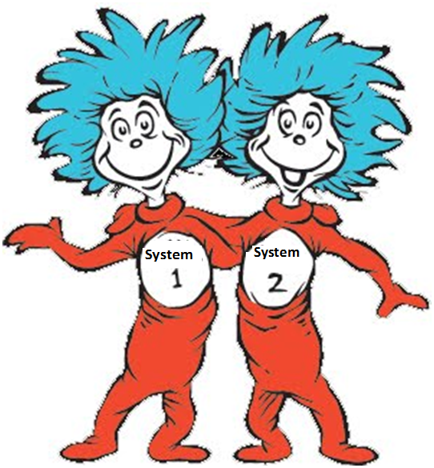
SECRRA To SARA
    To ensure reciprocity for current SECRRA students, states and institutions transitioning to SARA will continue SECRRA processes and procedures

Slide 40
After June 30, 2017
    Institutions in SREB states that do not join SARA will need to seek authorization from all states including the SREB region.
    Non-SARA institutions in SARA states in SREB region will need to seek authorization from all states including the SREB region.

Slide 41
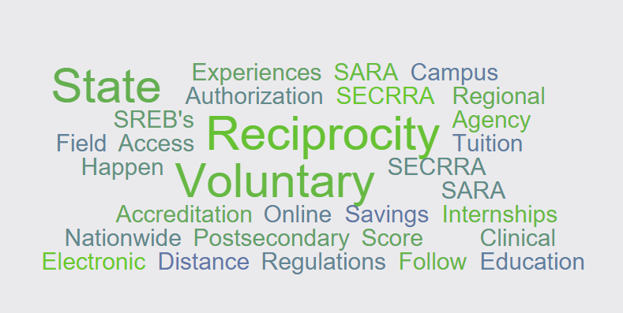
Questions?

