Slide 1
A Multi-case Simulation to Aid in Transition to Practice
Debora Nutt, DNP, RN
Lisa Engel, MSN, RN, CNE

Slide 2
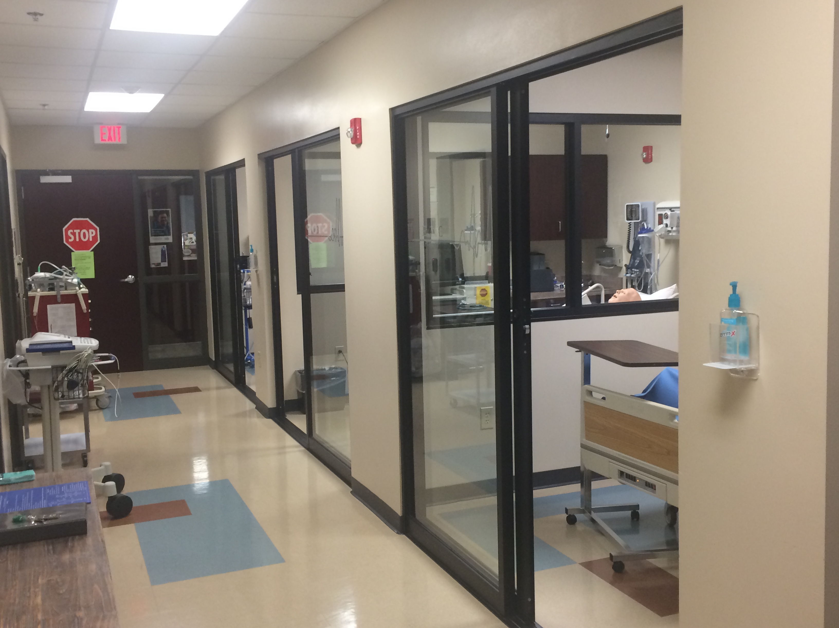
Introduction
Complex, chaotic hospital environment
Novice nurses need leadership skills (Marquis & Huston, 2017)
Novice nurses feel unprepared to handle difficult challenging clinical environment (Radovich et al, 2011)
Retention rate for new RNs 83% which means 17% leave their jobs during first year (Blegen et al, 2017; Kovner et al 2014)

Slide 3
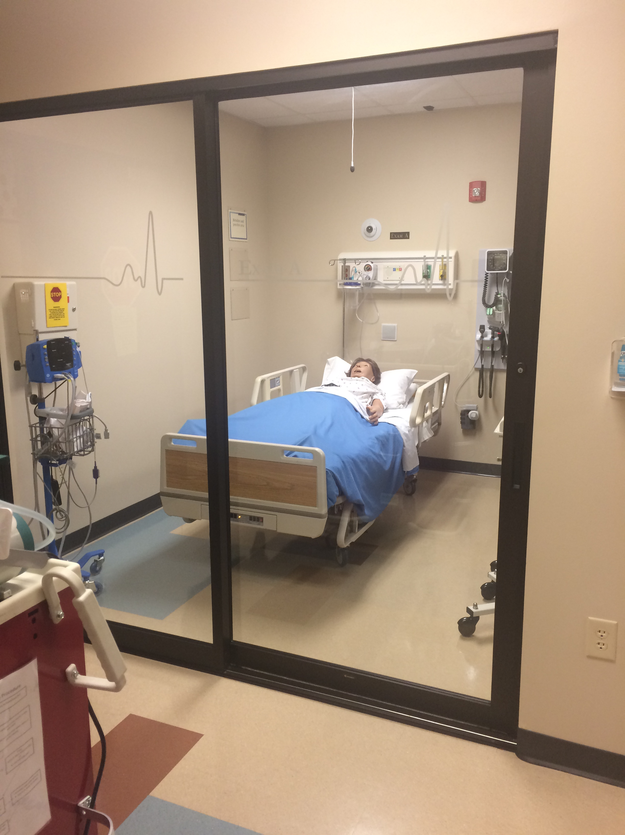
Transformational
Proposal to implement a multi-case simulation
Final semester course (Leadership)
Change from a group of students caring for 1 patient to a group of students would care for multiple patients
Use cases from content taught in previous medical-surgical courses
No prep the night before (nurses do not prep before work)
Culminating simulation experience for students
Planning: CC, Simulation coordinator, graduate student
Initial Pilot group of 7 students fall 2015
Notes:
Make it a realistic as possible

Slide 4
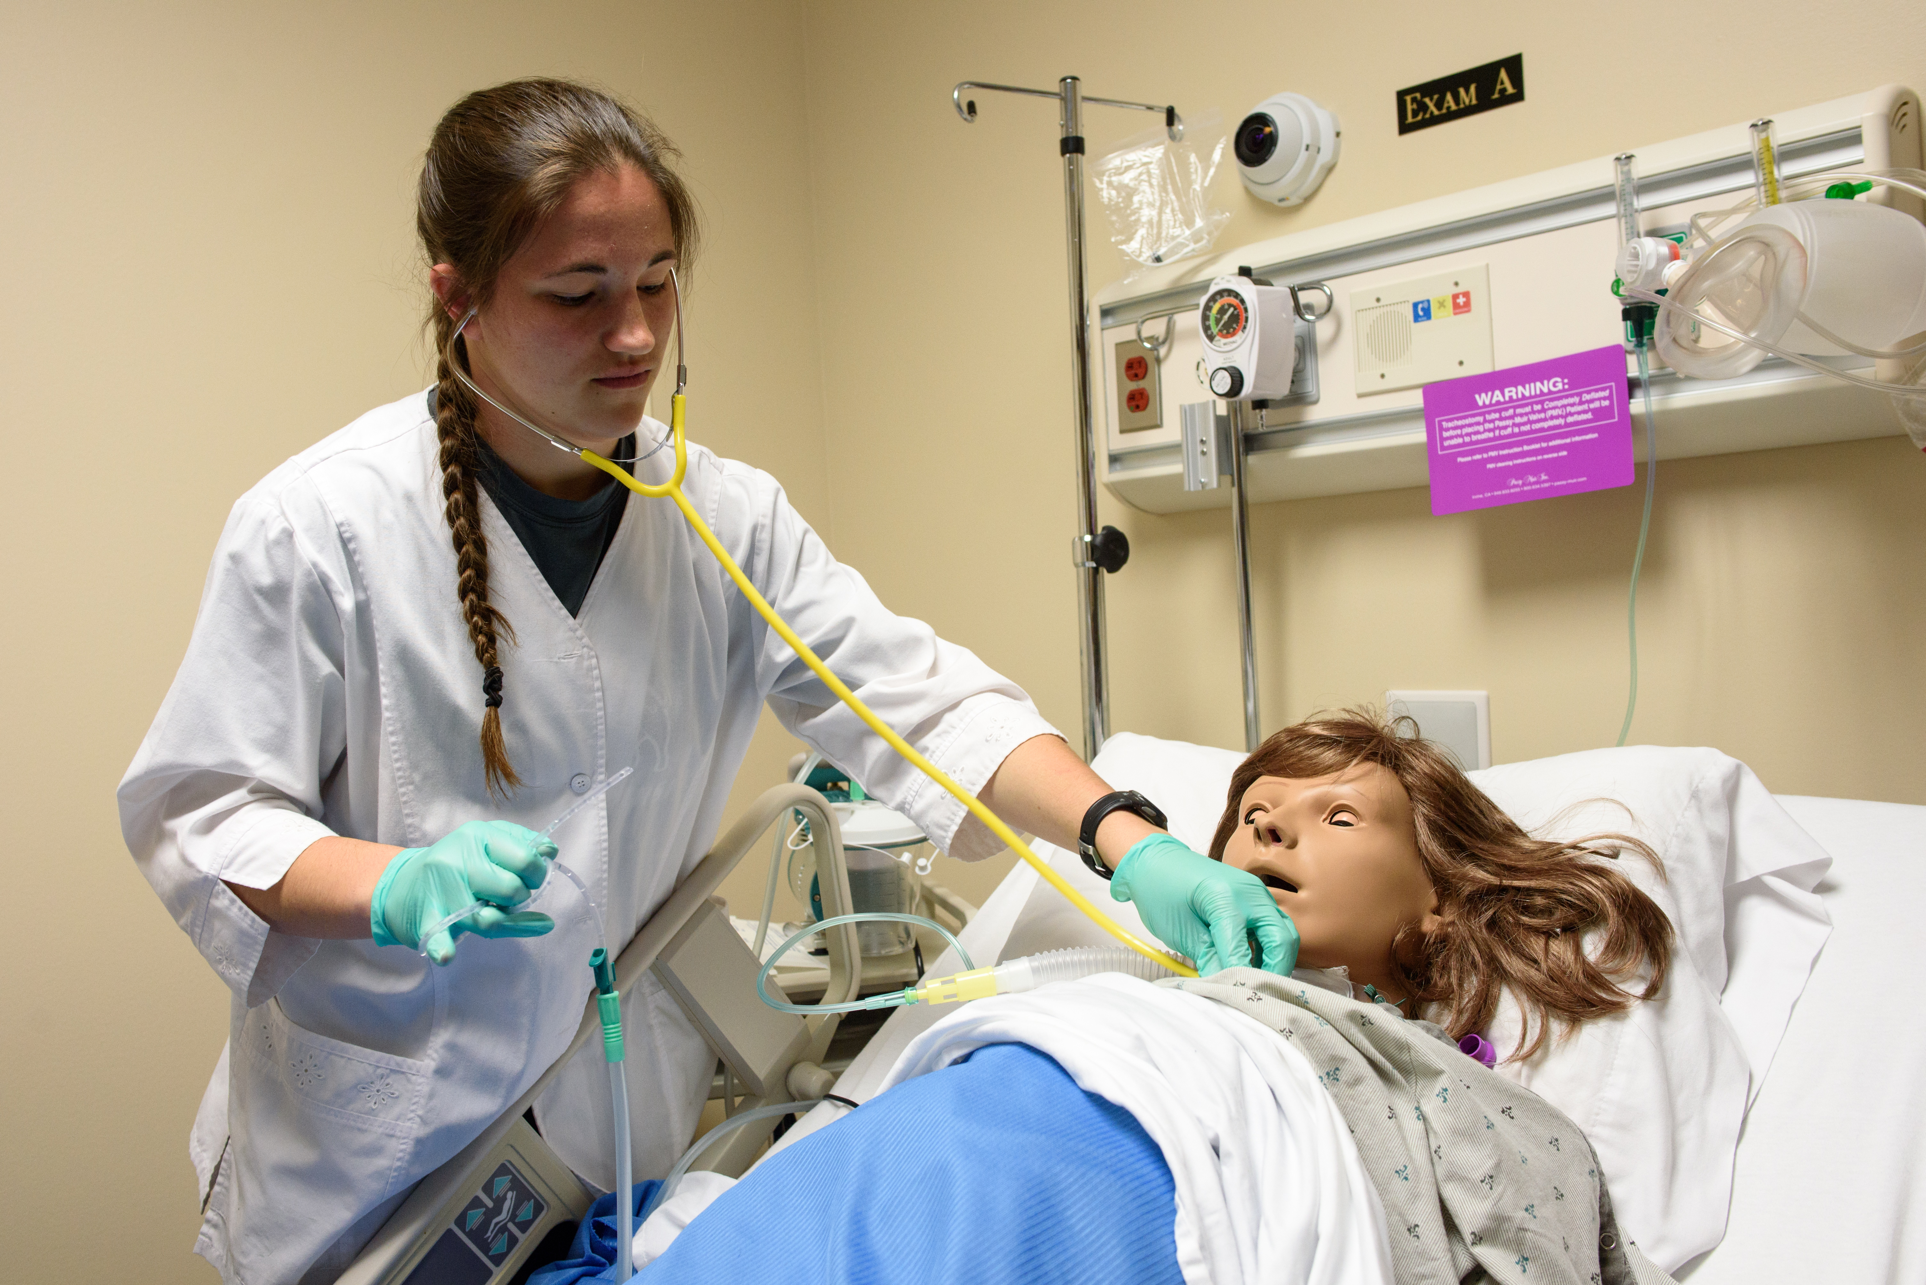
Purpose & Goals
To define how simulated learning simulations can enhance leadership skills and address lack of transition to nursing practice
Goals:
conduct an evaluation of current students to determine perceived confidence with providing nursing care in an independent manner
determine if simulation enhanced leadership skills needed for nursing practice such as delegation, conflict management, and critical thinking

Slide 5
Methods
Seniors students in leadership participated in 2 spaced simulated activities utilizing 4 patients
Simulation included 2 standardized (live) patients and 2 high fidelity manniquins
Sign confidentiality and video recording consents
Leadership Simulation objectives and orientation were shared prior to simulation
Pre-briefing: review of charts, choose a charge nurse discuss role of charge nurse, development of SOAP for each patient, discussion of each patient with priority plans
Simulation: brief simulation update to time, pyxis, bedside report from previous nurse, simulation
De-briefing: review and discussion of simulation
Documentation: update & revise SOAP with final prioritization of problems, complete unfinished documentation (assessment, nurses notes, MAR, new orders)

Slide 6
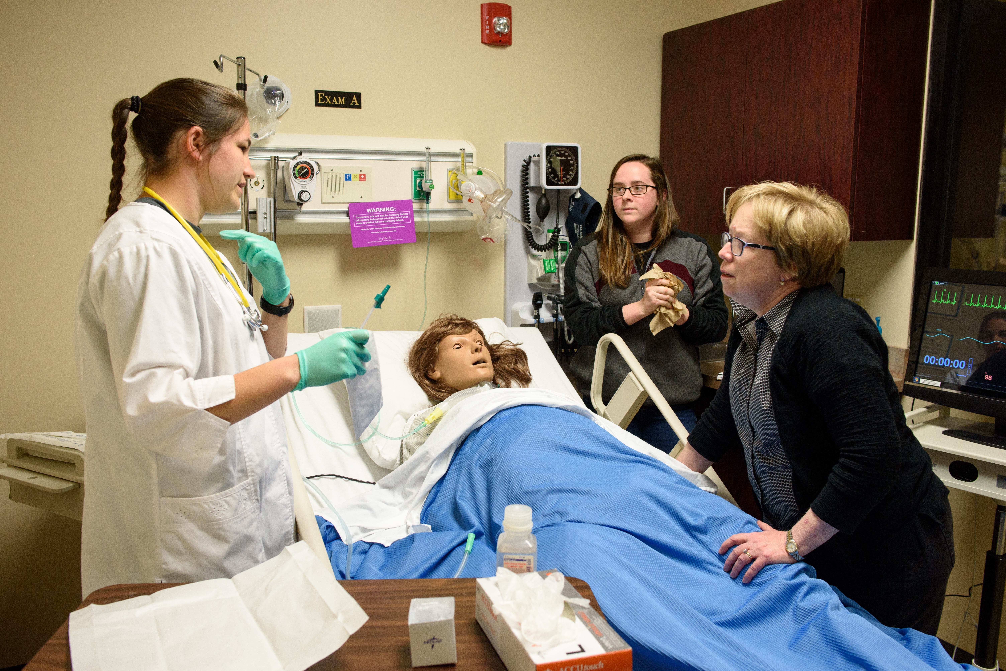
Methods continued
Simulation 1:
occurs week 5 & 6 of semester
4 patients with medical surgical problems
conflicts focus on patient, family and/or chart conflicts
Skills: environmental assessment, patient assessment, communication, am medication administration
Simulation 2:
Occurs week 10-12 of semester
same 4 patients but 48 hours later in care
Staff and family conflicts
Skills: environmental assessment, patient assessment, communication, PRN medications, clinical skills: IV start, foley insertion, NG tube insertion, trach care and suctioning

Slide 8
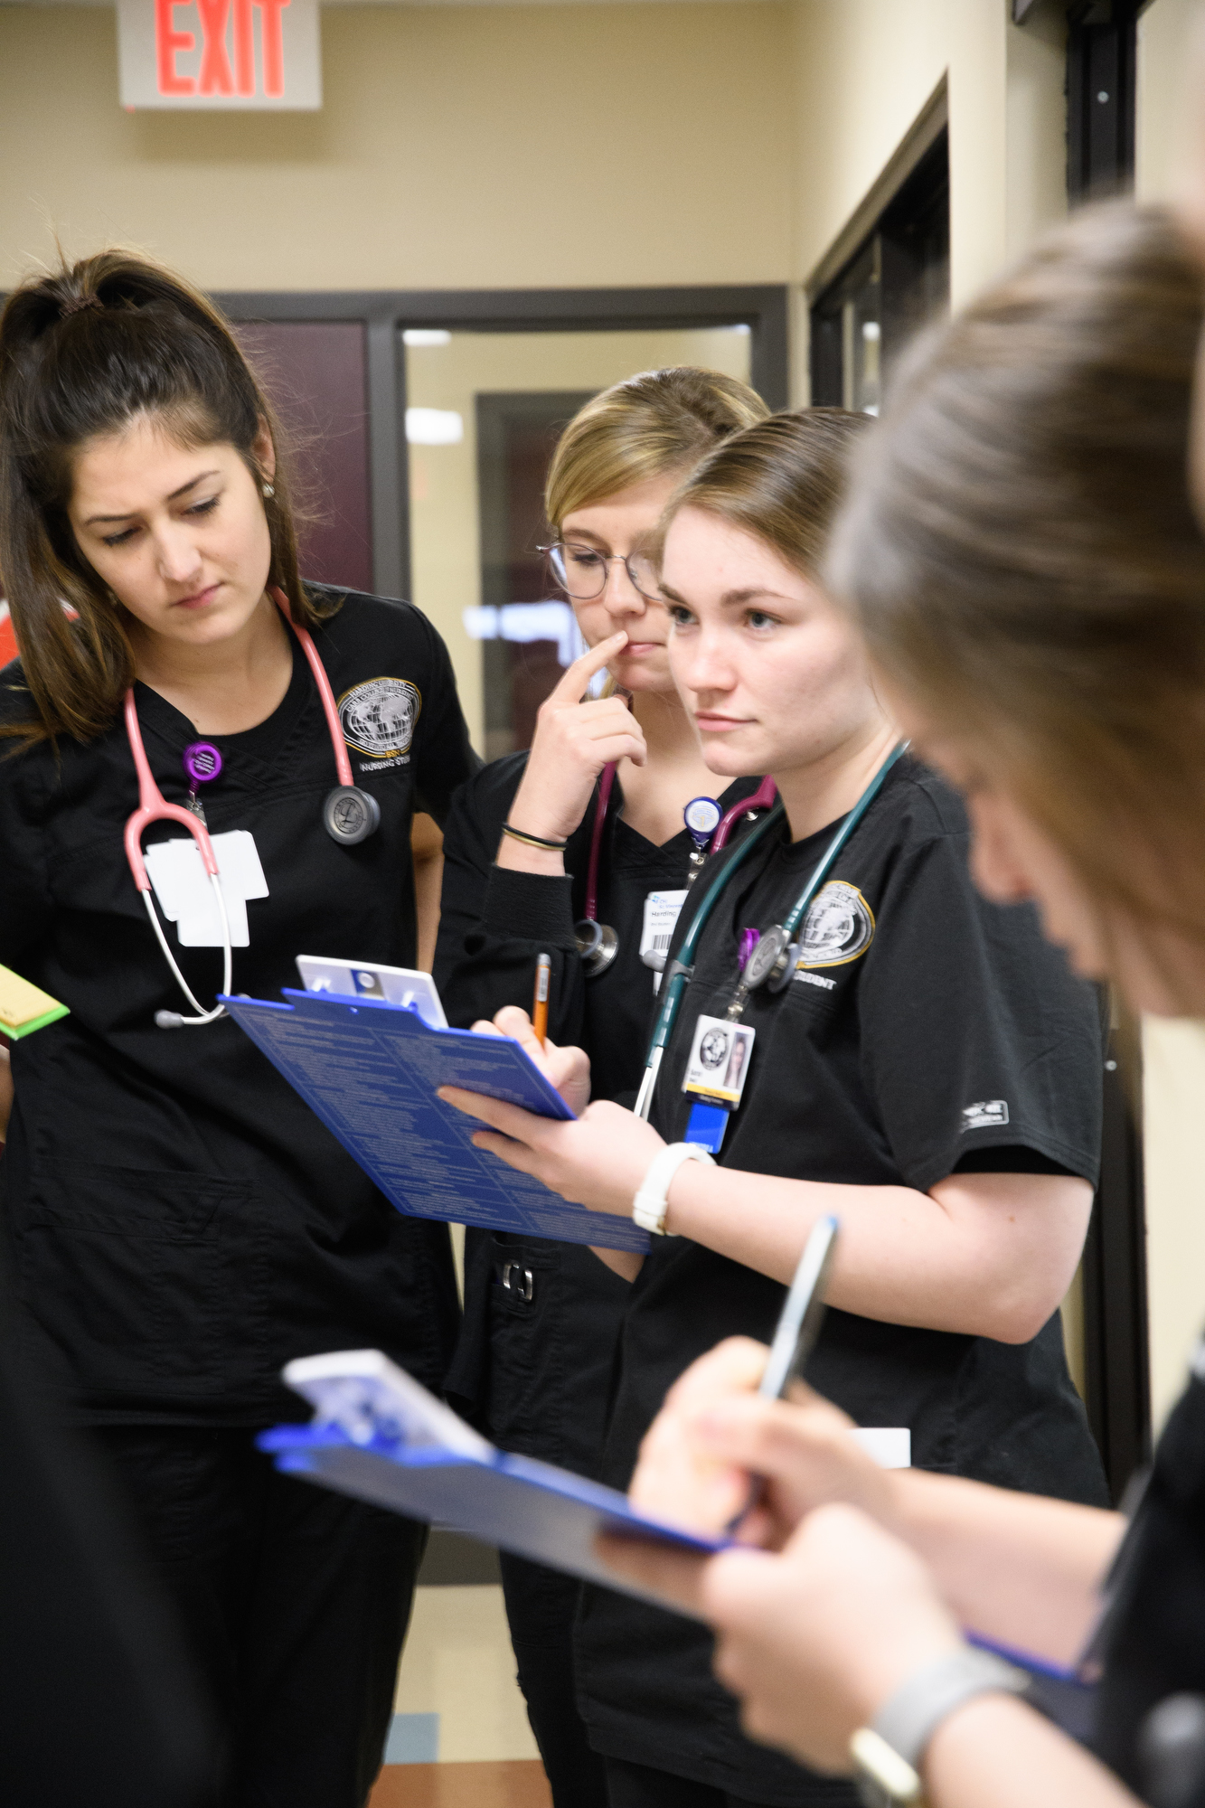
Methods continued
IRB consent obtained from University IRB committee
Students completed simulation evaluation after each simulation
Students watched simulation 1 and completed self-evaluation then one on one debrief with course coordinator
Consent obtained after 2nd simulation to avoid any Hawthorne effect
No identifying data collected with evaluations

Slide 9
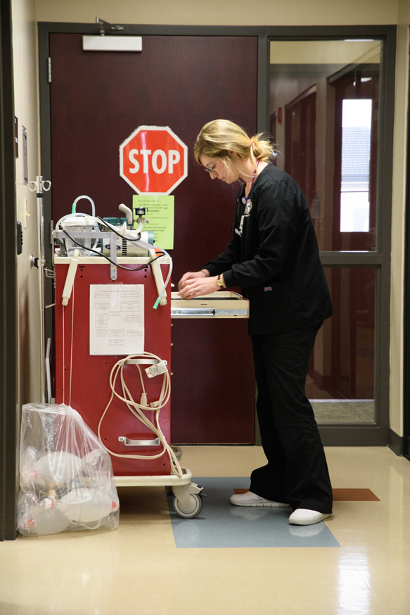
Data Collection & Analysis
Data collected over 5 semester spring 2016 to spring 2018
Researcher-developed questionnaire to address Leadership components and transition to practice based on NLN simulation evaluation
Likert scale questions reflecting teamwork, critical thinking, assessment, transition to practice, conflict resolution, communication, confidence in performing skills, delegation, areas of personal improvement, time to reevaluate care
Readiness to practice nursing ranked on a 1-10 scale
Questionnaire peer reviewed prior to implementation

Slide 10
Results Metrics
Student Self-Evaluation at End of Semester
Students Evaluations after Simulation 2 End of Semester All Combined (Spring 2016 to Spring 2018)
 | Strongly Agree | Agree | Neutral | Disagree | Strongly Disagree
Did you feel the simulation process enhanced your ability to work as a team? (N = 121) | 80.2% (97) | 19.0% (23) | 0.8% (1) | 0 | 0
Do you feel the simulation process enhanced your critical thinking skills? (N=121) | 77.7% (94) | 22.3% (27) | 0 | 0 | 0
Do you feel the simulation process enhanced your assessment skills? (N=121) | 62.0% (75) | 36.4% (44) | 1.7% (2) | 0 | 0
Do you feel the simulation process will assist you in transitioning into nursing practice? (N=120) | 77.4% (94) | 19% (23) | 2.5% (3) | 0 | 0
Do you feel the simulation process allowed you to practice handling conflict resolution? (N=121) | 76.0% (92) | 17.4% (21) | 5.0% (6) | 0.8% (1) | 0.8% (1)
Do you feel the simulation process enhanced your communication skills? (N=121) | 81.0% (98) | 18.2% (22) | 0.8% (1) | 0 | 0
Do you feel the simulation process enhanced your confidence in nursing skills? (N=121) | 67.8% (82) | 25.6% (31) | 4.2% (5) | 0.8% (1) | 0.8% (1)
Do you feel the simulation process enhanced your delegation skills? (N=121) | 62.0% (75) | 28.9% (35) | 9.1% (11) | 0 | 0
Do you feel the simulation process allowed you to see areas of personal improvement? (N=121) | 80.2% (97) | 19.0% (23) | 0.8% (1) | 0 | 0
Do you feel the post-simulation allowed you to assess and reevaluate actions taken during the simulation process? (N=121) | 76.9% (93) | 22.3% (27) | 0.8% (1) | 0 | 0
Notes:
Final sample N=123 2 chose not to participate
103 females 83.7% and 20 males 16.3%
Not all students completed form at both experiences
Not all questions were answered
Average student age 22.5 years

Slide 11
Results & Metrics: conflicts and preparation for career
All Combined (Spring 2016 through Spring 2018)
Likert scale (1 to 10) N=121 | Mean | Median | Std. Deviation
After participating in the competency simulation, how confident do you feel with handling conflicts? | 8.179 | 8 | 0.9411
After participating in simulation and competency, how prepared do you feel for beginning your nursing career? | 8.171 | 8 | 1.2611
Notes:
In Table 2, results of three self-evaluation questions regarding the students’ preparation to practice are presented. On a scale of 1 to 10 (with 1 being “not prepared at all” and 10 being “very prepared”), the students felt they were prepared to enter practice.

Slide 12
Results & Metrics Comparison of Means
Skill | Mean | SD | t | df | sig (2-tailed)
Assessment skills #1 | 4.4 | .658 | 2.722 | 115 | .007
Assessment skills #2 | 4.61 | .524
Skills confidence #1 | 4.32 | .669 | 3.666 | 113 | .000
Skills confidence #2 | 4.64 | .597
Delegation skills #1 | 4.25 | .686 | 3.229 | 114 | .002
Delegation skills #2 | 4.54 | .639
Communication skills #1 | 4.69 | .465 | 2.048 | 115 | .043
Communication skills #2 | 4.81 | .455
Conflict resolution #1 | 4.51 | .666 | 2.435 | 115 | .016
Conflict resolution #2 | 4.71 | .633
Notes:
To measure student growth over the semester, we compared the mean scores of evaluation items between the two experiences, using the paired samples t-test, (Table 3). There was a significant difference in the scores for communication skills, conflict resolution, assessment skills, skills confidence, and delegation skills, between the first experience, which occurred early in the semester, and the second experience, which occurred at the end of the semester.

Slide 13
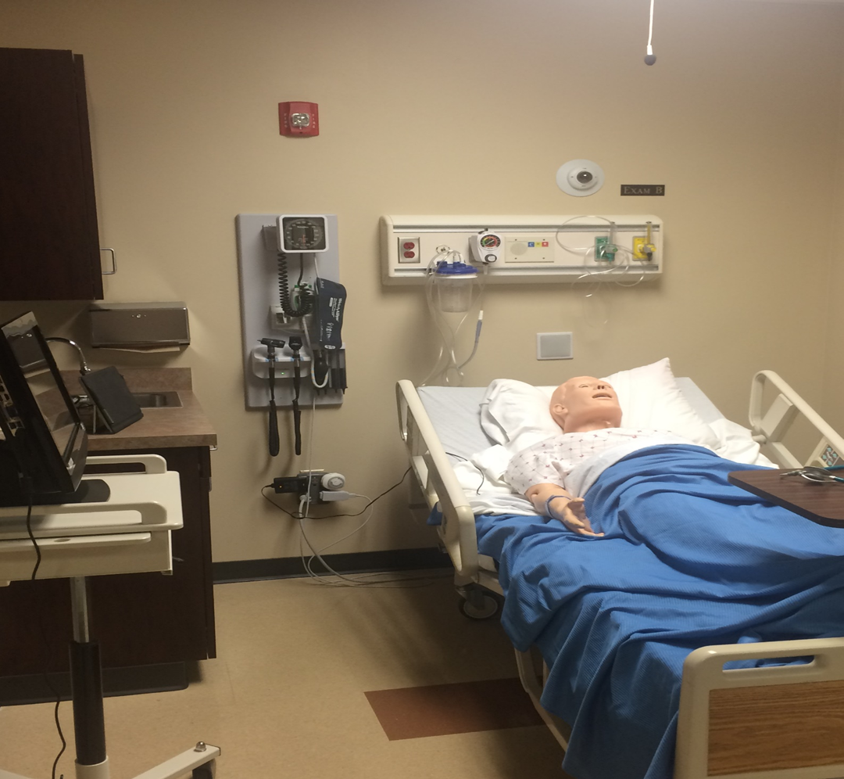
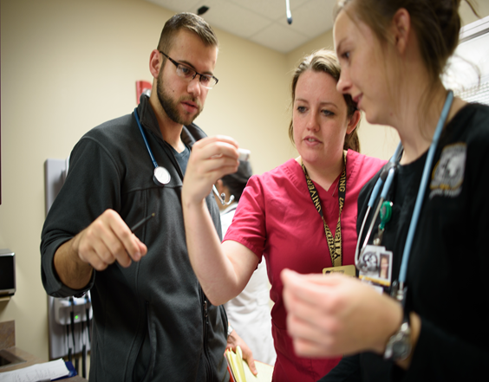
Barriers/Obstacles
Takes many faculty members and volunteers
Time and coordination to run 3 groups of students in a day
Coordination of simulation lab with other courses
Simulation realistic and stress involved which students are told about ahead of time
Adaptations to prepare for simulation with clinical orientation
Changes to debriefing and included 1-on-1 debriefing with course coordinator

Slide 14
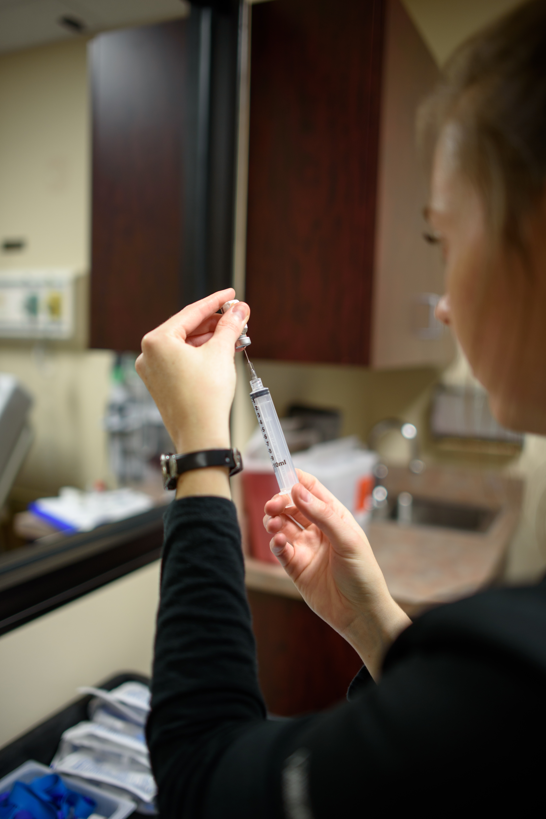
Discussion
Students viewed the simulation as helpful, beneficial, and realistic
Students liked being able to work more independently but have a peer resource with charge nurse
Students had opportunity to self-identify areas to improve
Between 1st & 2nd simulation student evaluation of assessment skills, delegation skills, communication skills, conflict resolution and confidence improved
Compared students preference for simulated (live) patients to high-fidelity mannequin: 52% preferred live simulated patients, 28.1 % benefited from both, and only 14% preferred working with high-fidelity mannequins. Need to do a cost analysis.

Slide 16
References
Blegen, M. A., Spector, N., Lynn, M. R., Barnsteiner, J., & Ulrich, B. T. (2017). Newly licensed RN retention: Hospital and nurse characteristics. The Journal of Nursing Administration, 47(10), 508-514. doi: 10.1097/NNA.0000000000000523
IBM. (2013). IBM SPSS Statistics [computer software]. IBM Corporation, Armonk, NY.
Kovner, C. T., Brewer, C. S., Fatehi, F., & Jun, J. (2014). What does nurse turnover rate mean and what is the rate? Policy, Politics, & Nursing Practice, 15(3-4), 7=64-71. doi: 10.1177/1527154414547953
Marquix, B. L., & Huston, C. J. (2017). Leadership roles and management functions in nursing. (9th ed). Philadelphia, PA. Wolters Kluwer/Lippincott Williams & Wilkins.
Radovich, P., Palaganas, J., Kiemeney, J., Strother, B., Bruneau, B., & Hamilton, L. (2011). Best practices in critical care: Enhancing leadership orientation through simulation. Critical Care Nurse, 31(5), 58-63. doi: 10.4037/ccn2011463

