Slide 1
Gerontologic Nursing Competency Tool and Web Toolbox for Pre-Licensure Nursing Students
Dr. Tanya Sudia; Dr. Dora Bradley
Professor Nan Ketcham; Dr. Rebecca Meraz
Project funding: Texas Higher Education Coordinating Board
Nursing Innovation Grant Program: Transition to Practice

Slide 2
This work is supported in part by a grant from the Texas Higher Education Coordinating Board (THECB). The opinions and conclusions expressed in this document are those of the author(s) and do not necessarily represent the opinions or policy of the THECB.

Slide 3
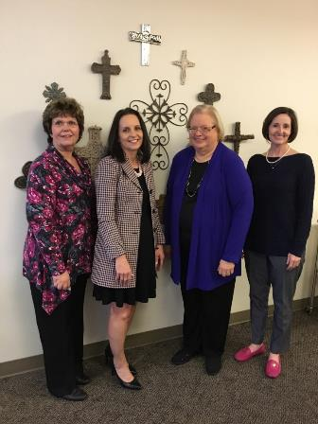
Project Leadership Team
Tanya Sudia, PhD, RN
Associate Dean for Research and Scholarship
Interim Graduate Program Director
Baylor University Louise Herrington School of Nursing
Dora Bradley, PhD, RN-BC, FAAN
VP of Nursing Professional Development
Baylor Scott & White Health * (at time of project)
Associate Dean for Strategic Partnerships
Baylor University Louise Herrington School of Nursing
Nan Ketcham, PhD(c), RN, CNE
Undergraduate Program Director
Baylor University Louise Herrington School of Nursing
Rebecca Meraz, PhD, RN
Clinical Assistant Professor
Baylor University Louise Herrington School of Nursing

Slide 4
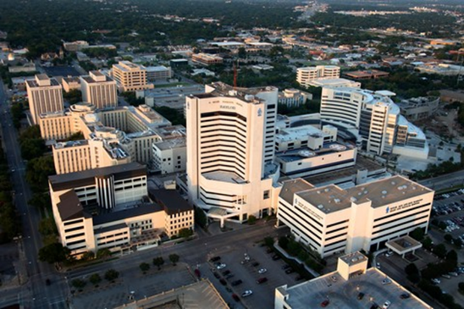
Practice Partners
Baylor Scott & White Health System
Baylor University Medical Center
Baylor Institute for Rehabilitation

Slide 5
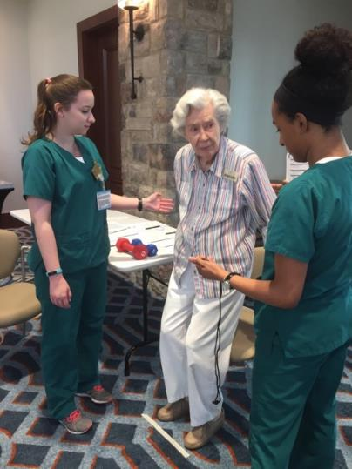
Project Goal
Develop and pilot a geriatric competency tool and toolbox for utilization with pre-licensure nursing students.

Slide 6
Tool Development
Initial Development
Utilization of National Guidelines
Resources from practice settings
Consultation with practice partners
Input from clinical faculty
Student input

Slide 7
Reviewed by National Panel of Experts
Revisions based on Reviewer feedback
2nd Review by National Panel of Experts
also reviewed by faculty and practice partners
Incorporation of additional feedback
Revised pilot version utilized

Slide 8
5 Key Competency Areas
Physical Care of the Older Adult
Cognitive Function of the Older Adult
Safety of the Older Adult
Communication with the Older Adult
Care Coordination for the Older Adult

Slide 9
Proficiency Levels
1 = Able to perform skill with prompting and assistance from preceptor
2 = Initiates without prompting and safely performs skill with assistance from preceptor
3 = Initiates and safely performs skill
independently

Slide 10
Gerontological Nursing Care Competency Tool

Slide 11
Physical Care of the Older Adult
Skin Integrity
Elimination
Nutritional Status
Pain
Sleep

Slide 12
Cognitive Function of the Older Adult
Assesses cognitive function using standardized
assessment tools
Assesses support network
Uses measures to enhance cognitive function
Explains assessments and interventions
Assesses and documents effectiveness of interventions

Slide 13
Communication with the Older Adult
Barriers
Strategies
Ensure adaptive devices are used
Acquire support for language differences
Speak slowly, distinctly, facing person
Make eye contact
Rephrase rather than repeat
Decision-Making

Slide 14
Safety of the Older Adult
Fall Prevention
Mistreatment
Medications
Comprehensive medication assessment
Performs reconciliation of medications at discharge
Assesses the ability to obtain and self-administer medications
Provides patient education as needed for the older adult and caregivers
Assesses understanding of medication using appropriate strategies

Slide 15
Care Coordination for the Older Adult
Delegation
Referrals
Assesses for need of referral(s) for the older adult
Determines available referral source(s)
Includes older adult and caregiver(s) in the process
Clearly communicates pertinent information when making referrals
Ensures completion of referral process

Slide 16
Gerontological Nursing Care Toolbox
Resources for Students and Faculty
Apps
Web-based modules
Evidence-based practice references

Slide 17
Compilation of Resources
Interactive Mobile Applications
Clinical and Applied Research References
BHCSClip.org
The Hartford Institute for Geriatric Nursing
ConsultGeri

Slide 18
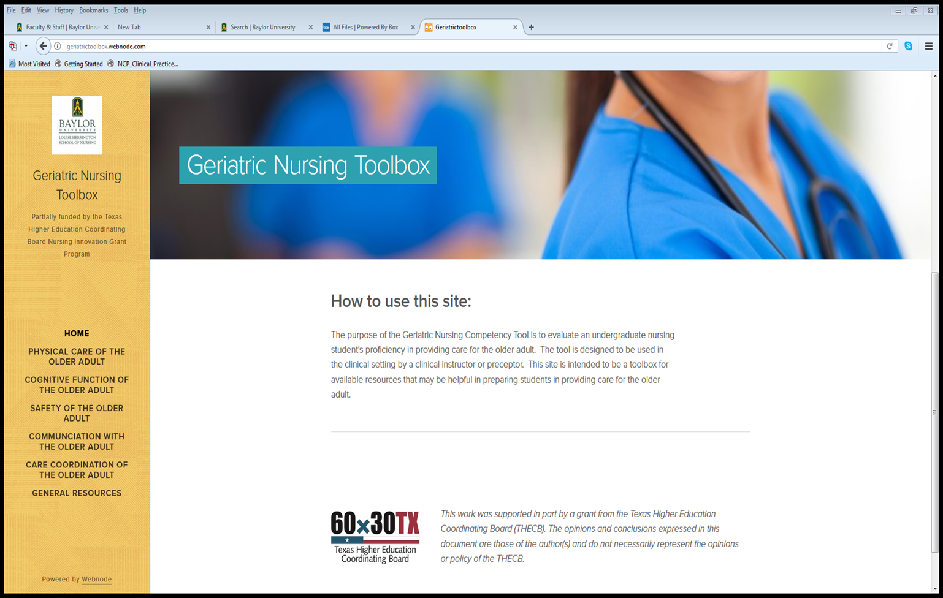

Slide 19
Phase II Partner Schools of Nursing
5 Texas Colleges/Universities
4 Public Schools of Nursing
1 Private University
2 ADN Programs
3 BSN Programs

Slide 20
Partner Schools of Nursing
College of the Mainland
Midwestern State University
Mountain View College
Texas A&M – Commerce
University of the Incarnate Word

Slide 21
Completed Tools by Site
Site | Completed Tools
1 | 238
2 | 90
3 | 107
4 | 128
5 | 30
6 | 9
Total: | 602

Slide 22
Participant Data: Students

Slide 23
Proficiency Levels
1 = Able to perform skill with prompting and assistance from preceptor
2 = Initiates without prompting and safely performs skill with assistance from preceptor
3 = Initiates and safely performs skill
independently

Slide 24
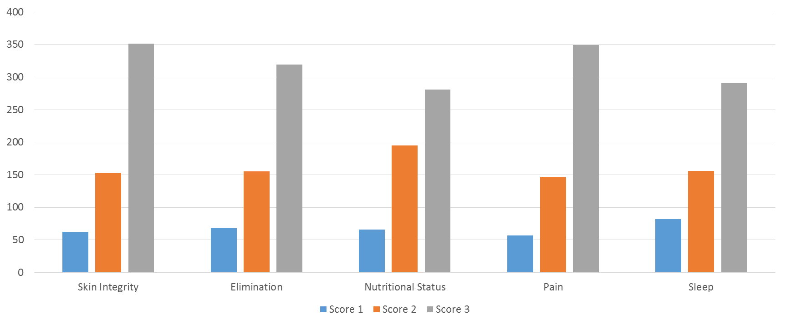
Physical Care

Slide 25
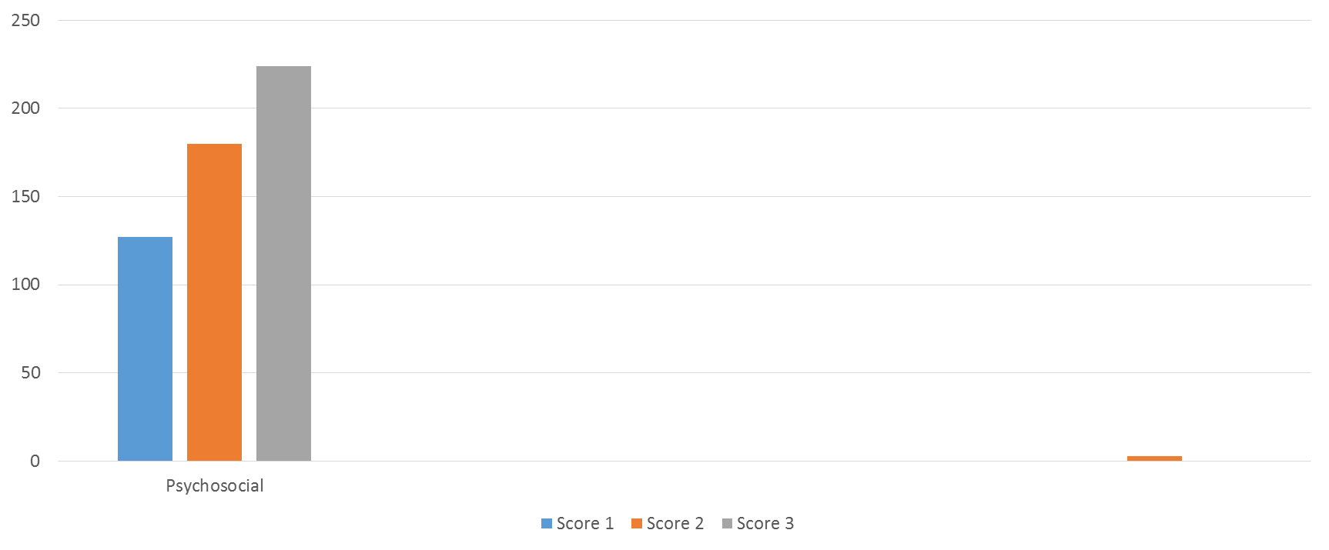
Cognitive Function

Slide 26
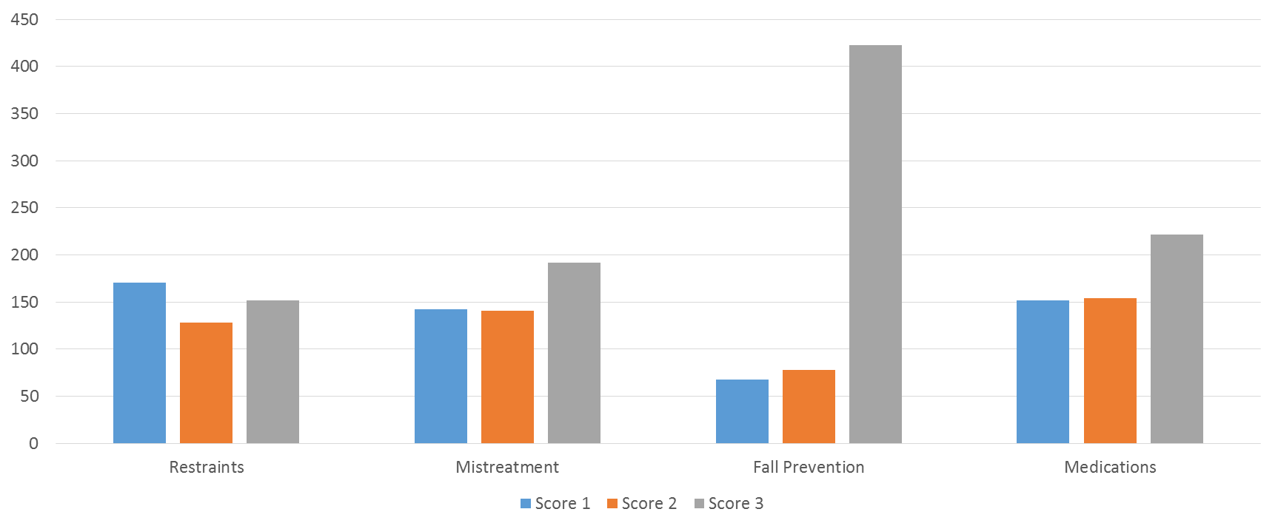
Safety

Slide 27
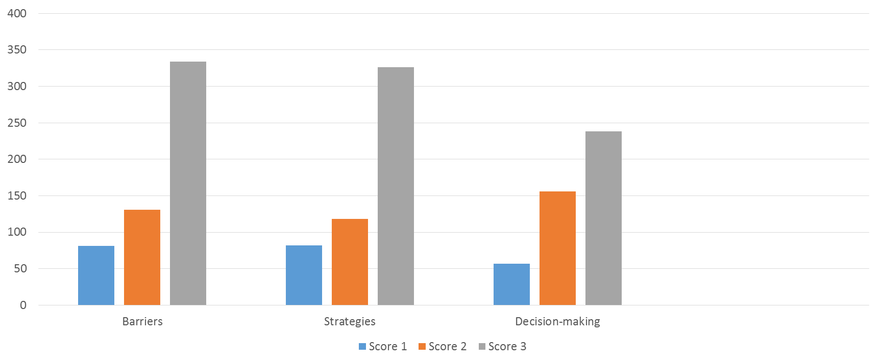
Communication

Slide 28
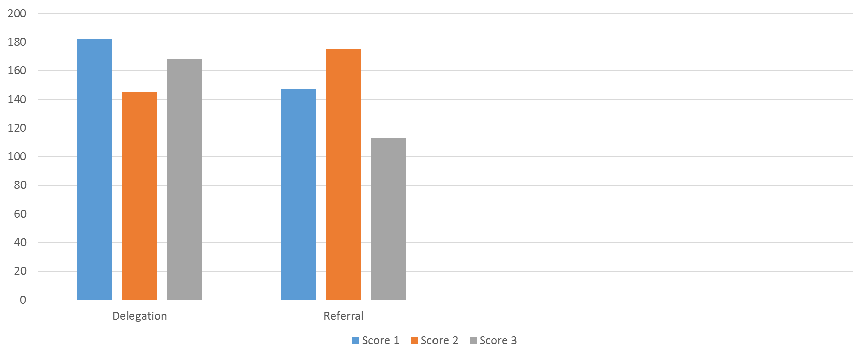
Care Coordination

Slide 29
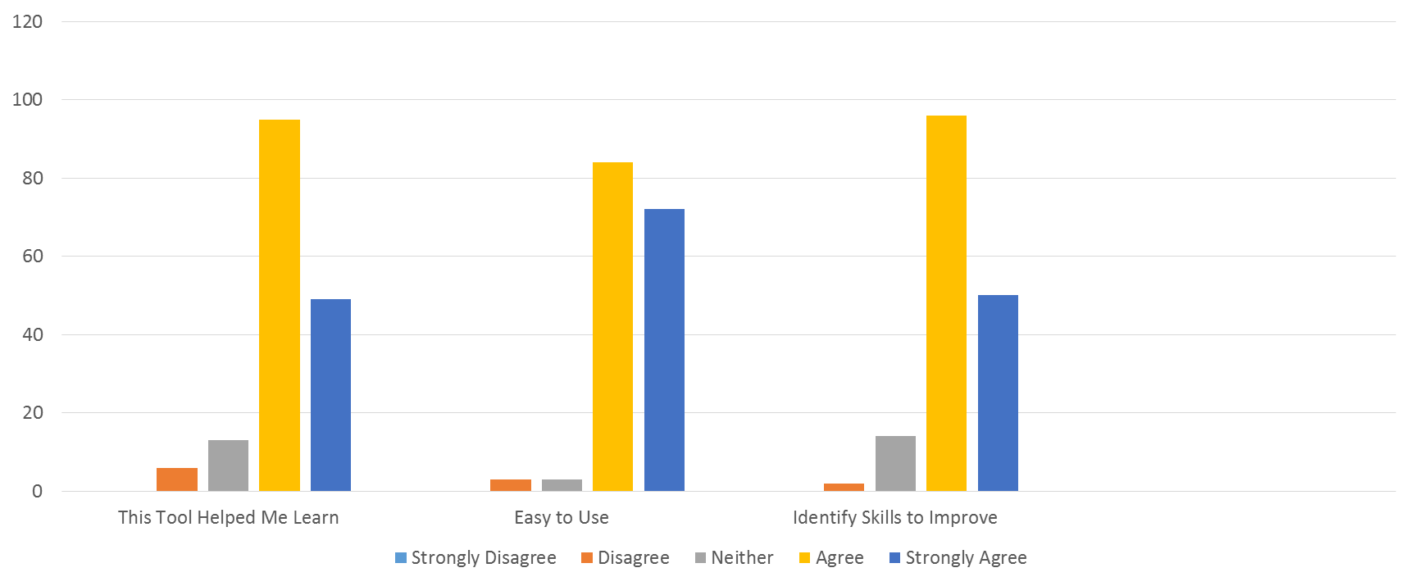
Survey Results - Tool

Slide 30
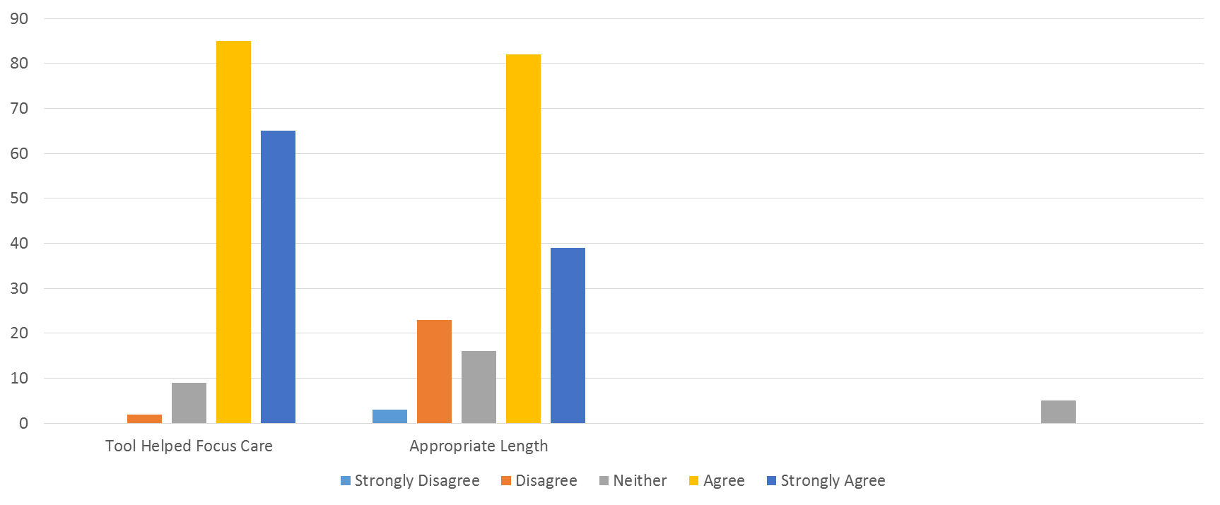

Slide 31
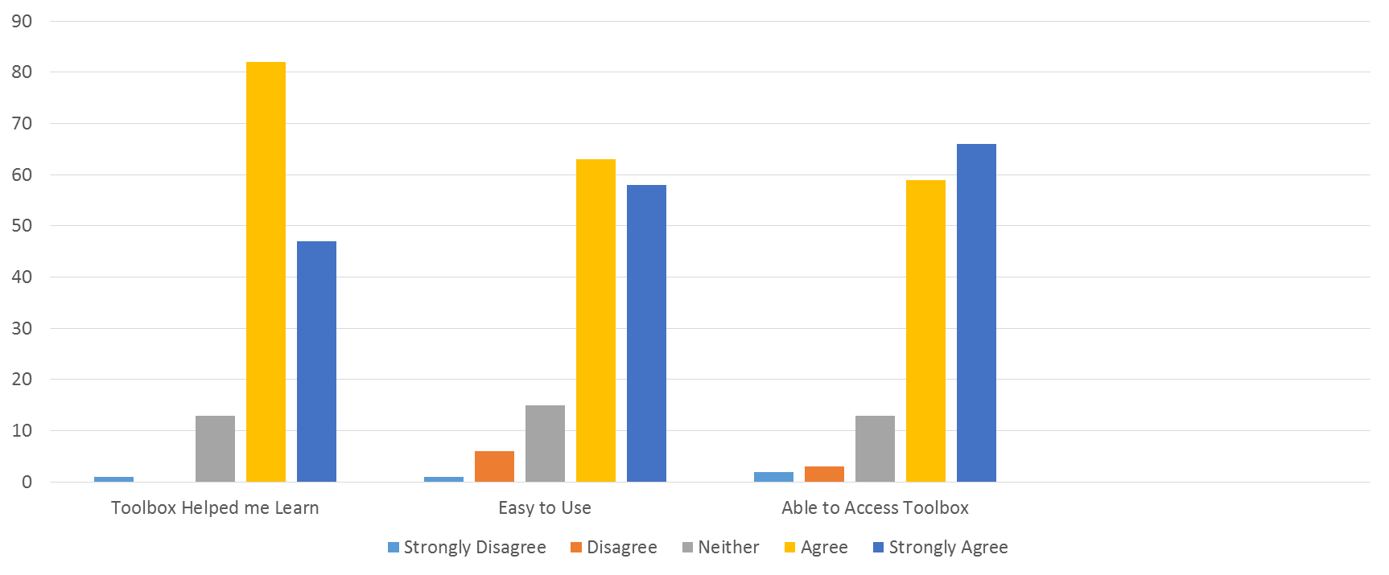
Survey Results - Toolbox

Slide 32
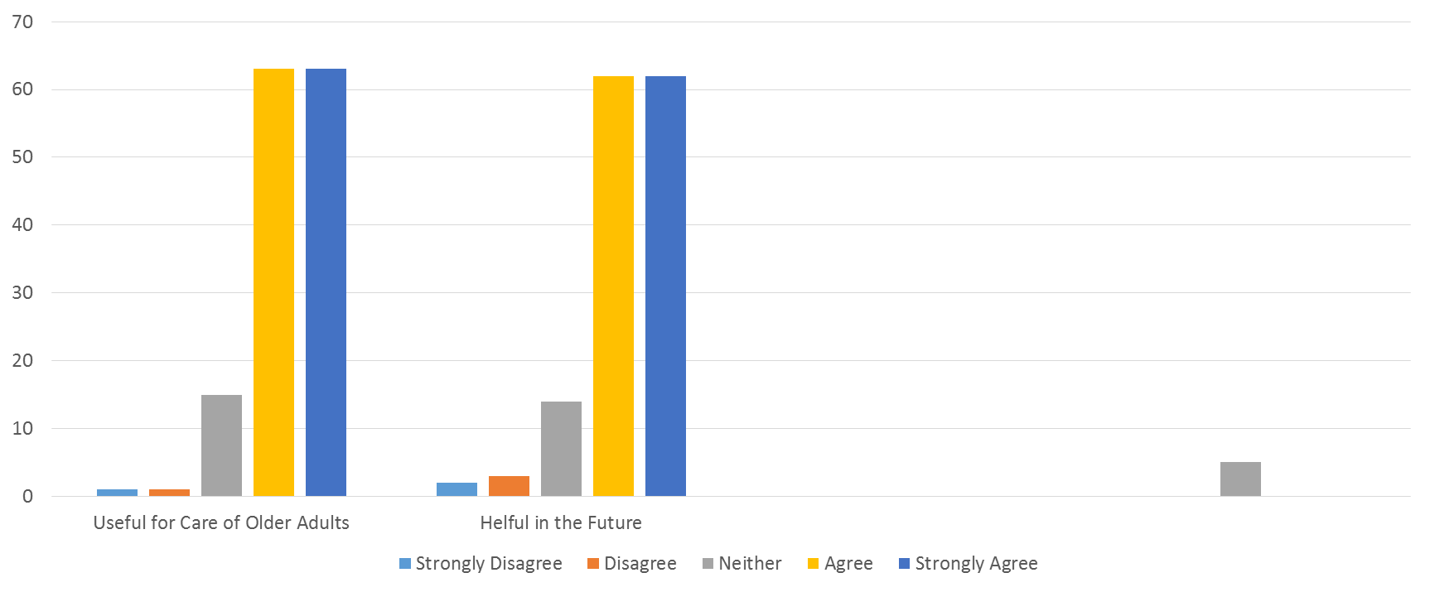

Slide 33
Student Comments
The tool is very easy to understand
It was organized and easy to access
The toolbox was very easy to navigate
The tool is very comprehensive
Add section on end-of-life care
The tool provided good information
about what is expected to be competent
in geriatric care

Slide 34
Web-based Tool and Toolbox
Future Toolbox Host Website:
Texas Nurses Association
(TNA)

Slide 35
Tanya_Sudia@Baylor.edu

