Slide 1
RCP Highlights
2024-2025 AY
Melissa Juarez, Analyst I

Slide 2
Overview
Data updated: April 16, 2025
611.5
Slots Funded
15
Programs
$18M
Tuition flow through
-
-
▵$533K

Slide 3
Where RCP Students Come From
Arkansas, South Carolina and Kentucky funded the greatest number of slots for the RCP.

Slide 4
Where RCP Students Study
Tennessee, Alabama and Georgia taught the greatest number of slots for the RCP.

Slide 5
Program Highlights
Most RCP students pursued veterinary programs, followed by optometry and dentistry.
Like in previous years, no students pursued podiatry or osteopathy.

Slide 6

Program Highlights

Slide 7
Tuition Flow Through

Slide 8
Last 5 Years

Slide 9
Last 5 Years

Slide 10
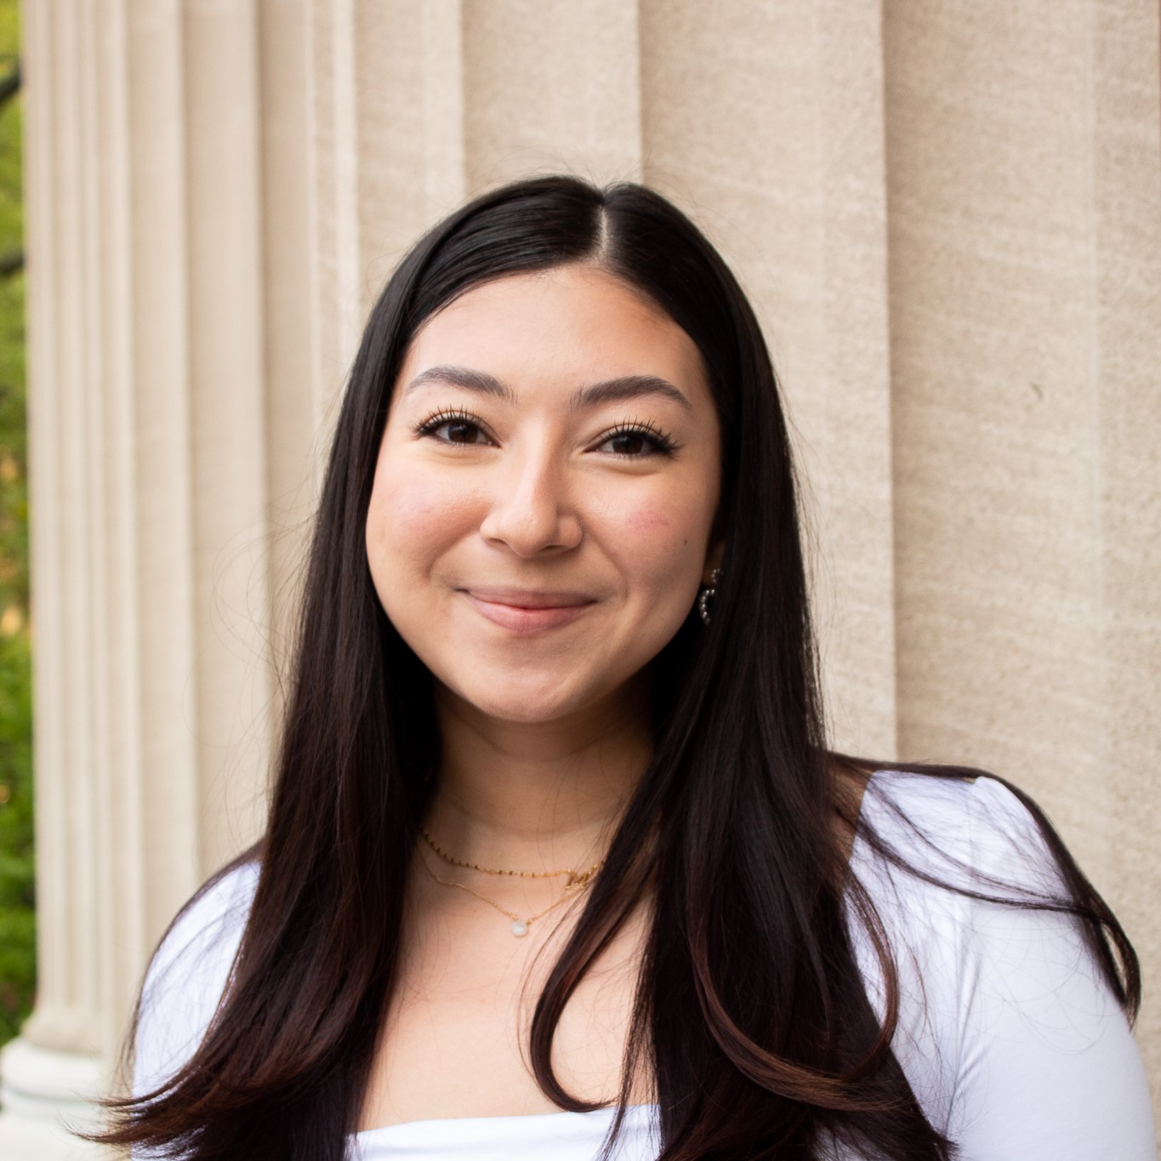
Questions?
Melissa Juarez
Analyst I
melissa.juarez@sreb.org

