Slide 1

Ready to Read
Ready to Succeed
State Policies that Support
Fourth-Grade Reading Success

Slide 2

“Research shows that a
‘spray and pray’ approach
to helping struggling readers
does not work…”
— Task Force to Study the Implementation
of a Dyslexia Education Program in Maryland. (2015).

Slide 3
In 2015, too many 4th graders fell below Basic on NAEP in reading.
In the SREB median state…
33% of all students
44% of students from low-income families
42% of Hispanic students
49% of black students
60% of English Language Learners
70% of students with disabilities

Slide 4
NAEP Definition of “Basic”
“Partial mastery of prerequisite knowledge and skills that are fundamental for proficient work at the grade level assessed”

Slide 5
In other words…
Students whose performance meets the Basic level on NAEP in reading are
not on grade level.
Students who fall below Basic on NAEP are
well below grade level.

Slide 6
Let’s take a look at the data…

Slide 7
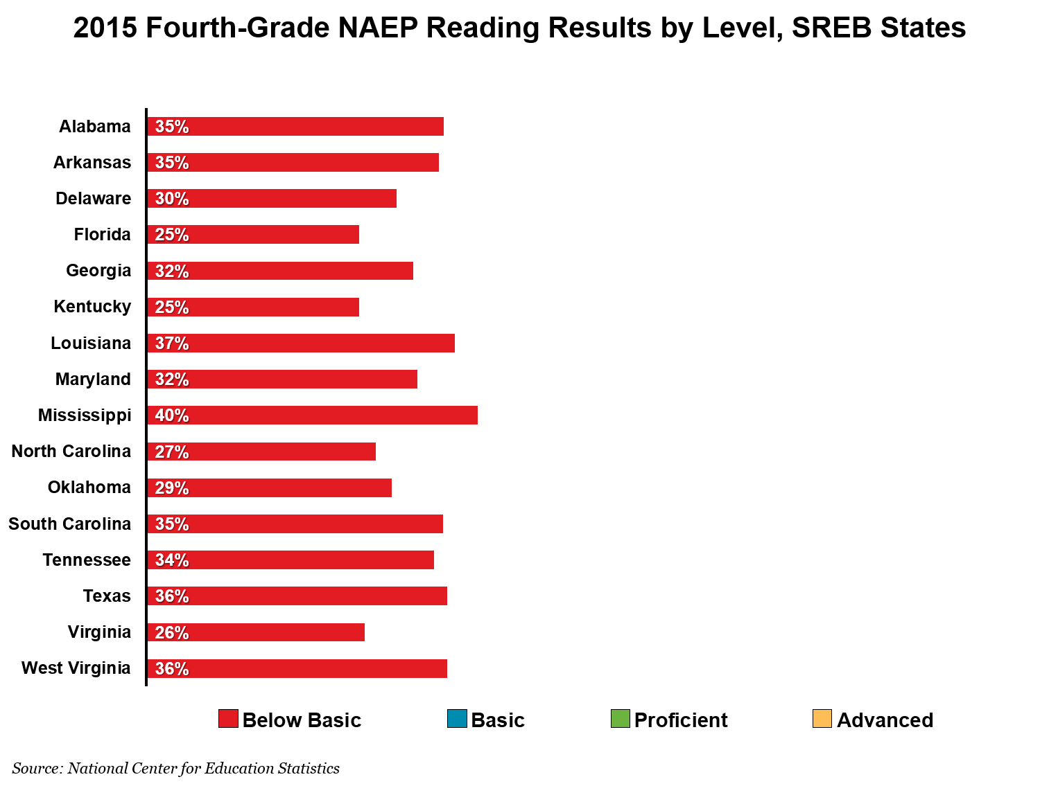
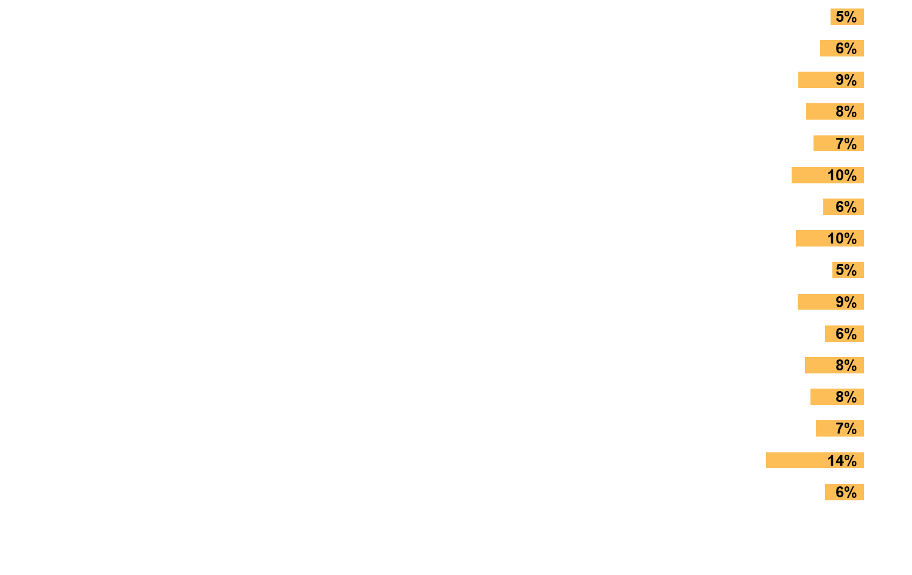
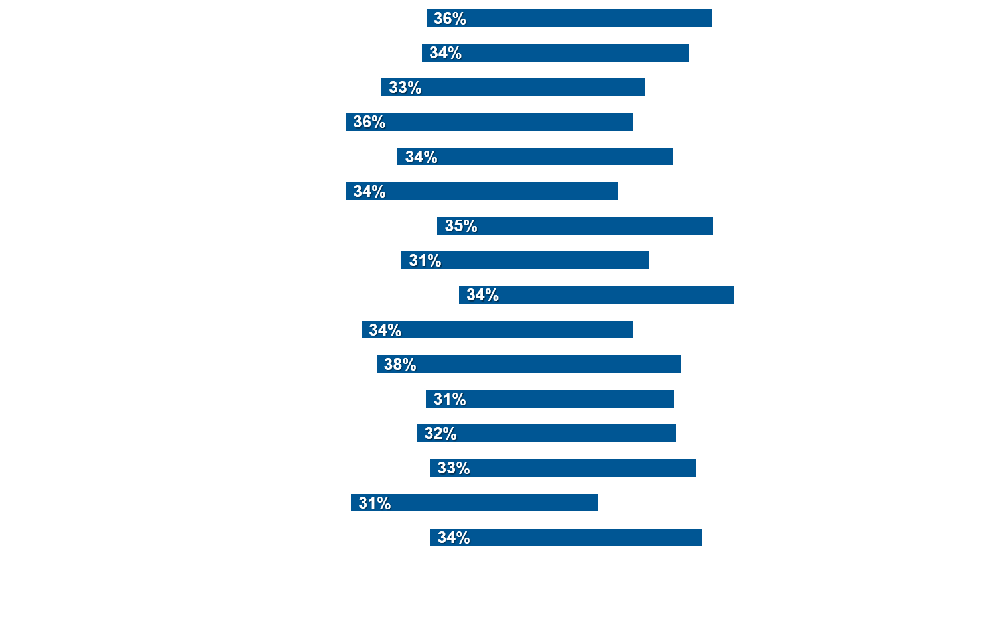
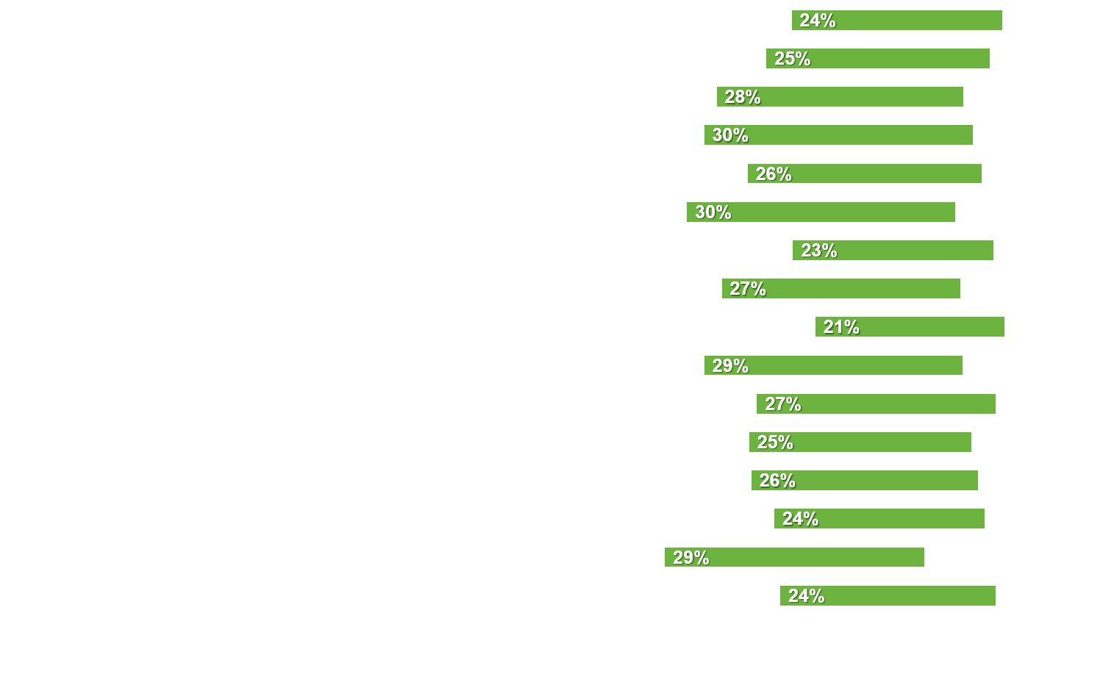


Slide 8
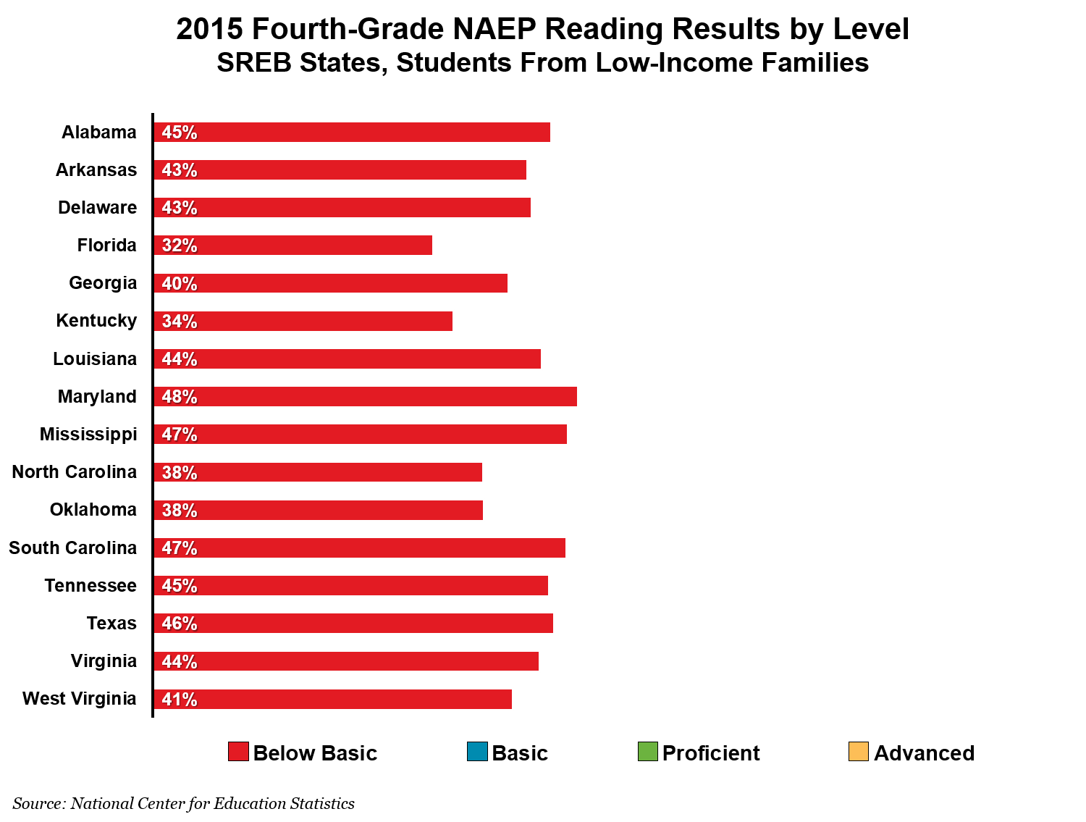

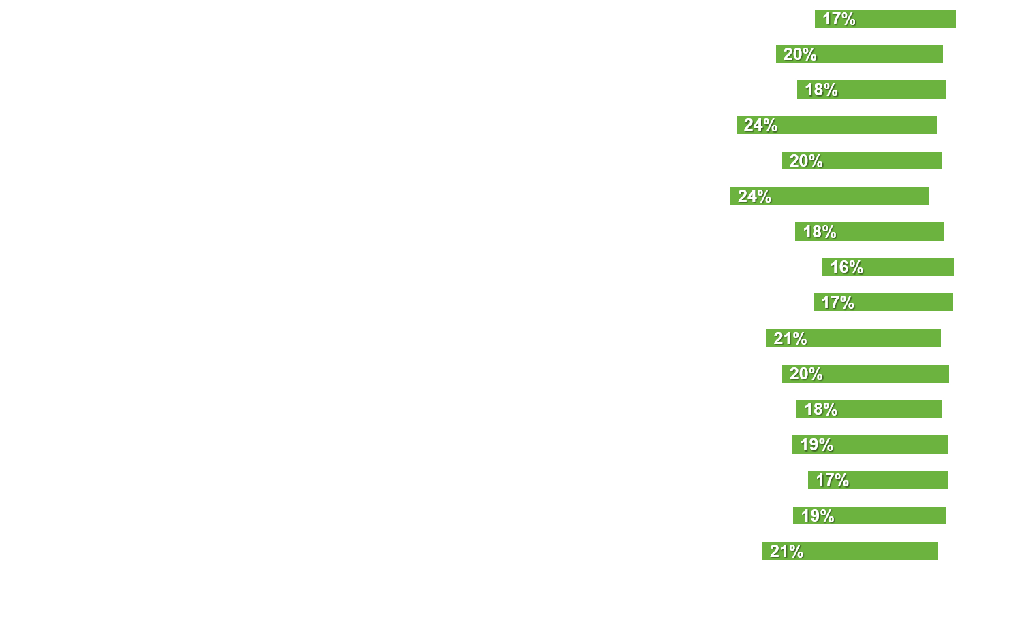
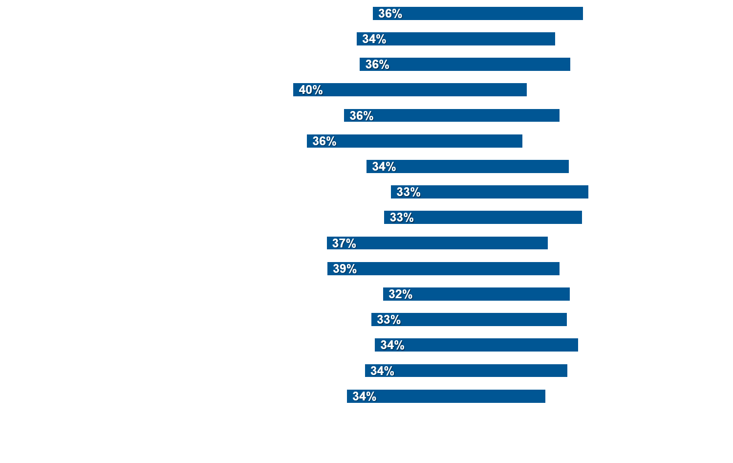

Slide 9
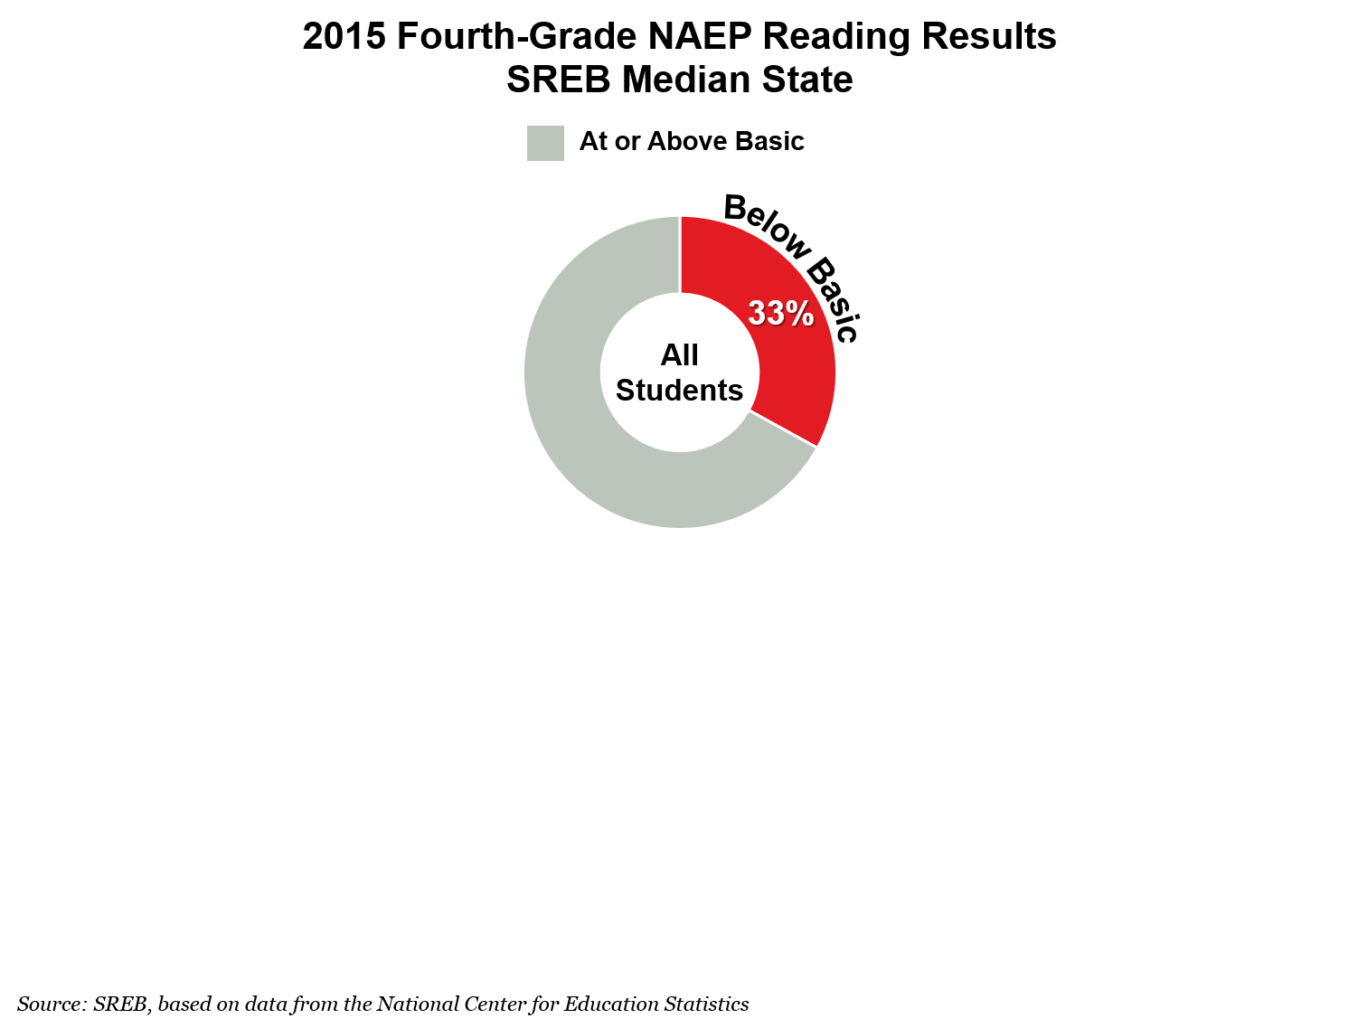
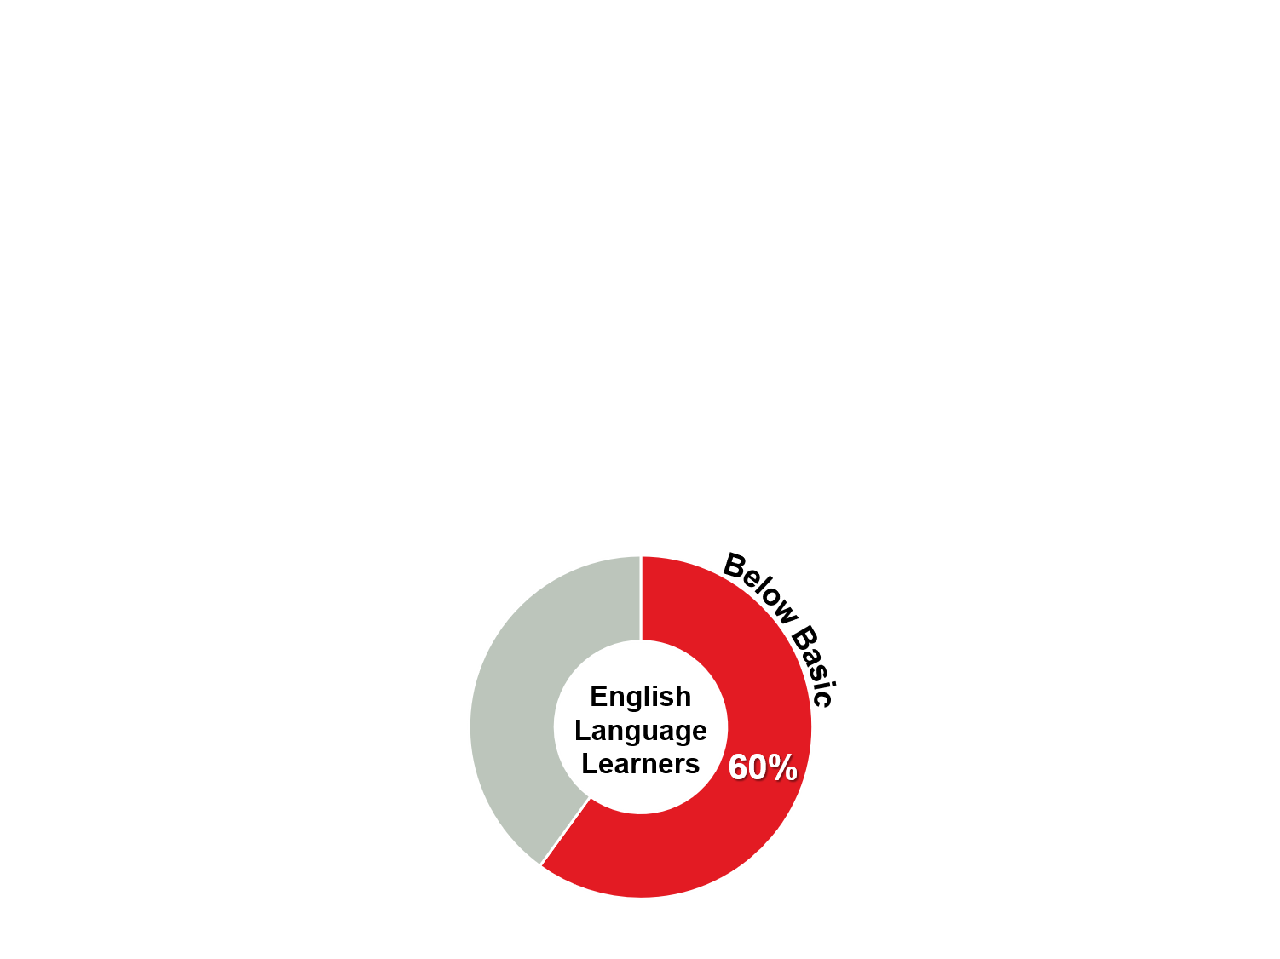
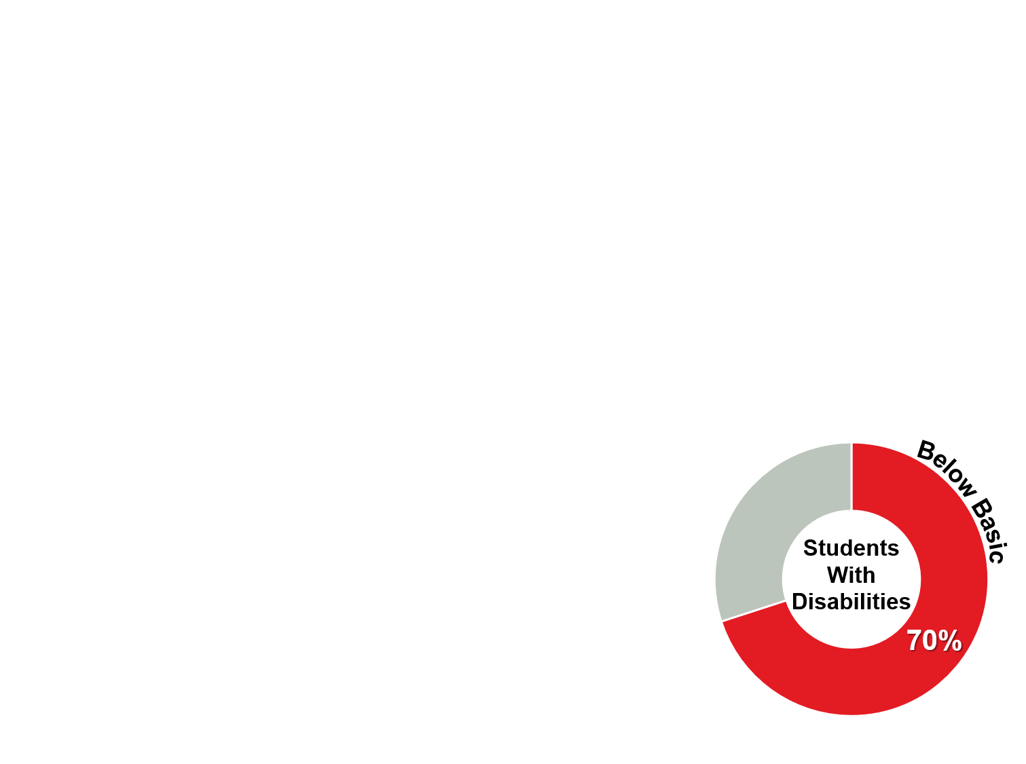
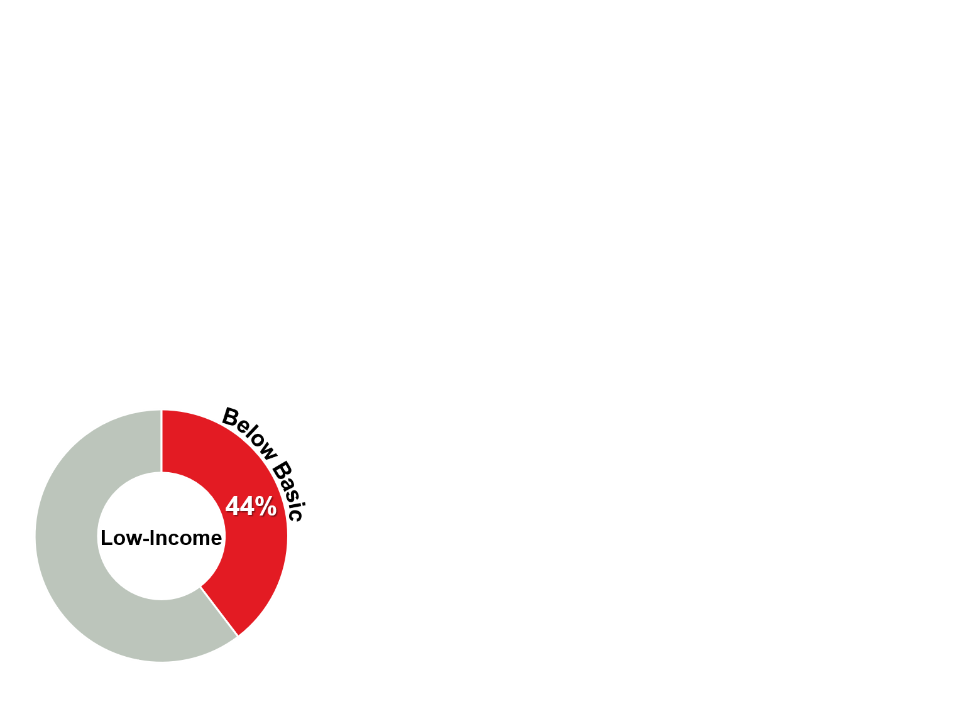

Slide 10
Goals for
Education
Challenge to Lead 2020
Ninety percent of fourth graders will score at or above the Basic level on NAEP in reading, math and science.
Percentages of fourth graders who score at or above the Proficient level on NAEP in reading, math and science will increase regularly — to above national averages.

Slide 11


Slide 12
How can states help make sure students become better readers?

Slide 13
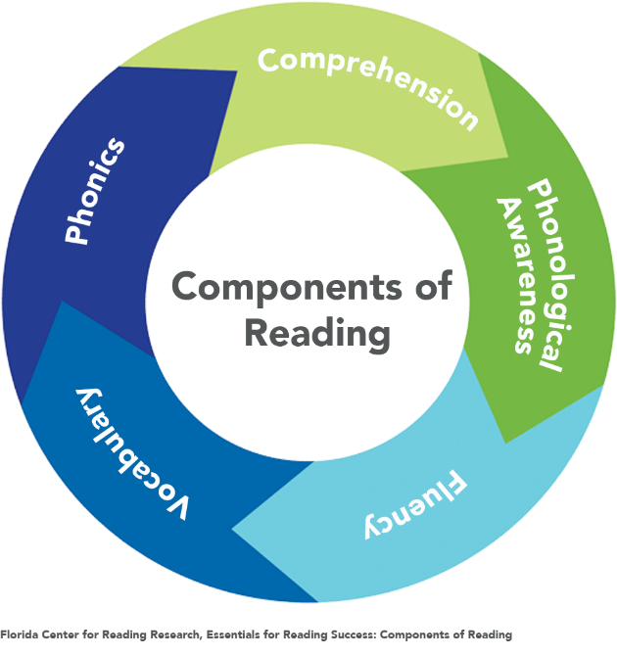
Strengthen Teacher Preparation for Teaching Reading
Make sure teacher preparation programs include all five essential components of reading
Require training on dyslexia identification and intervention

Slide 14
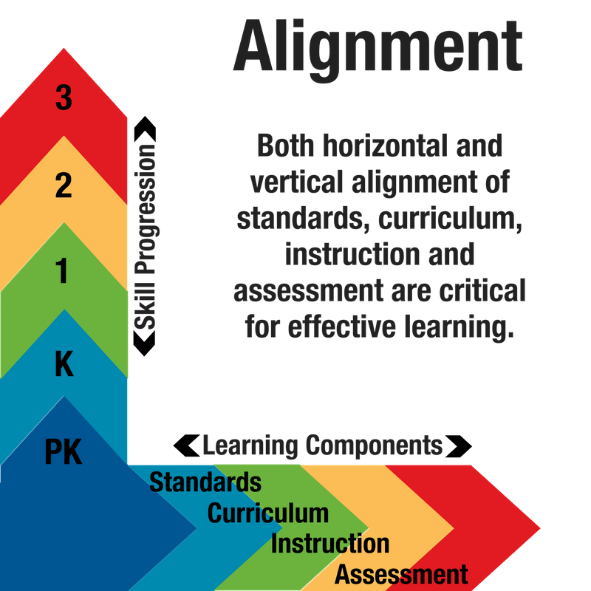
Align Standards, Curriculum, Instruction and Assessment
Make sure:
State standards are sequential and developmentally appropriate
Curricula are directly aligned to state standards
Instructional methods utilize age appropriate practices and are supported by aligned materials
Assessment is developmentally appropriate and used to inform instruction

Slide 15

Push toward high quality pre-K
Ensure access for all at-risk children, especially children from low-income families and English Language Learners
Strengthen teacher training and certification requirements
Consider the importance of
ongoing coaching, mentoring
and professional development

Slide 16

Support kindergarten programs
Fund seats for all at-risk children
Promote participation in kindergarten for all students
Keep class sizes small so teachers can individualize

Slide 17

Identify Early and Intervene
Incentivize the use of regular formative assessment and screenings to identify struggling readers early
Make sure schools use proven, research-based intervention programs and methods

Slide 18

Develop effective promotion policies for third-grade students
Provide students with multiple opportunities and methods to demonstrate reading proficiency before leaving 3rd grade
Make sure students who do not meet a reading benchmark receive intensive, individualized support

Slide 19

To be successful,
states should
ensure all of
these policies
are
integrated

Slide 20

And states should be ready to commit for the long haul.
Significant, lasting changes take time and sustained efforts.

Slide 21

Read the full report at www.sreb.org/ReadToSucceed
For more information, contact:
Samantha Durrance at Samantha.Durrance@sreb.org
or Joan Lord at Joan.Lord@sreb.org

